Slide 1
National Climate Monitoring Products
Fatima Driouech
WMO-CCl-OPACE-2 Co-chair (16th intersession)
CCl-TECO, Geneva 11-12 April 2017

Slide 2
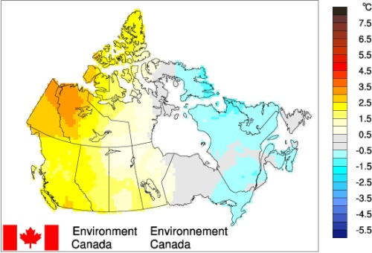
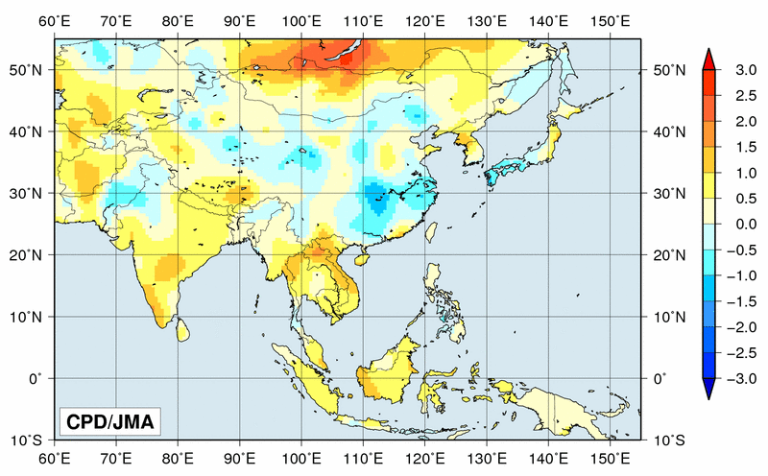
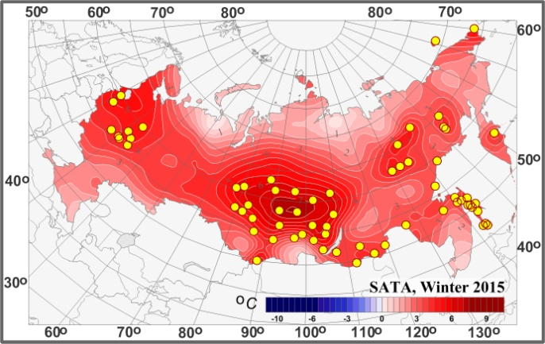
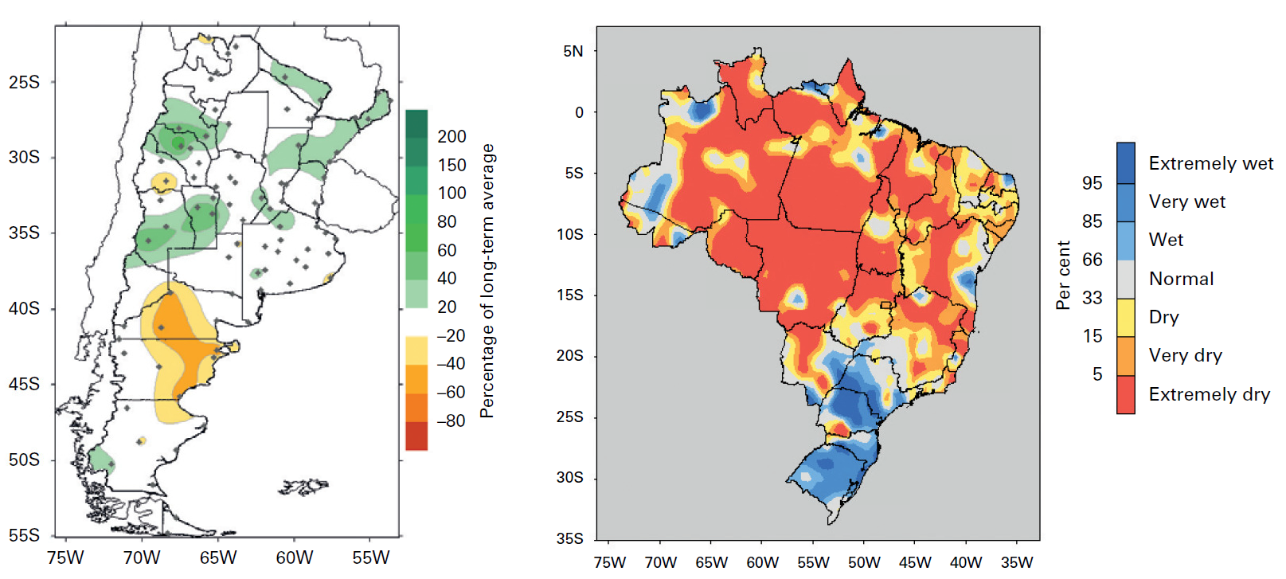
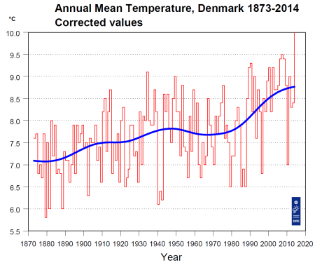
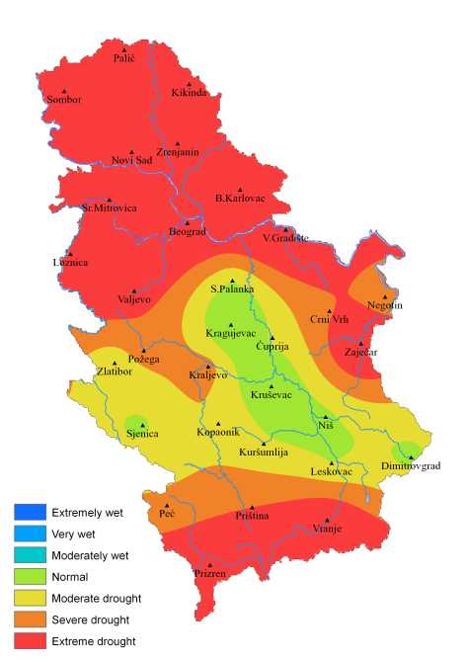
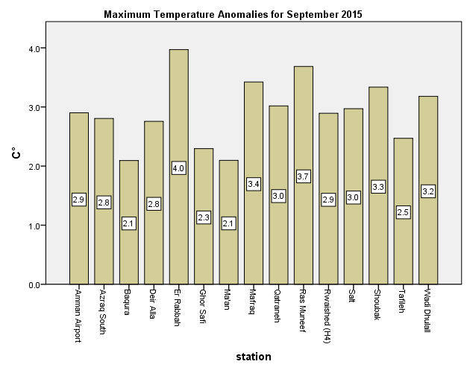
Climate monitoring : awareness increasing
Canada
Countries around the world have created a variety of climate monitoring products at different spatial and temporal scales
National climate monitoring products (NCMPs) : summarize climatic conditions at a national scale and show how current conditions compare with those in the past
JMA
Russian Federation
Argentina Brazil
Denmark
Serbia
Jordan
Notes:
to emphasize

Slide 3
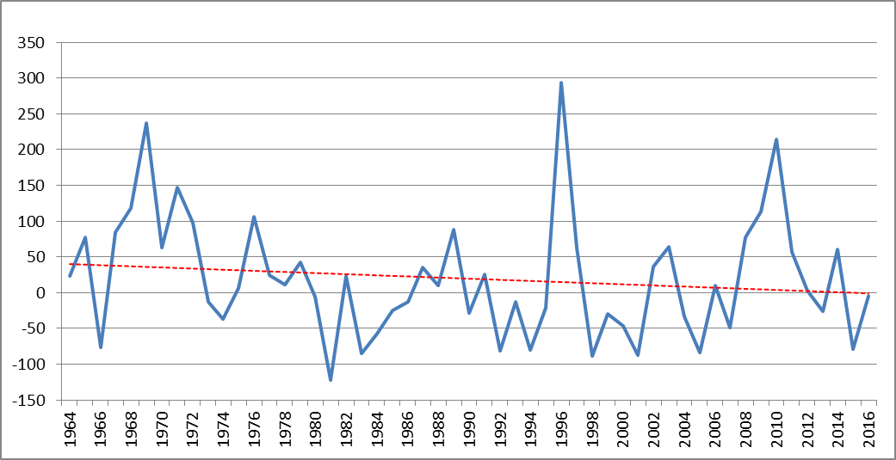
NCMPs value & usefulness
Annual precipitation anomalies for Morocco
Raise awareness and understanding of the effects of climate variability and change
Demonstrate the importance of national monitoring networks and services.
At regional and international levels, NCMPs aid the synthesis of information from different countries to provide a broader, regional or global view of climate variability and change.

Slide 4
To address the challenges of inconsistency and to help for a better climate monitoring around the world
➔ a short list of standardized NCMPs to be produced (and shared) in a consistent manner have been developed by the CCl (OPACE-2/ET-NCMPs)
Mean temperature anomaly averaged over the country
Total precipitation anomaly averaged across the country
Standardised precipitation index, averaged across the country
Percentage of days in the month when Tmax exceeded the 90th percentile, averaged across the country
Percentage of days in the month when Tmin was below the 10th percentile, averaged across the country
Count of stations which broke maximum and minimum temperature records and daily precipitation records

Slide 5
A detailed guidelines on production and dissemination have been developed
A software implementing the guidance and allowing production of the NCMPs from the input data to the final summary have been developed and tested across different regions.
A user manual Is also available
1. Conduct QC on the daily station data;
2. Consider the homogeneity of the data at each station;
3. Generate the indices at each station for each month and year;
4. Interpolate the data for each index for each month and year;
5. Average each index across the country using the interpolated data;
NCMP 6 reports daily temperature and precipitation records
6. Output the NCMP.
http://www.metoffice.gov.uk/hadobs/opace2_tt_ncmp/

Slide 6
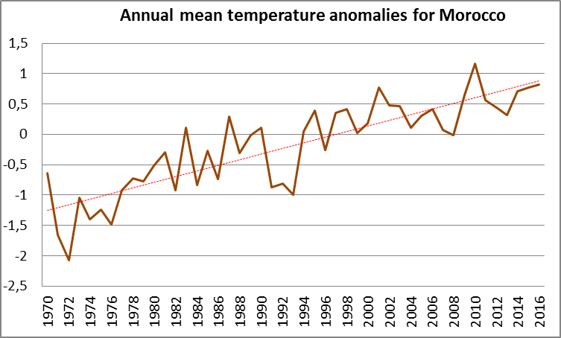
NCMPs examples
Data from: http://www.bom.gov.au/climate/change/acorn-sat/

Slide 7
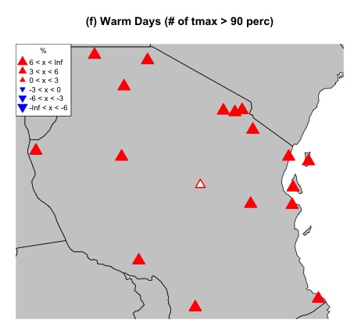
Examples of products generated by the software: Tanzania
Source: Ladislaus Chang’a (Tanzanian Meteorological Service)

Slide 8
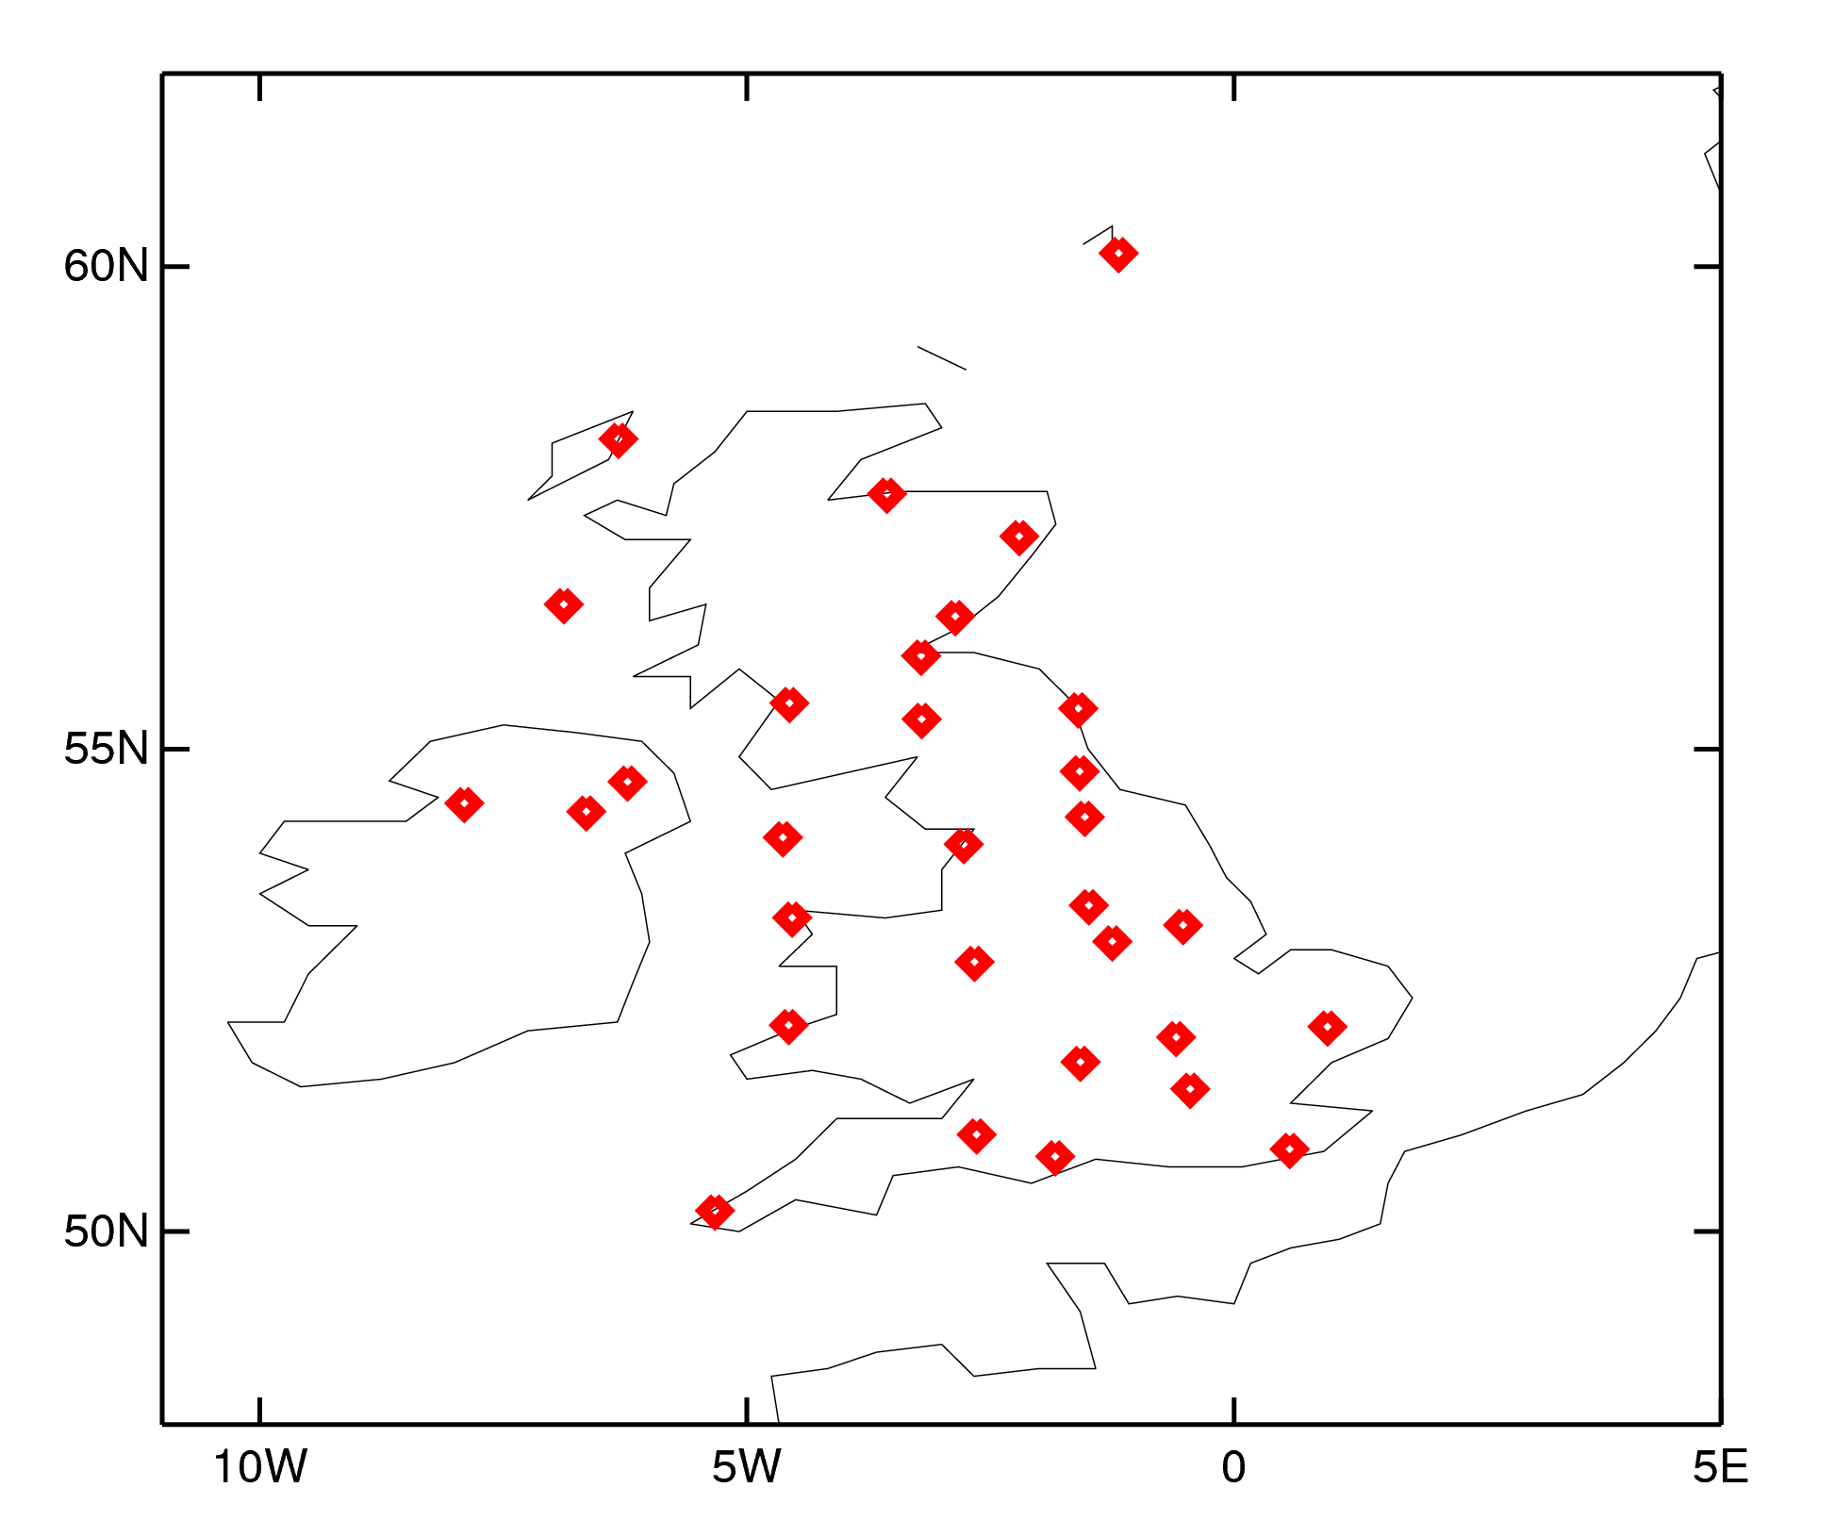
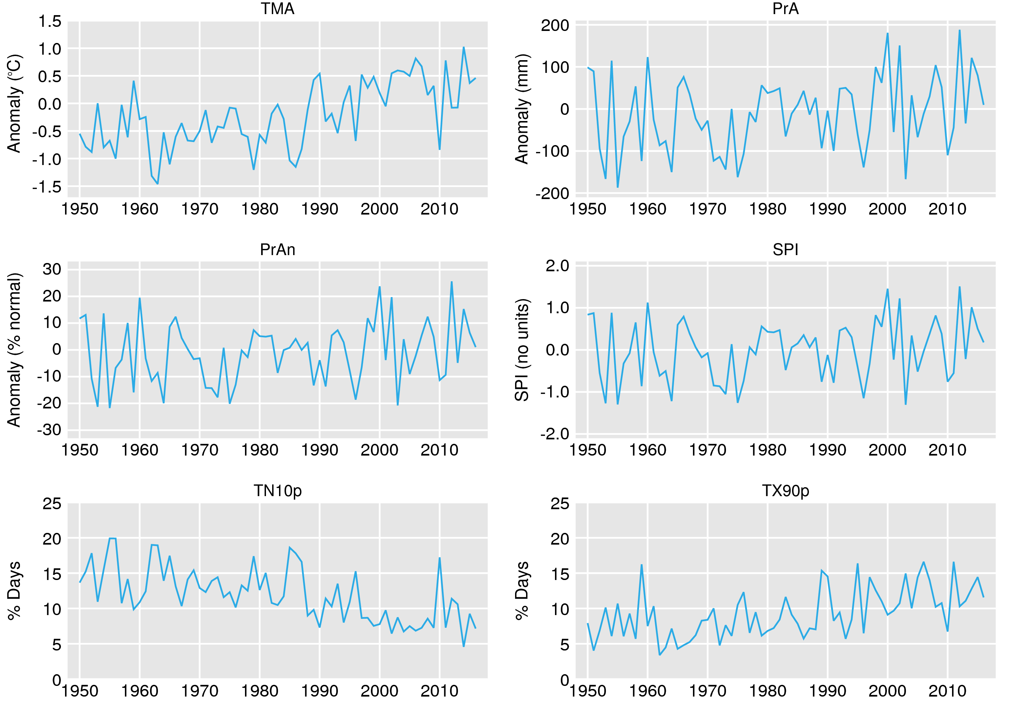
Examples of products generated by the software : UK
John Kennedy (UK Met Office) (Presented at ET-NCMP Meeting Marrakech, Morocco 5-7 March, 2018)

Slide 9
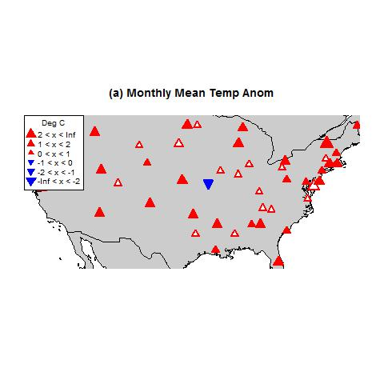
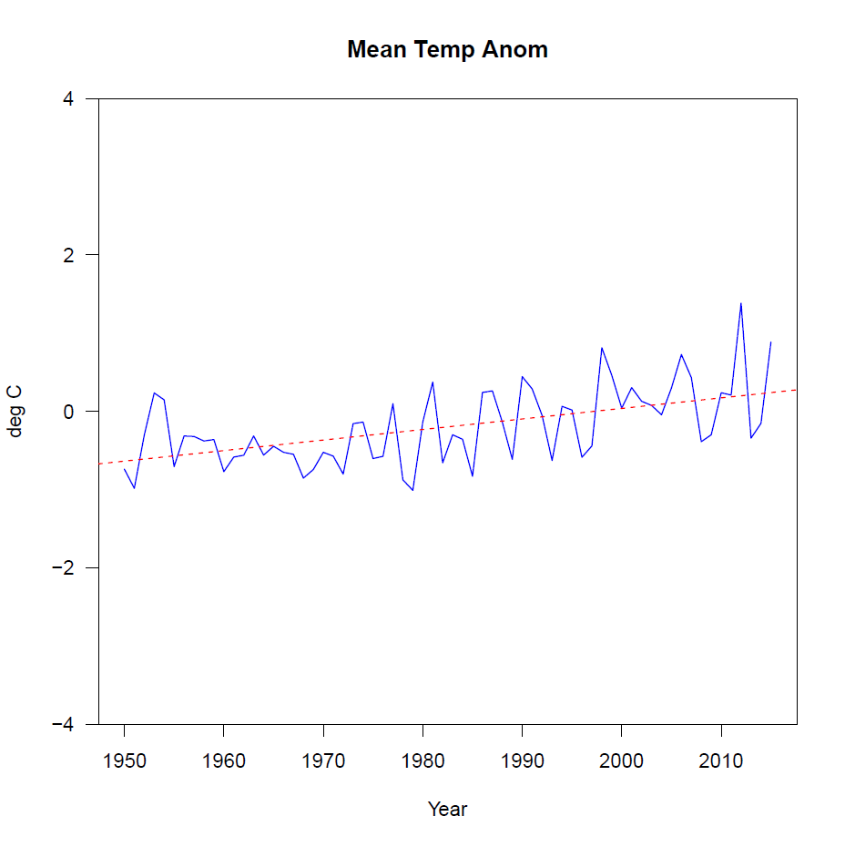
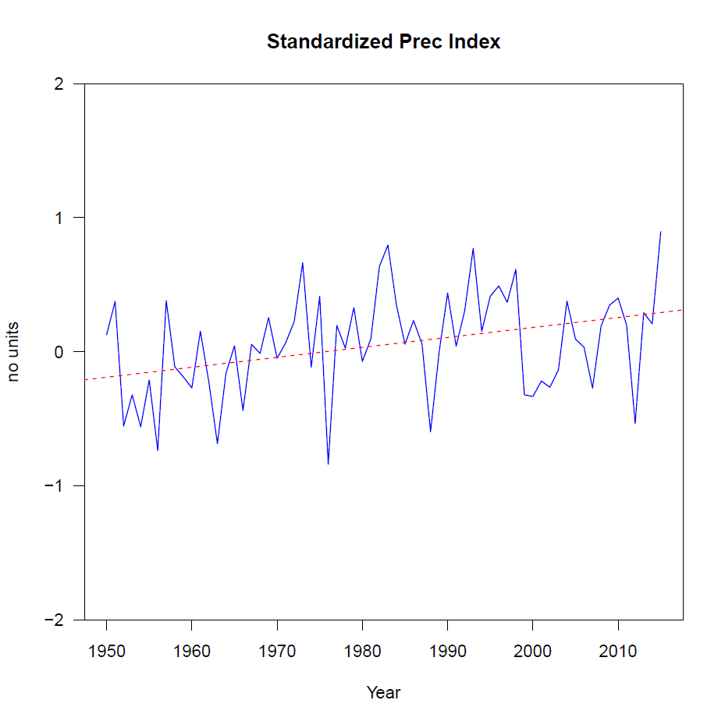
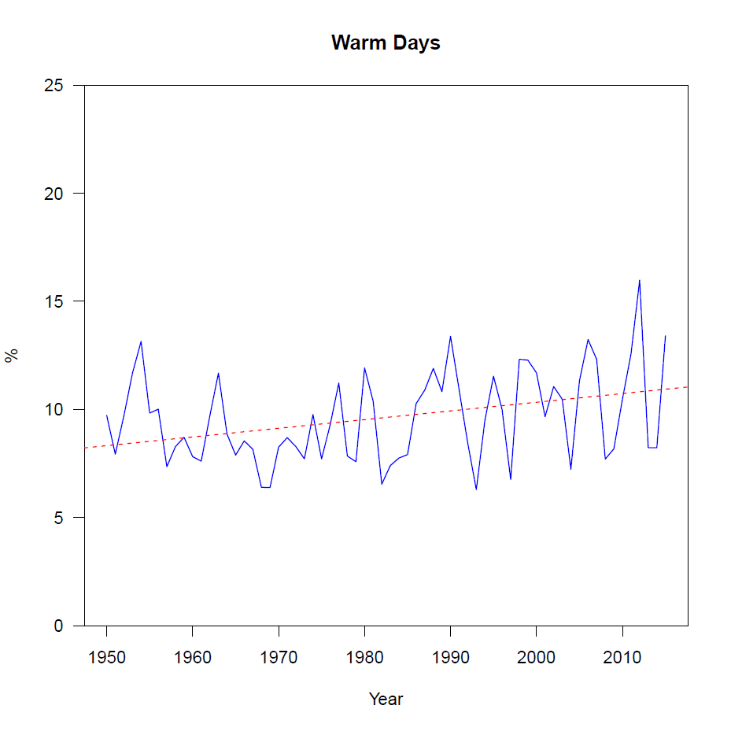
Examples of products generated by the software : USA
Jessica Blunden (NOAA)
(Presented at ET-NCMP Meeting Marrakech, Morocco 5-7 March, 2018)

Slide 10
Examples of products generated by the software: Canada
Lucie Vincent (Environnement Canada)
(Presented at ET-NCMP Meeting Marrakech, Morocco 5-7 March, 2018)

Slide 11
Summary of outputs to be transmitted
Year & Month
NCMP value & number of stations reporting each element used
A flag [0,1] to indicate whether the station data used were homogenized
A flag [0,1] to indicate whether the station data used had undergone QC
Base period (1981–2010)
Version of the software or guidance used to calculate the NCMP
Base period
1999,2,2.32,57,13.42,90,95.21,90,1.51,90,3,57,0,57,2,57,0,57,2,90,1,1,1,0,1981,2010,1.4
Guidelines
version
Monthly indices and the number of stations
Year & month
QC and homogeneity flags

Slide 12
Capacity building:
A series of regional workshops is planned for enabling countries to use the guidelines and the software for providing input to RCCs and the WMO Statement on the State of the Global Climate in a consistent manner.

Slide 13
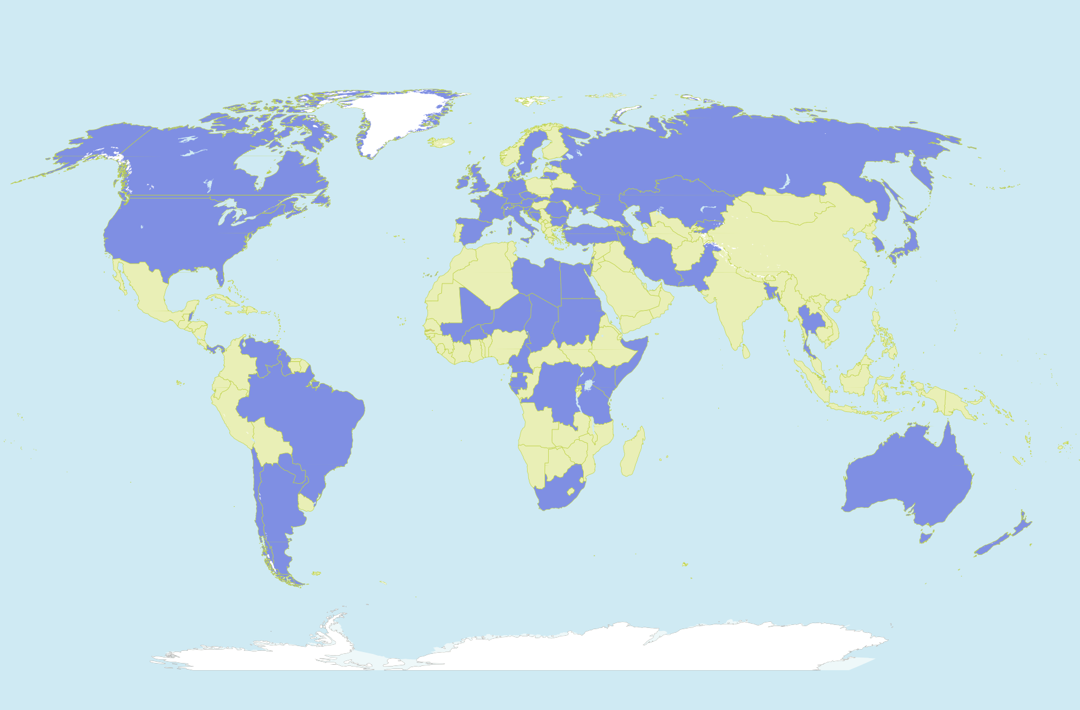
National Climate Monitoring Products Focal Points
Blue indicates countries already nominated their NCMP focal points
National focal points for NCMPs are responsible for facilitating the calculation of NCMPs at a national level and for disseminating NCMPs
Members of WMO have been invited to nominate a focal point for NCMPs

Slide 14
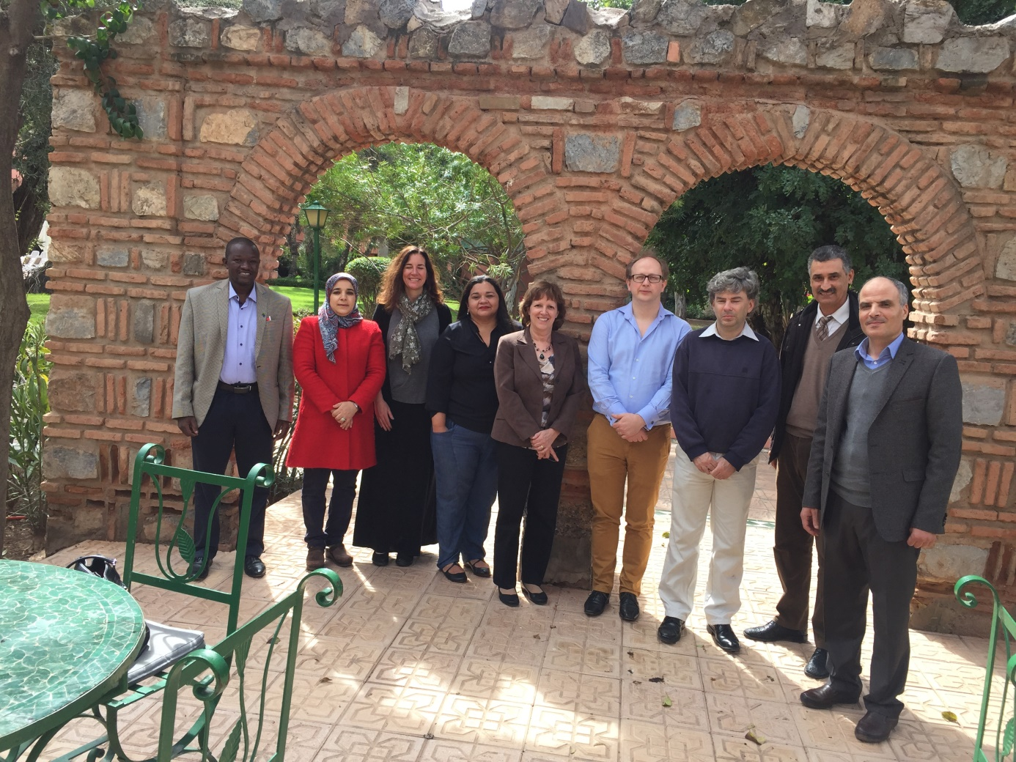
Thank you for attention
ET-NCMP Marrakesh meeting

