Slide 1
#VocabularyManager:
A tool for managing
BUFR tables
IPET-CM-III / Doc. 8.5
Simon Elliott and Daniel Lee
Marrakech, 15-19 April, 2019

Slide 2
Need for #VocabularyManager

Slide 3
BUFR at EUMETSAT
Several different facilities encode products in BUFR
Different encoding/decoding software is used
Each software implementation uses a different table format
The result: Effort to maintain all tables (including local tables) at all facilities

Slide 4
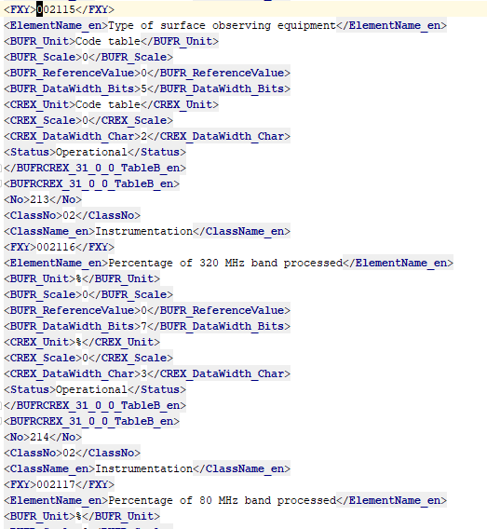
Common machine-readable BUFR tables
WMO
BUFRDC
ecCodes
Notes:
Translating these by hand is cumbersome.

Slide 5
The plot thickens: Local tables
Part of the complexity of table maintenance is because EUMETSAT uses local tables
Each software implements local tables differently
Maintaining the local BUFR tables requires expert knowledge of BUFR and the software in question
The tables must be implemented at every facility where BUFR are processed

Slide 6
Where the process gets brittle
When we:
Create local descriptors manually
Merge our local descriptors with WMO descriptors
Migrate between different software libraries
Deploy tailored tables to different facilities
Need to use new descriptors from WMO which aren’t packaged by the provider yet
Notes:
Few errors have occurred due to exceptional dedication on the part of many people at EUMETSAT, and we should hope that that continues in the future, but hope is not a strategy. It’s better to have their minds free to focus on other issues.

Slide 7
Meet the #VocabularyManager

Slide 8
#VocabularyManager’s purpose
Prevent mistakes when manually changing tables
Provide a single source of “canonical” BUFR tables at EUMETSAT
Track changes and provide browsing capabilities
Ensure independence from external software providers

Slide 9
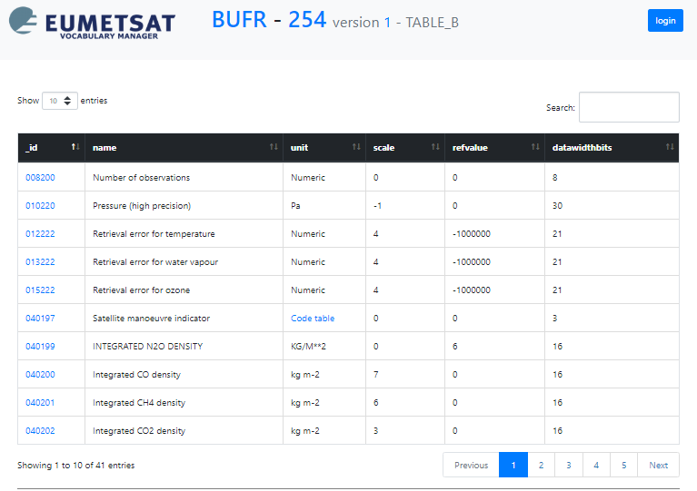
Features: Format independence
Table entries are stored independently of a text representation

Slide 10
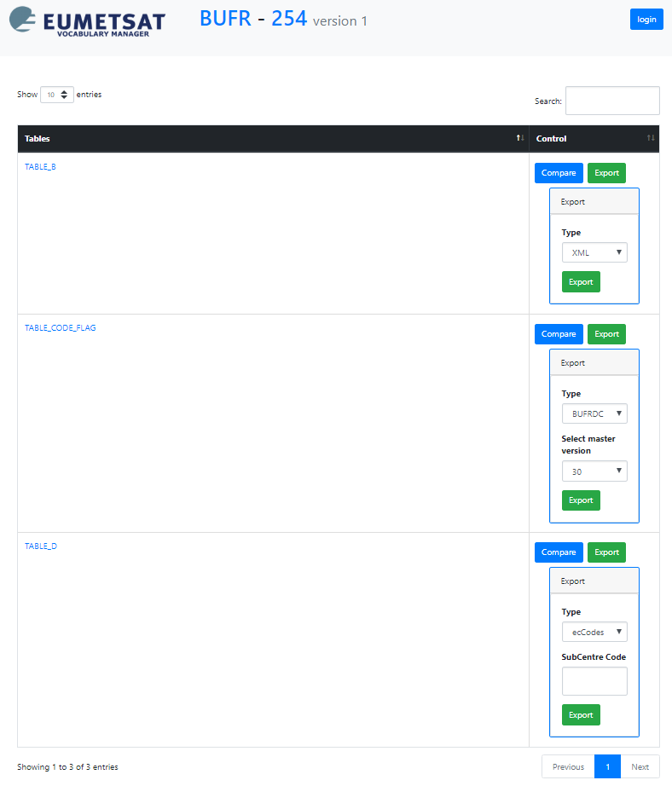
Features: Import / export capabilities
They can be imported from WMO (canonical source) or from ecCodes (for exchange between Centres)
They can be exported in WMO XML, BUFRDC and ecCodes formats ... and perhaps more in the future

Slide 11
Features: Integrity checks
Anyone can export tables, only administrators can import / create new entries
Table versions can be “frozen” to prevent accidental manipulation
Illegal descriptors produce errors (caveat: does not apply to flag/code tables)

Slide 12
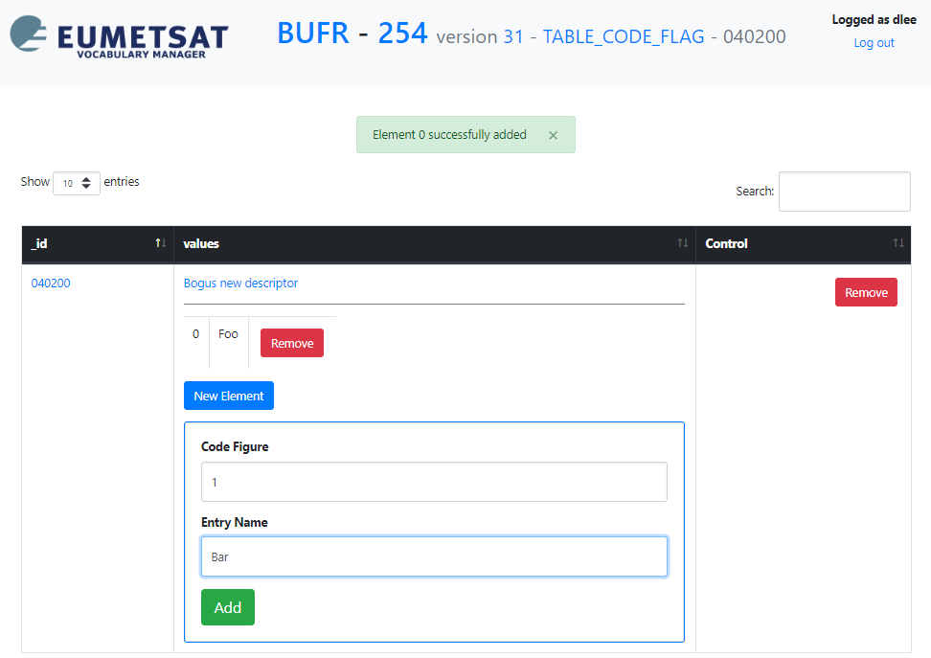
Features: Element creation guidance

Slide 13
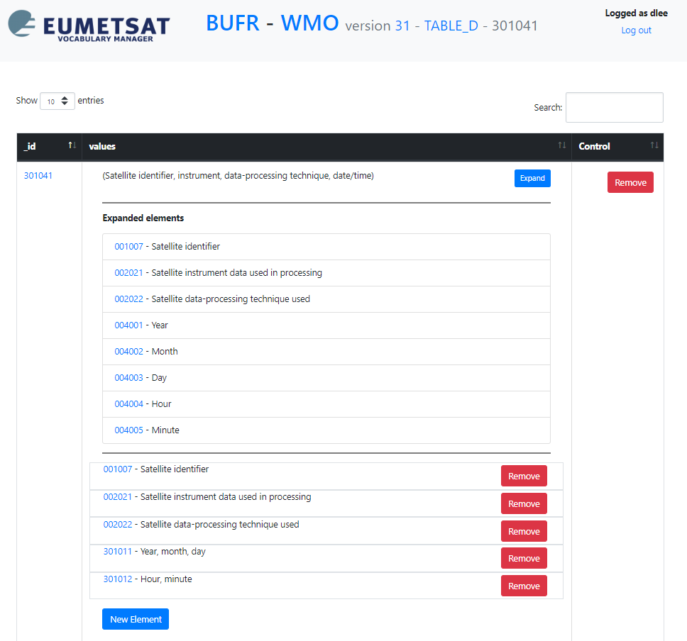
Features: Unpacking sequences
Sequences can be expanded to what they would resolve to at runtime

Slide 14
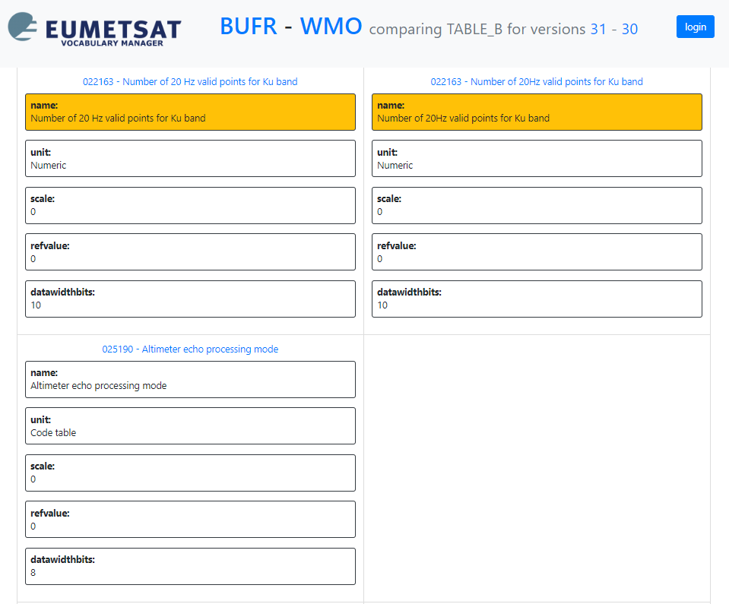
Features: Table version comparison
Table versions can be compared graphically

Slide 15
Example instances
From EUMETSAT network
It would also be possible to expose an instance to the Internet so that other Centres could download our tables in their format of choice
It would be possible in principle to allow other Centres to deploy their own #VocabularyManager

Slide 16
Simple, clean, clear: The end

