Slide 1

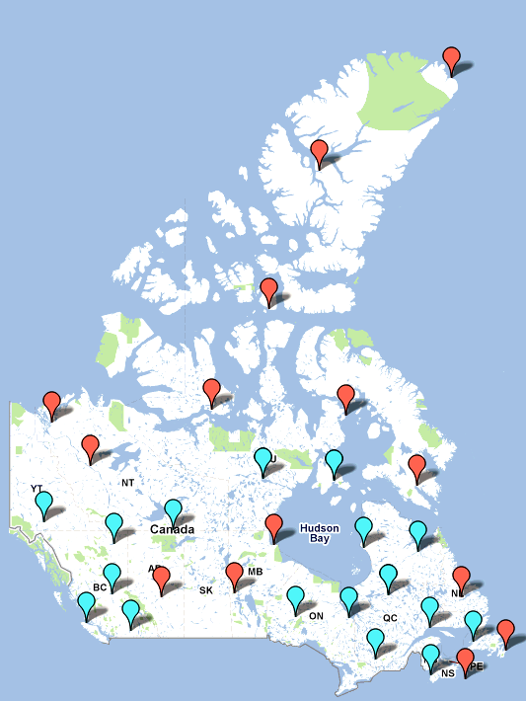
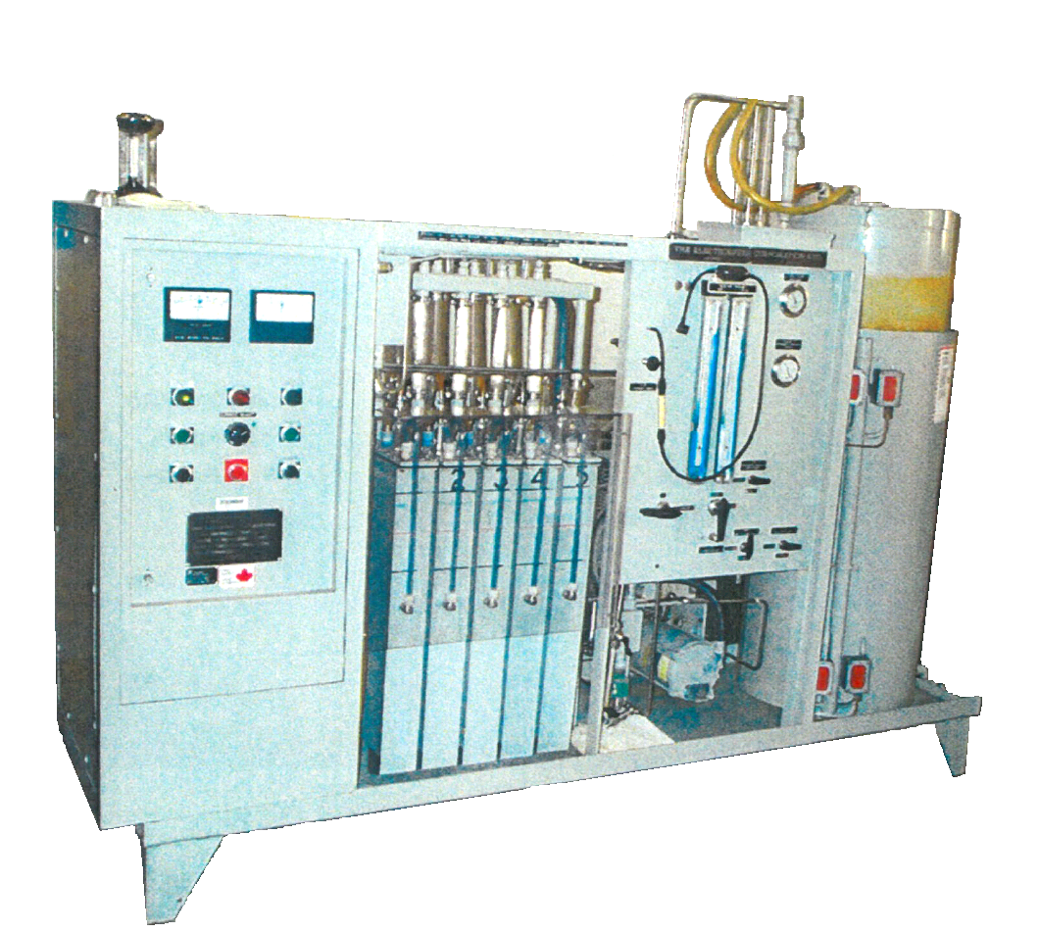
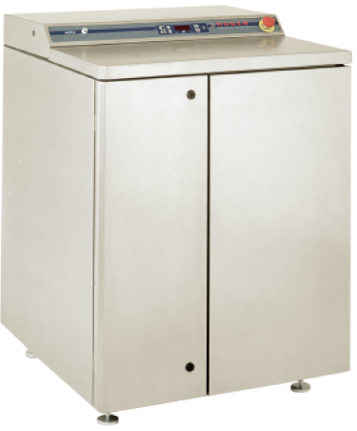
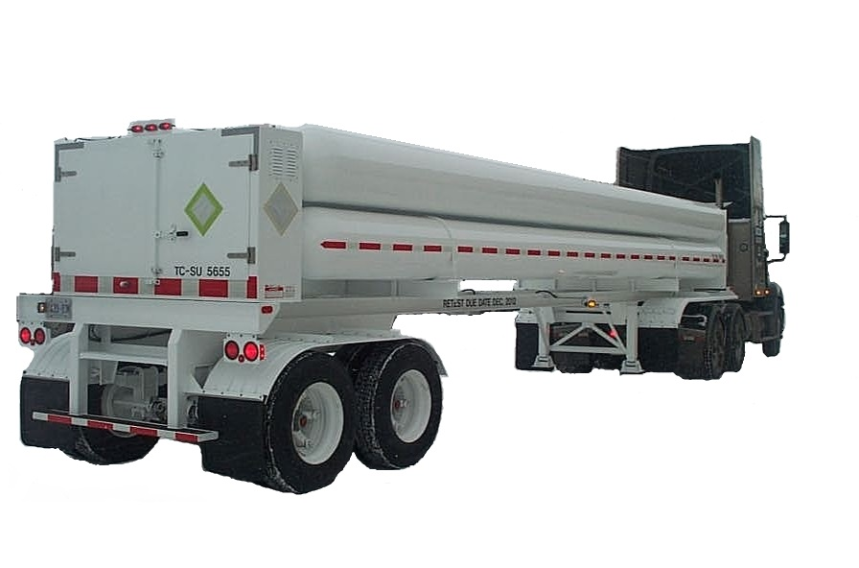
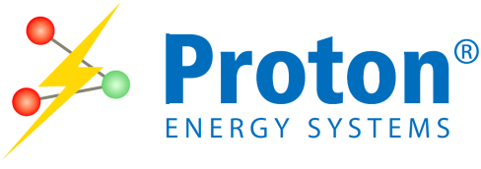
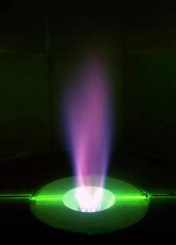
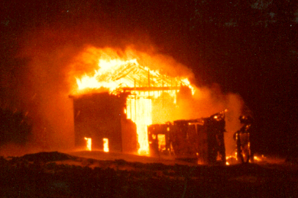
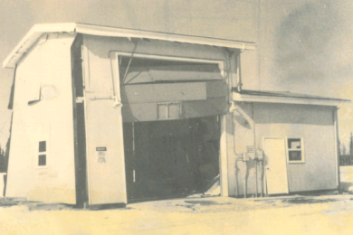
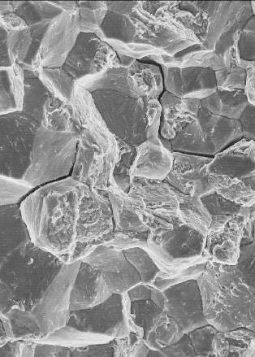
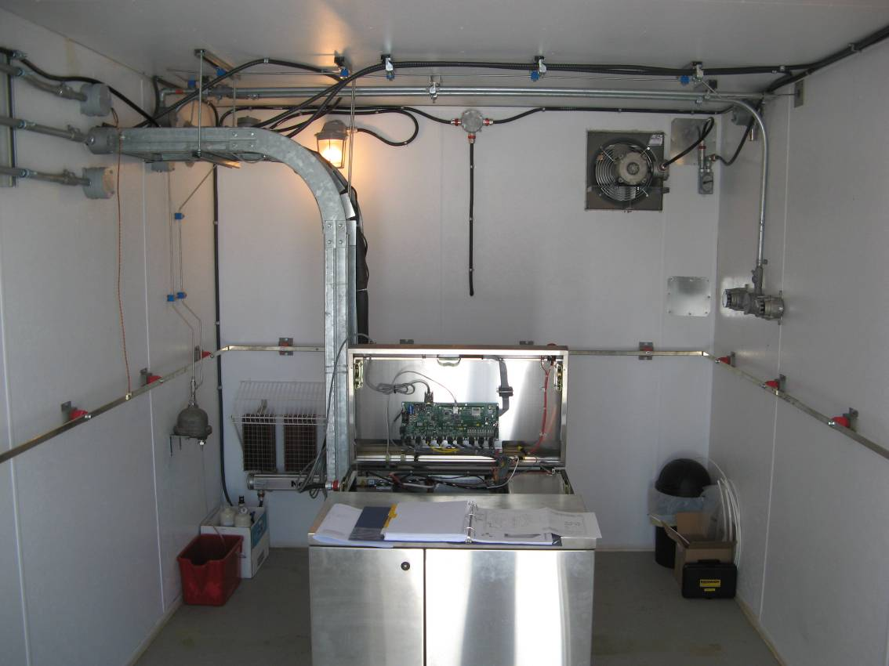
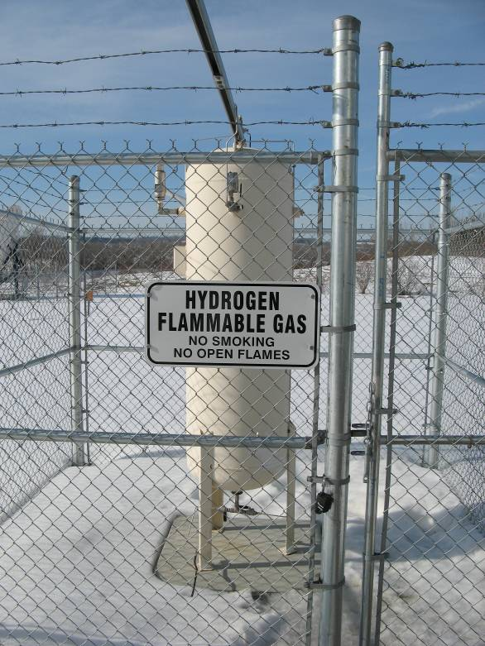
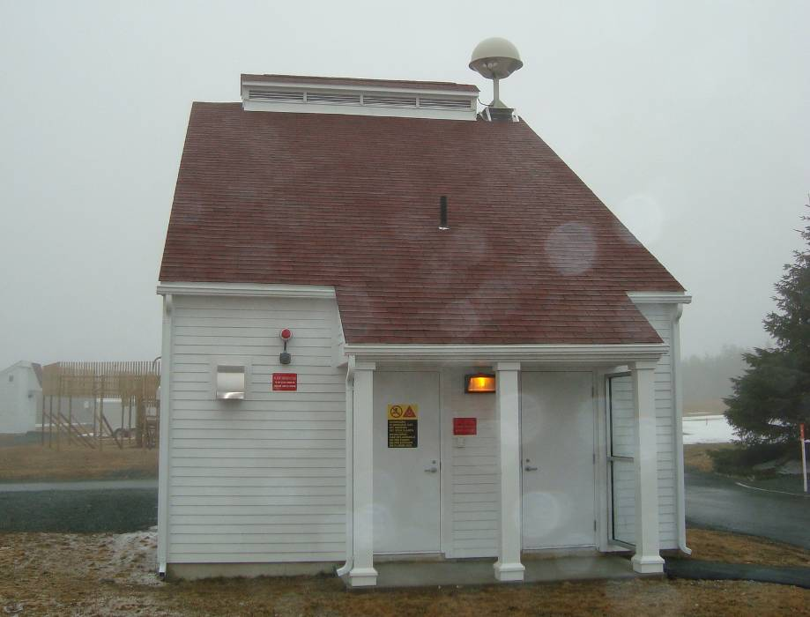
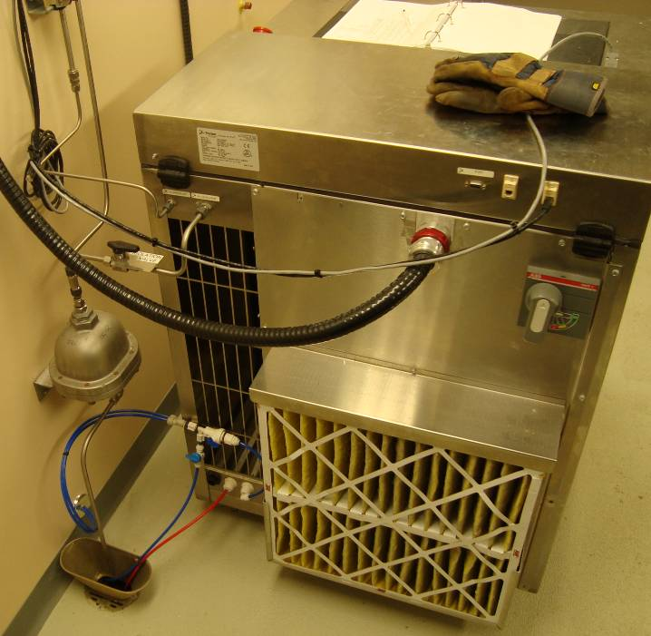


Environment Environnement
Canada Canada
Implementation of PEM Hydrogen Generation into an Existing Upper Air Network
Hydrogen
45%
Helium
55%
Abstract
Environment Canada currently uses helium gas to launch balloons at 17 of 31 upper air network sites. The remaining stations use hydrogen gas, generated by an aging alkaline electrolysis system. The rising acquisition and delivery costs of helium gas combined with concerns regarding the reliability of existing hydrogen generation have initiated a project to update Upper Air Network sites with modern hydrogen generators using Proton Exchange Membrane (PEM) technology. The contrasting requirements between the alkaline system and a PEM system present several challenges. Additionally, hydrogen safety standards developed since the original implementation of the alkaline system over 30 years prior require thorough review. This paper illustrates the challenges faced in the process of designing and implementing a modern hydrogen gas generation system that effectively combines safety and reliability into a cost effective solution.
Introduction:
Key Challenges:
HOGEN System Requirements differ from existing Electrolyser generation equipment
  13.8bar vs. 6.9bar
  Water quality standard increased
New equipment introduces safety challenges/opportunities
  HOGEN operates using a purge-pressurize safety principle
  ‘Smart’ system offers more safety system integration capability
  HOGEN is not certified for installation in an explosive atmosphere
Sites operating on hydrogen lift gas use an Electrolyser brand alkaline hydrogen generator. The units were installed into the network over 30 years ago and have reached the end of their service life. They generate low purity H₂ at 6.9bar (100psi) using a mechanical compressor.
Current Network Hydrogen Generator
The selected replacement H₂ generator uses a Proton Exchange Membrane (PEM) electrolysis process to generate high purity H₂ at 13.8bar (200psi) without mechanical compression.
Replacement Hydrogen Generator
Operating sites on helium lift gas requires a costly delivery program to maintain supply. In remote areas road access is seasonal, requiring large storage capacity. Additionally helium gas is becoming more costly to purchase as supply is finite.
Network Helium Supply
Hydrogen Safety:
Body of Knowledge:
Fault Tree Analysis
(FTA)
Past Problem History (PPH):
Hydrogen Properties:
Most common element in the universe (75% of all elemental mass)
Highly flammable, will burn in air at a very wide range of concentrations
Colourless, odourless, and combusts in air with a nearly invisible flame
Can permeate most materials due to its small molecular size
Lowest density gas, always rises to the highest point in enclosures
Hydrogen 4.0%~75.0%
Hydrogen Safety
Applicable Standards
Best Practices
Project Kick-off Package
Structural
HVAC
Electrical
Water Processing
Hydrogen Generation
Hydrogen Storage
Hydrogen Plumbing
Internal PPH:
Hydrogen Flame
Propane 1.7%~10.9%
Key Quality Points
(KQP’s)
Baker Lake, NU – 1979
Fire believed to have originated in the electrical compartment of the Electrolyser generator.
Fire spread to structure fully engulfing building.
Hydrogen tank inside building began to leak, feeding the fire intensity.
Leak rate was low enough to prevent explosion
No injuries reported, building lost.
Fort Smith, NT – 1979
During balloon fill, a full balloon lifted off the filler nozzle and was propelled toward the ceiling.
The hydrogen was trapped in the building and ignited by an unknown source.
The pressure wave pushed the walls of the building outward also entering the generation room..
No serious injuries were reported.
Gasoline 1.0%~6.0%
Flammable Mixtures in Air
(% by volume)
Operational Requirements
Current Processes
Areas for Improvement
Generate
Project
Viewpoints
0%
50%
100%
HOGEN Requirements
Installation/Connections
Maintenance
Cambridge Bay, NU – 1970’s
Occurred in the generation room, no operator onsite during incident
Room heating failed causing temperatures to drop below freezing
Water condensed out of the ‘wet hydrogen’ and collected at the bottom of the tank, eventually freezing and bursting a drain pipe
Hydrogen at 6.9bar then pushed the water out of the tank and escaped into the generation room.
No ignition occurred and hydrogen had dispersed before operator arrived.
Corral Harbour, NU – 1970’s
A fire was detected by the operator in the wall vent heater.
O₂ and H₂ by-products were vented outside the generator room into the atmosphere side by side.
Deep snow covered the vent opening and a ‘ice chamber’ was created by the warm O₂ - H₂ gases.
The chamber of explosive mixture was ignited by the thermostat switch used to heat the vent ports to prevent clogging by ice.
No injury or significant damage occurred.
+
H+ Atomic Hydrogen
Hydrogen Embrittlement:
A serious concern for metals exposed to Hydrogen, causing significant deterioration in mechanical properties
Variables such as H₂ purity, temperature, pressure, and material stress state have an impact of the level of embrittlement risk
Materials with a body centred cubic crystal lattice structure are particularly susceptible (ferritic steels)
Austentitic stainless steels have a face centred cubic structure making them one of the most resistant materials to hydrogen embrittlement
See mechanism illustrated to left
Specification Maturation
H₂ Gas
@100psi
T<0°C
O₂
H₂
+
H₂ Molecular Hydrogen
Hydrogen Embrittlement Damage
Past Problem History
Upper Air Network Events
General H₂ Event Statistics
Water
-
+
+
-
+
Final Specification
External PPH:
+
+
Resource Status
Existing Buildings
Water Quality
Study from ISO 15916
1974 study of 96 incidents involving hydrogen.
Investigated causal factors, in many cases multiple factors were involved, thus percentages do not add to 100%.
Countermeasures for H₂ Accidents
A 2005 study of 175 incidents in Japan occurring between 1949 and 2002.
26%
25%
Accident Type |  |  | Point of Failure | Occurrences
Human Error | Inadequate Quality | Incorrect tightening | Joint/Connection | 21 | 19%
 |  | Incorrect welding | Pipe/Tubing | 3
 |  | Poor inspection | All | 5
 |  | Impurity/Contamination | Pipe/Tubing | 3
 | Operational or Judgement Error | Unauthorized Operation | Equipment | 24 | 29%
 |  | Incorrect command | Accessory | 10
 |  | Wrong valve used | Valve | 10
 |  | Wrong part installed | Pipe/Tubing | 6
 | Procedural Error | Inadequate purge | Equipment | 7 | 20%
 |  | Inadequate verification | Equipment | 14
 |  | Dropped part | Dispenser | 11
 |  | Shift change hand-over | - | 3
Equipment Failure | Design | Sub-standard material | Pipe/Tubing | 4 | 9%
 |  | Manufacturing error | Joint/Connection | 6
 |  | Designing error | Pipe/Tubing | 6
 | Degradation | Erosion/Corrosion | Pipe/Tubing | 12 | 16%
 |  | Vibration | Pipe/Tubing | 12
 |  | Machine wear | Accessory | 3
Vehicle Collision |  | Accident | Dispenser | 5 | 6%
 |  | Speeding | Dispenser | 4
 |  | In factory | Hose | 2
Natural Disaster |  | Lightning | Vent Stack | 3 | 1%
 |  | Other | - | 1
Operational
Inadequate working conditions during installation, maintenance, cleaning.
Lack of training or specific instructions
Design
Inadequate component or system designs
Failure to specify safety devices or omission of other essential information
Failure to determine stress and fatigue.
Error in material notation (clerical error in drawing or specification)
Standards and Codes:
Several standards organizations have released documents regarding hydrogen safety. Viewpoints range from commercial production and storage to space exploration. Understanding the viewpoint and relevance is key to extracting the correct information.
Additional standards exist for classifying explosive environments. The Canadian Electrical Code (C22-1-06) was used as the primary authority.
25%
Basic Considerations for the Safety of Hydrogen Systems
ISO 15916
International Organization for Standardization (ISO)
Considers the unique safety requirements of hydrogen systems. Created to facilitate emerging hydrogen technologies.
Canadian Hydrogen Installation Code
CAN/BNQ 1784-000
Bureau de Normalization
du Quebec (BNQ)
An installation code developed to establish requirements for hydrogen infrastructure in Canada.
Procedural
Failure to follow established procedures
Failure to prepare procedures
7%
14%
HOGEN Requirements:
Planning
Failure to prepare test plans
Failure to complete hazard studies
Materials
Use of incompatible materials
Material failures within design limits due to contamination or quality issues.
Safety Standard for Hydrogen and Hydrogen Systems
NSS 1740.16
National Aeronautics and Space Administration (NASA)
Discusses NASA’s methods for hydrogen safety in their space, launch, and laboratory environments.
Standard for Gaseous Hydrogen Systems
NFPA 50A
National Fire Protection
Association (NFPA)
US fire code that covers the requirements for H₂ gas systems. Does not apply to systems where H₂ is generated on site, or storage <11m³
The HOGEN S40 Generator:
Uses a caustic free Proton Exchange Membrane (PEM) producing 99.9995% purity H₂
Integrated, automated, ‘site ready’ enclosure with tank fill and load following capability
Fully automatic control for unattended operation, capable of 100% duty cycle
Outputs and inputs available for complete integration with building safety systems
Ethernet connectivity for remote telemetry
1.05m3/hr H₂ output with 0~100% net delivery turndown range
0.94L/hr water consumption (ASTM Type2 minimum required)
Delivery pressure of 200psi without requiring a compressor
8%
NEC (USA)
Definition
PEM Electrolysis Process
+
Malfunctions
Components that fail to function as intended
-
-
-
H₂+ H₂O
www.H2Incidents.org
A database driven website constructed to facilitate the voluntary sharing of lessons learned
Funded by the US department of energy
Canadian
Electrical
Code
C22-1-06
Canadian Standards Association (CSA)
A broad document covering all aspects of safety for electrical installations. In depth discussion of classification of hazardous environments.
Standard for Classifying Hazardous Locations
NFPA 497
National Fire Protection
Association (NFPA)
US fire code illustrating the method and conventions used to classify areas containing and explosive atmosphere.
-
-
-
-
PE Membrane
-
-
+
-
+
-
+
Catalyst
-
-
-
-
-
-
+
+
+
+
+
O₂+H₂O
Area Classification:
Classification is made on the basis of the frequency, probability, and duration of the occurrence of an explosive atmosphere.
The main distinction between the US and European classification systems is the use of ‘Divisions’ or ‘Zones’ respectively.
The Canadian Electrical Code has adopted the ‘Zone’ system in recent years, however the option of using equipment rated for the North American system (Class-Division) or the European (IEC) system (Class-Zone) is available.
Class 1, Division 1
A location in which:
(1) Ignitable concentrations of flammable gases can exist under normal operating conditions.
(2) Ignitable concentrations of such flammable gases may exist frequently because of repair or maintenance operations or because of leakage.
(3) Breakdown or faulty operation of equipment or process might release ignitable concentrations of flammable gas and might also cause simultaneous failure of electrical equipment in such a way as to directly cause the electrical equipment to become a source of ignition.
Class 1, Division 2
A location in which:
(1) Volatile flammable gases are handled, processed, or used, but in which the gases will normally be confined within closed containers or closed systems from which they can escape only in case of accidental rupture or breakdown of such containers or systems or in case of abnormal operation of equipment.
(2) Ignitable concentrations of flammable gases are normally prevented by positive mechanical ventilation, and which might only be come hazardous through failure or abnormal operations of the ventilating equipment.
(3) That is adjacent to a Class 1 Division 1 location, and to which ignitable concentrations of flammable gases might occasionally be communicated unless such contamination is prevented by adequate positive-pressure ventilation from a source of clean air and effective safeguards against ventilation failure are provided.
H₂O
-
-
-
+
CSA (Canada)
Definition
The PEM Electrolysis process splits water into hydrogen and oxygen, producing hydrogen directly at pressure without mechanical compression. As shown, water (H₂O), enters the cell and is split at the surface of the membrane by a catalyst to form protons, electrons. and gaseous oxygen. The gaseous oxygen leaves the cell while the protons move through the membrane under the influence of the applied electric field and electrons move through the external circuit. The protons and electrons combine at the opposite surface to form pure gaseous hydrogen.
Resource Status:
Existing Standard Configuration:
All sites currently have infrastructure in place for either helium or hydrogen balloon inflation.
At sites where helium is being used, Electrolyser systems were previously installed and have been removed or decommissioned.
Electrolyser’s were installed in a ‘standard configuration’.
Standard Configuration
Balloon Inflation
Table
All electrical components explosion rated for hydrogen gas. All conductive surfaces bonded.
Inflation Room
Reserve Helium
Hydrogen Tank
High resistivity water is supplied to the HOGEN under pressure (22psi MIN) by a water purification unit. A valve controls water intake to maintain the correct fluid level in the A200.
Generator Room
H₂O
1
H₂
1
System Inputs:
Equal
Equal
6
Water is drawn from the A200 via a pump and sent through an internal ‘polishing’ filter to maintain high resistivity.
Electrical Power
Voltage: 205 ~ 240 VAC
Frequency: 50 ~ 60 Hz
Consumption Rate: 6.7kWh/Nm³
Phase: Single
Breaker: 12kVA recommended
Class 1, Zone 0
A location in which:
(1) Explosive gas atmospheres are present continuously or are present for long periods
Class 1, Zone 1
A location in which:
(i) Explosive gas atmospheres are likely to occur in normal operation; or
(ii) Is adjacent to a Class 1, Zone 0 location, from which explosive gas atmospheres could be communicated.
Class 1, Zone 2
A location in which:
(i) Explosive gas atmospheres are not likely to occur in normal operation and, if they do occur, they will exist for a short period of time only; or
(ii) Is adjacent to a Class 1, Zone 1 location, from which explosive gas atmospheres could be communicated, unless such communication is prevented by adequate positive-pressure ventilation from a source of clean air, and effective safeguards against ventilation failure are provided.
8
2
A200
Water/Oxygen
Separator
Water enters the PEM cell stack and is electrolysed on the anode (oxygen) side.
O₂
7
3
Water exits the PEM cell stack on the cathode side saturated with gaseous hydrogen. It is fed into the A300 where it is separated.
HOGEN Test Sites Two network sites were used as test sites for design trials
EM100
PEM Stack
4
Purified Water
Pressure: 1.5 ~ 4.0barg (22-58psi)
Temperature: 5 ~ 35°C
Demand: 0.0 ~ 0.94 L/hr
Quality: ASTM Type-2* minimum
*Type-2+ recommended
Connection: ¼” tube push-to-lock PP
Roll-up Door
(both sides)
Hydrogen Detector
(mounted to ceiling)
Electrolyser
Stony Plains, Alberta
‘Wet’ hydrogen gas exits the A300 and is fed into the dryer which uses a regenerating desiccant to remove water vapour from the product gas.
H₂O
9
3
4
5
Water Purification:
In most northern sites, municipal or well water is not available. Water is therefore supplied by tanker truck and stored on site.
The AquaSolutions system supplying the HOGEN with Type 2+ purified water requires a supply of at least tap water quality <1000ppmTDS
In cases where the minimum quality for the Aqua-Solutions system are not met, pre-filtration is necessary.
H₂O+H₂
‘Dry’ hydrogen gas exits the dryer and is output from the HOGEN under regulated pressure for storage.
10
6
2
5
X334
Hydrogen
Dryer
Water exits anode side of the cell saturated with oxygen and is circulated back into the A200 where the gaseous oxygen is separated.
Operational Requirements:
A300
Water/
Hydrogen
Separator
7
ESD (Emergency Shut Down)
Initiated by closing circuit between pin 6 & 7 on 9-pin serial connector located on back the of the HOGEN. ESD trips the input power breaker and safely shuts down the HOGEN
‘Wet’ oxygen gas is vented by HOGEN. Oxygen is inspected by a combustible gas detector to ensure no hydrogen is present.
Known Parameters:
Target ascent rate: 4.2~5.4m/s
Balloon mass: 800g
Total required lift: up to 2000g
Fill rate (MAX): 15g/s (lift)
Reserve H₂ (MIN): 2.5 balloons
H₂ buoyancy: 1120g/m³
Therefore:
The required minimum storage volume at 200psi is:
362.6L
Based on NTP
CP205
Water Pump
GB208
Water Filter
*Not shown: The A300 has a drain circuit that feeds water back behind the A200 where it is picked up by the pump.
8
HOGEN installed in stand alone building
Tank installed outdoors
HOGEN area is EX classified
If the water quality is not sufficient, the HOGEN will drain the A200 and draw a new supply from the inlet.
Inspect inflation table and filler frame.
During fill, observe balloon to detect holes or deformations. Close valve at half-fill point and enter fill room to listen for leaks.
The schematic shown is representative of the actual system layout, however it has been simplified for the purpose of understanding. Refer to HOGEN drawing XP-2001-0364 rev.T for a detailed schematic.
9
A small amount of ‘wet’ hydrogen gas is vented for disposal during the drying process.
Install weight hanger to nozzle. Amount to match required lift.
YES
Is balloon leaking?
NO
10
Unknown Quality
Mount Pearl, Newfoundland
Attach balloon neck to nozzle, secure with clamp. Unfold balloon onto table
System Outputs:
Water
from
Truck
Pre-Filtration Unit
Open roll up door (down wind side).
Abort inflation. Tie off balloon with string.
Continue to fill balloon until nozzle
rises from filler frame. Close valve.
H₂ Product
Delivery Pressure (Nominal): 13.8barg (200psi)
Production Rate: 1.05Nm³/hr
Purity: 99.9995%, -65°C Dewpoint
Connection: ¼” CPI Compression Fitting (SS)
O₂ Vent
Delivery Pressure: 0.0barg (atmospheric)
Production Rate: ~50% H₂ rate (0.53Nm³/hr)
Connection: Open port
Remote Alarm Contacts
Com, NC, and NO contacts are located on pins 1-3 respectively on the 9-pin serial connector located on the back of the HOGEN.
Type: Form C Relay, 2A/30VDC rated switching
RS232 Connection
Located on the front of the HOGEN beside the display panel. Used for diagnostic tool
ASTM Type 2+ Quality
Tap Water Quality
Open inflation valve. Target fill rate is: 1min/100g-lift
Remove leaking balloon from building. Allow to deflate outside.
Tie off balloon with string. Once tied, remove clamp.
Area for Improvement:
Current configuration allows fill rate to exceed 15g/s (lift) , posing a safety hazard
H₂-H₂O Vent
Delivery Pressure: 0.0barg (atmospheric)
Production Rate: ~10% H₂ rate (0.11Nm³/hr)
Connection: ½” CPI Compression Fitting (SS)
Ethernet Connection
Located on the back of the HOGEN beside the alarm contact connector. Used for remote communication with HOGEN for status and diagnostics.
H₂O Drain
Delivery Pressure: 0.0barg (atmospheric)
Connection: ¼” tube push-to-lock PP
Heat
The PEM cell produces heat during generation.
Maximum Heat Load: 4.3kW
HOGEN
Generator
HOGEN installed in purpose built new building (not retrofit)
Tank installed in inflation room
HOGEN area is EX classified, separate electrical room
Get a new balloon for 2nd fill attempt.
Record lift reading and tie off balloon.
Record hydrogen tank pressure.
Generating Project Viewpoints:
Defining project viewpoints allows the project team to remain focused on the top priorities by reinforcing the alignment between project objectives and client expectations.
The high level objectives of the HOGEN project were as follows:
Hydrogen Safety
Applicable Standards
Best Practices
Viewpoint 1:
Safety
Aspects of installation and operation must be scrutinized thoroughly to ensure any single mode of failure cannot lead to a hazardous situation for the operator or the facility.
Non-Heated Vent Stack
Tank contents contain no water vapour. Therefore freezing is not a concern. Measures to be taken to prevent water/contaminant/animal ingress
Eliminate dependency on Helium by implementing HOGEN equipment at priority Upper Air sites.
Operational Requirements
Current Processes
Areas for Improvement
Inflation Room
Balloon Fill Nozzle
Standard nozzle used at all upper air sites.
Meet HOGEN installation requirements
Meet network reliability requirements
Create specification with flexibility for all sites
HOGEN Requirements
Installation/Connections
Maintenance
A balance must be achieved between characteristics of Safety and Reliability to ensure that neither is sacrificed to achieve the other
Relief Valve @ 250psi
Relieves tank pressure above set point. Primary safety device.
4-Way Junction
Use larger diameter tubing for unrestricted flow
Quick Connect Coupling
Allows for easy switching of fill hose supply.
Improve H₂ safety over existing Electrolyser system using updated technology and the most applicable standards.
Past Problem History
Upper Air Network Events
General H₂ Event Statistics
Viewpoint 2:
Reliability
Due to the remote location of most sites, breakdown causing downtime would result in major delays to operations until service can be performed. System design must be robust as well as safe.
Tee Junction
NPT at one end for Swage-to-NPT fitting (allows positioning)
Relief Valve @ 250psi
Relieves tank pressure above set point. Primary safety device.
Metering Valve
Set flow rate to meet 15g/s requirement and lock out.
Solenoid Actuated Normally Closed Valve
Remote dispensing valve allows entire dispensing system to be outside generation room.
Minimize opportunity for human error
Reflect the latest hydrogen safety standards
Apply the most robust and reliable safety equipment
Resource Status
Existing Buildings
Water Quality
Solenoid Actuated Normally Closed Valve
Emergency Discharge Valve (EDD) used in case of fire. (voluntary code compliance)
Fault Tree Analysis (FTA):
2-Way Purge Valve
Used as vent for water purge
2-Way Isolation Valve
Isolates pressure measurement for servicing and confirming gauges
Tee Junction
NPT at one end for Swage-to-NPT fitting (allows positioning)
Analogue Gauge (0-300psi)
Displays tank pressure at tank location provided isolation valve is open.
Heated Vent Stack
Electrically heated vent to outdoor atmosphere. Heating prevents wet H₂ by-product from freezing and blocking vent.
Dispensing system inoperable
Hydrogen tank near empty
Balloon Cannot be Filled
Hydrogen lines blocked
Back up Helium not available
Solenoid Actuated Normally Closed Valve
Primary safety valve to immediately turn off H₂ supply to inflation room if leak, fire, or ESD is detected.
Pressure Transducer (0-300psi)
Sensor to detect tank pressure for remote display in generator room and operations building. Using remote sensing eliminates the risk of an analogue gauge leaking in the generation room.
Generator Room
3-Way Valve
Allows H₂ product to be sent to storage tank (normal operation), or to vent stack (trouble shooting)
Dispensing system locked-out
No power
to building
HOGEN not filling tank
Tank drained during service
Solenoid valves inoperable
Isolation valve out of sequence
KQP- Procedure:
Back up helium quantities to be sized based on site isolation level.
2-Way Isolation Valve
Isolates dispensing line for servicing solenoid valves.
4-Way Junction
Use 4-way junction rather than two 3-way junctions to reduce connection points. Vent to stack and trap must be oriented vertical.
A1
A2
B1
B2
C1
C2
H₂ Storage Tank
Approved for hydrogen service, rated for 300psi.
Check Valve (5psi)
Prevents tank contents from draining into generator room if a leak occurs.
Check Valve (5psi)
Prevents tank contamination from back flow if tank is run to empty.
Flow Switch
Switch to detect failure of the solenoid valves. If valves leak, or fail to close, switch will detect flow and sound alarm. Operator must then close manual isolation valve and solenoid valves must be repaired.
HOGEN S40
Shown are the H₂ Product and Wet H₂ By-Product ports.
Condensate Trap
Separates condensation from H₂ by product and drains to building drain or gray water storage.
Hydrogen gas present
Fire/Explosion
Oxygen present
Source of ignition
2-Way Isolation Valve
Isolates tank filling line for servicing HOGEN
H₂
H₂ +H₂O
Hydrogen gas escapes to local atmosphere
Combustible mixture achieved (4.0%-75.0%)
Oxygen enters Hydrogen atmosphere
A1
Two 2-Way Drain Valves
Redundant valve to prevent valve leak from requiring tank to be emptied and re-purged.
Check Valve (5psi)
Prevents tank contamination if drain valve is accidentally left open.
2-Way Isolation Valve
Allows H₂ by product port to be blocked to assist with diagnosing HOGEN faults.
Hydrogen Leak
Valve opened out of sequence
Component failure due to overpressure
CGD fails to trigger building alarm
Ventilation system fails
Storage tank drained to empty
Tank purged incorrectly
Burst disc deployed
B1
B2
B3
C1
C2
D1
D2

