Slide 1
WMO SPICE Weissfluhjoch
Site Configuration Update
Oct 10th, 2012
Information from Yves-Alain Roulet
Prepared by Rodica Nitu

Slide 2
Site Commissioning
Anticipated date of commissioning:1 5.11.2012
Expected status on commissioning:
References (where applicable):
R2:Pluvio2 in DFIR with Alter Shield at 3.50 m above ground
R3:Pluvio2 outside DFIR with Alter Shield at 3.50 m above ground
R3:Pluvio2 outside DFIR without Alter Shield at 3.50 m above ground
Instruments under test:
Provided by the host:
From Instrument Providers: Belfort at 3.50 m above ground, Geonor at 3.50 m above ground, Thies Precipitation Monitor at 2 m above ground
Instruments for Ancillary Measurements: Wind at several heights, temperature at 2 m above ground, solar radiation, webcam

Slide 3
Site Update
Gaps for the winter 2012/2013:
intended SPICE test/activities which may not take place, as anticipated during the 2012/13 season; Installation of the instruments under test
reasons: Lack of resources and time before winter starts
activities postponed for 2013: Hopefully none, if any then installation of some instrument under test
Data archive;
Data will be stored in MeteoSwiss database, and transferred to NCAR as well
Frequency of data transmission, site to archive: 10 min
Additional Information:
The DFIR should be mounted until Oct 25. Installation of the sensors, incl. wiring will take place in parallel. Production of metal mast and Alter Shield are still ongoing.

Slide 4
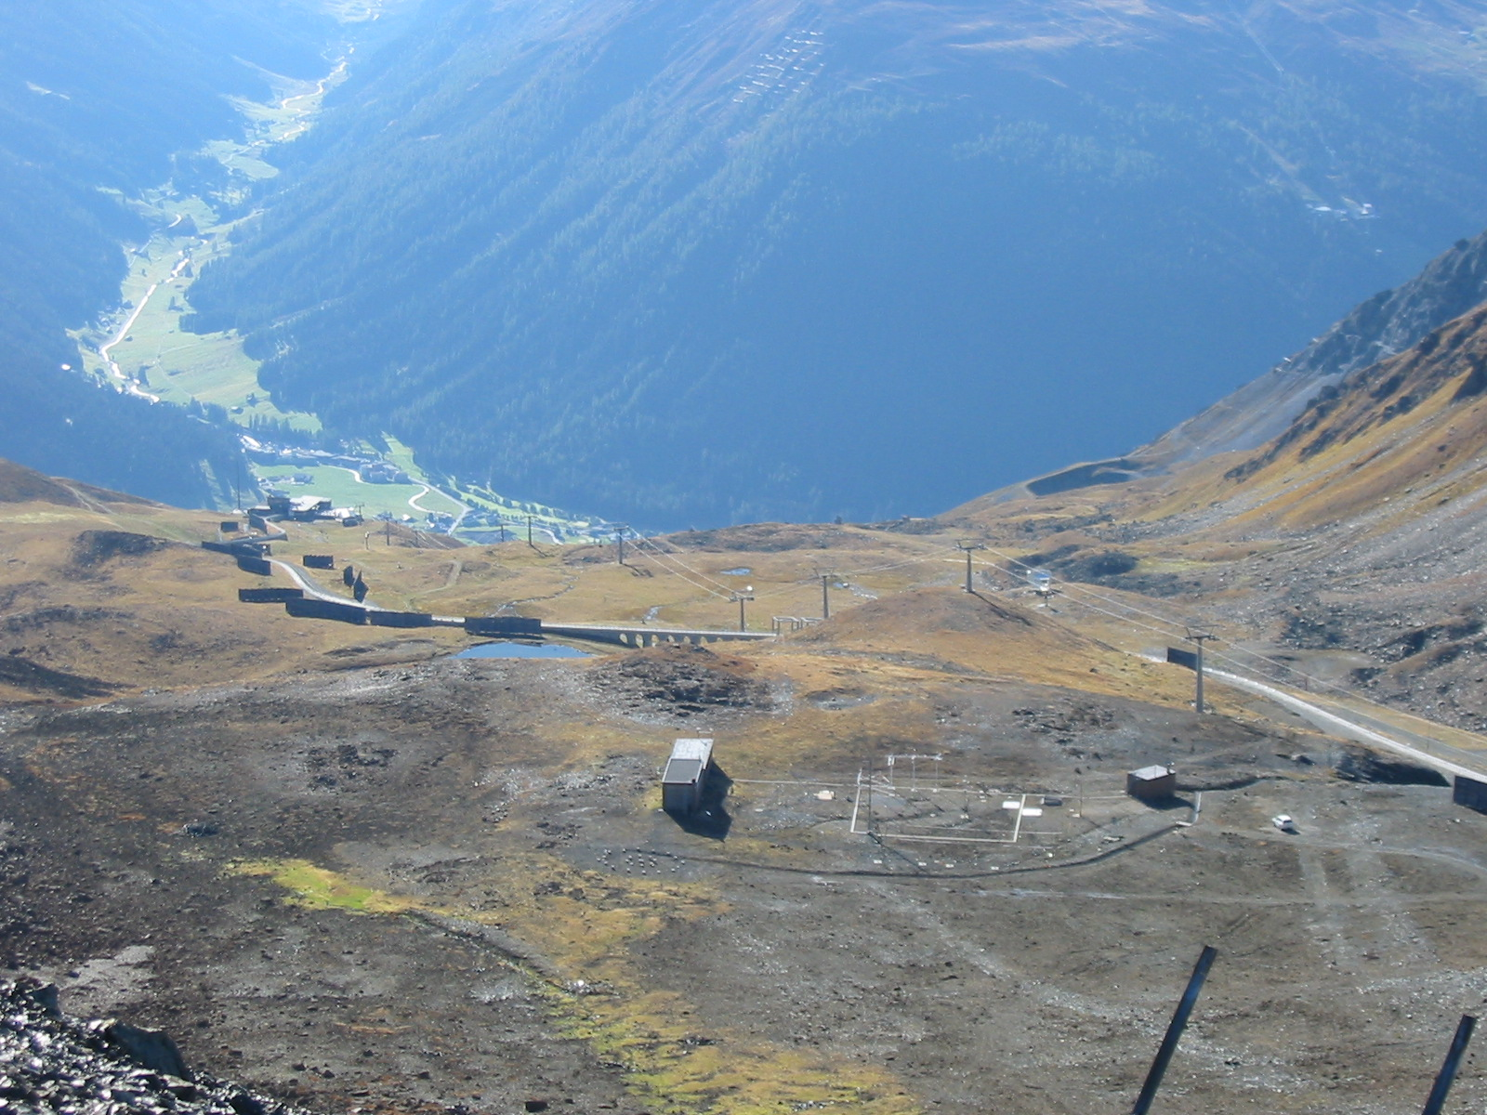
Weissfluhjoch Oct 2012 (courtesy B. Goodison)

