Slide 1
WMO SPICE Sodankyla (Finland)
Site Configuration Update
Oct 10th , 2012
Information from Osmo Aulamo and Timo Laine
Prepared by Rodica Nitu

Slide 2
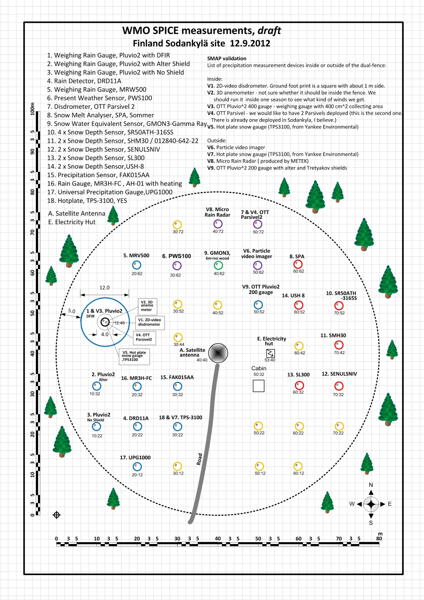
Site Layout

Slide 3
Sodankyla: Update on Instruments (Oct 10th, 2012)
Here's a list based on today's knowledge.
6.9.2012, SL300, Snow Depth Sensor, Felix Technology Inc.
10.9.2012, SHM 30 / 012840-642-22, Snow Depth Sensor, ESW GmbH (Jenoptik)
9.2012, Pluvio2 400cm2 (3 pcs), Precipitation Gauge, OTT
9.2012 Pluvio2 200cm2, (3 pcs), Precipitation Gauge, OTT
9.2012, SR50ATH-316SS, Snow Depth Sensor, Campbell Scientific
9.2012, USH-8, Snow Depth Sensor, Sommer
9.2012, UPG1000, Universal Precipitation Gauge, EML
x.xxxx, MRW500,Weighing Rain Gauge, Meteoservis v.o.s.
x.xxxx, PWS100, Present Weather Sensor, Campbell Scientific Ltd
9.2012, OTT Parsivel 2, Disdrometer, OTT Hydromet GmbH
x.xxxx, TPS-3100, Hit Plate, Yankee
x.xxxx, MR3H-FC, Rain Gauge, Meteoservis v.o.s.
x.xxxx, FAK015AA, Precipitation sensor, MTX s.r.l.
x.xxxx, GMON3-Gamma Ray, Snow Water Equivalent Sensor, Campbell Scientific
x.xxxx, SPA, Snow Melt Analyser, System Mess-Systemtechnik
x.xxxx, SENULSNIV, Snow Depth Sensor, E.T.G srl
x.xxxx: indicates that the sensor has not been received

Slide 4
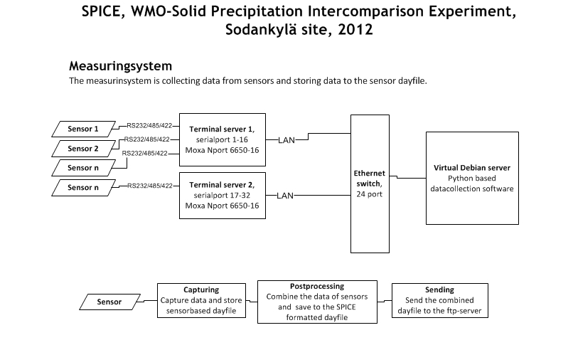

Slide 5
Sodankyla: Status Update
The Sodankylä SPICE field has been build ready for instrument installations.
DFIR constructions has been started. No instruments installed yet.
OTT Pluvios (3 pcs) with stands purchased by FMI have been received.
Other instruments from Jenoptik (Germany), Campbell Scientific (Canada), Sommer (Austria) and EML (UK) have been received.
The installation of instruments starts soon. Installation shall start first with Pluvios and following with other instruments.

