Slide 1
WMO SPICE
Marshall (USA)
Site Configuration Update
Oct 10th, 2012
Information from Scott Landolt
Prepared by Rodica Nitu

Slide 2
Marshall: Field References
(Info from updated submission: Sept 2012, S. Landolt)
WMO Secondary Field Reference:
  (DFIR) with a manual (Tretyakov) gauge and Tretyakov shield; Planned
  Orifice height is 2 m AGL.
  Fences match the WMO recommendations.
  Frequency of manual observations: Can be taken as frequently as required
  Methodology of measurement (planned) Weighing
  Length of time since operational: planned
Field Reference using an automatic weighing gauge in a DFIR:
  Existing: Orifice height at 2 m AGL. GEONOR T-200b gauge with 3 vibrating wires, heated
  Type of shield used: DFIR with single Alter shield
  Frequency and format of reference data: 1 min, ASCII flat files
  Length of time since operational (archived data):1997
Other field reference for the measurement of total precipitation, currently in use on the site: Orifice height is 2 m AGL, OTT Pluvio II, heated
  Type of shield (include height, diameter): DFIR
  Frequency and format of reference data: 1-minute

Slide 3
Marshall: Instruments Provided by the Host
Instrument Type | Instrument Make and Model | Configuration |  | instrum in same config
 |  | Shield type (if applicable) | Other configuration information
Weighing Gauge | GEONOR (600ml) | Unshielded | Heated orifice | 1
Weighing Gauge | GEONOR (600ml) | Single Alter | Heated orifice with 16” slats | 1
Weighing Gauge | GEONOR (600 ml) | Single Alter | Heated orifice with 18” slats | 1
Weighing Gauge | GEONOR (600 ml) | Double Alter, 6-foot diameter outer shield | Heated orifice | 1
Weighing Gauge | GEONOR (600 ml) | Double Alter, 8-foot diameter outer shield | Heated orifice | 1
Weighing Gauge | GEONOR (600 ml) | Double Alter, NOAA HCRN | Heated orifice | 2
Weighing Gauge | GEONOR (600 ml) | Belfort Double Alter | Heated Orifice | 1
Weighing Gauge | GEONOR (600 ml) | 2/3-scale DFIR | Heated Orifice | 1
Weighing Gauge | Belfort AEPG 600 (600 ml) | 2/3-scale DFIR | Heated Orifice | 1
Weighing Gauge | Belfort AEPG 600 (600 ml) | Belfort Double Alter | Heated Orifice | 1
Weighing Gauge | Belfort AEPG 600 (600 ml) | Double Alter | Heated Orifice | 1
Weighing Gauge | OTT Pluvio2 | Belfort Double Alter | Heated orifice | 1
Weighing Gaugee | OTT Pluvio2 | Tretyakov shield | Heated orifice | 1
Hotplate | Yankee Environmental Systems | None | None | 1 to 3
Weighing Gauge | OTT Pluvio1 | Tretyakov shield with outer Alter shield | Heated orifice | 1
Heated Tipping Bucket Gauge | Hydrological Services Heated TB3 | Double Alter, NOAA HCRN | Heated orifice | 2

Slide 4
Marshall (USA):
Instruments from Instruments Providers
Instruments | Status: Oct 10th, 2012
Geonor WG model T-200B3/T-200BM3, 1500 mm
MeteoServis Weighing Rain Gauge model MRW500
MPS Systems Total Rain Weighing sensor, model TRwS 204
OTT Pluvio model 200_RH
Sutron TPG model TPG-0001-1
Thies Laser precipitation monitor model 5.4110.01.200
Campbell Scientific Present Weather Sensor model PWS100
Droplet Measurement technologies: Meteorological particle sensor
Thies Precipitation transmitter, model 5.4032.35.008
CAE Tipping Bucket (heated) model PMB25R
Environmental Meas Limited Universal Precipitation Gauge UPG1000
ETG Heated Rain Gauge, model R102R
Hydrological Services Heated Tipping Bucket , model TBH/TBH-LP
Meteoservis MR3H-FC Rain Gauge, model AH-01 with heating
MTX TB Precipitation sensor , model FAK015AA

Slide 5
Marshall: Ancillary Measurements
Parameter | Instruments | Data available | Report Interval | Status (E-Existing, P-planned)
Air Temperature | 6 aspirated PRTs (2 meter height), 2 Vaisala HMP45c temp/rh sensors (2 meter height) | ASCII | 1 min | E
Relative Humidity | 2 Vaisala HMP45c sensors (2 meter height) | ASCII | 1 min | E
DewPoint Temperature | None, derived from RH
Atmospheric Pressure | Vaisala PTB101B | ASCII | 1 min | E
Wind Speed 10 m | 2D sonic anemometer, RM Young aerovane, Belfort aerovane | ASCII | 1 min | E
Wind Direction 10 m | 2D sonic anemometer, RM Young aeovane, Belfort Aerovane | ASCII | 1 min | E
Wind Speed at the gauge orifice (specify height) | MetOne cup anemometer & 2 RM Young aerovanes | ASCII | 1 min | E
Precipitation Detector (Y/N output) | 2 Vaisala wetness sensor | ASCII | 1 min | E
Precipitation type | Vaisala PWD22, Vaisala PWD33 | ASCII | 1 min | E
Ice detection sensor | Rosemount freezing rain | ASCII | 1 min | E
Snow Depth | Manual, Campbell sonic range finder, Judd sonic, GPS, Jenoptik laser depth sensor | ASCII | 1 min | E
Net Radiation | Kipp & Zonen CNR1 (2 meter height) | ASCII | 1 min | E
Visibility | Vaisala PWD22 & Vaisala PWD33 | ASCII | 1 min | E
Web / video / still cameras | Axis PTZ 214 | .jpg | 1 hr | E
Micro physical | 3D Video disdrometer OTT Parsivel | ASCII ASCII |  | E E
Snow Water Equivalent |  |  |  | N/A
Manual observations: | Manual snow depth | ASCII | 1 per event | E
Radar data | Metek k-band, vertically pointing | ASCII | 1 min | E
Other data available | Lufft R2S, Lufft WX600 | ASCII | 1 min | E

Slide 6
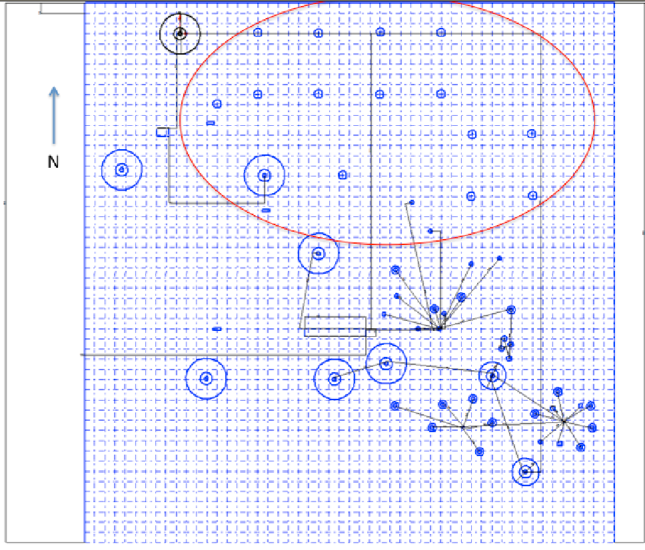
Marshall: Preliminary site Layout: July 10, 2012
This is digitized map of the Marshall site.
The large double-circles are the DFIR shields, the smaller double circles are the 2/3-scale DFIR shields and the small circles are the locations of single/double Alter shielded gauges.
The area circled in red is where the new SPICE instruments will be installed, with the blue circles inside being the proposed pedestal locations.
The diagram is drawn to scale and each square box is 10 feet (~3 meters) in length.
Once we have all the instruments in, we'll do an aerial photograph and will label everything accordingly.
(Scott Landolt, July 10, 2012)

Slide 7
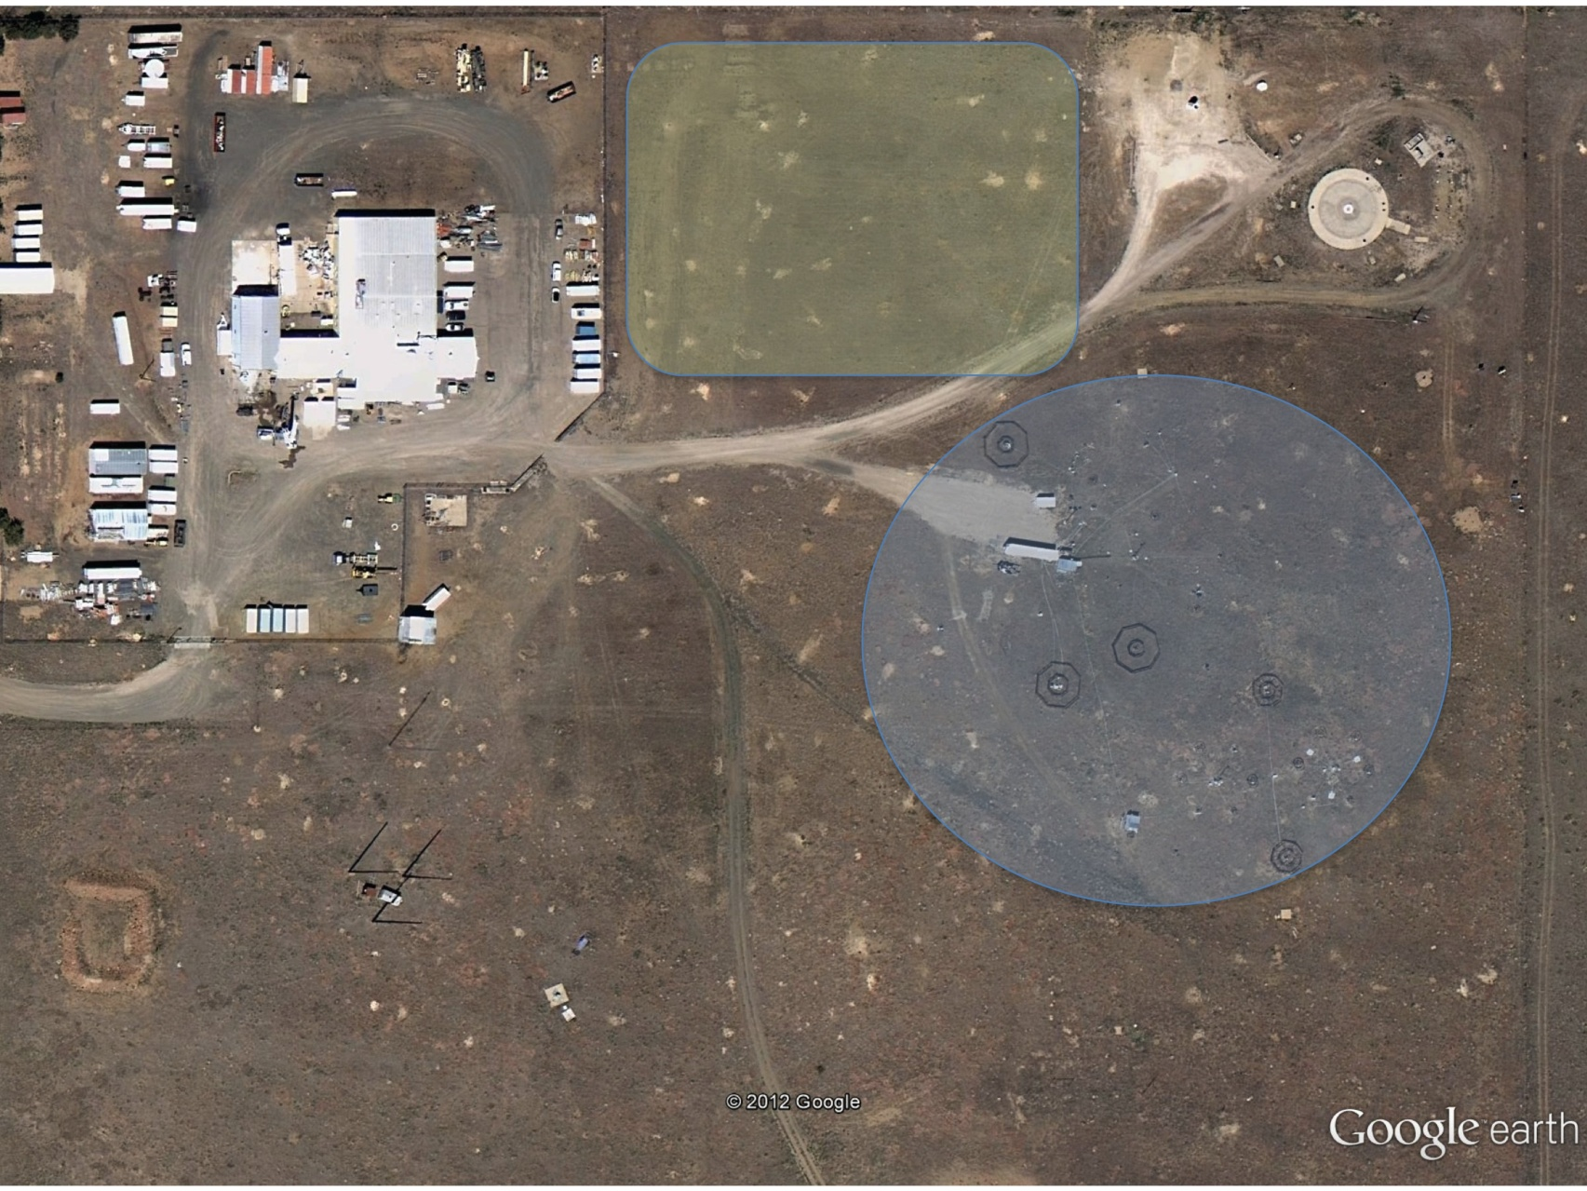
Marshall: Site layout (Sept 10, 2012)

Slide 8
Marshall: Data Flow

Slide 9
Site Commissioning

