Slide 1
IOC SPICE - 3 Chair Report
Rodica Nitu
Brussels
Oct 15, 2012

Slide 2
Project Update (1)
June 11-15, 2012: IOC-SPICE-2, Boulder Colorado
Summary of activities post IOC-SPICE-2
Modus operandi: weekly teleconferences,, via WebEx: well attended
Finalised the allocation of Instruments to Sites;
Formally invited Site proponents and Instrument Providers to participate;
Approved the Data Protocol; it includes publication guidelines, enabling the publication of partial results prior to the Final Report;
Approved the Commissioning Protocol: documents the site configuration at the onset of the experiment, as a baseline for the data analysis and assessments during the experiment;
Defined the configuration of references: consistent and defendable for all participating sites;
Obtained clarification regarding the Pluvio2 data to be used for the derivation of reference observations;
Assessed installation and configuration details: calibration of gauges, use of antifreeze, Alter Shield configuration.

Slide 3
Project Update (2)
Under way: refining the objectives for meeting SPICE goals regarding the measurement of snow on the ground and snowfall.
Work towards establishing a SPICE Data Archive, building on the archiving capabilities of each site:
will host all SPICE data;
Will ensure consistent data format and data quality;
Will enable the data analysis.
Potential hosts:
National Centre for Atmospheric Research (NCAR), USA (proposal under way)
Environment Canada, Canada (proposal still to be finalised)
Established the Data Analysis Team:
Coordinate the preparation a reference dataset for inclusion in the WMO-SPICE Final Report and the analysis of the intercomparison data.
Coordinate the preparation, interpretation and reporting on the SPICE results in accordance with project objectives.
Data analysis: Estimated: 30,000 daily files/season: (200 files/day x 5 months/year)
Decision needed on the use of data outside the winter season.

Slide 4
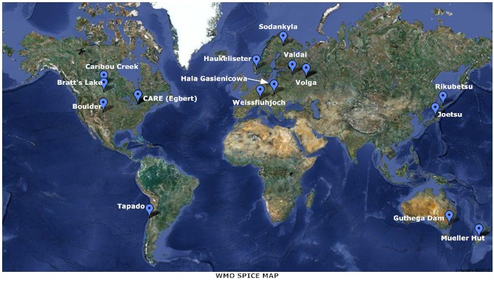
Participating Sites
15 sites, in 11 countries:

Slide 5
Instrument Participation
Detailed information in the IOC SPICE-2 Meeting report http://www.wmo.int/pages/prog/www/IMOP/reports/2012/IOC-SPICE-2.pdf
Received submissions from 20 Instrument Providers, for 26 different models of instruments; operating principles:
Weighing gauges
Tipping buckets
Optical gauges
Snow depth sensors
Snow water equivalent;
Two additional submissions received since the SPICE IOC-2:
Surfasense (USA) GPS reflections off the ground surface : rejected due to footprint required, and status of development;
Vaisala: rejected due to the timing of the submission; indication was given of an additional potential call for participation in 2013.
Two instrument models have been withdrawn:
Electrical Rain Gauge ( submitted by KNMI);
Snow Pack Analyser, model SPA - Summer - (submitted byHydrological Services America)
Included in SPICE: 24 models, a total of 50 instruments will be tested on 10 participating sites;
Each participating site will include instruments and configurations of interest and representative for the national applications.

