Slide 1
WMO SPICE Haukeliseter (Norway)
Site Configuration Update
Oct 11th, 2012
Information Provided by Mareile Wolff
Prepared by Rodica Nitu, updated by Mareile Wolff

Slide 2
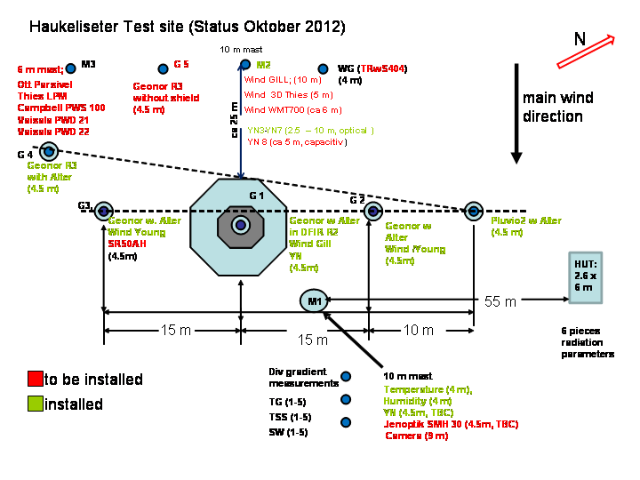
SITE LAYOUT

Slide 3
Haukeliseter: Data Flow

Slide 4
Haukeliseter: References
R2: Field Reference using an automatic weighing gauge in a DFI
Weighing gauge: GEONOR T200BM (1000mm, 3 transducers), Orifice Height 4.55m, Heating 200 W
Type of shield used with the automatic gauge: Alter wind shield
Frequency and format of reference data: 1 minute
Reference R3:
two Geonor gauges T200BM (1000mm, 3 transducers), one shielded (Alter), one unshielded (planned)
Note: The heaters on the WG used as part of the reference system will be modified to the CRN solution.

Slide 5
Instruments proposed by the Host
Instrument Type | Instrument Make and Model | Configuration |  | Number of instruments in the same configuration
 |  | Shield type (if applicable) | Other configuration information
Weighing Gauge | GeonorT200BM (1000mm) | Alter | 3 transducers, heated | 2
Weighing Gauge | GeonorT200BM (1000mm) | Alter | 3 transducers, heated | 1
Weighing Gauge | OTT Pluvio2 | Alter |  | 1

Slide 6
Haukeliseter: Ancillary measurements
Parameter | Instruments Used (model, make, configuration, height, number of instruments. | Reporting Interval | Status
Air Temperature | PT100 in MI2002B radiation screen (met.no product) Height: 4m | 1min | E
Relative Humidity | VAISALA HMP155 in MI2002B radiation screen (met.no product) Height: 4m | 1min | E
Atmospheric Pressure |  |  | P
Wind Speed 10 m | Gill WindObserver Extreme | 1min | E
Wind Direction 10 m | Gill WindObserver Extreme | 1min | E
Wind Speed at the gauge orifice Height: 4.55 m | 1 Gill WindObserver Extreme (inside DFIR) 2 Young Wind Monitor-SE (N and S Geonor) 1 Thies Ultrasonic Anemometer 3D (mounted at upstream mast at 5m) 1 Thies Ultrasonic Anemometer 3D (to replace the wind sensor inside the DFIR) | 1min | E E P P
Precipitation Detector (Y/N output) | 7 THIES Precipitation sensor Heights: 4 and 8 m on met. Mast 2,2.5,4.74,7.5 and 10m on upstream mast RQA6 from MPS-System, Height, ca 5m | 1min 1 min | E P
Precipitation type | VAISALA PWD21 Thies LPM Ott Parsivel VAISALA PWD 22 Height: 6m | 1min | E E E P
Snow Depth | Campbell SR50AH Jenoptik SMH30 | 1min | P P
Net Radiation |  |  | P
Web / video / still cameras | 1 IP video camera, ACTI TCM-6630 | hourly | P

Slide 7
Site Commissioning
Expected status on commissioning:
References (where applicable):
R2: installed, NCAR heating has to be mounted, field test has to be performed
R3: Geonor with Alter installed, Geonor without shield has to be installed, NCAR heating on both has to be mounted, field test has to be performed
Capacitive prec-sensor has to be installed, optical already available
Instruments under test:
Provided by the host:
Geonor installed, field test has to be performed
Pluvio 2, field test has to be performed
From Instrument Providers:
PWS100: delivered and tested, needs to be installed
TrWS204: TrWS404 delivered 8th of October
Instruments for Ancillary Measurements:
Wind 10 m and gauge height, Humidity, Temperature: installed
Several present weather sensors/disdrometers: re-install (new localization)
Snow depth: to be exchanged
Radiation, 3D wind: has to be installed (might be delayed)
Camera, air pressure: has to be installed

Slide 8
Site Updates
Anticipated date of commissioning: 15.12.2012 –estimated, a more accurate date depends on the re-configuration of the logger system (under preparation)
Expected status on Nov 15th: not finished
Data archive;
Data archive is existing, data flow into data archive needs to be realized; local backup server needs to be realized
Frequency of data transmission from the site to an archive (if any): hourly
Have you sent data to NCAR for pre-SPICE? NO
Do you have to change data format for transfer to NCAR: YES
How difficult is the process? Not difficult, but probably time consuming to write format conversion plus script to transfer data
Any risks if format is changed: new script necessary, risk is that no resources are available to do the changes immediately
Which is the reasonable frequency of data transfer to NCAR/SPICE archive to be expected during the experiment: once a week, maybe daily
Additional Information:
Due to the extension necessary for the SPICE project and the national avalanche project, we have to change(extend) the data collection system.
Currently the new loggers (2-3 Scanmatic loggers) are under configuration and we are waiting for a reliable delivery date from the logger-company. Further activities at the site has to be scheduled depending on that process.
I am expecting a delayed start of the measurement season in winter 2012/2013.

