Slide 1
WMO SPICE Hala Gąsienicowa(Poland)
Site Configuration Update
Oct 10th, 2012
Information from Maciej Karzyński
Prepared by Maciej Karzyński

Slide 2
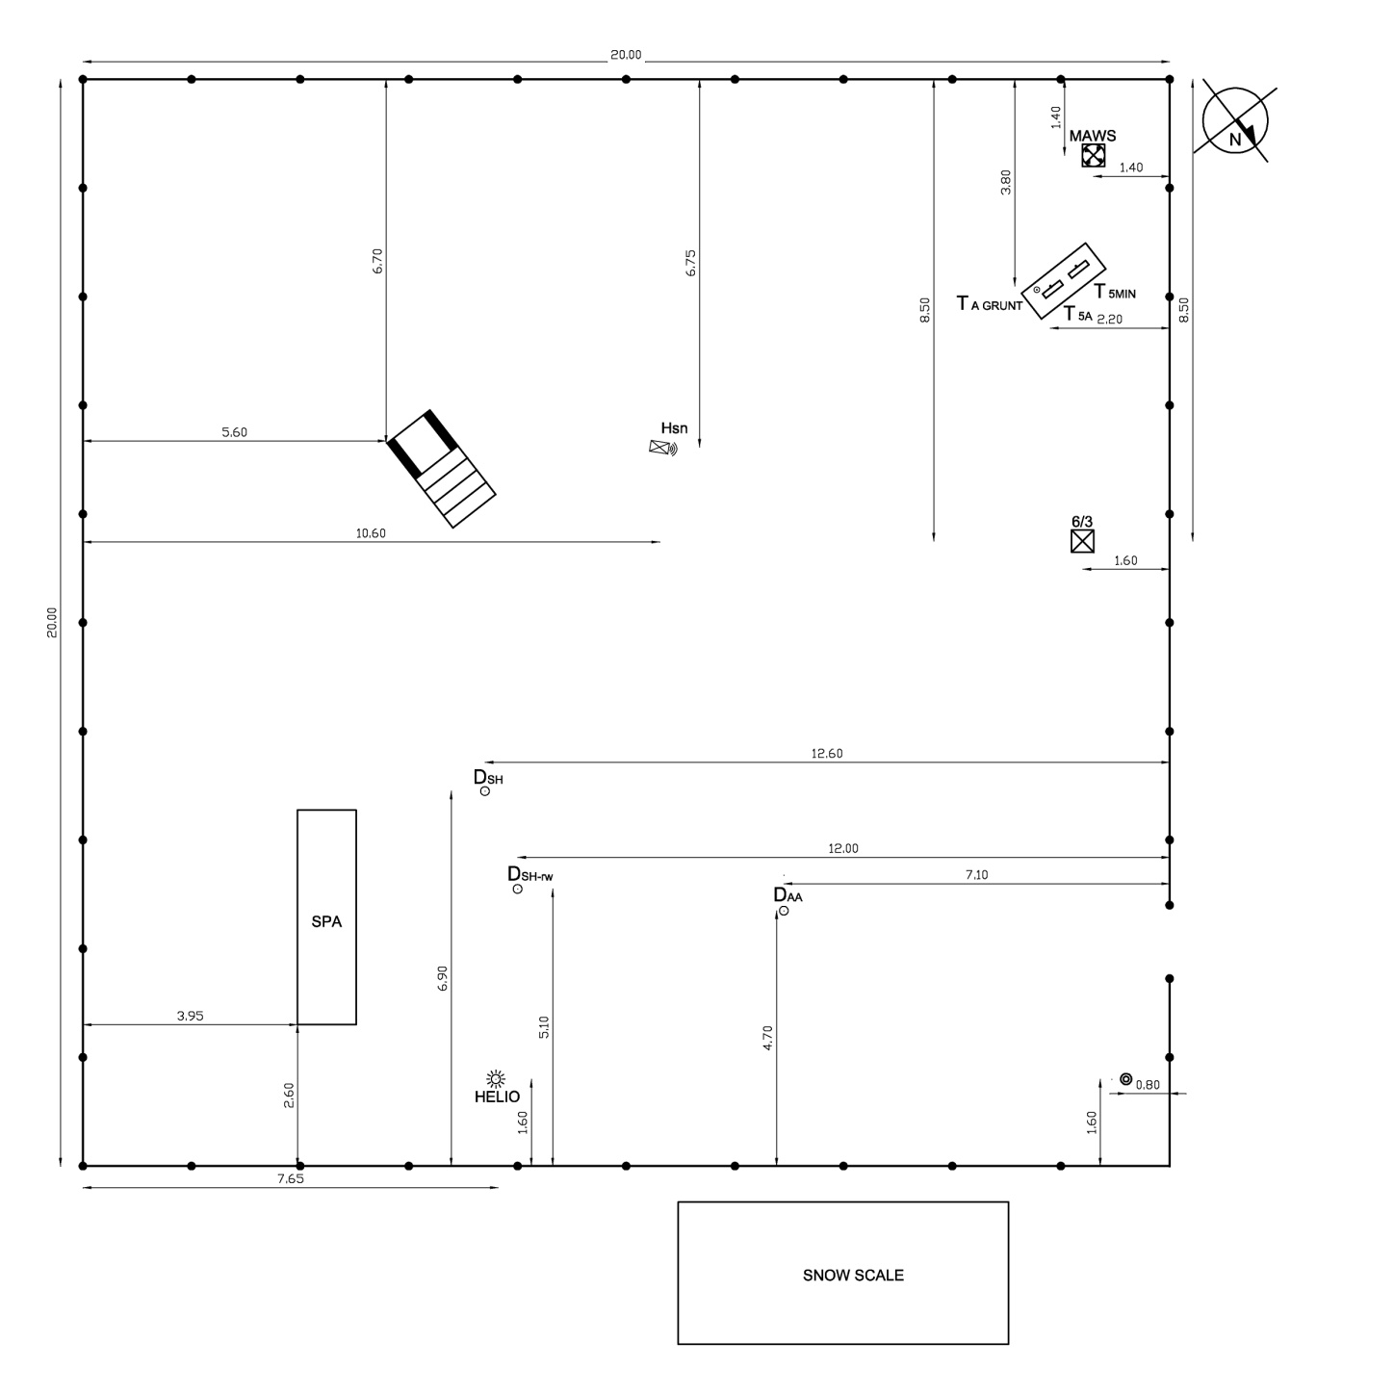
Hala Gąsienicowa: layout

Slide 3
Hala Gąsienicowa: References
R3 reference:
OTT Pluvio² 850mm + Ring heating
OTT Parsivel²
Sampling frequency: 6 seconds (1500 cycles)

Slide 4
Hala Gąsienicowa: Instruments Under Test
Currently there is no sensor tested

Slide 5
Hala Gasienicowa: Ancillary Measurements
Parameter | Instrument used | Data avaiable | Reporting Interval
Air Temperature | Vaisala HMP 45 D | ASCII | 1-minute
Relative Humidity | Vaisala HMP 45 D | ASCII | 1-minute
Wind Speed 10 m | Vaisala WMS302 | ASCII | 1-minute
Wind Direction 10 m | As above | ASCII | 1-minute
Precipitation Detector (Y/N output)
Snow Depth | Sommer - Snow Pack Analysing System | ASCII | 1-minute
 | manually |  | 24 h
Precipitation | Hellman |  | 6 h
 | ASTER | ASCII | 1-minute
Pressure | Vaisala PA 11 | ASCII | 1-minute
Temp 5 cm n.g. | Vaisala PT-100 | ASCII | 1-minute
Ground temperature | Vaisala QMT 107 | ASCII | 1-minute
Sunshime time | Heliograf
DOPISAC!!!!!!!!!!

Slide 6
Data Flow and Archive
Current data transfer from Hala Gasienicowa station
Instruments
Datalogger
Radio/GPRS link to server
Push to ORACLE Database

Slide 7
Site Commissioning
Anticipated date of commissioning: December, 2012
Expected status on commissioning:
References (where applicable):
S3: The planned installation of the supplied Cammbel SR50 on 30 November
Expected status on Nov 30th:
100% functional,
Start measurements and archiving data

Slide 8
Additional Info
I see the need to include the program SPICE sensors and OTT Pluvio2 and OTTParsival2. The term of the measurement setup and start within 1 month of delivery.

