Slide 1
WMO SPICE Guthega Dam (Australia)
Site Configuration Update
Oct 10th, 2012
Information from Shane Bilish
Prepared by Rodica Nitu

Slide 2
Site Layout
Under development

Slide 3
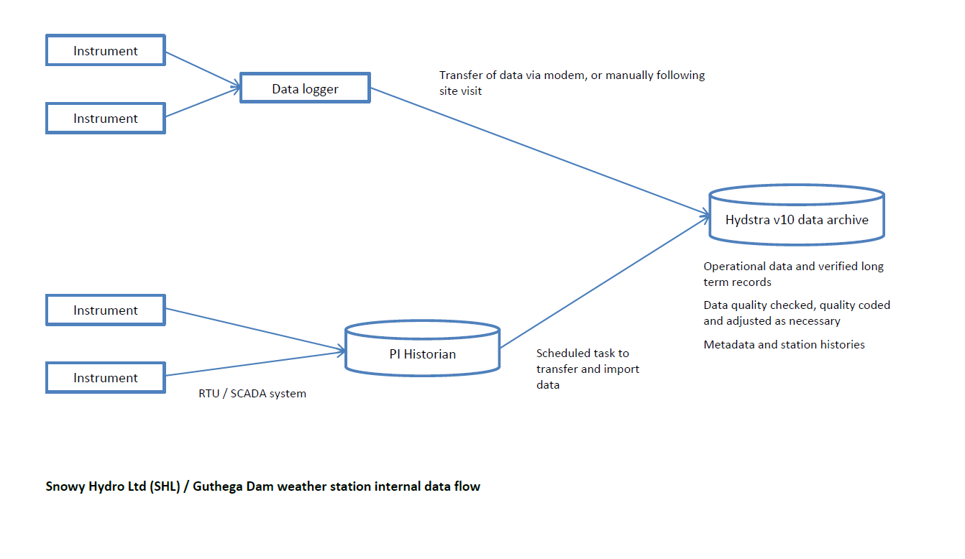
Data Flow and Archive

Slide 4
Site Commissioning
Anticipated date of commissioning: 01 May 2013
Expected status on commissioning:
References (where applicable):
R1: N/A
R2: N/A
R3: 2x Geonor T-200BM3, precipitation detector
Instruments under test:
Provided by the host: 3x ETI NOAH II (DFIR fence, Half DFIR fence, Alter shield only)
From Instrument Providers: N/A
Instruments for Ancillary Measurements: T, RH, P, wind speed and direction (3 m and 10 m); snow depth possible
Expected status on Nov 15th: Operational with existing instruments only (3x NOAH II, T, wind speed and direction)
Gaps for the winter 2013: The site is expected to be fully operational (see Additional Information below)

Slide 5
Additional Information (in blue, provided by the Shane Bilish, Oct 01, 2012)
Data archive;
Existing or planned: Existing
Frequency of data transmission site to an archive: At least weekly
Have you sent data to NCAR for pre-SPICE? No
Which is the reasonable frequency of data transfer to NCAR/SPICE archive to be expected during the experiment: To be agreed – weekly may be possible
Additional Information:
We are still in the process of finalising the site configuration and obtaining development approval.
In the event that approval is not received for two new instrument pedestals (for the R3 gauges), we propose to replace one existing NOAH II with a Geonor and install one new pedestal.

