Slide 1
WMO SPICE Bratt’s Lake (Canada)
Site Configuration Update
Oct 10th, 2012
Information from Craig Smith
Prepared by Rodica Nitu

Slide 2
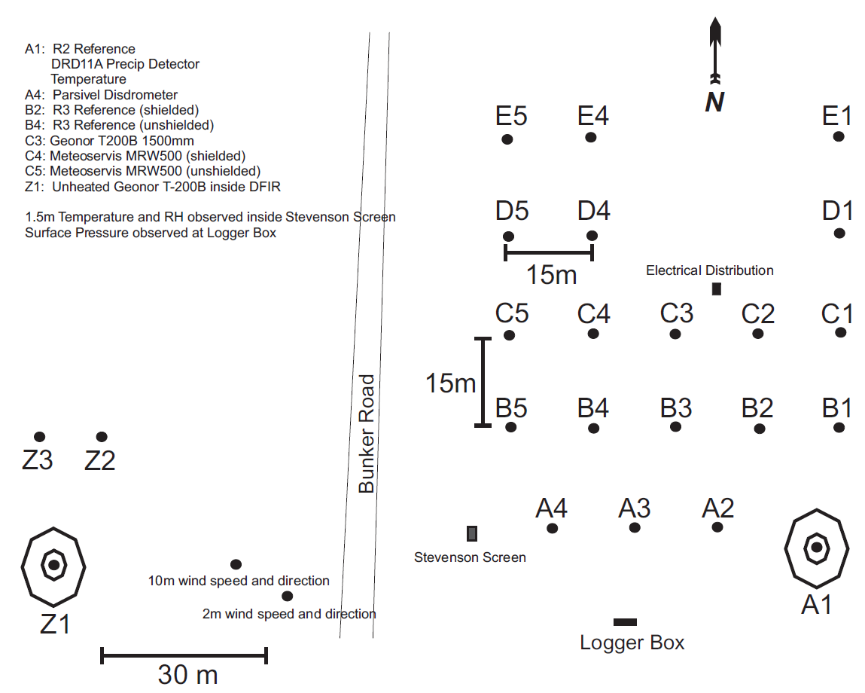
Bratt’s Lake: layout

Slide 3
Bratt’s Lake: References
R2 reference:
DFIR fence;
Geonor 600 mm, 3 transducers + CRN heating + single Alter;
DRD11
Sampling Frequency: 6 seconds (1500 cycles)
R3 reference:
Geonor 600 mm, 3 transducers + CRN heating + single Alter;
Geonor 600 mm, 3 transducers + CRN heating + no shield;
DRD11 (the same instrument as for the R2)
Sampling frequency: 6 seconds (1500 cycles)

Slide 4
Bratt’s Lake: Instruments Under Test
Instrument Type | Instrument Make and Model | Configuration |  | Number of instruments in the same configuration
 |  | Shield type (if applicable) | Other configuration information
Weighing Gauge | Geonor T-200B3 | DFIR | Non-heated | 1
Weighing Gauge | Geonor T-200B3 1500mm* | Single Alter | Heated | 1
Weighing Gauge | Meteoservis MRW500* | Tretyakov | Non-Heated | 1
Weighing Gauge | Meteoservis MRW500* | No shield | Non-Heated | 1

Slide 5
Bratt’s Lake: Ancillary Measurements
Parameter | Instruments Used | Data available | Reporting Interval
Air Temperature | Campbell Scientific HMP35, 1.5 m ventilated; Campbell Scientific 107B thermistor, 1.5m shielded | ASCII | 1-minute
Relative Humidity | Campbell Scientific HMP35, 1.5m ventilated | ASCII | 1-minute
Atmospheric Pressure | Campbell Scientific, CS105, surface pressure | ACII | 15-minute
Wind Speed 10 m | RMY 05103 | ASCII | 1-minute
Wind Direction 10 m | As above | ASCII | 1-minute
Wind Speed at the gauge orifice (specify height) | RMY 05103, 2.5m | ASCII | 1-minute
Precipitation Detector (Y/N output) | Vaisala DRD11A | ASCII | 1-minute
Precipitation type | Parsivel | ASCII | 1-minute
Snow Depth | Scientific SR50, 2m | ASCII | 1-minute

Slide 6
Site Commissioning
Anticipated date of commissioning: December, 2012
Expected status on commissioning:
References (where applicable):
R2: November 15, 2012; need to remedy some issues with the heating protocol and repair an intermittently bad sensor; wetness sensor still needs to be installed and tested, programs updated
R3: November 15, 2012; heaters need to be installed and tested, some intermittent sensor noise issues need to be examined
Instruments under test:
Provided by the host: October 30, 2012; unheated Geonor in DF requires networking and a new more secure mount
From Instrument Providers: Nov 30, 2012; shipping of gauges has been delayed, expected arrival in Canada mid- to late-October; if we get an early onset of cold temperatures, installation may not be possible before Spring 2013.
Instruments for Ancillary Measurements: unknown; we have a learning process to go through for some of this instrumentation as well as some technical issues to resolve with installing some instrumentation on site. It is probable that some of this instrumentation will not be installed prior to Summer 2013.
Expected status on Nov 15th:
50-75% functional,
heated vs. unheated R2 reference intercomparison should be ready to continue,
R3 reference gauges should be functional
will be missing some ancillary measurement such as the Parsivel precipitation detector.
Real-time communications may not be completely functional before Nov 15. Data flow protocols remain to be put in place.

Slide 7
Additional Info
Gaps for the winter 2012/2013:
intended SPICE test/activities which may not take place, as anticipated during the 2012/13 season; gauge intercomparisons of instruments provided by instrument manufacturers
reasons: late shipping, no time for testing before onset of cold temperatures
activities postponed for 2013: intercomparisons of instruments provided by manufacturers, extensive testing (with all ancillary instrumentation functioning properly) of reference intercomparisons.
Data archive;
Existing or planned: Data archiving at this site is still in the planning stage due to issues with communications logistics at the site, new equipment and protocols need to be put into place
Frequency of data transmission from the site to an archive (if any): unkown, probably daily when communications issues are resolved
Have you sent data to NCAR for pre-SPICE? (only pre-SPICE data from 2011/2012)
If yes, have you checked if satisfactory plots are available for conducting data quick view: No
Do you have to change data format for transfer to NCAR: yes
How difficult is the process? Not difficult but will take time
Any risks if format is changed: Not if done correctly
Which is the reasonable frequency of data transfer to NCAR/SPICE archive to be expected during the experiment: Daily
Additional Information:
It would have been desirable to have 2 months of warm season testing of new, repaired, and updated instrumentation prior to commissioning this site. This will not be possible before the start of the project. With a little luck, instrumentation will work correctly after initial installation and some useful data will be collected during the 2012/2013 winter. However, it is anticipated that some issues will not be resolved until Spring of 2013. Because of winter conditions at this site, it will be difficult to install instrumentation or diagnose problems after the onset of winter. This applies to both gauges under test and ancillary instrumentation.

