Slide 1

Operation of weather radars in mountainous regions
CIMO
Inter-Programme Expert Team on Operational Weather Radars (IPET-OWR)
First Session
Tokyo, Japan, 13-16 March 2017

Slide 2
Content
Background
Operation of radars in mountainous regions
  Challenges
  Recommendations
Proposed actions

Slide 3
Background
Weather radar is an indispensable tool for monitoring severe weather including rainstorms and typhoons, weather nowcasting and forecasting as well as quantitative precipitation estimates in NWP.
Weather radar stations have to stand head-and-shoulders above the surroundings to have an unobstructed view of the sky for weather monitoring.
In flatland, weather radar can be housed on a tower at the height up to tens of meters above ground.
In mountainous region, the favourite location to operate a radar station would be on the top of mountains. The site conditions to operate a radar system in mountainous region are usually more rigorous.
Purposes:
  Update information document on operation of weather radars in mountainous regions as urged by CIMO-XVI held in 2014.
  Discuss challenges and provide recommendations on operation of weather radar in mountainous regions

Slide 4
Major challenges on operation of weather radar in mountainous regions
Total/partial beam blockage
Missing data at low-level region or valley
Non-ionizing radiation level
Lightning strikes
Accessibility
Infrastructure for telecommunication

Slide 5
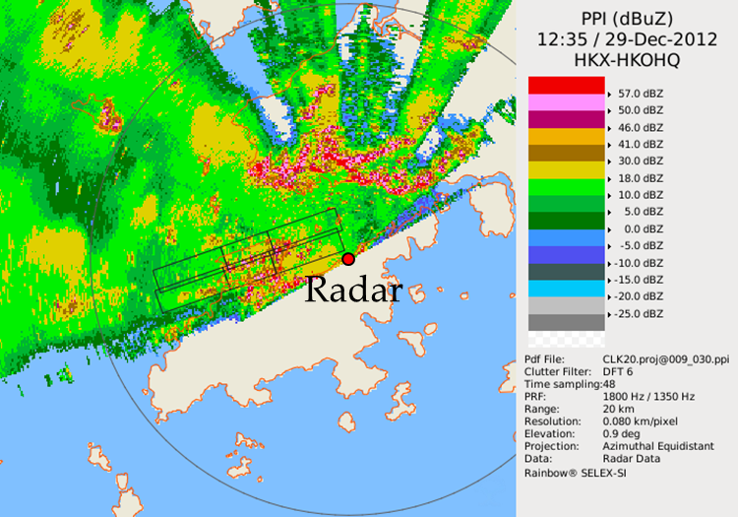
Challenge 1 - Total/partial beam blockage
In mountainous regions, the primary issue to operate a radar is not having a clear radar horizon due to total or partial beam blockage by terrain obstacles.
The bias in the measured reflectivity due to beam blockage depends on the amount of beam blockage and the reflectivity difference between precipitation and the ground clutter echo (Vivekanandan et al.,1999).
The bias in measurement of reflectivity would affect reliability and accuracy of radar QPE.
Intense ground clutters due to the terrains over the north of the radar. The terrains also cause total or partial beam blockage from azimuth of around 300° to 60°.

Slide 6
Recommendations (1) - Total/partial beam blockage
Correction of partial beam blockage (PBB)
  Digital Elevation Models (DEMs):
    to make use of the digital terrain information for comparing reflectivity in blocked and unblocked regions, and make corrections by constructing vertical profile of storms.
    to calculate the percentage of blockage based on beam geometry and digital terrain information.
    (Bech et al., 2003; Kucera et al., 2004; Krajewski et al., 2006; Kabeche et al., 2011; Shakti et al., 2012)
  Polarimetric measurement of dual-polarization radar
    Self-consistency of Z, KDP and ZDR
    Immunity of specific differential phase KDP
    (Carey et al. 2000; Ryzhkov et al, 1997; Giangrande and Ryzhkov 2005; Friedrich et al. 2007; Zhang, Zrnić and Ryzhkov, 2012)

Slide 7
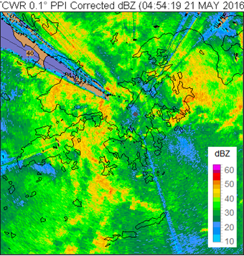
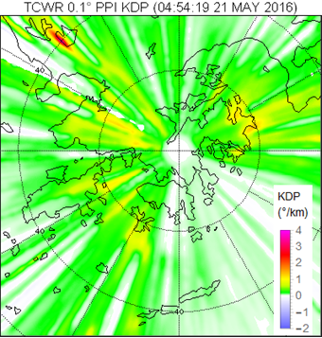
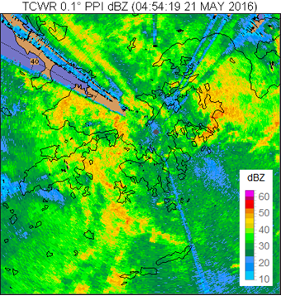
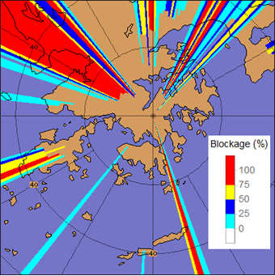
Example – Correction of PPB Echoes
Blockage of TCWR

Slide 8
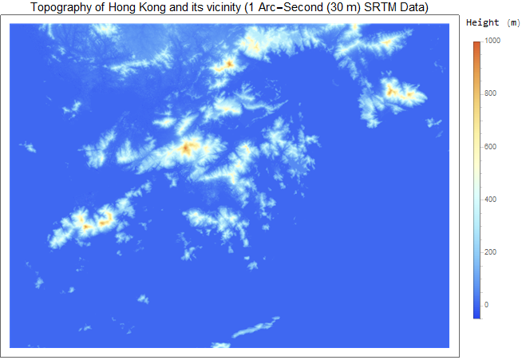
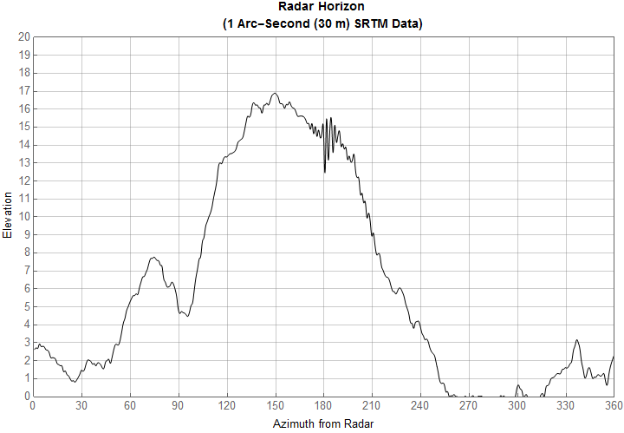
Recommendations (2) - Total/partial beam blockage
To conduct land surveys and produce a radar horizon map for each radar station. This would allow the operator to determine sector blanking with better accuracy and harmonize different radars on the network for a maximum coverage.
To utilize 1-arc second Shuttle Radar Topography Mission (SRTM) Data
624m
956m
677m
856m
904m
Radar horizon by on-site land survey
Errors of peak’s altitude over this region generally less than 30 m
Radar horizon by SRTM data

Slide 9
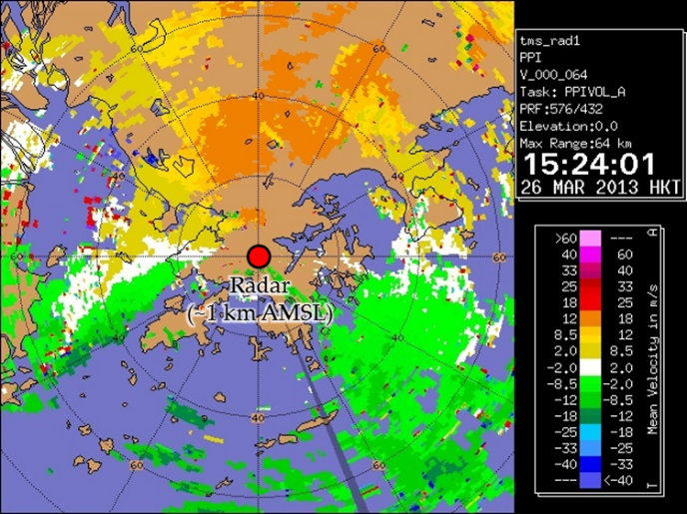
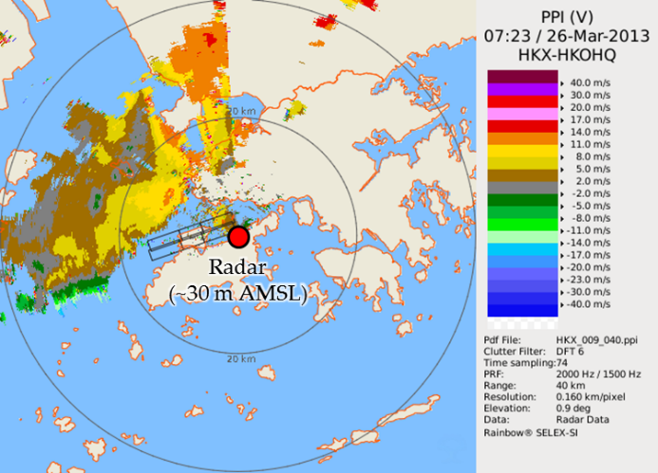
Challenge 2 - Missing data at low-level region or valley
While radar scanning should avoid total/partial beam blockage, in the meantime, it is desirable to keep the scanning angle as low as possible to capture weather data at low level as the scanning attitude is sensitive to the elevation in the long-range.
Weather radar thus sits on the top of a mountain (not necessary the highest mountain) will miss weather data at low level region or valley.
Example: The radar at ~30 m AMSL was able to detect surface convergence associated with the storm over the west of the territory but the radar at ~1 km AMSL failed to depict this feature at boundary level.
Recommendations:
  Scanning at negative elevation (Li Bai, 2011)
  Gap-filling using small radar (Chang et al., 2009)
  Anymore?
Doppler image from a radar located around 1 km above mean sea level (AMSL)
Doppler image from a radar located around 30 m above mean sea level (AMSL)

Slide 10
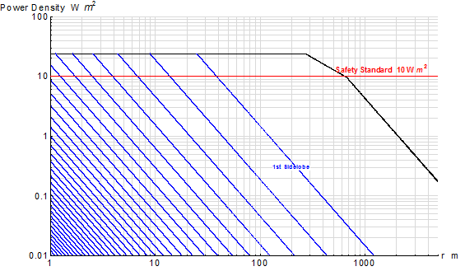
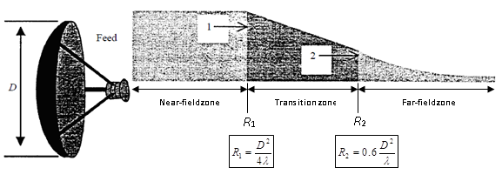
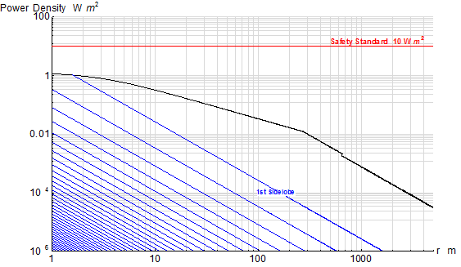
Challenge 3 - Non-ionizing radiation level
People living in mountainous regions would raise concerns of public health related to NIR when a radar station is close and visible to them.
Recommendations
  Conduct routine NIR survey to ensure radiation level is below the restrictions for power density according to ICNIRP guidelines, i.e. 10 W/m² for general public and 50W/m² for occupational exposure. (Health Physics 74 (4): 494-522; 1998).
  Estimate theoretical NIR level before implementation of new scanning strategy, particularly negative elevation scans.
  Anymore?
Power densities of mainlobe and sidelobes from a C-band radar
(Peak transmitted power = 250 kW)
Stationary Antenna
S_{nf} , S_{tran} , S_{ff} = power density
τ = pulse duration
F­_{pr} = pulse repetition frequency
P_{t} = Peak transmitted power
η = antenna efficiency
D = antenna diameter
r = distance from the antenna
G₀ = antenna gain of the mainlobe
Rotating Antenna
(ITU-R BS.2037)
Power Density Distribution

Slide 11
Challenge 4 - Lightning strikes
Weather radar station sits on the top of a mountain is particularly susceptible to lightning strikes.
A more stringent standard and additional measures on lightning protection should be adopted for safeguarding sophisticated electronics of weather radars against surge of unstable electrical current induced by lightning strikes.
Recommendations
  A common cause of damage to radar system by lightning strikes is the induced ground potential when a lightning hits the ground. Separate earthing systems of the station for equipment and lightning protection is recommended and the earthing resistance should not exceed 1 ohm to ground for a more effective discharge of current.
  The power line for the radar should be protected by Surge Protection Device (SPD) with capability of protecting the radar system from attacks of at least 600kA per phase.
  Copper wires at the station should be replaced with optic fibres as far as possible to avoid induce of current during lightning.
  Isolation of facilities’ alarm systems from the radar to avoid potential surge induced by lightning from other building facilities.
  Any closed loop of wires should be avoided both inside and outside the station.
  Anymore?

Slide 12
Challenge 5 - Accessibility
Accessibility to radar stations in mountainous region
  Dangerous to access the station in severe weather, like high winds in tropical cyclone, frequent lightning in storms, road ice, snow etc.
  In some extreme cases, roadway to the station is even unavailable and hours of trekking is needed.
Recommendations
  Deployment of maintenance staff before approaching of tropical cyclone.
  Anymore? Other experience from IPET-OWR members?

Slide 13
Challenge 6 - Infrastructure for telecommunication
Type of data link for data transmission
  Land line – Metro Ethernet, E1, broadband
  Microwave link
  3G/4G network
  Satellite
Pros and cons of different data links?

Slide 14
Proposed actions
Comments and inputs of IPET-OWR members are sought for challenges and recommendations on operation of weather radars in mountainous regions.
To prepare 2nd draft of information document by August 2017 (or other date to be discussed) for further comments by IPET-OWR members.

