Slide 1
Review low cost aws tahmo project
ariffudin

Slide 2
outline
Tahmo Project
Spesification of AWS sensor
Review
The expected design

Slide 3
automatic weather stations for continent-wide TAHMO network
The partnership began when Selker met with Dr. Gaylon Campbell at a technical conference and discovered they were working on a similar concept for a weather station. In 2012, TAHMO founders decided to collaborate with METER Group, Inc. USA, formerly Decagon Devices, Inc., for instrument development and manufacture.
TAHMO aims to deploy 20,000 weather stations, one station every 30 kilometer across the entire sub-Sahel. The stations provide ground-based observations in underserved regions, which are necessary for improving forecasts for weather-dependent industries such as agriculture. Today forecasting accuracy in Africa trails the rest of the world. Only a small number of surface stations are producing reports with high reliability, according to the World Meteorological Organization (WMO).

Slide 4
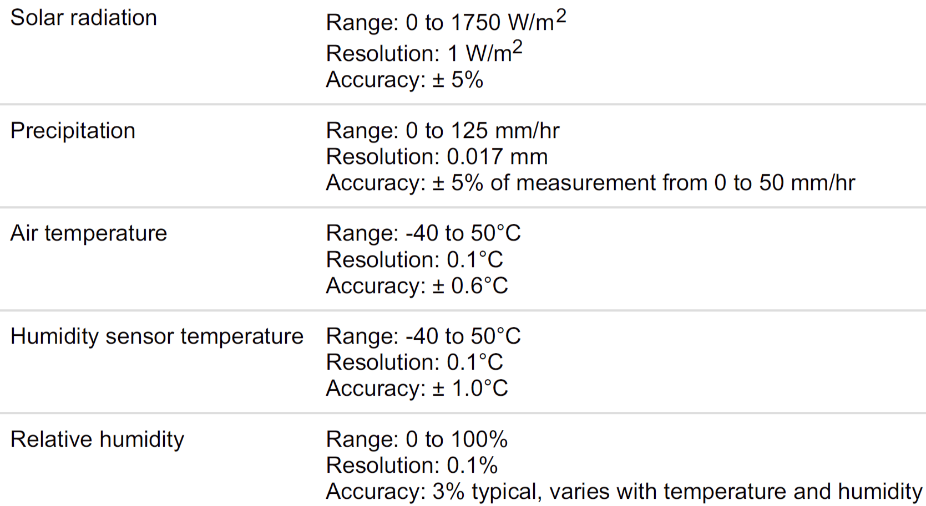
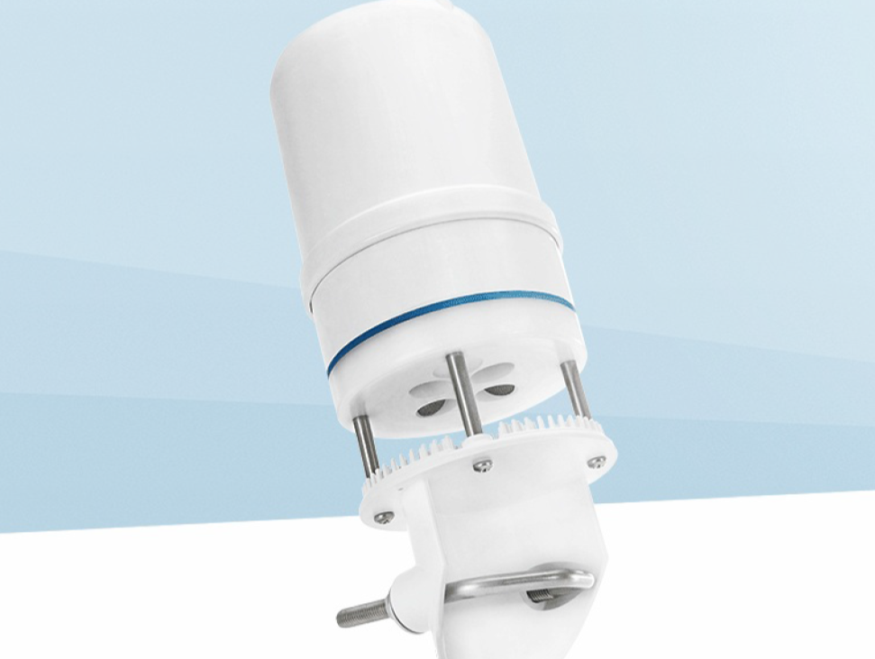
REVIEW TAHMO

Slide 5
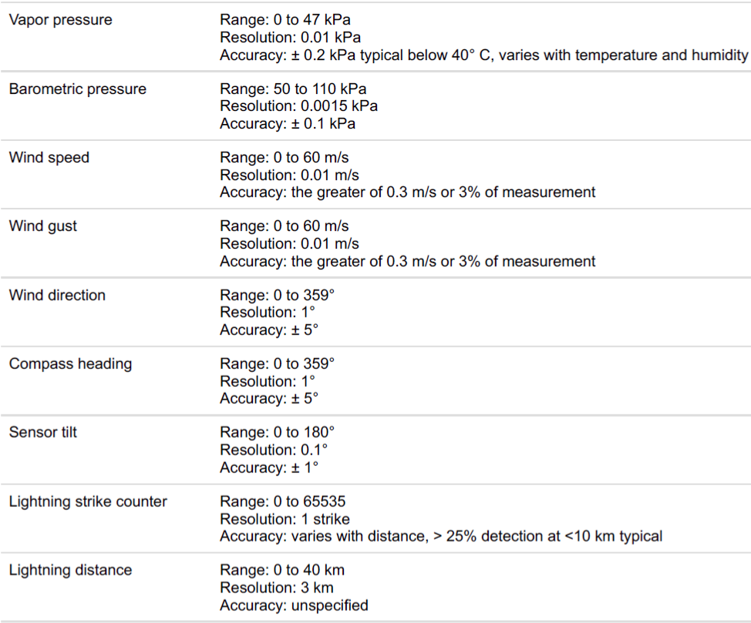

Slide 6
Review AWS METER (DECAGON)
ATMOS41 compact sensor
Tier 2 Category
Simple compact
Data Logger
The price is about 1700 US$ (the price is still expensive)

Slide 7
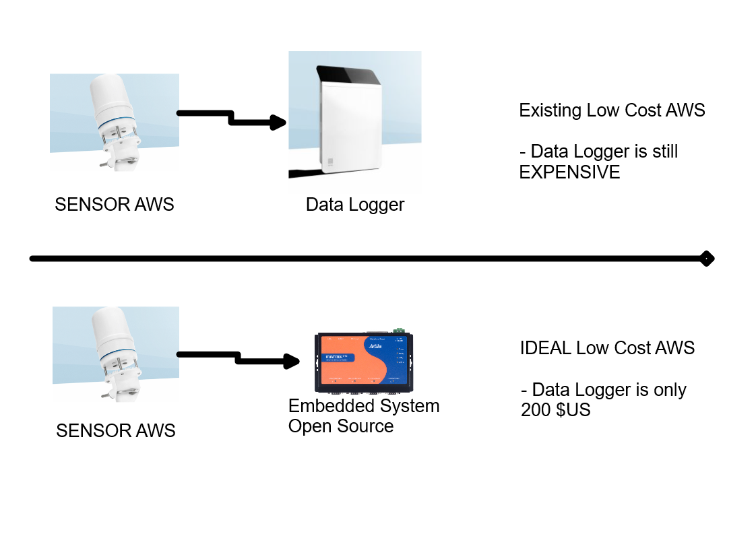
The expected design based on experience

