Slide 1
Cloud reporting practices and experiences at KNMI
Wiel Wauben
R&D Observations & Data Technology

Slide 2
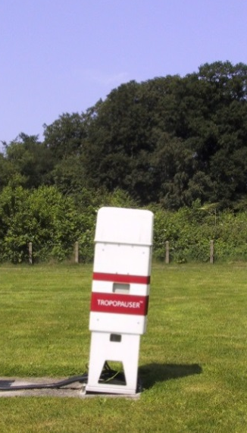
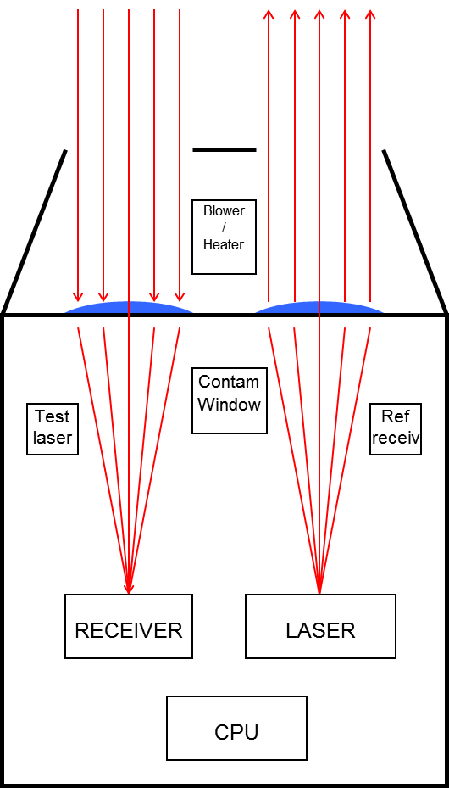
LD40 ceilometer
  Impulsphysik LD40
  range:
  25 (25) 43000 ft
  wave length:
  855 nm
  pulse repetition frequency:
  6494 Hz
  FOV:
  1.2 mrad
  Beam overlap at
  about 300 m
  status information
  backscatter profile
  up to 3 cloud base heights (C1, C2, C3)
  penetration depth per layer
  vertical visibility (ZV)
  measurement range (CX)
  precipitation indicator

Slide 3
LD40 ceilometer
Point measurement (12m @ 10km) directly overhead of sensor
Every 15” update of LD40 output, detection of high clouds uses integrated up to 10’
Slanted installation (5°) to suppress reflection by precipitation compared to suspended cloud droplets
Cloud base 0 of SIAM is clear sky; during fog cloud base of 25 ft is reported.
up to 3 cloud base heights (C1,C2,C3) reported by ceilometer every 12” and sensor vertical visibility (ZV)
Treat ZV as a cloud base C1 in ‘cloud free’ situations (suppress clear during precipitation).
10’ averaged MOR in SYNOP
10’ MD averaged aeronautical VIS in METAR

Slide 4
Cloud algorithm
SYNOP cloud algorithm uses last 30’ of data and the last 10-minutes have double weight.
METAR cloud algorithm uses last 10’.
When less than 75% of the data is available all cloud parameters are set invalid.
Add the height of the ceilometer above station level to the ceilometer data.
Sort ceilometer data according to cloud base height.
Determine the number of entries corresponding to each okta region taking account of the weight of the entries.
Note that 0 and 8 okta require no cloud hit and nothing but cloud hits, respectively.
The lowest cloud hit C1 is the cloud base and the total weight of cloud hits of C1 determines the total cloud cover.
Isolated low hits (the first 2 hits of the first layer) are ignored in METAR when the base is below 100 ft and is more than 500 ft below the third hit.

Slide 5
Cloud algorithm
Check for presence of cloud at middle of okta interval and if so use the lowest height in okta interval as the corresponding cloud base. Assume maximum overlap of the cloud layers.
Combine lower layer with the one above if they are close enough by making one layer with the height of the lowest and okta amount of the upper.
Repeat the above procedure for the C2 and C3 data of the ceilometer.
Combine the results of C1, C2 and C3. Make the cloud amount of a higher layer at least that of the layer below (overlap).

Slide 6
Cloud algorithm
Reduce the remaining cloud layers to at most four layers where the amount of the first layer is at least 1 okta, the second layer at least 3 okta, the third 5 okta and the fourth layer 7 okta.
Only the first 3 cloud layers are reported.
Any cloud layer above an 8 okta layer is ignored.
Sky obscure is reported (VertVis in METAR) if:
(i) only one cloud layer is reported with 8 okta and
(ii) cloud base below 500 ft,
(iii) not a single C2/C3 hit occurred, and
(iv) the MOR/VIS is less than 1000m.
The cloud base of the first and only cloud layer is then reported as the vertical visibility.
When MOR/VIS is missing vertical visibility cannot be reported.

Slide 7
CB/TCU
TS (≤ 20km) gives CB
weather radar reflectivity or MSG-SEVERI VIS and IR exceed thresholds within 15 km radius
# radar contours > 14 dBz (0.25 mm/hr)
maximum occurring radar contour
averaged cloud top temperature
number of pixels with T03.9-T10.8 < 0
HRV maximum - HRV minimum
tuned to reference set evaluated by MET for each location
weights vary per location
Performance POD=0.6, FAR=0.3

Slide 8
CB/TCU
the cloud base height is estimated by the dew point depression MAX[(TA-TD)*400, 1500 ft].
CB/TCU is added to an existing layer when close enough; otherwise a new layer is added.
When adding the CB/TCU to the ceilometer cloud information any OVC layer is reduced to BKN and Vertical Visibility is changed to a BKN cloud layer with the same height due to coding rules.
CB INFO NOT AVBL

Slide 9
Issues
Ceilometer
Cloud base height (definition)
Performance during precipitation
Shallow fog
Cloud detection threshold
Poor spatial representativeness
Algorithm / processing
Spatial representativeness → (larger) time window
Spatial representativeness → multiple sensors
Related to user complaints of non-representative or too slow
First cloud must reach the ceilometer(s) than wait time window interval for transition from 0 to 8 okta
Multiple sensors & reduction of time window

Slide 10
Issues
Other information sources
(Sky) camera, pyrometer, pyrgeometer, satellite, radar, …
How to add cloud cover / assign cloud base height
How to handle/select in conflicting situations
Runway dependent cloud for local routine and special report (?) versus
See also manual overruling / procedures
Usage of remote observations
The next slides give some examples

Slide 11
AUTO versus OBS total cloud cover
6 stations /3 years of data for inter-comparison manned/automated.
Results /scores generally the same.

Slide 12
Experiences
Missing high clouds vs moist layer reported as cloud.
“Gaps” in cloud deck during precipitation.
Missing information during shallow fog.
Faulty isolated hits.
Fewer cases with 1 and 7 okta compared to observer.
Missing spatial representativeness.

Slide 13
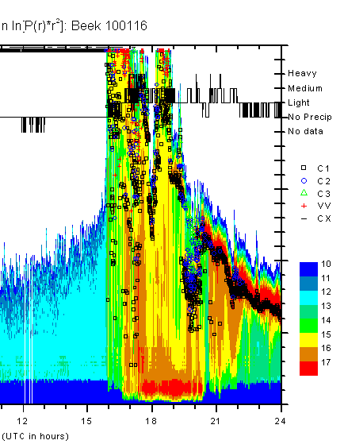
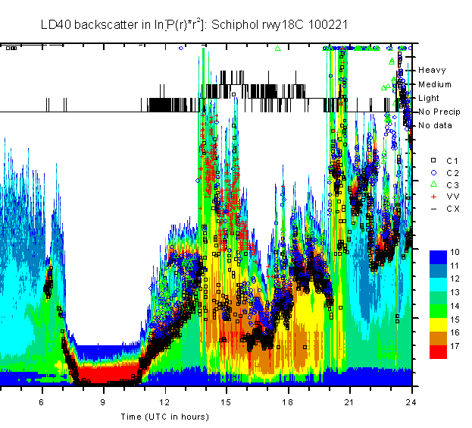
Ceilometer backscatter precipitation / usage ZV

Slide 14
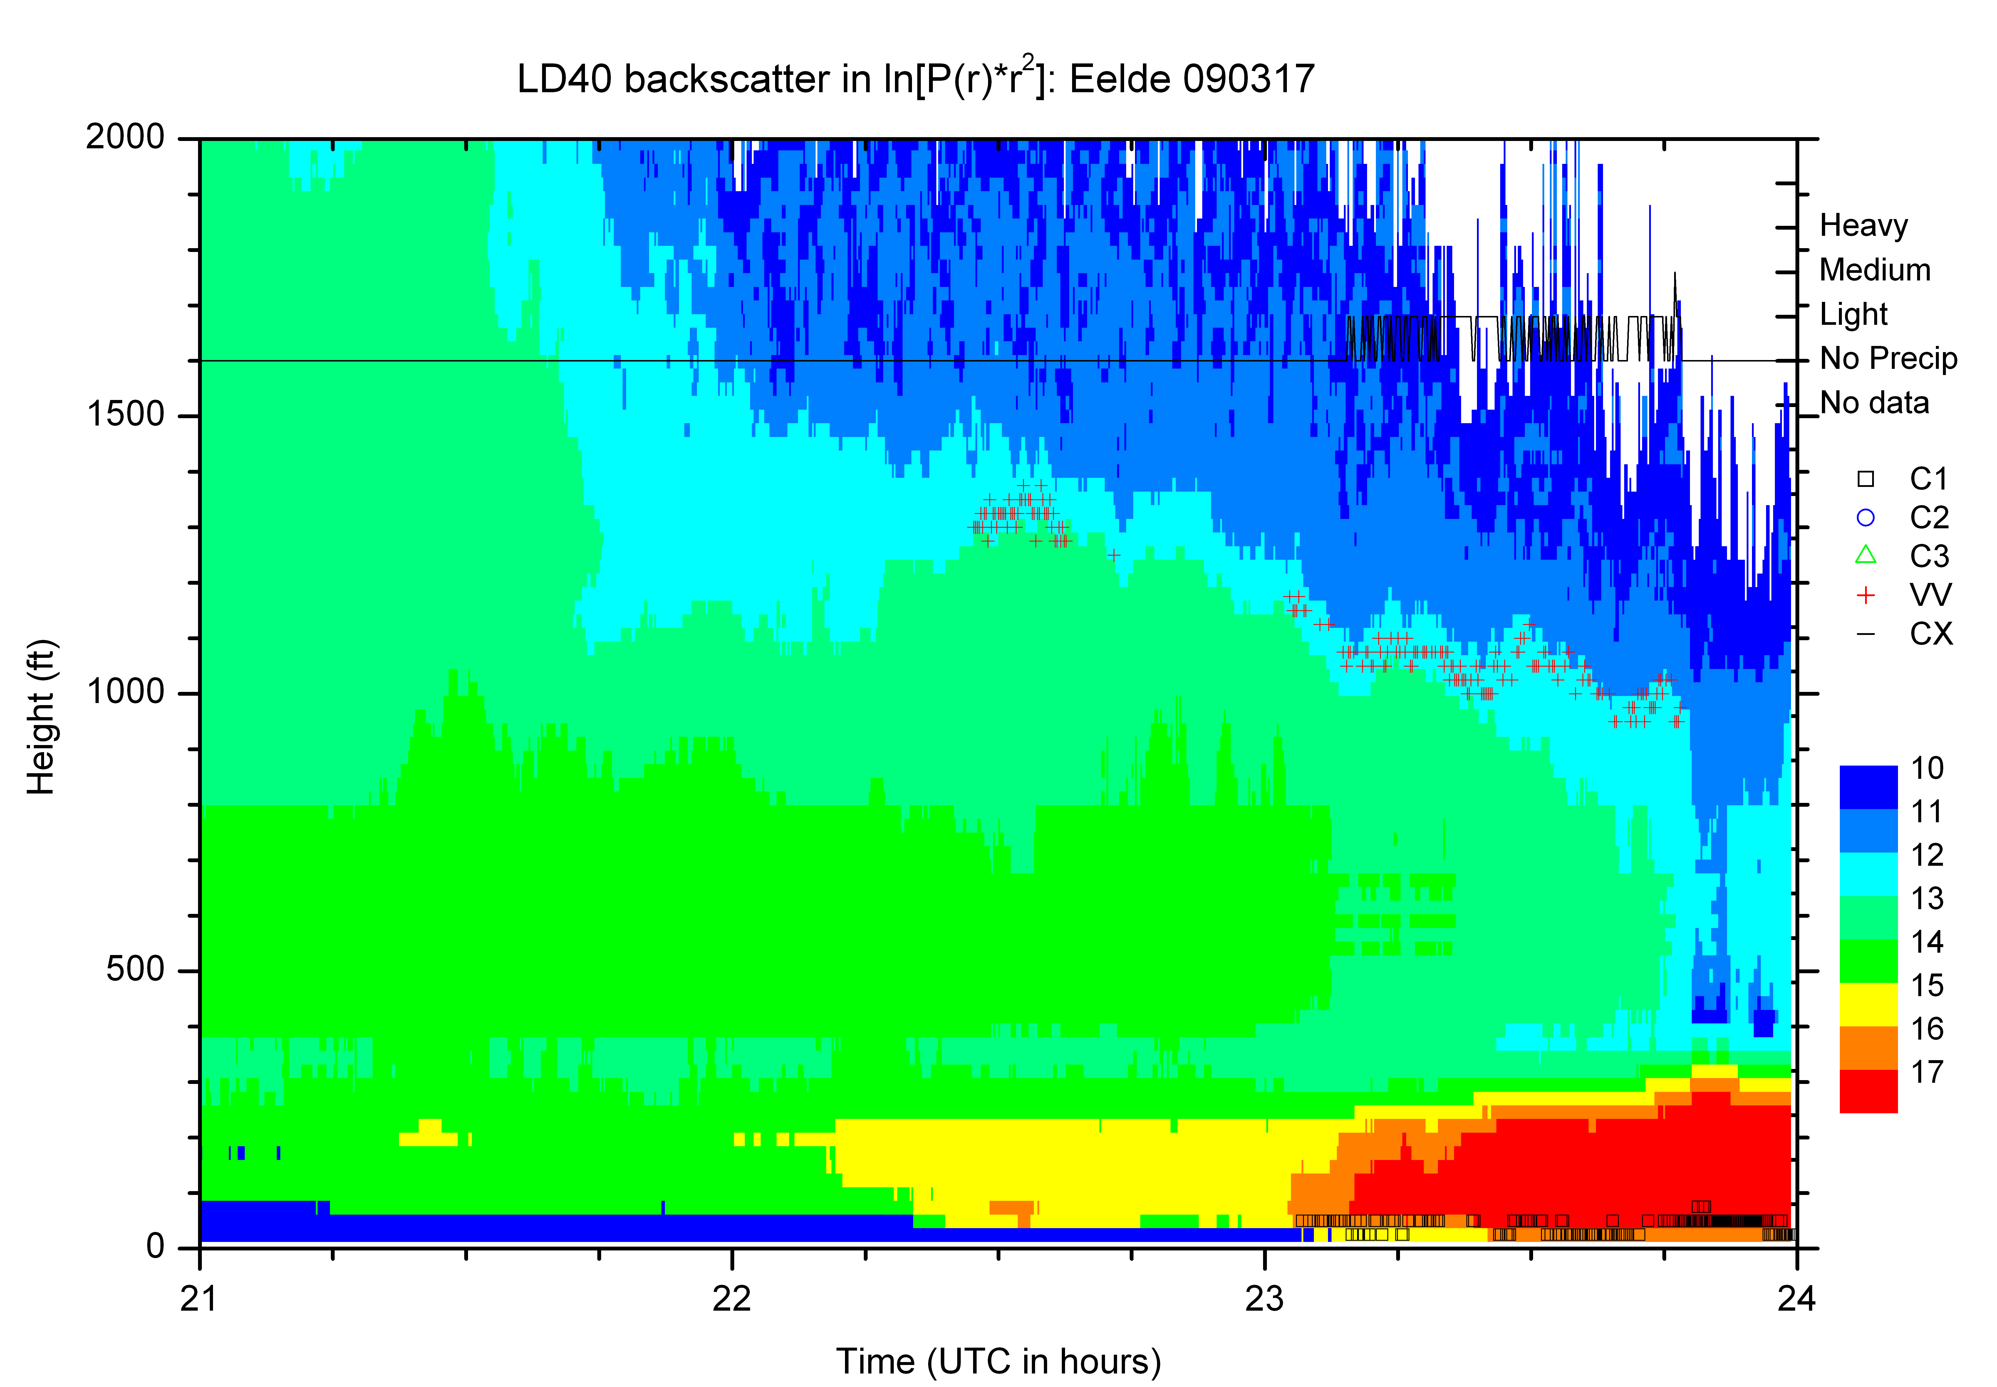
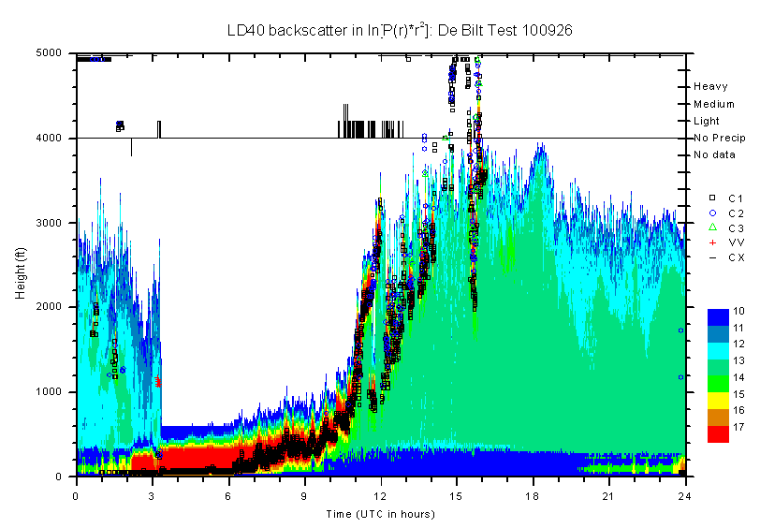
Ceilometer
(shallow) fog

Slide 15
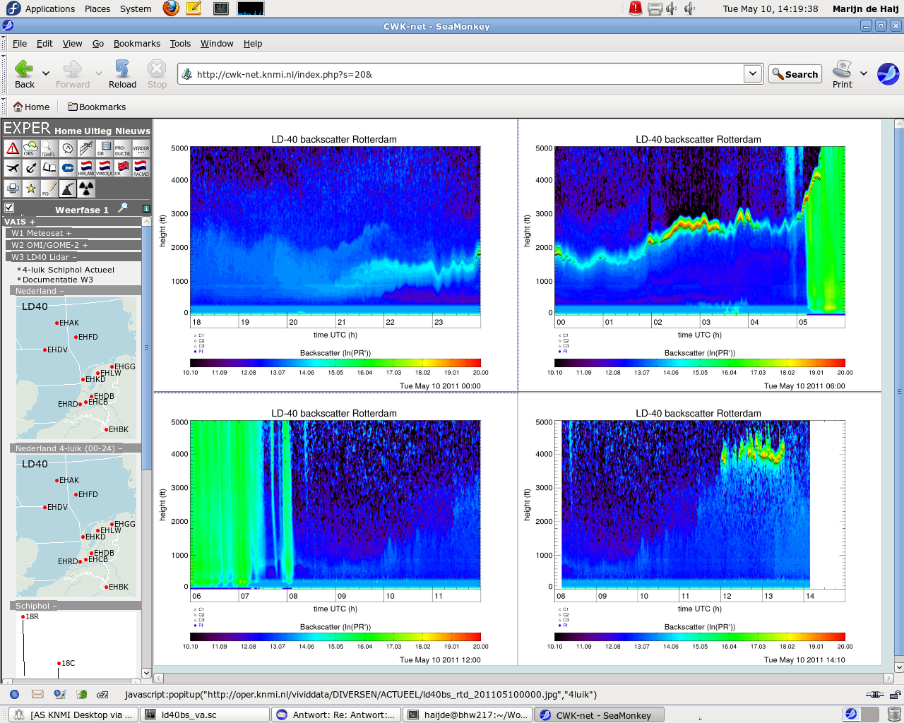
Ceilometer cloud detection threshold

Slide 16
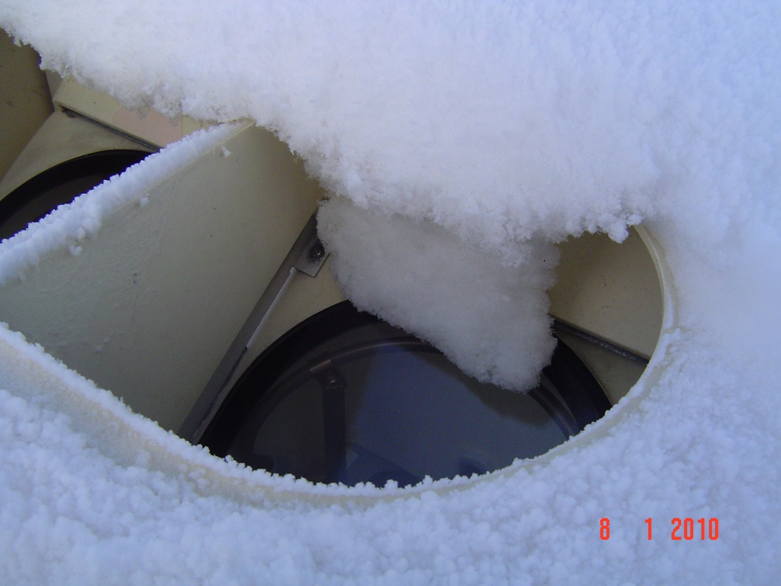
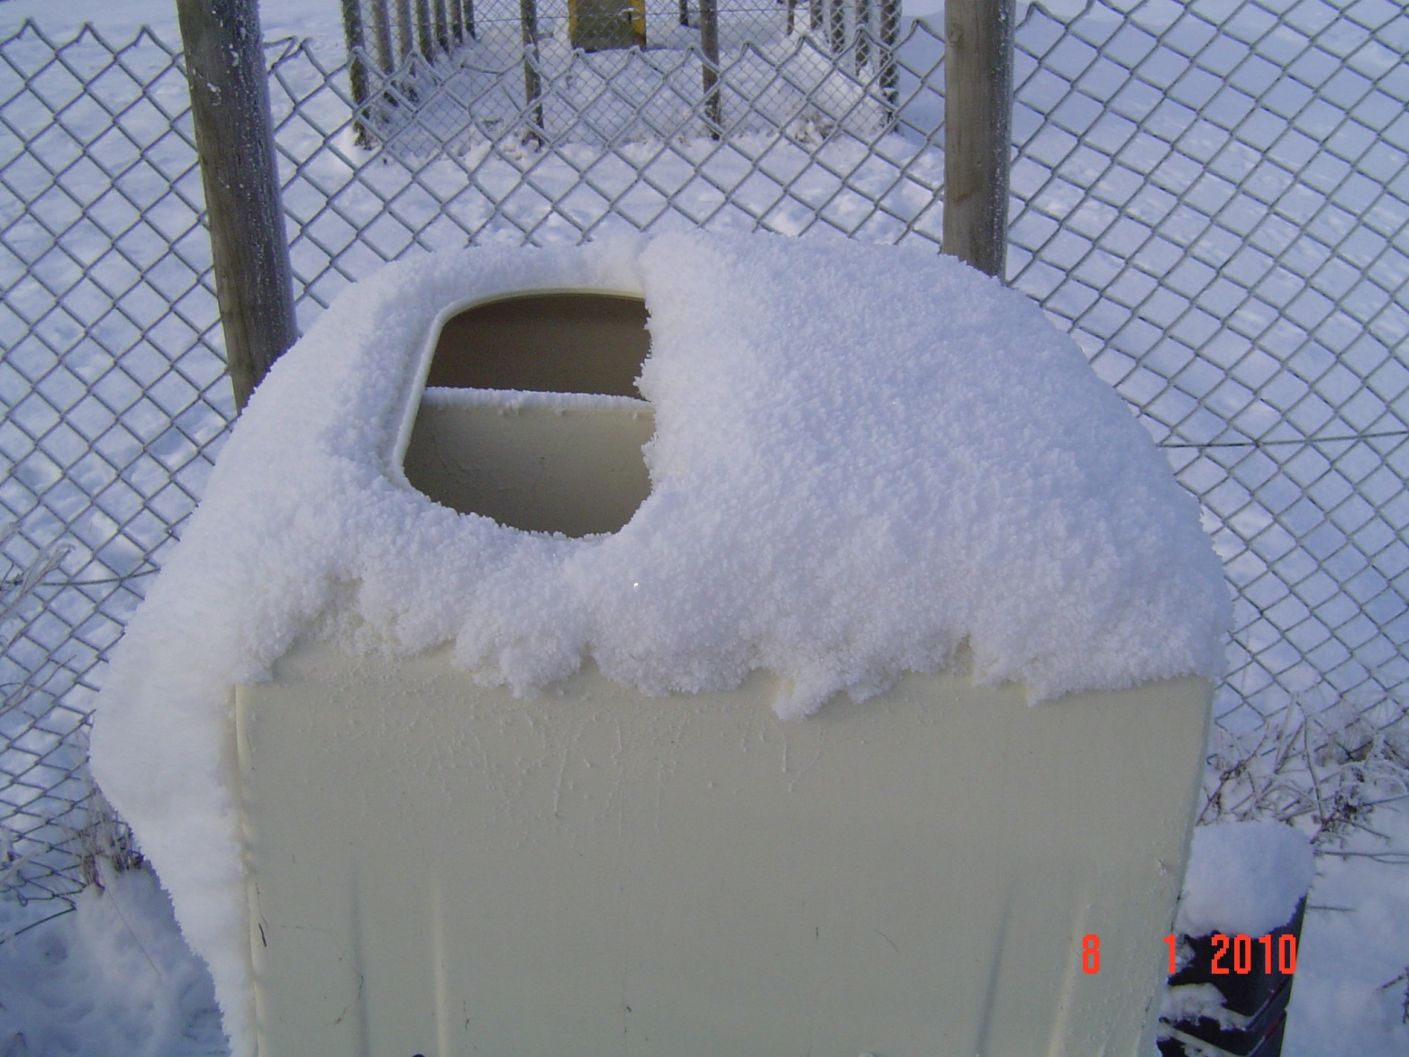
Ceilometer
snow

Slide 17
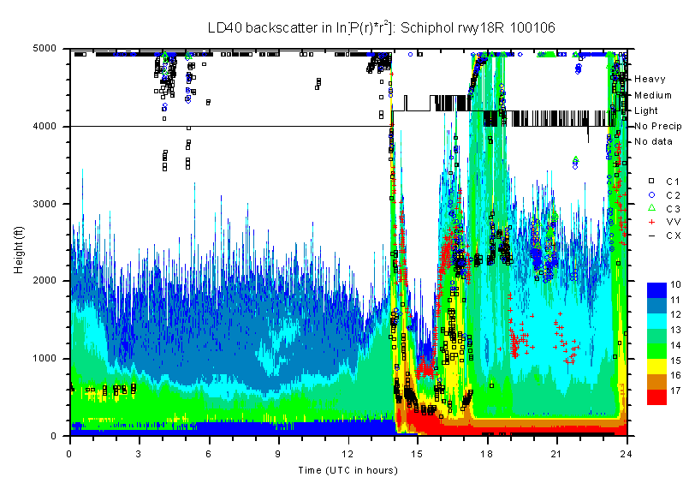
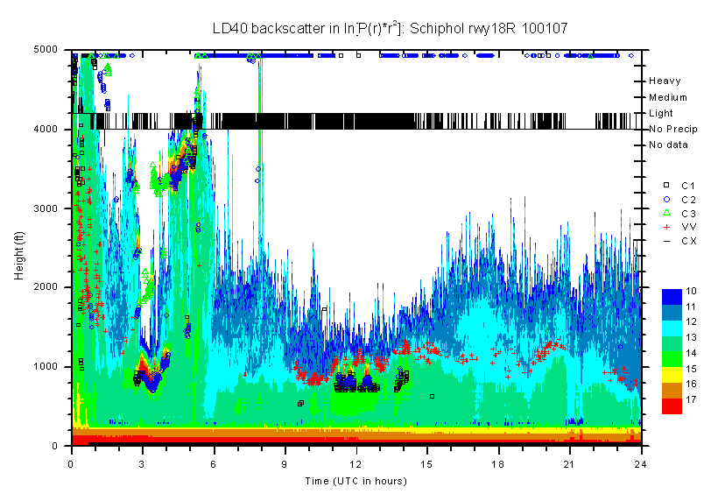
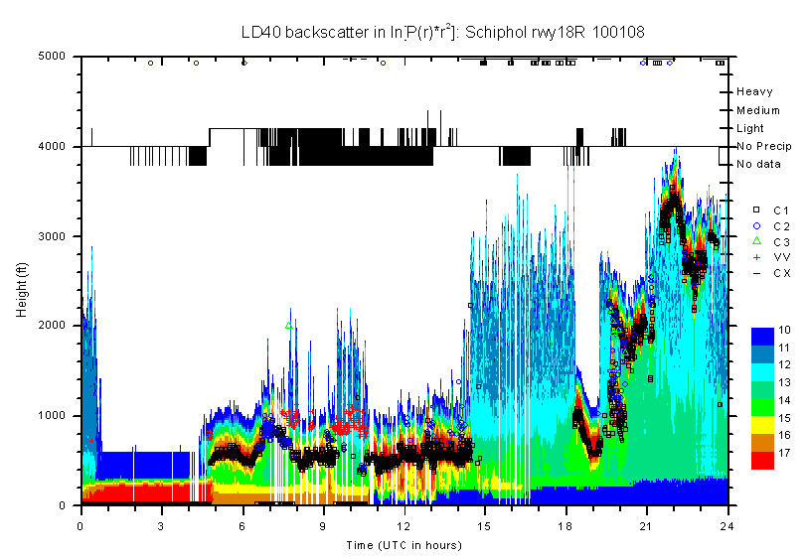
Ceilometer
snow

Slide 18
Usage of multiple LD40’s at Schiphol versus OBS

Slide 19
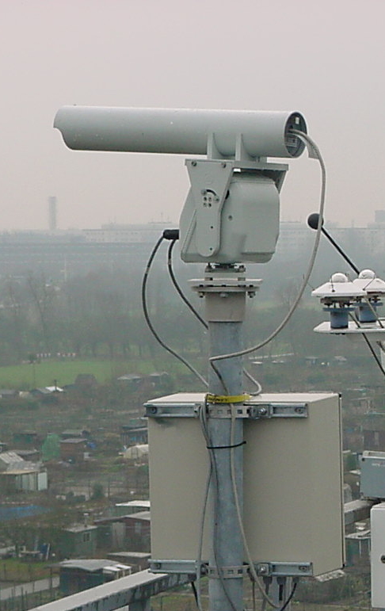
Ongoing developments NubiScope
Scanning pyrometer
Thermal IR, 8-14μm
FOV=3°
Scan every 10 minutes
36 azimuth * 23 elevation angles
Sky temperature →
cloud mask / coverage
MET Alliance AUTO METAR Workshop | Hamburg June 13-14, 2016

Slide 20
Ongoing developments NubiScope
Effect of scanning, spatial information
Evaluation:
good results for total cloud cover
Many applications require accurate height!?
cover = 0 and 8 ▼
cover = 1 and 7 ▲
percentage cases in okta interval →
cover = 2 to 6 ▲
zenith angle range →

Slide 21

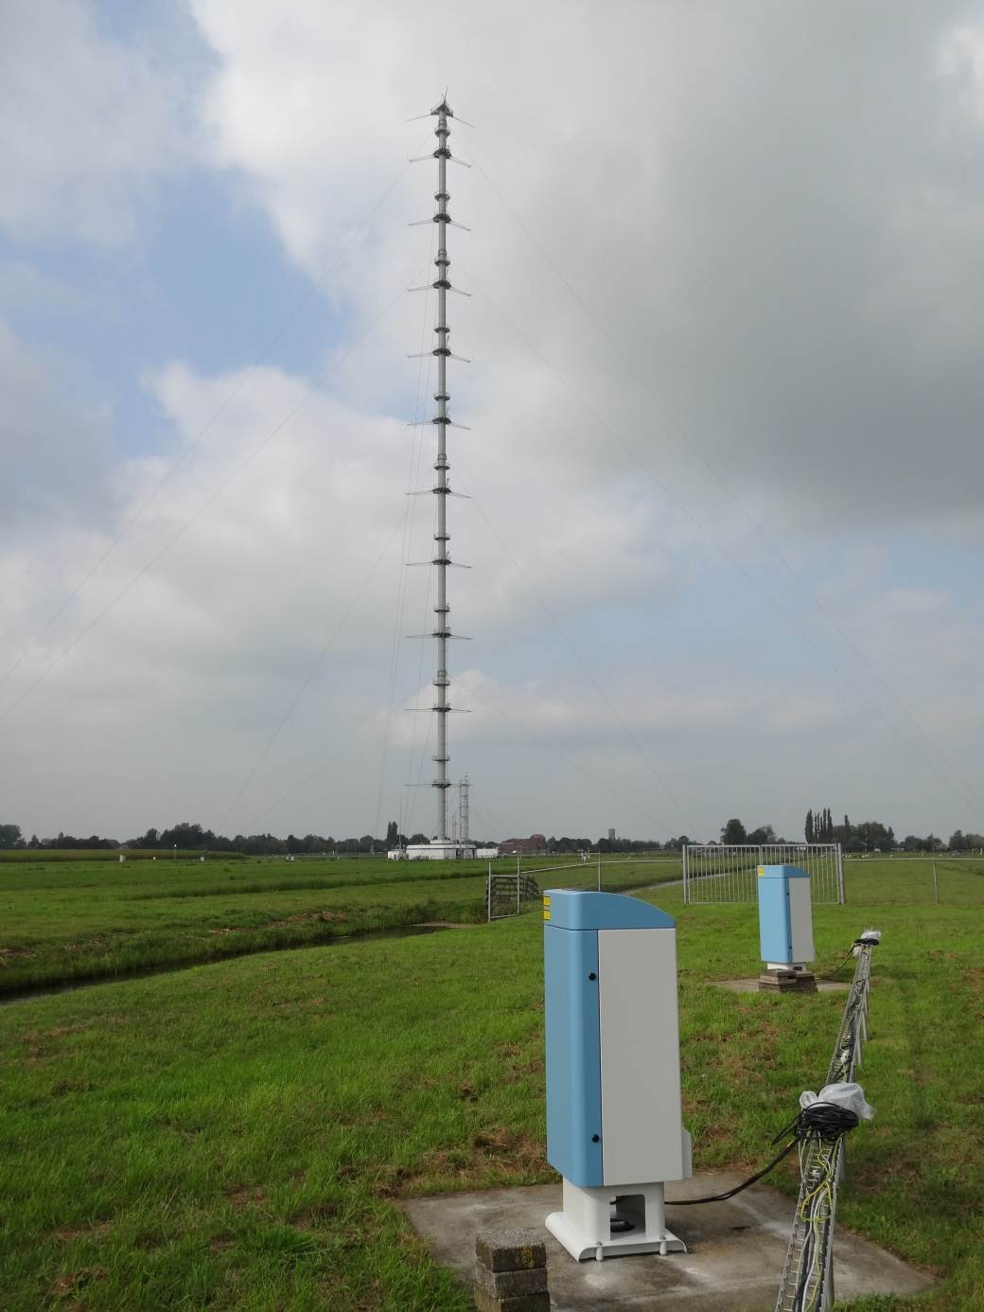
Ceilometer Acceptance Test at Cabauw (CAT)
  Goals: verify performance at CESAR site and assess impact of transition on operational (AUTO) SYNOP/METAR cloud reporting
  Two CHM15k’s at firmware 0.724
  28 Sep 2014–18 Jan 2015
  Reference systems:
  ALS450 UV lidar (355 nm)
  CAELI Raman lidar (355-532-1064 nm)
  Tower visibility sensors 2-200 m
  Optimal use of Cabauw facilities as testbed for new operational sensors
Cabauw, NL

Slide 22
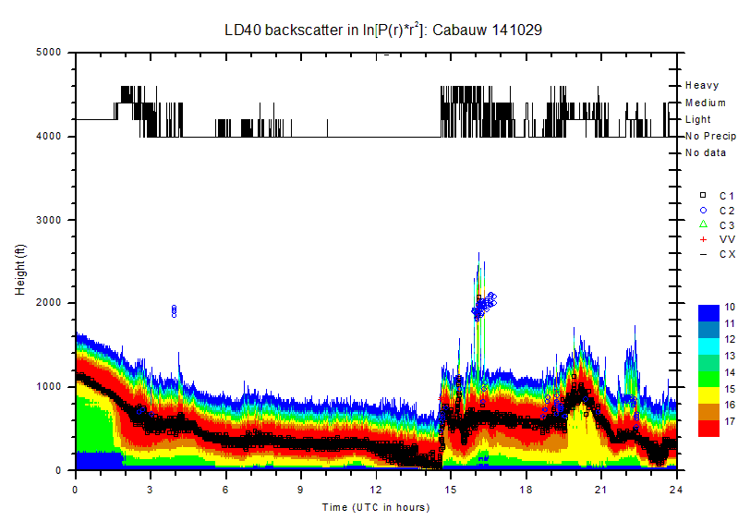
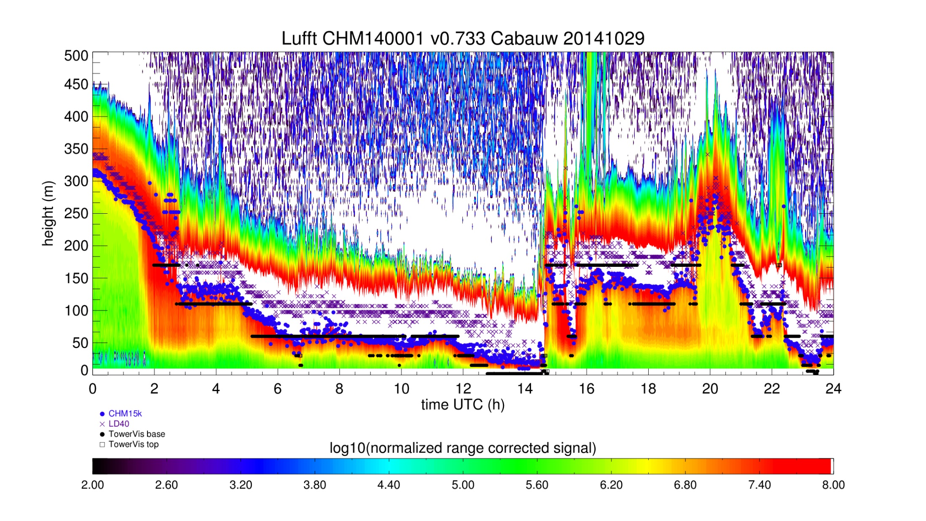
Low clouds

Slide 23
Low clouds
  Results for low clouds vs FS sensors (2,10,20,40,80,140,200 m)
  Main issue: no physical WMO definition for cloud & cloud base!
  LD40 vs CHM <Δh> -35 to -45 m, consistent with Martucci (2010)
  Offset caused by different (internal) cloud detection algorithms
  CHM15k agrees much better with TowerVis retrieved “cloud base”
“30 m level”
(100 ft)
“110 m level”
(360 ft)
  Percentage Correct
  CHM1 46%
  CHM2 45%
  LD40 <1%
  Percentage Correct
  CHM1 84%
  CHM2 82%
  LD40 20%

Slide 24
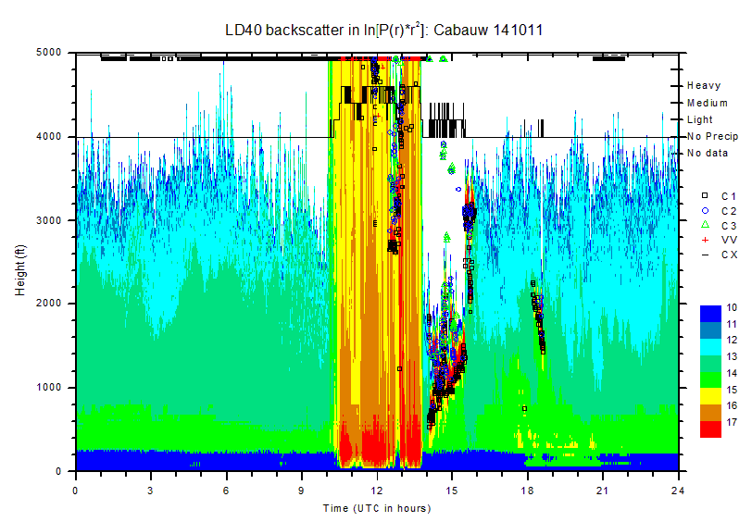
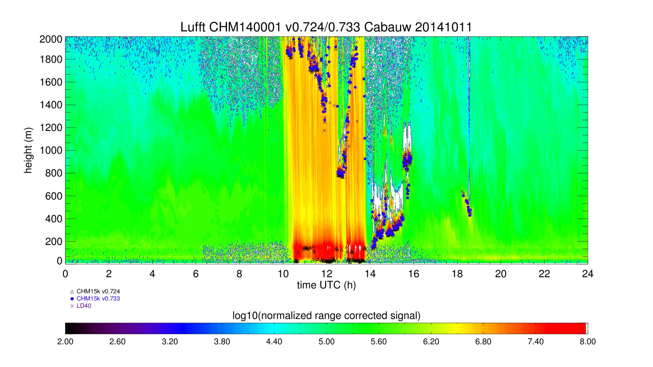
Precipitation
  Faulty cloud base in precipitation -> firmware updated (2014-12-03)

Slide 25
Detection in precipitation
  ZV output currently used in MetNet to overcome “gaps” in cloud base by LD40
  For all precipitation events [N=18376 ~ 306h (12% of time)]: 0.3% not detected vs 7% for LD40, worse for higher precipitation intensities
  Solid precipitation?

Slide 26
Conclusions/Outlook
  Conclusions from CAT
  Lufft CHM15k fulfills KNMI requirements
    Much better sensitivity for middle/high level clouds
    Improved consistency between instruments
    For 113 days <Δn> = +10%, but <Δn_low/middle> = +2%
    Offset in cloud height on average 35-45 m (115-150 ft)
    Large impact expected on AUTO METAR cloud reporting: lower ceilings (-1 class 25%/-2 classes 5%)
    Ignore ZV (VOR) as cloud base
  Next steps
  Evaluation of CHM15k data at Schiphol 06 by observer
  Determination of overlap of each sensor individually (May 2016)
  Parallel measurements at Cabauw/Vlissingen/De Bilt to assess impact on AUTO METAR and AUTO SYNOP products
  Implementation at AWS √ -> airports -> North Sea platforms

