Slide 1

World Meteorological Organization
Working together in weather, climate and water
WMO
GDPFS meeting
(Geneva, Switzerland, 10-12 Feb. 2016)
Proposal to GDPFS
for Global AgMet Early warning & Outlook Services
(GAMEOS)
Byong-Lyol LEE
Commission for Agricultural Meteorology
WMO
WMO CAgM
www.wamis.org

Slide 2
Backgrounds of GAMEOS from CAgM
Emerging Requirements
  Climate Service innovation for Agriculture & Food Security
  Early warnings for climate extremes
  Application of S2S for climate variability
  Interfaces between models, among stakeholders
  2) Technological challenges for better Climate Services :
  - Accessibility to non-meteorological data on time
  - RS/NWP need downscaling in space, time and elements
  - ICT resources for additional data production
  3) Implementation Strategies for better service provision:
  - Dedicated data collection & production centres
  - Virtual ICT infrastructure to share among members
  - User interface with GIS-Online under GRID/Cloud computing
WMO CAgM
GDPFS meeting

Slide 3
Functions of GAMEOS(1)
Global centres
Operational activities for downscaling on NWP outputs including S2s in space, time and element
Operational activities for Reanalysis on historical/in-situ data including non-meteorological data from RS areas.
Operational data services for high resolution AgroMeteorological products and supplementary RS information (on a semi-real time basis)
Operation activities for ICT sharable platforms under cloud environments with GIS-online interfaces
WMO CAgM
GDPFS meeting

Slide 4
Functions of GAMEOS(2)
Regional Centres
Operational services for AgroMeteorological Bulletin archival and dissemination,
Operational activities for Early Warning services on AgroMeteorological hazards/extremes, based on region specific needs:
Operational data services to support regional AgroMeteorological Outlook services;
Training in the use of operational AgroMeteorological products and services including promising tools:
WMO CAgM
GDPFS meeting

Slide 5
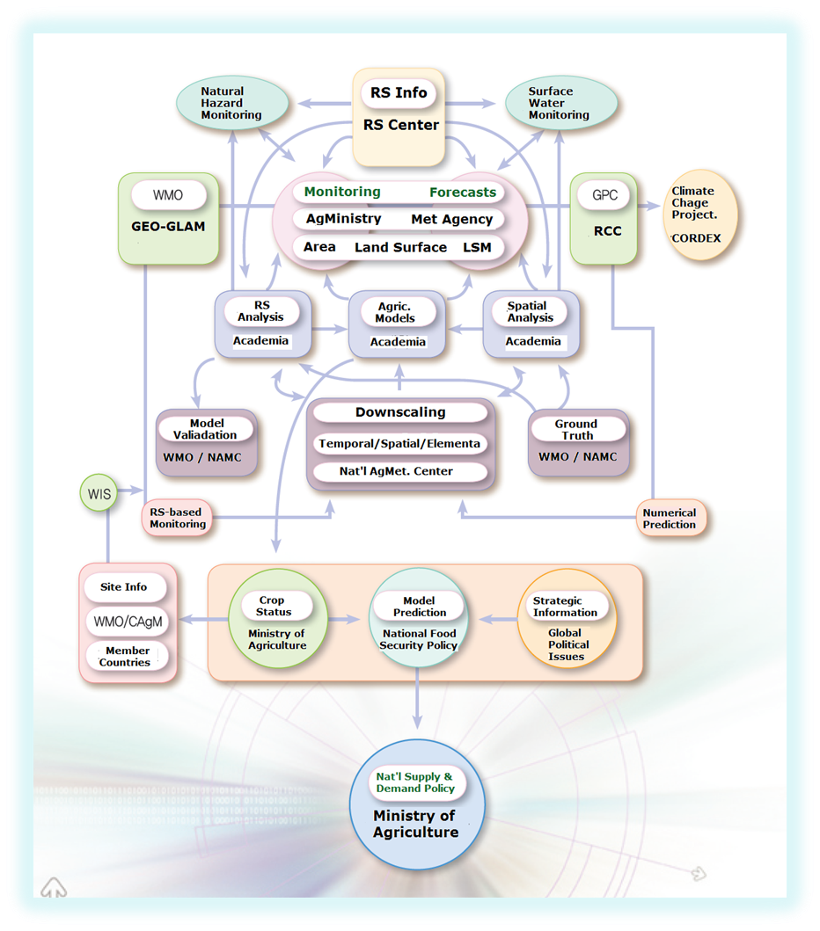
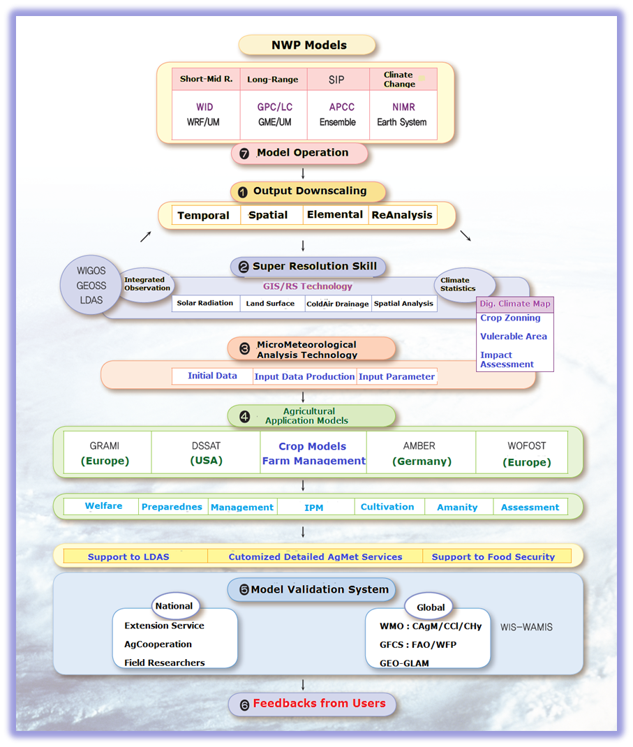
Core Climate Services : In-situ/RS/NWPs based
WIGOS
From now-casting
To climate change projection

Slide 6
CAgM/GIAM with GFCS-AgFS
Global Initiatives in AgroMeteorology
Climate Services
Information Systems
(CSIS)
WAMIS II
Climate User Interface
Programme
(UIP)
Capacity
Development
(CD)
GAMPP
GFAMS
GCREAM
Research,
Modeling and
Prediction
(RMP)
GAMOS
Observations &
Monitoring
(OBS)
Global Federation of AgMet Society (GFAMS) UIP, RMP
Global Center of Research, Excellency in AgMet (GCREAM) CD
Global AgMet Pilot Projects (GAMPP) RMP, CD
Global AgMet Outlook System (GAMOS) GAPON OBS, RMP
WAMIS next phase (WAMIS II) CSIS, UIP
- World AgroMeteorological Information Service

Slide 7
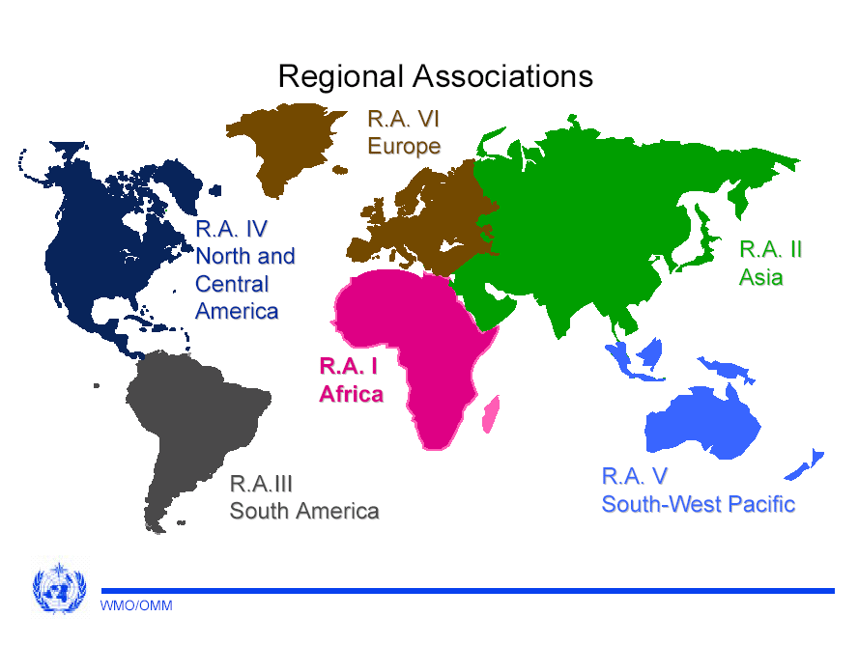
Global AgMet Outlook System
GAMOS(Global AgroMeteorogical Outlook System)
GDEWS(Global Drought Early Warning System)
GLUMS(Global Land Use Monitoring System)
GWHAS (Global Weather Hazard Assessment System )
GAPON(Global Alliance for Phenology Observation Network)
GAMOS
GDEWS
GLUMS
GWHAS
GPPON

Slide 8




GFCS-OBS/RMP)
CAgM-GEOGLAM : World AgroMet Early-Warning & Outlook System
S2S
WWRP/THORPEX-WCRP
GAMOS
GDEWS
GLUMS
GWHAS
GAPON
Downscaling
AgModels
ICT platform
ChiNAMOS
NWPs based
In-situ based
RS based
CAMS
CMA
NUIST
Members
GAMOS
GEOGLAM
Crop Watch
JECAM

Slide 9

GFCS Core Climate Service
S2S : Sub-seasonal to Seasonal Prediction Project
Bridging the gaps
between Weather and Climate
WMO CAgM
Notes:
9

Slide 10

Components of WAMIS II
Data Grid
GRID
Computing • Data • Access
Cloud
Computing
GTS/WIS
GISC
WAMIS
ICT Infrastructure
DCPC
NCAR
NCDC
TIGGE
(Joint)GISC
UNIDAT
Computation • Research
KMA/KISTI
Data Broker
OpenWIS
GDS
WAMIS Grid Portal
User Interface
GridSphere
NWP Outputs
LAS
Climate Projection
SIP
GDAPS / GME
RDAPS / GME : WRF
Mesoscale model
Nowcasting
Historical (Legacy) data
Non-Meteorological Data
END-USERS
Pilot Projects
WAMIS
.
.
.
.
MME
AMBER
DSSAT
GIS RS
AgModels
LDAS/LIS
Flux, GHG
Surface Flux
Vegetation
Soil Profile
Services
(WAMISs)
Applied
Meteorology
DCPC-WAMIS : KMA
Cloud Computing-KISTI
NWP Models - PKNU
WMO CAgM
AgModels - NCAM

Slide 11

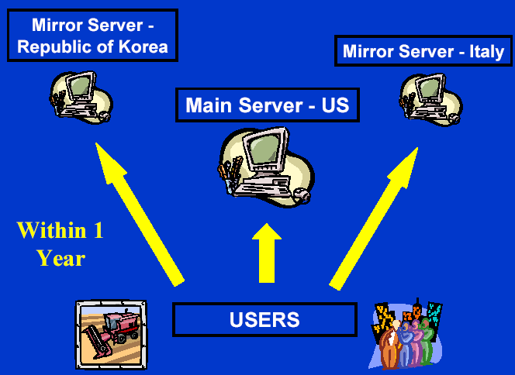
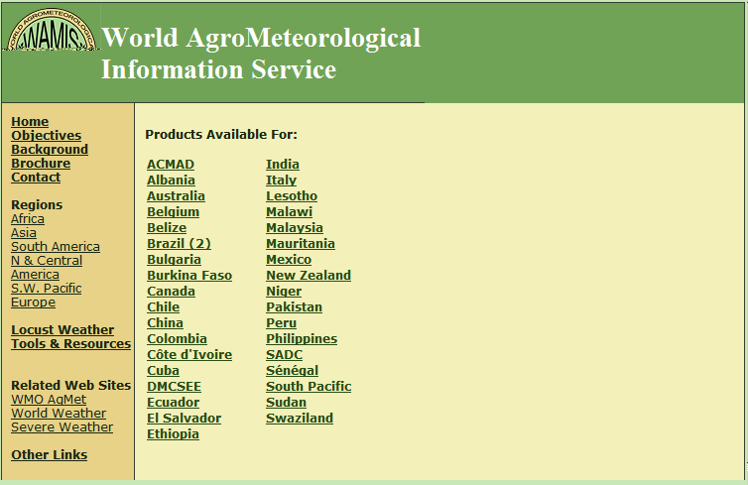
WAMIS – CAgM Service Platform
◎ uWAMIS - RS/GIS, Global Climate/weather info, NWPS,
(USA)
◎ kWAMIS - IT/GIS, IT Resource, NWPs, Downscaling,
(Korea) WAMIS-DCPC, GFCS
◎ iWAMIS - Model/GIS, INSAM, Reg. projects, Phenology
(Italy)
◎ bWAMIS - *Region-specific Information” INMET, Brazil
◎ aWAMIS – “Region-specific Information” - USQ / BoM
◎ vWAMIS - 3+ subregions ?, virtual servers ?
WMO CAgM

Slide 12

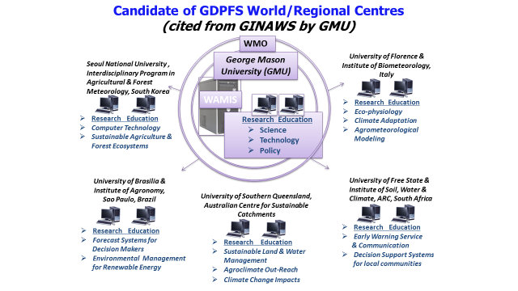

GFCS-CSIS/UIP)
ICT Sharable Platform of WAMIS II
KISTI
Science DMZ
WAMIS
DWD
KMA
INMET
QMD
NCAR
NUIST
KMA-KISTI
Science DMZ
WAMIS
DCPC
-WAMIS
GRID /
Cloud
GISC
Seoul (KMA) : Offenbach (DWD)
Mutual Backup
DCPC
-GMC
WAMIS Portal
Australia, Brazil

Slide 13
CAgM
WIS
GFCS
GISC-Seoul
GIS-OnLine : ESRI
Cloud Computing – KISTI/PLSI
AGMIP
Crop Models
WAMIS DCPC
Agric
WMO
AgModels
DSSAT/AMBER
NWP models
WAMIS II
3+3+?
CSIS
UIP
GPC LC
LRF MME
CD
GAMPP
6+?
GFAMS
11+?
GCREAM
8+?
Candidates :
1~3 regional pilot projects
in each RA
RMP
IKI : USQ/WMO
GCF : GRIAM/WMO
GAMOS
Phenoloy
GHG Flux
Soil moisture
OBS
NASNET
Phenology Monitoring
Ground truth information
ISB/CP, KMA/NIMR
Fluxnet/AsiaFlux
FAO, IRI, EU, USA
NASA -NEX
WIGOS
GTOS
GLAM

Slide 14
External Partnerships beyond WMO
ESSP
IHDP DIVERSITA IGBP WCRP
FAO GCP GEON GEOSS IPCC THORPEX TIGGIE CEOP
FluxNet | Phenology | GCOS | WIGOS | Models | Hydrology
GAMOS(Global AgroMeteorogical Outlook System)
GDEWS(Global Drought Early Warning System)
GLUMS(Global Land Use Monitoring System)
GWHAS (Global Weather Hazard Assessment System )
GPPON(Global Plant Phenology Observation Network)
Monitoring
with CAgM
Supporting NWPs available : WRF/MM5 GME/UM MME
Services
via WAMIS
NOAA/KMA
DWD/UK GPC-/RCC/APCC
Climate services expected
CC Scenario Climate Monitoring Short R. Med R, Monthly, Seasonal, decadal
NCAR/ESSP JAWF/MET-BROKER NCAM/NWS RCC COLA

Slide 15
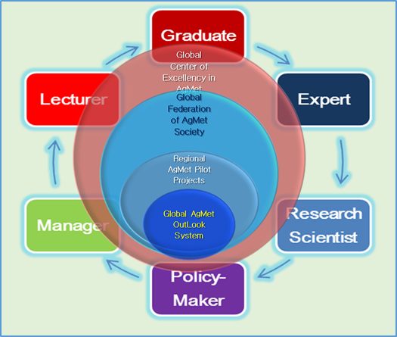
GFCS-CD/UIP/RMP)
GIAM Governance for CD with GRIAM
Agro
Met
Center
ICO-GIAM
Urban
Met
Center
ICO-HIW
Service
Innovation
Center
WMC-GDPFS
Eco
Met
Center
IPO-GCR
ICO-GIAM
GRIAM/China
GCREAM
Korea/India+8
GFAMS
Italy/Brazil/India+9
GAMPP
Australia/Korea+
GAMOS
China/Canada+8
WAMIS II
USA/Italy/Korea+2
GAMPP (in preparation for GCF)
-Global Challenge Research : LCA Framework for Sustainability Assessment
-ICT Sharable Platform for Operational S2S applications to AgFS

Slide 16
Matrix of R-based framework from CAgM perspectives
GFCS | CAgM | Requirements | Objectives/Input | Activities/Deliverables
OBS |  | Ground truth/in-situ | Exp.Pj1– joint projects | GEOSS/GAPON/SMDP
 | GAMOS | Outlook/flux/phenology | O1-AI-5) Tr, O2-AI-6) Tw | S2S/RS based Outlook Sys
RMP |  | Mitig/Adapt/Sustain. | Exp.Pj2–Global Challenge | S2S/Downscaling
 | GAMPP | Global challenge research | O2-AI-5) Re, O4-AI-1) Pc | NWP based LCA tool
CSIS |  | Service platform | Exp.Pj3-ICT platform | Cloud/ScienceDMZ
 | WAMIS II | On-line, ICT infra, tools | O3-AI-2) Sv, O2-AI-2) Pf | Sharable ICT platform
UIP |  | Off-line interfaces | Exp.Pj4-Global Soc. Mtng | GIS-Online/CyberGIS
 | GFAMS | Expertise transfer | O1, O2 | Consultations
CD |  | Human/Infra/Instit/Proc. | All-Virtuous CD cycle | RTC/Global Campus
 | GCREAM | E/T/R, Think-tank | O1-AI-5) Tr, O2-AI-4) Ts | Graduate program
Coordinate | ICO/IPO | In/ex-ternal partners | O5-AI-3) Rs | GIAM ICO with GRIAM
Resources | Donors | Trust fund, in-kinds, .. | O4-AI-2) Rs | ICO/GRIAM, GCF/GCR
Governance | AGMP | FAO/WFP/GEO/GACSA .. | O5 | PAC/TAC, GFCS focal point
Note : Green Color – Key projects in AgFS Exemplar, Red Color – Global partners/programmes

Slide 17
WMO
Structural
Schematics with partnerships from CAgM Perspective

Slide 18
End-User + Service Provider
=User + Servicer
= U Servicer
(You are Servicer !)
USER=SERVICER
AgMet = User + Servicer
Thank for Your Attention!

Slide 19
Work Plan for WAMIS II (1)
Establishment of closer collaborations with external partners in securing necessary resources, e.g. finance, ICT infrastructure and governance, through bilateral agreements. (KISTI/PKNU, NCAR, NASA, ESRI, ISB, KMA, APCC, NWS ..)
Reports on review over current status of linkages between NWPs and AgModels, especially for input data/parameters which are essential for calibration/validation/operation of AgMet applications
Establishment of Task Team to facilitate WAMIS next phase implementation through the provision of technical supports to outcomes from WAMIS II expert team meeting.
WMO CAgM

Slide 20
Work Plan WAMIS II (2)
Pilot projects to demonstrate potential applications by NWP-based AgMet service, especially for sub-seasonal, seasonal forecasts and climate projections with appropriate temporal, spatial and elemental enhancements to meet the requirements from AgMet community.
Institutionalization of WAMIS into an official project under AGMP of WMO for better implementation and seamless operation for promising candidate of GFCS CSIS in the sector of Agriculture and Food security.
Multilingual translation or symbolic description mechanism/function could be incorporated into WAMIS next phase for better exchange of data and products among Members with different languages or illiteracy problems through WAMIS.
WMO CAgM

Slide 21
Work Plan WAMIS II (3)
Early implementation of dedicated DCPC of WIS to WAMIS II will be greatly beneficial in providing a platform for data collection, processing, archival, retrieval through interlinks with external Data Clearing House such as GEO-Portal for sharing of non-meteorological information as a gateway to the globe (similar concept to WIS/GISC within AgMet community/Members, each WAMIS server can be DCPC in each RA)
Computer resource sharing architecture can be considered together with GIS-Online under cloud computing environment and user friendly interface for convenient communications with end users including feedbacks.
WMO CAgM

Slide 22
Suggestions from CAgM to PTC2016
Formal recognition/endorsement to CAgM partners by WMO, especially from non-NMHSs, for persistent collaborations with them, e.g. GIAM partner institutions and GRIAM
Continuous efforts within WMO and with other international entities to secure external resources (finance) from diverse donor agencies, especially to facilitate TC activities, e.g. CAgM with GCF
Consideration of new GDPFS centres in Agricultural Meteorology, e.g. WAMIS II institutions as World AgroMeteorological Early Warning and Outlook Production Centres (WAMIS portal and DCPC)
More chances to demonstrate feasible scientific and technological applications for user community through pilot projects, e.g. S2S-based applications for Agriculture and Food Security.
Submission of recommendations on the above issues to EC-68
WMO CAgM

Slide 23
Emerging Needs & Requirements
Urgent Needs : High quality, Value-added, Feasible, Operational,
  Diverse Applications at Farmer’s site (Quantitative)
  Value-added Operational Service (Qualitative)
  Feasible Communication Networks (Timely)
Impending Requirements :
  High-resolution information production (spatial/temporal/elemental)
  Feedback mechanism from Users (bidirectional communication)
  ICT Resource Sharing Platform (Computing/Storage/Networks/Interface)
Future Considerations
  Contribution to NWP models (as information provider)
  Multi-lingual Translation (efficient sharing of experiences/information)
WMO CAgM
GDPFS meeting

Slide 24
Implementation of Requirements
Advanced Services
  High-resolution information production (data processing)
  - Downscaling of climate/observation/forecast/projection data
  - GIS-based micrometeorological downscaling technology
  NWP-based Forecast services (AgMet forecasting)
  - Linking NWP outputs to AgModels for value-added forecasts
  - Short-, medium-, long-range, sub-seasonal to seasonal, CC scenario
  - Various AgModels : DSSAT, AMBER, etc.
  ICT resource sharing platform (ICT infrastructure)
  - Computing resources for NWP/AgModel with GIS/RS technology
  - User communication interface as information provider and feedback
WMO CAgM
GDPFS meeting

Slide 25
ICT Resource Sharing Platform
Region-specific Service Platforms
  Currently 3 to at least 6 servers with differentiated functions
Computing resources for
  NWPs operation on user domain on time
  NWP output downscaling to high spatial resolutions
  User-specific AgModel operation on time
  GIS S/W operation
  RS data processing
  Derived products processing
Large volume of data storage for
  NWP and AgModel outputs
  RS/GIS raw and processed data
  Ground truth data (vegetation, weather, soil)
WMO CAgM
GDPFS meeting

Slide 26
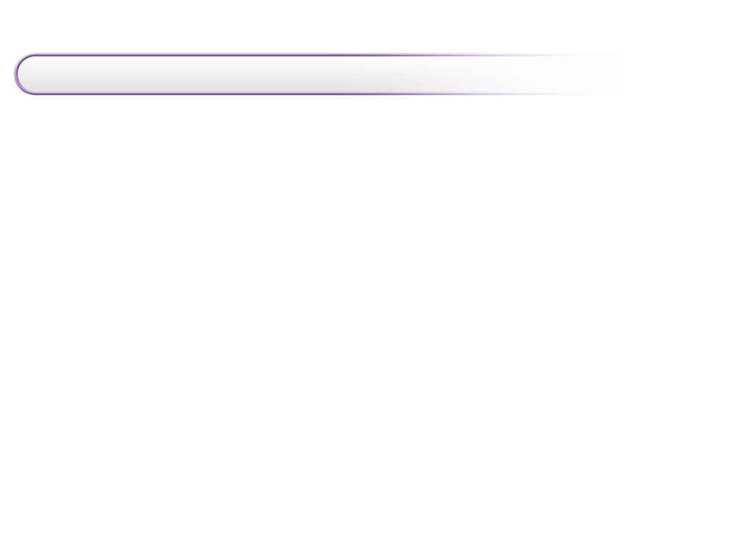

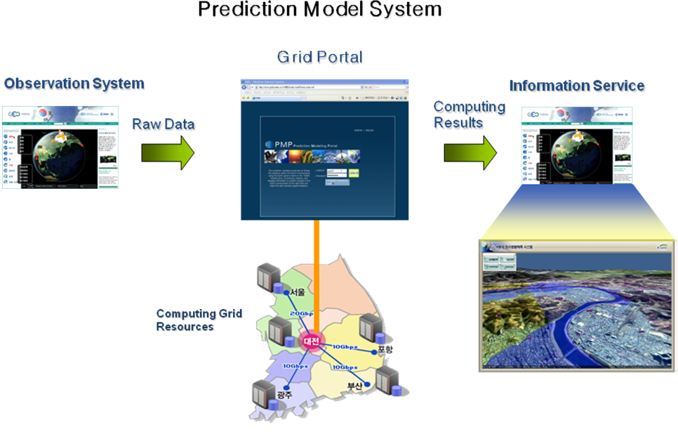
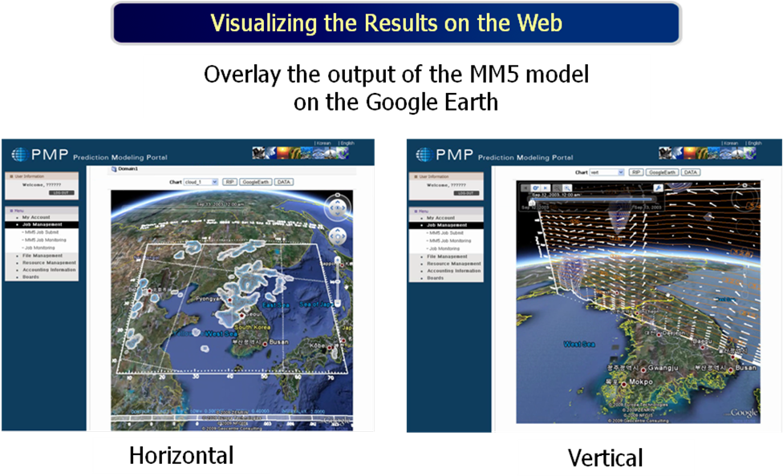
Web-based NWP operation
Near real-time Early Warning System against Hazards
WMO CAgM
GDPFS meeting

Slide 27
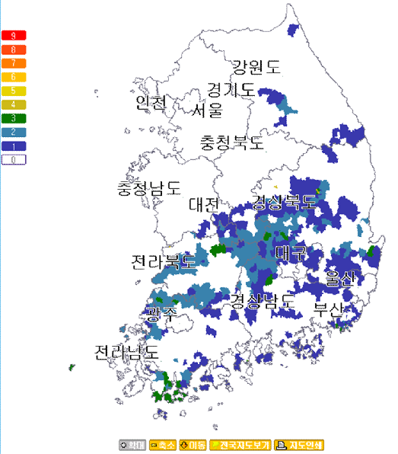
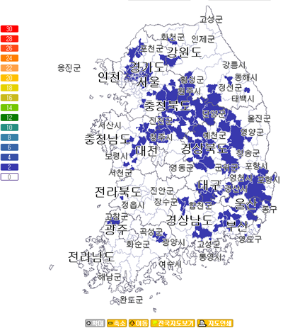
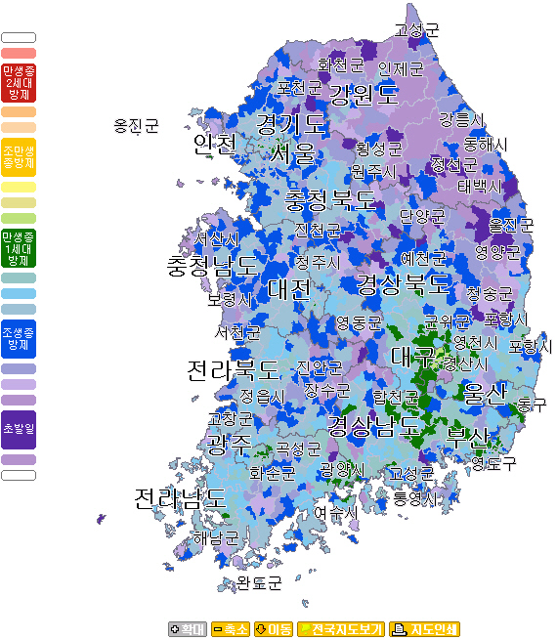
NWP-based AgMet forecasting
Plant disease and insect outbreak forecasting
Apple Scab
White Rot
Peach Fruit Moth
WMO CAgM
GDPFS meeting

Slide 28
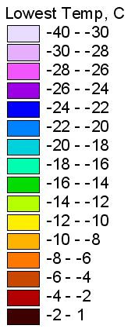
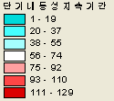

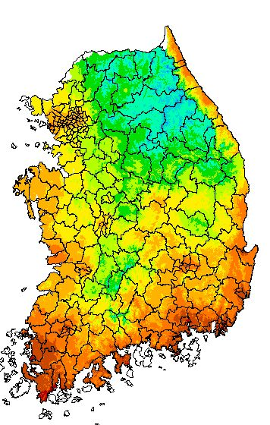
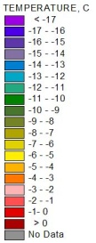
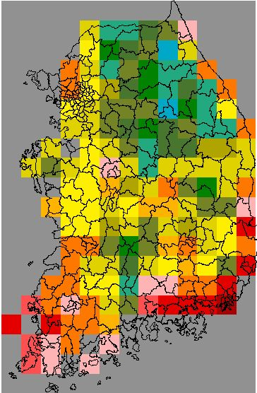
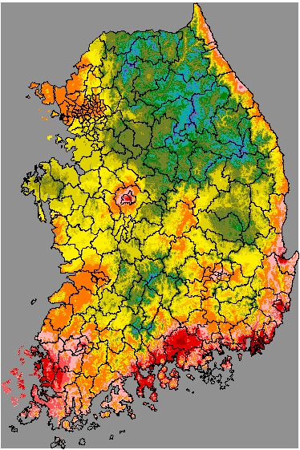
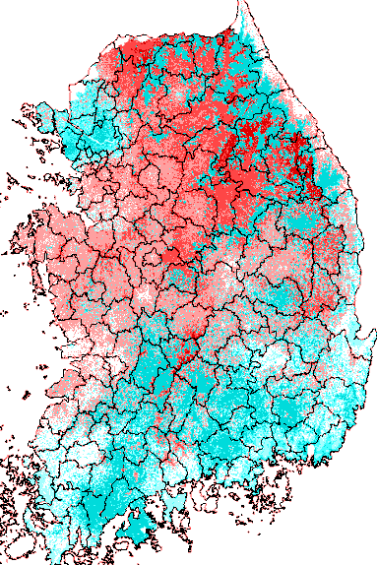
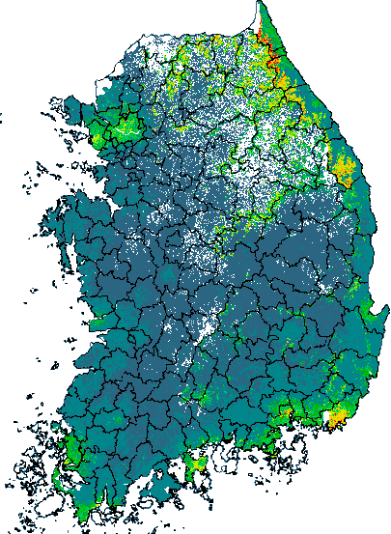
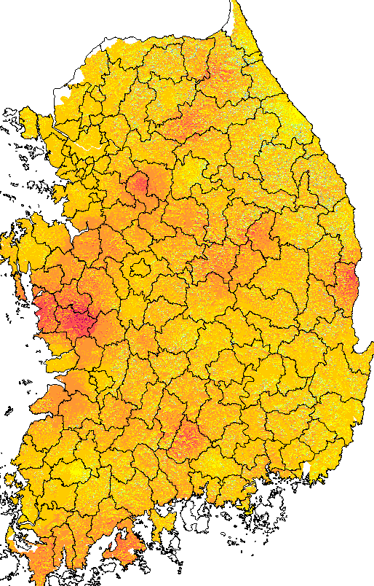
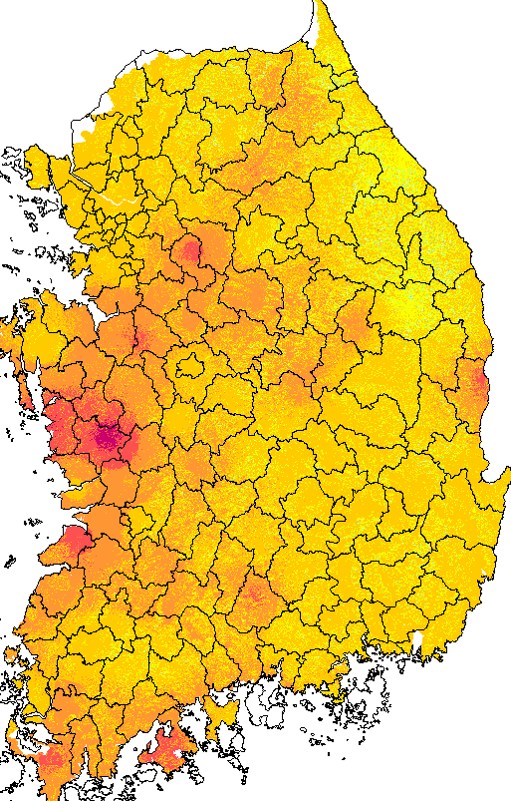
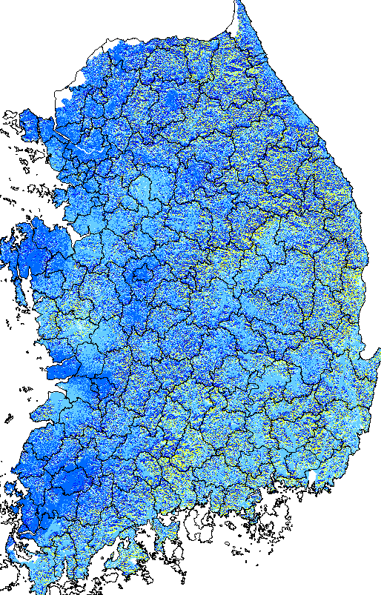
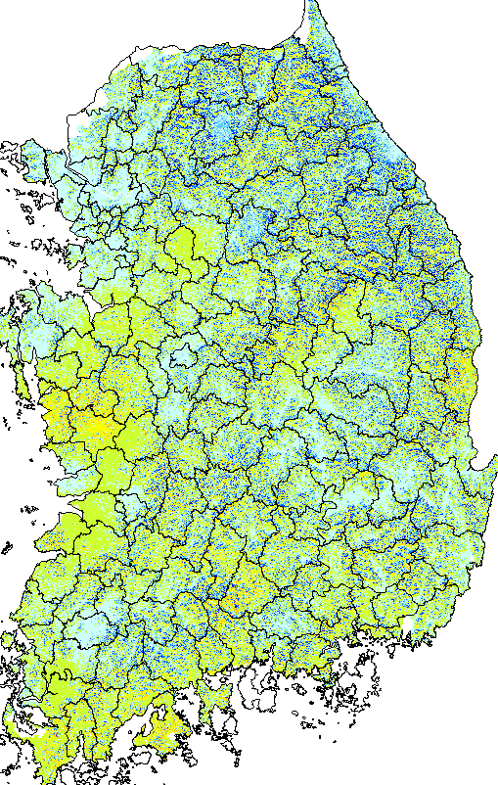
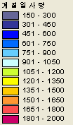
High spatial resolution Climate data
Risk analysis on cold damage under CC
High-Definition Digital Climate Map
2011-2040 A2
Extreme low temp.
Dormancy Depth
Cold tolerant period
Seasonal solar radiations

Slide 29
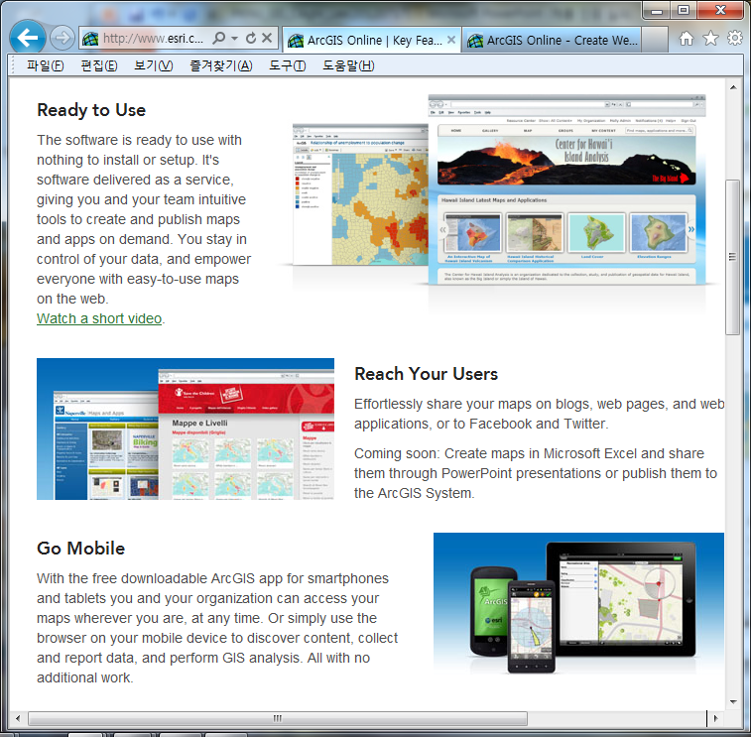
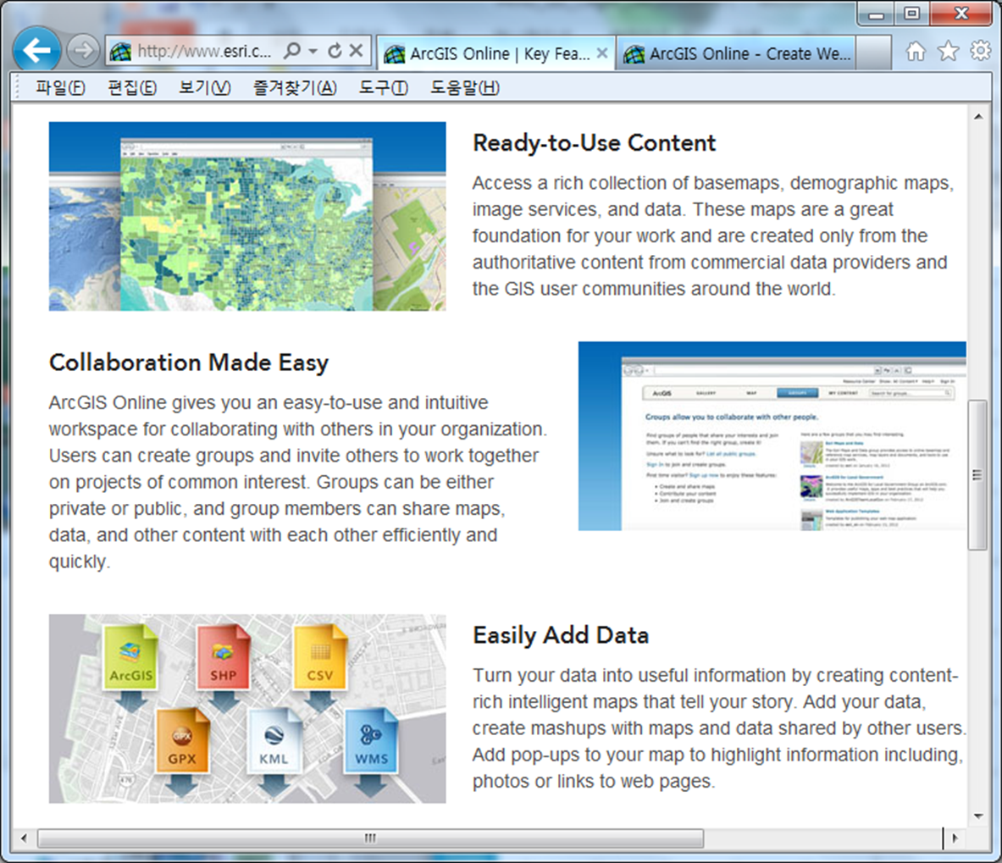
GIS
OnLine
WMO CAgM

Slide 30

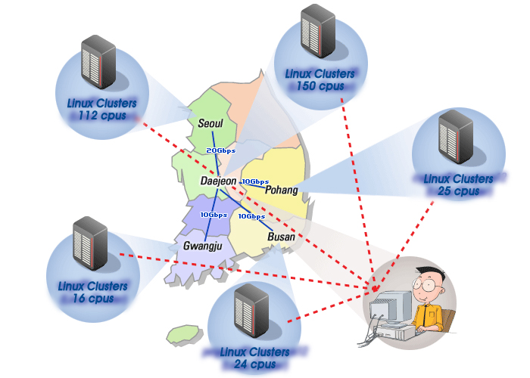
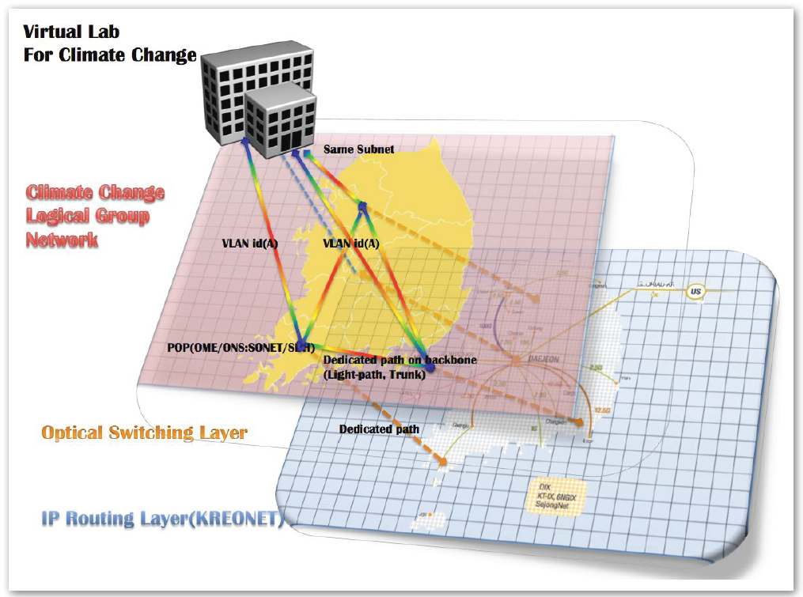
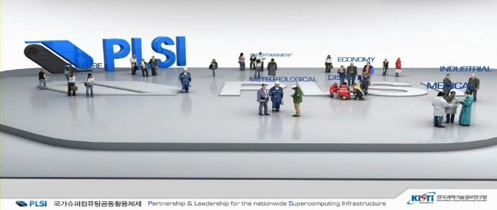
ICT resource sharing system
IT resources from PLSI Project
for WAMIS next phase
WMO CAgM
GDPFS meeting

Slide 31
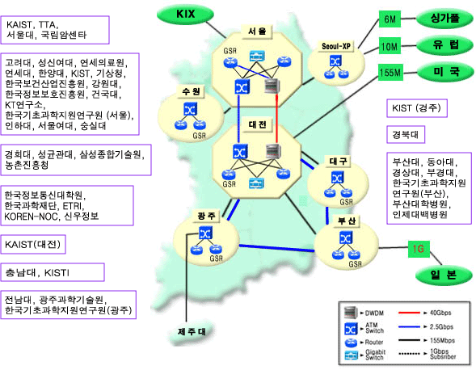
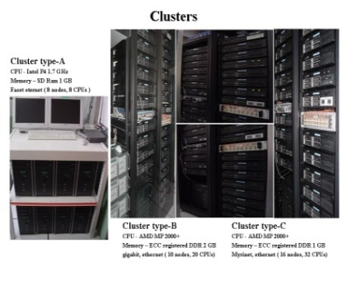
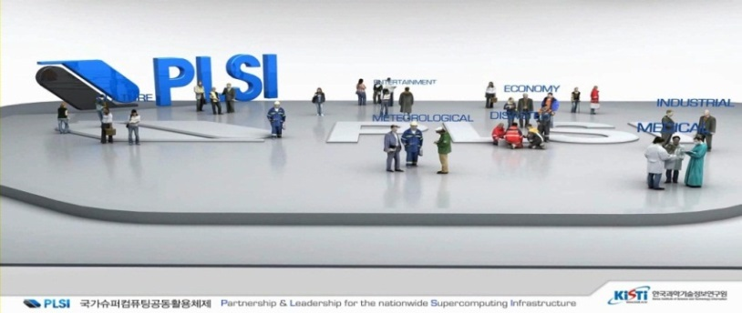
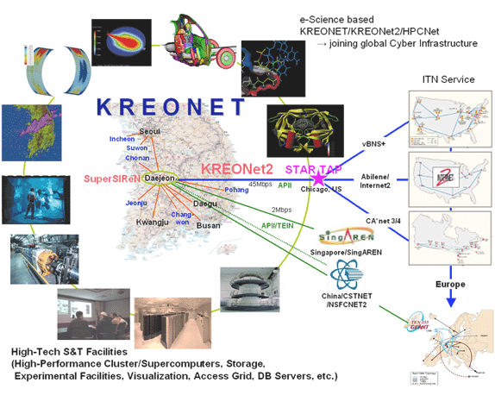
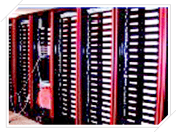
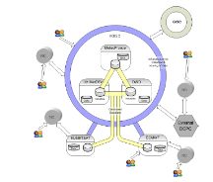
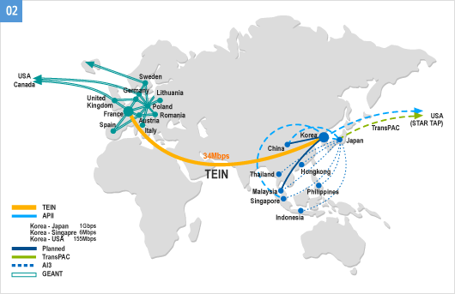
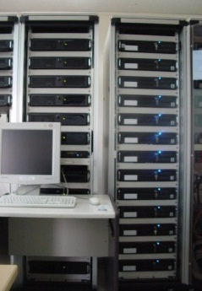
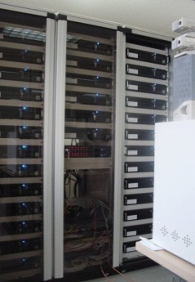
ICT Sharing Infrastructure with Cloud
DCPC-WAMIS supported by GISC-Seoul & KISTI
IT resources from PLSI Project
for WAMIS next phase
KOREN
uMeteo-K testbed
KISTI Cluster
KISTI Cluster
KISTI Cluster
TEIN
KT Cluster
KT Cluster
* ICT : Information, Communication Technology
31

Slide 32

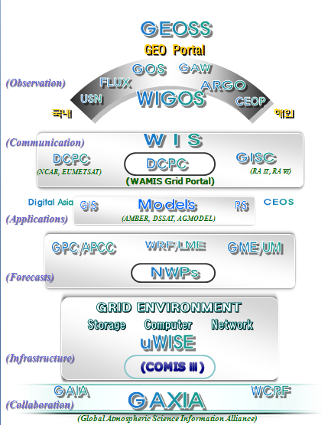
WIS-anchored
System Architecture
of CAgM
WMO CAgM

