Slide 1
GDPFS related activities and projects of CAeM
Mr Ian Lisk, vice-president CAeM

Slide 2
CAeM Mandates and Priorities in DRR (ER2)
Improve the ability of Members to provide sustainable high quality services…
… In support of safe and efficient international air navigation…
… With minimal impacts on the environment…
… As defined by the working arrangements agreed with and the requirements defined by the International Civil Aviation Organisation (ICAO)
No specific DRR mandates BUT…
All DRR planning, response and recovery activities rely on AIR TRANSPORT!

Slide 3
Priority projects & activities related to GDPFS
Alerts and advisory services in support of international aviation
World Area Forecast Centres (2)
Tropical Cyclone Advisory Centres (7)
Volcanic Ash Advisory Centres (9)
Regional Hazardous (Aviation) Weather Advisory Centres in development
Space Weather services in development
Nuclear advisories under review

Slide 4
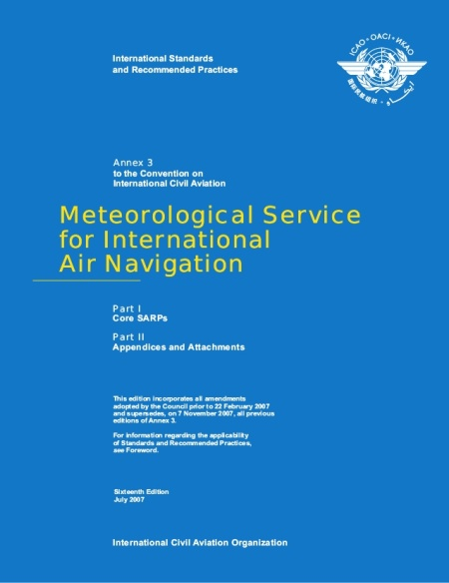
Guidelines, manuals & standards (related to GDPFS)
ICAO Annex 3 Standards and Recommended Practices
WMO Technical Regulations Volumes I and II
QMS requirements
Personnel competency Standards
Cost recovery
ICAO Safety Oversight Audits

Slide 5
Leveraging projects and activities of other RAs/TCs/TPs
Working with RAs to gather and define TOP priorities
Working with RAs to monitor, review and report on WMO implementation activities
Synergies (but clearly different mandates) with CBS DPFS and ERA activities
Joint SPW service development activities with CBS
Hong Kong Aviation RDP with CAS
Preliminary discussions with GEO on improved volcano monitoring

Slide 6
TBO : Concept for new aviation MET services
CAeM has identified needs for new MET services for airports/TMAs with high air traffic density
Previous CAeM activities related to new MET services for ATM with focus on terminal areas and development of ICAO REQs, in collaboration with CAeM.
ICAO Global Air Navigation Plan (GANP) delivered by Aviation System Block Upgrades (ASBU) 2014-28
GANP includes Trajectory-based Operations, DATA-centric and Performance focus
ASBU approach requires integration of MET DATA into ATM high resolution 4-D decision support-based systems
World Meteorological Organization (WMO)
6

Slide 7
Summary
Big changes, big challenges in the world of international aviation
Product-centric to data-centric services
Quality and performance
Increasingly regional service focus
Science, observations and interoperable data key enablers
WMO working ever more closely with ICAO
Guidance, Tech regs and Standards

