Slide 1
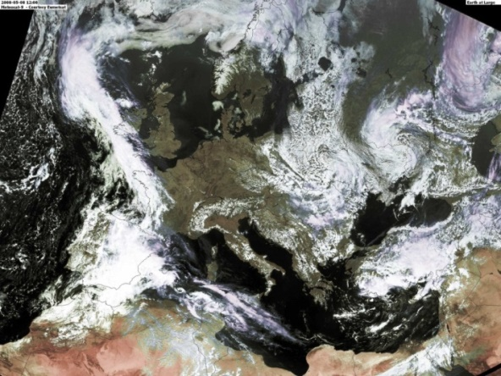
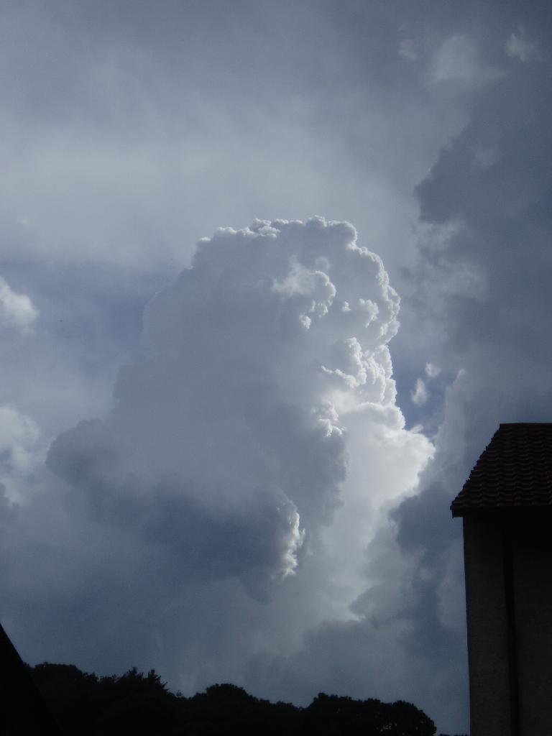
Seamless forecasting in time, space and complexity
Gilbert Brunet
Director
Meteorological Research Division
Environment Canada
FUTURE SEAMLESS GLOBAL DATA-PROCESSING AND FORECASTING SYSTEMS (GDPFS) MEETING
Geneva, Switzerland, 10-12 February 2016

Slide 2
What is seamless prediction?
To accelerate improvements in prediction and services through an inclusive approach to Earth-system sciences will require a suite of diagnostic and prediction models integrated over all spatial and temporal scales (e.g. UK Met Office, Met Service of Canada …) ;
It requires increased integration across the disciplines of physics, mathematics, chemistry, social and decision sciences;

Slide 3
What is seamless prediction?
The complexity of the scientific challenges and the need for improved knowledge of diverse impacts will necessitate collaborations between scientists in natural sciences and health, economic, water, agriculture, energy, food, and policy disciplines;
This demands proposal development guided by multi-agency and multi-national environmental and socioeconomic priorities, and long- term commitments from scientists, supporting agencies and stakeholders.

Slide 4
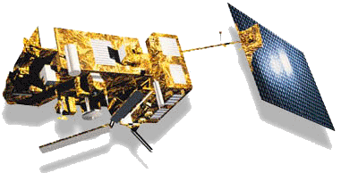
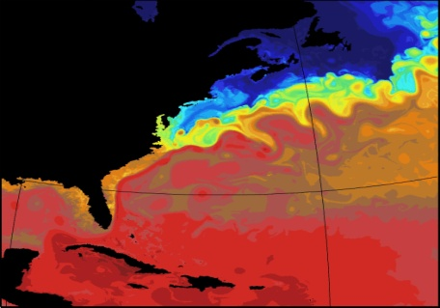
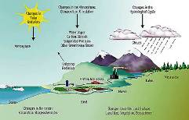
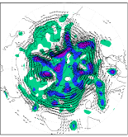
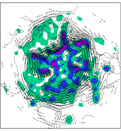
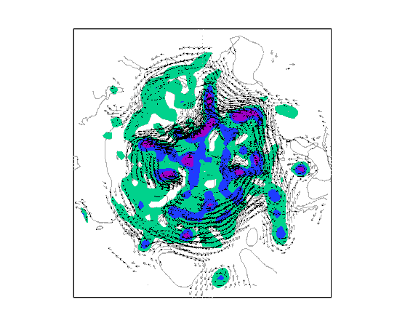
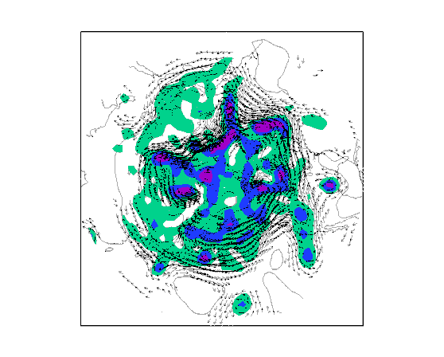
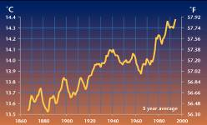
Seamless forecasting in time, space and complexity: the challenges
1/12⁰
Earth Observation
Resolution
Complexity
Computing
Resources
Duration and/or Ensemble size

Slide 5
Challenges of Seamless Numerical Weather and Environmental Prediction Research
The Way Forward
(We don’t need to reinvent the wheel!)
5
Notes:
5

Slide 6
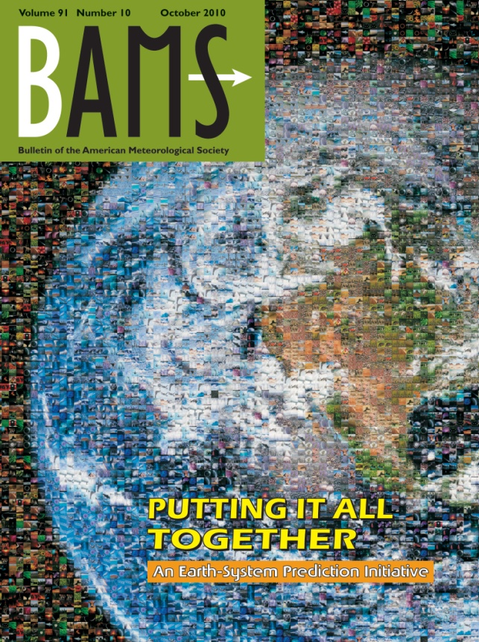
Putting it All Together (BAMS 2010)
World Meteorological Organization (WMO), World Weather Research Programme (WWRP), World Climate Research Programme (WCRP), International Geosphere-Biosphere Programme (IGBP), Global Climate Observing System (GCOS), and natural-hazards and socioeconomic communities.
An Earth-System Prediction Initiative for the Twenty-First Century (Shapiro et al.,)
Addressing the Complexity of the Earth System (Nobre et al.)
Collaboration of the Weather and Climate Communities to Advance Subseasonal-to-Seasonal Prediction (Brunet et al.)
Toward a New Generation of World Climate Research and Computing Facilities (Shukla et al.)

Slide 7
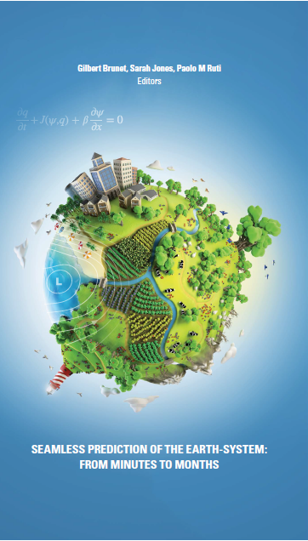
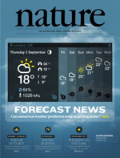
Seamless Prediction of the Earth System:
from minutes to months
Editors: (Brunet, Jones and Ruti)
  Provide a reference of current state and future challenges of NWP Science in 25 chapters.
  It is freely available on the WMO website
The quiet revolution of numerical weather prediction
Bauer, Thorpe and Brunet
(Nature, September 3, 2015)

Slide 8

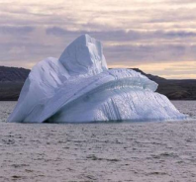
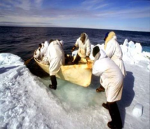
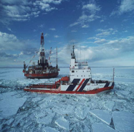
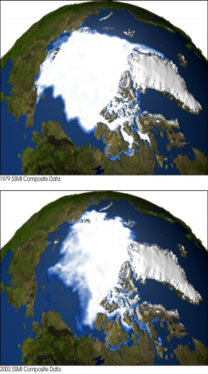
Challenges of Numerical Weather and Environmental Prediction Research
WWRP projects to advance the science of seamless prediction:
  HIgh-impact Weather (HIWeather) project (e.g. CHAMP);
  Polar Prediction Project (PPP) with joint WCRP activities (reanalyses, predictabilit; model error);
  the Sub-seasonal TO Seasonal (S2S) project (jointly with WCRP).

Slide 9
EC-RTT General Recommendations
The Council supported the recommendation that better technology transfer from research to operations and services with optimal use of observations can be accelerated through cross-cutting Forecast Demonstration Projects (e.g. CHAMP);
It requested the Secretary-General to implement specific recommendation 3.3 of EC-RTT to set up a mechanism connected with budgetary decision making, whereby cross cutting project proposals developed jointly by at least two Commissions, and one regional association could be reviewed and prioritized by the presidents of technical commissions, for consideration by EC and the Secretariat for eventual implementation.

Slide 10
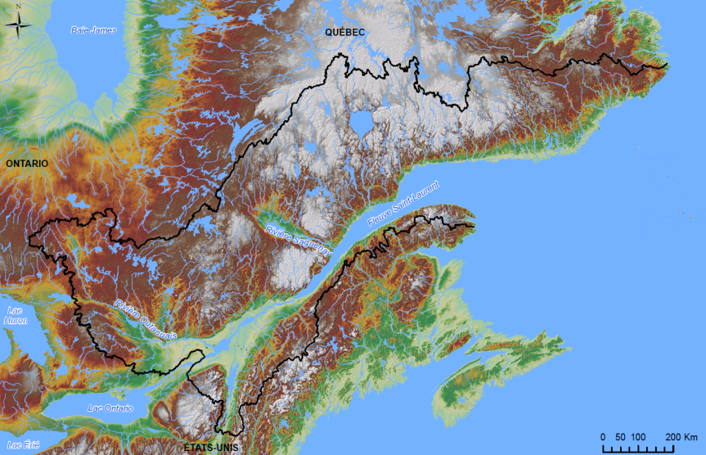
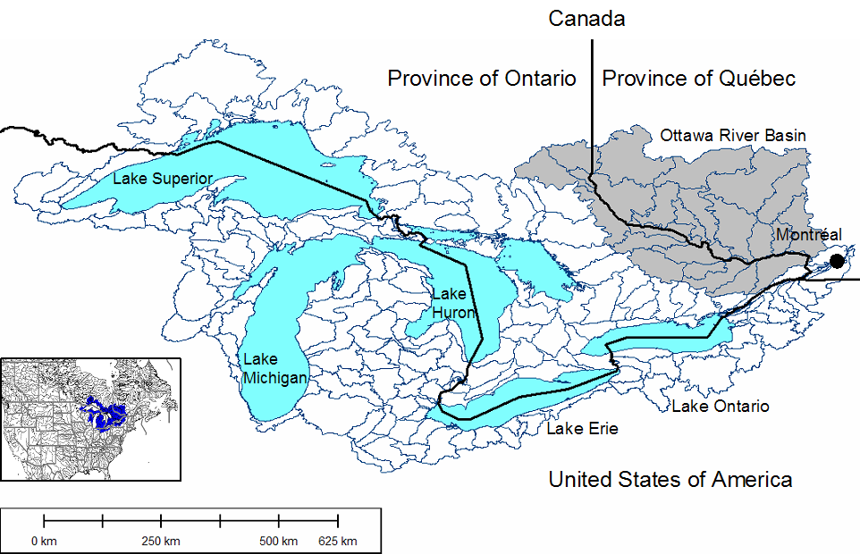
Context and motivations of RDP/FDP
The Great Lakes and St-Lawrence River:
make up the largest surface freshwater system on the planet connected with the world’s largest estuary;
meet the diverse needs of an estimated 105.3 million people in Canada and the United States;
are a transboundary water resource, co-managed between both Canada and the US;
are a major feature with significant regional influence on synoptic weather systems, and local climate and weather via lake/river feedbacks to the atmosphere;
and, a critical component of the freshwater system and hydrological cycle of the eastern half of North America.
On the science side, the increasing convergence in both atmospheric and hydrological sciences in the application of coupled atmospheric-hydrological modelling systems have led Canada and the United-States to collaborate on establishing such a capacity.
10

Slide 11
Coupled Hydrology-Atmospheric Modelling and Prediction in the Laurentian Great-Lakes-St Lawrence River of North America
CHAMP
Given the existing Canada-United-States collaboration, the natural test-bed that is the Great-Lakes-St Lawrence river and the advances in coupled atmosphere hydrology-atmosphere prediction, and the cross-commission expertise and impacts, the CHAMP project is proposed as a CAS-CHy-CBS inter-commission research and forecasting demonstration project to:
demonstrate the capacity for improvement to weather and hydrological forecasts of a coupled atmospheric-lake-ice-waves-hydrological numerical prediction system;
demonstrate that such environmental prediction systems have direct applications to the forecast and management of water levels and discharges in the Great-Lakes–St Lawrence system and ecosystem management; and
develop and evaluate specialized forecasting products and information packages to allow the community of users to take advantage of new knowledge to assist decision-making on time-scales ranging from real-time nowcasting (for weather and hydrological forecasting) to monthly and up to annual (for the surface water system).
11

Slide 12
Questions & answers

