Slide 1
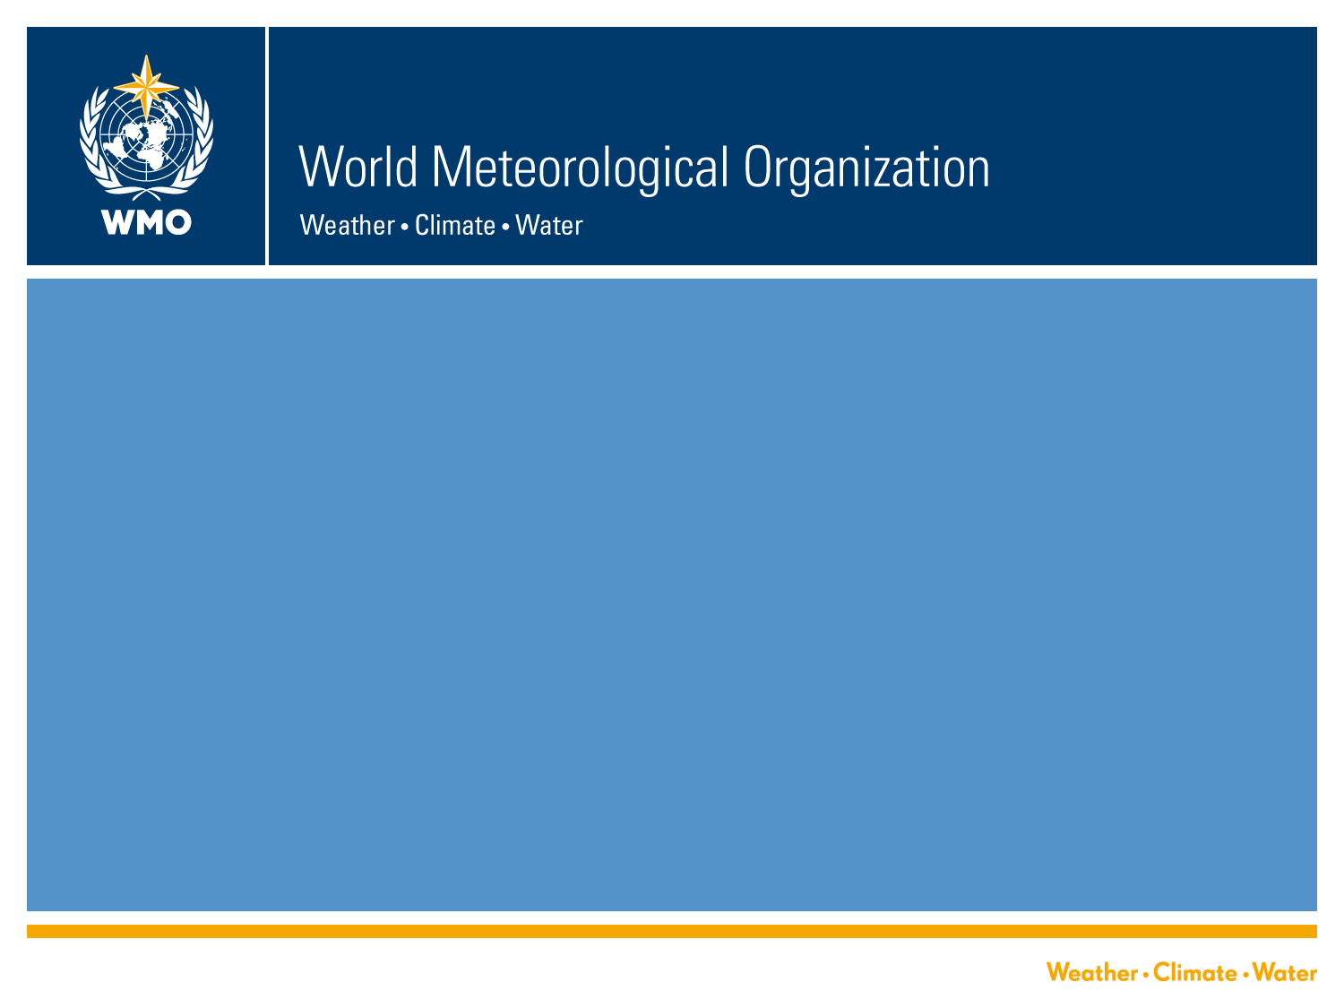
Future Seamless Global Data-processing and Forecasting Systems (GDPFS) meeting
Geneva, 10-12 Feb 2016

Slide 2
Origin of the GDPFS
UN Gen Assembly XVI (Dec 1961) adopted Resolution 1721 “International Cooperation in the Peaceful Uses of Outer Space”.
WMO was requested to study measures to advance the state of atmospheric science and technology and to develop weather forecasting capabilities
WMO Cg 4 (1963) created WWW composed of GDPS, GOS -> WIGOS and GTS -> WIS operated by WMO Members for the collection, analysis and dissemination of meteorological data and processed products
On Recommendation of CBS-Ext(02), Cg 14 (2003) changed GDPS to GDPFS

Slide 3
Purpose of the GDPFS
The GDPFS provides the core operational prediction capabilities and systems of WMO (operated by Members – 191)
  Nowcasting (VSRF) – 0-6h
  Numerical Weather Prediction & EPS – 6h-15d
  Long-Range Forecasting – Sub-seasonal to Longer Time Scales – up to 2 years
  Emergency Response Activities for Nuclear and Non-Nuclear dispersion
  Specialised centres – eg sand and dust-storm, tropical cyclone centres

Slide 4
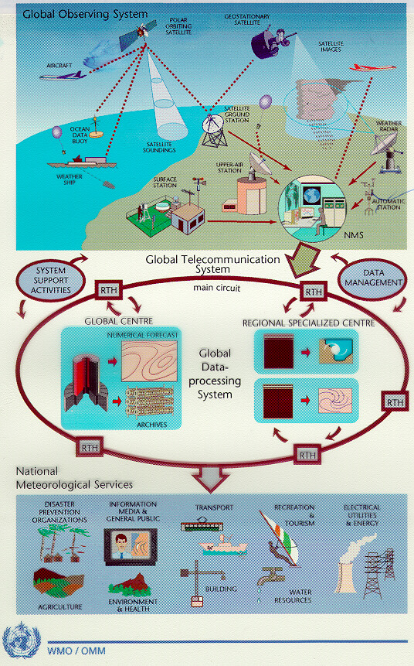
WMO operational networks
191 NMHSs: satellites, land, ships, buoys, and aircraft contribute to Global Observing every day
WIGOS
Global Telecom with Regional Hubs –
becoming the WMO
Information System
WIS
The GDPFS:
Global, Regional Specialized Met. Centres (RSMC, RCC), and National Centres
GDPFS
Service delivery
NMHSs deliver analyses, forecast and early warning services
Notes:
4

Slide 5
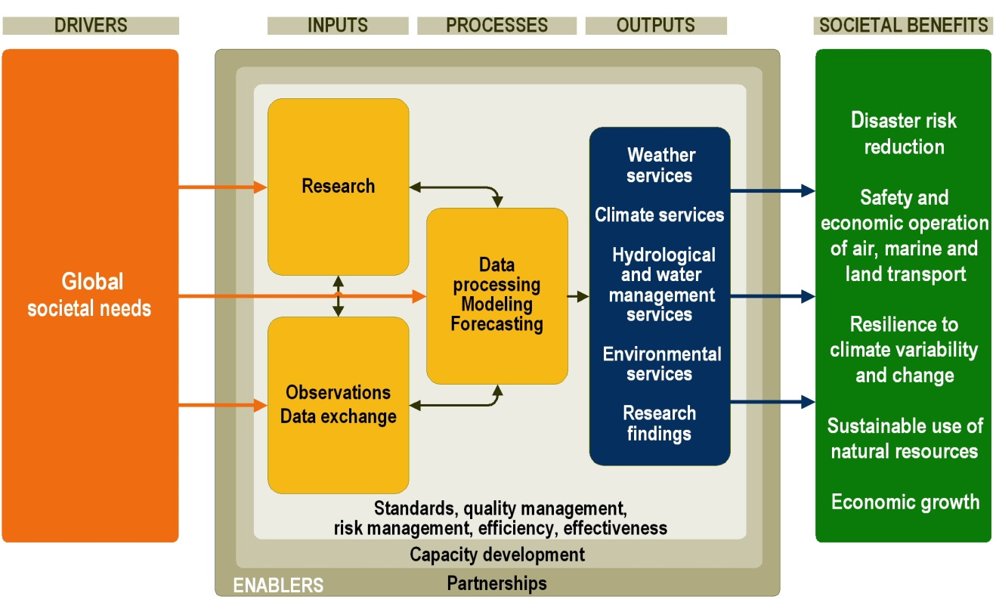
At the heart (engine room) of the WMO operational system
From WMO 2016-2019 Strategic Plan
5
Notes:
5

Slide 6
The GDPFS …
Is organized as a three-level system to carry out functions at global, regional and national levels
  World Meteorological Centre (WMC)
  Regional Specialized Meteorological Centre (RSMC) (incl. Regional Climate Centre (RCC))
  National Meteorological Centre (NMC)
Cg-17 Side Event
6

Slide 7
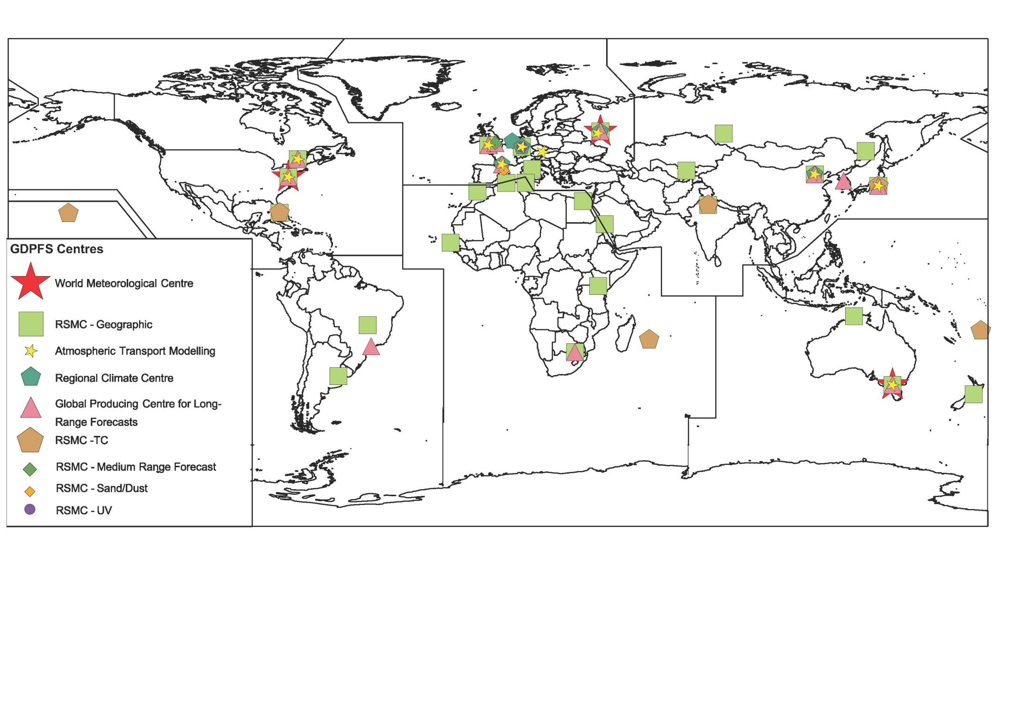
The GDPFS today…
3 World Meteorological Centres (WMCs)
25 Regional Specialiazed Meteorological Centres (RSMCs) with Geographical Specialization and 16 with Activity Specialization
12 Global Prediction Centres (GPCs) for Long Range Forecasts (LRF)
5 Regional Climate Centres (RCCs) and 1 RCC-Network
test footer
7
Notes:
7

Slide 8
GDPFS activities coordinated through the OPAG-DPFS
OPAG & ICT DPFS
Ken Mylne/Yuki Honda
SG SWFDP
Ken Mylne
Expert Team on Operational Weather Forecast Processes and Systems (ET-OWFPS)
David Richardson
ECMWF
Expert Team on Operational prediction from subseasonal to longer time scale (ET-OPSLS)
Richard Graham
UK Met)
Expert Team on Emergency Response Activities (ET-ERA)
René Servrankx
Canada
OPAG DPFS/PWS
CBS TT –Humanitarian
Chair- Michel Jean (CBS coordinator on DRR )
Assist with access to hi Res Reg NWP
Standards procedure for SFC verif
Guidelines on interpretation of VSRF products
…..
Provision of LRF products form GPcs and LCs
Dev of services to RCCs
LCs support to Global Seasonal Climate Update
Scoping/implementation of sub-seasonal forecasts and Longer than seasonal
…..
Maintain ope response readiness
Maintain MoU with IAEA
Explore new products
Dev operational procedures for non nuclear ERA
…..

Slide 9
10 Years (2023) Plan Developed by ICT DPFS
Vision: The GDPFS will be developed and expanded to cover all timesacles from short to multi-annual range
Sustain and enhance quality and reliability of existing operational services incl ERA
Consolidate SWFDP into sustainable operational services
Dynamical monthly, seasonal and multi-annual products understood and integrated in National and regional services and informing adaptation to clim var & change and informing decisons retaled to GFCS priority areas and DRR
ERA for non-nuclear hazards to reach same level of maturity as nuclear ERA

Slide 10
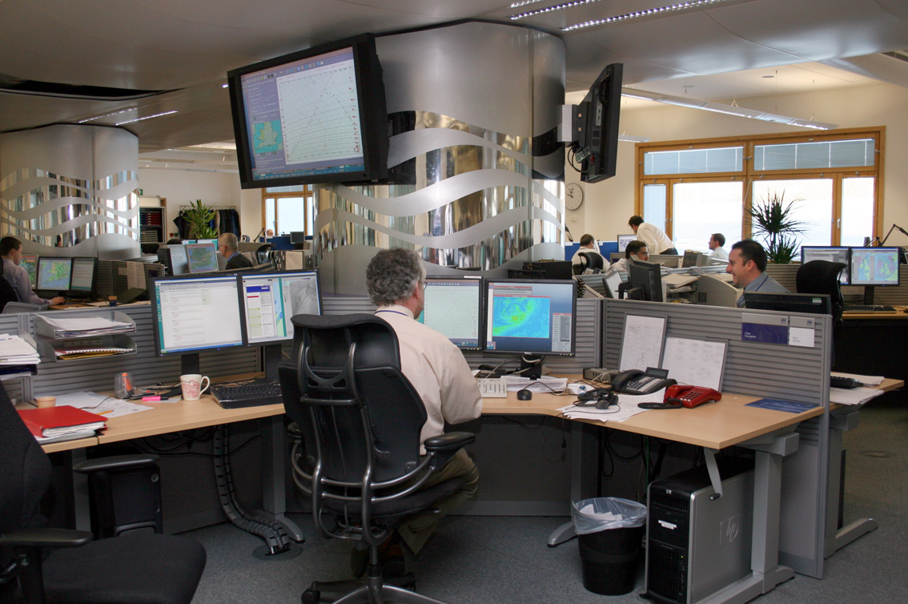
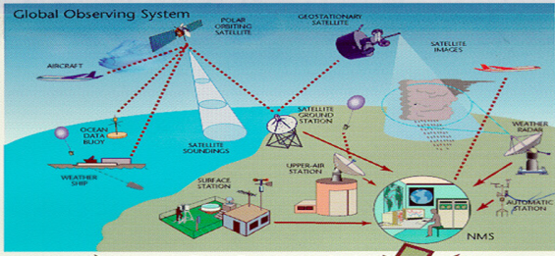
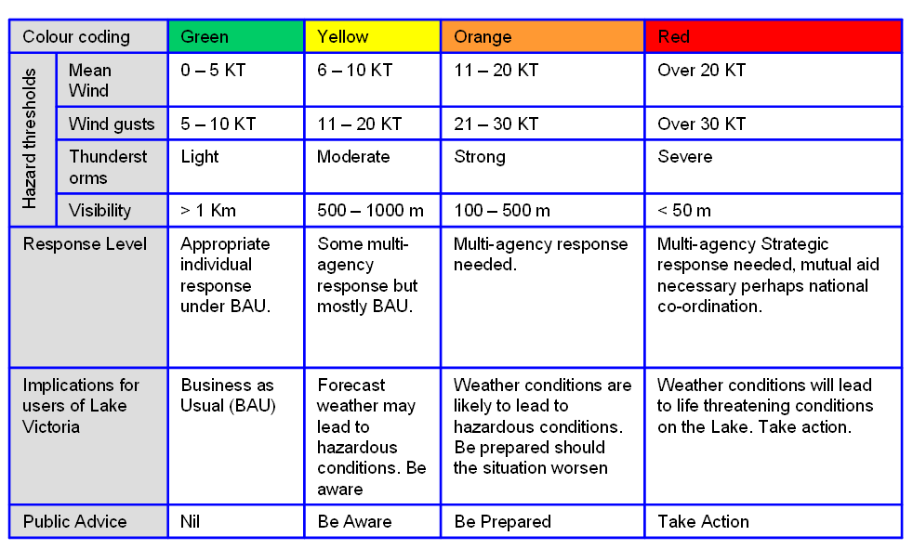

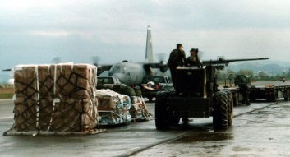



The Role of the GDPFS in creating services
80km high
70 levels
25km
Observations
(in situ and remote sensing)
Forecasting & service delivery
du = ∂p – fv
dt ∂x
dv = ∂p + fu
dt ∂y
p = RT
Ρ
Data processing & Forecast Model
LCs MME
. Seoul/Washington
WMC
GPC
RCC
NMC
RSMCs
• • •
WMC
Knowledge & Research
• • •
RCCs
GPC
NMC
LCs Ver
.Montreal/Melbourne for LRF
.Tokyo for EPS ver
.ECMWF for Deterministic NWP
NMC
Users (DMCPA, sectors)
Notes:
LCs MME: Lead centres for Multi-Models Ensemble
LCs for Verification: Lead Centres for verification: Tokyo for Ensemble Prediction System, deterministic forecast is ECMWF, Long Range Forecast: Montreal and Melbourne
RSMCs could provide deterministic, ensumble, and/or the provision of specialized products on ERAs, TC, Vocanic ash advisory, sand and dust storm, and more.such as for Agriculture Centers….
WMCs are designated to provide deterministric, ensumble, and long-range forecast.

Slide 11
Spreading Capability to WMO Members with limited Resources through…
The Severe Weather Forecasting Demonstration Project (SWFDP) and its cascading process in coordination with OPAG PWS
  SWFDP in development or operational in most regions: Southern Africa (16 Countries); South Pacific Islands (9); Eastern africa (7), South-East Asia (5), Bay of Bengal (6); West and Central Africa (initiated), Central Asia (initiated), South-East Europe (in discussion) Caribbean (in discussion)

Slide 12
Some Emerging Needs influencing the GDPFS…
Impact-Based Forecasting and Risk-based Warning: GDPFS need to integrate non conventional information: Vulnerability and Exposure
Trajectory-Based Forecasting for Aviation: Nowcasting (landing/take off), short term forecasts (enroute): Seamless Met Info required for take off, enroute and landing – Requires seamless blending of nowcasting, mesoscale and global NWP
Support to GFCS (extreme events, sub-seasonal to climate forecasting)
Climate change and variability are imposing new challenges to National Meteorological and Hydrological Services (NMHSs) requiring them to produce information at various time scales.
Technology advances at high pace (ie doubling of Computing capacity every ~18 months) and limited availability of resources

Slide 13
To meet these needs, the GDPFS must evolve to…
Being Capable of serving more users with one integrated system
Being more agile and adaptable to serve Applications Programmes (AeM, AgMet, MMO, PWS), HydroMet and weather (polar & mountain areas), climate and environment related needs (forest fire, chemical spills, sand & dust storms, etc)
Provide information seamlessly across:
  Time (nowcasting, through weather forecasts for days and weeks ahead to long-range forecasts on seasonal and up to multi-annual scales) and;
  Disciplines (Hydrology: flood, inundation, water management; Marine and Costal: Wave, Storm Surge; Air Quality and Sand and Dust Storm; Natural resources and Energy sectors , Tourism, Transports, etc.)

Slide 14
To that end Cg17 adopted Resolution 11:
“Towards a future enhanced integrated and seamless Data-processing and forecasting system” expressed Congress decision to:
“Initiate a process for the gradual establishment of a future enhanced integrated and seamless WMO Data-processing and Forecasting System, in the light of the conclusions of the first World Weather Open Science Conference held in Montreal, Canada in August 2014, in particular that a seamless system encompasses several dimensions including timescales, multiple weather related hazards and societal impacts”
14

Slide 15
In addition…
Cg-16 (2011) through, Resolution 6, recognized the central role of the GDPFS by affirming that the Manual on the GDPFS (WMO-No 485) is the single source of technical regulations for all operational data-processing and forecasting systems operated by WMO Members.
A new Manual is being developed and its adoption is planned for EC-69 (June 2017) following Recommendation from the upcoming CBS-16 (Nov 2016)
15

Slide 16
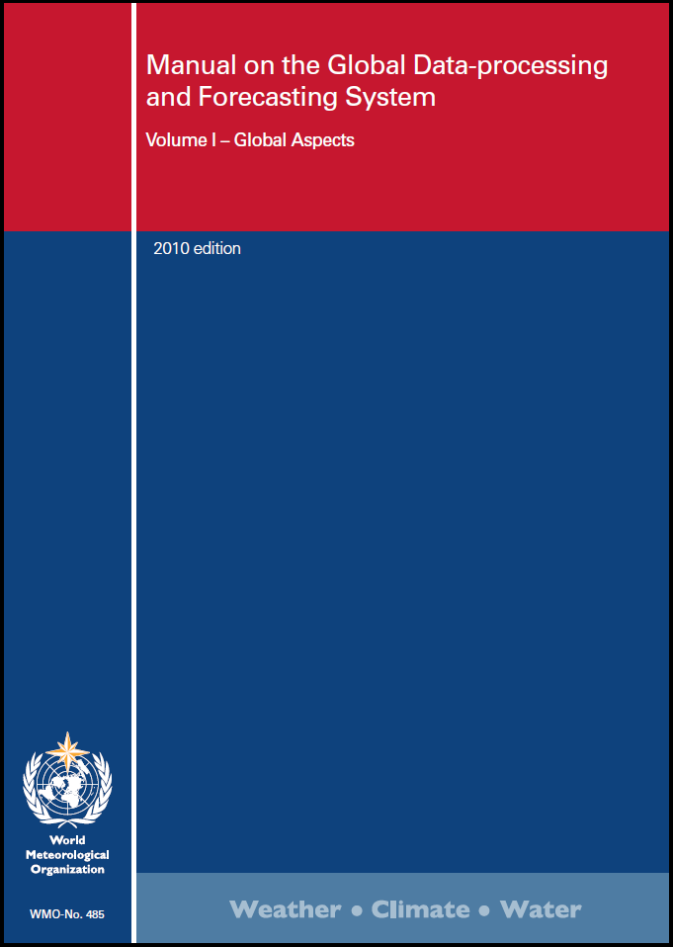
The Manual on the GDPFS
(WMO-No. 485)
A single source of technical regulations for all operational data-processing and forecasting systems operated by WMO Members (Cg-16)
It includes the designation of meteorological centres, including those coordinated by CBS, jointly with other technical commission(s) and/or WMO Programme(s), as well as with other international organizations
16
Notes:
16

Slide 17
Manual on the GDPFS (WMO-No. 485)
Current version: https://www.wmo.int/pages/prog/www/DPFS/Manual/GDPFS-Manual.html
New Edition (by 2017): should be approved by EC- 69 https://www.wmo.int/pages/prog/www/DPS/Manual/Table-of-content_Manual-gdpfs.html
17
Notes:
17

Slide 18
What is new in the New GDPFS Manual?
Clear Definition of Designation Criteria for Centres (WMC, RSMCs, GPCs) – Contribution of TCs (ie RSMC for Marine is required)
Provision of detailed information regarding Center’s implementation
  Systems description and characteristics
  Product metadata
Verification of products
Rolling Review of Centre Compliance (Regular Audit)
Clear Establishment of Procedures for designation
Additional WMCs possible when following criteria are met:
  Global deterministic numerical weather prediction, and
  Global ensemble numerical weather prediction, and
  Seasonal and climate numerical prediction
18

Slide 19
Planned short-term action for addressing Resolution 11 (Cg-17)
Setting up a team of Experts to discuss how to go about this task - Done
1st meeting of the team in Geneva, 10-12 Feb 2016 (underway), to propose a:
  Roadmap
  White paper on the subject
Output from the meeting will be submitted to EC-68 for its guidance

Slide 20

Thank you for your attention
www.wmo.int

