Slide 1
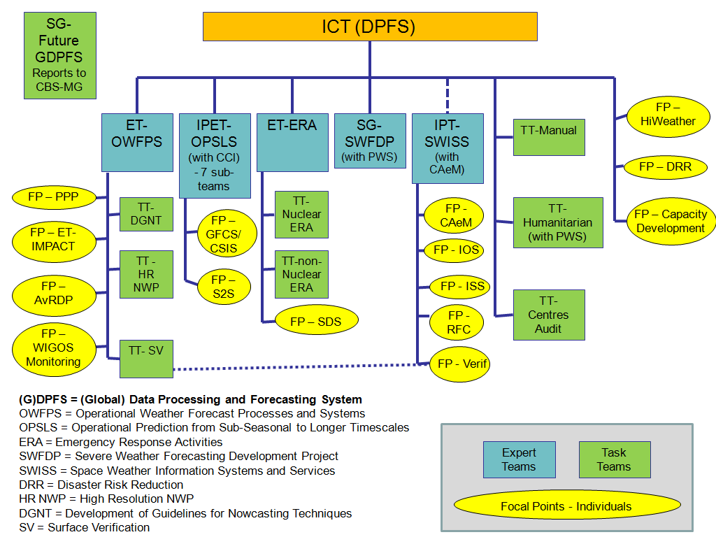

Slide 2
WWRP at a glance
WG
Nowcasting and Mesoscale
Tropical Meteorology
WG
Predictability, dynamics and ensemble forecasting
WG
WG
WG
Data assimilation and observing systems
Verification
WG
Social and economic research
WWRP a seamless programme
High Impact Weather
Urbanization
Predicting Water Cycle
Emerging Technologies
Polar Prediction
Sub-seasonal 2 seasonal
High Impact Weather
Challenges Projects Working Groups
2
Technical Commission for Atmospheric Science
2
Notes:
Here a brief overview of the new WWRP structure. The four challenges, the three legacy projects, Sub-seasonal to Seasonal, a joint WCRP WWRP initiative, Polar Prediction in collaboration with WCRP and High Impact Weather.
Finally the working groups and their main topics.

