Slide 1
THE
PWS COMPONENT OF SWFDP

Slide 2
Content
Introduction to the PWS Programme
WMO Strategy for Service delivery
Impact-Based forecasting
Common Alerting Protocol
Projects and Training
Publications by PWS Programme

Slide 3
Introduction to the PWS Programme

Slide 4
Purpose of PWS Programme
The PWS Programme assists National Meteorological and Hydrological Services (NMHSs) deliver improved weather and related services to the public and specialized users for sound decision-making on public safety, quality of life and social and economic activities

Slide 5
The WMO Strategy for Service Delivery

Slide 7
SSD Survey results
SSD Survey part of Implementation Plan
85 NMHSs responded (see results)
Majority of NMHSs need assistance on strengthening and sustaining improved levels of service delivery
In different aspects of service delivery 5 - 10% of NMHSs have “undeveloped” service delivery
For 15 - 43 % of NMHSs, service delivery has just been “initiated but not developed”.
a - undeveloped
b - just initiated
c - development in progress
d - developed
e - advanced

Slide 8
The PWS Component of SWFDP
To:
Establish service delivery baseline
Identify gaps
Develop action plan to fill gaps
Q _{t=12 mois}
Q _{t=0}

Slide 9
Examples of Gaps
Lack of staff
There is staff but they lack SD skills
Staff with skills exist but not assigned clear SD duties
Insufficient communication channels
Website
Email
TV
Radio (National, community, commercial …)
Social media
Mobile phone app

Slide 10
Examples of Gaps (continued)
Lack of skills to engage users
Media
Disaster community
public
Social and economic sector
Lack of skills to provide high quality products
Daily forecasts
Warnings including impact-based forecast and warnings
Seasonal outlooks

Slide 11
SWFDP Training in PWS
Impact-based forecast and warning services
PWS Programmes of NMHSs
Gaps in service delivery
Website
Social Media
Mobile phone weather Apps
The Common Alerting Protocol (CAP) system
Working with the media
Disaster Management and Civil Protection Authorities
Developing SOPs and MoUs

Slide 12
Impact-Based Forecast
and
Warning Services
Aftermath of typhoon Haiyan, Philippines, 2013

Slide 13
Impact-Based Forecast and Warning Services
Impact-based warnings provide information of how hazards may impact warning recipients
NMHSs issue accurate hazard warnings yet populations suffer many casualties and damage because of lack of knowledge of likely impacts of the hazard
An NMHS cannot deliver impact-based warning services on its own
Creating systems to support impact warnings is based on close coordination between NMHSs and different organizations e.g. Disaster Reduction and Civil Protection Agencies (DRCPAs), social scientists etc.

Slide 14
Benefits of an Impact Warning Service
Relays a message to enable those at risk to take appropriate actions
Improved planning for different scenarios based on different impacts
Contains information about level of confidence in the forecast for better decision-making
Provides basis for post-event analysis of multi-hazard impacts to assist in planning, response and mitigation of impacts
A comprehensive and coordinated process to address disaster response and preparedness
Common situational awareness

Slide 15
Example

Slide 16
«WMO Guidelines on Multi-hazard Impact-Based Forecast and Warning Services»
PWS Programme coordinated effort to produce the publication: WMO No. 1150 (view it here)
It provides a road map to assist members develop impact-based warning services
Defines the necessary steps and explains likely levels of complexity
Publication highly recommended for use by Members

Slide 17
Common Alerting Protocol
(CAP)

Slide 18
The Common Alerting Protocol (CAP)
CAP is an XML-based data format for exchanging public warnings and emergencies between alerting technologies.
An international standard format for emergency alerting designed for “all-hazards” and “all-media”, … cell phones, faxes, radio, television, digital communication networks …
Enables simultaneous communication of alerts over many different alerting systems, thus increasing effectiveness while simplifying the alerting task
Cg-15 endorsed adoption of a warnings Standard such as CAP for alerting

Slide 19
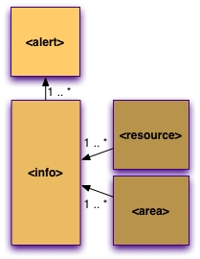
Structure of a CAP Message
CAP Messages contain:
Text values for human readers, such as "headline", "description", "instruction", "area description", etc.
Coded values useful for filtering, routing, and automated translation to human languages
Notes:
This is a critically important feature of CAP messages.
CAP Messages contain various text values for human readers, such as "area description", "headline", and "instruction".
But, CAP messages also contain coded values that are necessary for filtering, routing, and display of messages.
Coded values are also very useful for automated translation to human languages.

Slide 20
Implementation of CAP
WMO through PWS programme assists Members through the «CAP Jump-start» arrangement
Experts visit NMHSs and provide training and freeware
LDCs and developing countries are supported
WMO CAP Jump-start
(Link to more information)

Slide 21
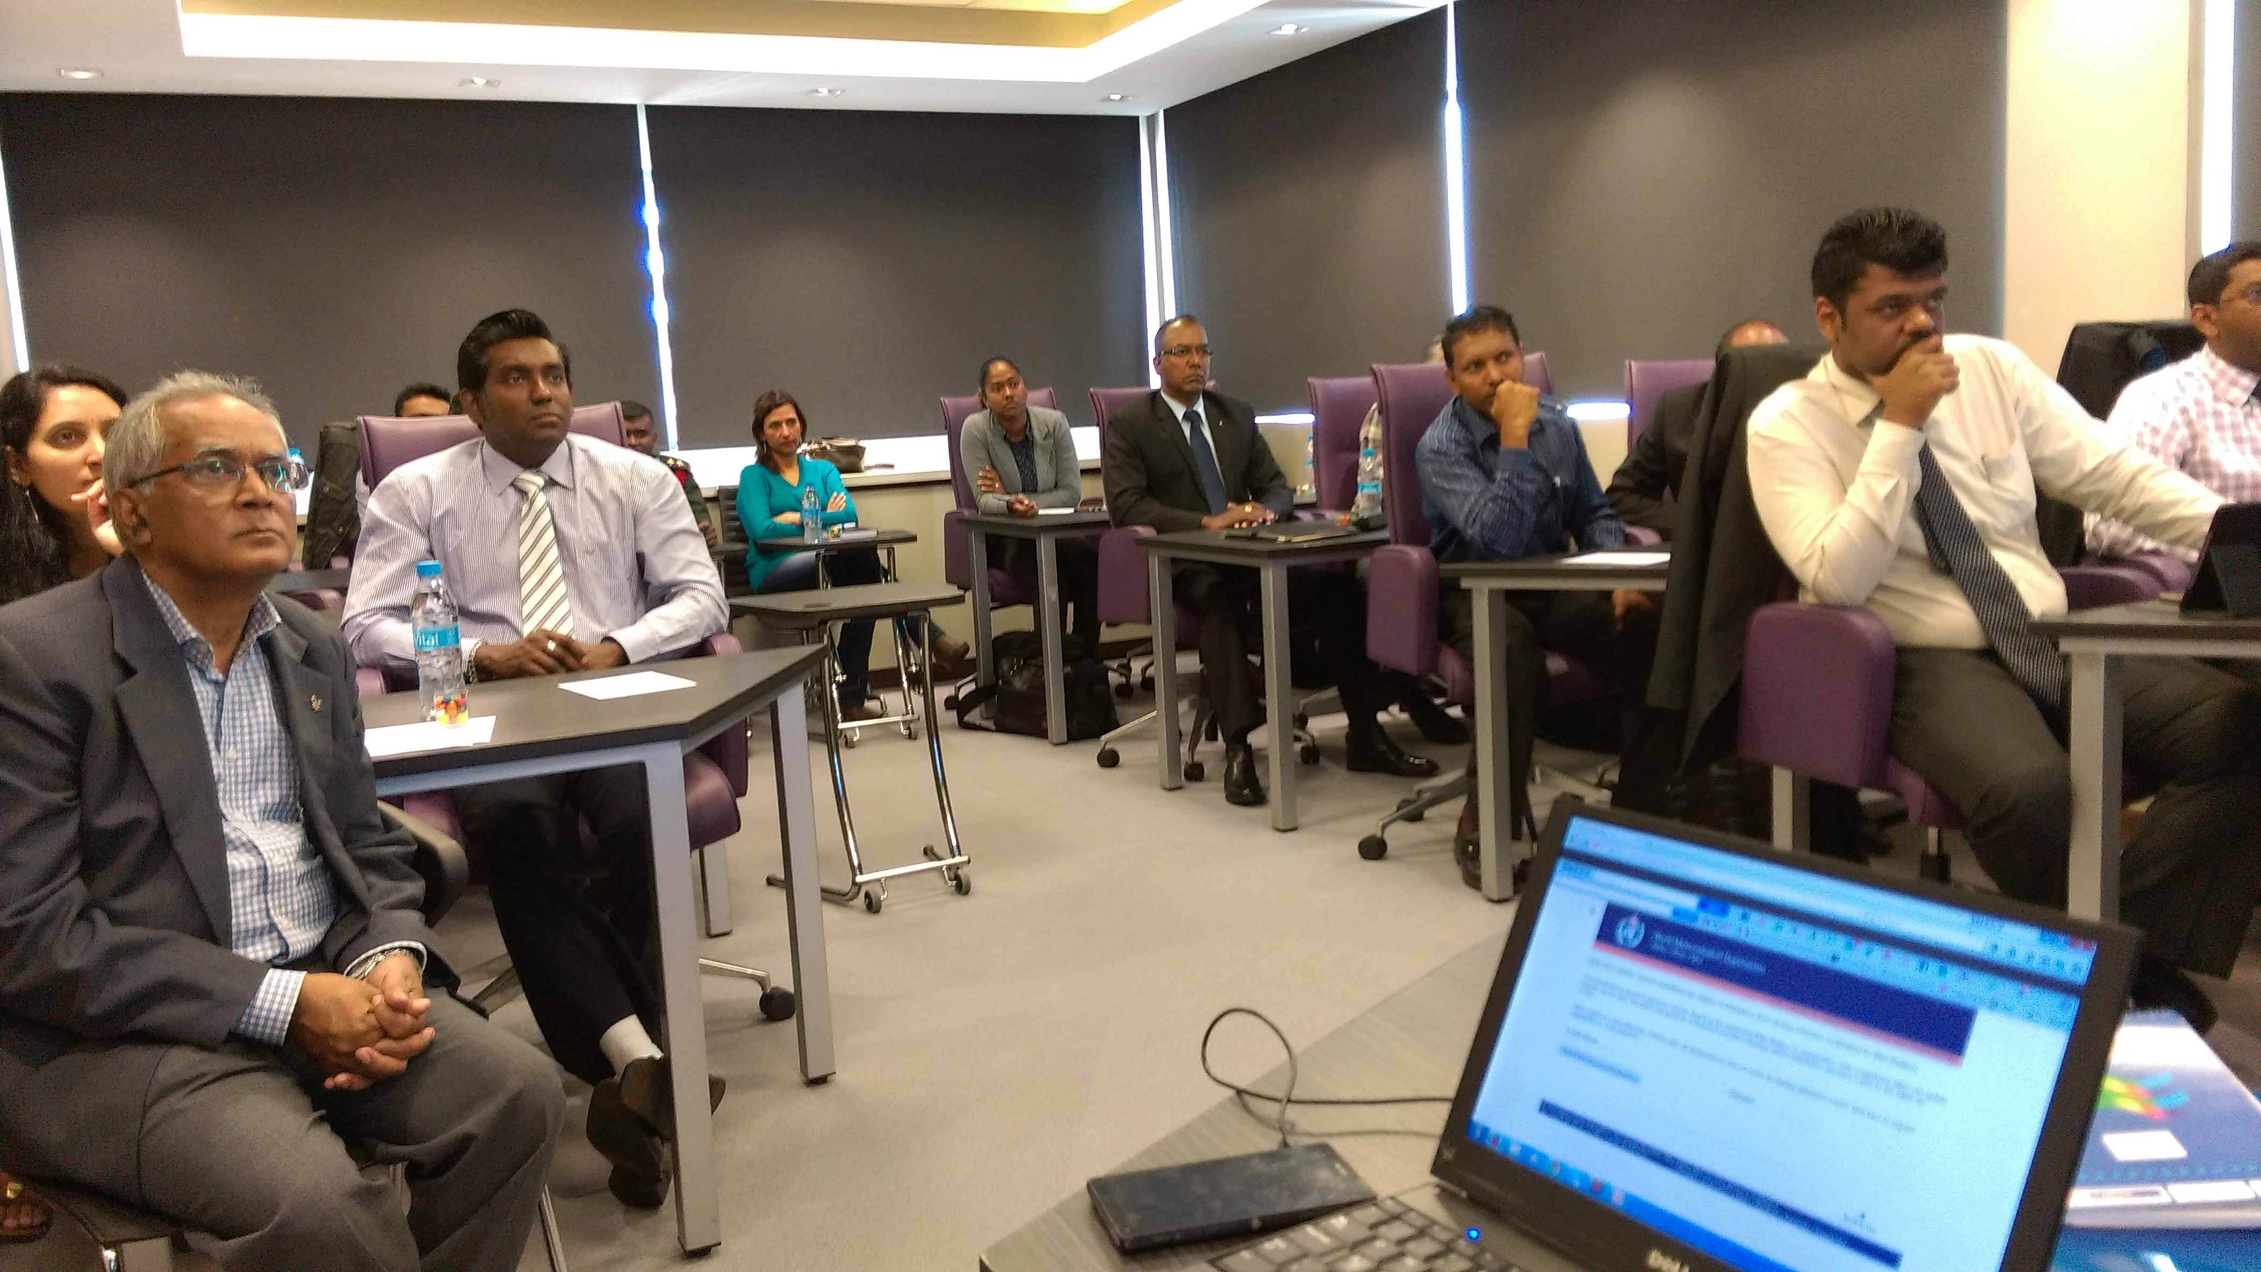
CAP Jump-Start Workshop, Vacoas, Mauritius, 31 August – 4 September 2015
WMO Organized 16 CAP-Jump Start workshops by PWS Programme

Slide 22
WMO Register of Alerting Authorities
Purpose:
To provide emergency managers, the media, other intermediaries and the public, an authoritative register of organizations authorized to issue alerts in each country
To serve in the filtering of authorized warning authorities by aggregators including the planned WMO Alert Hub
PRs nominate editors to maintain respective country register pages
WMO, through the PWS Programme has published the “Administrative Procedure for Registering WMO Alerting Identifiers” WMO/TD No. 1556 (Link to the publication)

Slide 23
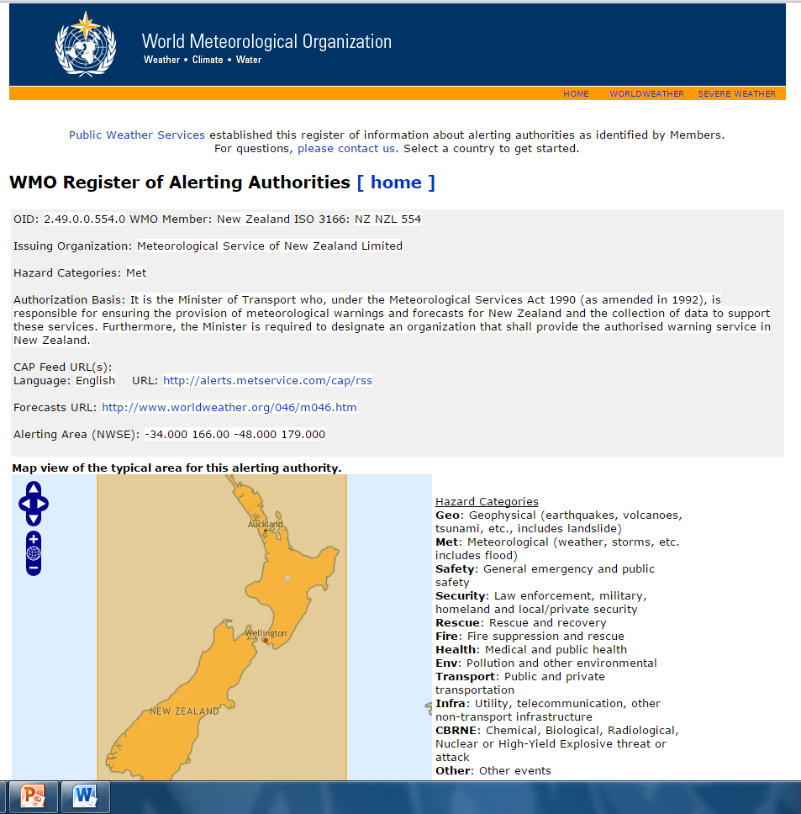
Example
The Register page for the Meteorological Service of New Zealand

Slide 24
The W MO Alert Hub
WMO planning on developing an alert hub for all alerts from Members
Hub planned to provide one-stop platform for alerts provided by authorized agencies/institutions
The Filtered Alert Hub which is part of the NOAA Big Data Project is considered prototype for the WMO Alert Hub
Courtesy: Eliot Christian

Slide 25
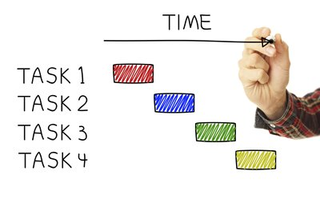
Projects and Training
conducted by PWS

Slide 26
Severe Weather Forecasting Demonstration Project
SWFDP Regional Subproject
Southern Africa
Eastern Africa
South Pacific
Southeast Asia
Bay of Bengal
Central Asia
6
5
4
2
3
1

Slide 27
SWFDP Training and Improvements in PWS
Evaluation of PWS Programmes of NMHSs
Carrying out gaps analysis in service delivery
Establishment and improvement of communication channels
Website
TV studios
Social Media
Mobile phone weather Apps
The Common Alerting Protocol (CAP) system
Working with the media
Disaster Management and Civil Protection Authorities
Developing Standard Operating Procedures (SOPs) and Memorundum of Understanding (MoUs)
Developing warning services

Slide 28
PROJECTS / TRAINING CONDUCTED by PWS PROGRAMME 2013-2016
COUNTRY | PROJECT / TRAINING
BURUNDI | TV Studio construction, equipping and training Establishment of Social Media channels Common Alerting Protocol
BOTSWANA | Establishment of Social Media channels Common Alerting Protocol
CARRIBEAN, RA IV | on Designing Socio-Economic Benefits (SEB) Studies of Meteorological / Hydrological Services and Products for the Caribbean
CONGO, REPUBLIC OF (CONGO-BRAVILLE) | Provision of TV Studio equipment by Dec 2016 TV Weather presenter training
GHANA | Establishment of Social Media channels Common Alerting Protocol Implementation of the WMO Strategy for Service Delivery
MADAGASCAR | Upgrading of Internet connectivity and the Website of DGM Training of weather presenters Climate and health project

Slide 29
PROJECTS / TRAINING CONDUCTED by PWS PROGRAMME 2013-2016
MALAWI | Establishment of TV weather presentation studio establishment of Social media channels Implementation of Common Alerting Protocol (CAP) standard WMO Strategy for Service delivery (SSD)
MALDIVES | Implementation of Impact-based Forecasting and Risk-based Warnings
MAURITIUS | Establishment of Social media channels Common Alerting Protocol (CAP) standard Pilot Project on Impact-based Forecasting and Risk-based Warnings
MOZAMBIQUE | Pilot Project on Impact-Based Forecasting and Risk-Based Warnings
MYANMAR | Impact-based forecasting and risk-based warnings,
RWANDA | Training of TV weather presenters Provision of studio equipment Social media channels and training in social media Common Alerting Protocol (CAP) standard

Slide 30
PROJECTS / TRAINING CONDUCTED by PWS PROGRAMME 2013-2016
SEYCHELLES | Project on Socio-Economic Benefits (SEB) Studies
TANZANIA | Climate and Health Project Development of a mobile weather application (App) training of TV Journalists in weather presentation
UGANDA | Conversion of Office space to a TV Studio Provision of TV studio equipment Training for Presenters and Graphics Operators
ZAMBIA | Replacement of some old studio equipment anti-virus software for ZMD website
ZIMBABWE | Establishment of Social media channel Implementation of Common Alerting Protocol (CAP) standard
WESTERN AFRICA | TV Weather Presenter Training Workshop (Dakar, Senegal)
EASTERN AND SOUTHERN AFRICA | TV Weather Presenter Training Workshop (Nairobi, Kenya)
EUROPE, RA VI | Designing Socio-Economic Benefits Studies of Meteorological / Hydrological Services and Products for Members of RA VI (Europe) (Zagreb, Croatia)

Slide 31
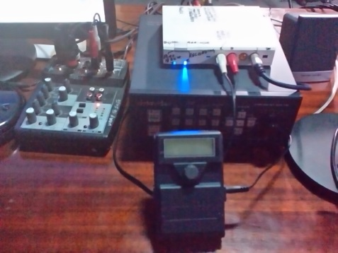
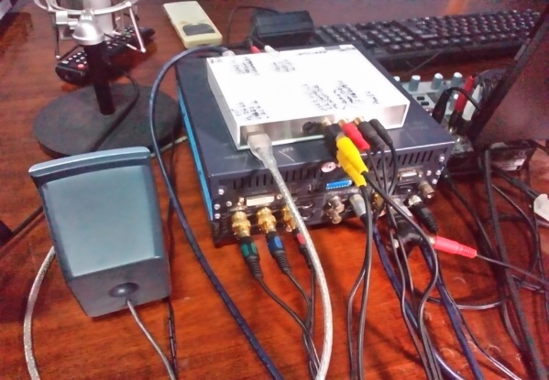
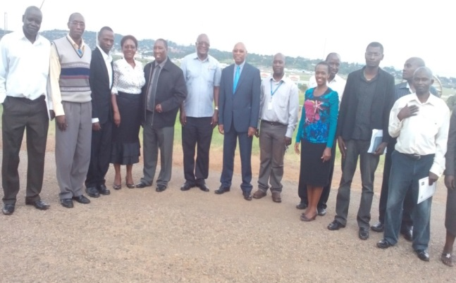
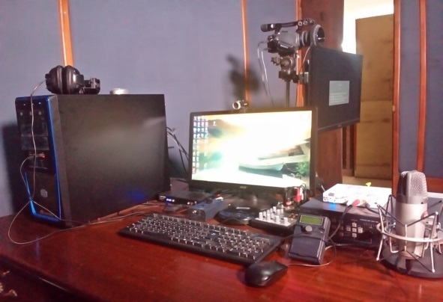
Example of TV Studio Assistance: Uganda
The Project content:
Establishment of TV weather presentation studio and training a team
Conversion of Office space to a TV Studio, purchasing, transporting, installing, testing and training on studio equipment in collaboration with UK Met Office
Provision of Internet connectivity for 1 year
Training for TV presenters and graphics operators,
Training of radio weather presenters

Slide 32
Example of TV Studio Assistance: Uganda
Key outcome of the Project:
Old TV studio renovated and equipped;
Internet connectivity provided
10 weather presenters and 5 graphics developers trained;
Re-commencement of TV weather presentation the after a 6-year absence
Very positive comments by decision/policy makers
UNMA introduced a budget line for studio maintenance
Millions of Ugandans now receive official forecasts and warnings through TV and radio

Slide 33
Publications
by
PWS Programme

Slide 34
YEAR | TITLE | PWS NO. | WMO-NO.
2015 | WMO guidelines on multi-hazard impact-based forecast and warning services |  | 1150
2015 | Valuing weather and climate: Economic assessment of Meteorological and Hydrological Services |  | 1153
2014 | The WMO strategy for service delivery and its implementation plan |  | 1129
2012 | Proceedings of the WMO Regional Association VI (Europe) Conference on | 23 | -
2012 | Guidelines on strategies for use of social media by National Meteorological and Hydrological Services | 24 | 1086
2012 | Guidelines on Participation of National Meteorological and Hydrological Services in the WMO World Weather Information Service | 25 | 1096
2012 | Guidelines for creating memorandum of understanding and a standard operating procedure between a National Meteorological or Hydrometeorological Service and a Partner Agency | 26 | 1099
2011 | Guidelines on international and cross-border collaboration in the warning process | 22 | 1560
2010 | National Meteorological and Hydrological Services, their partners and user communities | 19 | 1510

Slide 35
YEAR | TITLE | PWS NO. | WMO-NO.
2010 | Administrative procedure for registering WMO alerting identifiers | 20 | 1556
2010 | Guidelines on early warning systems and application of nowcasting and warning operations | 21 | 1559
2008 | Guidelines on communicating forecast uncertainity | 18 | 1422
2007 | Guidelines on capacity building strategies in Public Weather Services | 15 | 1385
2007 | Supplement to guidelines on biometeorology and air quality forecasts | 16 | 1400
2007 | Examples of best practice in communicating weather information | 17 | 1409
2006 | Public Weather Services – Strategy for developing public education and outreach | 14 | 1354
2005 | Guidelines on quality management procedures and practices for Public Weather Services | 11 | 1256
2005 | Guidelines on weather broadcasting and the use of radio for the delivery of weather information | 12 | 1278
2005 | Guidelines on integrating sever weather warnings into disaster risk management | 13 | 1292
2004 | Guidelines on biometeorology and air quality forecasts | 10 | 1184
2003 | Guidelines on cross-border exchange of warnings | 9 | 1179

Slide 36
YEAR | TITLE | PWS NO. | WMO-NO.
2002 | Public Weather Services in Region VI (Europe) - Report of Survey | 5 | 1100
2002 | Guide on the application of new technology and research to Public Weather Services | 6 | 1102
2002 | Supplementary guidelines on performance assessment of Public Weather Services | 7 | 1103
2002 | Guide on improving public understanding of and response to warnings | 8 | 1139
2001 | Technical framework for data and products in support of Public Weather Services | 1 | 1054
2001 | Weather on the Internet and other new technologies | 2 | 1084
2001 | Guidelines on the improvement of NMSs – Media relations and ensuring the use of official consistent information | 3 | 1088
2001 | Guidelines on graphical presentation of Public Weather Services Products | 4 | 1080
2000 | Guidelines on performance assessment of Public Weather Services |  | 1023
1996 | Guide to Public Weather Services |  | 834

Slide 37
Accessing the publications
Publications URL: http://www.wmo.int/pages/prog/amp/pwsp/publications_en.htm

Slide 38
Thank you
Merci

