Slide 1
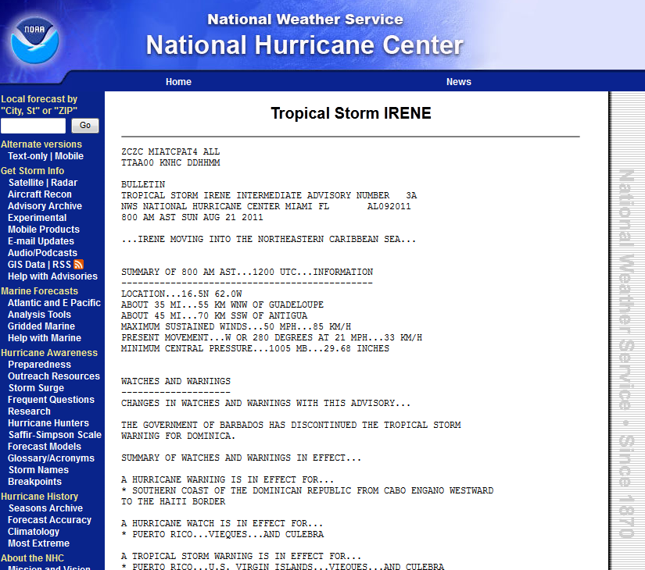
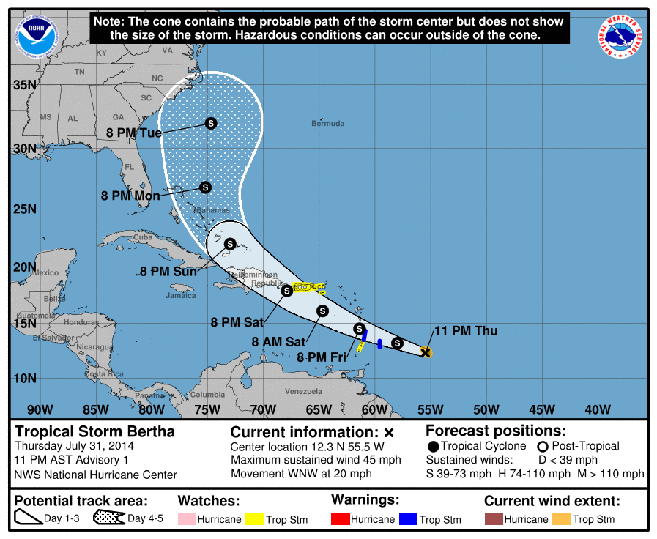
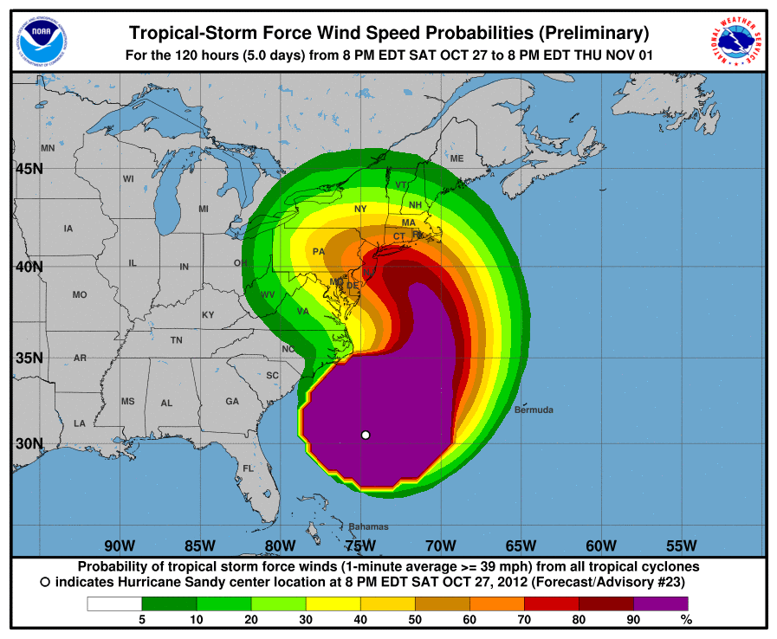
RSMC Miami
Tropical Cyclone Products
RSMC Miami provides the “big picture” that complements and guides local U.S. NWS and Caribbean NMC forecast offices products

Slide 2
National Hurricane Center
Text Products
Tropical Weather Outlook
Public Advisory
Forecast Advisory
Forecast Discussion
Wind Speed Probabilities
Tropical Cyclone Update
Tropical Cyclone Reports
Monthly Tropical Weather Summary

Slide 3
RSMC Miami
Graphical Products
Graphical Tropical Weather Outlook
Track Forecast Cone
Surface Wind Field
Wind Speed Probabilities
Cumulative Wind History
Storm Surge Probabilities
Potential Storm Surge Flooding Map
Storm Surge Warning Graphic

Slide 4
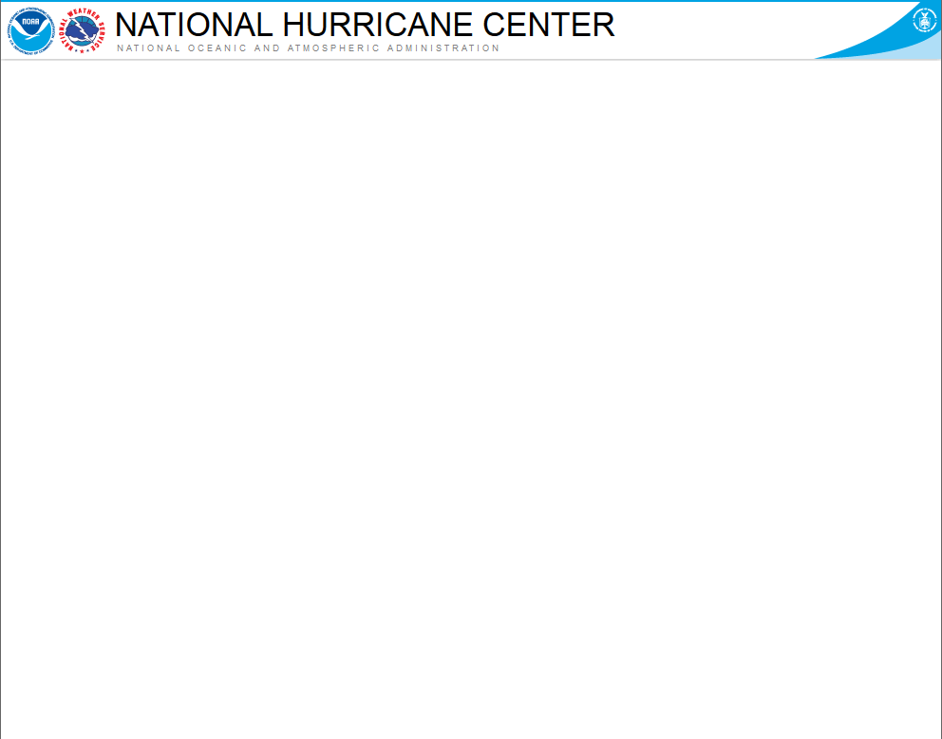
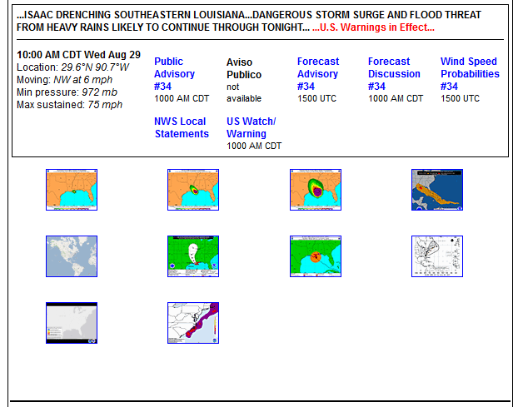
Tropical Outlook
Assessment of tropical activity
TROPICAL WEATHER OUTLOOK
NWS NATIONAL HURRICANE CENTER MIAMI FL
800 PM EDT MON OCT 20 2014
For the North Atlantic...Caribbean Sea and the Gulf of Mexico:
Showers and thunderstorms associated with an area of low pressure
located over the southwestern Bay of Campeche have changed little
in organization since this afternoon. This system has the potential
to become a tropical cyclone during the next couple of days while it
moves slowly eastward across the southern Bay of Campeche. Later
in the week, the low is forecast to interact and possibly merge
with a frontal system over the southeastern Gulf of Mexico or
northwestern Caribbean Sea. An Air Force Reserve reconnaissance
aircraft is scheduled to investigate the disturbance tomorrow
afternoon, if necessary. Interests in the Yucatan Peninsula should
monitor the progress of this system.
* Formation chance through 48 hours...medium...50 percent.
Formation chance through 5 days...medium...60 percent.
Forecaster Brown
Potential for development?
Headed where?

Slide 5
Tropical Outlook
Assessment of tropical activity
TROPICAL WEATHER OUTLOOK
NWS NATIONAL HURRICANE CENTER MIAMI FL
800 PM EDT MON OCT 20 2014
For the North Atlantic...Caribbean Sea and the Gulf of Mexico:
Showers and thunderstorms associated with an area of low pressure
located over the southwestern Bay of Campeche have changed little
in organization since this afternoon. This system has the potential
to become a tropical cyclone during the next couple of days while it
moves slowly eastward across the southern Bay of Campeche. Later
in the week, the low is forecast to interact and possibly merge
with a frontal system over the southeastern Gulf of Mexico or
northwestern Caribbean Sea. An Air Force Reserve reconnaissance
aircraft is scheduled to investigate the disturbance tomorrow
afternoon, if necessary. Interests in the Yucatan Peninsula should
monitor the progress of this system.
* Formation chance through 48 hours...medium...50 percent.
Formation chance through 5 days...medium...60 percent.
Forecaster Brown
Sending a plane?

Slide 6
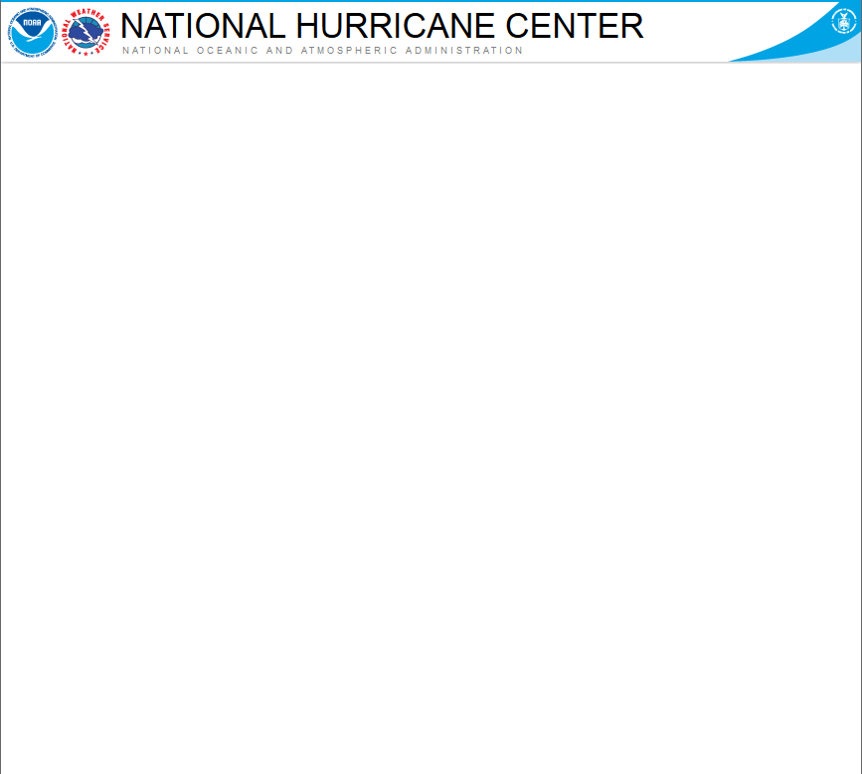
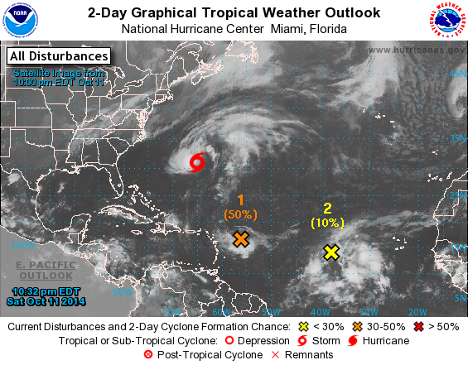
Tropical Outlook
2-Day Formation Potential
Current location of disturbances
(discussed in the Tropical Weather Outlook)
Formation chance during the next 48 hrs
Categorical
(Low, Medium, and High)
Probabilities

Slide 7
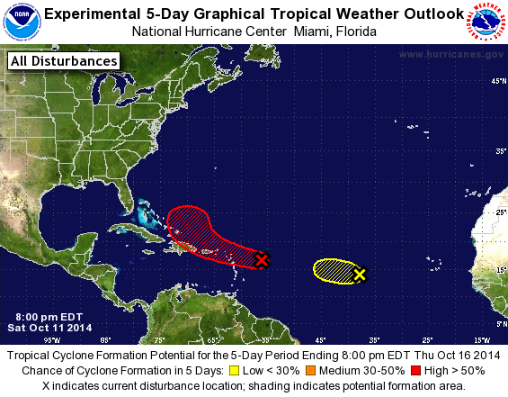
Tropical Outlook
5-Day Formation Potential
Formation potential during the next 5 days
Initial location of disturbance (X) indicated
Shading represents potential formation area
What’s the chance this area
forms during the next 5 days?

Slide 8
Special Tropical Outlook
Significant or unexpected changes
SPECIAL TROPICAL WEATHER OUTLOOK
NWS NATIONAL HURRICANE CENTER MIAMI FL
430 PM EDT MON JUN 30 2014
Special outlook issued to update discussion of the area of low
pressure east of Florida.
Updated: An Air Force Reserve unit reconnaissance aircraft is
investigating the area of low pressure centered about 110 miles east
of Melbourne, Florida. While the low is well defined, the
associated thunderstorm activity is just below the organizational
threshold required to initiate tropical cyclone advisories.
Environmental conditions continue to be favorable for development,
and only a slight increase in the organization and persistence of
the thunderstorm activity would result in the formation of a
tropical depression.
Data from the reconnaissance aircraft indicate that peak sustained
winds with the low are about 30-35 mph. The low is moving
southwestward at around 5 mph, but is expected to turn westward
tonight and northward by Wednesday when it will be near the east
coast of Florida. If this system becomes a tropical cyclone, a
tropical storm watch could be required for portions of the central
or northern Atlantic coast of Florida. A turn toward the northeast
near the southeastern U.S. coast is expected by Thursday.
* Formation chance through 48 hours...high...80 percent.
* Formation chance through 5 days...high...80 percent.
$$
Forecaster Franklin
What is it issued for?

Slide 9
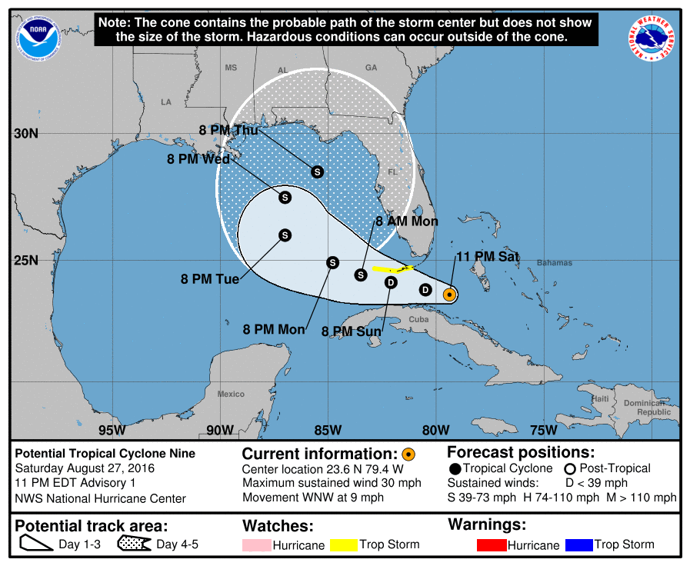
There is a Storm.
Potential, Post-, Tropical Cyclones
  Tropical Cyclones
  - Tropical Depressions
  - Tropical Storms
  - Hurricanes
  Post-Tropical Cyclones
  Pose a threat to land
  (e.g., Sandy & Hermine)
  Potential Tropical Cyclones
  - Systems not yet a tropical cyclone
  - Threat of TS-force winds to land within 48 hours. (New for 2017)
Potential Tropical Cyclone Advisory
example from Pre-Hermine (2016)

Slide 10
Public Advisory
Location. Strength. Hazards. Warnings.
HURRICANE ISAAC ADVISORY NUMBER 34
NWS NATIONAL HURRICANE CENTER MIAMI FL AL092012
1000 AM CDT WED AUG 29 2012
... ISAAC DRENCHING SOUTHEASTERN LOUISIANA...DANGEROUS STORM SURGE
AND FLOOD THREAT FROM HEAVY RAINS LIKELY TO CONTINUE THROUGH
TONIGHT...
SUMMARY OF 1000 AM CDT...1500 UTC...INFORMATION
-----------------------------------------------
LOCATION...29.6N 90.7W
ABOUT 0 MI...0 KM N OF HOUMA LOUISIANA
ABOUT 45 MI...75 KM SW OF NEW ORLEANS LOUISIANA
MAXIMUM SUSTAINED WINDS...75 MPH...120 KM/H
PRESENT MOVEMENT...NW OR 310 DEGREES AT 6 MPH...9 KM/H
MINIMUM CENTRAL PRESSURE...972 MB...28.70 INCHES
WATCHES AND WARNINGS
--------------------
CHANGES WITH THIS ADVISORY...
The Tropical Storm Warning has been discontinued east of the
Alabama-Florida border.
SUMMARY OF WATCHES AND WARNINGS IN EFFECT...
A HURRICANE WARNING IS IN EFFECT FOR...
* EAST OF MORGAN CITY LOUISIANA TO THE MISSISSIPPI-ALABAMA BORDER...
INCLUDING METROPOLITAN NEW ORLEANS...LAKE PONTCHARTRAIN...AND LAKE
MAUREPAS
A HURRICANE WATCH IS IN EFFECT FOR...
* INTRACOASTAL CITY TO MORGAN CITY LOUISIANA
A TROPICAL STORM WARNING IS IN EFFECT FOR...
* EAST OF THE MISSISSIPPI-ALABAMA BORDER TO THE ALABAMA-FLORIDA
BORDER
* MORGAN CITY TO SABINE PASS TEXAS
A TROPICAL STORM WATCH IS IN EFFECT FOR...
* EAST OF HIGH ISLAND TEXAS TO JUST WEST OF SABINE PASS
FOR STORM INFORMATION SPECIFIC TO YOUR AREA...PLEASE MONITOR
PRODUCTS ISSUED BY YOUR LOCAL NATIONAL WEATHER SERVICE FORECAST
OFFICE.
SPECIAL TROPICAL WEATHER OUTLOOK
NWS NATIONAL HURRICANE CENTER MIAMI FL
430 PM EDT MON JUN 30 2014
Special outlook issued to update discussion of the area of low
pressure east of Florida.
Updated: An Air Force Reserve unit reconnaissance aircraft is
investigating the area of low pressure centered about 110 miles east
of Melbourne, Florida. While the low is well defined, the
associated thunderstorm activity is just below the organizational
threshold required to initiate tropical cyclone advisories.
Environmental conditions continue to be favorable for development,
and only a slight increase in the organization and persistence of
the thunderstorm activity would result in the formation of a
tropical depression.
Data from the reconnaissance aircraft indicate that peak sustained
winds with the low are about 30-35 mph. The low is moving
southwestward at around 5 mph, but is expected to turn westward
tonight and northward by Wednesday when it will be near the east
coast of Florida. If this system becomes a tropical cyclone, a
tropical storm watch could be required for portions of the central
or northern Atlantic coast of Florida. A turn toward the northeast
near the southeastern U.S. coast is expected by Thursday.
* Formation chance through 48 hours...high...80 percent.
* Formation chance through 5 days...high...80 percent.
$$
Forecaster Franklin
Plain-language text
Originally intended as “rip and read”
miXeD-caSe in 2015

Slide 11
Forecast Advisory
Position. Size. Radii. Intensity.
HURRICANE ISAAC FORECAST/ADVISORY NUMBER 34
NWS NATIONAL HURRICANE CENTER MIAMI FL AL092012
1500 UTC WED AUG 29 2012
THE TROPICAL STORM WARNING HAS BEEN DISCONTINUED EAST OF THE
ALABAMA-FLORIDA BORDER.
SUMMARY OF WATCHES AND WARNINGS IN EFFECT...
A HURRICANE WARNING IS IN EFFECT FOR...
* EAST OF MORGAN CITY LOUISIANA TO THE MISSISSIPPI-ALABAMA BORDER...
INCLUDING METROPOLITAN NEW ORLEANS...LAKE PONTCHARTRAIN...AND LAKE
MAUREPAS
HURRICANE CENTER LOCATED NEAR 29.6N 90.7W AT 29/1500Z
POSITION ACCURATE WITHIN 15 NM
PRESENT MOVEMENT TOWARD THE NORTHWEST OR 310 DEGREES AT 5 KT
ESTIMATED MINIMUM CENTRAL PRESSURE 972 MB
MAX SUSTAINED WINDS 65 KT WITH GUSTS TO 80 KT.
64 KT....... 30NE 40SE 0SW 0NW.
50 KT....... 80NE 70SE 40SW 40NW.
34 KT.......150NE 150SE 140SW 100NW.
12 FT SEAS..180NE 240SE 90SW 0NW.
WINDS AND SEAS VARY GREATLY IN EACH QUADRANT. RADII IN NAUTICAL
MILES ARE THE LARGEST RADII EXPECTED ANYWHERE IN THAT QUADRANT.
Only source for all
the forecast data
HURRICANE ISAAC ADVISORY NUMBER 34
NWS NATIONAL HURRICANE CENTER MIAMI FL AL092012
1000 AM CDT WED AUG 29 2012
... ISAAC DRENCHING SOUTHEASTERN LOUISIANA...DANGEROUS STORM SURGE
AND FLOOD THREAT FROM HEAVY RAINS LIKELY TO CONTINUE THROUGH
TONIGHT...
SUMMARY OF 1000 AM CDT...1500 UTC...INFORMATION
-----------------------------------------------
LOCATION...29.6N 90.7W
ABOUT 0 MI...0 KM N OF HOUMA LOUISIANA
ABOUT 45 MI...75 KM SW OF NEW ORLEANS LOUISIANA
MAXIMUM SUSTAINED WINDS...75 MPH...120 KM/H
PRESENT MOVEMENT...NW OR 310 DEGREES AT 6 MPH...9 KM/H
MINIMUM CENTRAL PRESSURE...972 MB...28.70 INCHES
WATCHES AND WARNINGS
--------------------
CHANGES WITH THIS ADVISORY...
The Tropical Storm Warning has been discontinued east of the
Alabama-Florida border.
SUMMARY OF WATCHES AND WARNINGS IN EFFECT...
A HURRICANE WARNING IS IN EFFECT FOR...
* EAST OF MORGAN CITY LOUISIANA TO THE MISSISSIPPI-ALABAMA BORDER...
INCLUDING METROPOLITAN NEW ORLEANS...LAKE PONTCHARTRAIN...AND LAKE
MAUREPAS
A HURRICANE WATCH IS IN EFFECT FOR...
* INTRACOASTAL CITY TO MORGAN CITY LOUISIANA
A TROPICAL STORM WARNING IS IN EFFECT FOR...
* EAST OF THE MISSISSIPPI-ALABAMA BORDER TO THE ALABAMA-FLORIDA
BORDER
* MORGAN CITY TO SABINE PASS TEXAS
A TROPICAL STORM WATCH IS IN EFFECT FOR...
* EAST OF HIGH ISLAND TEXAS TO JUST WEST OF SABINE PASS
FOR STORM INFORMATION SPECIFIC TO YOUR AREA...PLEASE MONITOR
PRODUCTS ISSUED BY YOUR LOCAL NATIONAL WEATHER SERVICE FORECAST
OFFICE.
SPECIAL TROPICAL WEATHER OUTLOOK
NWS NATIONAL HURRICANE CENTER MIAMI FL
430 PM EDT MON JUN 30 2014
Special outlook issued to update discussion of the area of low
pressure east of Florida.
Updated: An Air Force Reserve unit reconnaissance aircraft is
investigating the area of low pressure centered about 110 miles east
of Melbourne, Florida. While the low is well defined, the
associated thunderstorm activity is just below the organizational
threshold required to initiate tropical cyclone advisories.
Environmental conditions continue to be favorable for development,
and only a slight increase in the organization and persistence of
the thunderstorm activity would result in the formation of a
tropical depression.
Data from the reconnaissance aircraft indicate that peak sustained
winds with the low are about 30-35 mph. The low is moving
southwestward at around 5 mph, but is expected to turn westward
tonight and northward by Wednesday when it will be near the east
coast of Florida. If this system becomes a tropical cyclone, a
tropical storm watch could be required for portions of the central
or northern Atlantic coast of Florida. A turn toward the northeast
near the southeastern U.S. coast is expected by Thursday.
* Formation chance through 48 hours...high...80 percent.
* Formation chance through 5 days...high...80 percent.
$$
Forecaster Franklin
Watches and Warnings
Data is used in HURREVAC and other commercial tracking software

Slide 12
Forecast Discussion
Confidence. Scenarios. Key Concerns.
HURRICANE JOAQUIN DISCUSSION NUMBER 15
NWS NATIONAL HURRICANE CENTER MIAMI FL AL112015
1100 AM EDT THU OCT 01 2015
An Air Force Reserve Hurricane Hunter aircraft reported 700-mb flight-level winds of 119 kt in the northwestern eyewall, with a 117 kt surface wind estimate from the Stepped Frequency Microwave Radiometer in the southwestern eyewall. The latest central pressure was 942 mb. Based on these data, the advisory intensity is increased to 110 kt. Satellite imagery indicates that an eye is trying to form in the central dense overcast, and that the cirrus outflow is good in all directions. Joaquin is expected to intensify a little more in the next 12 to 24 hours as it remains over very warm waters and in an environment of decreasing vertical shear. After that time, there could be some fluctuations in intensity due to eyewall replacement cycles. There is some uncertainty in the intensity forecast in the 48-96 hour period. The statistical models suggest that Joaquin should weaken due to increasing shear. However, several of the global models forecast the hurricane to move into an area of strong upper-level divergence and show a falling central pressure. The new forecast will continue to show weakening during this time, but it would not be a surprise if it is stronger than currently forecast. The initial motion is 220/5. Water vapor imagery shows a mid- to upper-level ridge north of the hurricane, with a developing deep-layer trough over the eastern and southeastern United States. The dynamical models forecast this trough to become a cut-off low as it moves southeastward and weakens the ridge. This pattern evolution should cause Joaquin to turn northwestward in 24 hours or so and then turn northward. After 36 hours, the guidance remains very divergent. The Canadian, GFDL, HWRF, and NAVGEM models forecast Joaquin to turn northwestward and make landfall over the Carolinas and mid-Atlantic States. The ECMWF continues to forecast a slower northeastward motion taking Joaquin near Bermuda and out to sea. The UKMET and GFS are in between these extremes showing a generally northward motion. Given the spread and the possibility that the 1200 UTC guidance could show additional changes, the forecast track after 36 hours is nudged only slightly to the east at this time. The new track lies to the east of the landfalling models, but to the west of the GFS, UKMET, ECMWF, and the various consensus models. Further adjustments to the track may be needed later today depending on how the models do (or do not) change.
KEY MESSAGES:
1. Preparations to protect life and property in the central Bahamas should be complete. The slow motion of Joaquin over the next day or so will bring a prolonged period of hurricane force winds, storm surge, and very heavy rainfall to those islands.
2. Confidence in the details of the forecast after 72 hours is still low, since there have been some large changes in the model guidance overnight and a large spread in the model solutions remains, with potential impacts from the Carolinas through New England. It is also possible that Joaquin will remain far from the U.S. east coast. A hurricane watch for the U.S. coast would likely not occur until at least Friday morning.
3. Efforts to provide the forecast models with as much data as possible continue, with twice daily NOAA G-IV jet missions in the storm environment, and extra NWS balloon launches.
4. It's too early to talk about specific wind, rain, or surge impacts from Joaquin in the United States. Regardless of Joaquin's track, strong onshore winds will create minor to moderate coastal flooding along the coasts of the mid-Atlantic and northeastern states through the weekend.
5. Many portions of the eastern U.S. are currently experiencing heavy rains and gusty winds associated with a frontal system. These heavy rains are likely to continue for the next few days, even if the center of Joaquin stays offshore. The resulting inland flood potential could complicate preparations for Joaquin should it head toward the coast, and even more substantial inland flooding is possible if Joaquin later passes near or over these same areas.
FORECAST POSITIONS AND MAX WINDS
INIT 01/1500Z 23.0N 73.9W 110 KT 125 MPH
12H 02/0000Z 22.9N 74.2W 115 KT 130 MPH
24H 02/1200Z 23.7N 74.6W 120 KT 140 MPH
36H 03/0000Z 25.2N 74.4W 120 KT 140 MPH
48H 03/1200Z 27.5N 73.7W 110 KT 125 MPH
72H 04/1200Z 32.0N 73.0W 95 KT 110 MPH
96H 05/1200Z 36.0N 73.5W 75 KT 85 MPH
120H 06/1200Z 40.0N 72.5W 55 KT 65 MPH
$$
Forecaster Beven
Forecast reasoning
Relevant Observations
Model Guidance
Forecast Uncertainties

Slide 13
Tropical Cyclone Update
Unexpected Changes. Location. Landfall.
HURRICANE ISAAC TROPICAL CYCLONE UPDATE
NWS NATIONAL HURRICANE CENTER MIAMI FL AL092012
1100 AM CDT WED AUG 29 2012
...ISAAC CONTINUES TO MOVE SLOWLY OVER SOUTHEASTERN LOUISIANA... HEAVY SQUALLS LASHING NEW ORELANS AND THE MISSISSIPPI COAST...
At 1100 am CDT...1600 UTC...The center of hurricane Isaac was
Estimated near latitude 29.6 north...Longitude 90.7 west...Or very
Near Houma Louisiana...And about 45 miles southwest of New Orleans
Louisiana. Isaac is moving toward the northwest near 6 mph...9
Km/h and this general motion is expected to continue through tonight.
A gust to 67 mph was recently reported at Shell Beach, Louisiana.
Tropical storm conditions continue along the Mississippi and
Alabama coasts.
SUMMARY OF 1100 AM CDT...1600 UTC...INFORMATION
--------------------------------------------------
LOCATION...29.6N 90.7W
ABOUT 1 MI...2 KM W OF HOUMA LOUISIANA
ABOUT 45 MI...75 KM SW OF NEW ORLEANS LOUISIANA
MAXIMUM SUSTAINED WINDS...75 MPH...120 KM/H
PRESENT MOVEMENT...NW OR 310 DEGREES AT 6 MPH...9 KM/H
MINIMUM CENTRAL PRESSURE...972 MB...28.70 INCHES
$$
FORECASTER STEWART/BEVEN/ZELINSKY
NNNN
Unexpected changes
occur in the cyclone
Cyclone landfall
Issuing international
watches and warnings
1-hourly position estimates when a cyclone with an eye is nearing land

Slide 14
There is a storm.
Where is the greatest concern?
When will the hazards begin?
Watches and Warnings

Slide 15
Watches & Warnings
Where. When. What. Action.
Storm Surge Watch
  There is the possibility of life-threatening inundation from rising water moving inland from the shoreline somewhere within the specified area, generally within
  48 hours.
Storm Surge Warning
  There is a danger of life-threatening inundation from rising water moving inland from the shoreline somewhere within the specified area, generally within 36 hours.

Slide 16
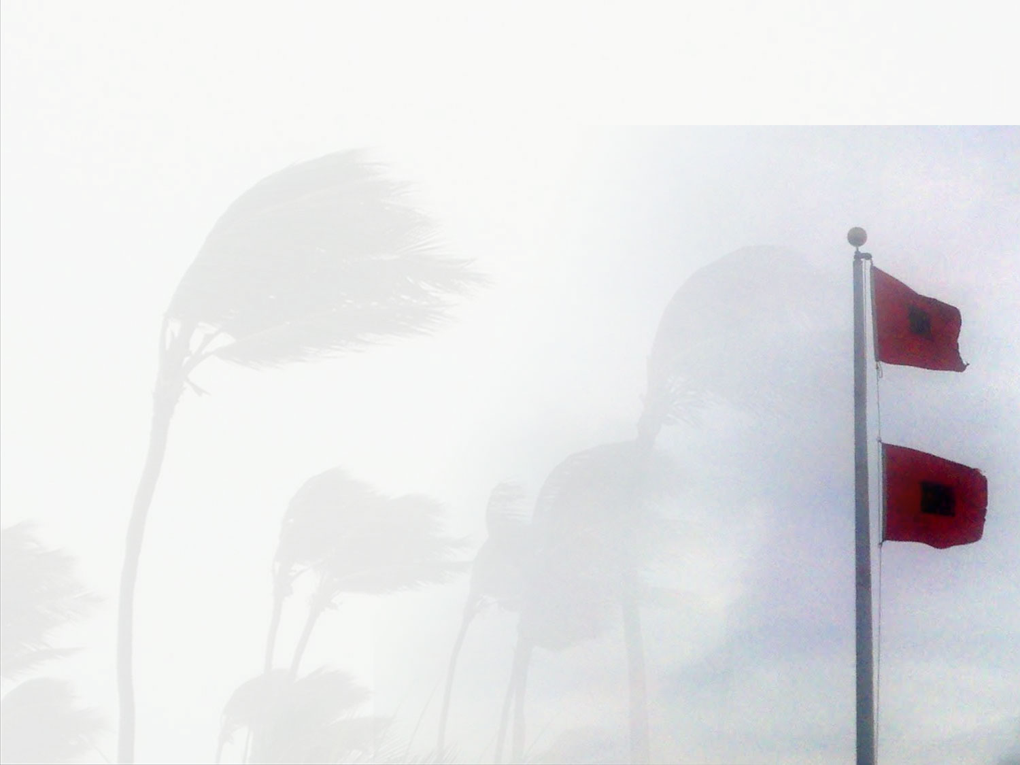

Watches & Warnings
Where. When. What. Action.
Hurricane Watch
  Hurricane conditions are possible within the watch area, generally within 48 hours
Hurricane Warning
  Hurricane conditions are expected within the warning area, generally within 36 hours
Note: The lead time for Hurricane Watches and Warnings is tied to the anticipated arrival time of tropical-storm-force winds

Slide 17
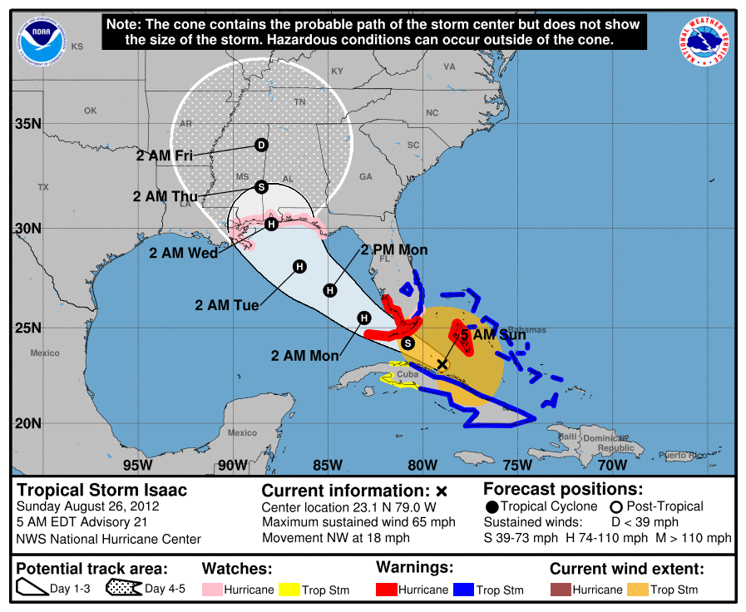
5 Day – Forecast Cone
Probable Track. Watches. Warnings.

Slide 18
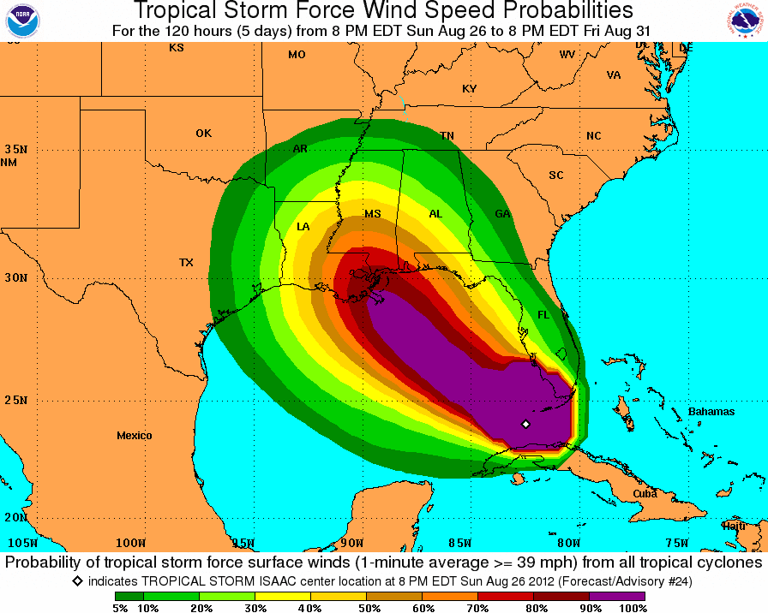
Wind Speed Probabilities
How Likely. Arrival Times. Inland Threat
Depicts location-specific probabilities
Tropical-storm-force
58 mph
Hurricane-force

Slide 19
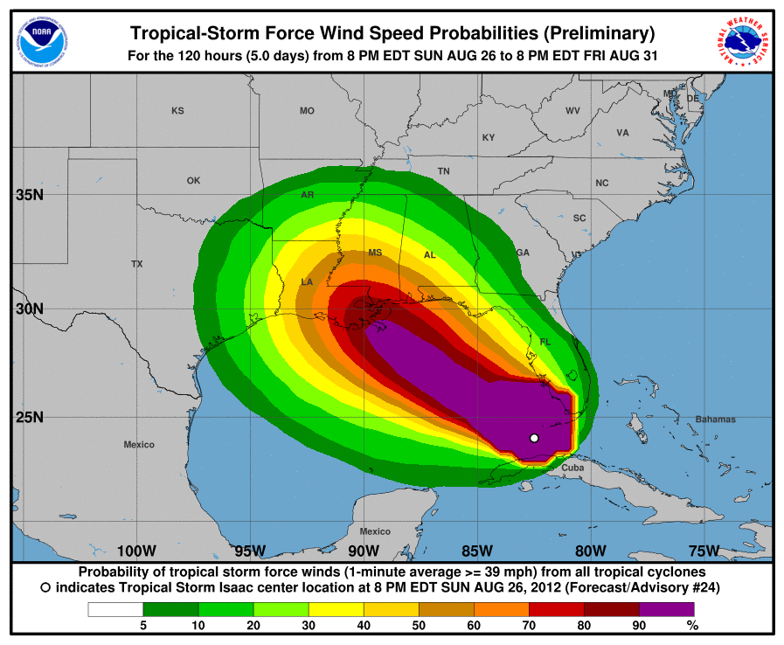
Wind Speed Probabilities
How Likely. Arrival Times. Inland Threat
Depicts location-specific probabilities
Tropical-storm-force
58 mph
Hurricane-force

Slide 20
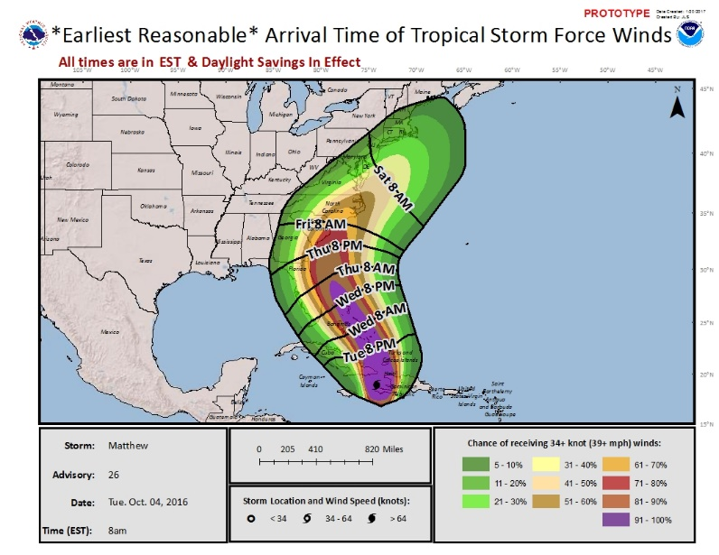
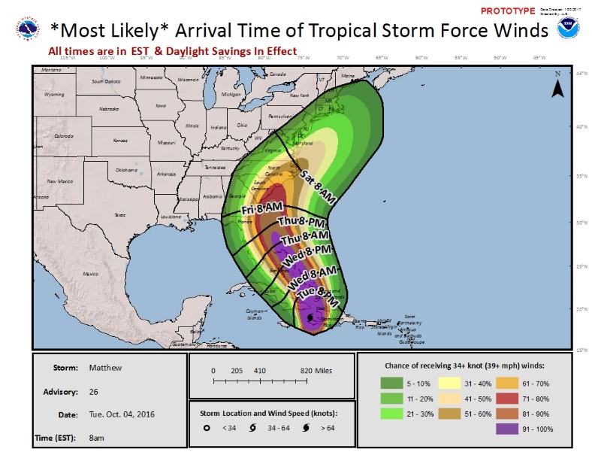
Time of Arrival Graphic
Timing of Onset of TS-force winds
Earliest reasonable (10%) onset
Depicts the time window that one can safely assume will be free from TS-force winds
Most likely (50%) onset
Depicts the time before or after which the onset is equally likely
Accounts for track, intensity, and size uncertainties.

Slide 21
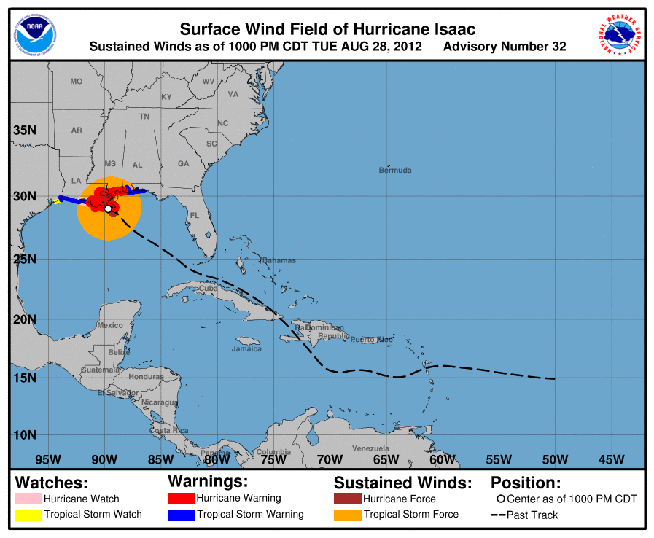
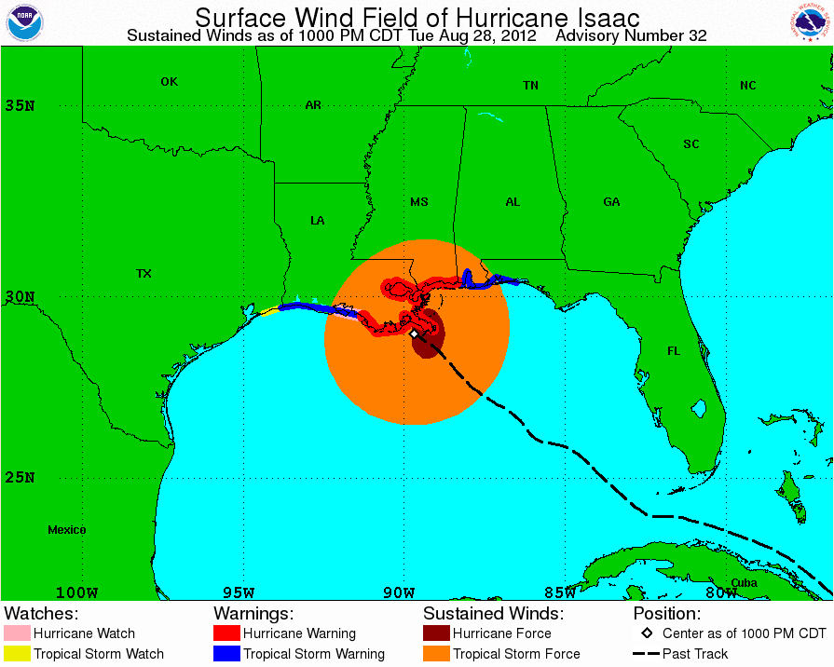
Surface Wind Field
Size. Watches. Warnings.
Wind field
Past track
Current watches & warnings

Slide 22
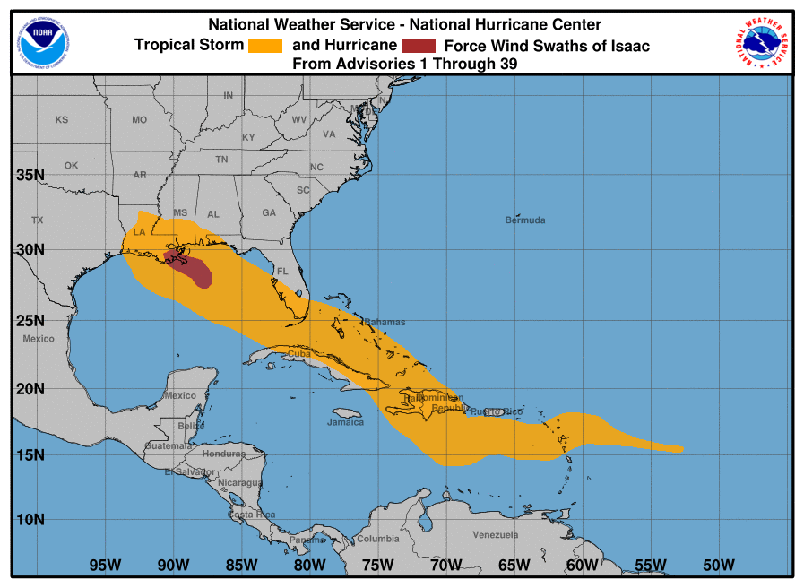
Cumulative Wind History
Areas Affected
Areas potentially affected by the Tropical Cyclone
(through that advisory)
Tropical Storm
(in orange)
Hurricane
(in red)

Slide 23
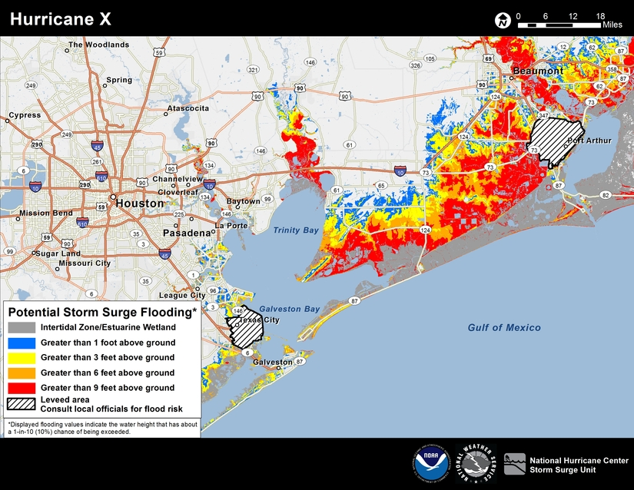
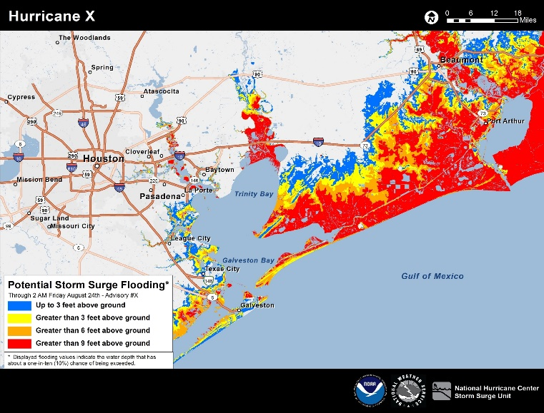
Storm Surge
Potential Inundation Graphic

Slide 24

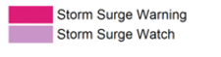
NHC Tropical Cyclone
Advisory Products
Storm Surge Warning
Graphic

Slide 25
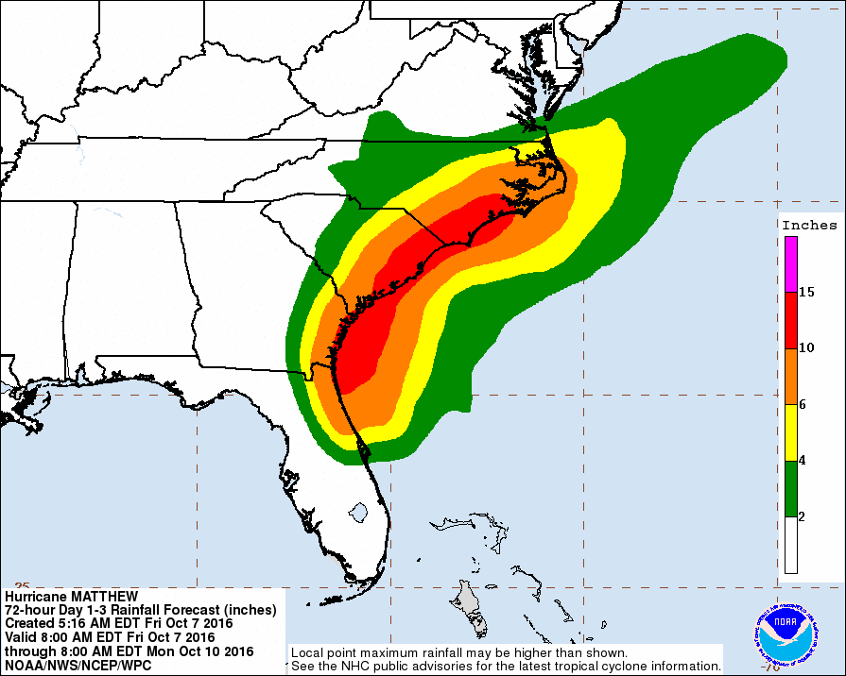
NHC Tropical Cyclone
Advisory Products
U.S. Rainfall Potential
Weather Prediction Center

Slide 26
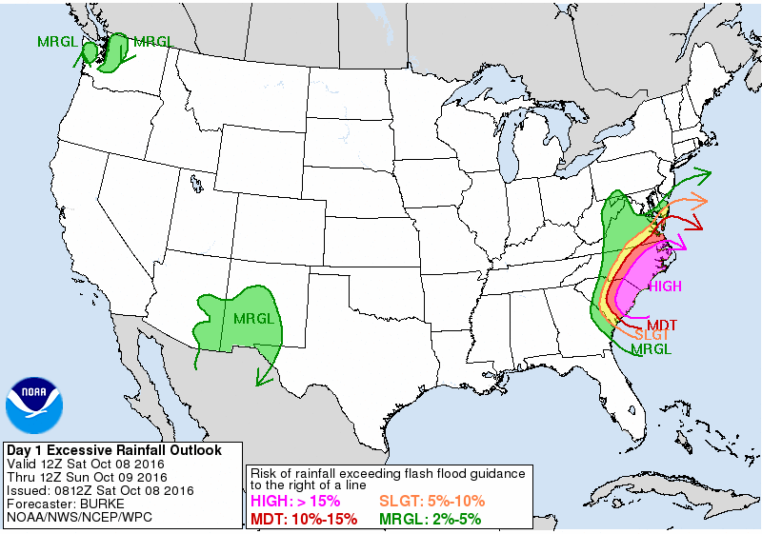
NHC Tropical Cyclone
Advisory Products
Excessive Rainfall
Weather Prediction Center

Slide 27

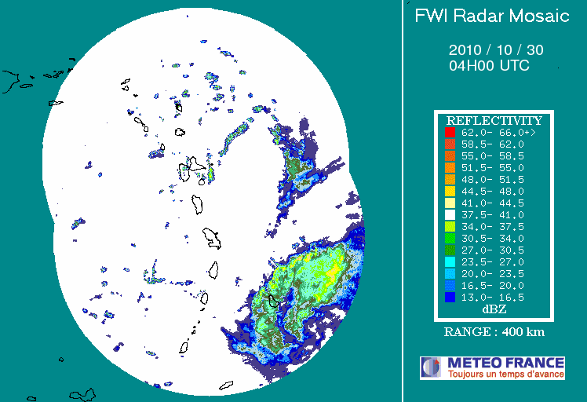
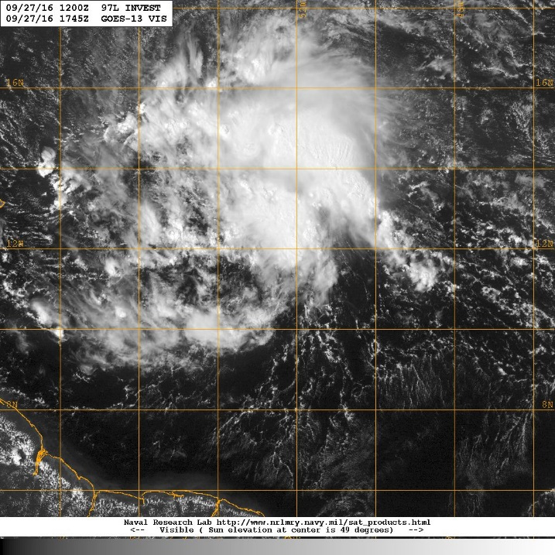
Watches and Warnings Before Tropical Cyclone Formation
NHC has the option to issue advisories, watches, and warnings for disturbances that are not yet a tropical cyclone but which pose a threat of bringing tropical storm or hurricane conditions to land within 48 hours.
Regular Tropical Storm and Hurricane Watch and Warning criteria would apply
  Watch – conditions possible within 48 h
  Warning – conditions expected within 36 h
Systems would be identified as Potential Tropical Cyclones
  Same numbering system as depressions – “One”, “Two”, etc.
Tomas 2010
Pre-Matthew 2016

Slide 28
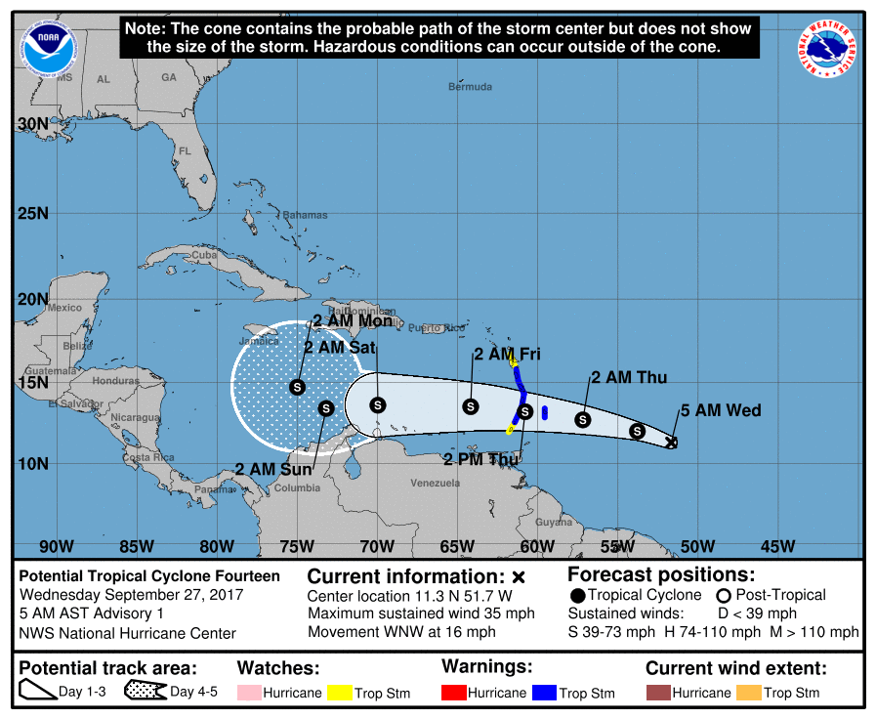
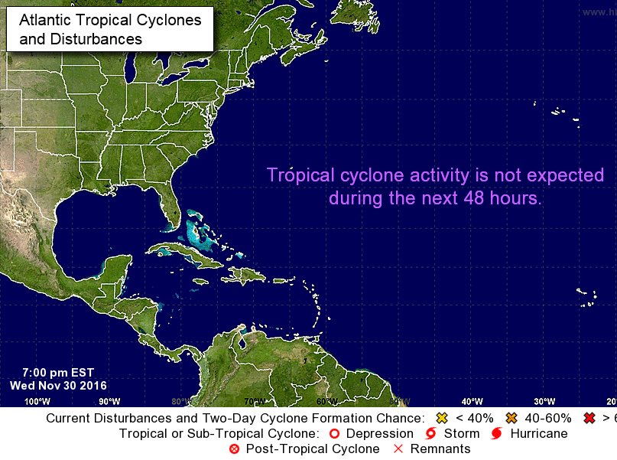
Watches and Warnings Before Tropical Cyclone Formation
Accompanied by the standard suite of NHC advisory products at standard advisory times
  Public Advisory (including Intermediates)
  Forecast Advisory
  Discussion
  Wind Speed Probabilities
  Cone graphic
  Storm surge products, as needed
Genesis probabilities will appear in both the Tropical Weather Outlook and the Public Advisory.
The Graphical TWO will no longer display a formation area for these systems, to avoid confusion with the (now available) 5-day track forecast and cone graphic.
Fourteen
X

Slide 29
Watches and Warnings Before Tropical Cyclone Formation
Issued only for systems threatening land within the watch/warning time frame.
Advisory packages will be discontinued when watches and warnings are no longer necessary. This could result in occasional gaps in product issuance when the threat is not imminent.
POTENTIAL TROPICAL CYCLONE ONE PUBLIC ADVISORY NUMBER 1
NWS NATIONAL HURRICANE CENTER MIAMI FL AL012016
400 PM CDT WED JUN 5 2016
...TROPICAL DISTURBANCE OVER THE EAST-CENTRAL GULF OF MEXICO EXPECTED TO BECOME A TROPICAL STORM...
...TROPICAL STORM WARNING ISSUED FOR PORTIONS OF THE WEST COAST OF FLORIDA...
SUMMARY OF 400 PM CDT...2100 UTC...INFORMATION
-----------------------------------------------
LOCATION...25.3N 86.5W
ABOUT 310 MI...500 KM SW OF TAMPA
ABOUT 320 MI...510 KM SSW OF APALACHICOLA FLORIDA
MAXIMUM SUSTAINED WINDS...35 MPH...55 KM/H
PRESENT MOVEMENT...N OR 360 DEGREES AT 3 MPH...6 KM/H
MINIMUM CENTRAL PRESSURE...1010 MB...29.92 INCHES
WATCHES AND WARNINGS
--------------------
CHANGES WITH THIS ADVISORY...
A Tropical Storm Warning has been issued fro the west coast of Florida from Boca Grande to Ochlockonee River.
SUMMARY OF WATCHES AND WARNINGS IN EFFECT...
A Tropical Storm Warning is in effect for...
* The west coast of Florida from Boca Grande to Ochlocknee River
A Tropical Storm Warning means that tropical storm conditions are expected somewhere within the warning

Slide 30
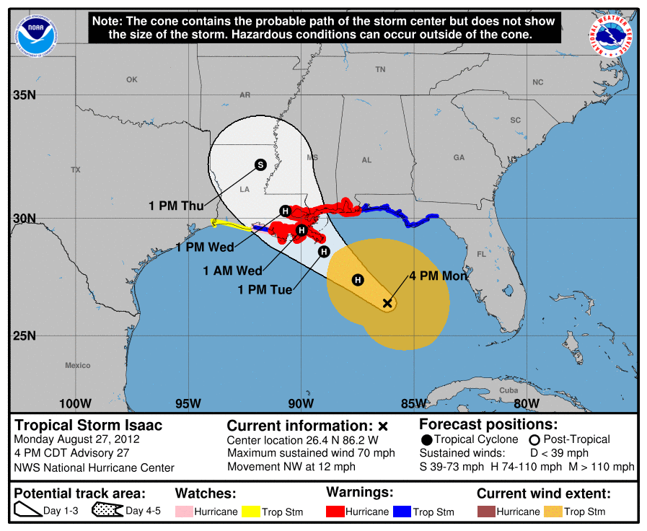
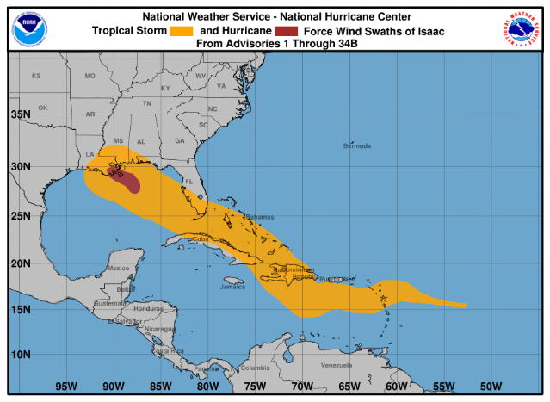
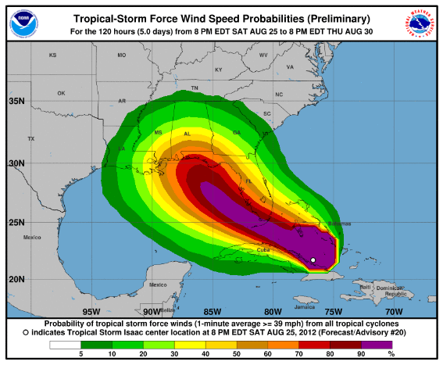
Update to NHC Graphical Products
NHC will be updating the look of its tropical cyclone advisory graphics.
Graphics suite will have consistent background maps and colors and a “cleaner” look and feel.
Storm size information (initial wind field) can now be toggled onto the cone graphic. This will reinforce that hazardous conditions occur outside the cone.

Slide 31
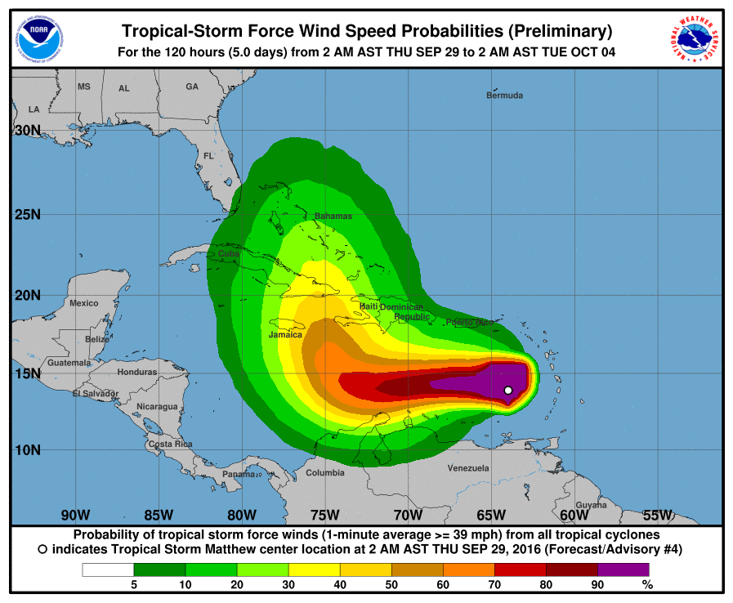
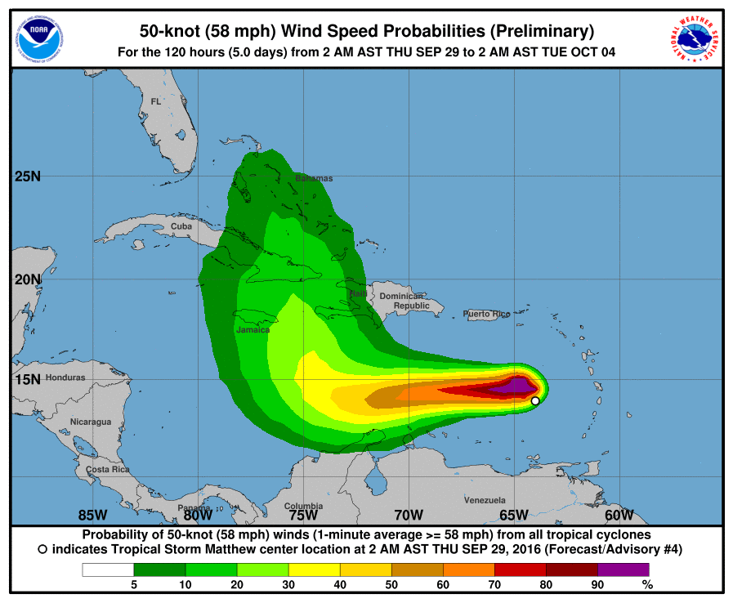
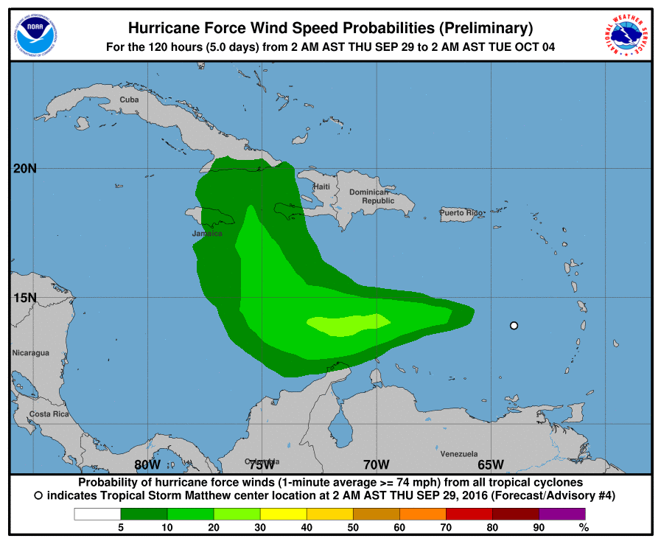
NHC Tropical Cyclone
Advisory Products
Wind Speed Probabilities
How Likely. Arrival Times. Inland Threat
Graphics depicts location-specific cumulative probabilities of tropical-storm-force, 50-kt, and hurricane-force winds.

