Slide 1
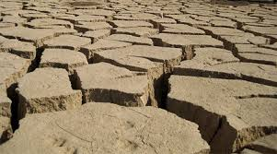
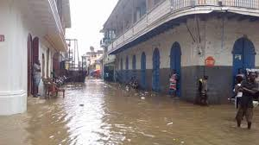
MARNDR
Capacities, weaknesses and expectations
of the NMHS of Haiti (UHM Unité HydroMétéorologique)
with regards to severe weather
and
Early Warning System (EWS)
Presented by Marcelin ESTERLIN, UHM/Deputy Director

Slide 2
Plan
1- Context
2- Capacities in observation
3- Capacities in forecast
* Flash Flood Guidance System
* WRF for Haiti
4- Capacities for service delivery
5- Technical Assistance Package (WMO-Canada project)
6- Haitian MH-EWS
7- Expectations within the SWFDP
MARNDR

Slide 3
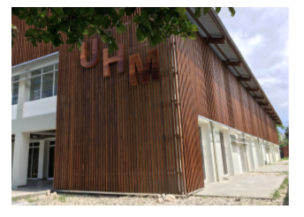
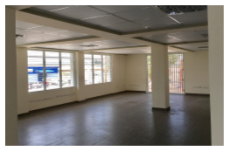
Contexte
MARNDR
Staff of UHM :
2 deputy directors, 1 with meteorological background & competences, 1 with hydrological background & competences
6 forecasters, on shift (14h/24 x 7 ...24 x7 if needed)
12 weather and hydro observers,
2 hydrologists,
3 climatologists with database competences,
2 technicians for IT and maintenance
Housing & Equipments :
New building... almost operational (WMO-Canada)
Only a « slow » internet connexion currently working
(no dedicated line) + 1 with Fixed IP to be re-opened
Only regular PCs with Internet access (no workstation)

Slide 4
Observation
Real-time human observations + assistance for aviation at Port-au-Prince (2 AWS) and Cap Haïtien (1 AWS) international airports (but no direct link to GTS/WIGOS/WIFS)
3 other AWS at national airport (Jérémie, Cayes, Jacmel) with challenges for maintenance.
(Note : All these complete AWS were donated to Haiti by WMO after the 2010 earthquake)
Automated data collection system via GSM (in collaboration with INSMET of Cuba)...currently only available at the forecast office (no external access, not displayed on the website)
Secondary network owned by other institutions (raingauges) with difficult access/consultation in real time (20 sites)
MARNDR

Slide 5
Forecast
No workstation or system for expertise and no direct link with the GTS/WIFS ...the forecasters relie on websites (Extranet SHERPA Meteo-France, NOAA (NHC, NCEP,), Haiti public web site for imagery (Canada), CIMH, FFGS, …)
No radar, poor real time obs network and no coastal sea station (buoys or waveriders) for nowcasting and monitoring.
No inhouse capacities/competencies to run local models.
But ...
MARNDR
.

Slide 6
Forecast...ctnd
1- A specific FFGS (Flash Flood Guidance System) developped (NOAA/HRCwith WMO ) for Haiti and Dom Rep
→ Integrated tool/system that combines obs, forecast and help for decision making/warning) up to 24h lead time. (cf next slide)
2- A new nested HRF regional model centered on Haiti is under progress thnaks to Cuban leadership and expertise under a WFP project (cf next slide)
3- And the implementation on the Technical Assistance Package on the WMO/Canada project
MARNDR
.

Slide 7
Le Flash Flood Guidance System (FFGS)
MARNDR
The primary goal of the FFGS (developed by the Hydrologic Research Center of San Diego ) is to provide operational forecasters and DRM agencies with real-time informational guidance products pertaining to the threat of small-scale flash flooding throughout a specified region.The FFGS provides the necessary products to support the development of warnings for flash floods from rainfall events through the use of remote-sensed precipitation (radar and satellite-based rainfall estimates) and hydrologic models.
2 Haitians forecasters have been intensively trained on-line (COMET) and recently in San Diego (one month)
The current calibration has been possible only with obs from DomRep. A next step will consist in runing a calibration with obs in Haiti

Slide 8
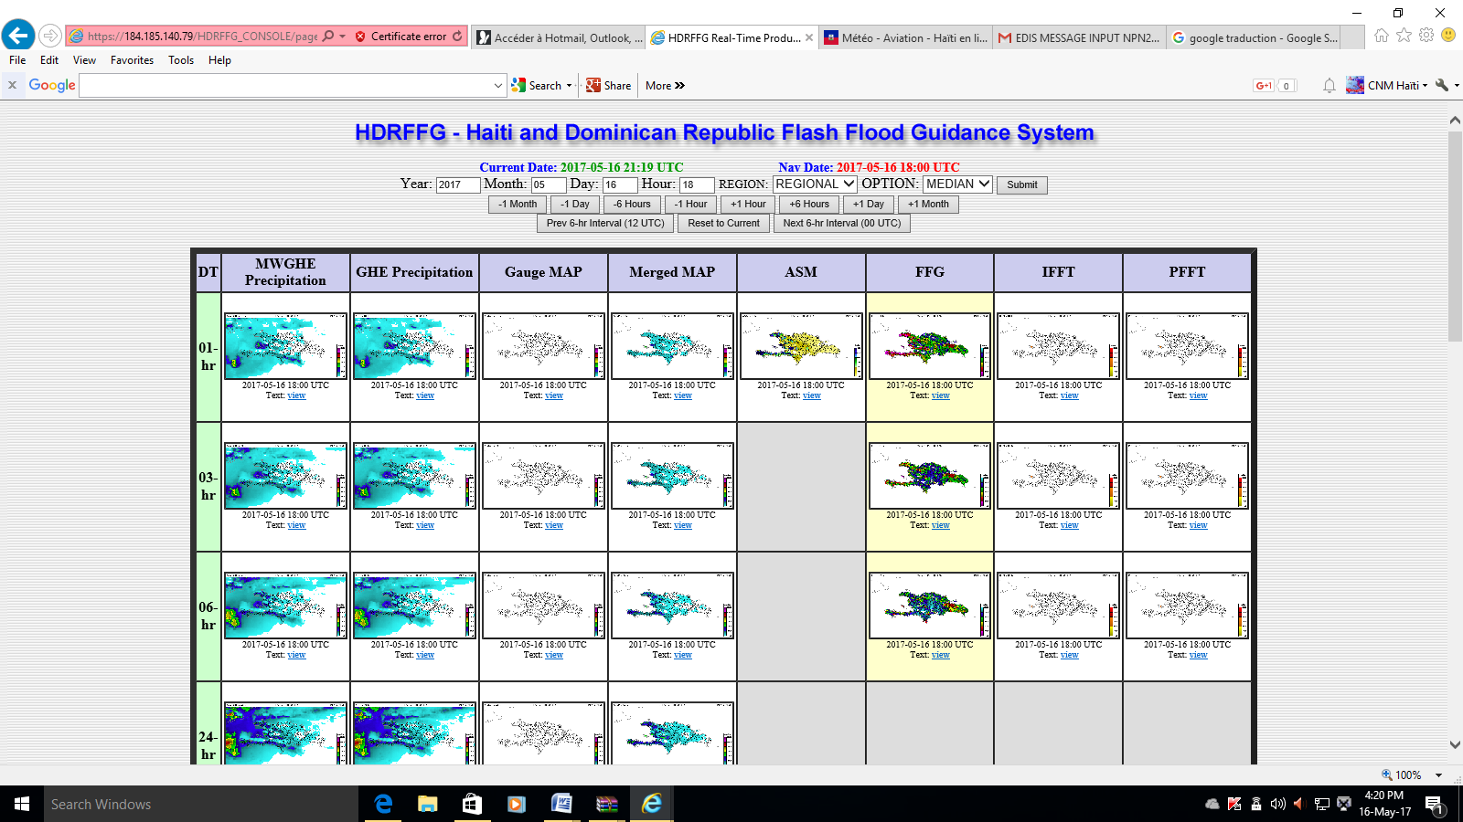
HRD-FFGS main menu
MARNDR

Slide 9
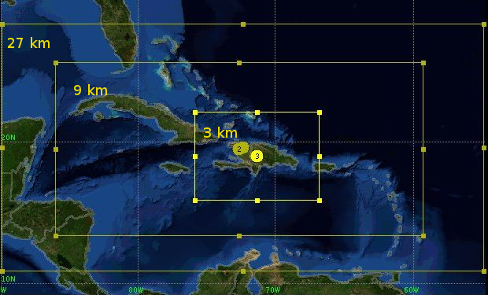
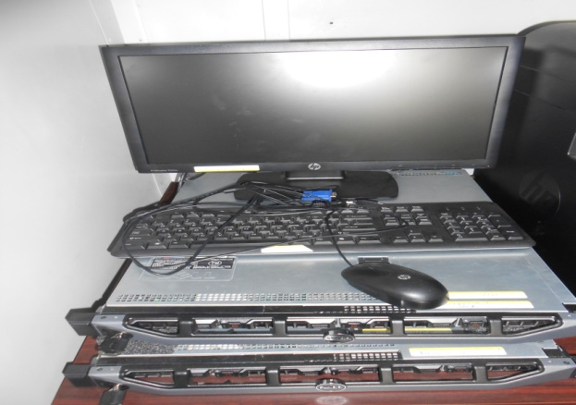
WRF(SisPi) model for Haiti
MARNDR
3 nested domains
to deal with boundaries issues
2 servers installed
at the UHM
Training for IT staff
and forecasters in Cuba

Slide 10
Service delivery
MARNDR
.
No workstation or system for production and dissemination
→ production is based on « word documents » only (the remote access on Meteo-France MeteoFactory Server is no longer available due to internet issues)
→ dissemination (including aviation products) is made by email only (google account). The public Website managed by Canada also give access to bulletins and aviation messages.
Poor working/commercial arrangements with the media
Lack of SOP especially for EWS (cf next slide)

Slide 11
WMO-Canada-MARNDR Project for Climate services
Funding Agencies : Environnement Canada
Budget: CAD 6.5M
Time window : March 2012-March 2018
Objective: To strengthen the capabilities of weather and hydro services to enable them to provide services and issue early warning notices.
Goals : Governance (UHM), housing (new building), technical capacities (Technical Assistance Package ...cf next slide), Capacity building (training and qualification)
MARNDR
Project Manager : Juan Peña Fernández (Haïti)
Technical Adviser : Jean-Jean Noël Degrace National Project Director : Pierre Karly Jean Jeune (Haïti) Project Officer : Lina Sjaavik (OMM Genève)

Slide 12
WMO-Canada-MARNDR Project for Climate services
The TECHNICAL ASSISTANCE PACKAGE
MARNDR
Objective: To improve capacities in observing, forecasting and
service delivery
Time window : june 2017 – march 2018 (tender done, company selected)
Observation : synoptic network (6 to 8 complete AWS) with data collection system and multi-access (note : complementary World Bank Project for secunday networks, hydro network and database for climatology)
Forecast : Workstation for expertise with dedicated data flux (Obs, models, …)
Service delivery : system for aeronautical assistance, workstation for finalised products and multi-support dissemination

Slide 13
MH-EWS in Haiti
MARNDR
An embryo (no concrete/complete SOPs) of a national EWS for tropical cyclone has been developed in 2004 just after the catastrophic event of TS Jeanne (severals thousands fatalities in Gonaives and Fond-Verette) based on pre-existing Alerts from Civil Protection, RSMC Watch/warnings and MF color-coded vigilance
EWS developped at community level in the 2 impacted areas
Automated systems for flood warning were implemented but with no input from the NMHS, with no identified role and no coordination (no longer operational)
The embryo has grown with the inclusion of « heavy rainfall and consequences » as a danger apart from TC.

Slide 14
MH-EWS ...ctnd
MARNDR
The Haitian MH-EWS is under construction and needs to be upgraded, finalised (SOPs) and visible.
The main issues are
1- The cross-ministerial governance and coordination of actions
2- The governance of the UHM itself
3- National capacities and expertise National funding (Initiatives come from external funds within project)
4- Lack of visibility, credibility and knowledge about Socio-Economic-Benefits and return on investment

Slide 15
Expectations within the SWFDP
MARNDR
1- National capacity building (training)
2- Access to wide variety of NWP
3- Upgrade of the pre-existing Extranet (SHERPA) with more capacities (superposition, zoom, etc. )
4- Guidance maps and products with information useful for downscaling and identifying local threat.
5- Strengthening support from regional centers (coordination and advice in case of threat)
6- (a bit outside the scope but still very useful ) Sharing seasonal forecasts (+ training )

Slide 16
MESI ANPIL !
MARNDR

