Slide 1
Meteorological Department St. Maarten
Severe Weather Forecasting Demonstration Project (SWFDP)
Regional Subproject for RAIV (Eastern Caribbean)
Joseph Isaac
Department Head
NHC, Miami May 23 – 26, 2017

Slide 2
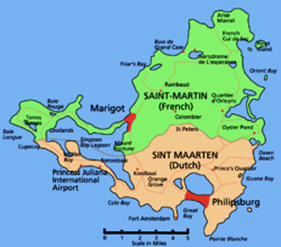
St. Martin/St. Maarten
The country of St Maarten is located in the extreme northeast section of the Eastern Caribbean.
It is part of an island which is approximately 37 square miles shared by two countries: French St. Martin to the north and Dutch St. Maarten to the south.
The Dutch side occupies 16 square miles.

Slide 3
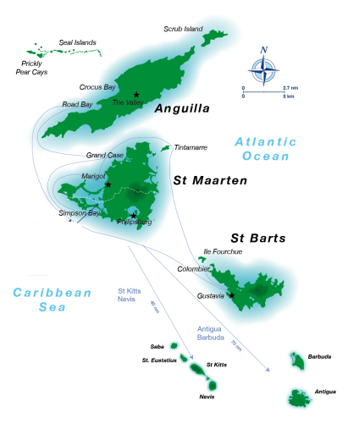
METEO FRANCE
MDS
METEO FRANCE
KMNI

Slide 4
About MDS
Vision Statement:
“Deliver services of high quality and accuracy
MISSION STATEMENT:
“Protect life and property through the issuance of timely and appropriate weather products for the adjacent waters, air space, the general public and provide meteorological, hydrological and seismological related services to specific sectors, in order to sustain social and economic developments..”

Slide 5
Operational Capacity Observing Stations
1 Synoptic and Upper air Observation Station.
2- AWS: 1 Vaisala & 1 Sutron - at the airport.
DAVIS Vantage Pro- Backup
1 manual rain gauge at the airport.

Slide 6
Operational Capacity….. Forecasting Capabilities
Forecasters use internet base NWP for forecasting. ( GFS, MeteoFrance, WRF, CMC, Earth.nullschool, Metlab)
Forecasters use one basic computer intenet often fluctuates.(8mbps)
There is no verification of forecasts at this time.

Slide 7
Operational Capacity Hazards
Flash Flooding
Storm Surge
Strong winds
Drought- Bush fires, high population of fish death due to lack of oxygen in ponds.

Slide 8
Operational Capacity Human Resource & Contingency Plan
Department head
5 Forecasters
6 Observers
1 Technician
NMC contingency plan

Slide 9
Service Delivery…. Forecast Dissemination
Website: www.meteosxm.com
Emails
Social media (facebook, twitter)
In the event of storms authorities are contacted via telephone.
Daily Newspaper

Slide 10
Service Delivery… Threshold for Warnings
 |  | SPECIAL BULLETINS
 | HAZARDS | Warning
1. | Small Craft | Expected within 6hrs – winds >33kts And/or waves >10 feet
2. | High Surf | Periods >15 seconds expected during the forecast period.
3. | Heavy Rainfall | Expected within 1 hr- 15mm/hr <Heavy rainfall< 25 mm/hr
4. | Severe Thunderstorms | Expected within 1hr- 15mm/hr <Heavy rainfall< 25 mm/hr, Lightning, 28kt < winds >34kts, funnel clouds.
5. | Severe Winds | Expected within 2 hr- 28kt < winds >34kts or 44 kts< Gusts <50kts.

Slide 11
Service Delivery…. User Feedback
There is no official feedback mechanism in place.
Prior to hurricane season forecasters do an awareness program with media. Interactive question and answer also pre recorded.

Slide 12
Service Delivery… SOPs
Standard Operating Procedure between ODM
SOP with Princess Juliana International Airport. (PJIAE)

Slide 13
Expectations from SWFDP-Eastern Caribbean.
Need access to the ECMWF Products
Training for forecasters
Training on new satellite GOES-R
Interactive forum for forecasters
Exchange programs SXM/METEO FRANCE
Split screen monitor.
Upgrade equipment
Rainfall network (St Maarten/ St Martin)

