Slide 1

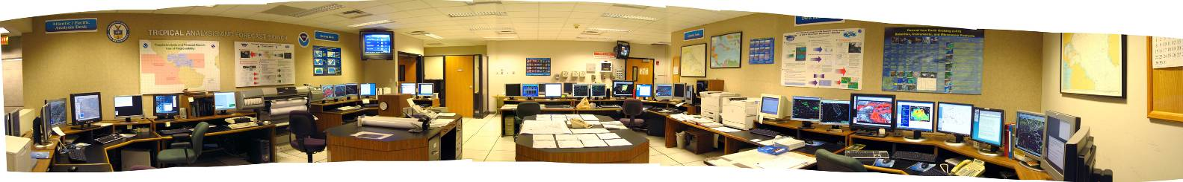
Tropical Analysis and Forecast Branch
Recent Advances in Marine Forecasts and Tropical Analysis
RA-IV Severe Weather Forecasting Demonstration Project (SWFDP) Workshop
May 23, 2017

Slide 2
Tropical Analysis and
Forecast Branch (TAFB)
Year round (24/7/365) products
  Marine forecasts (Gridded, Graphical and Text) and discussions (MIM)
  Surface analyses and Tropical Weather Discussions
  Backup responsibilities (Marine and Aviation)
  Satellite-derived rainfall estimates
Hurricane Season
  Tropical cyclone intensity estimates using Dvorak technique
  Media support to NHC (English, Spanish, French)
  Radar tracking of tropical cyclones
  Forecast support to Hurricane Specialists (Marine)
TAFB produces 55 graphic products
& 56 text products each day.

Slide 3
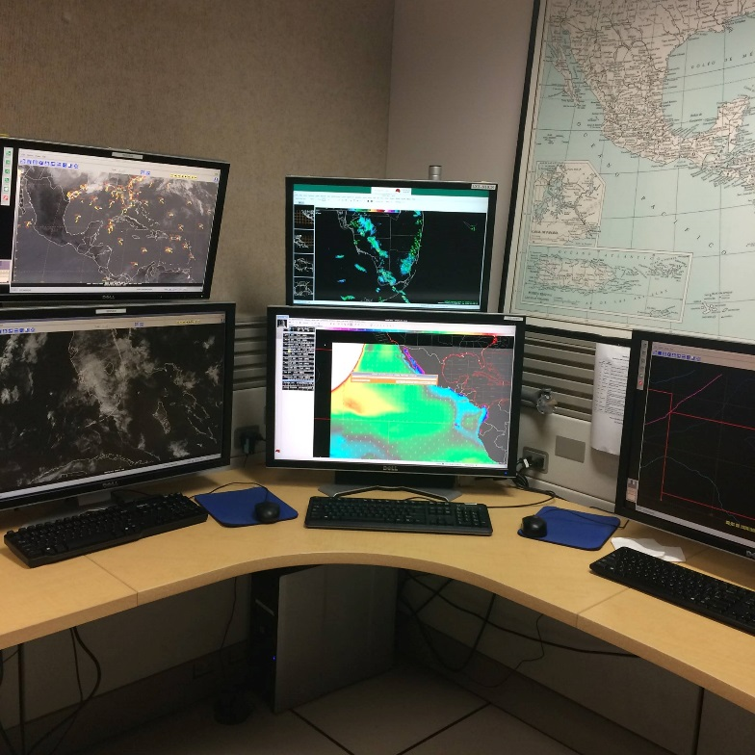
TAFB Forecast Duties
EAST PACIFIC DESK
Gridded/Text Marine Forecast Products
Northeast Pacific High Seas Forecast
(FZPN03 KNHC)
Southeast Pacific High Seas Forecast
(FZPN04 KNHC)
Tropical Cyclone Wave Height Estimates
Meteorological Discussion
East Pacific Tropical Weather Discussion
(AXPZ20 KNHC)
Graphical Products
Satellite Products
Dvorak Tropical Cyclone Satellite
Intensity Estimates
Sea State Analysis
Wind & Wave Forecasts
Wave Period Forecasts
High Wind Graphic
TC Danger Area Graphic
Microwave Satellite Position Estimates
Satellite Rainfall Estimates

Slide 4
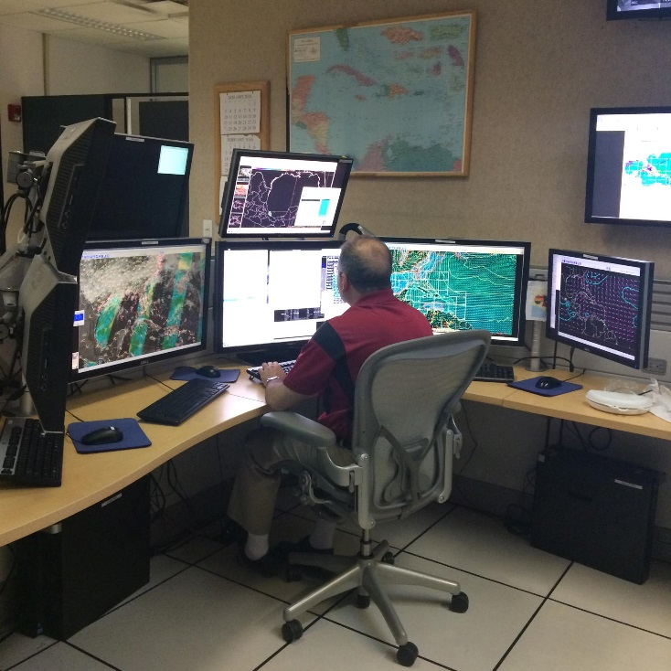
TAFB Forecast Duties
Gridded/Text Marine Forecast Products
Graphical Products
Atlantic High Seas Forecast
(FZNT02 KNHC)
Sea State Analysis
Wind & Wave Forecasts
Wave Period Forecasts
Gulf of Mexico Offshore
Waters Forecast (FZNT24 KNHC)
Caribbean/Atlantic Offshore
Waters Forecast (FZNT23 KNHC)
Meteorological Discussion
Marine Weather Discussion
(AGXX40 KNHC)
NAVTEX Forecasts (3)
(FZNT25 KNHC, FZNT26 KNHC, & FZNT27 KNHC)
ATLANTIC DESK
VOBRA Forecasts (2)
(FZNT25 KNHC, FZNT26 KNHC, & FZNT27 KNHC)

Slide 5
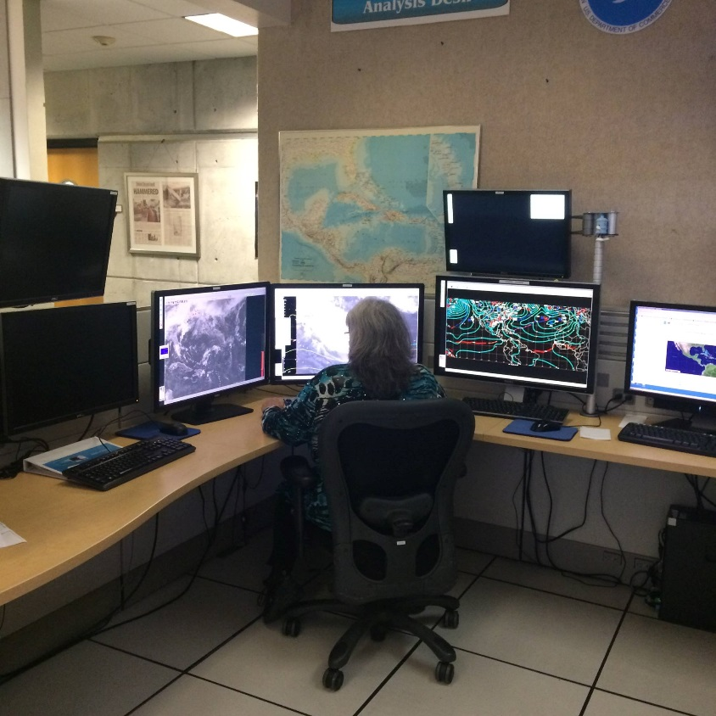
TAFB Forecast Duties
ATLANTIC/EAST PACIFIC
ANALYSIS DESK
Surface Analysis
6-hourly for area from 20S to 30N
between 10E and 140W
3-hourly mainly for Gulf of Mexico,
Florida, Mexico
Pan-American
Temperature/Precipitation Table
Meteorological Discussion
Graphical Forecast Products
Atlantic Tropical Weather Discussion
Surface Prog. Forecasts

Slide 6
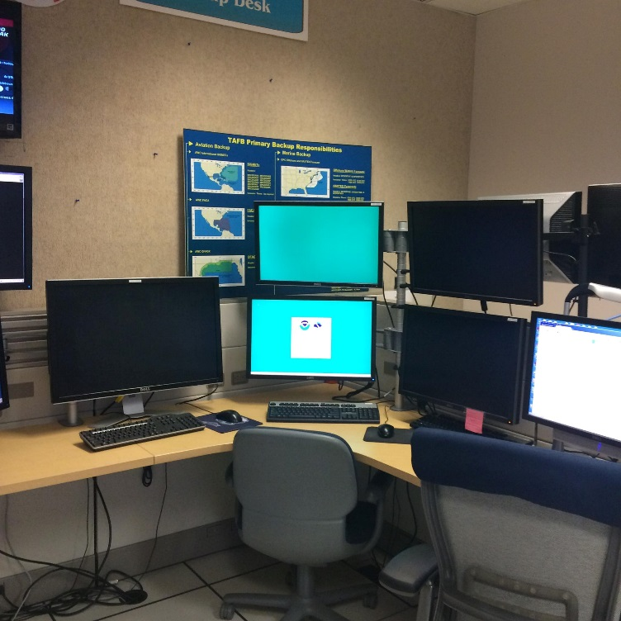
Additional TAFB Duties
TAFB Staffs “4th” Desk between August 10 - October 20.
Relieves other 3 desks during the busy peak of the hurricane season.
BACKUP DESK
Back-Up Responsibilities
    OPC’s Atlantic High Seas & Offshore
    Forecasts
    Honolulu S. Pacific HSF & Satellite
      Products
    Aviation Products over Caribbean
    & Gulf of Mexico (FACA &
    SIGMETS)

Slide 7
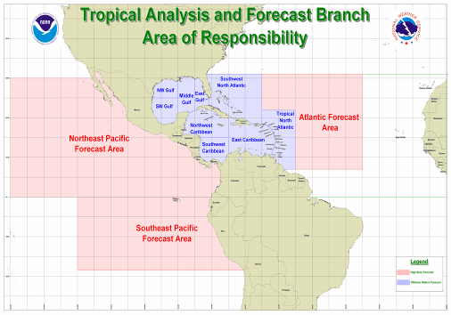
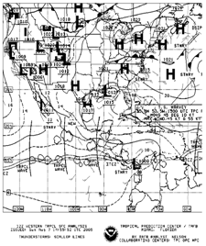
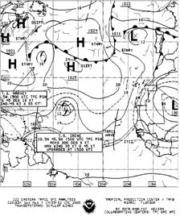
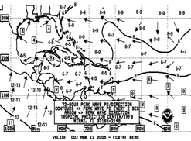
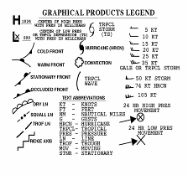
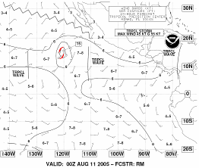
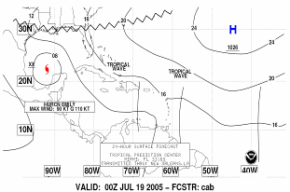
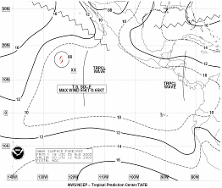
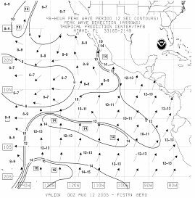
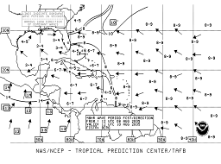
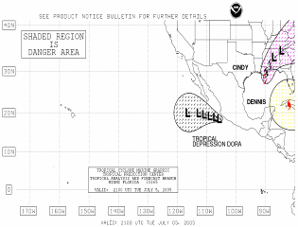
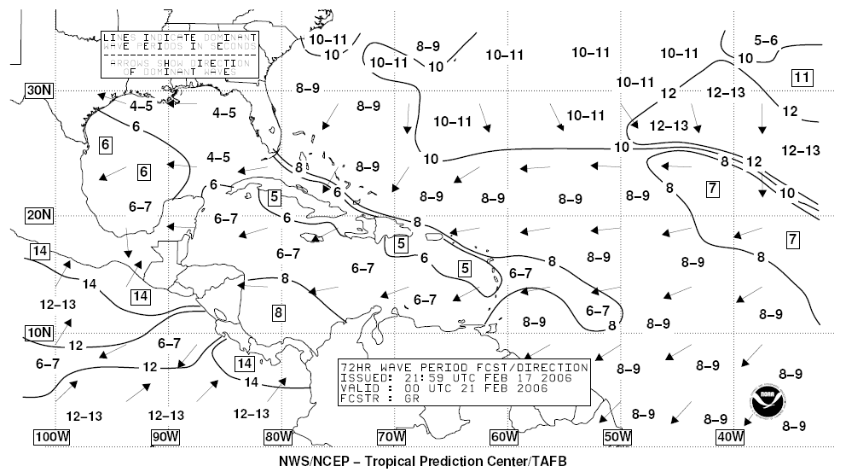
Suite of Marine Radiofax Charts Produced by TAFB
Pt. Reyes and Honolulu Radiofax
New Orleans Radiofax
Pt. Reyes Broadcast
Frequencies
4346 kHz
8682 kHz
12786 kHz
17151.2 kHz
22527 kHz
Honolulu Broadcast
Frequencies
9982.5 kHz
11090 kHz
16135 kHz
23331.5 kHz
Surface Analysis
Surface Analysis
New Orleans
Broadcast
Frequencies
4317.9 kHz
8503.9 kHz
12789.9 kHz
17146.9 kHz
Sea State Analysis
Wind/Wave Forecasts
Surface Forecasts
Wind/Wave Forecasts
Surface Forecasts
24
hr.
24
hr.
Sea State Analysis
Peak Wave Period & Swell Direction
48
hr.
48
hr.
Peak Wave Period & Swell Direction
72
hr.
72
hr.
48 hr.
High Wind Graphic
TC Danger Graphic
High Wind Graphic
TC Danger Graphic
48 hr.
72 hr.
72 hr.

Slide 8
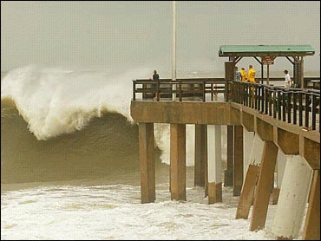
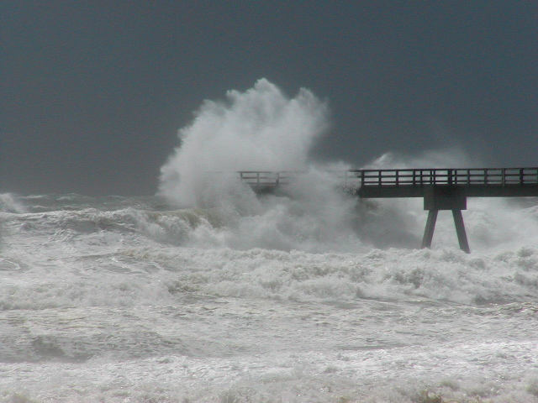
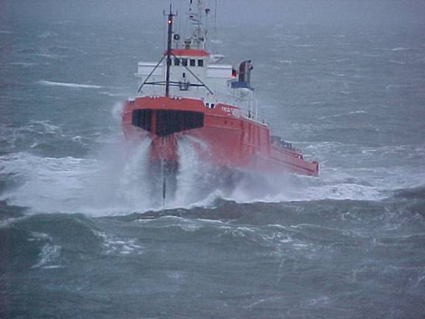
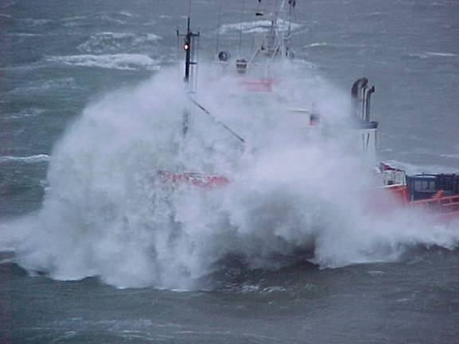
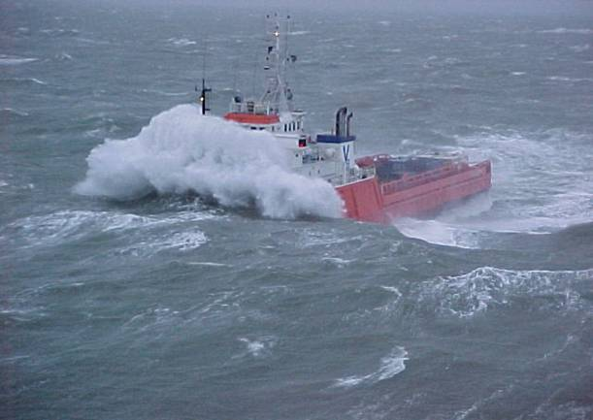
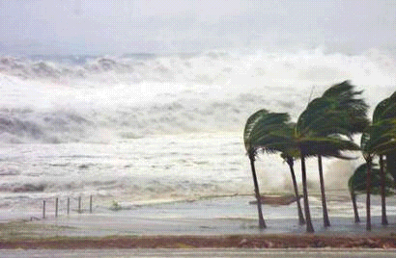
TAFB Marine Forecasts

Slide 9
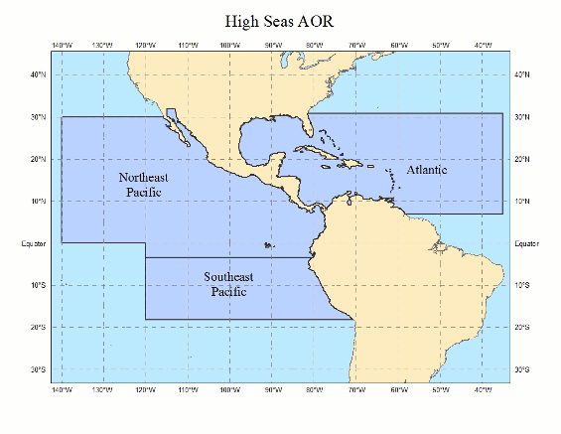
30⁰ N
31⁰ N
140⁰ W
35⁰ W
High Seas
Forecast Areas
7⁰ N
18.5⁰ S
~ 14 million sq. nautical miles

Slide 11
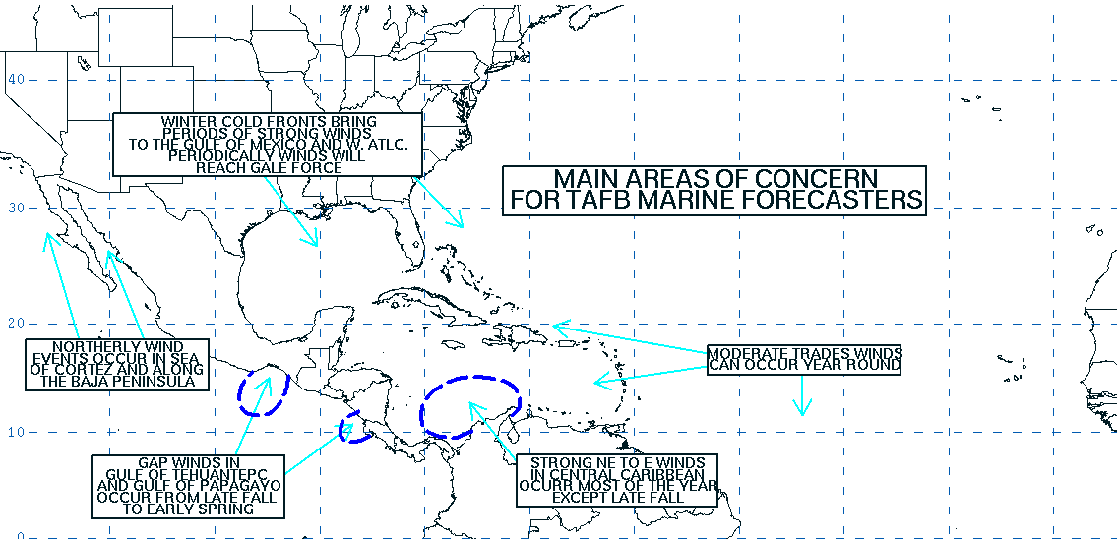
  Pacific
  Cold Fronts
  NE Trades
  Funneling “Gap” winds
    Gulf of Tehuantepec
    Gulf of Fonseca/Papagayo
    Gulf of Panama
    Sea of Cortez
    Baja California
  Atlantic
  Gales in Gulf of Mexico/SW North Atlantic in Winter
  Shelf water effect in NW Gulf of Mexico in winter
  Persistent Easterly Trades
  Funneling winds
    Yucatan Channel
    Florida Straits
    Caribbean Passages
    SW Caribbean within 60-120 NM of Colombian coast

Slide 12
Average Monthly Percentage of TAFB High Seas Forecasts
with Warnings* (Atlantic and East Pacific )
Extratropical (Gale, Storm and Hurricane Force)
Tropical (Tropical Storm and Hurricane)

Slide 13
Gridded Marine Forecasts
NATIONAL DIGITAL FORECAST DATABASE
OPC High Seas
2018-19
OPC High Seas
2018-19
HFO High Seas
2017

Slide 14
TAFB NDFD Gridded Marine Forecasts
Spatial/Temporal resolution
  10 KM
  3-Hourly out to 72 hours
  6-Hourly 78-156 hours
Parameters
  10-M Wind/Gusts w/ TCM Wind Tool
  Significant Wave Height
  Primary/Secondary Swell HGHT/Period/Direction (Not in NDFD)
  Hazards

Slide 15
Gridded Marine Parameters in the NDFD
10-M WINDS
Significant Wave HGHTS
Warning Hazards

Slide 16
TAFB SWAN/NWPS
Large domain covers OFF/HSF AOR
3-hourly output
Approximately 60-75 minutes to run
Nested Domains over target areas
TAFB value added WW3 output used for boundary conditions for WFO SWAN/NWPS runs

Slide 17
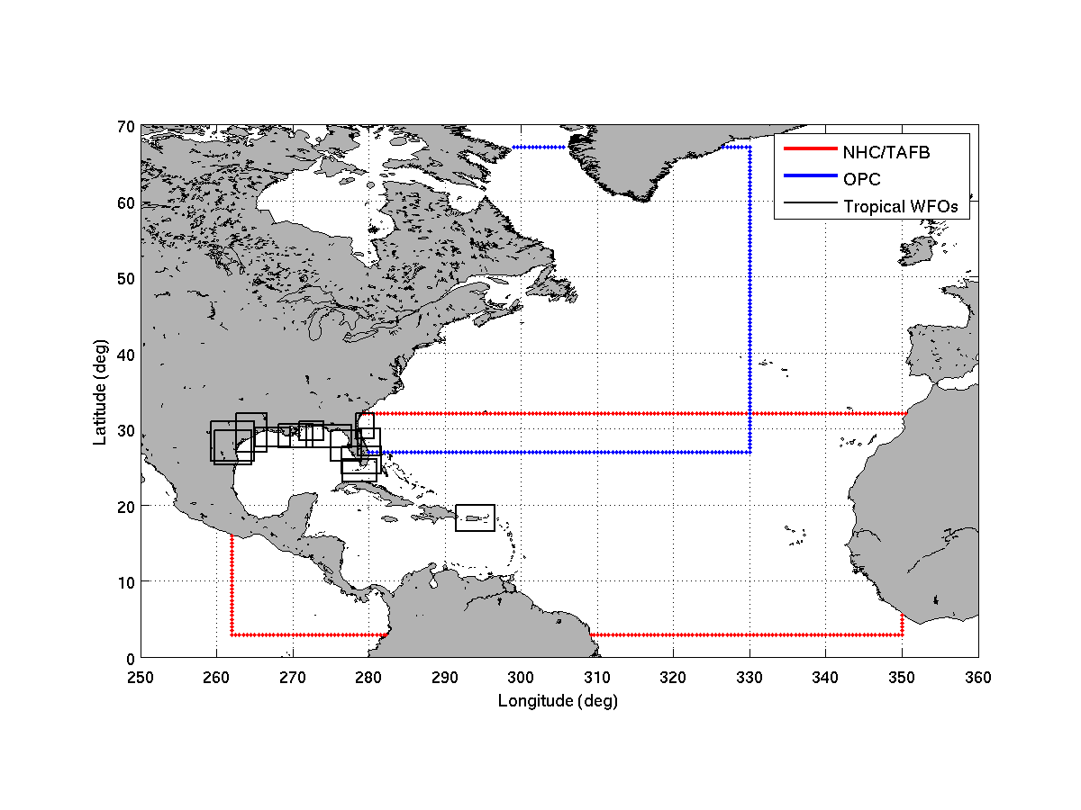
NWPS domains for TAFB/OPC

Slide 18
NWPS system architecture
WWIII Boundary Conditions
Water levels/
CWater levels/
Currents, e.g.
Ext. winds,
TCM/TAFB OFF Winds
Other Input
FTP/LDM
AWIPS II Environment
NWPS (on PX server)
CAVE
(D2D, GFE)
ADCIRC
WWIII
SWAN
Wave/surge model guidance
Forecast wind fields
EDEX
(Data Server)
Additional wave output (e.g. NetCDF, HDF5)
NDFD (total field; partitions)
CAVE: Common AWIPS Visualization Environment
EDEX: Environmental Data Exchange
LDM: Local Data Manager

Slide 19
Experimental East Pacific Offshore Waters
MIAOFFPZ7
MIAOFFPZ8

Slide 20
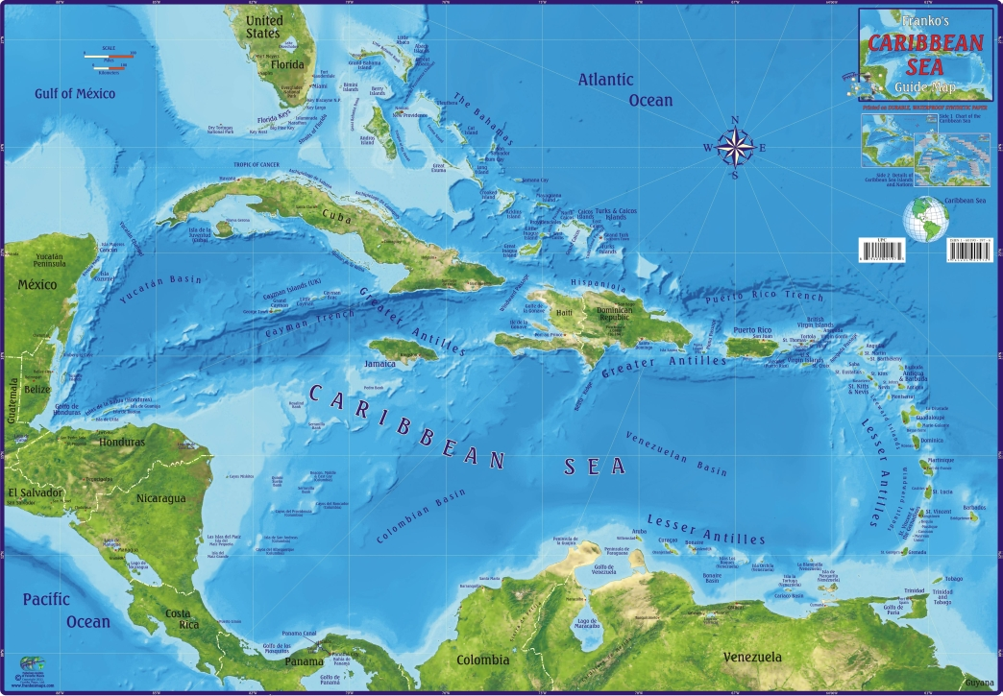
Possible Caribbean Sea
SWAN Domains

Slide 21
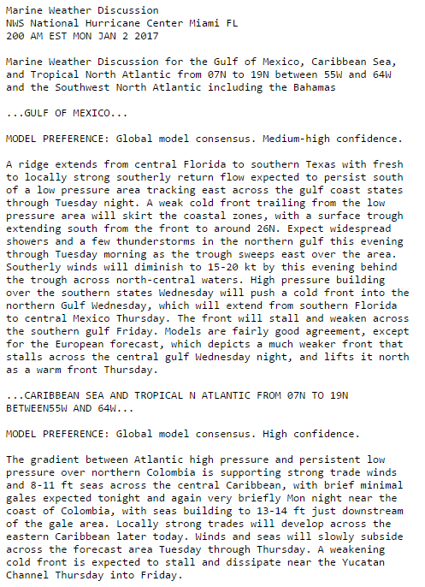
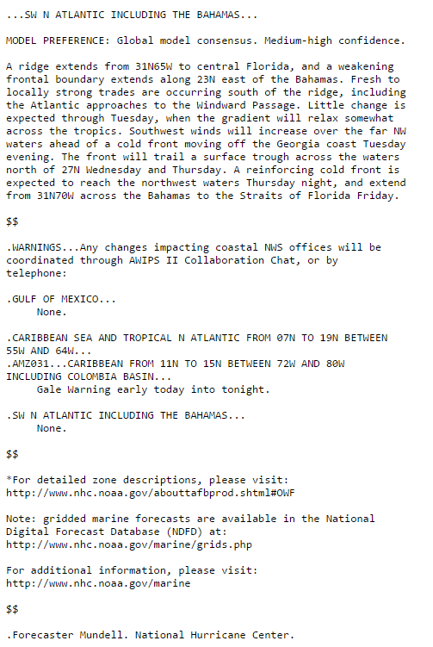
Marine Weather Discussion
Coordination Tool

Slide 22
Surface Analysis and
Tropical Weather Discussions

Slide 23
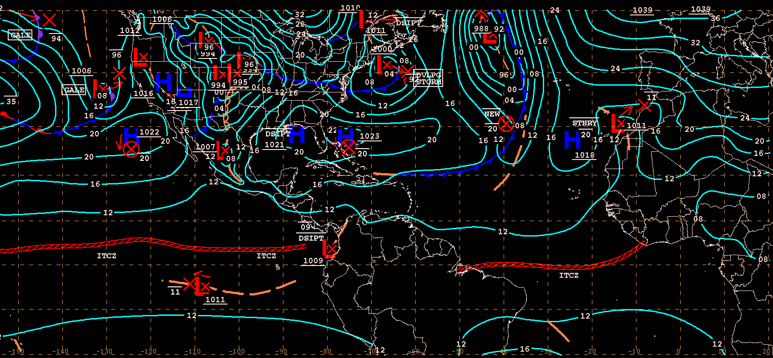
Unified Surface Analysis

Slide 24
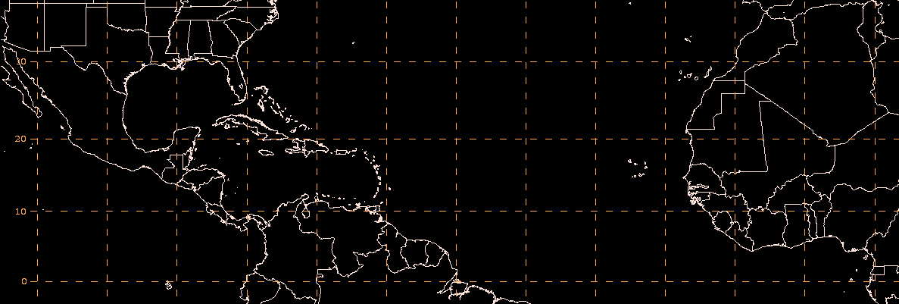
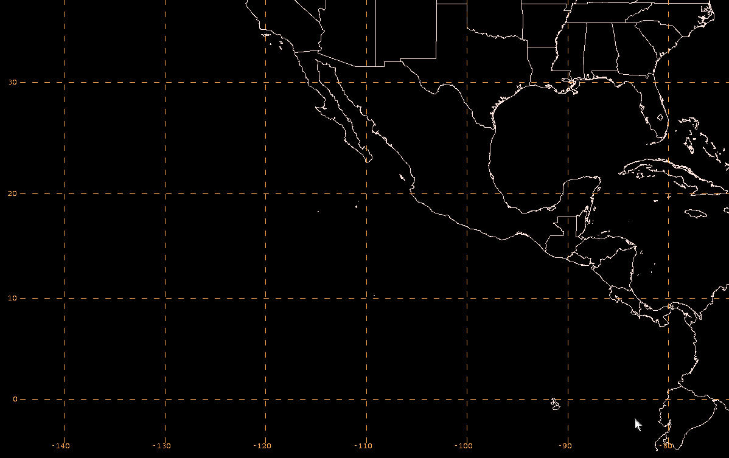
TWD Areas of Responsibility
North Atlantic
32º N
Includes: Mexico, Central America, northern South America, Florida/SE US, Gulf of Mexico, Caribbean Sea, North Atlantic to the African coast, and coastal west Africa
30º N
East Pacific
Includes west coastal areas of Mexico, Central America, and northern South America
140º W

Slide 25
What is the Tropical Weather Discussion (TWD)?
Plain language narrative text product describing:
  Major synoptic scale features and marine warnings
  Short-term trends and forecasts (up to ~48 hours)
  Meteorological reasoning for current features/weather and trends/forecasts
  Model performance; degree of confidence in forecast
Two separate products cover tropical North Atlantic and eastern North Pacific Oceans, and adjacent land areas

Slide 26
General TWD Format
Special Features
  Tropical and Subtropical Cyclone
  Significant feature that has the possibility of developing into a TC.
  Extra-tropical marine warning areas
Tropical Waves
ITCZ/Monsoon trough
Discussion- Areas can change with weather pattern
  Gulf of Mexico
  Caribbean
  Hispaniola – Support since 2010 earthquake
  Atlantic/Eastern Atlantic

Slide 27
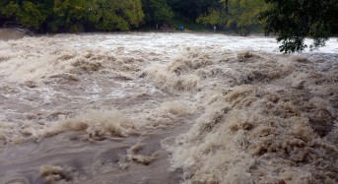
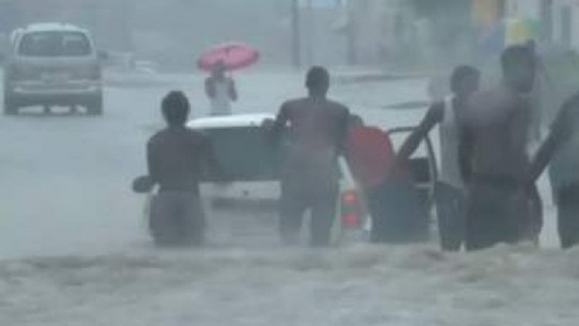
Heavy Rainfall/Flooding
Eastern Cuba, Hispaniola and Jamaica – May 15-18, 2017

Slide 28
Heavy Rainfall/Flooding
Eastern Cuba, Hispaniola and Jamaica – May 15-18, 2017
24-HOUR rainfall
Jamaica
Kingston/Norman Manley – 63 mm – 15-16 May
Montego Bay/ Sangster – 63.5 mm – 15-16 May
Montego Bay/ Sangster – 92.6 mm – 17-18 May
Grand Cayman - 70.6 mm - 17-18 May
Dominican Republic – ONAMET
Barahona – 146.4 mm – 15-16 May
Mao-Valverde – 126 mm – 15-16 May
Juncalito – 74.2 mm – 15-16 May
La Isabela, Puerto Plata – 72.1 mm – 15-16 May

Slide 29
GFS 700 hPa streamfunction/IR
VT 1800 UTC 17 May 2017

Slide 30
GFS 315K Potential vorticity/Wind
VT 1800 UTC 17 May 2017

Slide 31
GFS 850 hPa Wind/Streamfunction
VT 1800 UTC 17 May 2017

Slide 32
GFS 200 hPa Wind/Streamfunction
VT 1800 UTC 17 May 2017

Slide 33
GFS 850 hPa Rel Vort/Vort Aonomalies
Hoevmoeller

Slide 34
Tropical Weather Discussion
2354 UTC 17 May 2017

Slide 35
Contact TAFB
Tel: 305-229-4425 (Pacific)
305-229-4424 (Atlantic)
305-229-4426 (Analyst)
305-229-4454 (Hugh Cobb)
E-mail: Hugh.Cobb@noaa.gov

