Slide 1
NOAA’s National Weather Service
An Overview of the Weather Forecast Office in San Juan, Puerto Rico
Ernesto Rodriguez
Science and Operations Officer
ernesto.rodriguez@noaa.gov

Slide 2
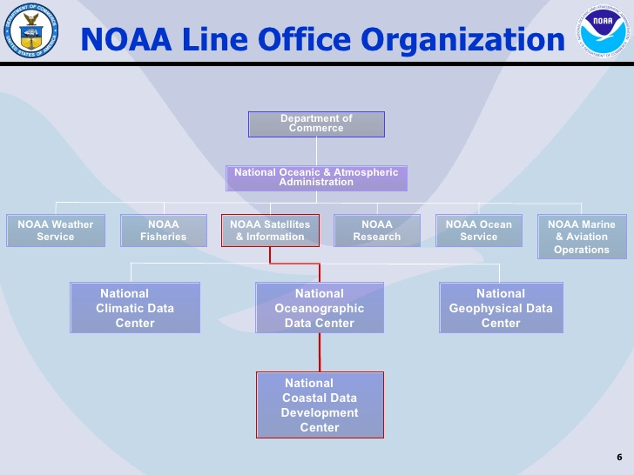





NOAA’s Five Line Offices

Slide 3
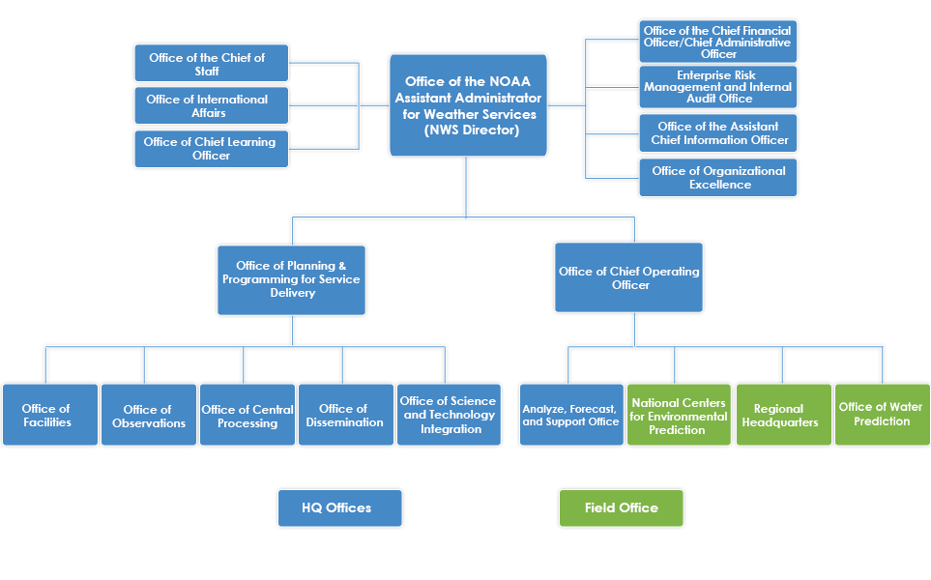
NOAA’s National Weather Service

Slide 4
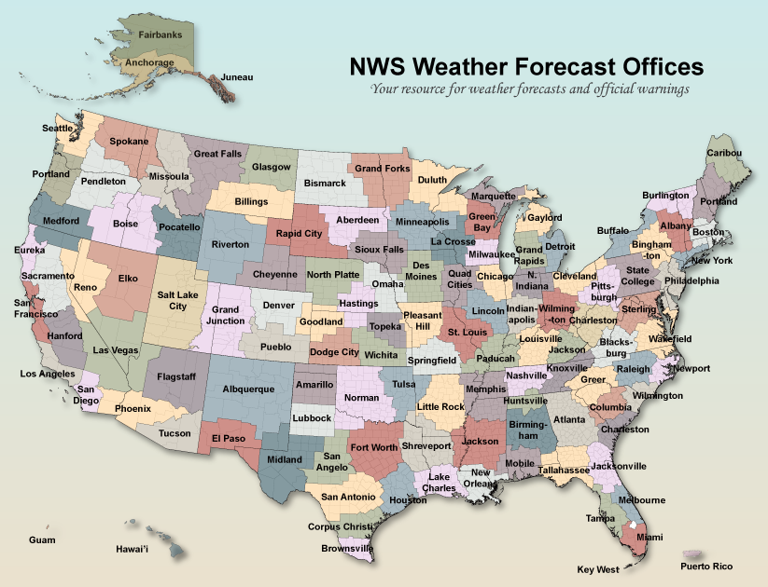

Slide 5



National Weather Service Mission
“The NWS provides weather, hydrologic, and climate forecasts and warnings for the United States, its territories, adjacent waters and ocean areas, for the protection of life and property and the enhancement of the national economy.”
National Weather Service San Juan

Slide 6








¿Who We Are?
WFO
SJU
METEOROLOGIST IN CHARGE
Administrative
Assistant
(1)
(1)
SCIENCE OPERATIONS
OFFICER
WARNING COORDINATION
METEOROLOGIST
(1)
(1)
(1)
(1)
SUPERVISORY INFORMATION
TECHNOLOGY SPECIALIST
Information Technology
Officer
HYDROLOGIST
FORECASTER
IN
CHARGE
(1)
(5)
OBSERVATION PROGRAM LEADER
GENERAL
FORECASTER
(1)
(5)
ELECTRONIC
TECHNITIANS
MET INTERNS &
HYDROMETEOROLOGICAL
TECHNITIANS
SJU
(2)
(6)
Total Employees: 26

Slide 7


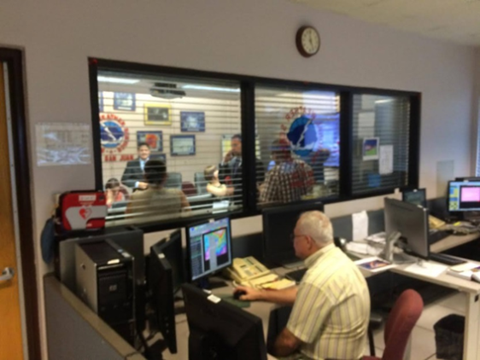
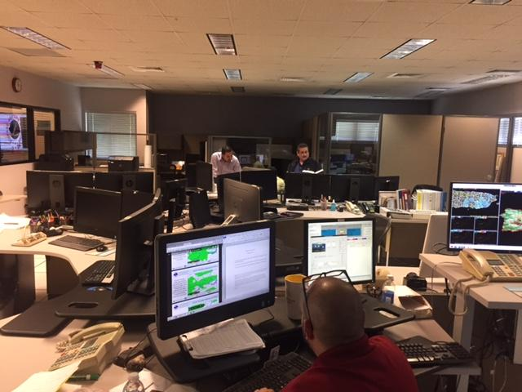

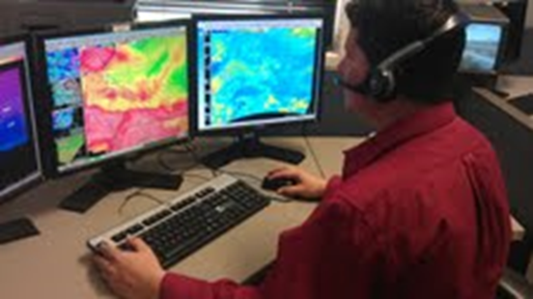
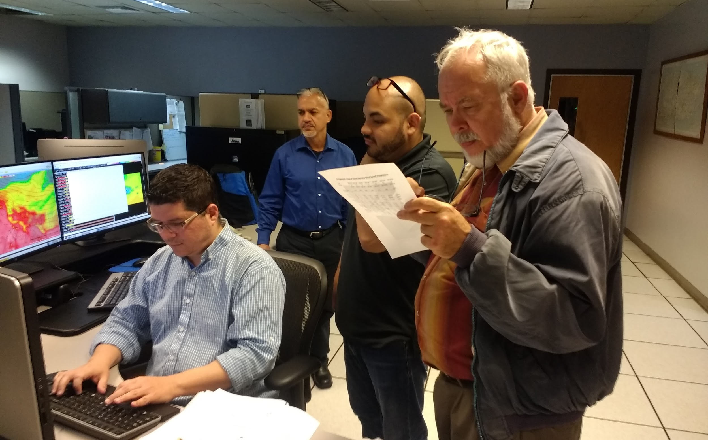
Our
Office
WFO
SJU
National Weather Service: www.weather.gov/sju

Slide 8

Forecast Background
TV
Radio
Internet
Private Weather Companies
NATIONAL WEATHER SERVICE
122 Weather Forecast Offices Issue Local Forecasts & Warnings
National Centers for Environmental Prediction
Model Simulations
Climate & Seasonal Outlooks
Aviation & Marine Forecasts
Storm & Tornado Prediction
Hurricane Tracks
River Forecasts
Hydropower, Flood warnings
Irrigation, River Navigation
Observations
Radar Network, Satellites, Weather Balloons, Ground-level observations at airports, Aircraft, Lightning Network, Data Buoys, Stream Gauge Network, 11,000 Volunteer daily-data collectors, Thousands of Volunteer storm spotters

Slide 9
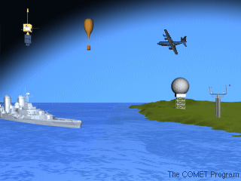
NOAA/NWS Assets
Satellites
Reconnaissance
Dropsondes
and RAOBs
Radar
Land
Stations
Ships and Buoys

Slide 10
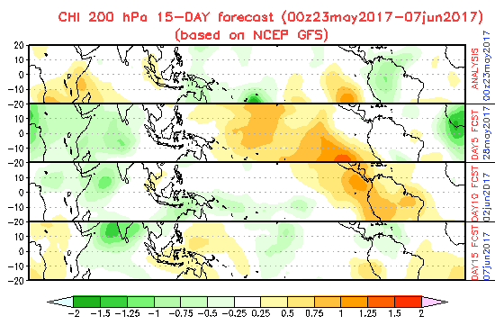
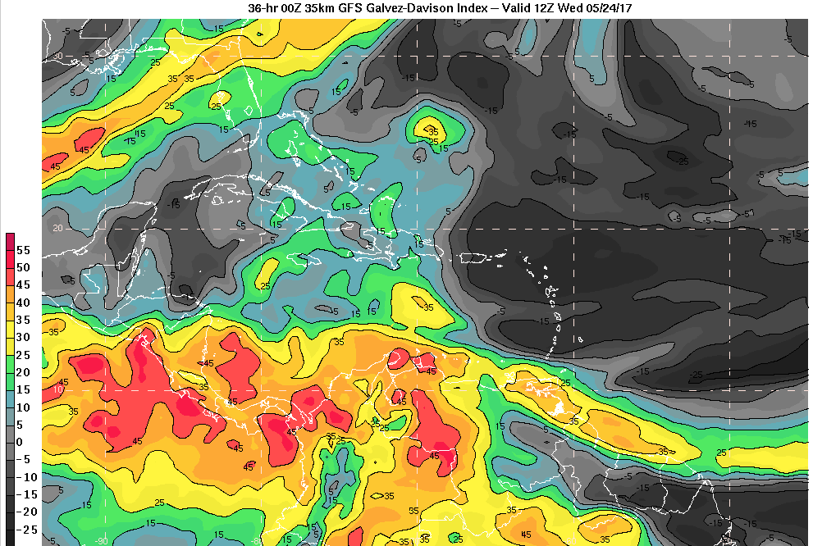
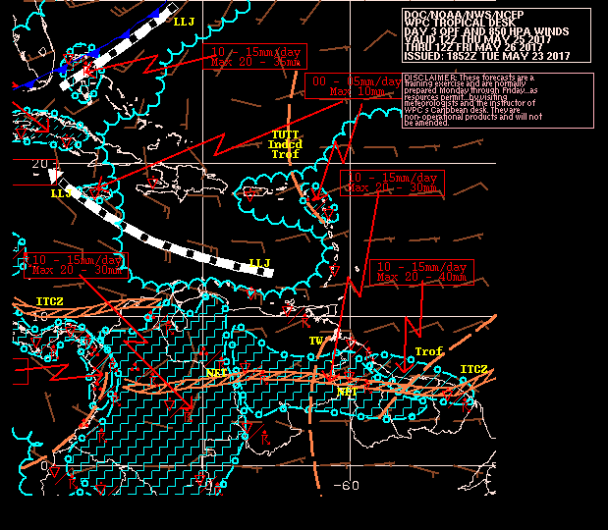
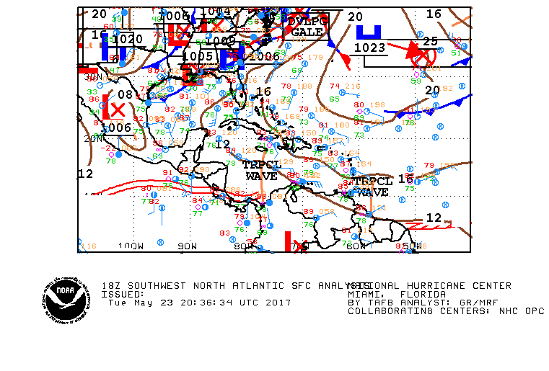
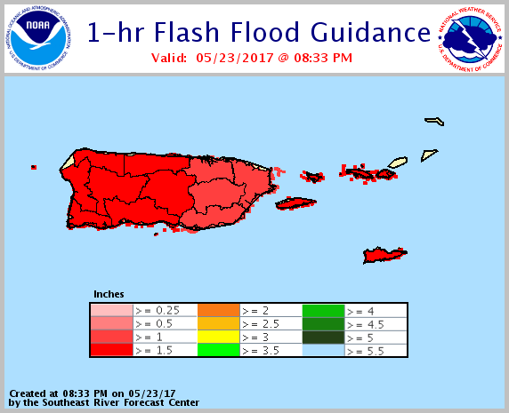
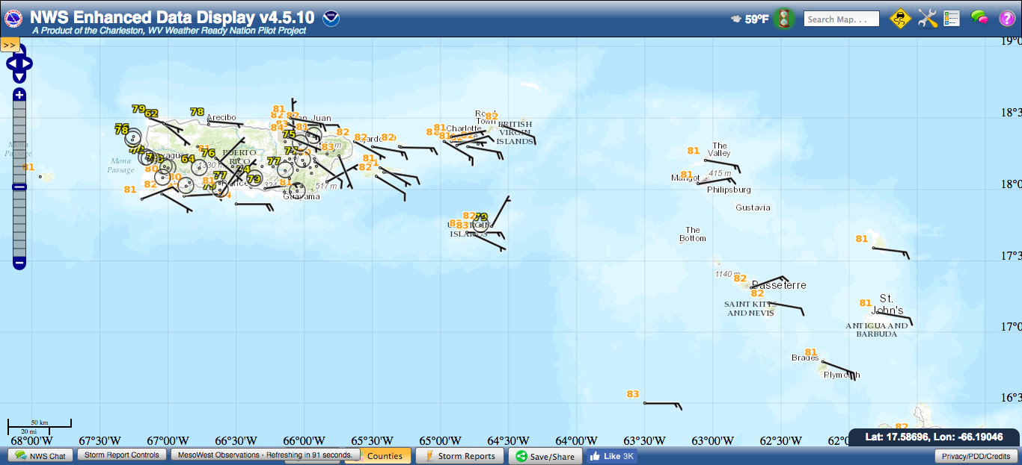
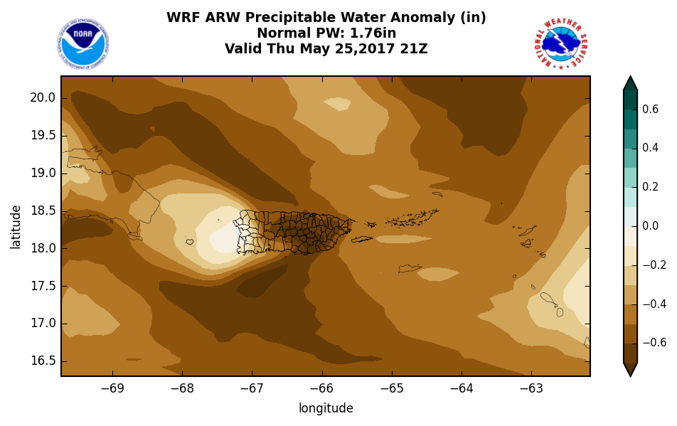

Slide 11
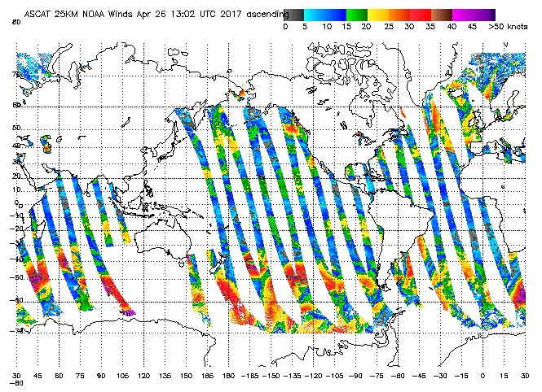
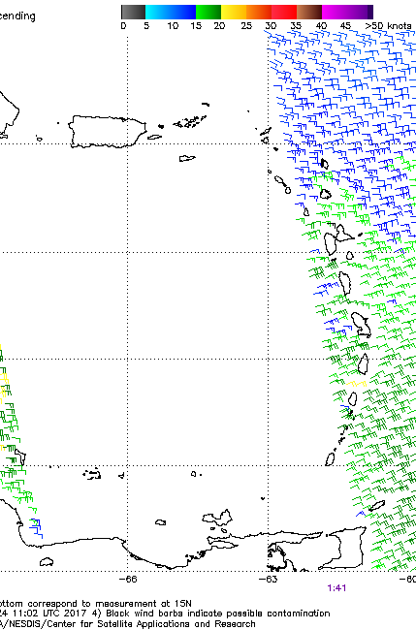
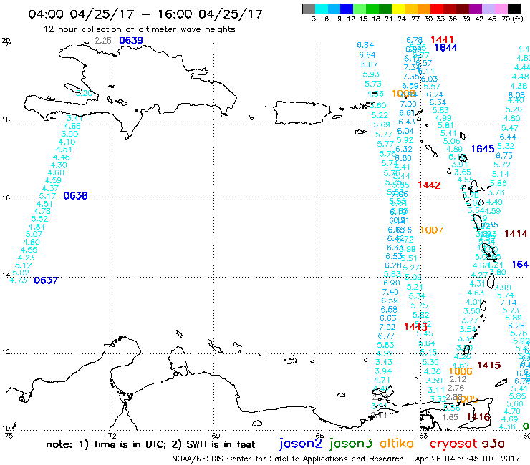
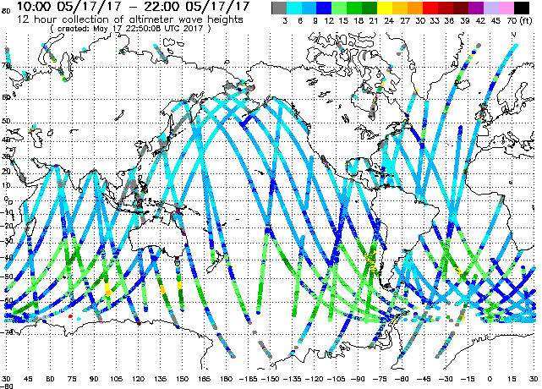
Marine Forecasting using satellite observations
https://manati.star.nesdis.noaa.gov/datasets/SGWHData.php

Slide 12
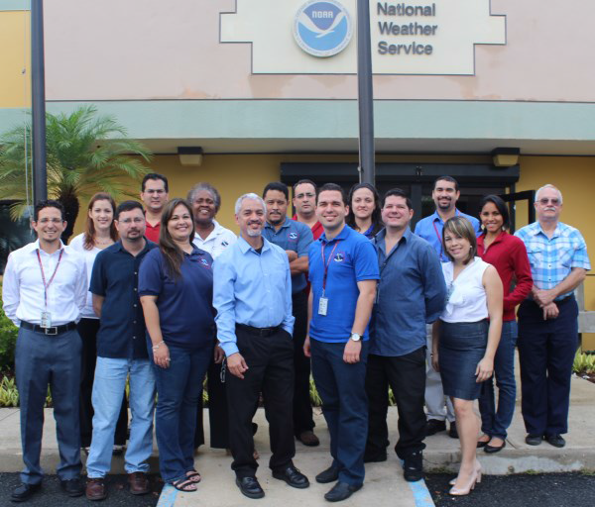
What We Do
Issues all Local Forecasts & Warnings
Builds and Maintains Relationships With Local and State Governments
Provides Expert Advice
to Emergency
Operations Centers
Solicits Customer
Feedback on Products
and Services
Conducts Community
Awareness and Education Programs
Trains Volunteer Observers and Storm Spotters

Slide 13
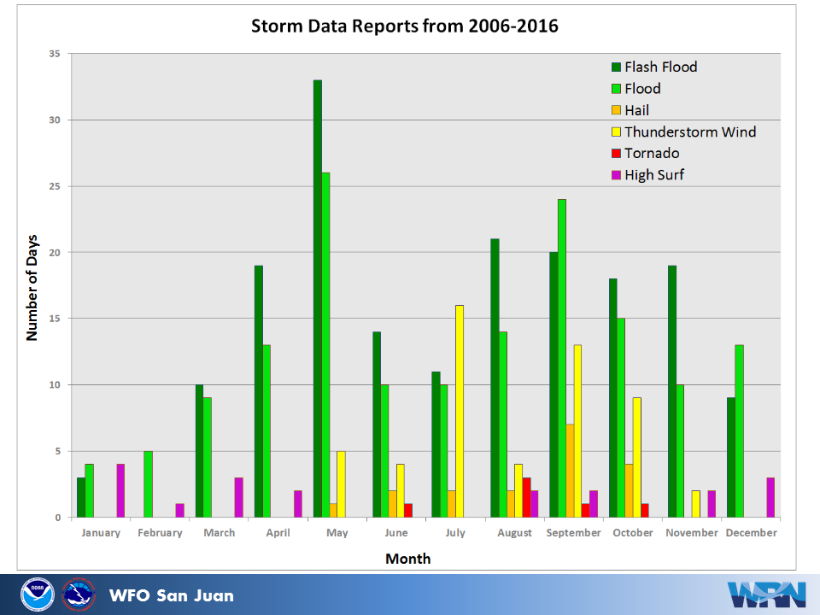

Slide 14
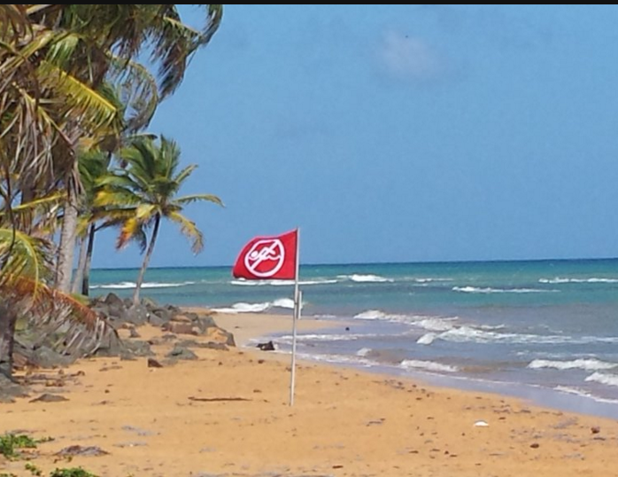
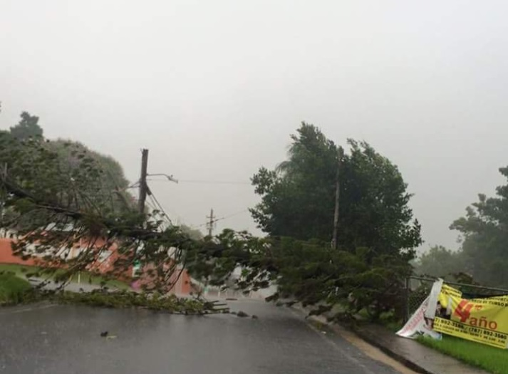
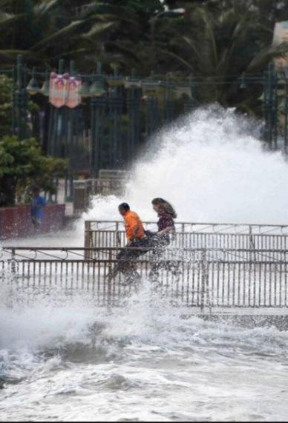
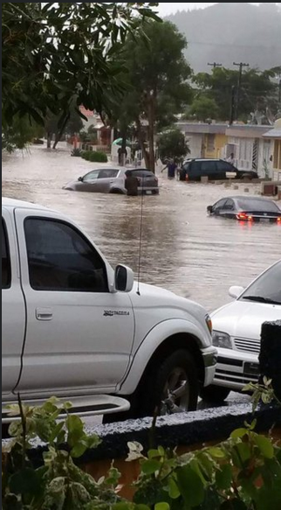
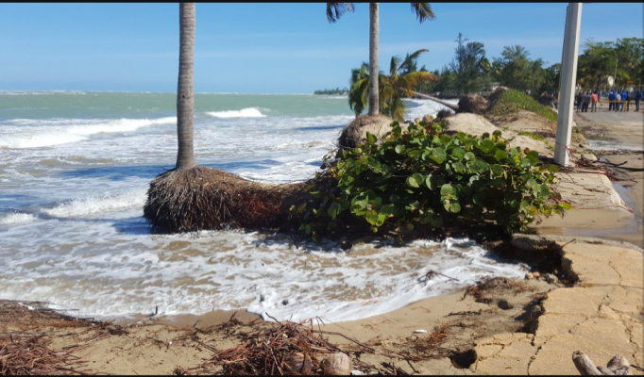
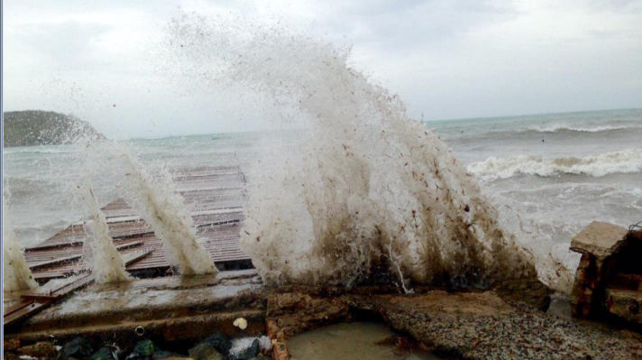
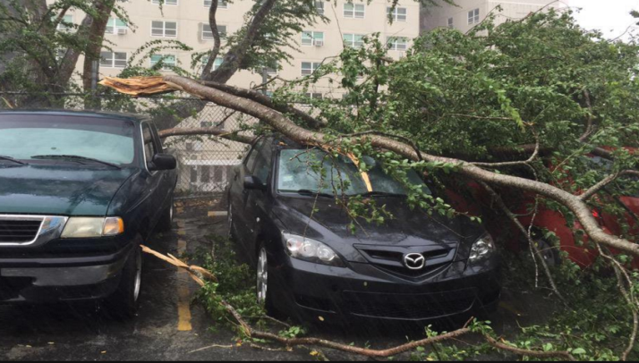
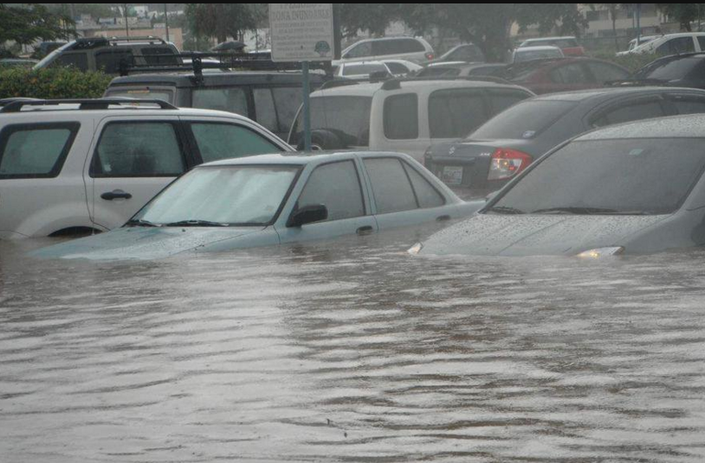
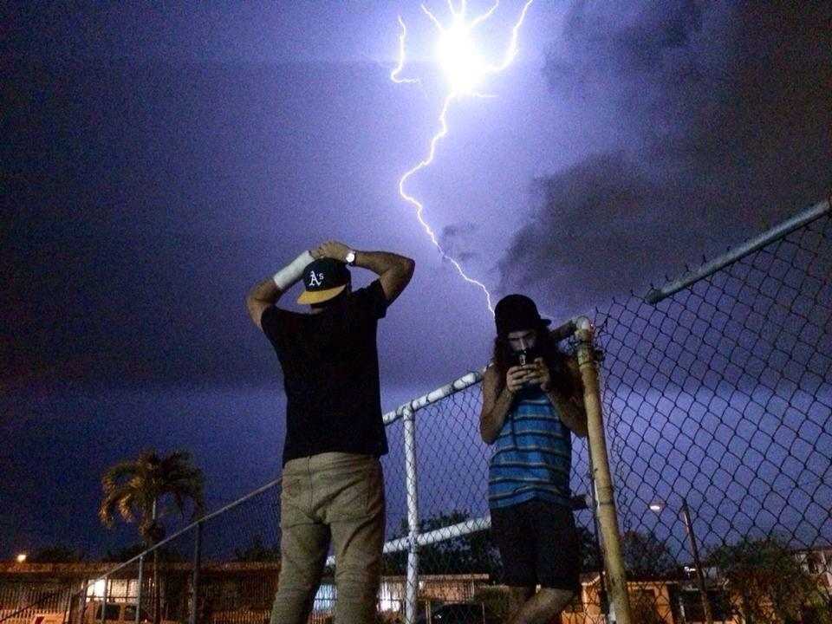
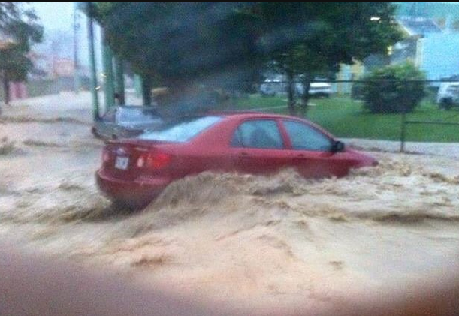
@JANET DONES
@wilfredodiazPR
@NadeshaWAPA
@Nael Fontán
@Yarim Correa
@waltersotoleon
@Ektor79
@Jose Soto Anglero
@Edgar Rodriguez

Slide 15
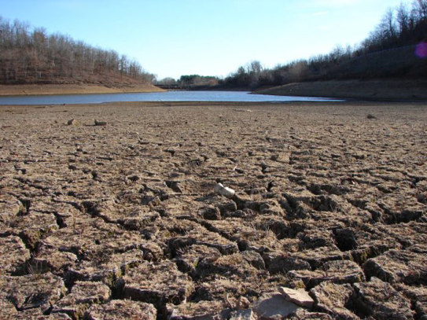
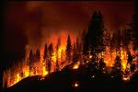
Other Dangers
Drought
  Meteorological
  Agriculture
  Hydrologic
Extreme Heat
  What is an extreme
  New products
Fire
  Strong Winds
  Fuel
  Humidity
Pollutants
  Wind Direction and velocity
  Atmospheric Stability

Slide 16
Our Products
Routine
Non-Routine
Zone Forecast
Marine Forecast
TAF Aviation Forecast
Weather Summaries
Graphicast
Hazardous Weather Outlook
Graphical HWO
Nowcast
Advisories
Special Weather Statements
Watches
Warnings

Slide 17
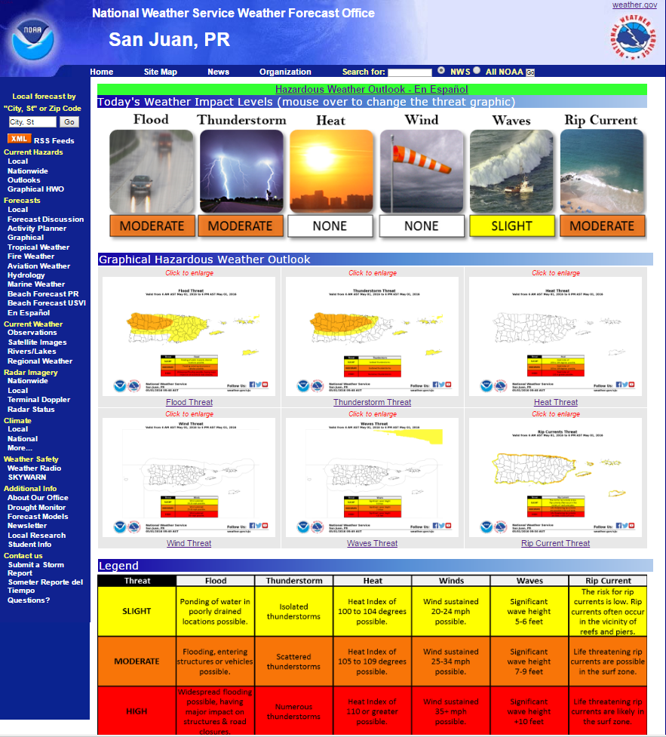
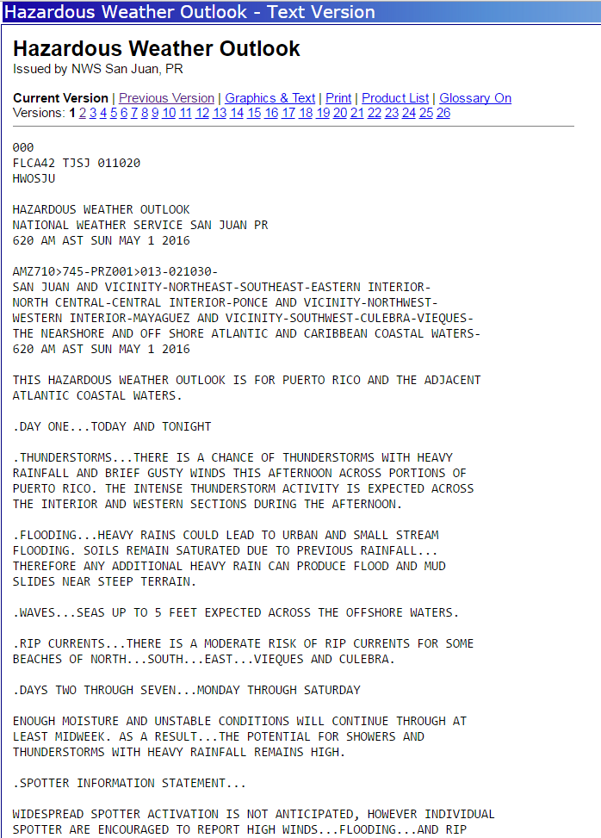

Slide 18
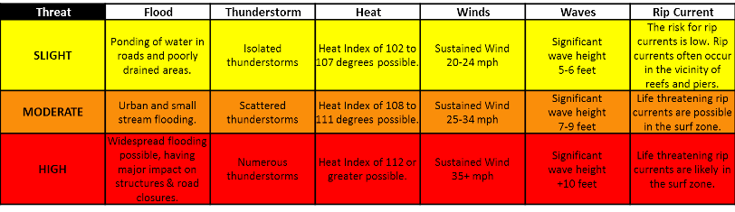
THREAT LEVELS

Slide 19
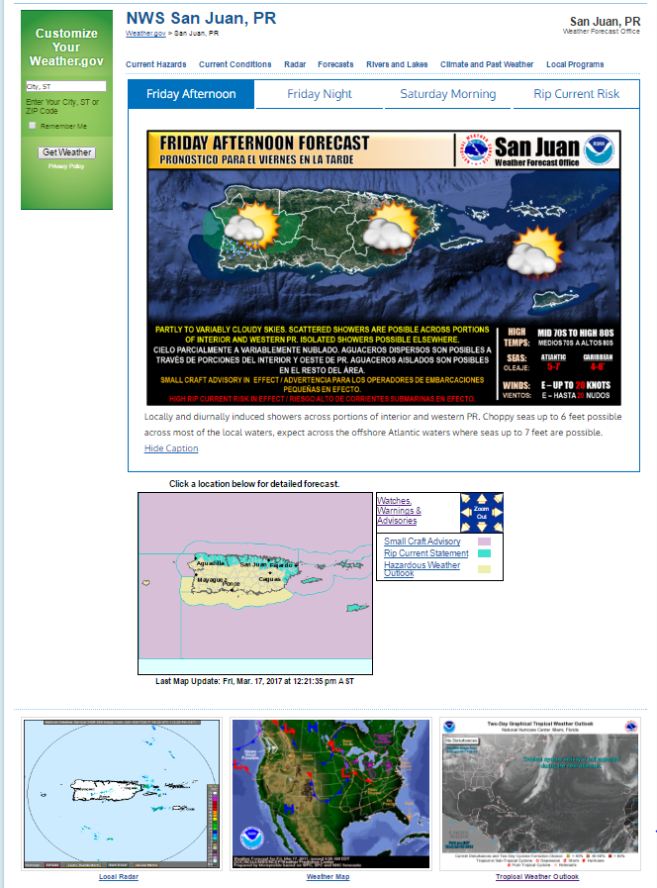
weather.gov/sju/

Slide 20

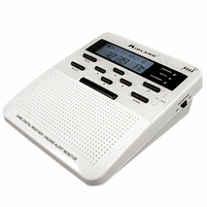



Sources of information
Webpage
Facebook
Twitter
NOAA Radio
Wireless Emergency Alert

Slide 21
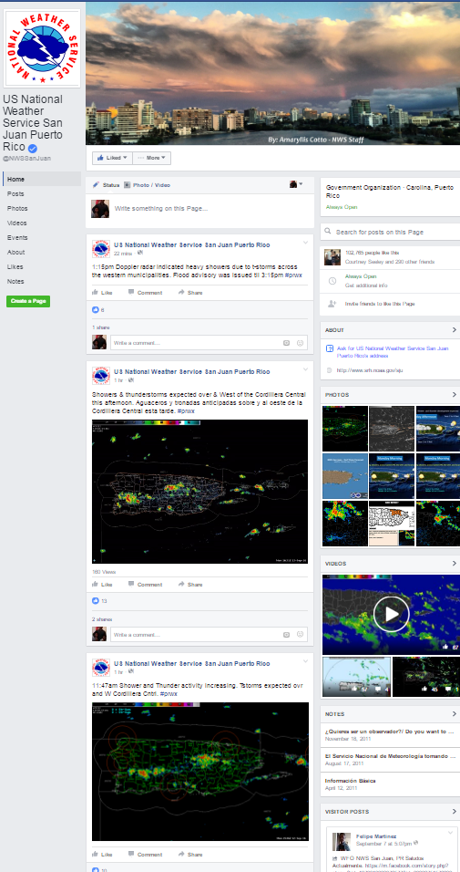
Facebook/Twitter
Forecast
Watches, Warnings & Advisories
Radar
Interesting Weather Facts
Activities

Slide 22
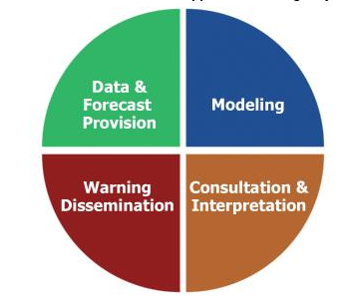
Impact Decision Support Service
Works closer with collaborating agencies and partners to more effectively achieve goals
Works with Social Scientists to better understand how weather and flooding impact society and how people respond to weather threats and warning messages
More emphasis on climate and environmental impacts

Slide 23
Increasingly direct interaction
between NWS and
decision makers
Increasing adaptation
of NWS information for
specific decision(s)
Individual Decision
Assistance
Group
Decision Assistance
Organization-Specific
Decision Support Information
Sector-Specific
Decision Support Information
General Access to NWS Information
All NWS Customers / Partners
National Weather Service San Juan

Slide 24
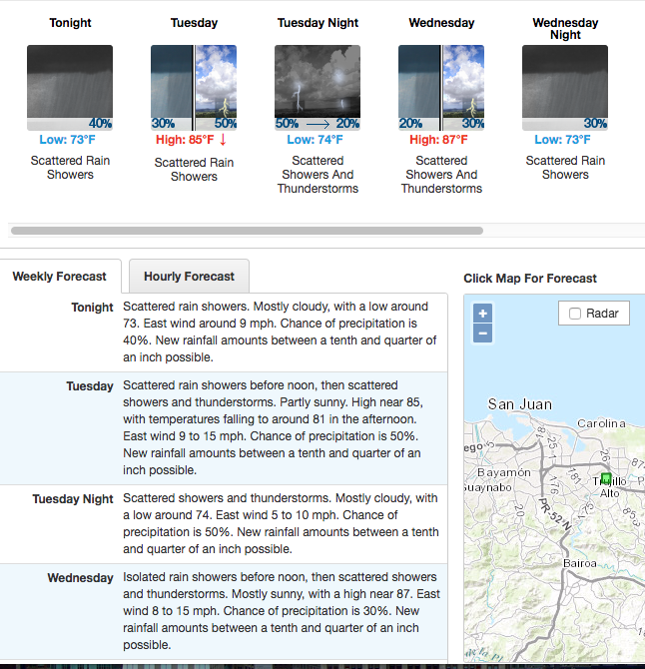

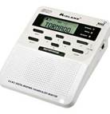
General Information - Point and Click
Updated every 6 hours and available via web and NOAA weather radio

Slide 25

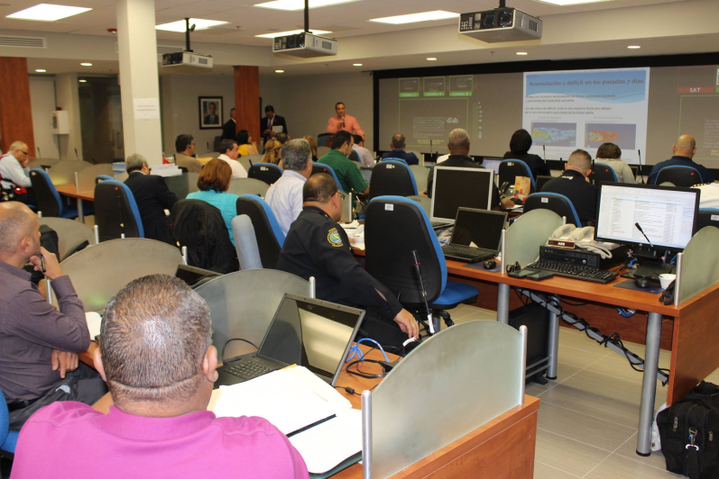
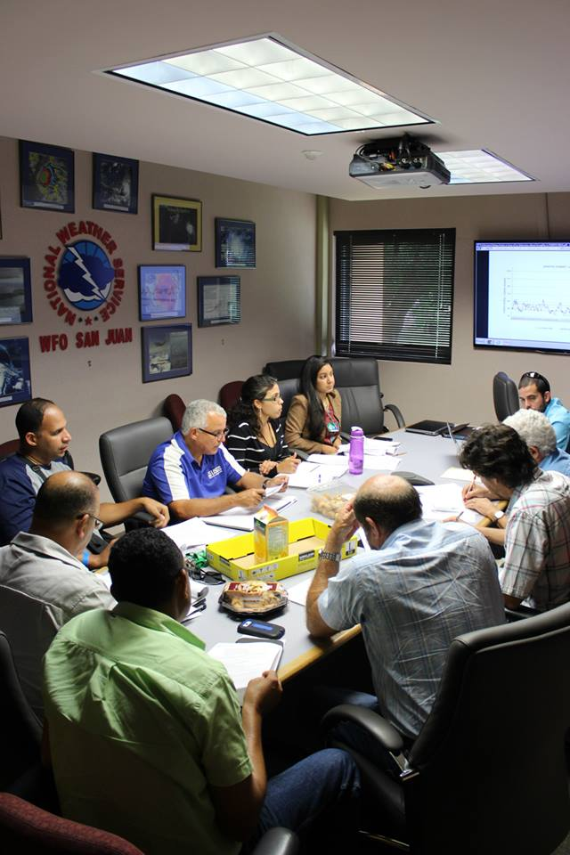
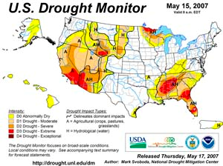
Sector Specific Decision Support
Aviation
Marine
Fire Management
Water Management

Slide 26
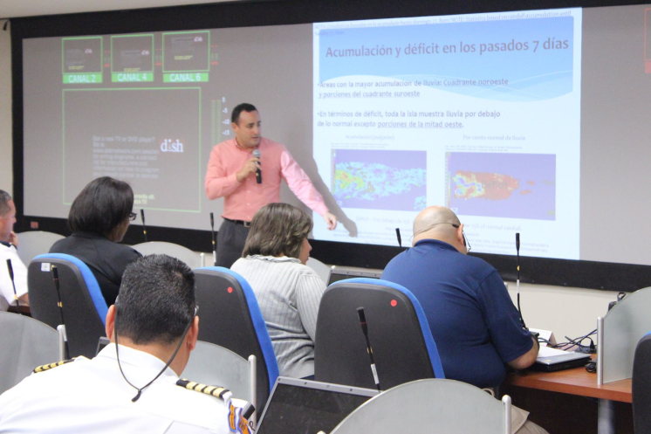
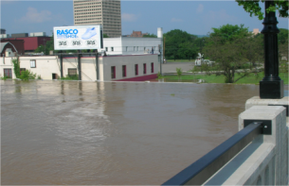
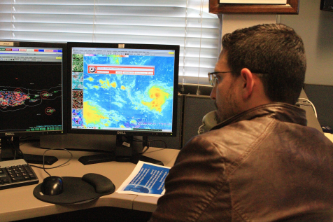

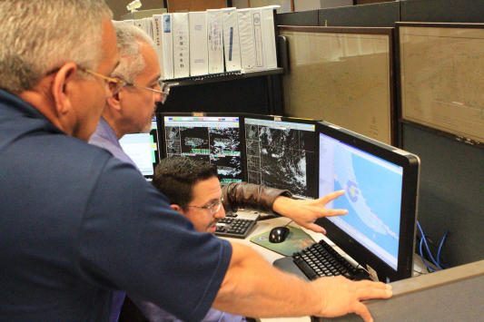
Group Decision Support
Prior to Significant Weather Events:
Webinars
Conference Calls
To State and municipal EOCs and other key partners
To help prepare, respond and mitigate against potential harm to public and property

Slide 27
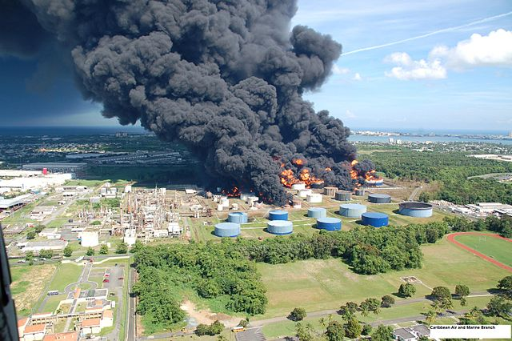

Individual Decision Support for Non-Weather Incidents

Slide 28


HAZMAT Events
Impact Decision Support Services
USCG Sector San Juan

Slide 29



Individual Decision Support to Incident Command for Large Public Events

Slide 30


Individual Decision Support
Briefing to the Governor of Puerto Rico

Slide 31





Individual Decision Support to help with Preparedness and Mitigation
Hazard Mitigation
Risk Assessment
Safety & Preparedness Education
StormReady
Specialized Training
Exercises
Drills

Slide 32


Collaborative Studies

Slide 33


Towards a Better Understanding of African Dust Impacts on the Caribbean Basin.
PI: Gerardo Morell & Olga Mayol
Project Objectives:
Analyze synergy between aerosol depth and summer weather-related events (bioaerosols, heat, precipitation).
Evaluate the effects of summer weather-related events on society (e.g., visibility, human health).
Collaborative Studies
Image credit: Primera Hora

Slide 34




Collaborative Studies

