Slide 1
The WMO Rolling Review of Requirements (RRR)
Etienne Charpentier
Chief, Observing Systems Division
ICT-DPFS Meeting, Geneva, February 2018

Slide 2
WMO Rolling Review of Requirements (RRR) http://www.wmo.int/egos
Addressing the requirements for all WMO applications
Initiated in early 2000s’ through the WMO Space Programme in cooperation with CEOS
Regulated in the WIGOS Manual (WMO No. 1160, para 2.2.4 and Appendix 2.3), and GOS Manual (WMO No. 588)
Members, both directly and through the participation of their experts in the activities of regional associations and technical commissions, shall contribute to the RRR process and assist the designated Points of Contact for each application area in performing their roles in the RRR
Commission for Basic Systems (CBS) in charge of RRR
Inter Programme Expert Team on Observing System Design and Evolution (IPET-OSDE)
Chairperson, Erik Andersson, ECMWF

Slide 3
WMO Application Areas
Definition: an activity involving primary use of observations, in a chain of activities which allow NMHSs or other organizations to render services contributing to public safety, socio-economic well-being and development in their respective countries, in a specific domain related to weather, climate and water. The concept of a WMO Application Area is used in the framework of the WMO Rolling Review of Requirements (RRR) and describes a homogeneous activity for which it is possible to compile a consistent set of observational user requirements agreed by community experts working operationally in this area.
Global Numerical Weather Prediction
High Resolution Numerical Weather Prediction
Nowcasting and Very Short Range Forecasting
Sub-seasonal to longer predictions
Aeronautical Meteorology
Forecasting Atmospheric Composition
Monitoring Atmospheric Composition
Providing Atmospheric Composition information to support services in urban and populated areas
Ocean Applications
Agricultural Meteorology
Hydrology
Climate Monitoring (GCOS)
Climate Applications (Other aspects, addressed by the Commission for Climatology)
Space Weather
Climate Science
Cross cutting:
Global Cryosphere Watch (GCW)
Global Framework for Climate Services (GFCS)

Slide 4
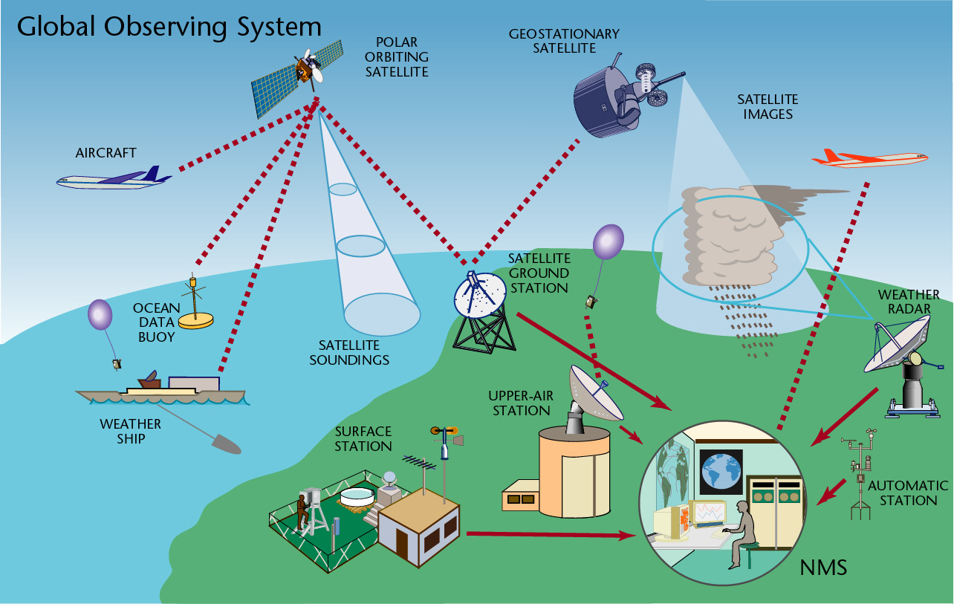
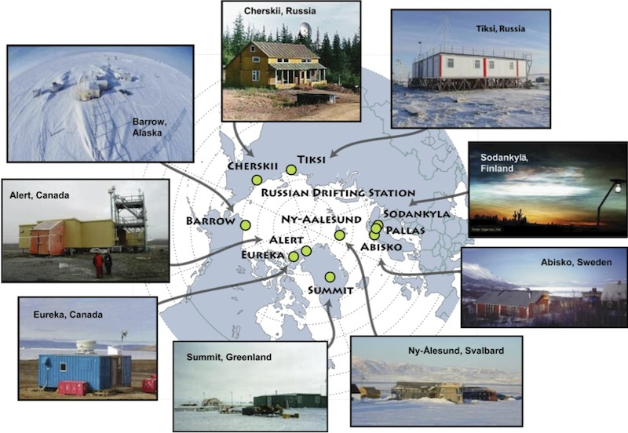
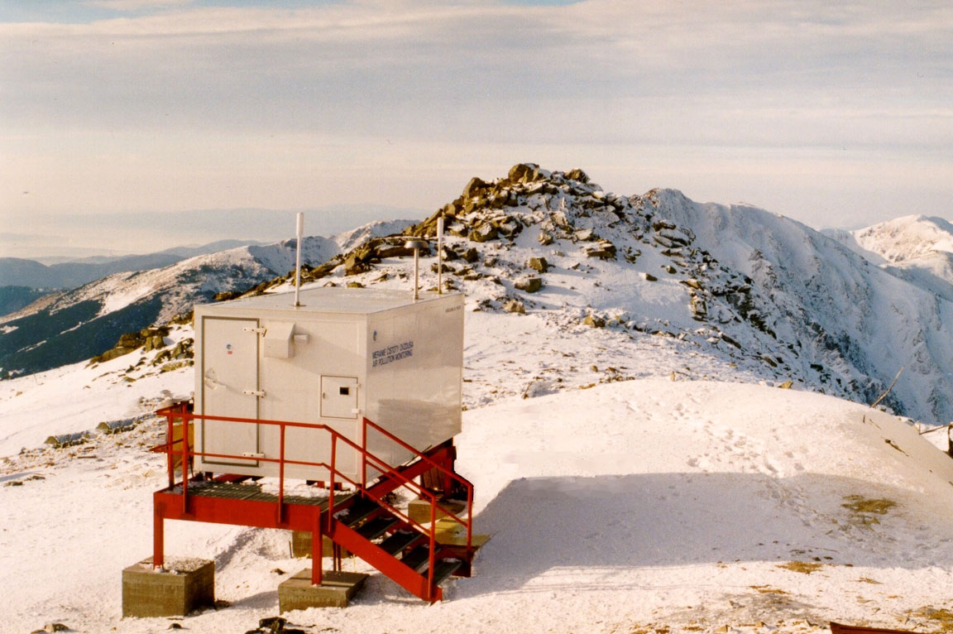
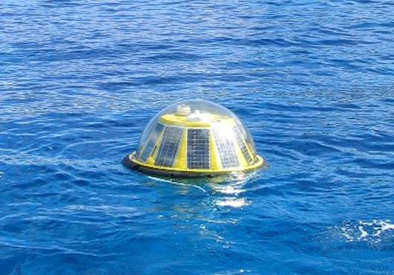
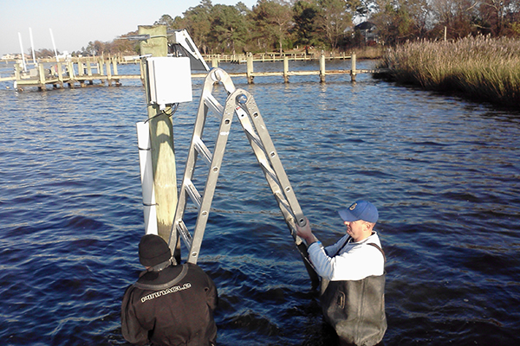
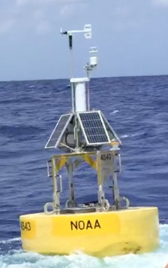
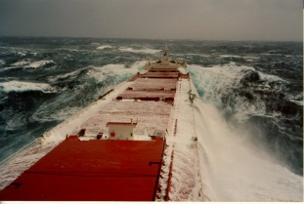
Observing systems contributing to WIGOS
Space-based
Geostationary
Polar orbiting LEO
Eliptical orbit, ....
Surface-based
Surface stations (RBSN, RBCN, AWS ..)
Climate stations (GSN)
Upper air soundings (incl. GUAN, GRUAN)
Wind profilers
Weather radars
Lightning detection systems
Aircrafts (e.g. AMDAR)
Aeronautical stations
Hydrological stations (WHOS)
Atmospheric composition, air quality monitoring (GAW)
Cryosphere observations (GCW)
Marine observations (drifters, floats, moorings, tide gauges, ships, gliders …)
Terrestrial observations (GTOS)
Surface-based space weather observations
GNSS radio-occultation
…

Slide 5
Global Observing Systems Vision 2025
(multidisciplinary)
Other considerations:
WMO Priorities
Cost effectiveness
New Technologies
Current national investments and plans
…
WIGOS Metadata
(capabilities – space & surface)
Implementation Plan
EGOS-IP
(115 actions)
OSCAR
Statements of Guidance
(gap analysis)
Critical review:
Gap analysis
Impact studies
Expert knowledge
Monitoring of actions
Implementation
Requirements
Action
“owners”
NFPs
WMO Application Areas
(direct use of observations)
WMO Members
USERS

Slide 6
The RRR process
OSCAR Platform (oscar.wmo.int) includes
OSCAR/Requirements (“technology free”)
Observing systems capabilities
OSCAR/Space: Space-based capabilities
OSCAR/Surface: Surface-based capabilities (operated with MeteoSwiss)
Critical review
Assessing gaps by comparing capabilities vs. requirements
Undertaking Impact Studies, e.g.
Observing System Experiments (OSEs)
Observing System Simulation Experiments (OSSEs)
Forecast Error Contribution (FEC), Forecast Sensitivity to Observations (FSO), …
Analysed by Experts to produce gap analysis and Statements of Guidance (SoGs)
SoGs reviewed by IPET-OSDE
Feeds into the ET-EGOS Implementation plan, and Vision of the GOS
Current EGOS-IP responding to the Vision of the GOS in 2025
Vision for WIGOS Component Observing Systems in 2040 in development with Cg-18 approval target

Slide 7
How user requirements are specified in OSCAR/Requirements
Technology free, quantitative
For each application & each geophysical variable
Horizontal resolution
Vertical resolution
Accuracy
Observing cycle
Timeliness (Delay)
Long term stability
For each parameter
“min” (or threshold)
value below which observations are worthless
“max” (or goal)
value beyond which improvement gives no additional value
“breakthrough” (or optimum)
proposed target for significant progress
optimal cost/benefit

Slide 8
Performance-benefit curve for an observing system

Slide 9
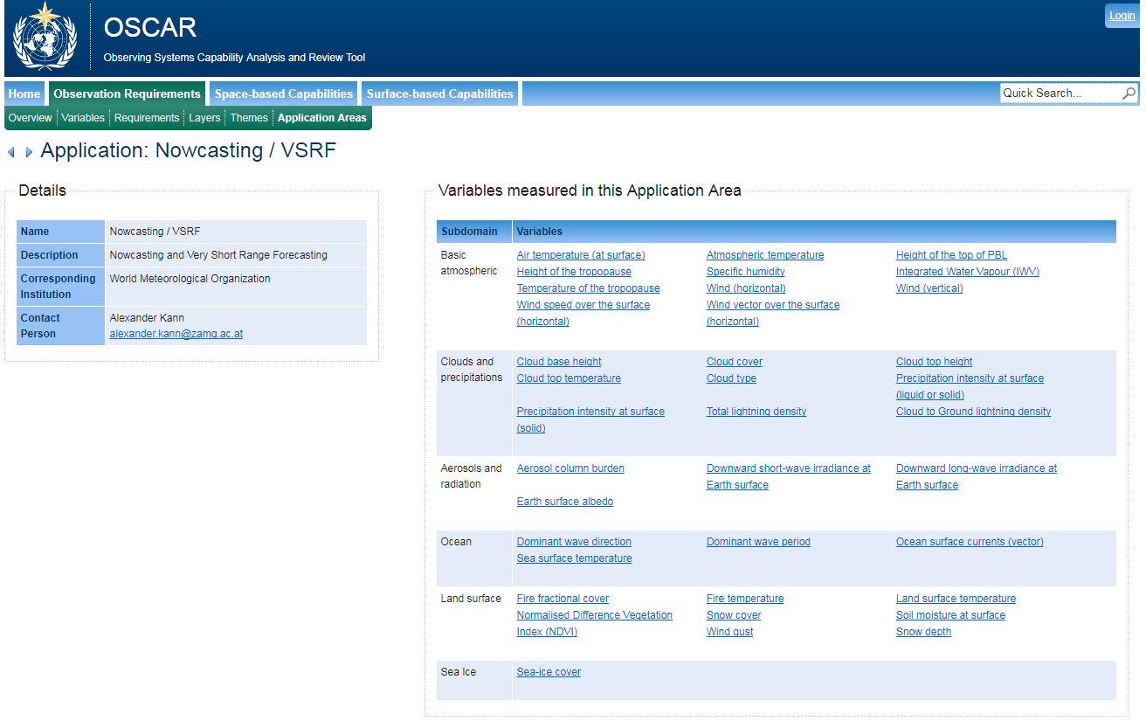

Slide 10
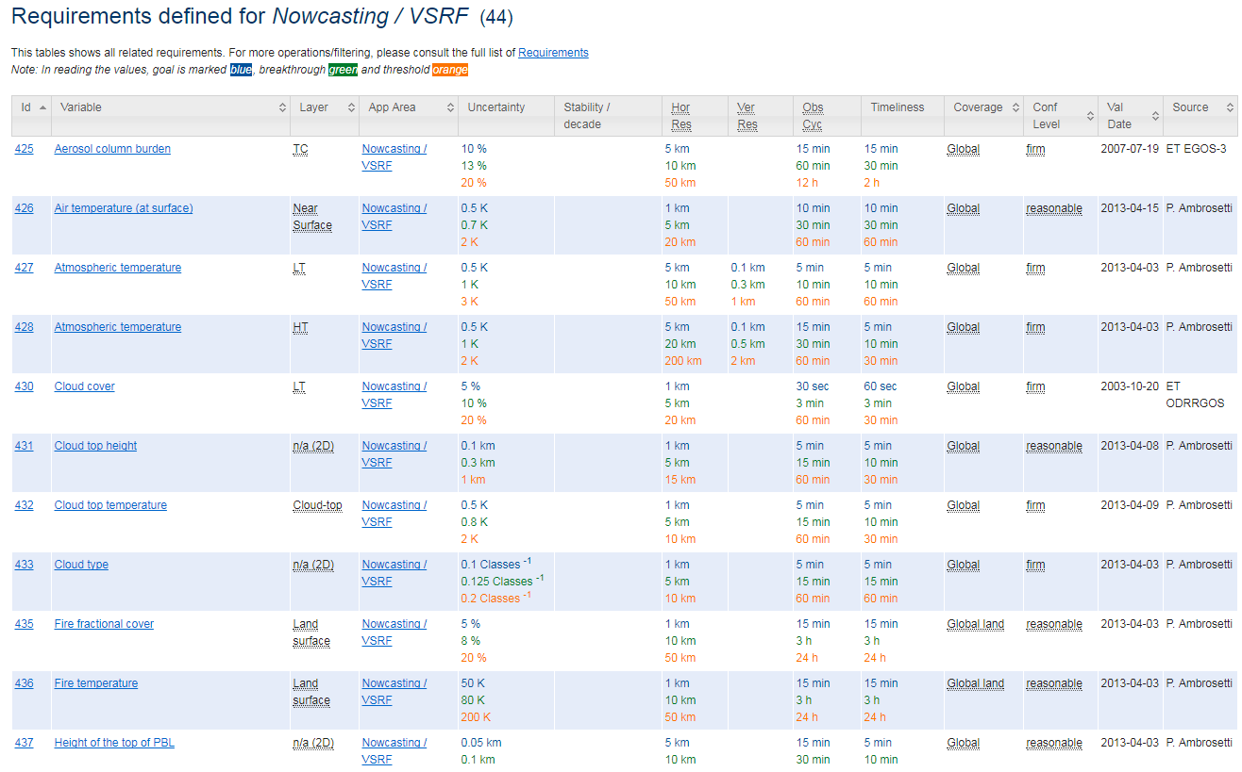
Nowcasting and Very Short Range Forecasting (example)

Slide 11
Statements of Guidance (gap analysis)
The Statement of Guidance interprets the output of the critical review as a gap analysis and identifies priorities for action: the most feasible, beneficial and affordable initiatives to deal with the identified gaps or shortcomings in WMO observing systems for an application area. This draws on the subjective judgement and experience of the Points of Contact, the experts and other stakeholders they consult within their application area.
This stage of the RRR requires the Points of Contact to coordinate with their application area community and stakeholders, as needed, in order to produce, review and revise the Statement of Guidance for the application area.

Slide 12
Statement of Guidance for Nowcasting and Very Short Range Forecasting
Developed (coordinated) by PoC
Paolo Ambrosetti (Switzerland) until Dec. 2017
Alexander Kann (Austria) since Dec. 2017
Latest version :
June 2016 (official)
Jan. 2018 (revised)

Slide 13
Statement of Guidance for Nowcasting and Very Short Range Forecasting – Summary 1/2
Key variables required
Clouds and precipitation
3-D wind field
3-D humidity field
3-D temperature field
surface variables: pressure, wind (including wind gust), temperature, humidity, present weather, visibility and precipitation intensity/accumulation, short wave irradiance, snow layer, soil moisture, lightning (actually a 3D phenomenon, but usually used as surface variable), fires
Dust/sand/volcanic ash

Slide 14
Statement of Guidance for Nowcasting and Very Short Range Forecasting – Summary 2/2
Recommendations to address gaps
Technical Infrastructure
Increase radar network density, improve frequency & geometry of scanning of obs.
Improve access to satellite data
Dev. & use of merging and interpolation techniques; foster bending techniques (obs. + NWP products)
Data availability & quality
Improve QA/QC and recording of metadata
Access to 3rd party data when «significan events»
Rapid transmission of data
Cross-border exchange of data
Capacity Building for Cross border Severe Weather Management
Promote low cost nowcasting systems
Encourage MoUs on data exchange

Slide 15
Implementation Plan for the Evolution of Global Observing Systems (EGOS-IP)
A result of the RRR process taking into account gap analyses for all WMO Application Areas, cost-effectiveness of observing systems, and the priorities of the Organization
A key document providing Members with clear and focused guidelines and recommended actions in order to stimulate cost-effective evolution of the observing systems to address in an integrated way the requirements of WMO programmes and co-sponsored programmes
Available on WMO website in 5 languages
http://www.wmo.int/pages/prog/www/OSY/gos-vision.html#egos-ip

Slide 16
115 EGOS-IP Actions
13 Overarching and cross-cutting actions (C1 to C13)
C8 - For WMO and co-sponsored observing systems, ensure continued adherence to WMO data sharing principles irrespective of origin of data, including data provided by commercial entities
59 Surface-based observing systems actions (G1 to G59)
G45 - Increase the deployment, calibration & use of dual polarization radars in those regions where it is beneficial
G46 - Perform comparison of weather radar software with the objective to improve quality of the quantitative precipitation estimates (QPE)
G47 : Weather radars for developing countries & DRR – For areas in developing countries which are sensitive to storms and floods, a special effort has to be made to establish and maintain weather radar stations
G48: Weather radar data exchange – Define weather radar data to be exchanged at regional and global levels, propose frequency of exchange of those data and develop a weather radar data processing framework, in concert with development of products based on national, regional, global requirements.
35 Space-based observing systems actions (S1 to S35)
S27 : Organize the delivery of GPM data in real-time to support nowcasting and operational hydrology requirements.
8 Space weather actions (W1 to W8)

Slide 17
Current focus of WMO regarding RRR
CBS monitoring implementation of EGOS-IP actions by Members and identified agents
CBS providing additional guidance to Members for better addressing the gaps (i.e. in addition to EGOS-IP)
Updating observational user requirements in OSCAR/Requirements and the Statements of Guidance (liaison with identified Points of Contact)
Making sure observing systems capabilities are up to date in OSCAR/Surface and OSCAR/Space
Conducting impact studies per list of science questions identified by CBS-16 per Recommendation 31 (CBS-16) and Decision 24 (EC-69)
Development of new WIGOS Vision 2040 (to replace the current Vision for the GOS in 2025) – target Cg-18 in 2019

Slide 18
More information
Website:
http://www.wmo.int/pages/prog/www/OSY/GOS-redesign.html
Vision for the GOS in 2015:
http://www.wmo.int/pages/prog/www/OSY/gos-vision.html
Statements of Guidance:
http://www.wmo.int/pages/prog/www/OSY/GOS-RRR.html#SoG
EGOS-IP:
http://www.wmo.int/pages/prog/www/OSY/gos-vision.html#egos-ip
OSCAR: http://oscar.wmo.int
Contact : echarpentier@wmo.int

Slide 19
Thank you
Merci

