Slide 1
Big Data and the WMO EC-TT-DPEI-1(2016)-d04-1(2)-Summary of Issues CBS
Fred Branski
President, commission for Basic Systems
World Meteorological Organization (WMO)
WMO; OBS/SAT

Slide 2
The Information Value Chain
What is Big Data?
“… high-volume,
high-velocity and
high-variety information assets that demand cost-effective, innovative forms of information processing for enhanced insight and decision making.” [Gartner]
Need
Requirement
Want
Observe
Measure
Collect
Transmit
Access
Share
Process
Integrate
Store
Assimilate
Incorporate
Visualize
Apply
Inform
Decide
Asses
Evaluate
Verify
Value Chain Approach to Information
Information = Data & Products

Slide 3
Data Stewardship
Data stewardship covers all the matters pursuant to the management and fitness of data and information elements as well as their relevant metadata.
This includes policies, regulations, guidelines, practices and processes, and administration to ensure compliance with those items.
Stewardship begins with generation of data and information and continues through its manipulation, usage, storage, sharing, archiving and evaluation.
It applies to existing data and information as well as planning for new data and information or new uses of data and information.
Individuals or organizations with stewardship responsibilities may have end to end roles or pick up and drop various roles at any point or points along the data and information lifecycle.

Slide 4
CBS & the Information Value Chain
DRR/ GFCS
OPAG- IOS
Need
Requirement
Want
Observe
Measure
Collect
Transmit
Access
Share
Process
Integrate
Store
Assimilate
Incorporate
Visualize
Apply
Inform
Decide
Asses
Evaluate
Verify
OPAG- PWS
DRR/GFCS
Value Chain Approach to Information
OPAG-DPFS
OPAG-ISS
DRR/GFCS

Slide 5
Products Data
OPAG- IOS
Need
Requirement
Want
Observe
Measure
Collect
Transmit
Access
Share
Process
Integrate
Store
Assimilate
Incorporate
Visualize
Apply
Inform
Decide
Asses
Evaluate
Verify
DRR/GFCS
OPAG- PWS
Services Systems
DRR/GFCS
Value Chain Approach to Information
OPAG-DPFS
OPAG-ISS
DRR/GFCS

Slide 6
CBS & the Data/Products Value Chain
Big Data
More obs
External sources
Partners
Quality?
Non-WMO standards
IoT
Timeliness
Crowd sourced
Policy
External data
Veracity
Quality?
Complexity
Forecaster tools
Filtering
Social media
Partner relations
DRR/ GFCS
OPAG- IOS
Need
Requirement
Want
Observe
Measure
Collect
Transmit
Access
Share
Process
Integrate
Store
Assimilate
Incorporate
Visualize
Apply
Inform
Decide
Asses
Evaluate
Verify
OPAG- PWS
What effect
will “Big Data”
have?
DRR/GFCS
OPAG-DPFS
OPAG-ISS
Data Volume
Integration
Filtering
Format, eg GIS
Quality?
Veracity?
Data Policy
Partner relations
External sources
Data management
Securtity
Data volume
Comms costs
Archiving
IoT
DRR/GFCS

Slide 7
WMO & the Information Value Chain
Four Functional Areas:
WIGOS
WIS
GDPFS
SDS
Need
Requirement
Want
Observe
Measure
Collect
Transmit
Access
Share
Process
Integrate
Store
Assimilate
Incorporate
Visualize
Apply
Inform
Decide
Asses
Evaluate
Verify
SDS
WIGOS
Technical Commisions
“ENGINE ROOM”
DPFS
WIS

Slide 8
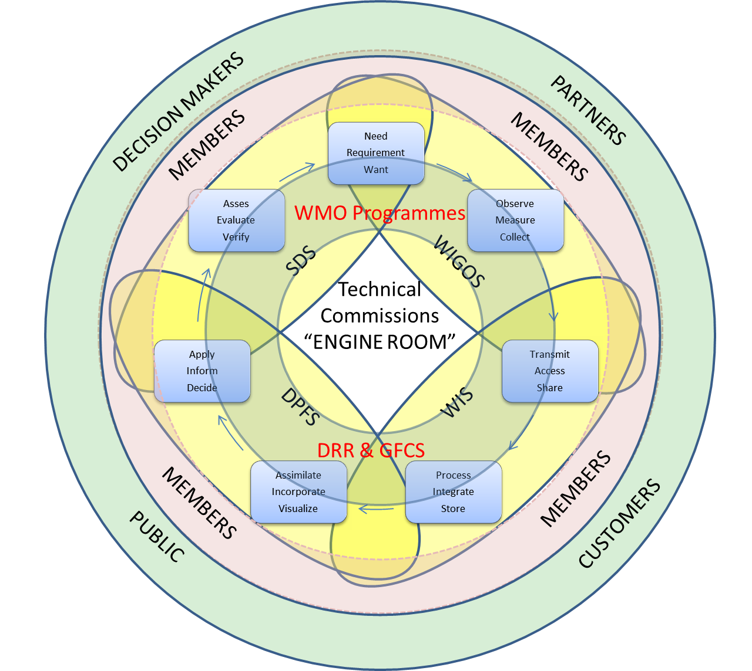
WMO & the Information Value Chain
Four Functional Areas:
WIGOS
WIS
GDPFS
SDS
Research

Slide 9
WMO & the Information Value Chain
Services Systems
Four Functional Areas:
WIGOS
WIS
GDPFS
SDS
Products Data
Research

Slide 10
Services Systems
Policy
External data
Veracity
Quality?
Complexity
Forecaster tools
Filtering
Social media
Partner relations
External sources
Partners
Quality?
Timeliness
Non-WMO
standards
Crowd sourced
IoT
External sources
Data management
Securtity
Data volume
Comms costs
Archiving
IoT
Products Data
Data Volume
Integration
Filtering
Format, eg GIS
Quality?
Veracity?
Data Policy
Partner relations
Research

Slide 11
Characterization of Big Data Issues
Straight forward to map BD issues and considerations to the functional areas
Cross referencing them with applicable TCs, Programmes or crosscuts
Matrices can help Members understand how the issues may affect them
Provide a mechanism to track strategies for dealing with them.
Some BD issues or at least their impacts and challenges are primarily in the area of technology.
Often the case for those BD issues related to volume or velocity.
Other BD issues have clear policy considerations
Often associated with the issue of BD variety.
May include privacy and intellectual property concerns
Traditional data sharing & cost recovery issues.
BD issues related to how they apply to services or more specifically to users.
User connection is very important, affects how NMHSs will service user needs.
Users vary in sophistication and ability to deal with information.
Have similar issues with volume, velocity and variety.
Useful to characterize BD issues as to whether they are policy related, technology related or user-interface related. Some may lie in more than one of these characterizations.

Slide 12
BD and the Private Sector
Changes in sourcing, provision and sharing of information that has historically been done by Members.
Not necessarily volume or velocity issues, but it is a variety issue.
Some information today is primarily provided by the private sector.
More and more traditional information is being sourced through the private sector.
Often new information types and sources especially those either outside of the mainstream hydromet realm or from social media sources are often only available either through the private sector or with their assistance.
In many cases, NMHSs may not have the skills, infrastructure, or agility to be capable these new BD sources.
The private sector plays a role in processing BD in ways NMHSs can’t.
Likewise the private sector has a role with the dissemination or delivery of information through avenues not often done well by NMHSs.

Slide 13
Closing Considerations
IDSS drives the need for not just observational data but data associated with factors and domains closely tied to users’ needs and sometimes alien to NMHSs. It also changes what and how we share our data and deliver our services.
As computational costs of models increase with more timesteps, higher resolution, etc processing demands dramatically increase. Can we increase sharing of pre-processed analysis sets? Can we move more of the modelling and post processing towards users’ devices, and let them extract whatever level of detail they need?
Traditional 'big data' analytics will become more important – to help us understand and respond to our users; to help us and them mine more information and value from each other’s data.
Although we may be focused on handling ever increasing amounts of data, we may find that the issue is not using all that data but how do we find the right data or the right amount of data that makes a significant difference. In a sense, how to we shrink BD back to small data or more appropriately the right data?

Slide 14
Closing Considerations
The value comes not from scale but from the ability to extract useful information and make decisions on the smallest, or is that smartest, data sets.
The value of data lies in it being fitness-for-purpose. How well does it meet new service needs? Does it support new monitoring, policy and research goals?
How will we use crowd-sourced data – fit for what purpose? Verification, phenomena or situation awareness, rapid response? Has the wind changed direction, where is the fire front, how big is the hail, how deep is the snow etc.
The concepts of mesonets taken to a new level, high density, urban environments, the Internet of Things – a whole new realm of opportunities.
How will BD be exchanged, processed, disseminated and archived?

Slide 15
Closing Considerations
What are the most effective dissemination infrastructures when BD just keeps getting bigger?
Where will the WIS and its dissemination and exchange infrastructure need to be in 10 years' time?
Do we need to increase high-level processing on the data before exchange.
Increased used of data portals for data discovery. Improved metadata to make datasets more discoverable within WIS or by popular search engines (e.g., Google …..)
Do we rely on existing IT tools and infrastructure or do we rely on global players in IT and the cloud – private sector (Google, Amazon, Microsoft …..)
Interoperability is key. Furthering compliance with standards and governance to enable interoperability: OGC, INSPIRE, ISO 19xxx series, NetCDF-CF, WIS, GEOSS …

Slide 16
Closing Considerations
Web services, APIs for data retrieval and manipulation. Processing done close-to-the-data.
Leverage Cloud Computing: (NIST) A model for enabling convenient, on-demand network access to a shared pool of configurable computing resources (e.g., networks, servers, storage, applications, and services) that can be rapidly provisioned and released with minimal management effort or service provider interaction.
Software As A Service (SAAS): Users can use the applications of the service provider via the network. Examples: Google Apps, SalesForce
Platform As A Service (PAAS): Users can deploy their applications on the cloud infrastructure within the technical framework offered. Examples: Google App Engine,
Infrastructure As A Service (IAAS): Clients can rent computing, storage or network capacity according to their need. They control their part of the system. Examples: Amazon EC2

Slide 17
Closing Considerations
Cloud computing has matured and is increasingly used. The development of commercial cloud services has made significant progress. US companies lead the market with large commercial clouds (Amazon, Google, Microsoft, Oracle, IBM, Vmware, etc.)
Google and global IT players are approaching Earth Observation data holders to offer their services to develop business based on information from different datasets (EO data with other non-EO data).
With Big Data from multiple sources, it is very difficult to move the data to the processing. Instead move the analysis, processing and visualisation to the data.
Pressure is increasing to reduce the cost of running IT infrastructure.
Legacy Model: Move the data to users’ computers
New model: Move the users’ computers to the data
Web services provide a standard means of interoperating between different applications, running on a variety of platforms and/or frameworks

Slide 18
Closing Considerations
The Open Geospatial Consortium (OGC) have defined a number of specifications for accessing geospatial information ... maps, features, grids etc. The OGC is a non-profit international organization founded in 1994. It is based on consensus from governments, private Industry, Academia and NGOs. Some standards are fast tracked in ISO. The aim is to ensure interoperability for geospatial data and services.
Are NMHSs nimble enough to adopt and apply new approaches to handling BD before they become outdated? It’s hard for government agencies with strict procurement processes; maybe this is something that encourages us to look at private sector partnerships
Finding the right balance between focusing on data, systems, science and service – these are our 'nexus of forces', making sure we maintain an alignment and balance across them. That has driven the big revolution in forecasting – as satellite data exploded and supercomputers got bigger, our NWP/science got smarter and our services got better. The challenge in the future is too keep that balance – or at least, to keep the tension between these 4 things at the right level to push the others along and upwards together. Too much data and it is wasted time and money; if the science cannot keep up, we won't extract the value from the data; etc

Slide 19
Closing Considerations
Security – everything is at risk these days. As they say, all systems will be infiltrated. The challenge is to know when and where it has happened and recover quickly. Understanding what you have to protect, where the value is, what is reproducible, what is critical to services is key. It's not just about 'big' data but valued data.
Verification – data that can tell you that you are delivering value, delivering accurate and trusted forecasts, warnings, etc. You need the proof to demonstrate that the services you deliver are right, to build confidence to ensure that they are trusted and applied, in order to deliver real value to users (economic, safety etc).
BD may the meteor of volcano that drives an NMHS extinction event or it may be the holy grail that gives us new life – it all depends on how we prepare and deal with it.
Our ability to observe and process are outpacing our ability to analyse and distribute.
This is made more complex and difficult because we are moving from a paradigm where we have had control of the data because we generated it to one where we are increasingly need and use externally sourced data.

Slide 20
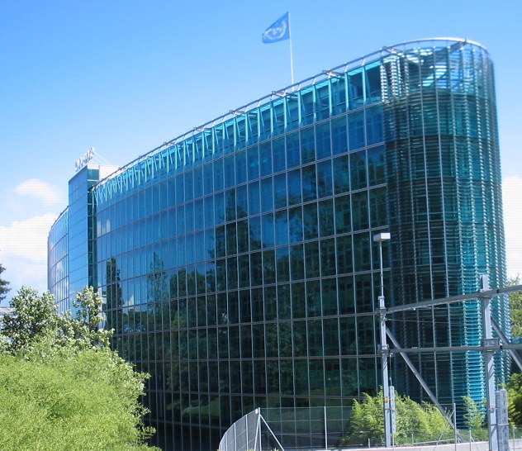
Thank You!
Notes:
20
20

