Slide 1
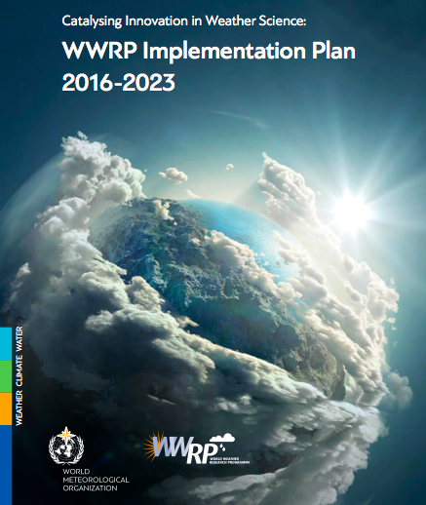
Arctic and Antarctica drive a new era in climate and weather science
Paolo Ruti, World Weather Research Division

Slide 2
Historical background
1950
63
1967
1970 ---- 1974
1985
1985
1998
2004
2014
WGNE, Working Group on Numerical Experimentation
THORPEX (Observing System and Predictability Experiment) established as a WWRP Working Group
GARP (Global Atmospheric Research Programme) established by WMO (World Meteorological Organization)
WMO the specialized agency of the United Nations for meteorology
Conduct of GARP Regional Experiments:
GATE:GARPAtlanticTropicalExperiment
MONEX:MonsoonExperiment
ALPEX:AlpineExperiment
AMEX:AirMassTransformationExperiment
WWRP (World Weather Research Programme) established in cooperation with GEWEX.
MAP & Sidney2000
World Weather Watch
WCRP, World Climate Research Programme
(WMO, ICSU)
1st World Weather Research Open Science Conference, Canada
Notes:
GARP 15 years programme
WCRP first agreement in 1980 WMO-ICSU, new agreement in 1993 WMO-ICSU-ICO … it is time to have a new one in 2020 …
Why an observational campaign is so important …

Slide 3
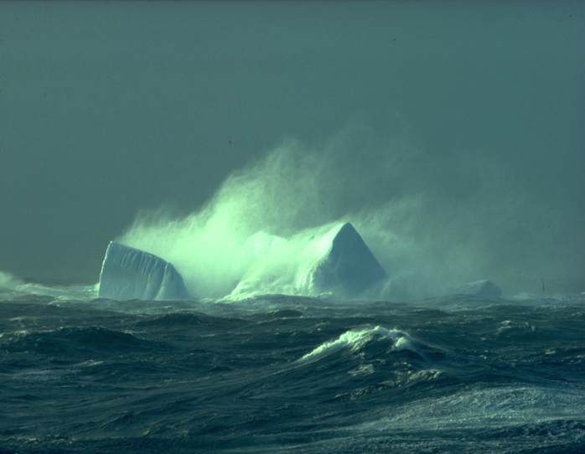
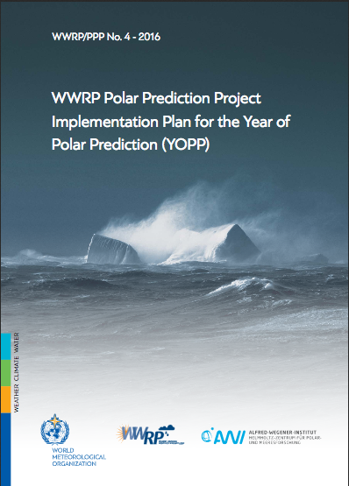
The Polar Prediction Project
Promote cooperative international research enabling development of improved weather and environmental prediction services for the polar regions, on time scales from hourly to seasonal
Chair: Thomas Jung, AWI
Project Office: Alfred Wegener Institute, Germany
Budget: Only Voluntary Contributions
Notes:
WMO decisions ….

Slide 4
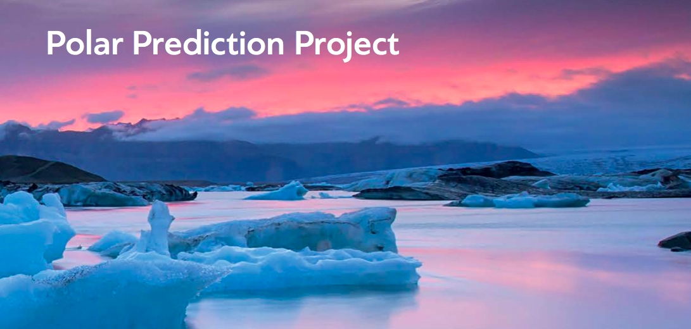
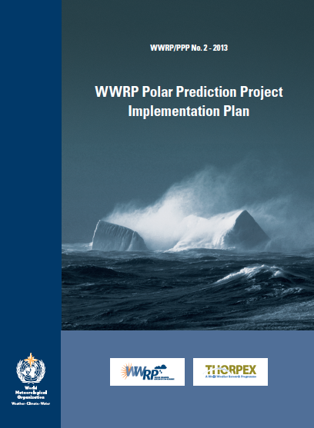
Promote cooperative international research enabling development of improved weather and environmental prediction services for the polar regions, on time scales from hourly to seasonal
Chair: Thomas Jung, AWI
Project Office: Alfred Wegener Institute, Germany
Project Office: Alfred Wegener Institute, Germany

Slide 5
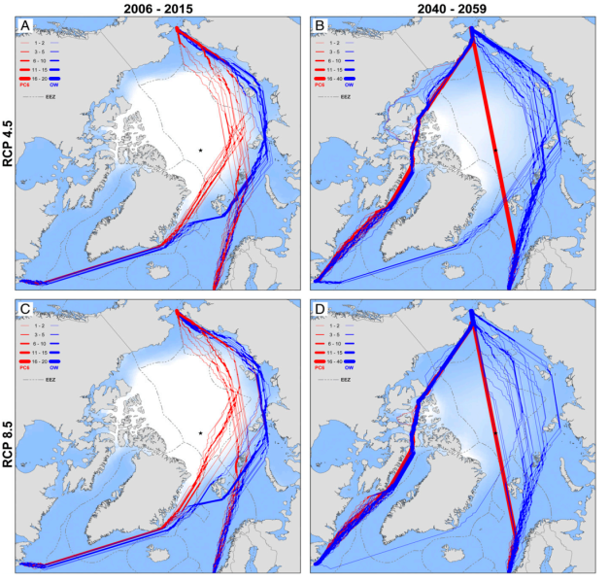
Anthropogenic divers
Projected future shipping traffic for a medium-low radiative forcing – RCP4.5 (A, B) and high radiative forcing – RCP 8.5(C, D) for the 2050 time period compared to 2006-15 baseline period. The blue line represents projections for an open-water vessel (not ice-strengthened), and the red line represents projections for Polar Class 6 (ice-strengthened) vessels. (Smith and Stephenson, 2013
Notes:
Ship routing

Slide 6
Gaps to be filled
Observations, modeling, services. How to make polar challenges and opportunity

Slide 7
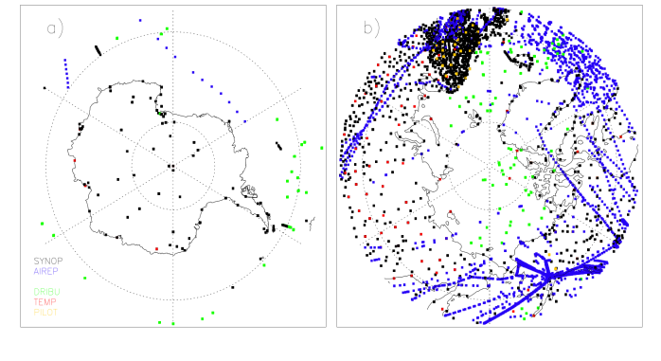
Gaps in the observing systems
Synop, AIREP, DRIBU, TEMP and PILOT
P. Bauer (ECMWF)
Polar data coverage of conventional observations in the ECMWF operational analysis on a particular winter day
“We commit to the shared development of a science-driven, integrated Arctic-observing system that has mechanisms to maximize the potential of community-based observing …. and actions to provide enhanced and open access to data, products, and services.” Joint statement of 22 countries, EU and in partnership with Arctic Indigenous representatives at the first White House Arctic Science Ministerial 28 September 2016, Washington, DC, USA
Notes:
Synop, Radisoundings (TEMP), AIRcraft REPorts (AIREPS), Drifting Buoy (DRIBU), data entered into the ECMWF assimilation system.

Slide 8
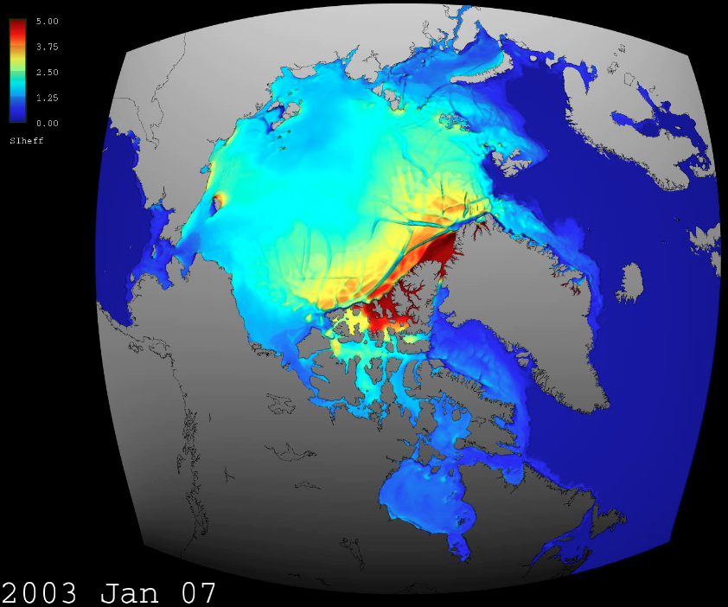
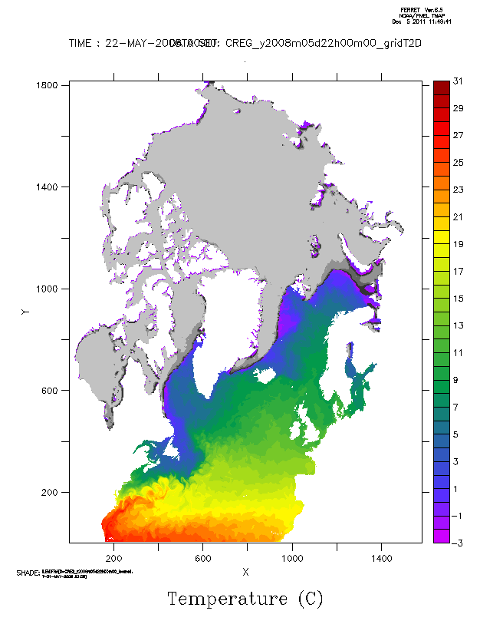
Need for coupled predictions
Example: High-resolution sea ice modelling
MITgcm @ 4km resolution, Simulation desribed in Nguyen et al (2012) and Rignot et al. (2012)

Slide 9
The Year of Polar Prediction
Main plans, countries contribution, data strategy

Slide 10
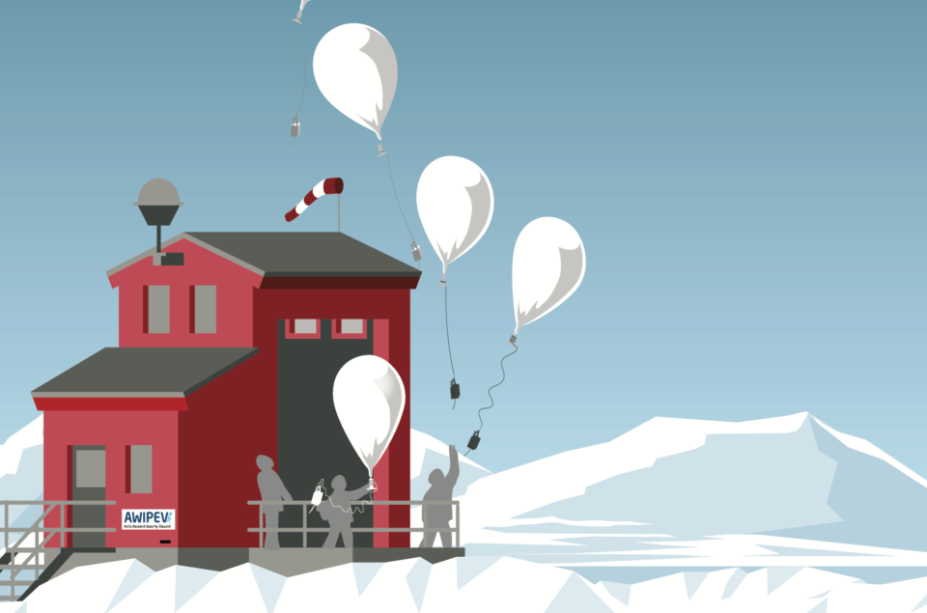
2017-2019
The Year Of Polar Prediction
Driving Innovation Together
Arctic-Antarctic
And linkages to mid-latitudes
WMO Polar Prediction Project is launching a modelling and field campaign (Year of Polar Prediction, mid-2017 to mid-2019) assist planning an Arctic observational network for improving predictive capabilities
Notes:
The WMO World Weather Research Programme’s Polar Prediction Project aims to advance the science in numerical models, data acquisition and assimilation, ensemble forecast methods, verification, and the production of prediction products – all with a polar emphasis. Observations are a key element in this endeavour. The polar regions are among the most sparsely observed parts of the globe by conventional observing systems such as surface meteorological stations, radiosonde stations, and aircraft reports.
Recognizing this, one important international initiative is the Year of Polar Prediction (YOPP) with a large field campaign scheduled from mid-2017 to mid-2019. Given the relatively high costs of taking observations in polar regions, it is necessary to agree on at least some special observing periods (SOPs), both for the Arctic and Antarctica. For the Arctic we expect to have one SOP during the winter of 2017/18, one in the extended summer season of 2018 and one during the winter of 2018/19. In total we should aim for 7 months worth of SOPs (3 in summer + 4 in winter) during the YOPP core period when increased radiosounding (up to 4 per day), sea-ice and ocean buoy measurements, additional land observations, flights will flow into the GTS system.

Slide 11
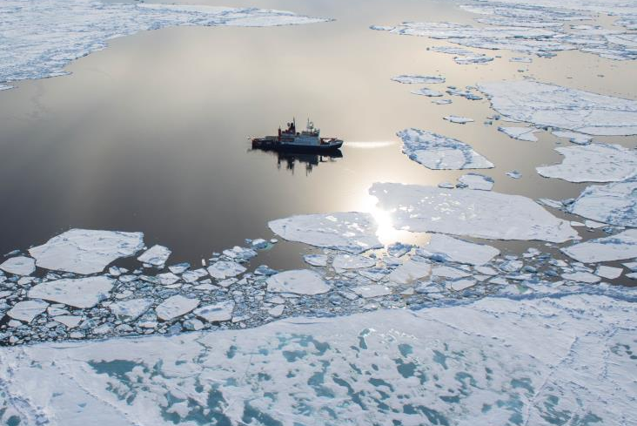
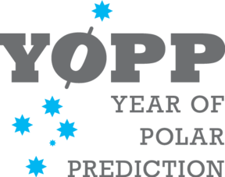
Designing Polar Prediction Systems
A modelling and field campaign from mid-2017 to mid-2019 for improving predictive capabilities
Year of Polar Prediction
Notes:
The YOPP Core Phase will be from mid-2017 to mid-2019, flanked by a Preparation Phase and a Consolidation Phase. YOPP is a key component of the World Meteorological Organization – World Weather Research Programme (WMO-WWRP) Polar Prediction Project (PPP).
The WMO World Weather Research Programme’s Polar Prediction Project aims to advance the science in numerical models, data acquisition and assimilation, ensemble forecast methods, verification, and the production of prediction products – all with a polar emphasis. Observations are a key element in this endeavour. The polar regions are among the most sparsely observed parts of the globe by conventional observing systems such as surface meteorological stations, radiosonde stations, and aircraft reports.
Recognizing this, one important international initiative is the Year of Polar Prediction (YOPP) with a large field campaign scheduled from mid-2017 to mid-2019. Given the relatively high costs of taking observations in polar regions, it is necessary to agree on at least some special observing periods (SOPs), both for the Arctic and Antarctica. For the Arctic we expect to have one SOP during the winter of 2017/18, one in the extended summer season of 2018 and one during the winter of 2018/19. In total we should aim for 7 months worth of SOPs (3 in summer + 4 in winter) during the YOPP core period when increased radiosounding (up to 4 per day), sea-ice and ocean buoy measurements, additional land observations, flights will flow into the GTS system.

Slide 12
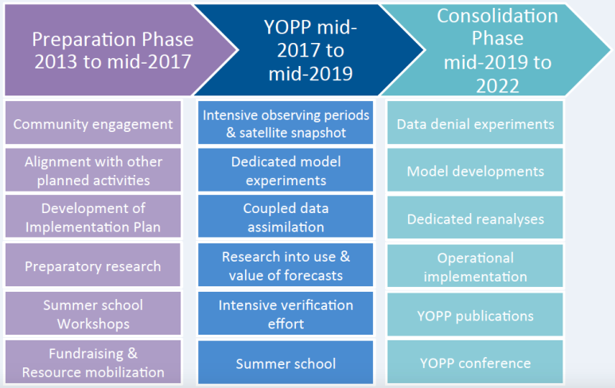
How? Year of Polar Prediction

Slide 13
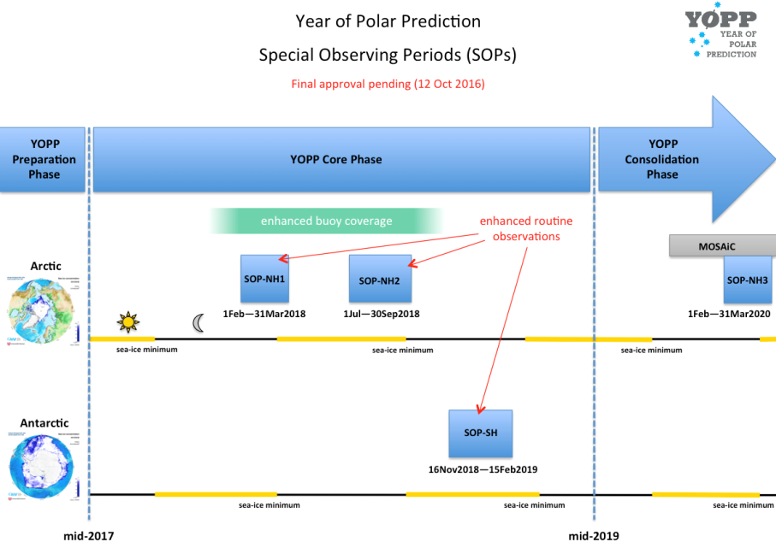
Special Observing Periods

Slide 14
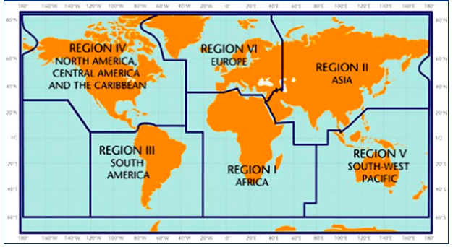
International Engagement
Canada, USA
Germany, UK, Iceland, Norway, Sweden, Finland, France, Denmark, Belgium, Netherland, Italy, Spain
China, Japan, Rep of Korea, Russia
Brazil
EU
Australia, New Zeeland

Slide 15
Polar & High Mountain Regions
Global Integrated Polar Prediction System
Global Cryosphere Watch
Polar Climate Predictability Initiative
Polar Prediction project
WIGOS
Notes:
WMO decisions ….

Slide 16
Useful links
Polar Prediction Project
http://www.polarprediction.net/background/
YOPP
http://www.polarprediction.net/yopp-activities/
YOPP explorer
http://www.polarprediction.net/yopp-activities/yopp-explorer/
YOPP observation layer
http://www.polarprediction.net/yopp-activities/yopp-observations-layer/…
Notes:
WMO decisions ….

Slide 17
Thank you
Merci

