Slide 1
Overview of the WMO Integrated Global Observing System (WIGOS);
Lars Peter Riishojgaard
WMO Secretariat, Geneva

Slide 2
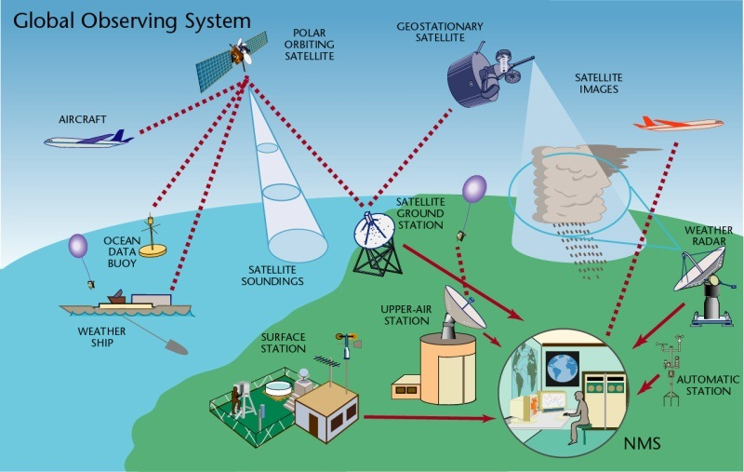
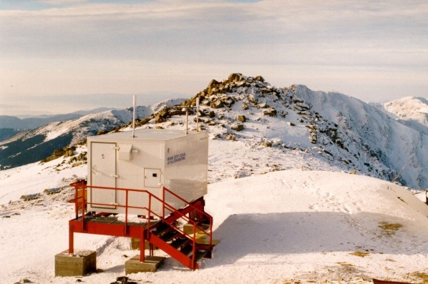
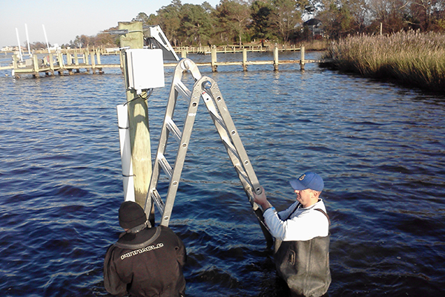
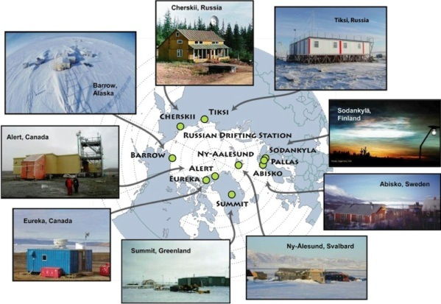
WIGOS Component Systems
Global Observing System (WWW/GOS)
Observing component of Global Atmospheric Watch (GAW)
WMO Hydrological Observations (including WHYCOS)
Observing component of Global Cryosphere Watch (GCW)

Slide 3
WIGOS Implementation Phase (2012-2015) (decided by Cg-16 in 2011)
WIGOS Regulatory Material, including a WIGOS Metadata Standard
Formal adoption of Rolling Review of Requirements
Initial development of RRR tools, i.e. OSCAR databases
OSCAR/Requirements
OSCAR/Space
OSCAR/Surface
Concept development of WIGOS Data Quality Monitoring System
Plan for WIGOS Pre-operational Phase 2016-2019

Slide 4
The WIGOS Pre-Operational Phase (2016-2019) decided by Cg-17 in 2015
Increased emphasis on regional and national activities
Five main priority areas:
WIGOS Regulatory Material, supplemented with necessary guidance material
WIGOS Information Resource, including the Observing Systems Capabilities analysis and Review tool (OSCAR), especially OSCAR/Surface
WIGOS Data Quality Monitoring System (WDQMS)
Regional Structure; Regional WIGOS Centers
National WIGOS Implementation, coordination and governance mechanisms

Slide 5
WIGOS Operational Phase (2020 - ) to be decided by Cg-18 in 2019
WIGOS tools ready to serve Members in operational mode
WIGOS to become WMO Program element or WMO Basic Infrastructure
Exact role will depend on WMO governance structure reform, currently still in development
Congress-18 will discuss and hopefully adopt a Vision for WIGOS in 2040
This will become the main driver of the further development of WIGOS

Slide 6
A few key WIGOS principles
Design observing systems to meet specific requirements
Requires structured inventory of requirements and existing and planned capabilities
Design observing systems with a view toward synergies between different application areas
Do not install separate systems for weather and climate measuring of e.g. atmospheric temperature
One observation, many applications, many users
Space- and surface-based observing networks seen together as one integrated system
Complementary capabilities, designed based on information about what the other component can/will provide

Slide 7
What do we mean by Integration?
Integrated network design, e.g. across national borders:
Radar and lightning detection networks
Radiosonde networks designed together with those of neighboring countries
Integration across disciplines: Multi-purpose networks
No separate networks for application areas that rely on measurements of the same variables, e.g. weather and climate
Integration across organizational boundaries:
Take advantage of other organizations outside the NMHS that operated observing systems; partner with them where possible

Slide 8
What do we mean by Integration? (II)
Integration across technological boundaries; space- and surface-based observing system as one
Space-based components provide excellent spatial and temporal coverage
Ground-based components provide fine-scaled structure, in situ validation and can provide measurements not possible from space
Integration across different levels of performance; concept of tiered networks can include e.g.
Crowd-sourced data, IoT observations (massive amounts of data, poor or unknown quality)
Standard networks; routine, operational quality data
Reference networks with data traceable to SI standards (fewer data, very high quality)

Slide 9
WIGOS Network Design Principles (from WMO 1160 « Manual on WIGOS »)
According to the Manual on WIGOS, networks should be designed with a view toward:
1. Serving many application areas
2. Responding to user requirements
3. Meeting national, regional and global requirements
4. Designing appropriately spaced networks
5. Designing cost-effective networks
6. Achieving homogeneity in observational data
7. Designing through a tiered approach
8. Designing reliable and stable networks
9. Making observational data available
10. Providing information so that the observations can be interpreted
11. Achieving sustainable networks
12. Managing change

Slide 10
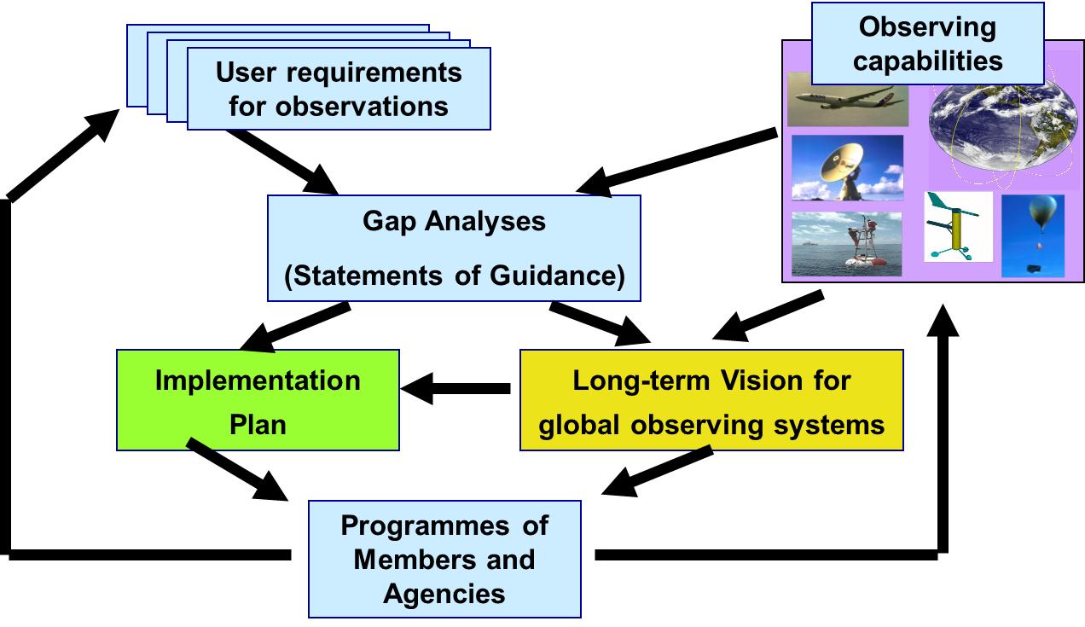
Rolling Review of Requirements (RRR)
WMO Congress: All WMO and WMO co-sponsored observing systems shall use the RRR to design networks, plan evolution and assess performance.
The RRR is the process used by WMO to collect, vet and record user requirements for all WMO application areas and match them against observational capabilities
Rolling Review of Requirements

Slide 11
WMO Application Areas listed in the RRR
(February 2018)
Global numerical weather prediction
High-resolution numerical weather prediction
Nowcasting and very short range forecasting
Seasonal and inter-annual forecasting
Aeronautical meteorology
Forecasting atmospheric composition
Monitoring atmospheric composition
Atmospheric composition for urban applications
Ocean applications
Agricultural meteorology
Hydrology
Climate monitoring
Climate applications
Space weather
Climate Science

Slide 12
OSCAR
The RRR is supported by three key databases of OSCAR, the Observation Systems Capabilities and Review tool :
OSCAR/Requirements, in which “technology free” requirements are provided for each application area, expressed in units of geophysical variables (260 in total currently), not measurands; not just atmosphere, also terrestrial, ocean, cryosphere, …
OSCAR/Space, listing the capabilities of all satellite sensors, whether historical, operational or planned
OSCAR/Surface, list surface-based capabilities; developed by MeteoSwiss for WMO, operational since May 2016
OSCAR homepage

Slide 13
OSCAR/Requirements
The following requirements are listed for each of the (currently 14 application) areas and for all relevant geophysical variables (currently more than 200):
Spatial (horizontal and vertical) and temporal resolution, uncertainty, data latency, required coverage area, source, and level of confidence
Each requirement is expressed in terms of three separate values:
Threshold (observations not useful unless this is met)
Break-through (optimum cost-benefit ratio)
Goal (exceeding this provides no additional benefit)
OSCAR/Requirements information content is assembled by CBS and other WMO Inter-Program Expert Teams and Task Teams and is informed by the broader scientific community

Slide 15
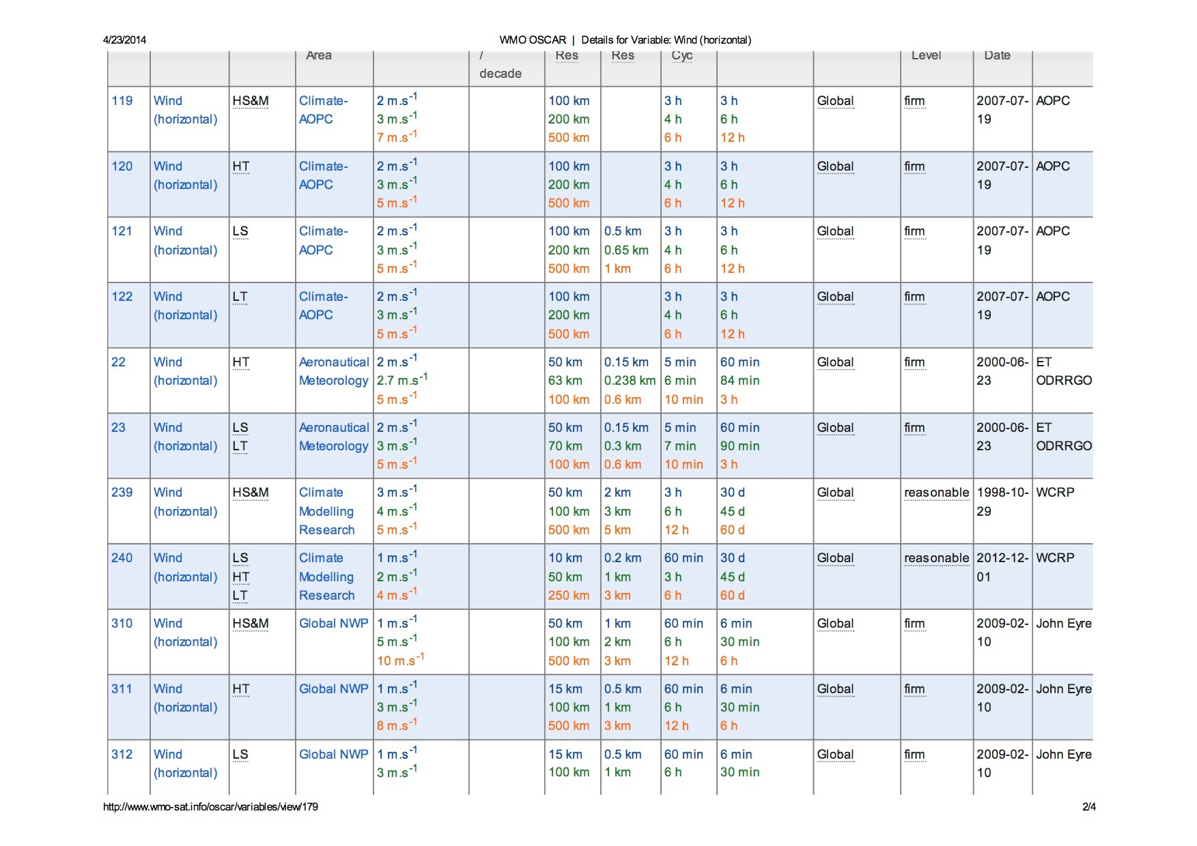

Slide 16
OSCAR/Space
Repository of metadata about all satellite sensors (past, present and future) relevant to WMO Programs and Application Areas
Instrument type, measurement technique, high-level characteristics (mass, power, data rate)
Programmatic information, e.g. agency, measurement program, operating period, heritage, etc.
Orbit, coverage, repeat frequency, resolution
Capabilities, expressed in terms of geophysical variables that can be derived from the measurements provided by the sensor, listed in order of decreasing fidelity
OSCAR/Space 2.0 released in June 2016
Objective, rule-based assessment of capabilities
Unique to OSCAR/Space

Slide 17
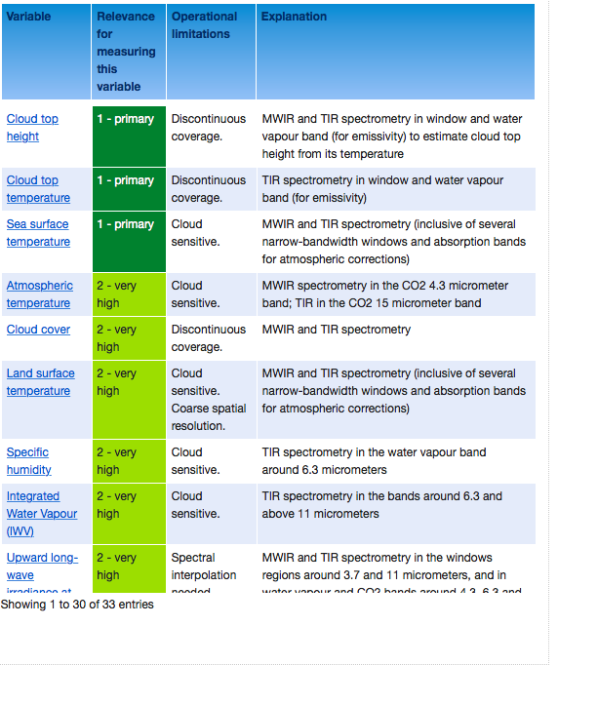
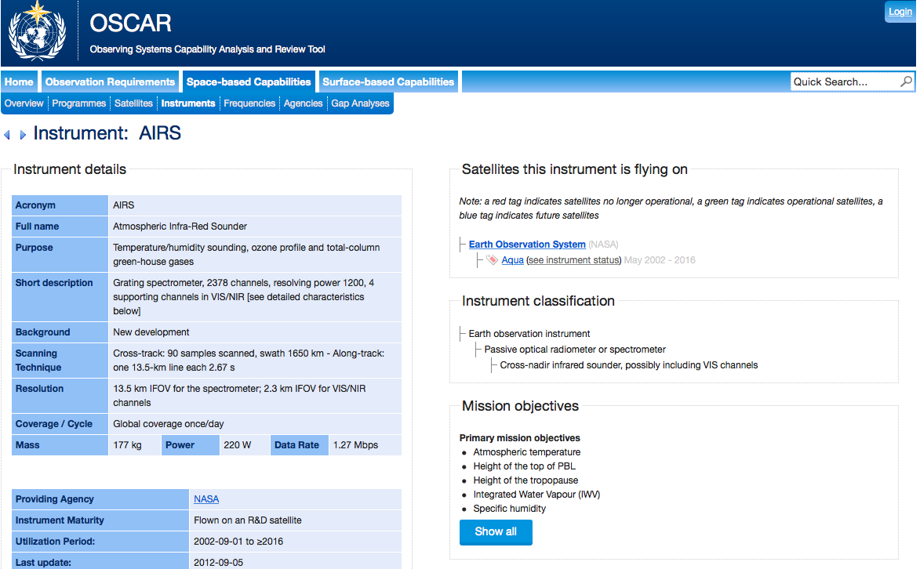

Slide 18
OSCAR/Surface
(“What is WIGOS?”)
Implementation layer of the WIGOS Metadata Standard: Modern, electronic, searchable inventory of metadata for all observing stations/platforms under WIGOS
OSCAR/Surface will replace WMO Pub. 9, Volume A, but will also include information from similar inventories for other (non-GOS) components of WIGOS
Developed jointly by WMO and MeteoSwiss, with the Swiss government providing the major part of the funding
Operational since May 2016
Education and training Members in populating, editing and using OSCAR/Surface is a major priority for 2016-2019 financial period

Slide 19
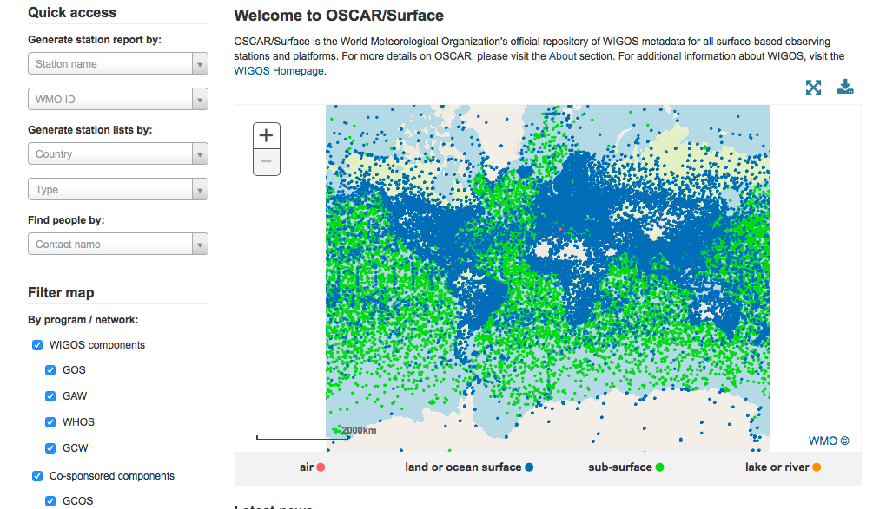
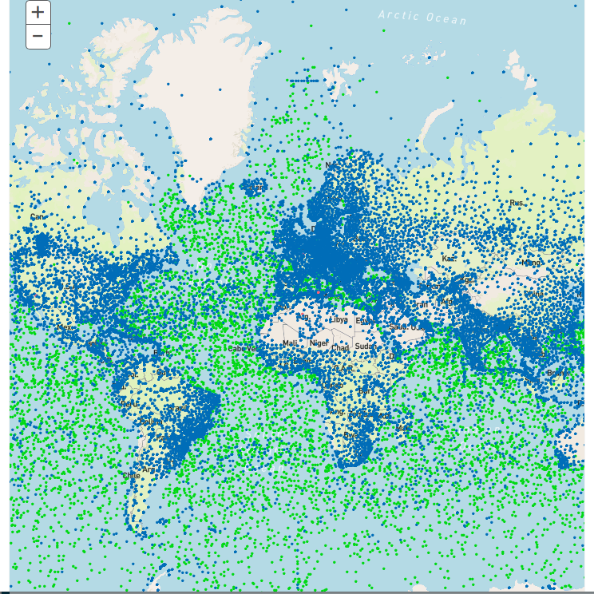
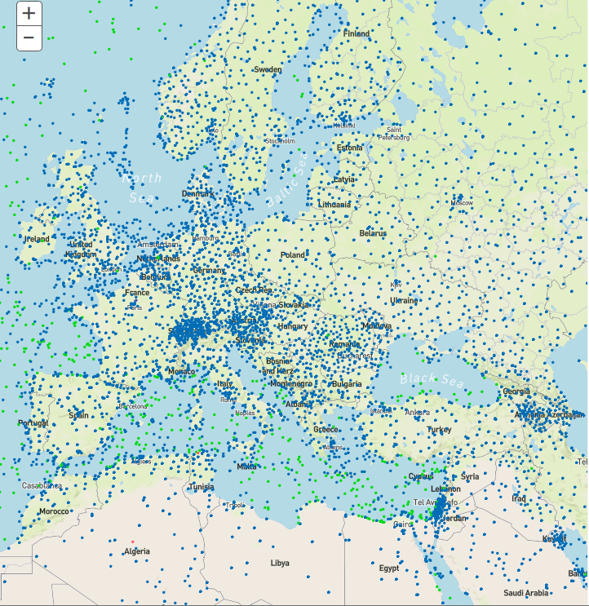
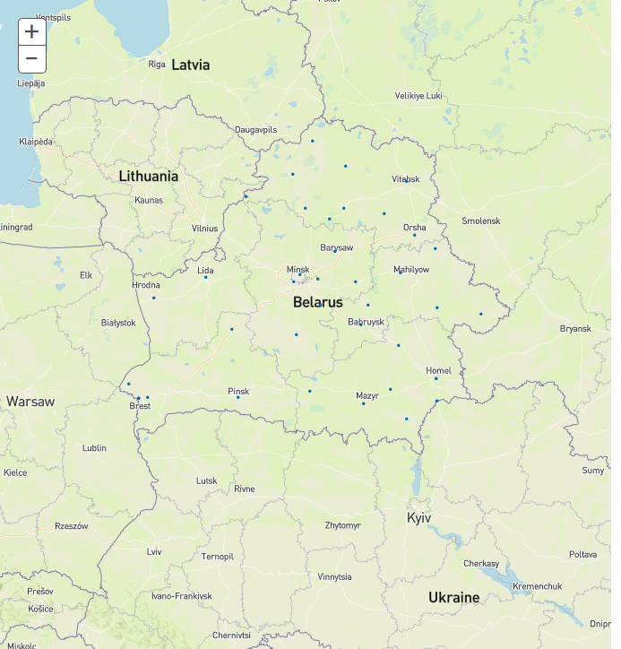
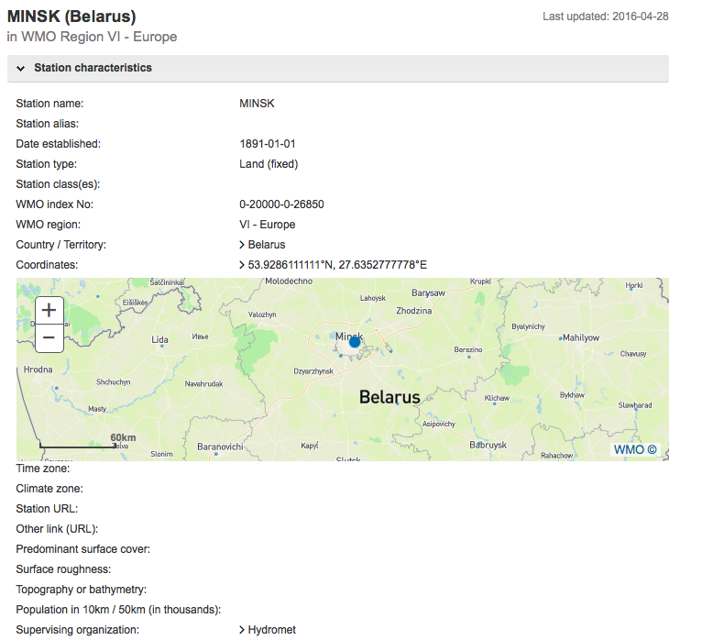
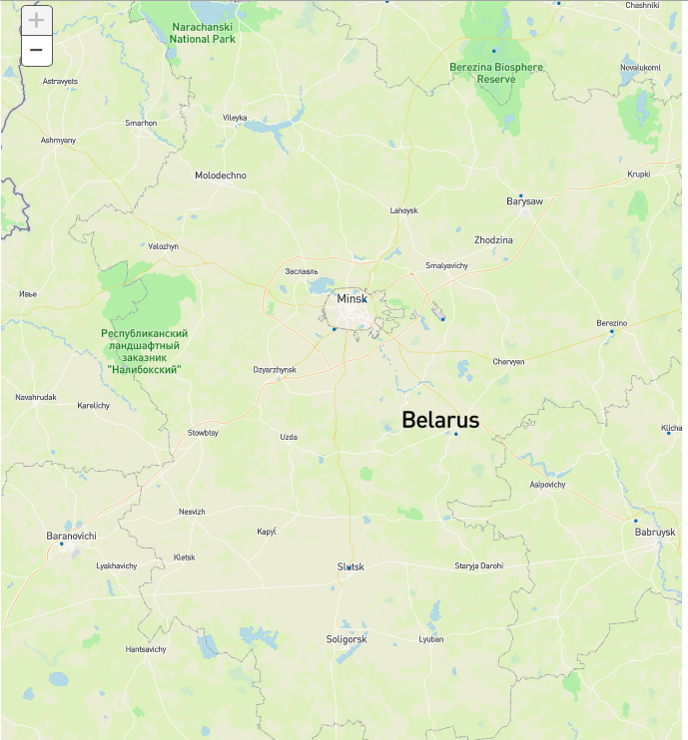

Slide 20
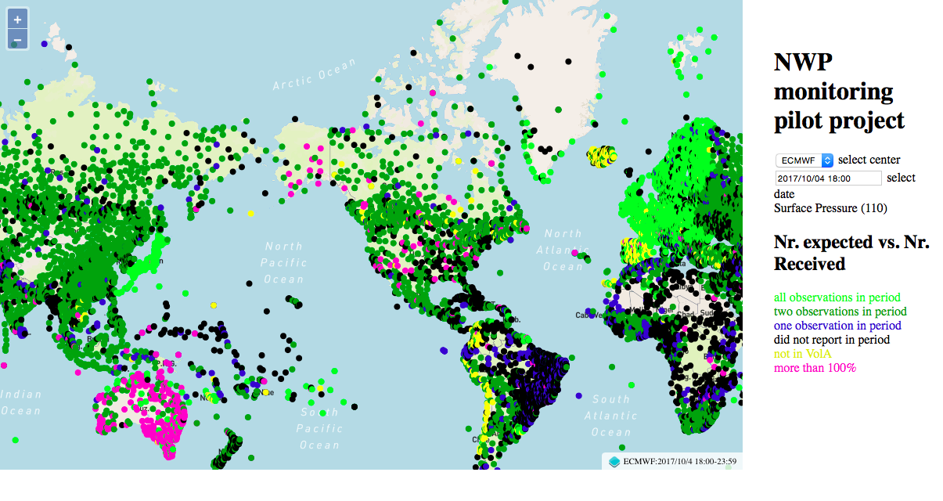
WIGOS Data Quality Monitoring System (WDQMS)
Real-time monitoring of performance (data availability and data quality) of all WIGOS components, searchable by region, country, station type, period, etc.
Delayed mode monitoring of data quality as measured against reference sources of information will be included for non-real time observations
Incident management component for mitigation of performance issues
The WDQMS will provide a complete description of how well WIGOS is functioning
Current activities
Pilot project on NWP-based monitoring; ECMWF, NCEP, DWD, JMA
RA-I Demonstration Project of monitoring and incident management involving Kenya and Tanzania running through 2017

Slide 21
WIGOS Station Identifiers
Using the old 5-digit WMO station IDs many WMO Members have run out of numbers, and this problem will be exacerbated my integrating external (non-NMHS owned) systems in WIGOS
WIGOS four-block IDs {nnn.nnn.nnn.xxx} will solve this problem, but will create new ones:
No national process for assigning the new IDs
Observation databases and NWP ingest software is often hard-coded for old-style WIGOS IDs
TAC cannot accommodate WIGOS IDs; will force migration to BUFR
Guidance under development in the Secretariat
Task Team on WIGOS IDs established by ICG-WIGOS

Slide 22
Regional WIGOS Centers (RWC)
Why?
Many WMO Members requesting support from Secretariat for national implementation efforts
Can be addressed more efficiently and effectively at regional level
What?
Initial role or RWC will be to support national WIGOS Implementation efforts, in particular as concerns
OSCAR/Surface; ensuring metadata input and QC
WDQMS; especially fault management component
How?
To be decided by individual WMO Regions - will likely take place primarily at the sub-Regional level, aligned with existing cultural, linguistic and/or political groupings of countries

Slide 23
Regional WIGOS Centers (II)
Region I: Interest (e.g. Morocco, Tanzania); limited national resources, WMO seeking donor funds; sub-regional basis.
Region II: Interest from China, Japan, Saudi Arabia; will be done on a sub-regional basis; two Workshops planned for 2018
Region III: plans for Virtual RWC maturing; Region VI used as model; will be centered on WIGOS-SAS Project
Region IV: no way forward yet
Region V: Australia, Fiji, Indonesia and Singapore have all informally expressed interest; to be discussed during RA-V MG at EC-70
Region VI: successful RWC operating in pilot mode at DWD thanks to EUTMETNET engagement, with partial functionalities; interest also from Croatia (marine observations) and Belarus (Eurasian countries in RA II and RA VI)

Slide 24
Summary and Conclusions
WIGOS is a global framework for integrating all WMO and co-sponsored observing systems under a common regulatory and management umbrella
Purpose is to help WMO Members provide and gain access to more observational data at reduced cost by taking an integrated approach
Regulatory material and technical systems to facilitate has been implemented by WMO and is still undergoing further development
Strong involvement from Members is necessary and is beginning to happen
Transition to WIGOS IDs and uptake of OSCAR/Surface are the main technical tasks
Regional WIGOS Centers to provide important support functions for Members

