Slide 1
WMO GMAS
Global Multi-Hazard Alert System
Framework for Meteorological and Hydrological Early Warnings
and Hazard Mapping Services
Ivan Čačić President RA VI
Member of WMO EC WG DRR / EG GMAS

Slide 2
Developent of Global DRR Services Platform
Key Drivers
WHY
Background - World Meteorological Organization Convention:
All WMO Members need to work together to coordinate, standardize, improve and encourage efficiencies in the exchange of meteorological, climatological and hydrological and related information between them, in the aid of human activities
Meteorology is best coordinated at the international level
The need for close cooperation with other international organizations
Increasing impacts related to weather, water and climate hazards at the national, regional and global levels
Significant advancements in the accuracy and timeliness of monitoring, forecasting and warnings capacities
The development of global indicators to measure success of warnings (i.e. Sendai Framework Agreement) which will require coordinated responses from Members
2 /16

Slide 3
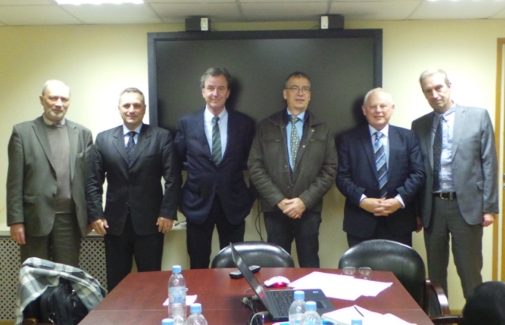
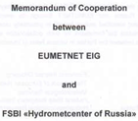
Developent of Global DRR Services Platform
Some roots of the WMO GMAS Initiative
WHY
Moscow meeting
14th October 2016, Moscow, Russian Federation
Connecting EUMETNET, and Roshydromet under the RA VI umbrella
Preliminary discussions on establishment of cooperation
between the WMO/RA VI-Roshydromet-EUMETNET
--- closer co-operation of Meteo-Alert and MeteoAlarm ---
Moscow meeting has given initial momentum
for launching WMO GMAS initiative,
and acts as the first GMAS milestone
3 /16

Slide 4
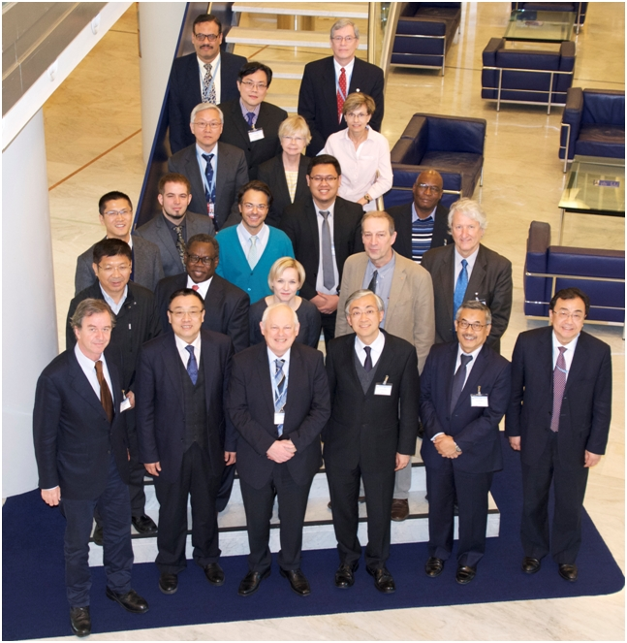
Developent of Global DRR Services Platform
WMO GMAS Initiative
WHY
Excellent way to strengthen the
authoritative source of information
visibility of NMHS at the
national, regional and global scales
visibility of the WMO at the UN level
Fits the need for an aggregated platform to inform on hazard-related events worldwide to support UN Humanitarian activities, including the new UN Operation and Crisis Center (UNOCC)
known also as the “nerve centre of the United Nations”
First Meeting of the Advisory Group
and Technical Team on WMO GMAS
Geneva, 13-15 March 2017
4 /16
Notes:
UNOCC is known as the “nerve centre of the United Nations”. The UNOCC provides support to senior leaders across the UN system, enabling informed, timely and coordinated decision-making and strategic engagement on UN field operations and crisis-related issues. UNOCC was established at UN Headquarter in a joint effort by 10 stakeholders, which represent the three UN pillars of peace and security, human rights and development. The UNOCC has three basic functions: situational awareness, crisis response support, and executive communication.

Slide 5
Developent of Global DRR Services Platform
WMO GMAS Benefits
WHY
Provision of authoritative information and advice to agencies operating at global and regional levels (including UN and humanitarian agencies)
Increased recognition of the NMHS products and services
Increased standardization of hydrometeorological warning information among WMO Members (through utilization of Common Alerting Protocol)
Increased sharing and harmonization of hydrometeorological
warning and hazard products / information (when appropriate)
among WMO Members
Increased focus on NMHS capacity development to provide reliable, actionable and timely warnings for hydrometeorological hazards
Better informed
United Nations system, particularly decision makers in humanitarian agencies
general public
tourism sectors
other sectors vulnerable to hydro-meteorological hazards
through quick access to national warning information
5 /16

Slide 6
GMAS Vision
WHAT
To be recognized globally
by decision makers
as a resource
of authoritative warnings and information related to high-impact
weather, water, ocean and climate events
6 /16

Slide 7
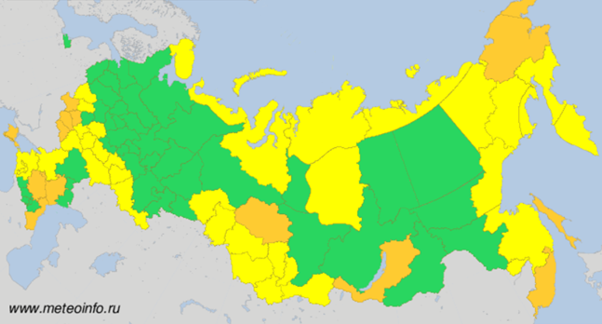
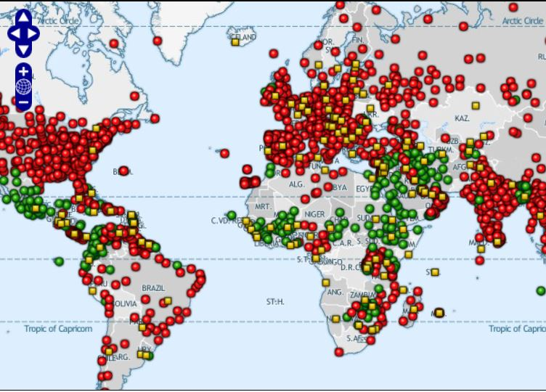
Existing DRR Services Platform
Meteoalarm (EUMETNET)/ Meteo-Alert (Roshydromet)
WWIS/SWIC
7 /16

Slide 8
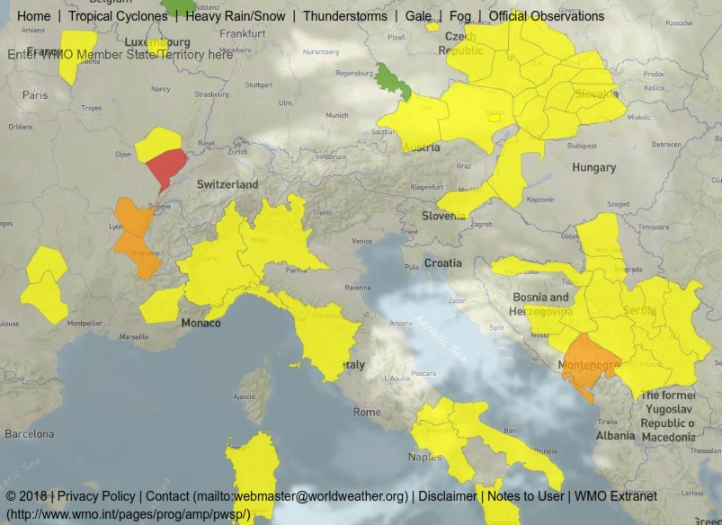
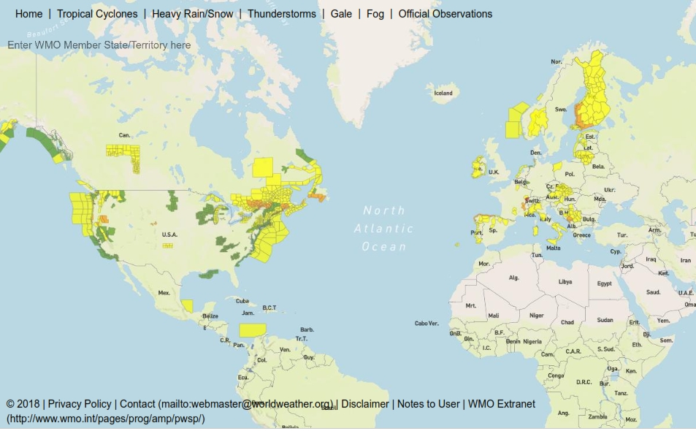
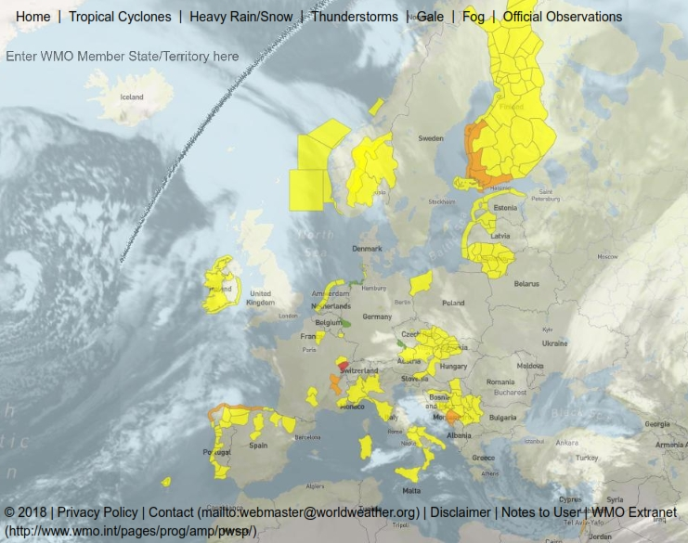
Existing DRR Services Platform
Filtered Alert Hub (SWIC GMAS Demo)
HOW
8 /16
Notes:
Here is a screen shot, taken on March 4, showing then-recent alerts.

Slide 9
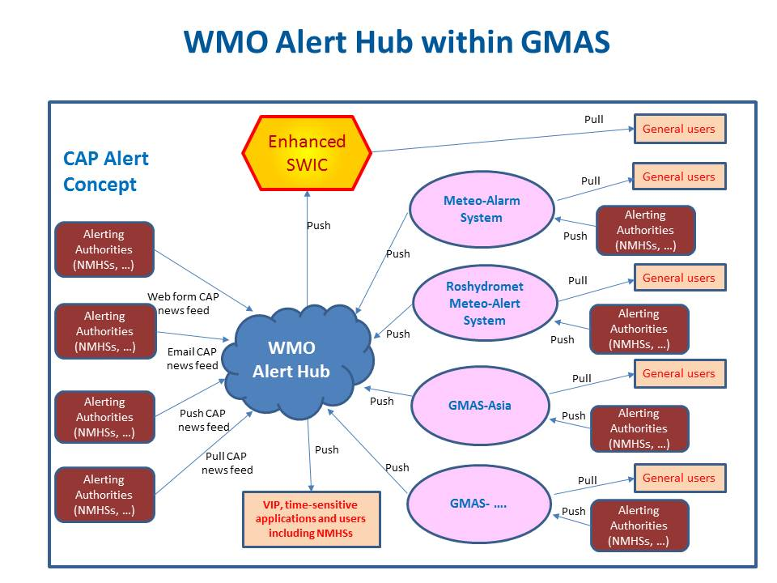
HOW
.....................................
WIS
9 /16

Slide 10
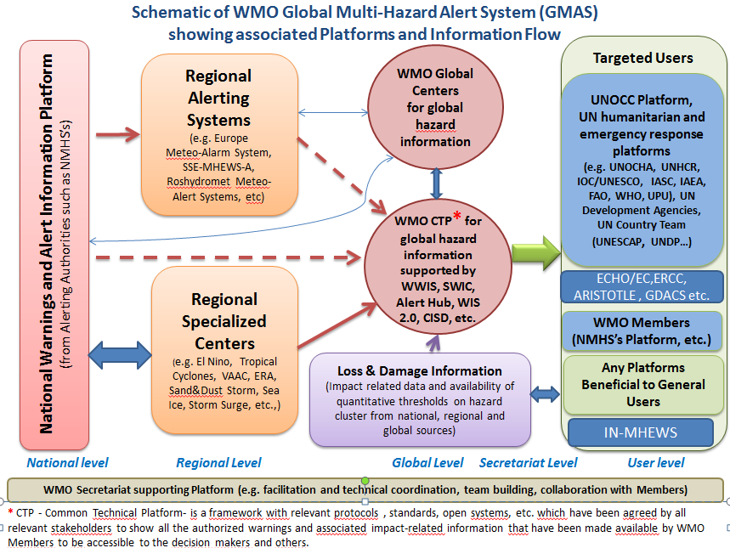
HOW
10 /16

Slide 11
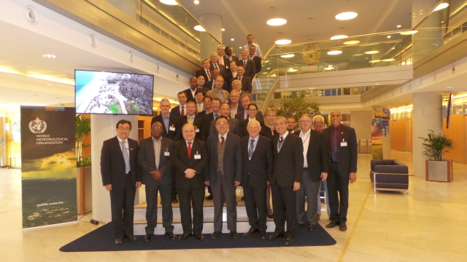
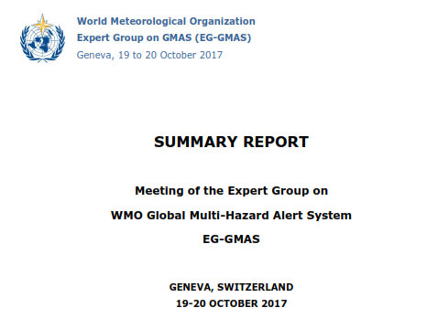
GMAS Initiative Realization Process
Expert Group on WMO GMAS
HOW
EG on WMO GMAS started to respond
to the EC-69 request what should be
worked out for the EC-70
GMAS Scope
User requirements
Stakeholder roles
User / stakeholder benefits
Policy aspects
Project plan and roadmap
also taking into account results of
pilot and demonstration projects
EG on WMO GMAS consists of the two TTs
TT Policy
TT Technical
1st meeting of EG on WMO GMAS
Geneva 19-20 October 2017
11 /16

Slide 12
GMAS Implementation Roadmap
HOW
Development Phase (2017 to 2020)
GMAS Concept (mid 2017 - mid 2018)
GMAS Concept to be submitted for approval by EC-70
GMAS Implementation Strategy (mid 2018– mid 2019)
Subject to EC-70 approval
GMAS Implementation Strategy will be developed and submitted for approval by Cg-18
GMAS Implementation Plan (mid 2019– mid 2020)
GMAS Implementation Plan will be developed and submitted for approval by Cg-18
Implementation Phase (mid 2020–mid 2024)
Implementation stage 1 (mid 2020 – mid 2022)
major (priority) users, such as UN agencies that have operational activities
Implementation stage 2 (mid 2022 – mid 2024)
all users, all warnings
Testing Phase (mid 2024–end 2024)
System will run in a pre-operational mode to test all components and to identify and fix the problems
Operational Phase (2025 onwards)
GMAS will continue to evolve to improve its performance responding optimally to the needs of users and evolving technological opportunities
12 /16

Slide 13
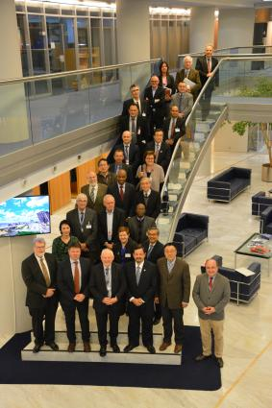
PRA Recommendations
Presidents of Regional Associations were pleased with the development of the GMAS concept so far, and agreed that
GMAS is a WMO global platform that will provide
WMO Members, relevant UN agencies and humanitarian
organizations, governments and other relevant stakeholders
with an aggregated and standardized authoritative
multi-hazard alerts and warnings issued by
National Alerting Authorities (NAA)/NMHSs
as the only authoritative source of alert and warning information
through the aggregation of their common alerting protocols (CAPs)
GMAS will also make available relevant information, tools, knowledge and training to all WMO Members
including initiatives - pilot and demonstration projects - such as
Meteoalarm, MeteoAlert, South East European Multi-Hazard Early Warning Advisory System (SEE-MHEWS-A) and GMAS-Asia
Geneva, 21 January 2018
13 /16

Slide 14
PRA Recommendations
Presidents of Regional Associations were pleased with the development of the GMAS concept so far, and agreed that
The objectives of GMAS
To enhance the authoritative voice of Members’ NAA/ NMHSs in issuing official early warnings
To enhance the visibility of WMO and its Members in contributing to the Sendai Framework for Disaster Risk Reduction 2015–2030 and the Sustainable Development Goals to the UN
To address WMO Members’ needs for development impact-based forecasting and warning
To provide a central repository for CAP messages of authoritative multi-hazard alerts and warnings
GMAS Principles
GMAS is neither replacing nor duplicating existing mechanisms developed under the auspices of the WMO technical commissions, regional associations and their respective programmes and projects
14 /16

Slide 15
PRA Recommendations
Presidents of Regional Associations were pleased with the development of the GMAS concept so far, and agreed that
GMAS Principles
GMAS is to facilitate and promote
usage of existing national capabilities and national investment for further NMHS development
cross boarder collaboration wherever / whenever is possible
Important building block of the GMAS is the GDPFS with a role to support the NAA/NMHSs in tuning their perspective in the process of tailoring of national alerts and warnings / CAPs. Thus GDPFS with its centers of excellence act
as an advisory entity and a vital source of information, in particular for developing and least developed Members that are primarily most vulnerable
as global driving force for the national development and maintenance of its observation network and derivation of local NWP products primarily produced by the NMHSs
15 /16

Slide 16
PRA Recommendations
Presidents of Regional Associations were pleased with the development of the GMAS concept so far, and agreed that
GMAS Principles
GMAS development and implementation process will include:
clear protocols, standards, code of behaviors - standard operative procedures - need to be elaborated
Demonstration and pilot projects - to test
Risk assessment - should be the vital part
16 /16

Slide 17
Potential UNOCC support

Slide 18
Thank you

