Slide 1

,
Tropical Cyclone Verification Operations in STI/CMA
Hui YU
Shanghai Typhoon Institute
MEETING OF THE CBS (DPFS) EXPERT TEAM ON OWFPS
BEIJING, CHINA 12-16 MARCH 2018

Slide 2
Outline
History of TC forecast verification at STI/CMA
  National level activities in China
  International activities
Capability and commitment to fulfil the role of LC-TCFV as required in the Manual on GDPFS (2.2.3.5 and 2.2.38)
Future plan

Slide 3
History of tropical cyclone forecast verification at STI (National level activities)
Tropical cyclone forecast data exchange around China
STI started the TC forecast evaluation authorized by CMA
Add landfall forecast evaluation
1972
1992
2009
2012
2014
2016
1985
2006
2010
2013
2015
Started to assess the performance of TC forecast
Track & intensity error analysis

Slide 4
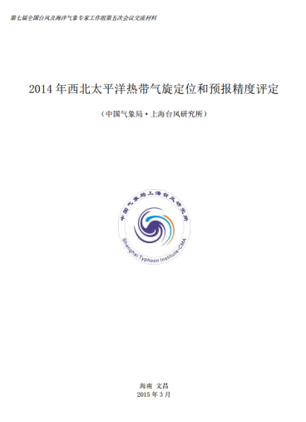
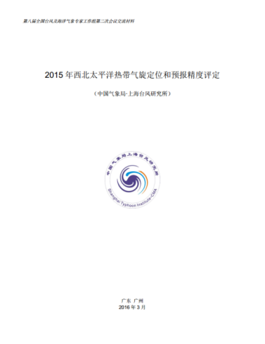
History of tropical cyclone forecast verification at STI (National level activities)
Authoritative verification organization
  Submit annual verification report to the National Working Group of Experts on Typhoon and Marine Meteorology.
  Evaluate the prediction skill of all the forecast methods
  Provide the recommendations regarding whether the methods could continue to be used in operation.
Rule: forecast guidance which get negative skill score for the latest two years will be disqualified.
TC Forecast Guidance in China
Subjective method | NWP models | EPS | Other objective method
CMA | T213 | CMA-GEFS | GX-multi-fault
Shanghai | T639 | STI-GRAPES | JS-probabilistic
Zhejiang | STI-GRAPES |  | WIPS
Fujian | STI-WARMS |  | SH-XSLD
Guangdong | GZ-TRAMS |  | SH-PLSC
Hainan | LN-WRF
Jiangsu

Slide 5
History of tropical cyclone forecast verification at STI (International activities)
Metrics development:
TC genesis
Ensemble probability
Prediction system error
NWP characteristic analysis
(Supported by WMO-TLFDP coordination with JWGFVR)
Tropical cyclone forecast data exchange around China
STI started the TC forecast evaluation authorized by CMA
Add landfall forecast evaluation
1972
1992
2009
2012
2014
2016
1985
2006
2010
2013
2015
Started to assess the performance of TC forecast
Track & intensity error analysis
Built real-time & post-season verification systems (supported by WMO-TLFDP, coordination with JWGFVR)

Slide 6
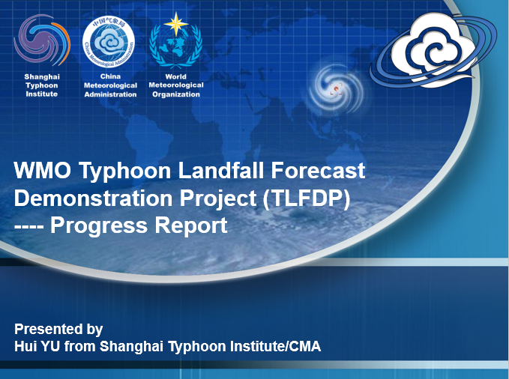
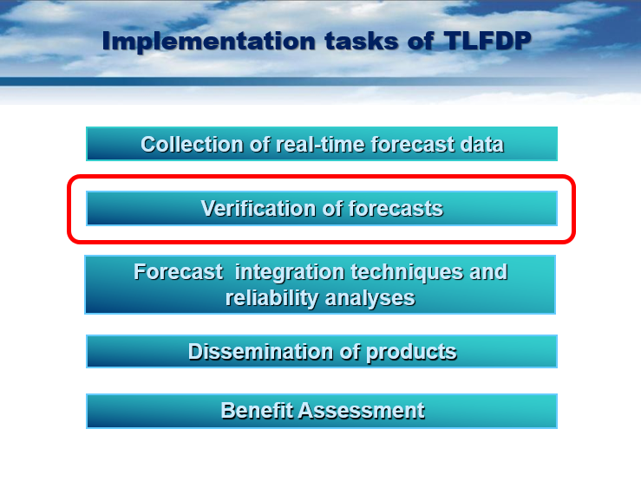
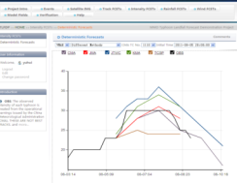
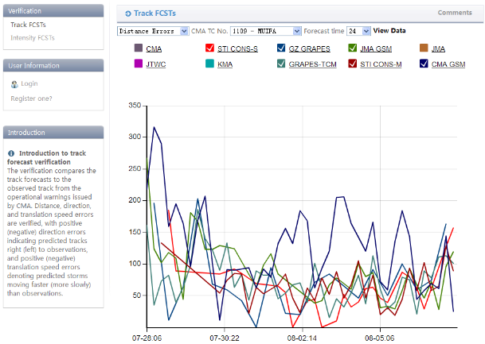
History of tropical cyclone forecast verification at STI (International activities)
Development of verification systems
(Supported by WMO-TLFDP, coordination with JWGFVR)
  Real-time verification system
    Provide track, intensity, speed, direction error
    Via website
  Post-season verification system
    Provide basic forecast errors
    Implement new verification techniques
    Comprehensive analysis of errors
Real-time verification web-page

Slide 7
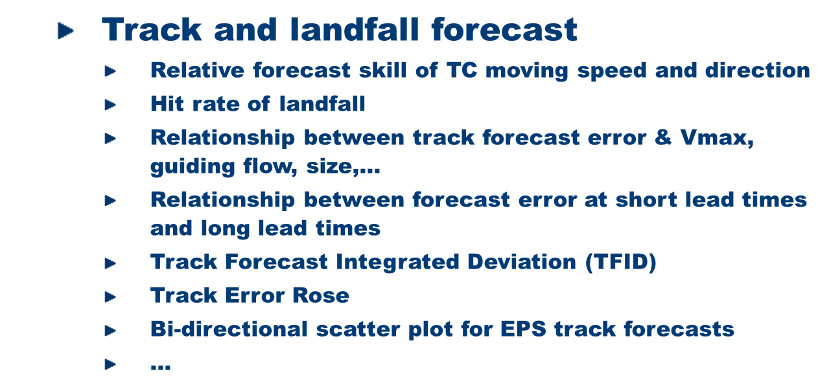
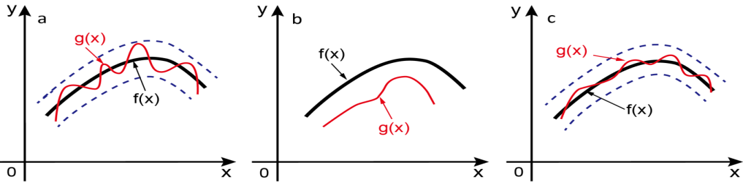
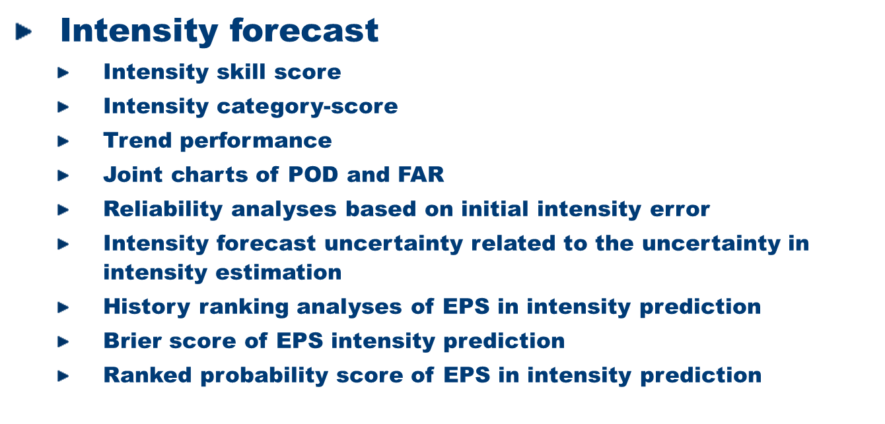
History of tropical cyclone forecast verification at STI (International activities)
Metrics development
(Supported by WMO-TLFDP, coordination with JWGFVR)
Schematic charts for TFID
Brier score of the seven TIGGE ensemble prediction systems in 2010

Slide 8
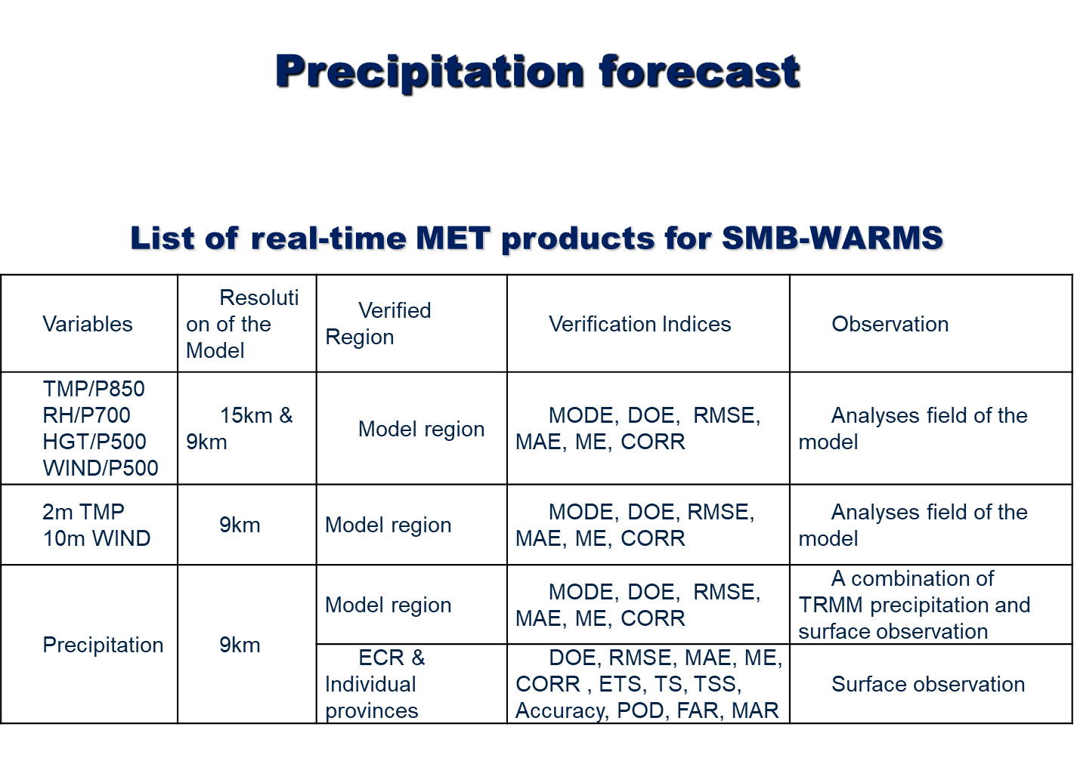
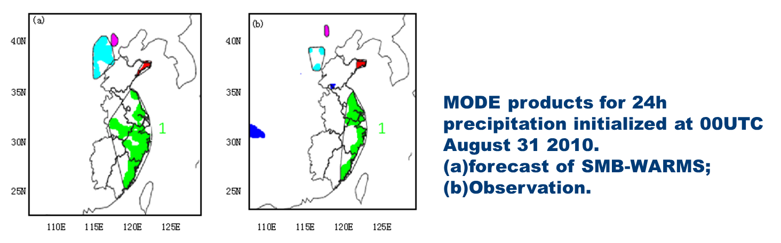
History of tropical cyclone forecast verification at STI (International activities)

Slide 9
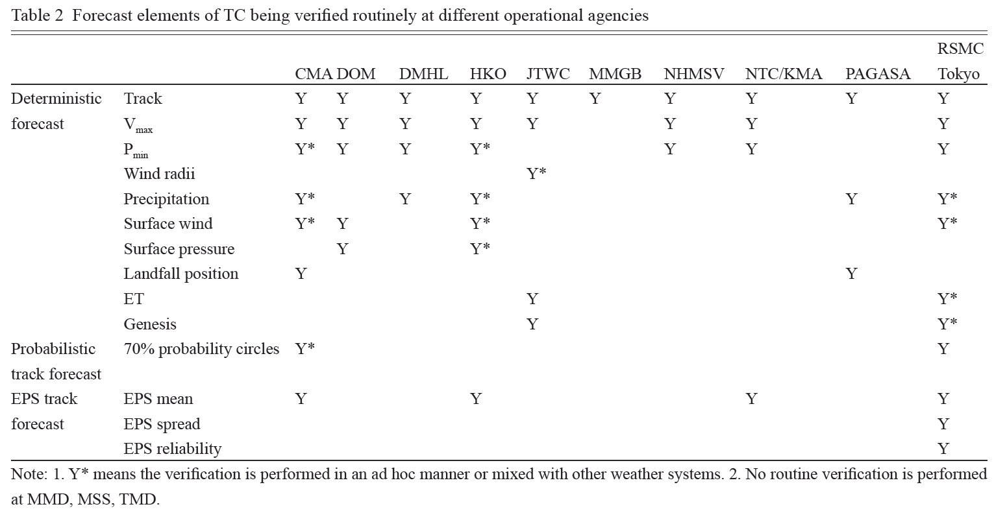
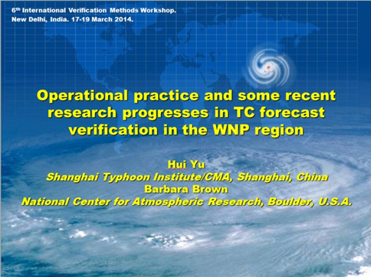
  The operational status of TC forecast verification up to 2012 is analyzed on the basis of an e-mail survey covering all the Members of UNESCAP/WMO Typhoon Committee
  Main conclusions
    Significant efforts have been focused on the verification of TC forecast guidance by operational forecast agencies in the region
    Only a few verification products are available for the probabilistic forecasts from EPS
    Verification of TC precipitation and high wind forecasts are also lacking sufficient attention in the region
CMA – China; DOM – Cambodia; DMHL – Laos; JTWC – USA; MMGB – Macao; NHMSV – Vietnam; NTC/KMA – Korea; PAGASA – Philippines
Yu, Chan, Brown, et al., 2012, TCRR
Invited talk at the 6th International Verification Methods Workshop in March 2014.

Slide 10
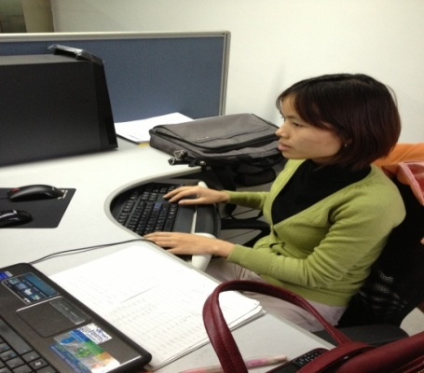


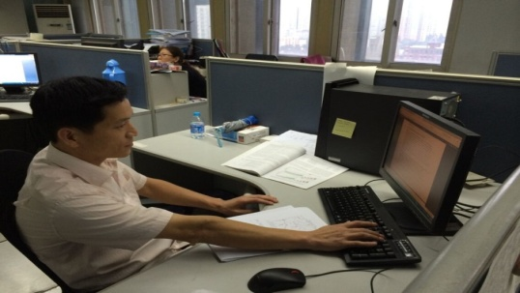
History of tropical cyclone forecast verification at STI (International activities)
Metrics development
(Research fellowship projects of UNESCAP/WMO Typhoon Committee)
Ms. Lethihai YEN
from Viet Nam (2013)
Mr. Boothum TANGLUMLEAD
from Thailand (2014)
Seven research fellowship projects were implemented as jointly supported by the UNESCAP/WMO Typhoon Committee, STI and HKO. The successful applicants of these projects visited STI or HKO for one or two months and implemented research.
Research topics:
TC genesis forecast evaluation technique
TC precipitation forecast evaluation technique
TC track ensemble forecast evaluation technique
Improvement of TC verification system
Mr. Yong Chol SONG
from DPRK (2014)
Mr. Sang Il PAK
from DPRK (2014, 2015,2016)

Slide 11
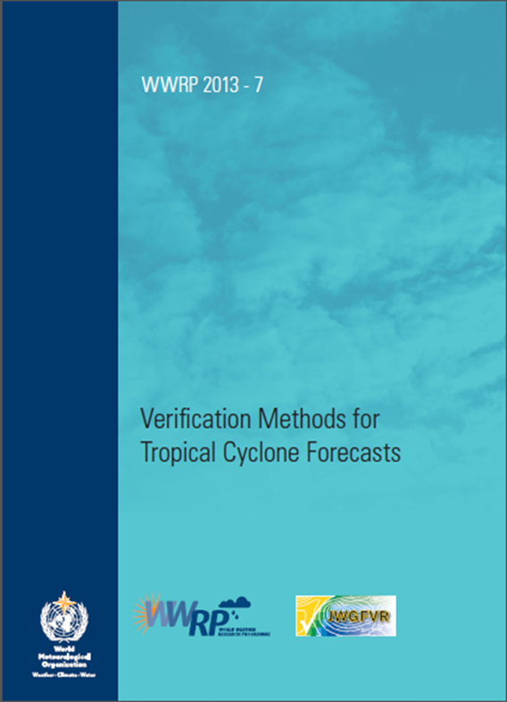
History of tropical cyclone forecast verification at STI (International activities)
Metrics development
  A number of comments were provided to the authors of the WMO document “Verification
  of tropical cyclone forecasts” (by JWGFVR), with special attention given to increase the
  visibility of related efforts in the western North Pacific region. This document has been
  published by the WMO and is available on the website of the WWRP.
  http://www.wmo.int/pages/prog/arep/wwrp/new/Forecast_Verification.html

Slide 12
History of tropical cyclone forecast verification at STI (International activities)
Metrics development:
TC genesis
Ensemble probability
Prediction system error
NWP characteristic analysis
(under WMO)
Tropical cyclone forecast data exchange around China
STI started the TC forecast evaluation authorized by CMA
Add landfall forecast evaluation
1972
1992
2009
2012
2014
2016
1985
2006
2010
2013
2015
Started to assess the performance of TC forecast
Track & intensity error analysis
Built real-time & post-season verification systems supported by WMO-TLFDP
Submit annual verification report to ESCAP/WMO Typhoon Committee
Research fellowship projects on verification
Typhoon Committee members: Vietnam, DPR Korea, Thailand

Slide 13

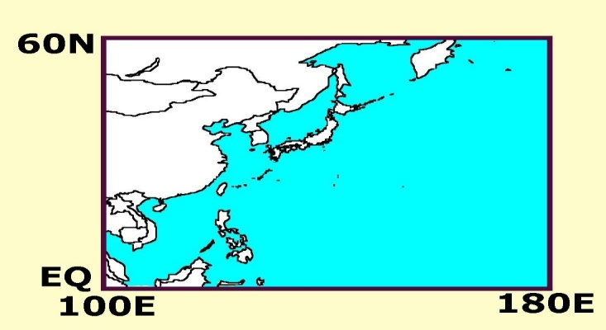
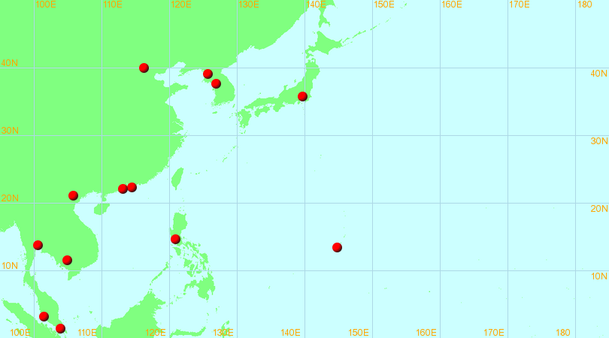
UNESCAP/WMO Typhoon Committee
http://www.typhooncommittee.org
Established in 1968
Members：14
  Cambodia, 1968
  China, 1968
  DPRK, 1992
  HongKong/China, 1968
  Japan, 1968
  Lao PDR, 1968
  Macao/China, 1992
  Malaysia 1968
  Philippines, 1968
  RoK, 1968
  Singapore, 1997
  Thailand, 1968
  USA, 1998
  Viet Nam, 1968
An intergovernmental body in order to promote and coordinate the planning and implementation of measures required for minimizing the loss of life and material damage caused by typhoons in Economic and Social Commission for Asia and the Pacific region.

Slide 14
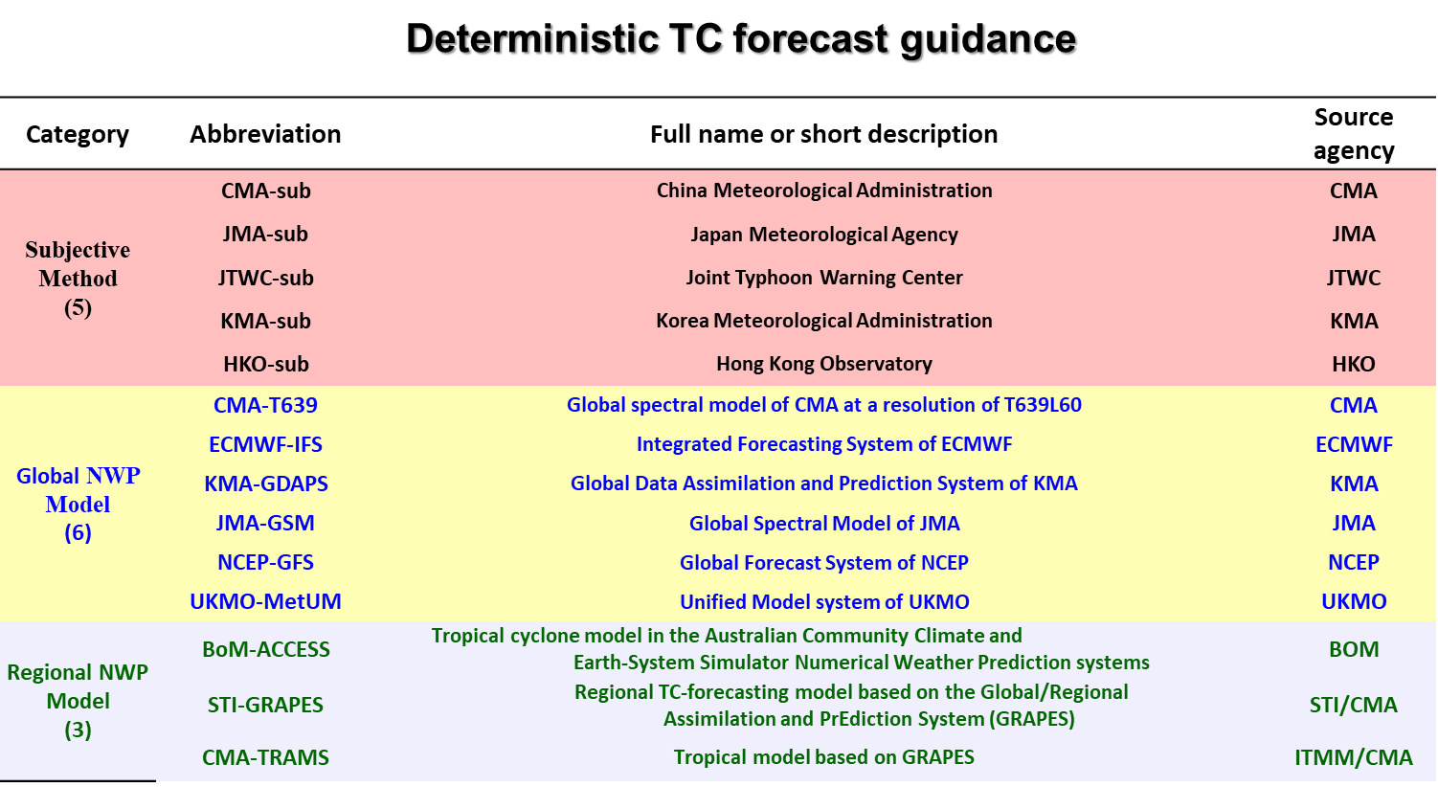
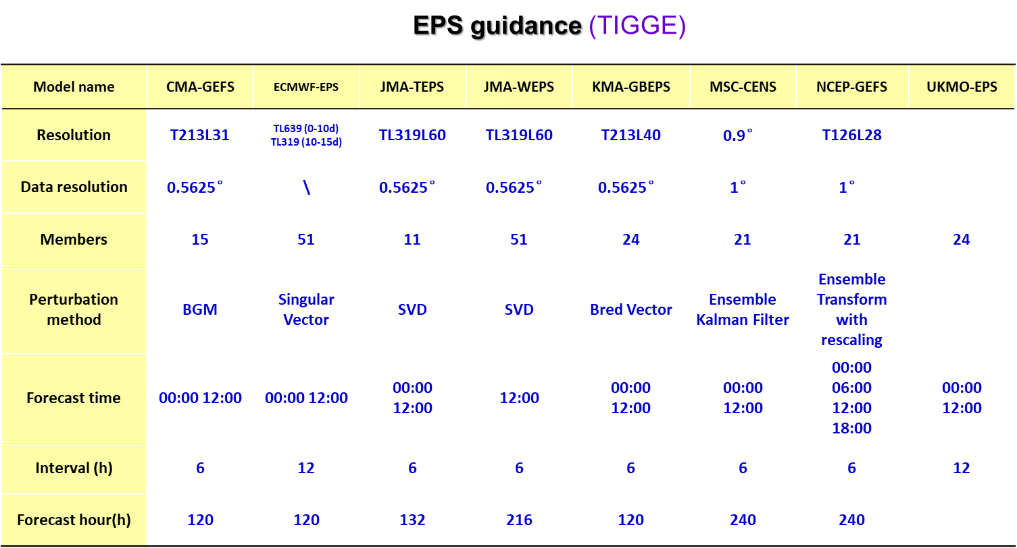
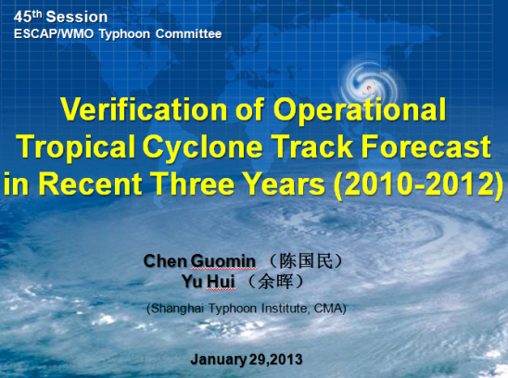
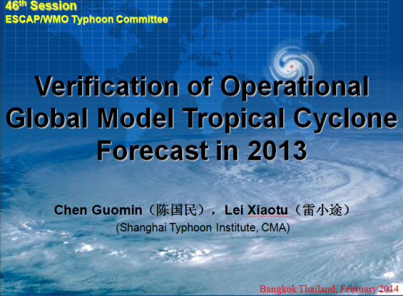
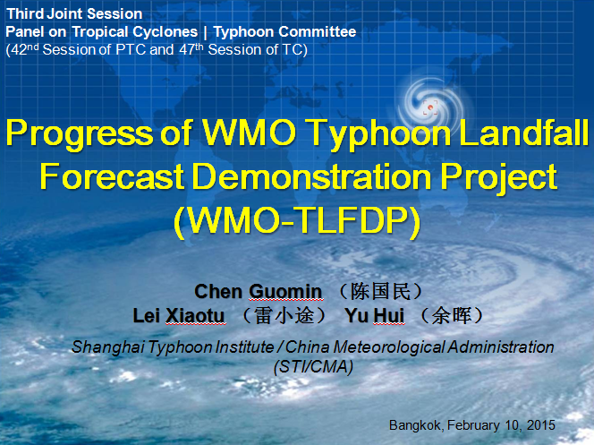
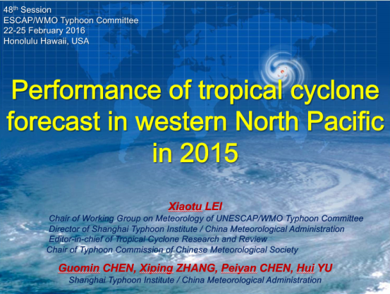
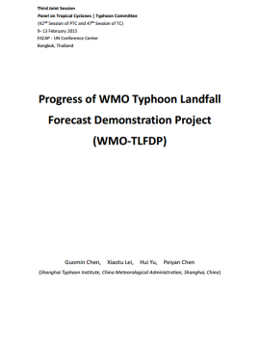
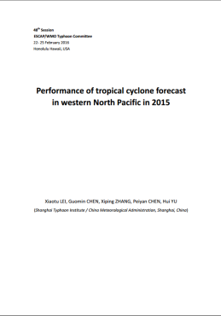
History of tropical cyclone forecast verification at STI (International activities)
  Submit the annual TC verification report in western North Pacific region to Typhoon Committee since 2013 (Typhoon Committee PPP project).
  The report has become the important technical material to determine the annual working plan of Typhoon committee.

Slide 15
History of tropical cyclone forecast verification at STI
Metrics development:
TC genesis
Ensemble probability
Prediction system error
NWP characteristic analysis
(under WMO)
Tropical cyclone forecast data exchange around China
STI started the TC forecast evaluation authorized by CMA
Add landfall forecast evaluation
Application for Lead Centre for Coordination of TCFV
1972
1992
2009
2012
2014
2016
1985
2006
2010
2013
2015
Started to assess the performance of TC forecast
Track & intensity error analysis
Built real-time & post-season verification systems supported by WMO-TLFDP
Submit annual verification report to ESCAP/WMO Typhoon Committee
Research fellowship projects on verification
Typhoon Committee members: Vietnam, DPR Korea, Thailand

Slide 16
Capability and commitment to fulfil the role of LC-TCFV as required in the Manual on GDPFS (2.2.3.5 and 2.2.38)

Slide 17
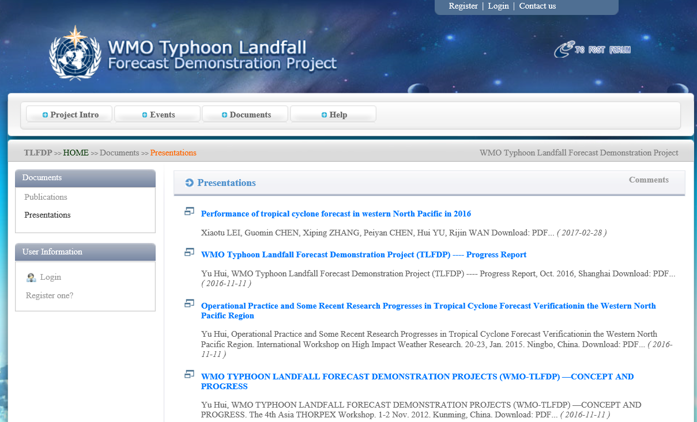
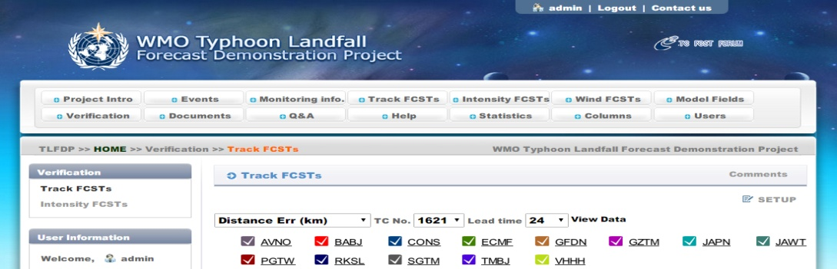
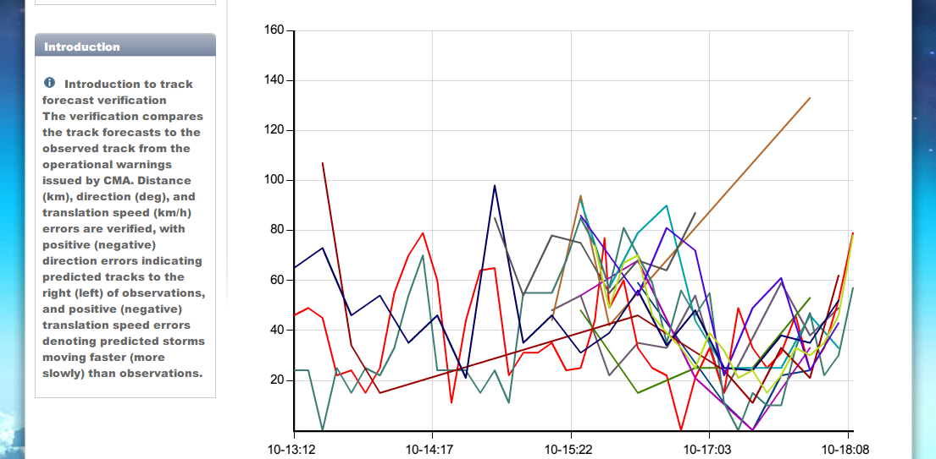
Website
Verification reports and related publications & presentations
Real time verification (charts and data)
WMO-TLFDP official website：http://tlfdp.typhoon.gov.cn

Slide 18
Parameter(s)
MSLP (Mandatory)
Maximum wind speed
Track
Precipitation
Note: TC track and intensity forecasts are provided by the producing centres on the GTS or FTP site

Slide 19
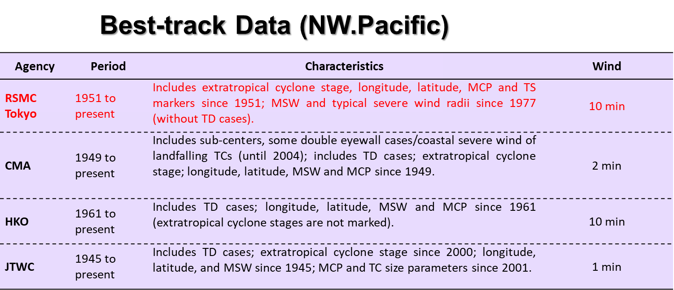
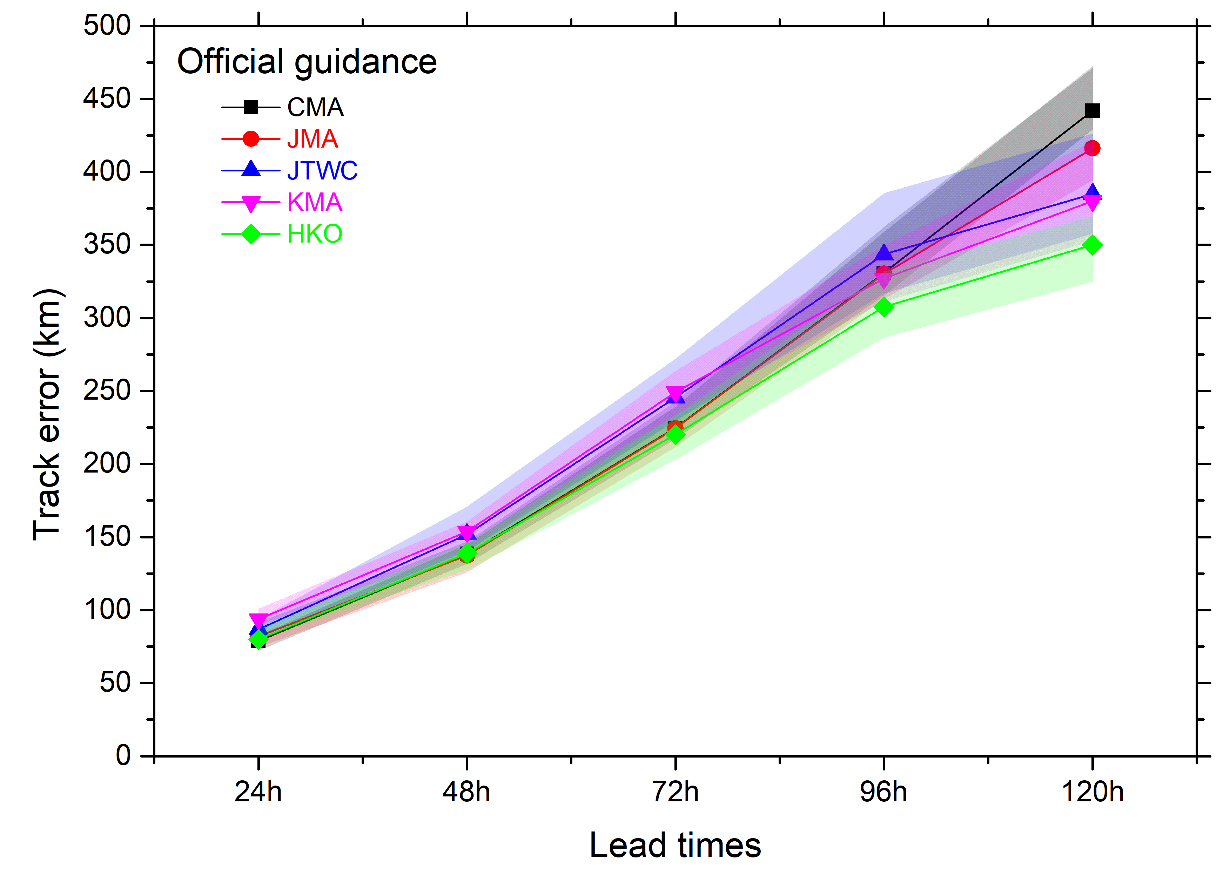
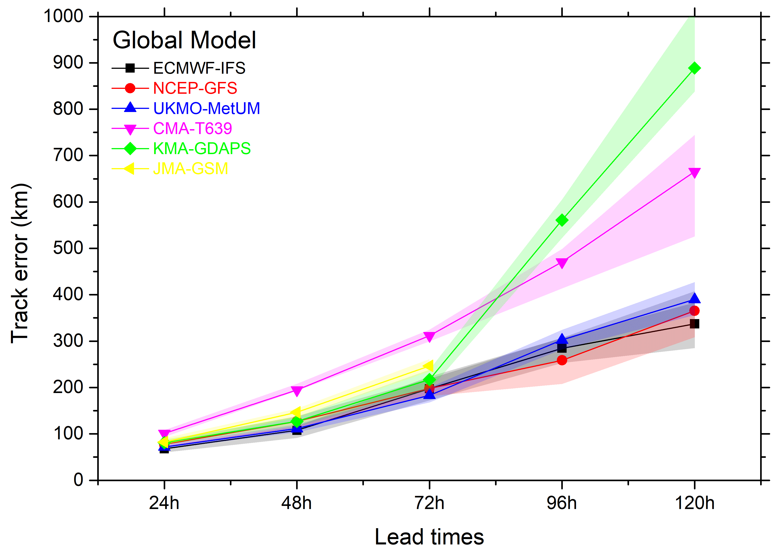
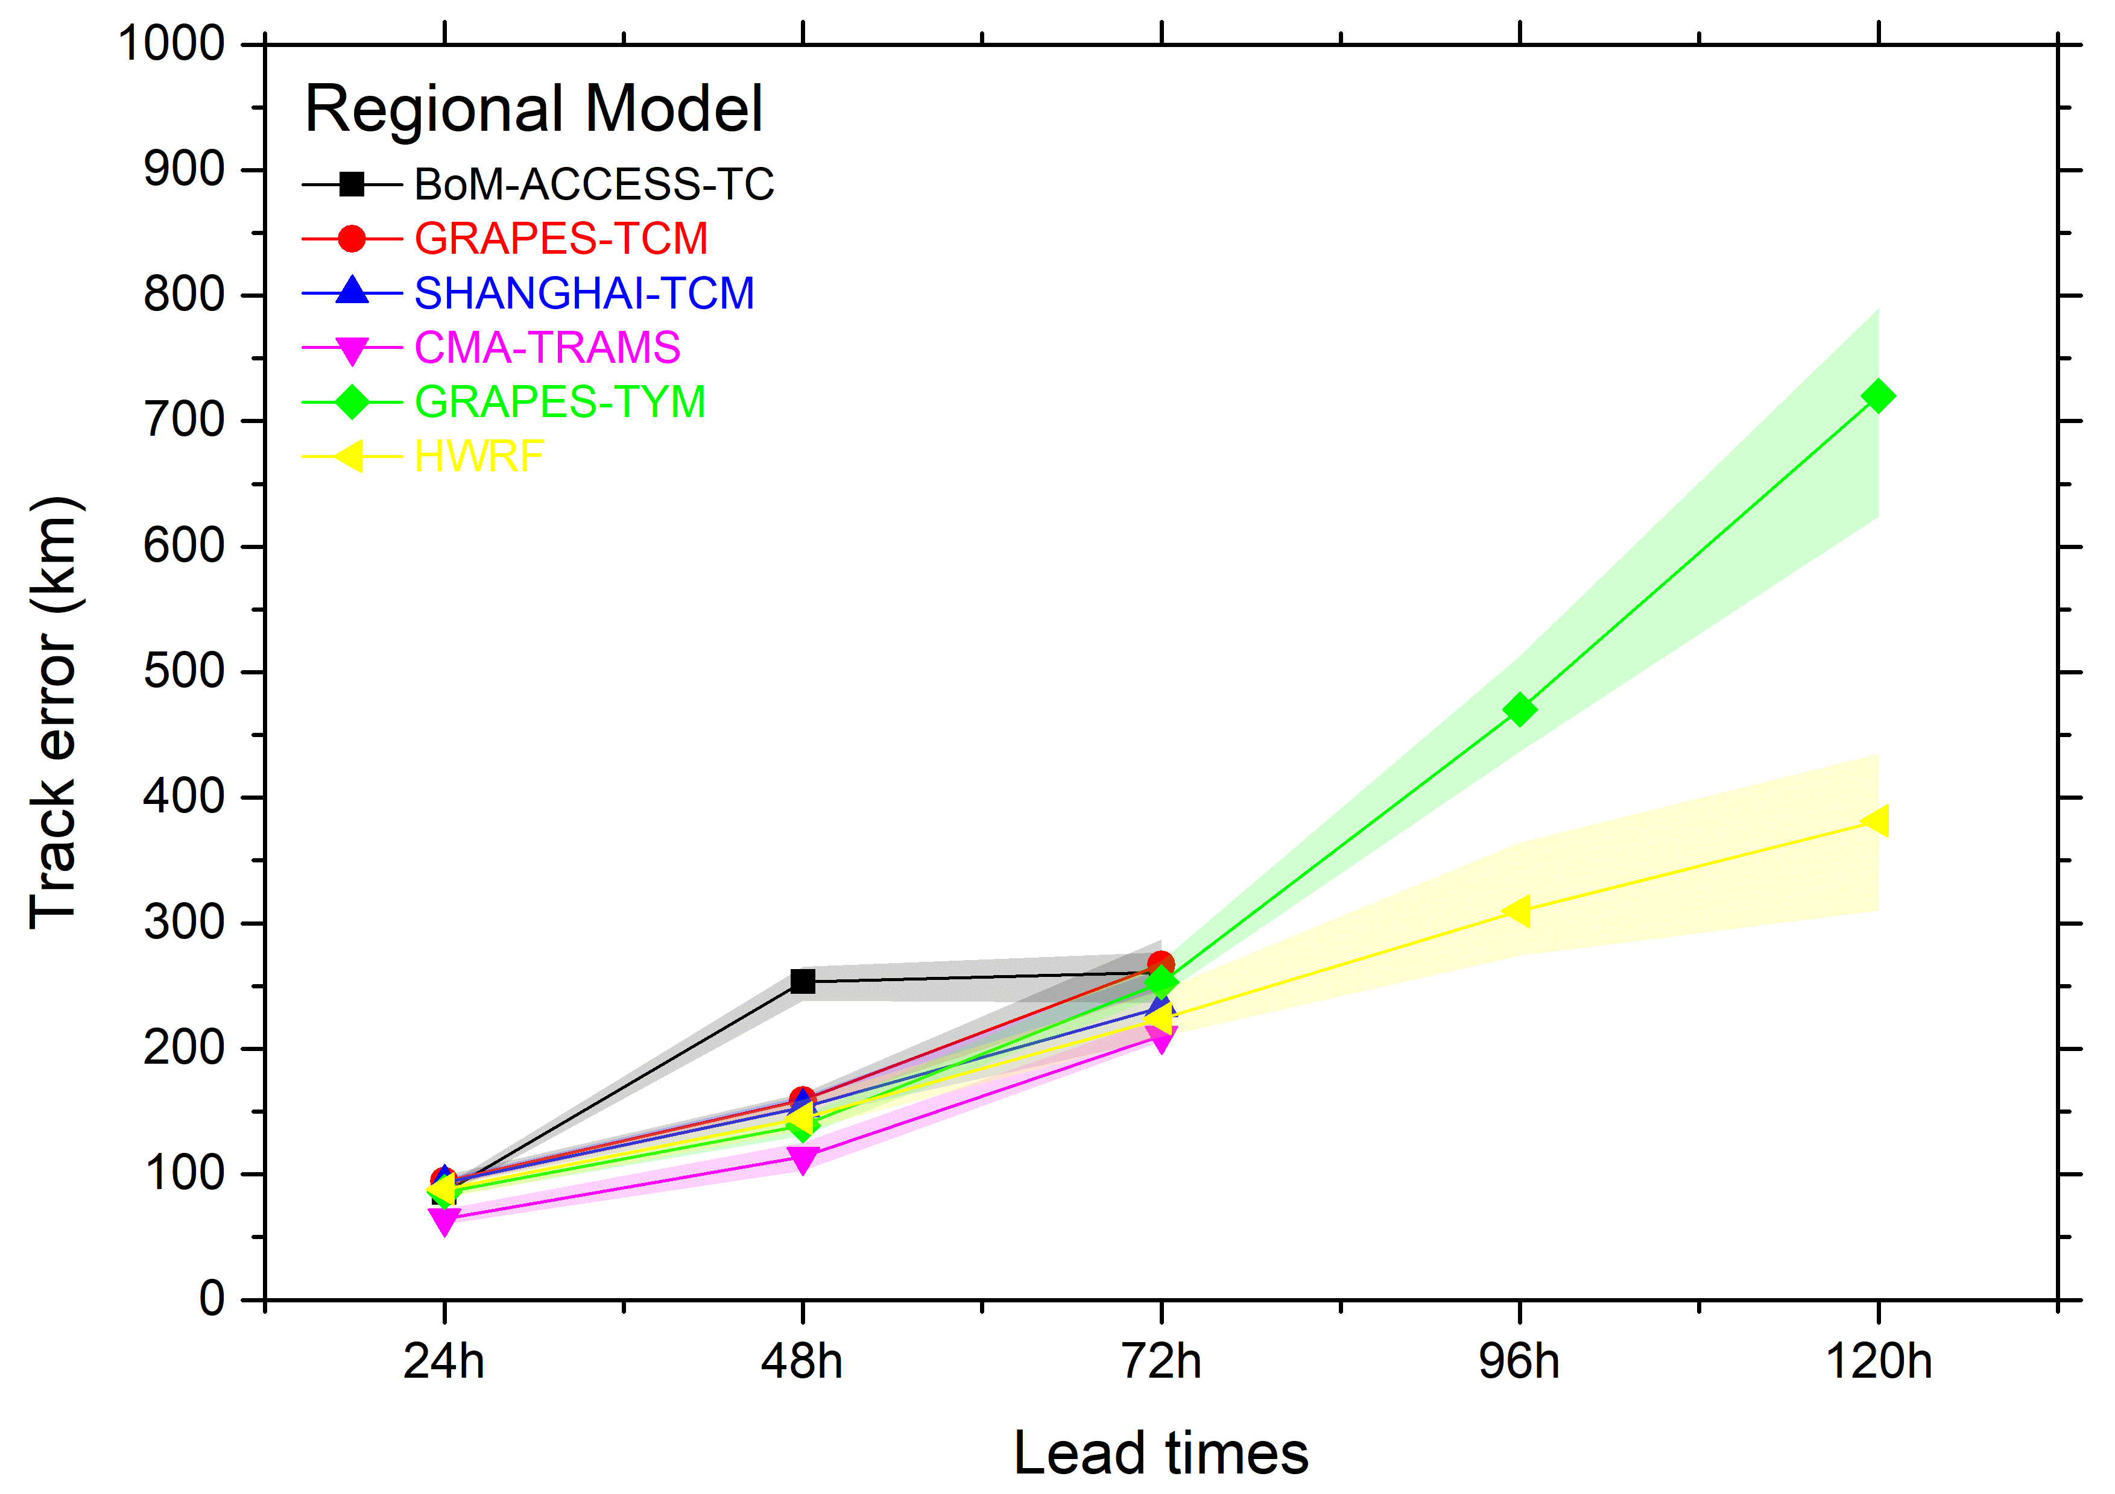
Verification datasets
Impacts of different best track data on the verification results are clear
Variation intervals of track errors for official guidances, global models and regional models by referring to different TC best tracks in 2017.

Slide 20
Scores
Detection rate (Not available. A score related to the vortex location technique.)
 |  | Basic verification | Statistical verification | Notes
Track | Deterministic | Position error Along-track/cross-track (ATCT) bias Direction error Speed error Track forecast integrated deviation (TFID) | Box-plots with SS information Observed vs Forecast relative position images Track error rose Probability distribution analyses | Binned by : seasonal, regional, intensity, life-stage, steering flow
 | Probabilistic (EPS) |  | Hitting ratio of the probabilities Bidirectional track forecast scatter plot for EPSs
Intensity | Deterministic | Bias Absolute error Tendency error Category contingency table | Box-plots with SS information Category-score POD-FAR joint chart Observed vs Forecast intensity images | Binned by : seasonal, regional, intensity, intensity change rate, life-stage NWP initial error to be provided as an indicator of reliability
 | Probabilistic (EPS) |  | EPS history ranking EPS BS EPS PRS | Development of a baseline : climatology probabilistic forecast
Landfall | Deterministic | Position error Timing error
Precipitation | Gridded | MET |  | Only for WARMS now Need an expansion to more models
 | Stations |  | TS score, POD, FAR, Bias
Winds | Gridded | MET
 | Stations |  | High winds score, POD, FAR

Slide 21
Future Plans
STI is planning to further strengthen its capability to fulfil the role of LC-TCFV as required in the Manual.
Further develop the verification metrics as supported by WMO-TLFDP and in coordination with JWGFVR. A workshop is being planned in June 2018.
Extend the verification areas from NWP to other basins.
Provide the scores through the website in the required format.
Implement a standard vortex location technique for gridded outputs and carry out verification.
(GFDL vortex location technique has been implemented in STI for ECMWF-IFS, NCEP-GFS, and CMA-T639)

Slide 22
Thank you for your attention !
谢 谢 !
MEETING OF THE CBS (DPFS) EXPERT TEAM ON OWFPS
BEIJING, CHINA 12-16 MARCH 2018

Slide 23
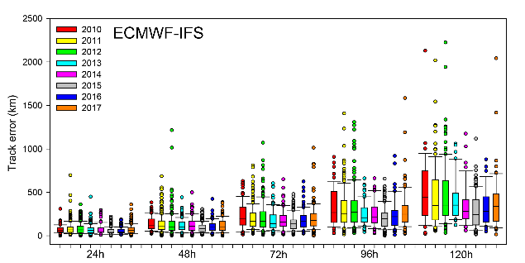
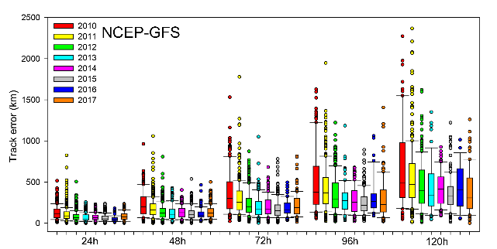
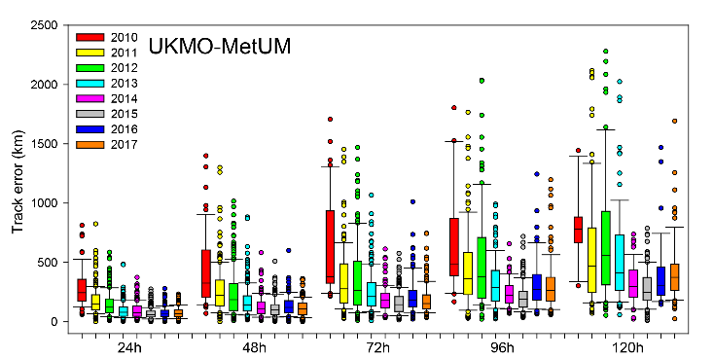
Verifications for 2017
There has been a trend of decrease on model TC track forecast errors since 2010, with a small perturbation over last two years (2016 and 2017)
Box plots of position errors for ECMWF-IFS, NCEP-GFS and UKMO-MetUM in TC track forecasts from 2010 to 2017. The bar in the middle of the plot represents the median values of errors, the lower and upper ends of the boxes represent the 25th and 75th quantile values. The bars below and above the box represent the non-outlier extreme values, and the circles represent the outliers.

Slide 24
Verifications for 2017
Impacts of different best track data on the verification results are clear
Variation intervals of track errors for official guidances, global models and regional models by referring to different TC best tracks in 2017.

Slide 25
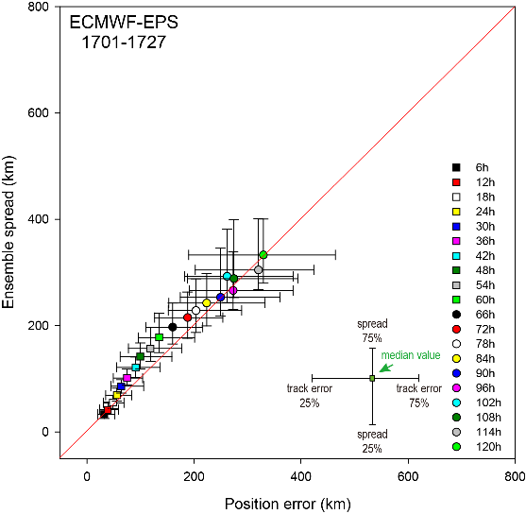
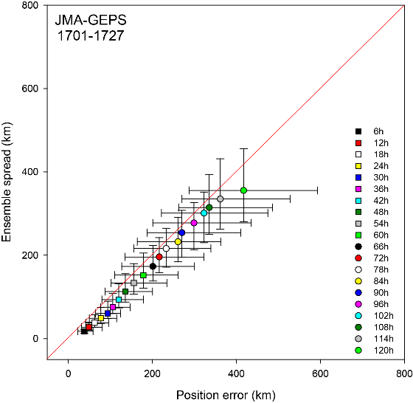
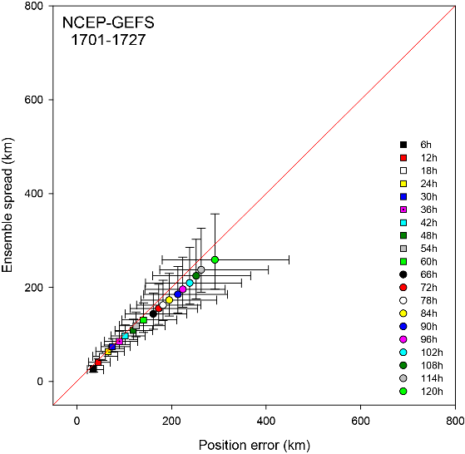
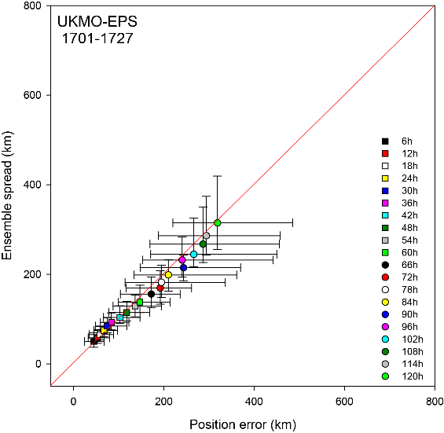
Verifications for 2017
Over-estimated uncertainty
Under-estimated uncertainty
Bidirectional track forecast scatter plot for EPSs in 2017. The blocks represent the mean values of spread or position error. The lower (left) and upper (right) bars represent the 25th and 75th quantile values.

Slide 26
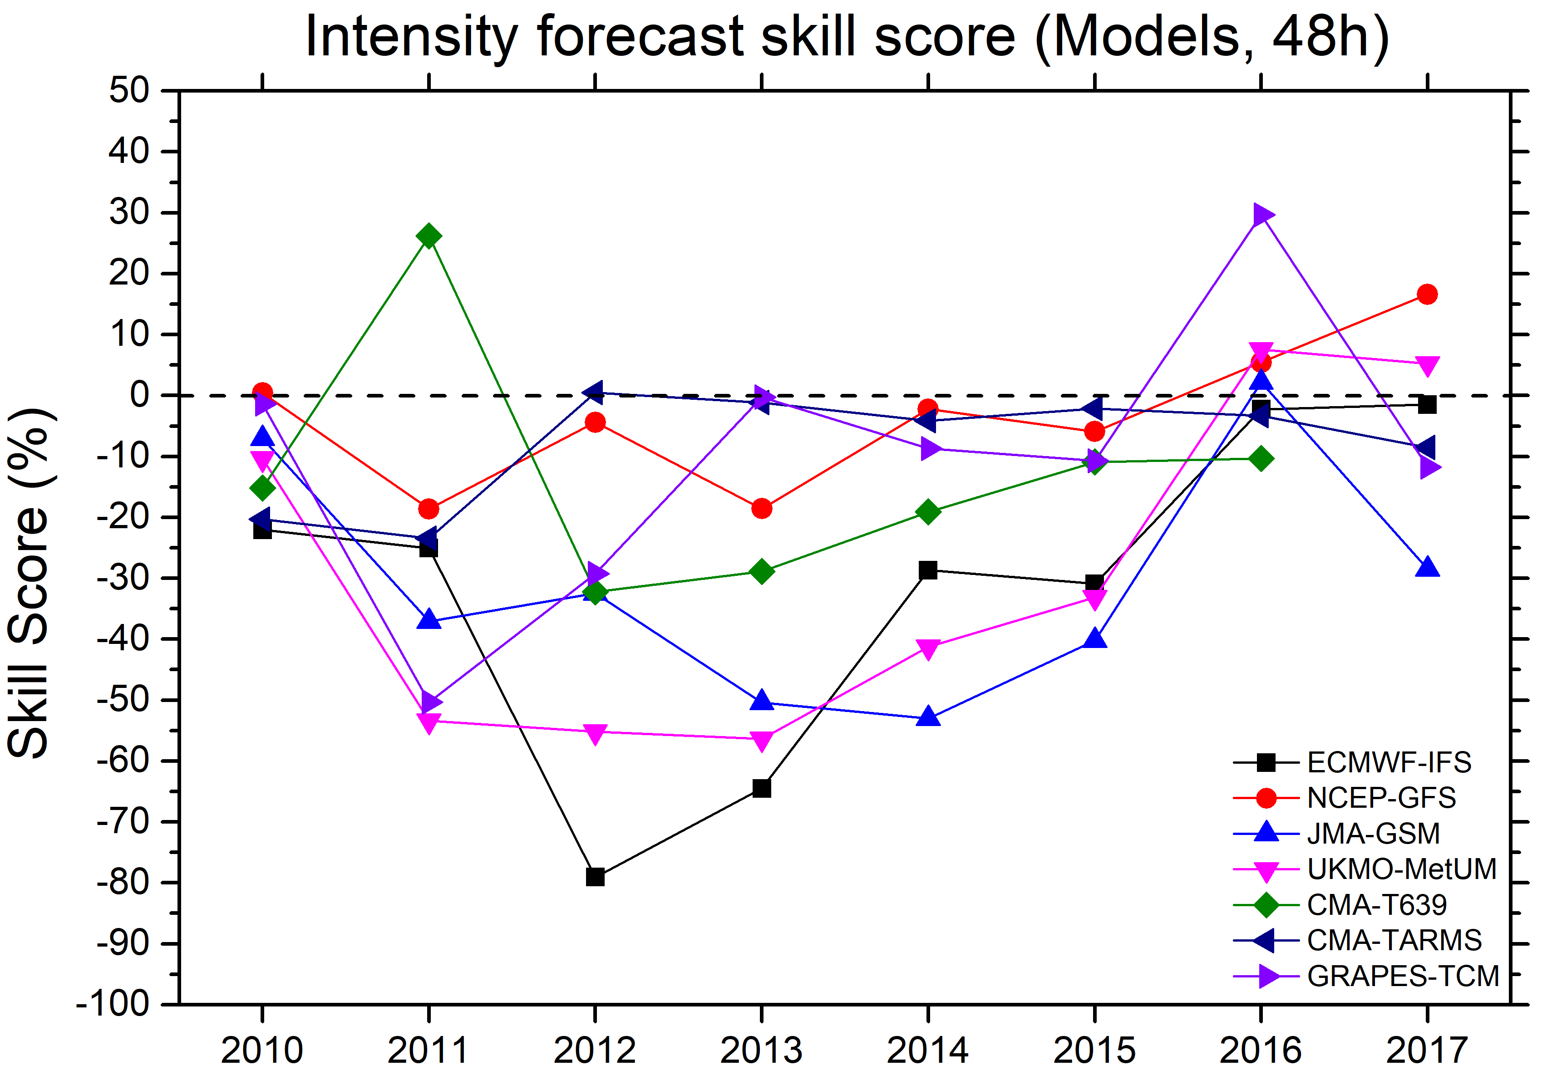
Verifications for 2017
There has been little progress on the performance of intensity prediction for both global and regional models since 2010
Intensity forecast skill scores at the lead times of 48 h for global and regional models.
Brier scores for EPS intensity forecast in 2017.

