Slide 1
Observation uncertainty in verification
ET-OWFPS
Beijing, China
Tom Robinson
CMC, Montreal
March 12-16, 2018

Slide 2
Contents
Sources of uncertainty
Experiment with surface data (B. Casati)
  Different networks (SYNOP vs METAR)
  Effects of thinning
  Effects of quality control
Representativeness and sampling (T. Haiden)
  Analysis vs observations
Examples of dealing with uncertainty
  ECMWF (Zied Ben Bouallegue)
  CMC (V. Fortin et al.)
Reducing radiosonde error

Slide 3
Sources of observation error and uncertainty
Observations can be affected by different types of uncertainties:
  Measurements errors: e.g. instrument failure (abrupt or slowly degrading);
  Round-off and reporting procedures (precipitation trace from gauges reporting in inches vs mm; no report when no precipitation);
  Quality Control (elimination of large values; rejection of precipitation measurements in strong wind (undercatchment));
  Representativeness and sampling error (both in space and time): is the point observation representative of the (nearest) model grid-point value? is the observation network homogeneous and representative of the region verified?
  Assumptions of remote-sensing retrieval algorithms.
  Uncertainties introduced by interpolation / gridding procedures.
Driving Questions:
  What are the effects of the observation uncertainties on verification results?
  Which observation uncertainties have the largest impacts?
  How can we account for observation uncertainties in verification practices?

Slide 4
B. Casati: Experimental Design (1/2)
Aim: identify observation uncertainties which have the largest impact on
verification results
Variables and scores
T2m, TD2m, MSLP, Wind speed bias, rmse, stdev, corr
Wind direction multicategorical HSS
6-hour accumulated precipitation FBI, HSS, ETS
NWP systems and period/domain
RDPS (10 km resolution) versus HRDPS (2.5 km resolution).
Two seasons: July-August 2015 and January-February 2015.
Domain: Canada. Subdomains for thinning and QC, climatology

Slide 5
Experiment Design (2/2)
Traditional verification scores:
TT,TD,PN,UV,WD: synop vs metar
TT,TD,PN,UV,WD,PR6h: thinning vs no thinning
TT,TD,PN,UV,WD, PR6h: QC vs no-QC
TT,TD,PN,UV,WD, PR6h
  - verify against analysis values at observation locations
  - filling: from station network to whole domain
Different Networks
Spatial sampling
Quality Control
Representativeness
Spatial Sampling

Slide 6
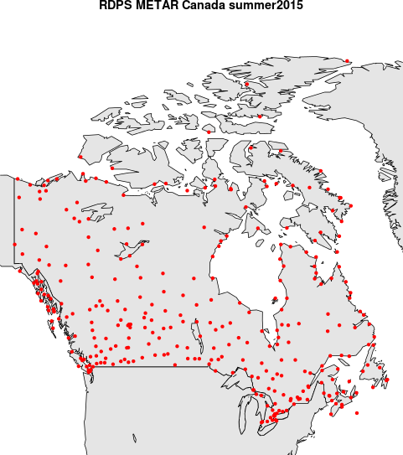
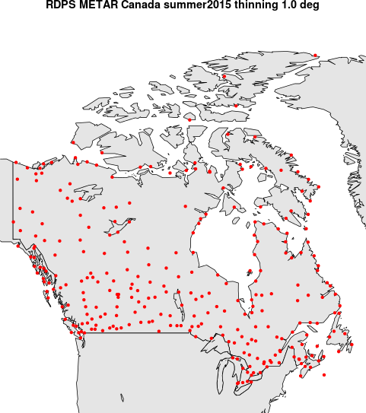
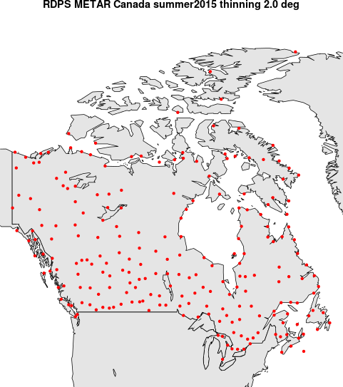
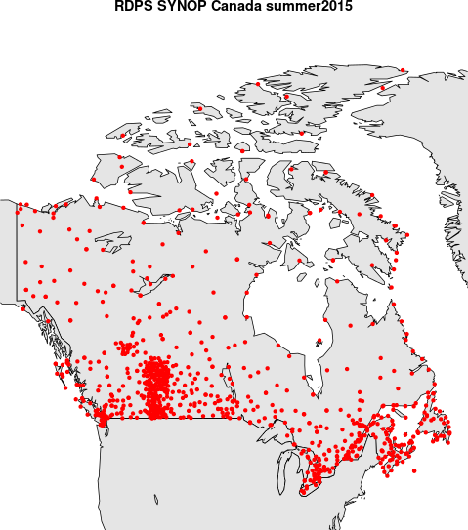
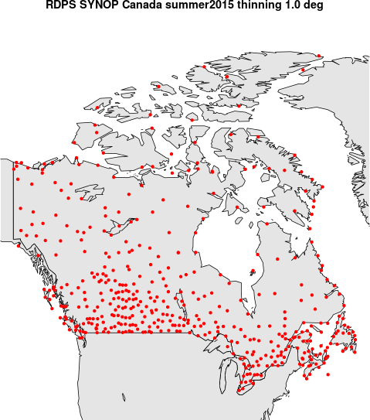
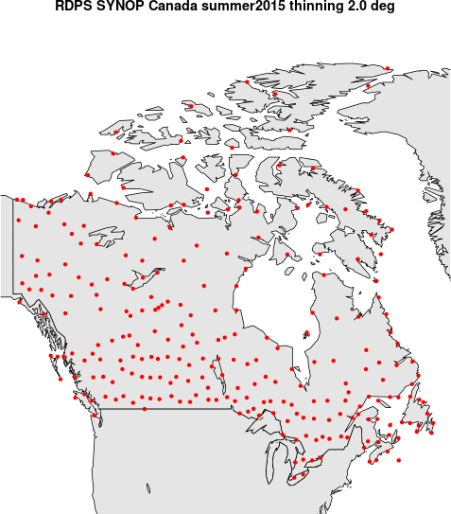
Network and spatial sampling
METAR
METAR
THIN
1^{O}x 1^{O}
METAR
THIN
2^{O}x 2^{O}
~17,000
~15,000
~12,000
SYNOP
SYNOP
THIN
1^{O}x 1^{O}
SYNOP
THIN
2^{O}x 2^{O}
~40,000
~20,000
~10,000

Slide 7
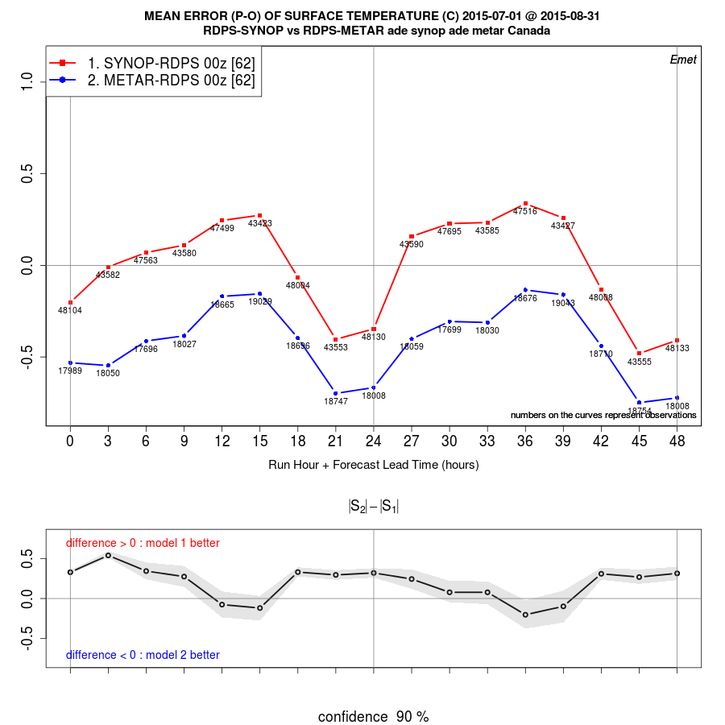
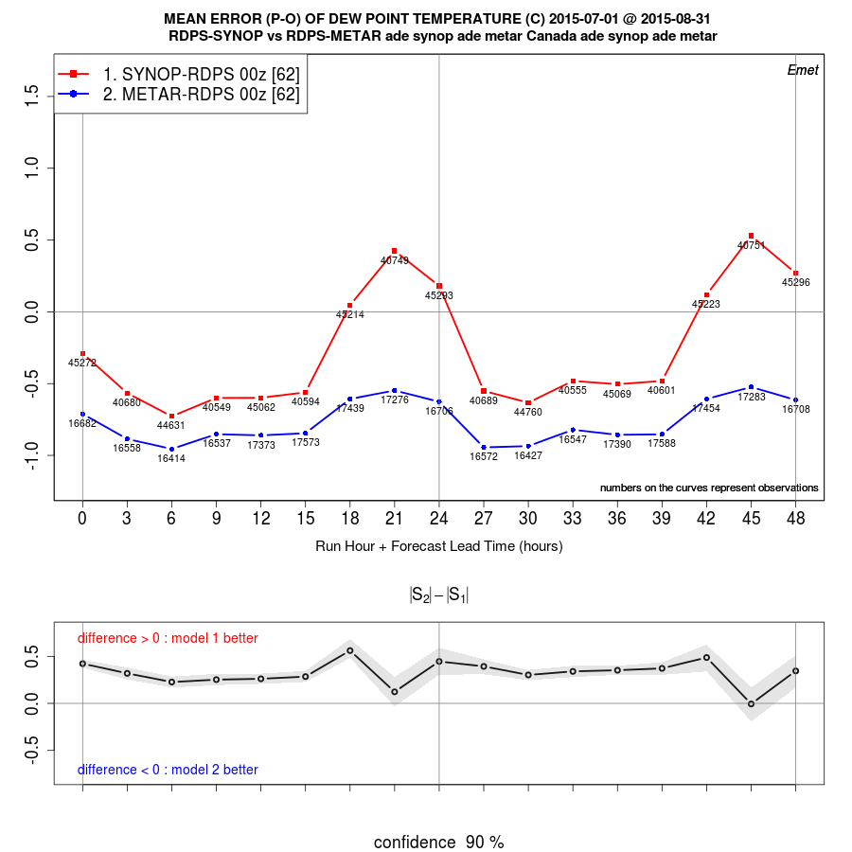
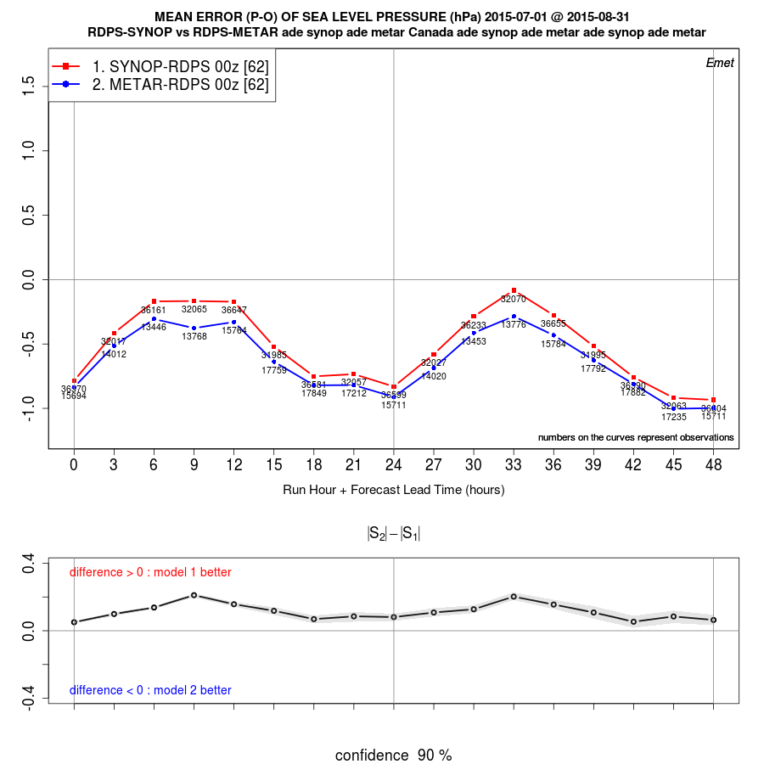
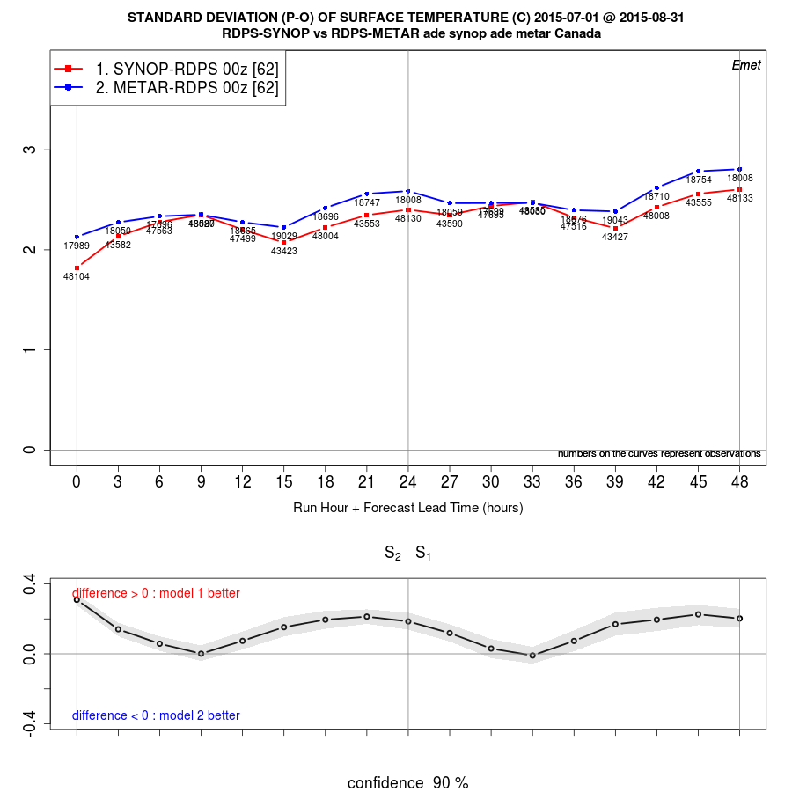
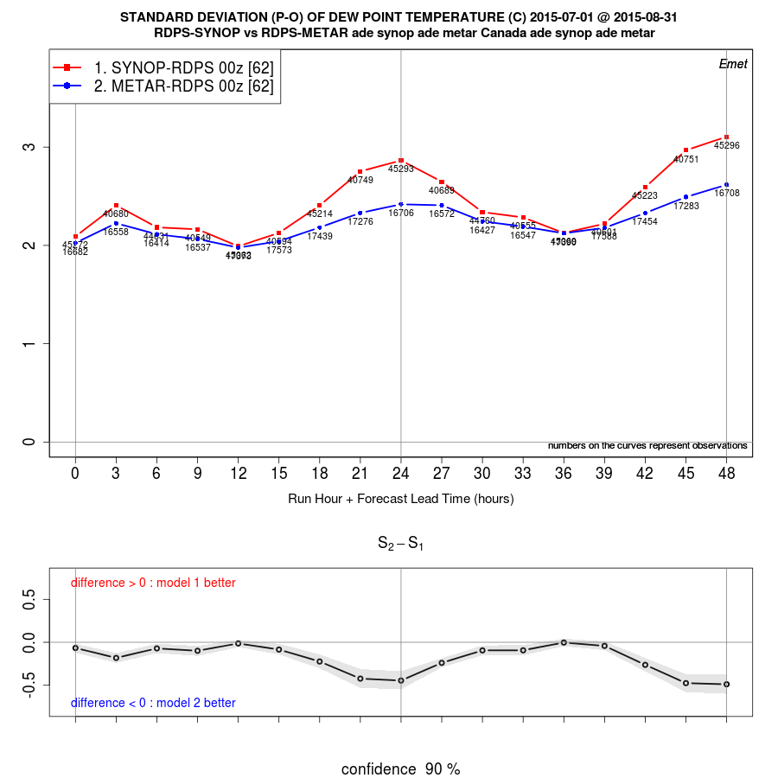
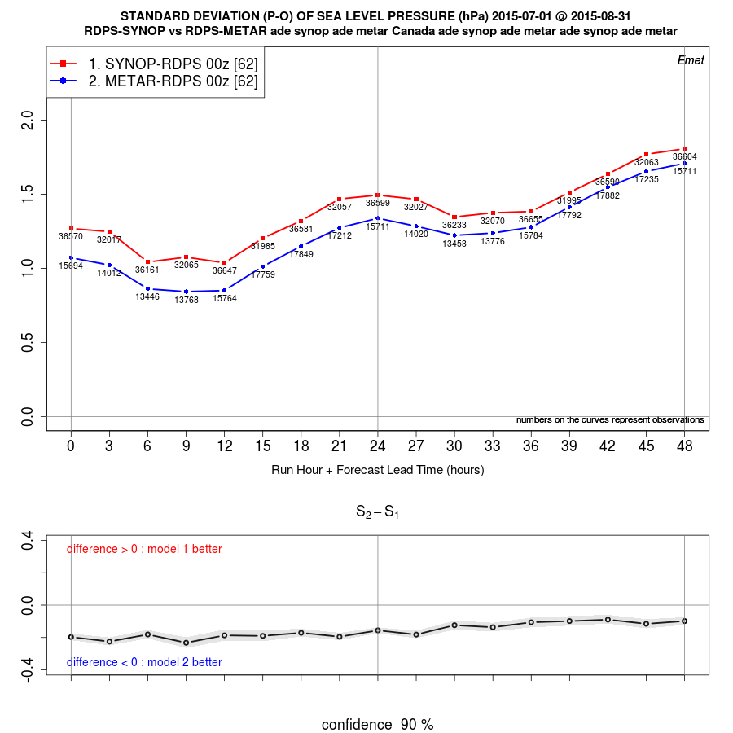
SYNOP vs METAR
Bias
RDPS, TT
RDPS, TD
RDPS, PN
err std dev

Slide 8
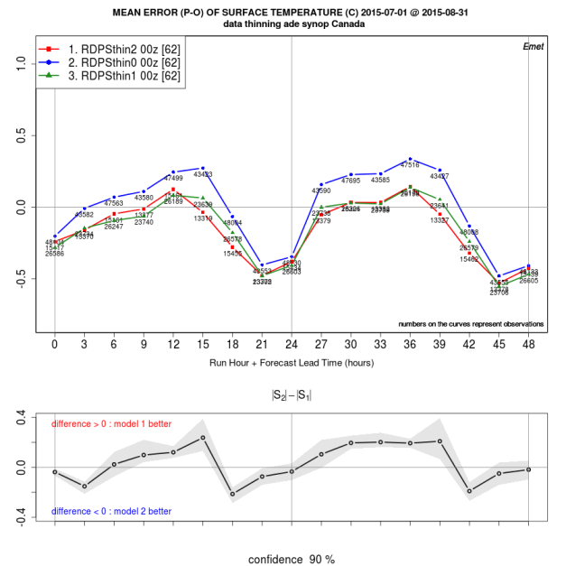
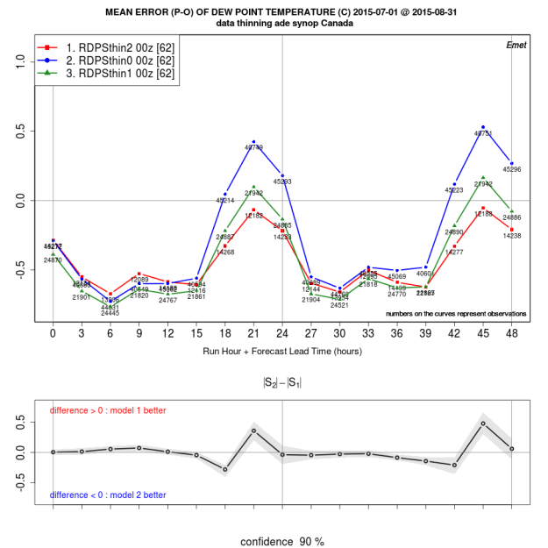
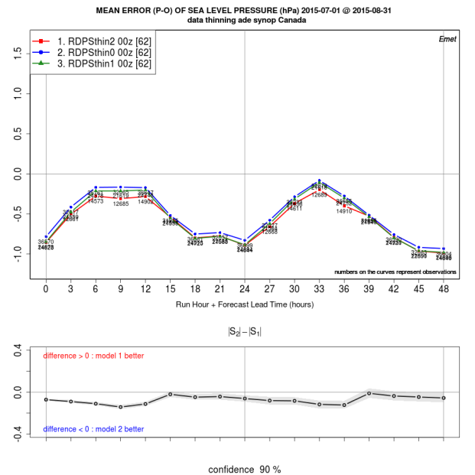
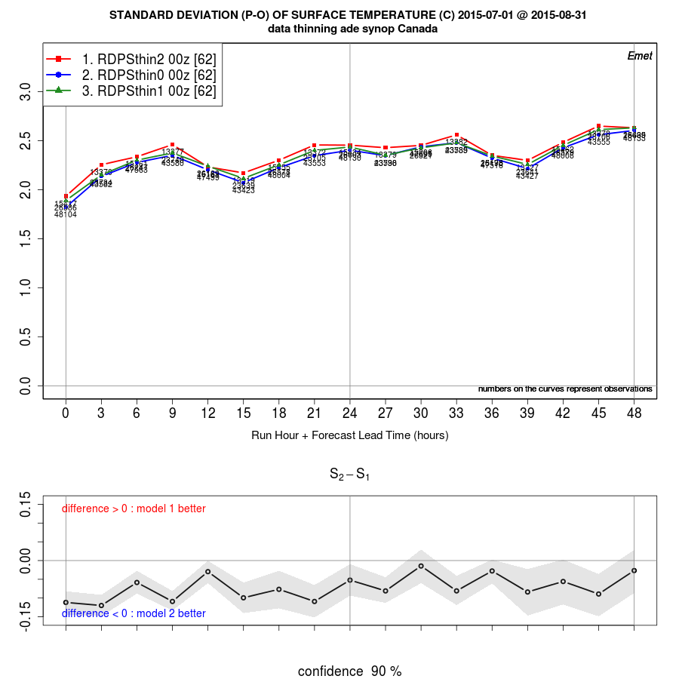
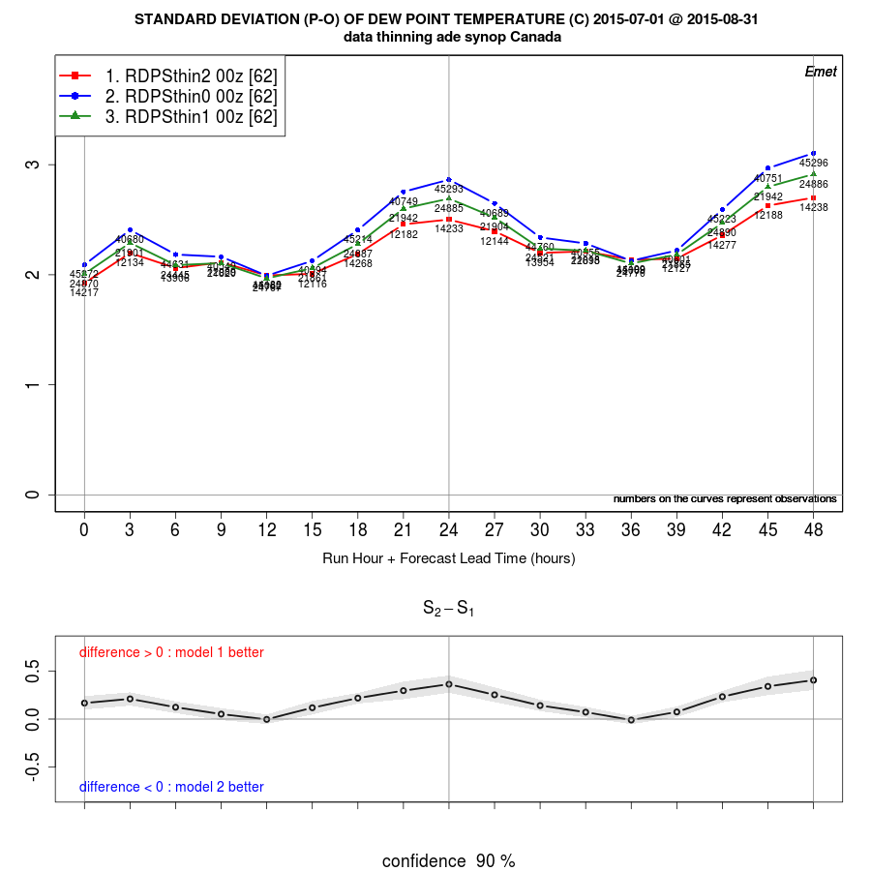
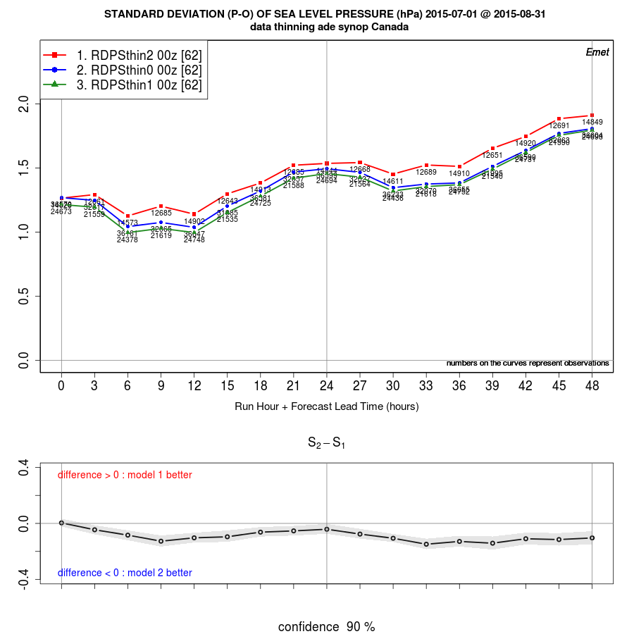
thin 0º (no thinning) - thin 1º - thin 2º
RDPS, TT
RDPS, TD
RDPS, PN
Bias
RDPS, TT
RDPS, TD
RDPS, PN
err std dev

Slide 9
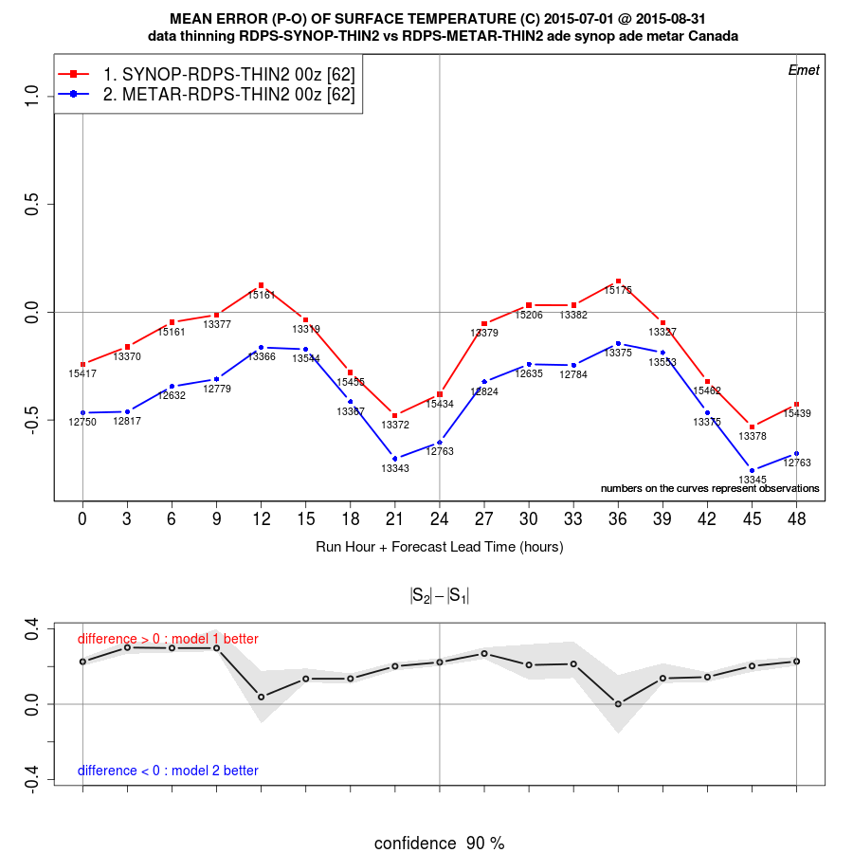
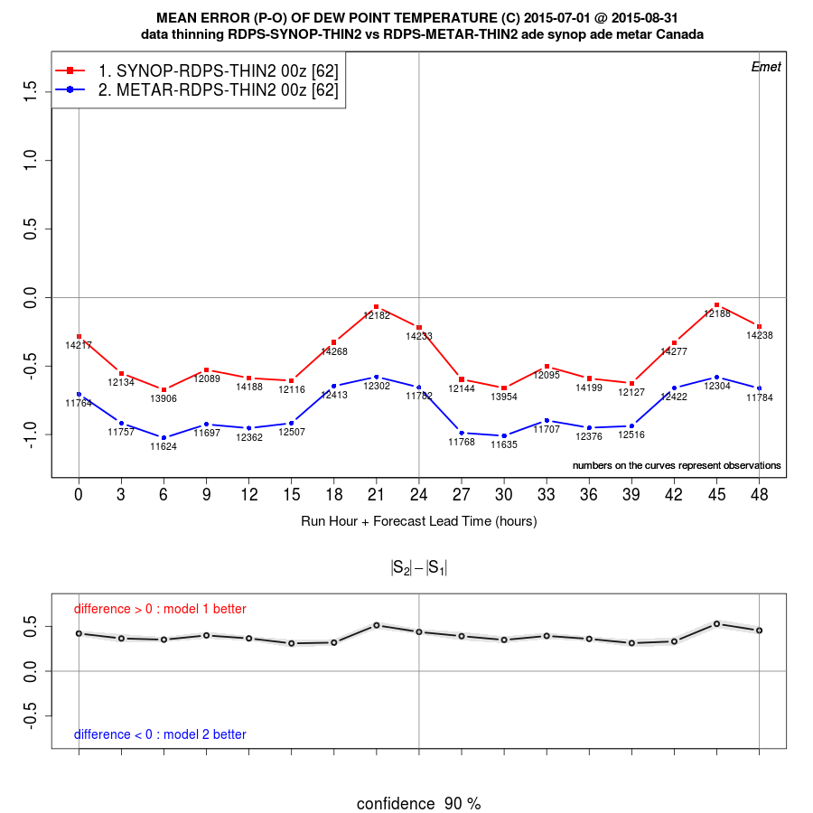
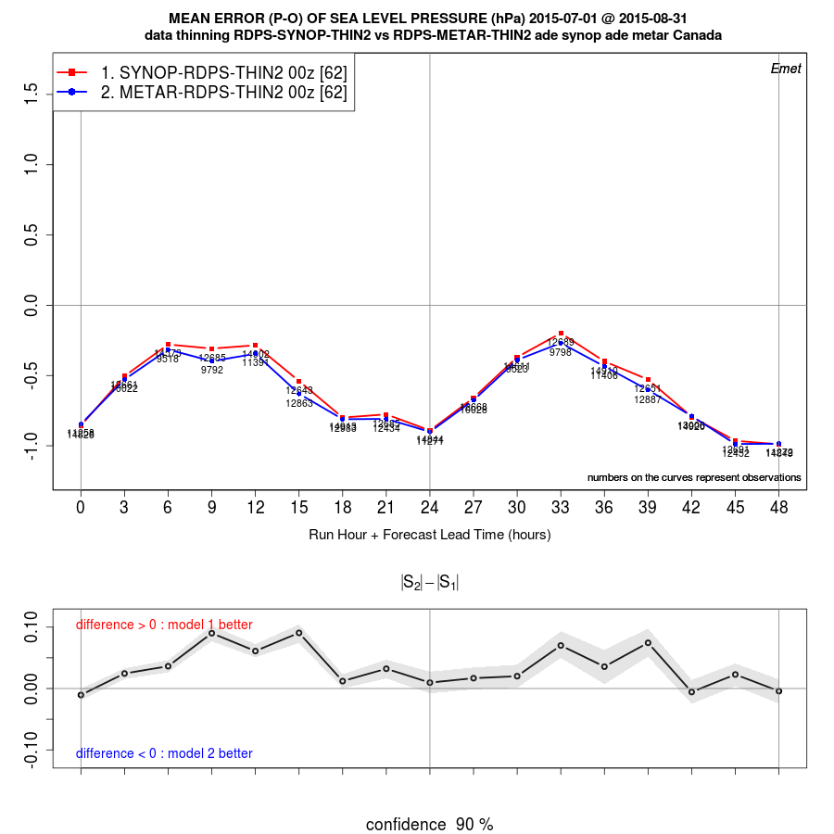
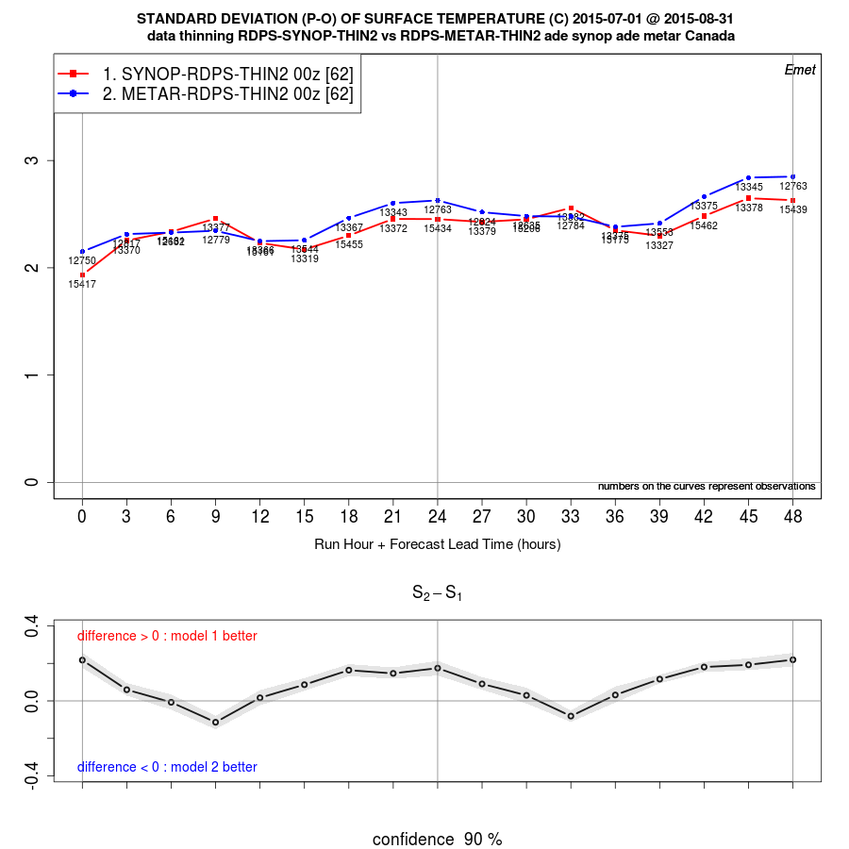
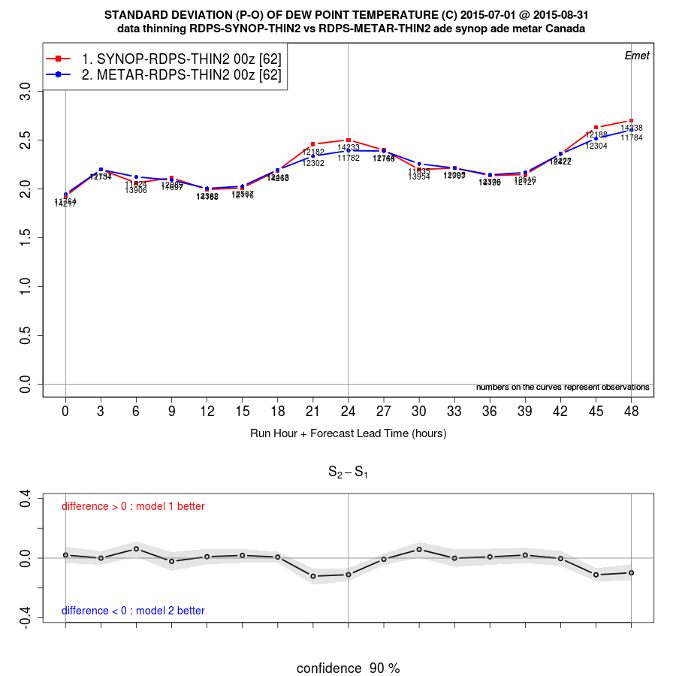
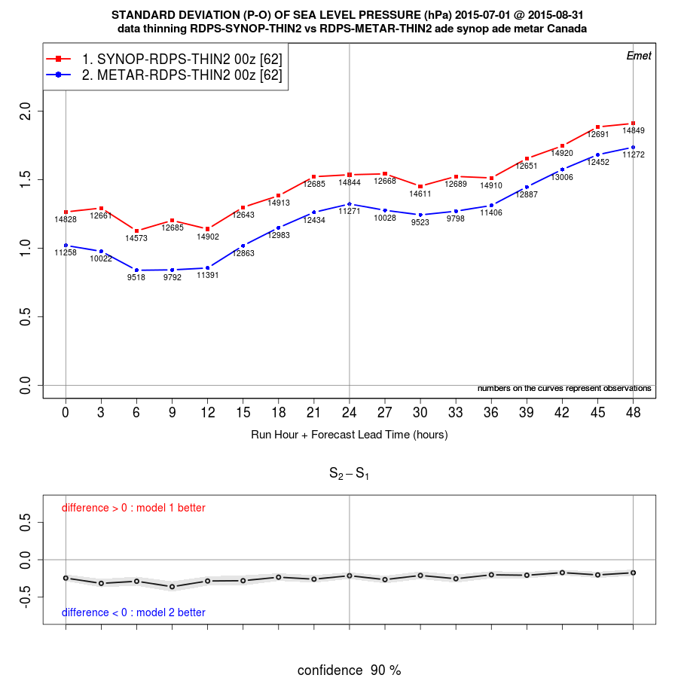
SYNOP vs METAR with 2⁰ thinning
THIN 2º, TT
THIN 2º, TD
THIN 2º, PN
Bias
THIN 2º, TD
THIN 2º, PN
THIN 2º, TT
err std dev

Slide 10
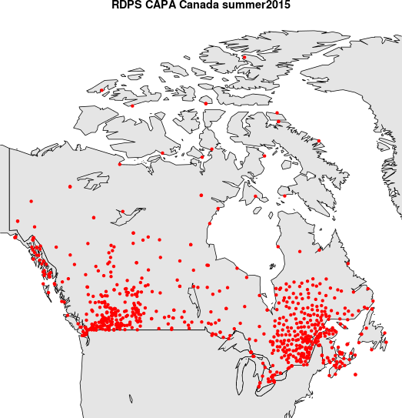
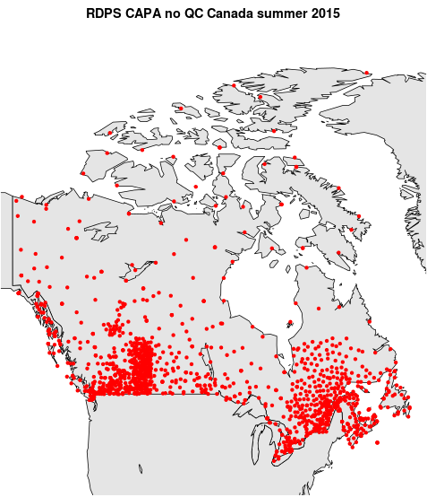
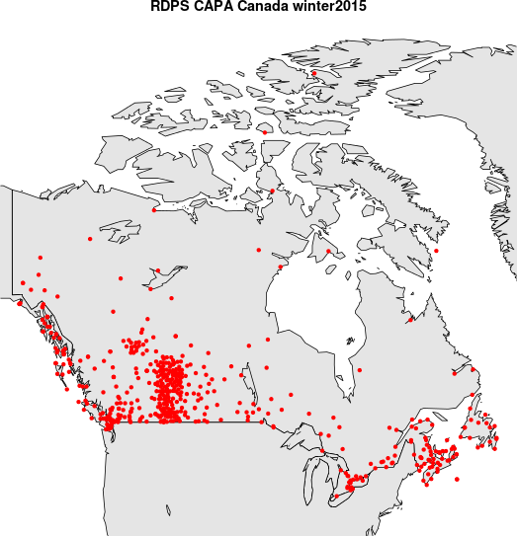

Season, Quality Control (QC)
Summer
CaPA
QC
Summer CaPA
no QC
Summer sample size:
1mm QC = 3,000
1mm noQC = 6,000
10mm QC = 400
10mm noQC = 1,000
Winter sample size:
1mm QC = 800
1mm noQC = 4200
10mm QC = 100
10mm noQC = 400
Winter
CaPA
QC
Winter CaPA
no QC
Quebec winter:
tipping bucket
gauges freeze
QC reject PR obs
with strong wind
(undercatchment)

Slide 11
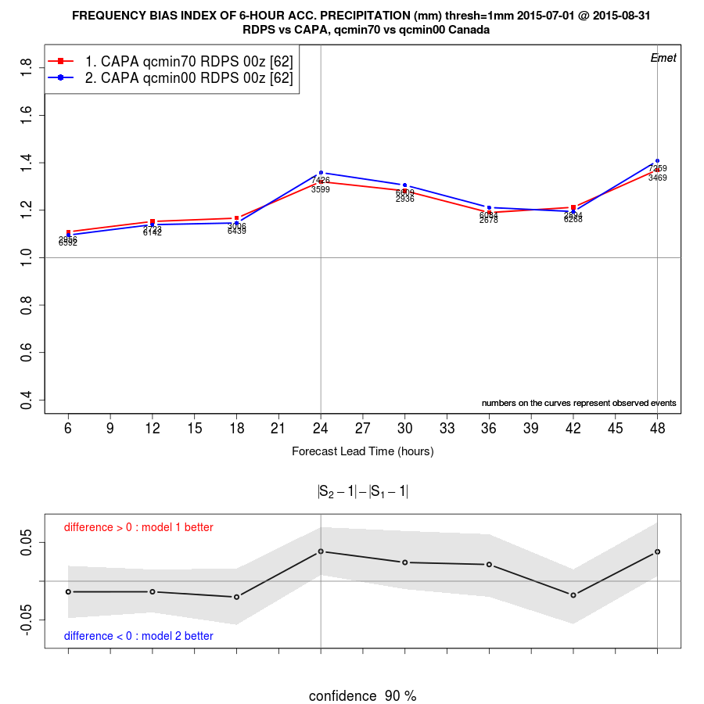
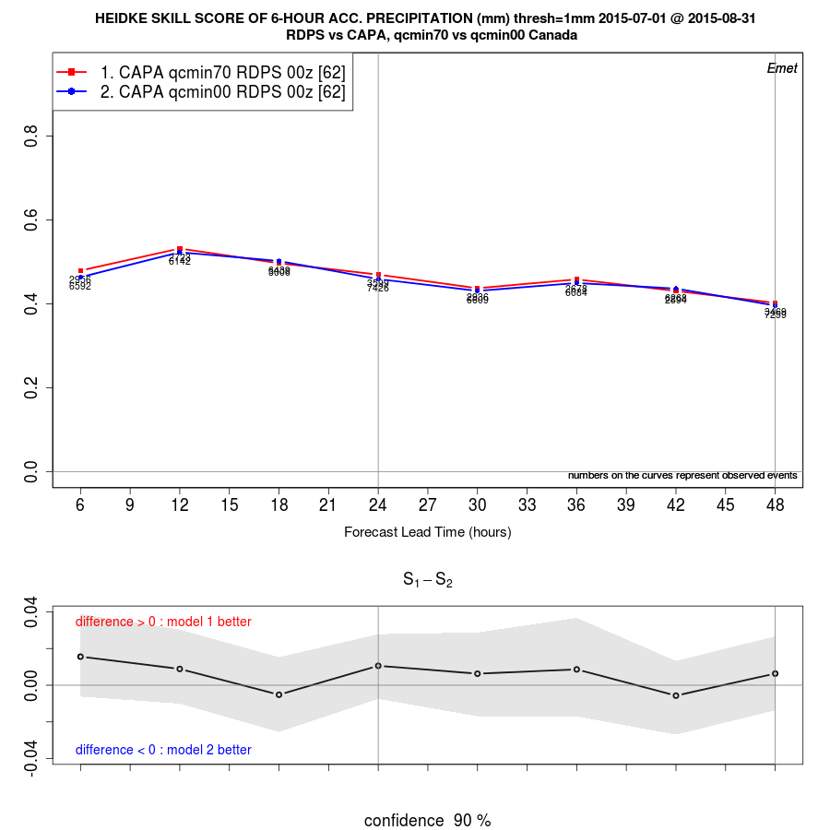
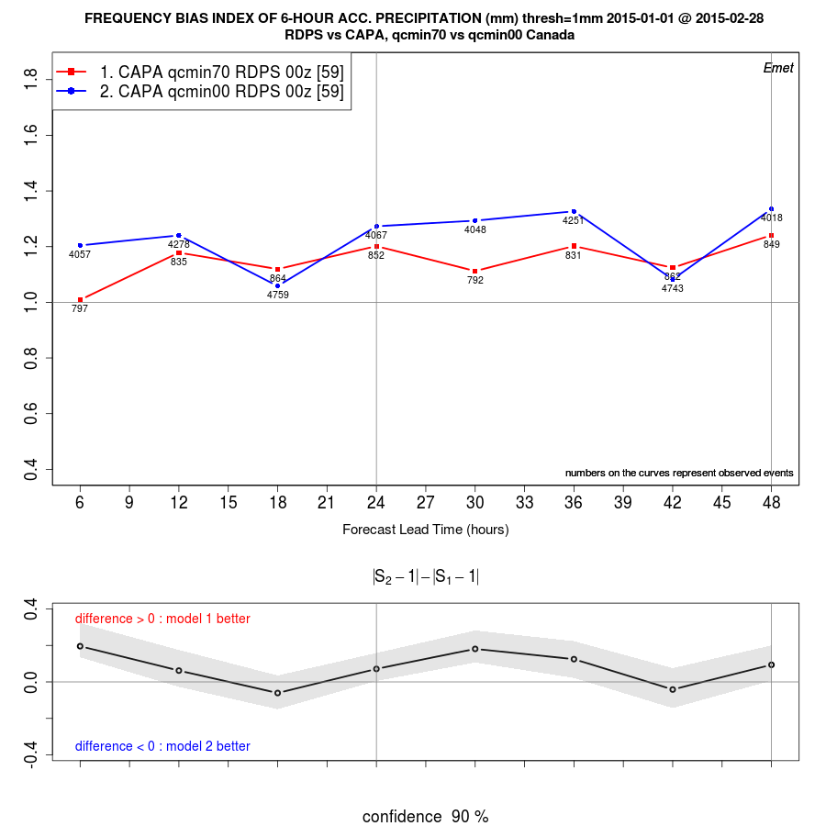
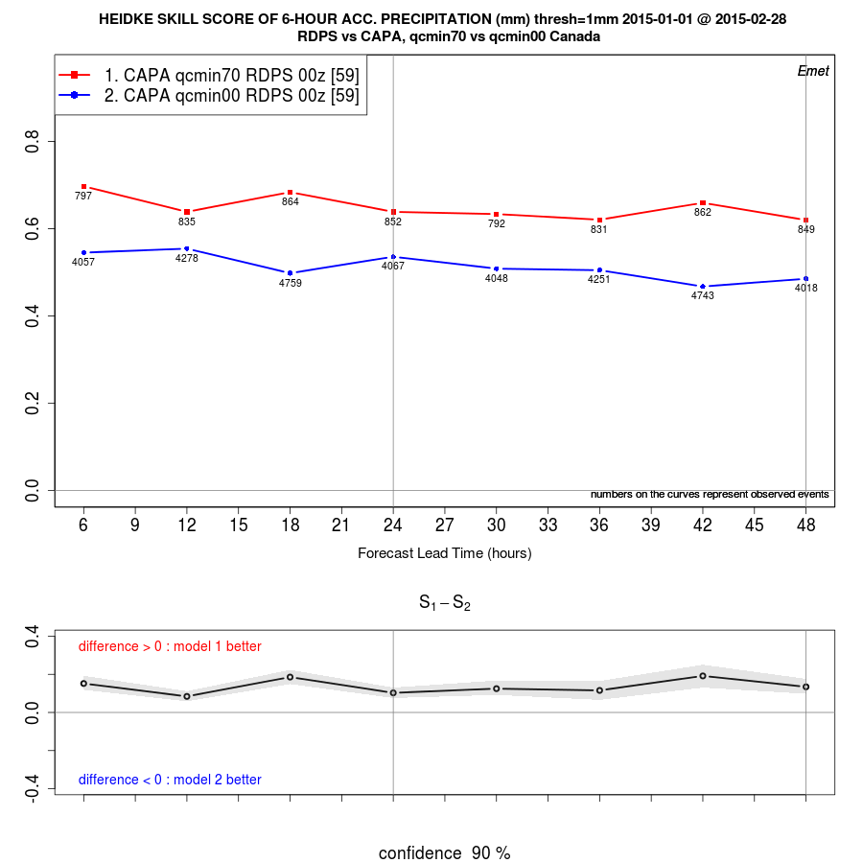
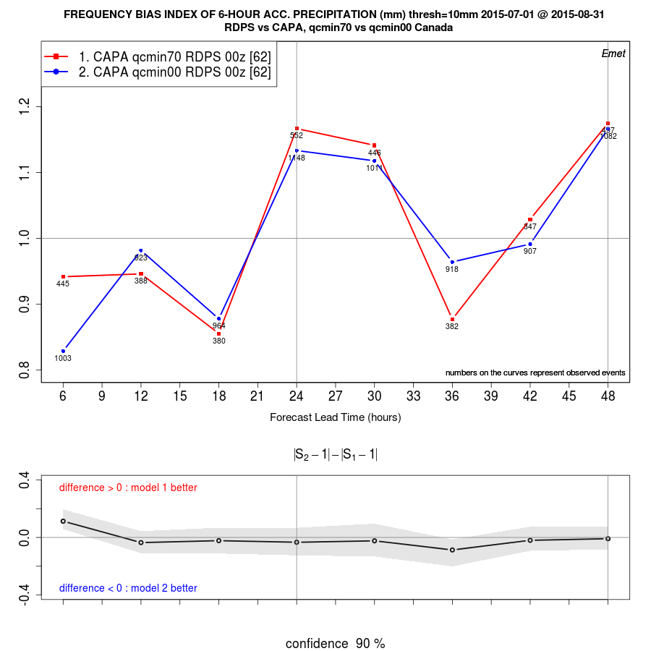
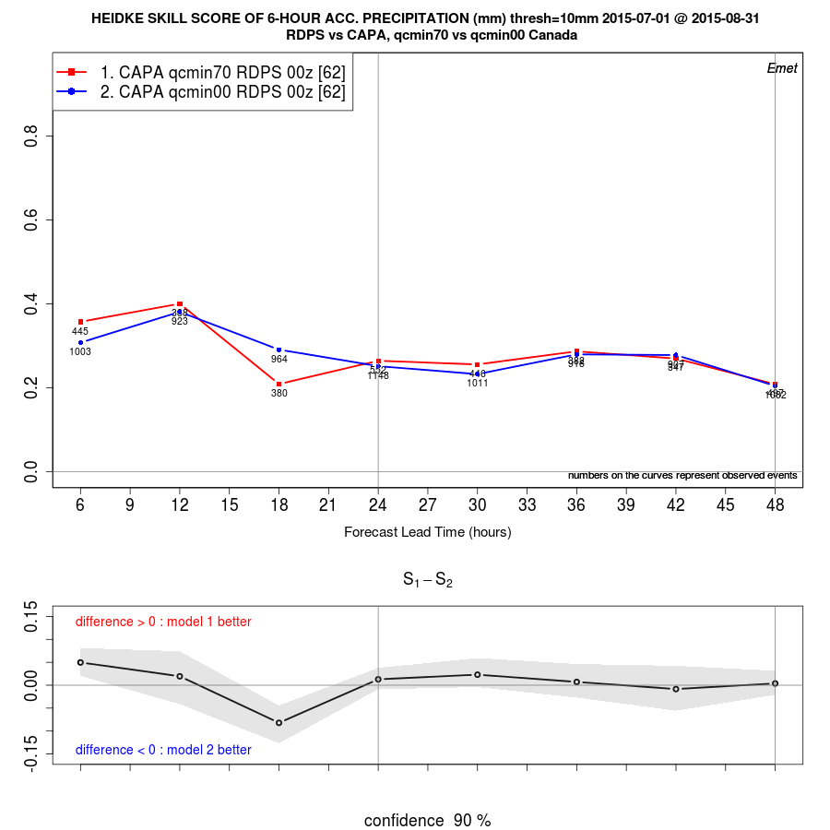
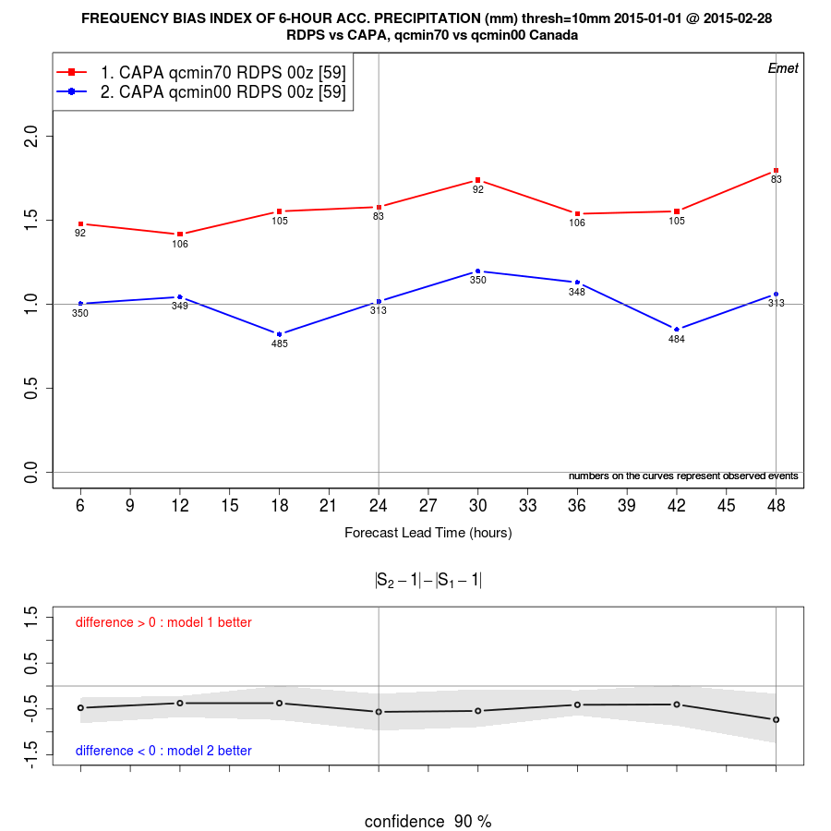
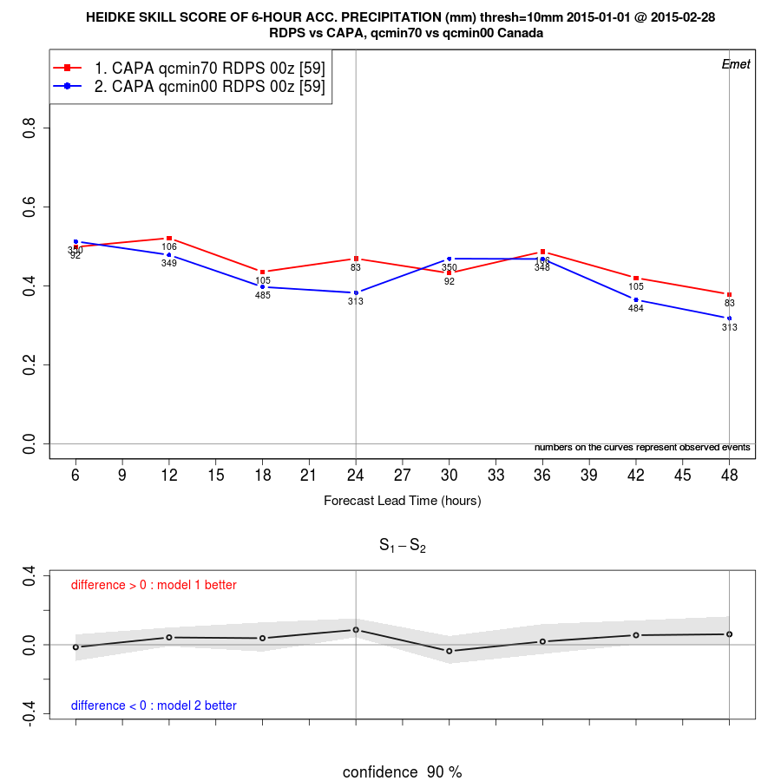
Quality Control vs no Quality Control
Bias
Err std dev
RDPS 1mm
Summer ←→ Winter
RDPS 10mm

Slide 12
Results
Verification against different networks (SYNOP vs METAR) exhibits larger differences than thinning
Thinning at 2º leads to more homogeneous and similar spatial sampling and sample size: reduces SYNOP / METAR differences
Bias curves against SYNOP are systematically higher than those against METAR (more over-forecast than METARs).
  NOTE: SYNOP stations equipped with Stephenson screen, METAR stations are not: SYNOP observations are colder than METAR observations!
Quality Control versus no Quality Control, PR6h, categorical scores:
  Summer 2015: no significant differences in verification results.
  Winter 2015: for the FBI, QC affects curves behaviour (diurnal cycle vs constant); 1mm HSS significantly better for Quality Controlled observations.
Conclusions: Verification against different networks / with or without thinning / with or without quality control: exhibits significant differences, affect interpretation of verification results (e.g. over/under estimation for the bias, ranking for error stdev).

Slide 13
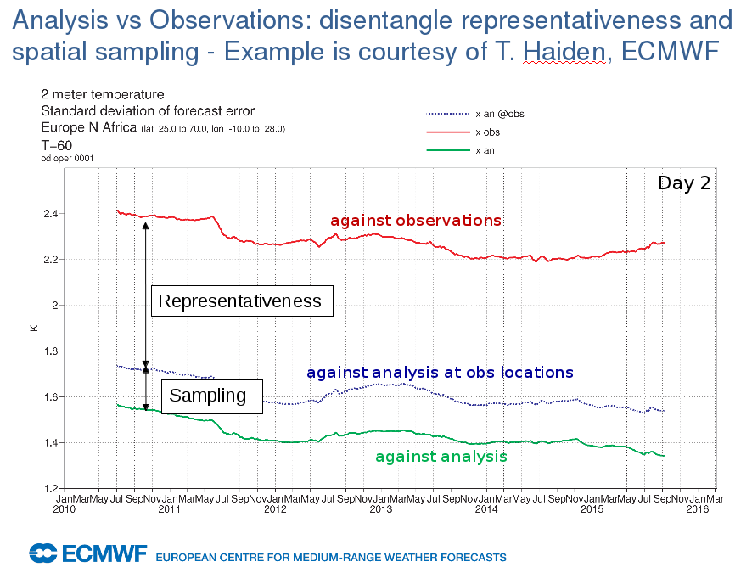

Slide 14
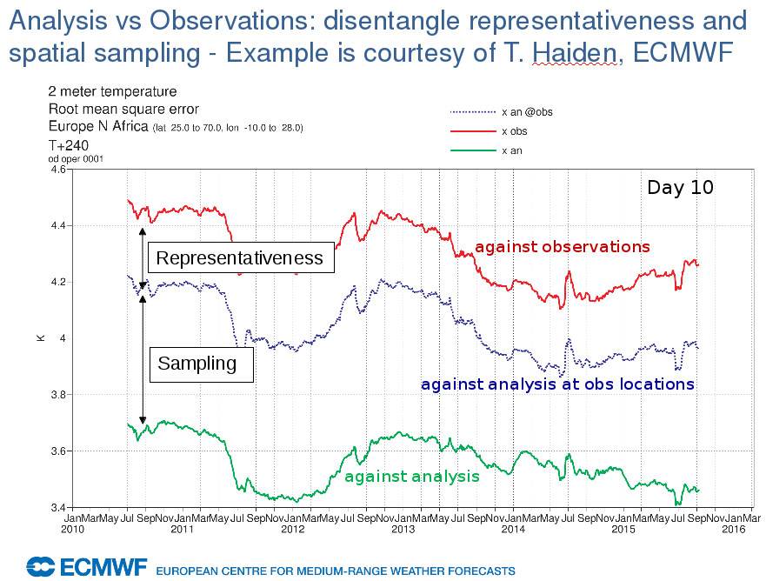

Slide 15
Impact of observation uncertainty on verification results
ECMWF (Zied Ben Bouallegue)
Method:
“perturbed-member” approach following Saetra et al. 2004
random noise added to each ensemble member
standard deviation of the observation uncertainty estimated by data assimilation experts
Results:
Large impact on the ensemble spread at “short” lead times
major impact on the ensemble reliability
decisive impact on the interpretation of the verification results
Saetra O, Hersbach H, Bidlot JR, DS Richardson, 2004. Effects of observation errors on the statistics for ensemble spread and reliability. Mon. Weather Rev. 132: 1487-150.

Slide 16
RMSE [m/s] and ensemble spread [m/s] of wind speed at 500 hPa
2 experiments are compared:
  reference (dashed) and new (full lines) as a function of the lead time [d]
RMSE
Spread without obs. uncertainty
Spread with obs. uncertainty
Notes:
Obs. uncertainty has no impact on the ensemble mean and so no impact on RMSE

Slide 17
CRPS difference [m/s] of wind speed at 500 hPa
reference exp. – new exp. (positive means new is better)
as a function of the lead time [d]
without observation uncertainty
with observation uncertainty

Slide 18
CMC (Fortin, et. al): apparent under-dispersion
Comparison of RMSE to the spread calculated as the average of the standard deviation

Slide 19
Corrected spread using variance instead of standard deviation
De-biased spread compared to a biased estimation of RMSE
Spread multiplied by sqrt((R+1)/R), where R=20 (no. of EPS members)

Slide 20
RMSE corrected for observation error
MSE = RMSE²_{F} + RMSE²_{O}
De-biased spread compared to de-biased RMSE
Radiosonde error evaluated at 6.9m for GZ500

Slide 21
Estimated radiosonde observation error
hPa TT(C) T-Td(C) UV(m/s) GZ(m)
1000 1.5 1.8 2 4.9
925 1.3 2.3 2.1 4.5
850 1 3.1 2.1 4.6
700 0.9 3.6 2.2 5.3
500 0.8 3.9 2.3 6.9
400 0.7 3.6 2.4 8.4
300 0.7 3.4 2.5 10.5
250 0.9 3.4 2.6 11.4
200 1.1 4.6 2.8 12
150 1.3 4.6 3 12.8
100 1.4 4.6 3 14.8
70 1.7 4.6 3 16.6
50 1.7 4.6 2.9 18.5
30 1.7 4.6 2.8 21.7
20 1.7 4.6 3 26.8
10 2.1 4.6 3.5 36.1
7 2.5 4.6 4.5 45
5 3.6 4.6 5.5 55
3 5 4.6 4.5 70

Slide 22
Reducing radiosonde observation error GZ and RH
Both variables are currently derived quantities
Meanwhile
  Relative humidity is directly measured
  GPS sondes are able to provide significantly more accurate position data
The ET-OWFPS should propose to relevant bodies that relative humidity and GPS based geopotential height be reported from the radiosonde

Slide 23
Conclusions
To account for observation uncertainties in verification practices
  Identify major sources of observation uncertainties and quantify their effects on verification
  correct observation uncertainties → quality control
  incorporate observation uncertainty in verification results
  →probabilistic approach + confidence intervals

