Slide 1
7.3 Update on WDQMS:
WDQMS NWP Pilot Project
Cristina Prates and Erik Andersson
ECMWF
With thanks to :
Y. Ota (JMA), T. Pröscholdt (WMO), J. Whiting (NCEP), A. Cress(DWD)
7 February 2018, Geneva, Switzerland

Slide 2
Outline
WDQMS Inception
Pilot Project on Data Quality Monitoring :
Land surface observations
Upper-air observations
Contribution for Demonstration Project
WMO web-based GUI
Future challenges
Side Event, Regional Association VI, 17Th Session 7 February 2018, Geneva, Switzerland

Slide 3
WDQMS – The WIGOS Data Quality Monitoring System
To review and modernise the NWP-based monitoring of the conventional components of WIGOS
To provide real-time monitoring of the performance (data availability and quality) of observing stations
To be able to identify issues/problems
To take actions towards the supplier so that identified issues can be solved.
WDQMS comprises
monitoring function (QM),
analysis and evaluation function (Ev),
incident management function (IM).
Side Event, Regional Association VI, 17Th Session 7 February 2018, Geneva, Switzerland

Slide 4
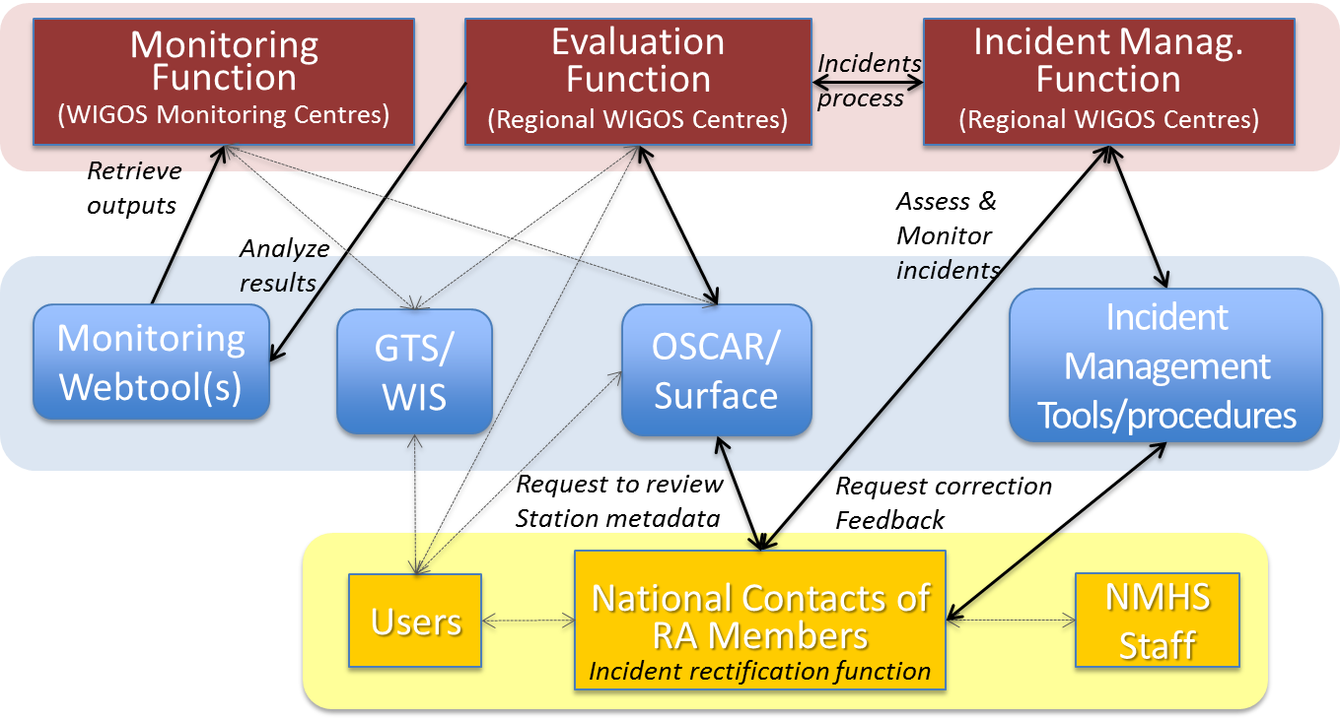
WDQMS concept
QM: to compare observational data received at NWP Centres against OSCAR/Surface metadata, and quality standards – and display in an agreed format.
Ev: to extract the information from QM outputs and identify issues
IM: It’s up to this function to take the necessary actions to solve the issue raised by Ev function.
Process of the WDQMS. From Guidance on QM, Ev and IM Procedures for RWC.

Slide 5
Pilot Project on Data Quality Monitoring : Overview
Practical implementation of the Monitoring function of WDQMS relies on the monitoring information provided by Global NWP Centres: pilot project on data quality monitoring was established so that work could be initiated to implement and test this component of the system.
Four Global NWP Centres providing quality information based on feedback from their data assimilation (DA) systems on a daily basis. Participating NWP Centres:
ECMWF & NCEP (2015)
JMA & DWD (2016)
Monitoring of land surface observations (2015): ECMWF, NCEP, JMA and DWD.
Monitoring of Upper-air land observations (2016): ECMWF and JMA
Side Event, Regional Association VI, 17Th Session 7 February 2018, Geneva, Switzerland

Slide 6
Pilot Project on QM – Land Surface Observations
ECMWF WIKI page on QM pilot project
Near-real time information about the availability/usability of land surface observations (based on surface pressure observations)
Side Event, Regional Association VI, 17Th Session 7 February 2018, Geneva, Switzerland

Slide 7
Pilot Project on QM – Upper-air Land Observations
ECMWF WIKI page on QM pilot project
Near real-time product: daily maps with the total number of radiosonde ascents per day reporting air temperature
ECMWF
JMA
Side Event, Regional Association VI, 17Th Session 7 February 2018, Geneva, Switzerland

Slide 8
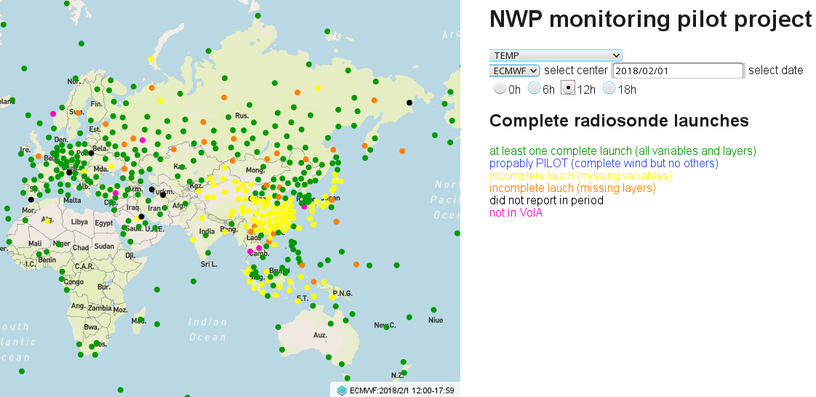
WMO web-based GUI for pilot project on QM
Allow us to detect small and large scale patterns on observations:

Slide 9
WMO web-based GUI for pilot project on QM
Allow us to detect small and large scale patterns on observations:

Slide 10
WDQMS in a nutshell
Cooperation between Global NWP centres
Cooperation with the Regional WIGOS Centres
Facilitates processing of the quality monitoring information together with the observing station metadata in OSCAR/Surface and displays it
In progress
Generate Quality Reports;
Generate automatic alerts and daily summaries to be used by the Regional WIGOS Centres (RWC)
Establish pre-operational phase

