Slide 1
Multi-model seasonal forecast
Operational systems
issue time free data Freq. data archived
access
APCC ~8GPC 20th Y monthly
C3S-Copernicus 3GPC+ 10th Y higher(6h-24h)
NMME 2GPC 8th Y monthly
WMO LC-LRFMME 13GPC 15-20th X monthly
Notes:
At the workshop we had 3 presentation on Multi-model systems. Here the summary.
What can we do to enhance the LC_LRFMME profile and promote the usage of its products
Can change the issue time ?
Can we make the data available ?
Processed data, including data represented in the graphs
Forecasts from individual systems and multi-system combinations
The great value of the multi-model activity is the collaboration NMME and C3S have constant exchange between GPC and users. May be for the LC this could be improved.

Slide 2
C3S – Available Products
Observations
ECVs global estimates (satellite/in-situ)
Reanalysis
Global
Model data
Multi-system seasonal forecasts
Reprocessed CDRs, reference observations
Regional (Europe/Arctic)
Coupled reanalysis (100 yr)
CMIP Data and products (global)
Climate services´ roadmap
CMIP Data and products (regional)
Data rescue
Started
In preparation
Free, full and open access to data and services for any citizen or organization
Notes:
provide an overview of C3S, touch on NMME and APCC seasonal forecasts. It will be good to stress the open data policy of C3S and NMME to support discussion on opening access to hindcast data at the Lead Center website.

Slide 3
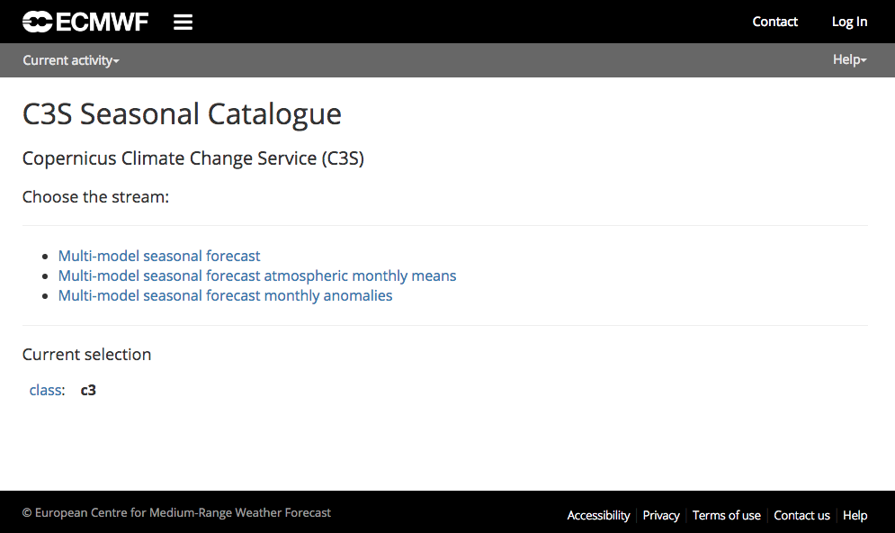
C3S Seasonal Forecasts – Data Products
Scope of the data service
Original provider data: 1 deg gridded data sets for many variables (atmosphere, ocean; high temporal resolution: 6h - 24h)
Processed data, including data represented in the graphs
Forecasts from individual systems and multi-system combinations
Information on (average) skill will accompany forecast products wherever possible.
Current status – preliminary data service using ECMWF´s MARS WebAPI
http://climate.copernicus.eu/seasonal-forecasts/
Notes:
Current status:
An interim data service (to be linked with CDS) is is now available, with the following data available:
Original (daily/subdaily) data from the providers
Monthly statistics (mean, max, min, stdev)
Products based on monthly means: (providers)
Anomalies: forecast – hindcast mean
Heavily based in EUROSIP, helped to speed up the initial release of products, but somehow constrained what we could offer to the users

Slide 4
C3S Seasonal Forecasts – Data Products
Scope of the data service
Original provider data: 1 deg gridded data sets for many variables (atmosphere, ocean; high temporal resolution: 6h - 24h)
Processed data, including data represented in the graphs
Forecasts from individual systems and multi-system combinations
Information on (average) skill will accompany forecast products wherever possible.
Current status – preliminary data service using ECMWF´s MARS WebAPI
http://climate.copernicus.eu/seasonal-forecasts/
Notes:
Transition from development phase…
3 “core” providers: ECMWF, Met Office, Météo-France
… to operations
5 European providers (first stage)

Slide 5
Products - Technical Description
Horizontal grid: global 1deg x 1deg
Ensemble size:
Forecasts: ~50 members
Hindcasts: ~25 members x 24 years (1993-2016)
Variables
Surface
7 vars every 6h
30+ vars every 24h
Pressure (11 levels, from 925 hPa to 10 hPa)
8 vars every 12 h
Agreed netCDF specification C3S-0.1 (based on CF)
Publication date: currently 15th of the month; change to an earlier date planned for second half of 2018
Notes:
Description of technical requirements for providers. Important for the ‘content’ of the service, but could be too technical for some audiences.

Slide 6
NMME Data Access
ftp://ftp.cpc.ncep.noaa.gov/International/nmme/
binary
Grads ctl file
Forecast data
SST
Precipitation
2-meter temperature
cpt
All NMME model hindcasts & forecasts data are available in cpt format

Slide 7
Model Overview
Models | Initial Conditions | Members
CFSv2 (NCEP) | 1st to the 8th of month | 32
CCMs (Canada) | 1st of each month | 20
GFDL | 1st of each month | 10
GFDL-FLOR | 1st of each month | 24
NASA | /5dy 4mb / lstdy 7mb | 11
NCAR | 1st of each month | 10
NMME | Combined | 107
Forecasts released by the 8th of each month
All models have the same horizontal resolution 1.0◦ X 1.0◦
Hindcasts are from 1982 - 2010

Slide 8
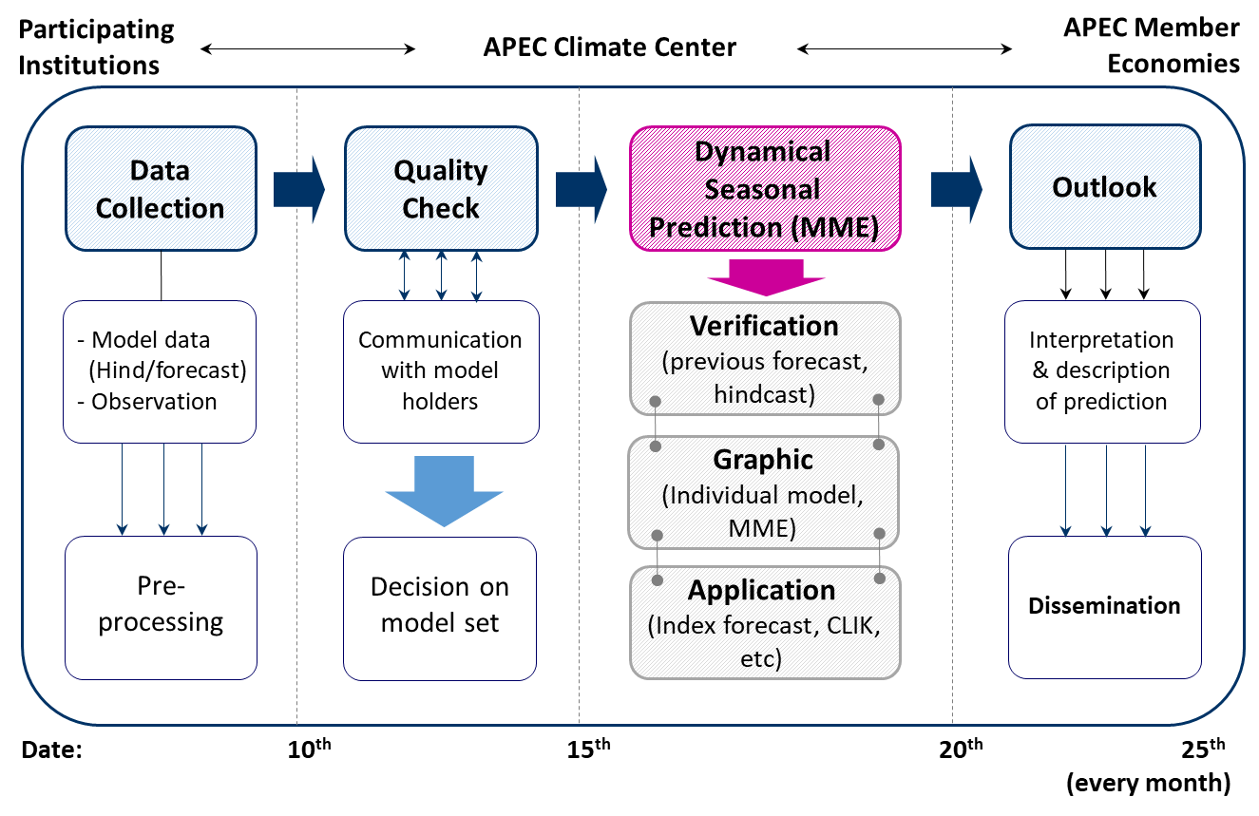
Operation Schedule
Notes:
Hindcast -> 1990 after (overlap period different…..) , late arrival, observed SST : MGO (unfair comaprison: predicted SST)
1982-3~2005 : APCC common hindcast period

Slide 9
Regionalized NMME Forecasts
http://www.cpc.ncep.noaa.gov/products/international/nmme/ensm/index.shtml

Slide 10
Seasonal forecasts-forecast systems
Models
Current model configurations:
ECMWF (Seas5): IFS atmosphere (TCo319, equivalent to N320: ~30km and 91 levels), NEMO ocean (0.25 deg, 75 levels), LIM sea ice
Met Office (GloSea 5): UM atmosphere (N216, ~50 km and 85 levels) , NEMO ocean (¼ deg, 75 levels), CICE sea-ice
Météo France (System 5): ARPEGE atmosphere (TL255), NEMO ocean (1 deg, 42 levels), GELATO sea-ice
CMCC (SPS.v3): CSEM atmosphere ( 1 deg, ~100 km, 46 levels), NEMO ocean (¼ deg, 50 levels), CICE sea-ice
DWD (GCFS 1.0): ECHAM6 atmosphere (T63, ~300 km, 47 levels), MPIOM ocean (1.5 deg, 40 levels; includes sea ice)
Versions planned for 2017/2018, where applicable:
Météo France (System 6): ARPEGE atmosphere (TL359, ~60km, 91 levels), NEMO ocean (1 deg, 75 levels), GELATO sea-ice
DWD (GCFS 2.0): ECHAM6 atmosphere (T127, ~150 km, 95 levels), MPIOM ocean (0.4 deg, 40 levels; includes sea ice)
Met Office: update likely, but not to resolution
Ensemble generation: lagged or burst, with or without perturbations to initial conditions.
Notes:
Additional (hidden) slide
Details about current (and future, where appropriate) forecast systems

Slide 11
Seasonal Forecasts- Variables
From the atmosphere model:
every 6 hours: 2 metre temperature
2 metre dewpoint temperature
10 metre u wind
10 metre v wind
mean sea level pressure
total cloud cover
soil temperature level 1
sea-surface temperature
sea-ice temperature
every 24 hours: sea-ice concentration
volumetric soil moisture in model (or total soil moisture)
snow depth (water equivalent)
snow density
Tmax and Tmin at 2 metres
Max 10m wind gust
every 24 hours, accumulated:
large scale precipitation
convective precipitation
(or total precipitation)
snow fall
surface sensible heat flux
surface latent heat flux
surface incoming solar radiation
surface incoming thermal radiation
surface net solar radiation
surface net thermal radiation
top of atmosphere net solar radiation
top of atmosphere net thermal radiation
eastward surface stress
northward surface stress
evaporation
surface runoff
sub-surface runoff
(or total runoff)
every 12 hours: geopotential
temperature
specific humidity
vorticity/divergence
(or u/v wind components)
at 925, 850, 700, 500, 400, 300, 200, 100, 50, 30, 10 hPa
Notes:
The list of requested variables. Some are not yet made available through the data service (technical obstacles).

Slide 12
C3S Seasonal Forecasts – Next Steps
Generate and display verification scores for products presented in the graphs
Add monthly mean based products to the plots
Add new providers to the multi-system; regularly generate data and graphical products from all contributors
CMCC and DWD in Q2 2018
By the end of 2018 NCEP, JMA?
and possibly BoM and ECCC
Introduce new products in the C3S suite of outputs
probability forecasts for ENSO indices
indices of atmospheric circulation (NAO, SOI)
products based on within-season statistics (frequency/length of spells)
…
Notes:
Not necessarily in the order they will finally happen, but in the order of priority

Slide 13
Decadal Prediction Service (Prototype)
Rationale:
Current user requirements surveys and discussions with C3S stakeholders clearly indicate the need for information at decadal timescales, e.g. in economic sectors such as energy, infrastructure, transport, water and urban issues, etc., where there is a need from planners and policy makers to make informed decision about future investment, resource allocation, etc.
Decadal forecasts are designed to predict variations of the climate system over the next few years and decades, taking into account natural variability and human influences.
Process:
The proposed approach is to organise a workshop (probably Q1 2019) involving key stakeholders, the scientific and user community, in order to assess the level of maturity of decadal prediction science (including verification), and the level of ambition of a possible operational service.
Objective:
Prototype service (2019-2020), followed by operational service (2021-..)
Heritage:
EU projects (e.g. SPECS), Copernicus Roadmap for European Climate Projections (C3S_34a lot 3), WCRP international Conferences on Subseasonal to Decadal Prediction (Boulder - October 2018), WMO workshops on Operational Climate Prediction, etc.

Slide 14
C3S and Climate Predictions
Products/data from state of the art prediction systems (e.g. seasonal forecasts), for climate services
Technical infrastructure for data access and processing (CDS and toolbox)
‘Quality’ information (operational evaluation and quality control)
Ingredients for climate prediction producers (reanalyses)

Slide 15
Climate projections
Global projection-related service
Provision of support to one Earth System Grid Federation (ESGF) node in Europe – solution for access to and manipulation of global climate projections from the CMIP archive, consistent with the requirements of climate services.
Multi-model product generation
metrics for fidelity of models in simulating historical climate, to be translated into quality for specific applications
interactive tools for generic products (e.g. maps of intra-ensemble variability for different models and scenarios), and tailored products for several economic sectors
Roadmap towards a reference set of climate projections for Europe: studies on how well climate projections address sectoral needs, to guide requirements for the operational phase of C3S. Areas of interest: the benefit of ensemble size versus resolution for global models, and the benefit of initialised decadal predictions, in relation to the specific needs of different economic sectors.
Regional climate projection service
Access to and manipulation (via the CDS) of output of regional climate projections over Europe and boundary conditions from GCM simulations needed for future regional projections.
Define, agree and complete a matrix of global/regional model combinations and scenarios (for Europe) which allows robust assessment of the uncertainties arising from these factors in a multi-model set of regional projections.
Evaluation and quality control component for climate projection-based services – similar in concept to the equivalent activity for the seasonal forecast service; started in 2016

