Slide 1
Background on the IPET-OPSLS
Arun Kumar
Chair, CBS/CCL IPET-OPSLS
Climate Prediction Center, USA
arun.kumar@noaa.gov

Slide 2
World Meteorological Organization (WMO)
Vision: WMO provides world leadership and expertise in international cooperation in the delivery and use of high-quality, authoritative weather, climate, hydrological and related environmental services by its Members, for the improvement of the well-being of societies of all nations.

Slide 3
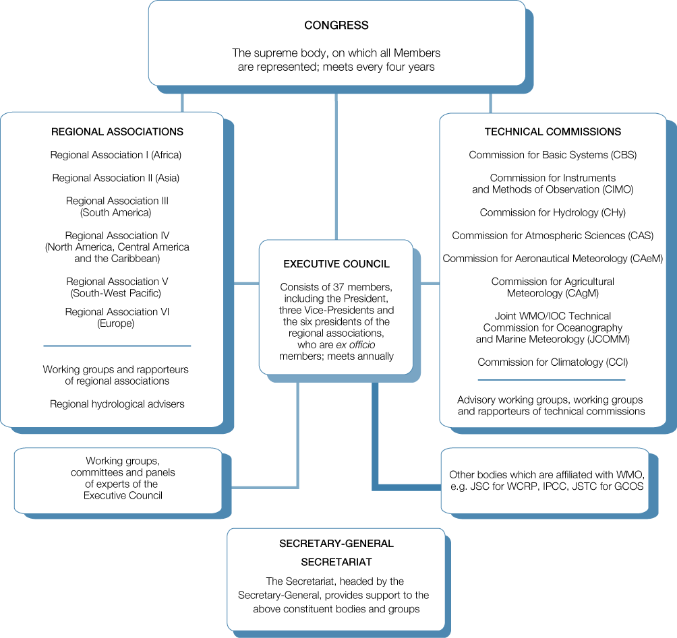
WMO Technical Commissions
There are eight Technical Commissions responsible for studying meteorological and hydrological operational systems, applications and research. They establish methodology and procedures and make recommendations to Executive Council and Congress.
Commission for Basic Systems (CBS)
Commission for Climatology (CCl)

Slide 4
Commission for Basic Systems: The Commission for Basic Systems oversees the development, implementation and operation of integrated systems for observing, data processing, data communication and data management.
Commission for Climatology: The Commission for Climatology leads international technical activities under the World Climate Programme in view of applying climate information and knowledge to support sustainable socio-economic development and for environmental protection.

Slide 5
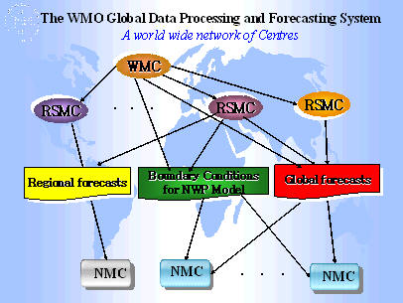
Data Processing
The main purpose of the Global Data-processing and Forecasting Systems (GDPFS) is to prepare and make available to Members the meteorological analyses and forecast products.

Slide 6
GDPFS Manual governs Technical Regulations to facilitate exchange of meteorological analysis and forecast products.

Slide 7
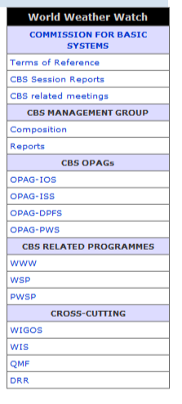
More on CBS…
CBS is divided into four Open Programme Area Groups (OPAG)
One OPAG is on Data Processing and Forecast Systems (DPFS)
OPAG-DPFS coordinates the implementation of decisions by CBS related to GDPFS and the GDPFS Manual

Slide 8
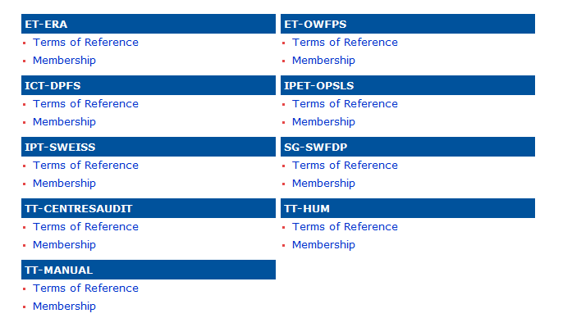
CBS is divided into four Open Programme Area Groups (OPAG)
One OPAG is on Data Processing and Forecast Systems (DPFS)
OPAG-DPFS coordinates the implementation of decisions by CBS related to GDPFS and the GDPFS Manual
Structure of OPAG-DPFS

Slide 9
Overall functioning of OPAG-DPFS is governed by the “Implementation Coordination Team on Data-Processing and Forecasting Systems (ICT-DPFS)”

Slide 10
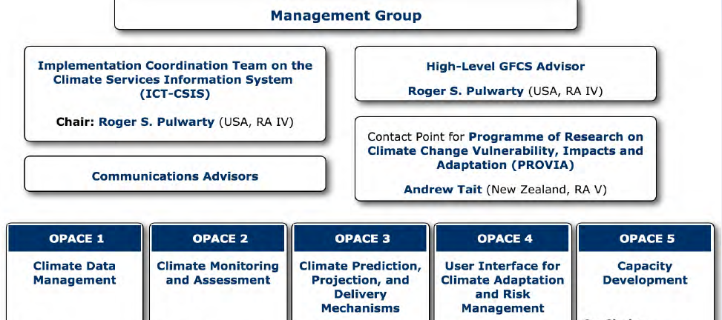
Structure of CCl: Open Panel of CCl Experts (OPACE)

Slide 11
Structure of CCl: Open Panel of CCl Experts (OPACE)

Slide 12
IPET-OPSLS
Inter-Programme Expert Team for Operational Prediction from Sub-seasonal to Longer-time Scales (IPET-OPSLS) is joint CBS & CCl Expert Team (with CBS as the lead)
IPET-OPSLS oversees and coordinates activities in long-range predictions : sub-seasonal, seasonal, decadal

Slide 13
IPET-OPSLS Reporting Structure
IPET-OPSLS
IPET-DPFS (CBS)
OPACE3 (CCl)
CBS Management Group
CCl Management Group
Executive Council
Relevant decisions recommended by EC or Congress are implemented by IPET-OPSLS
Congress

Slide 14
Thanks!

