Slide 1
CPC’s CFS.v2 Assessment and Implementation Briefing
GPC – Washington
Summary Report
27 March, 2012

Slide 2
Current Real-time Extended-Range Forecast Configuration
Implemented April, 2011 – Climate Forecast System version 2 (CFS.v2)
Old system
Climate Forecast System version 1 (CFS.v1) – implemented September, 2004
Still operational (at least until 31st October, 2012)

Slide 3
CFS Version 1 vs. Version 2
 | CFS.v1 | CFS.v2
Atmosphere | GFS 2003 (T62/L64) | GFS2009 (T126/L64)
Land | OSU 2-L | NOAH 4-L
Ocean | MOM3 | MOM4
Sea ice | Climatology | Predicted
CO₂ | Fixed at 1988 level | Evolving with time
Initial conditions | R2/GODAS | CFSR
Hindcast | 15/month | ~24/month (4 runs / 5 days)
Forecast | 4 runs/day | 4 runs/day (seasonal) 16 runs/day (45 days)
http://cfs.ncep.noaa.gov/

Slide 4
CFS.v2 Real-time Forecast Configuration
Coupled model
T126/L64
MOM4
MOM4- Sea-ice
Seasonal: 4 runs/day; 9-month predictions
Monthly: 16 runs/day; 45-day predictions
Initial conditions for the ocean, atmosphere, land are from the Climate Forecast System Reanalysis (CFSR)
Real-time forecast products are calibrated based on the hindcasts climatology

Slide 5
CFS.v2 Hindcasts : Seasonal
Period : 1982 - 2010
4 runs/day; every 5th day
Hindcasts are used for
Lead time dependent climatology
Calibration (mean; standard deviation)
Skill assessments and skill masks

Slide 6
CFS.v2 Hindcasts : Monthly
Period : 1999- 2010
4 runs/day; 45 day
Hindcasts are used for
Calibration (mean; standard deviation)
Skill assessments and skill masks

Slide 7
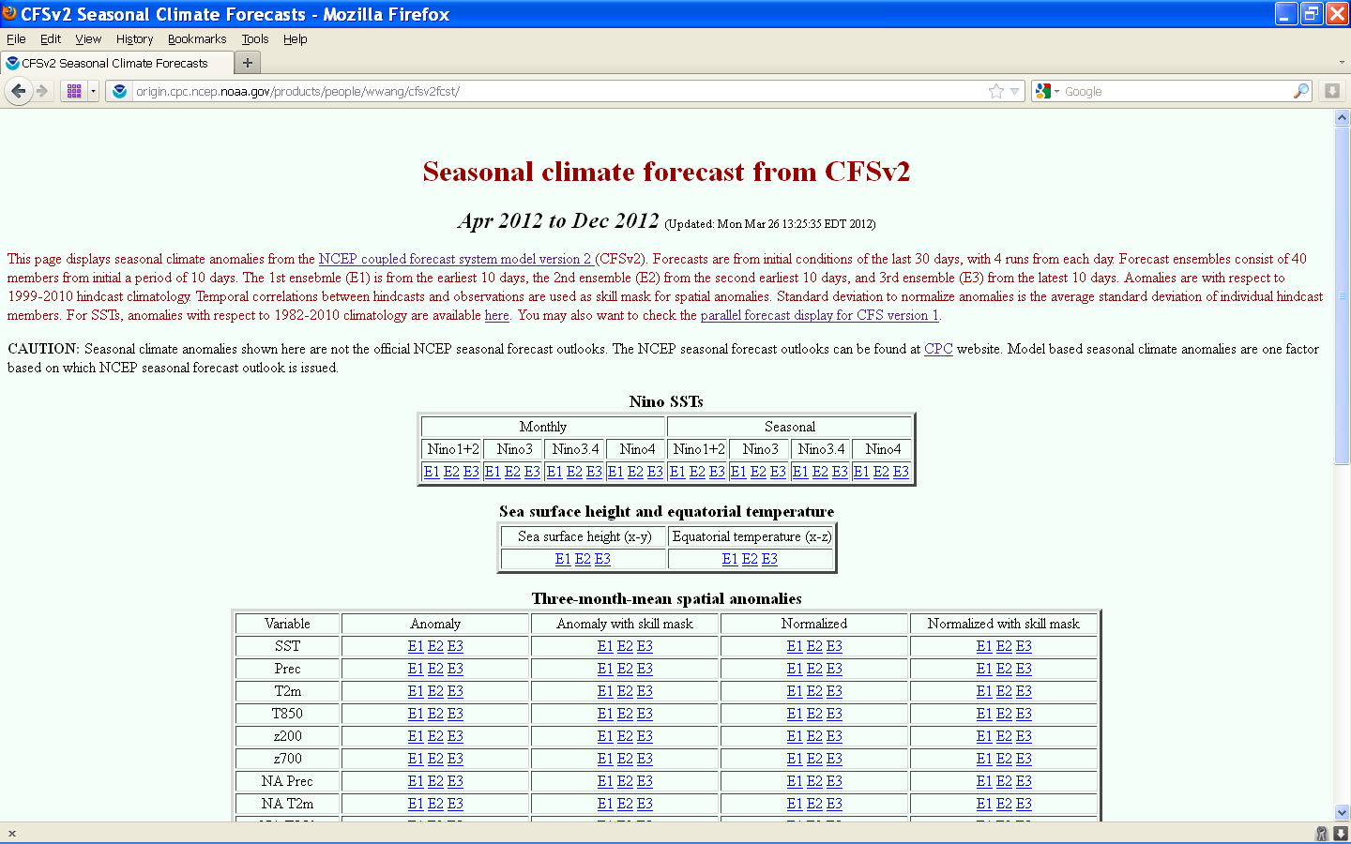
Seasonal Forecasts

Slide 8
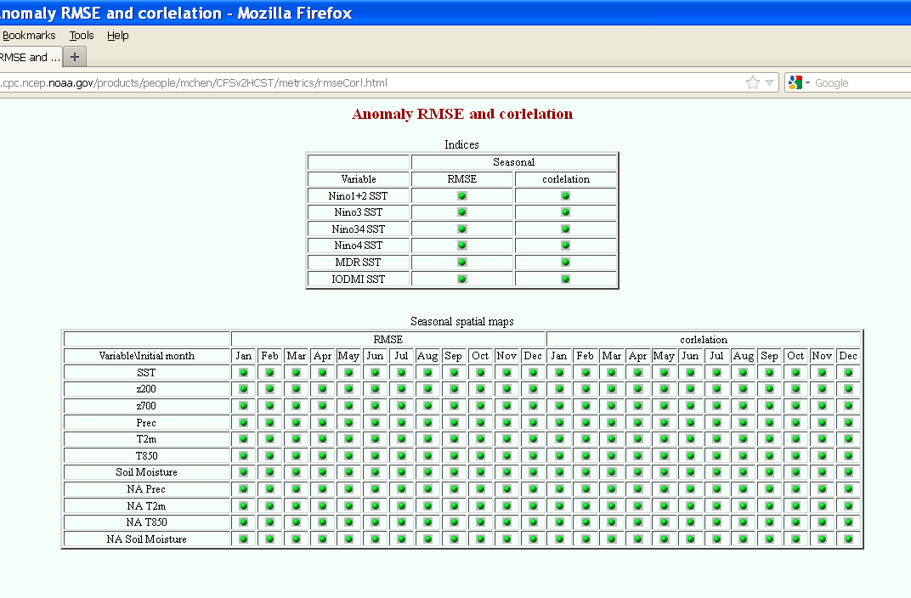
Seasonal Forecasts : Hindcast Verification

Slide 9
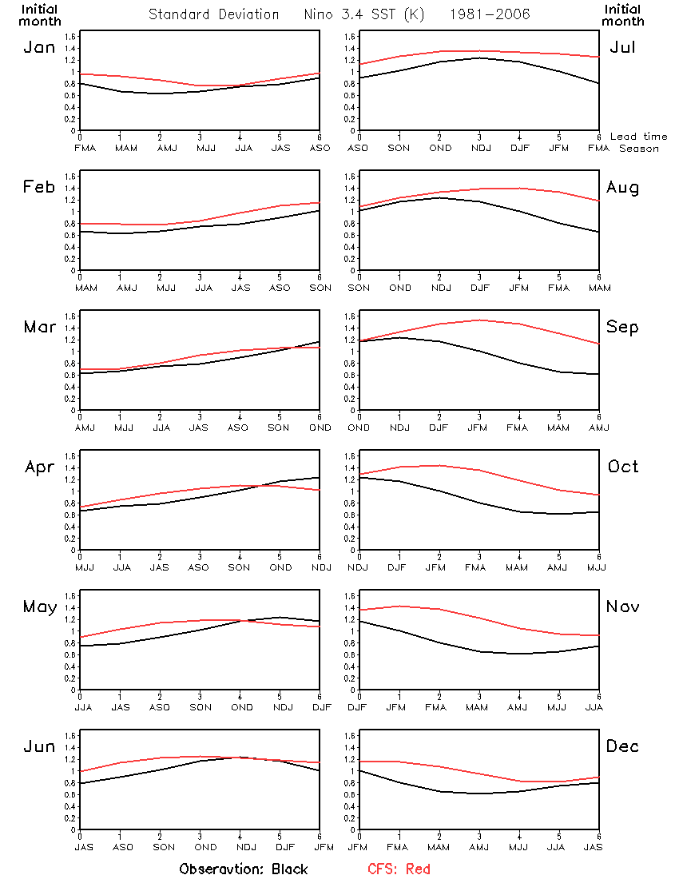
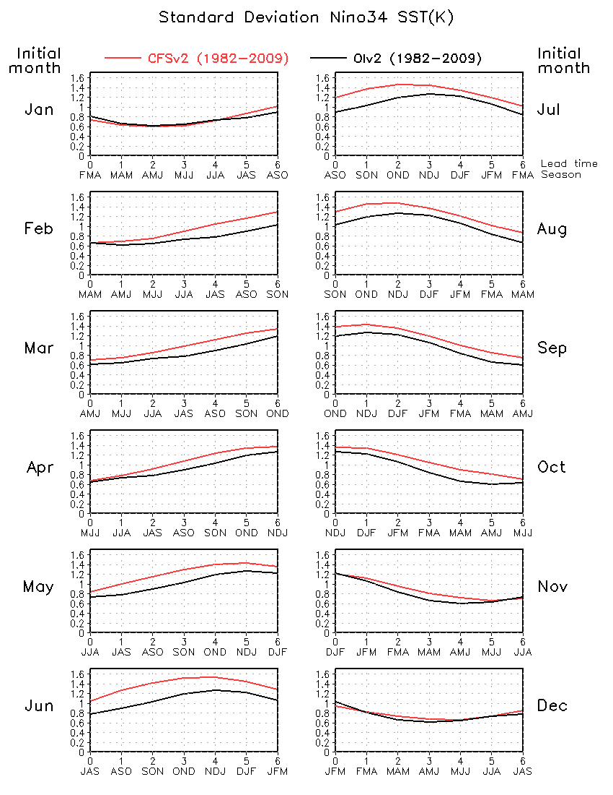
CFS.v1 vs. CFS.v2
Nino34 SST standard deviation
CFSv1
CFSv2
CFSv1
CFSv2
Obs
Obs

Slide 10
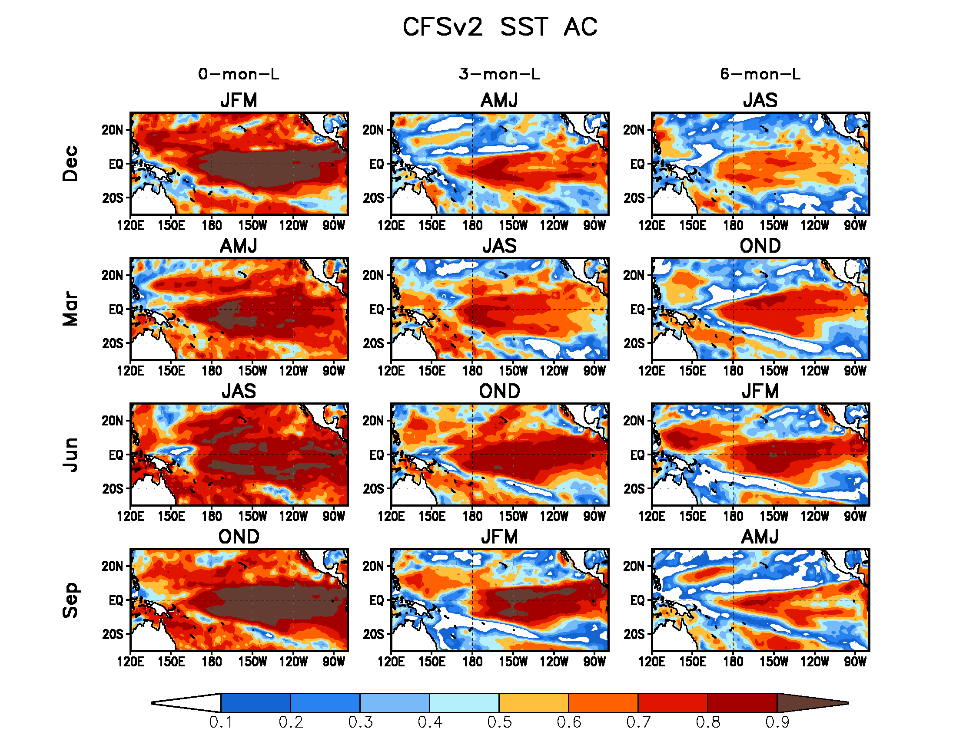

Slide 11
Hindcast anomaly Correlation – Sfc. Temp.

Slide 12
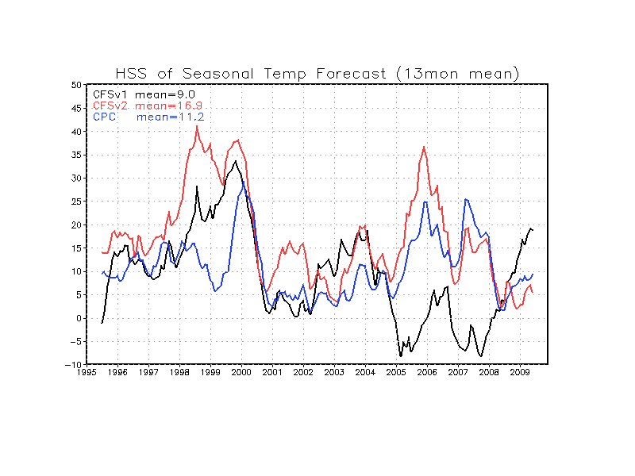
T2M: HSS in Spatial Domain

Slide 13
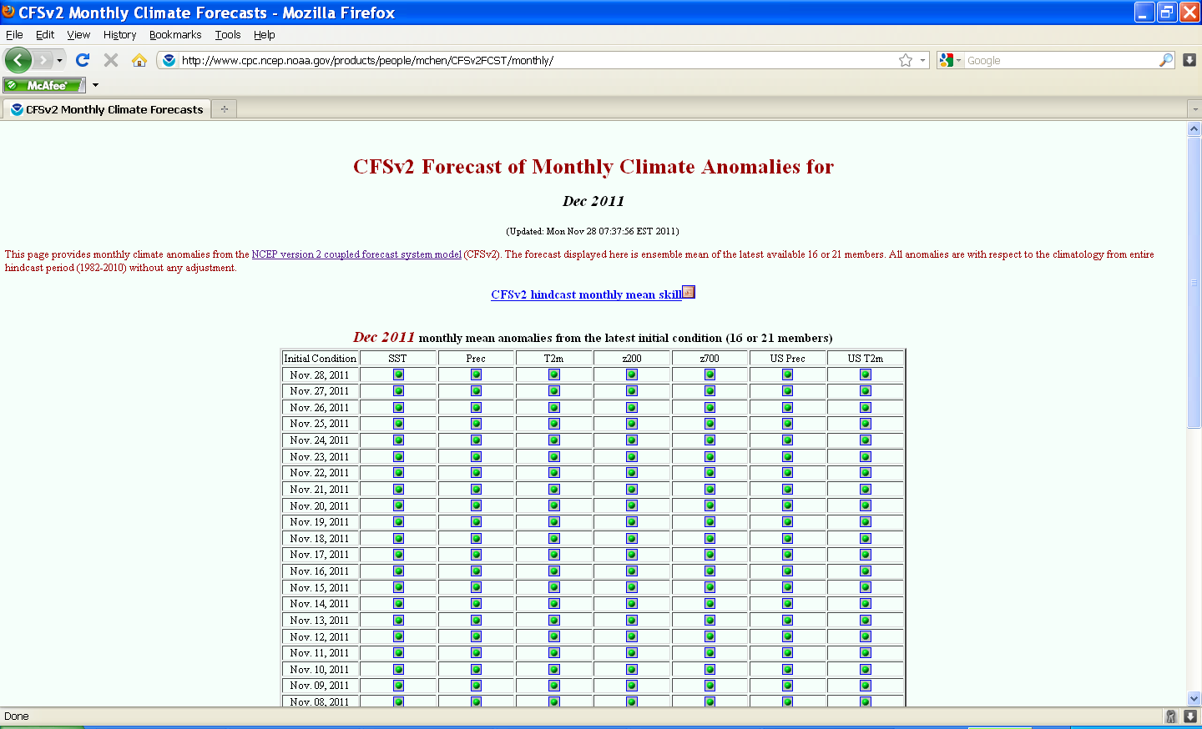
Monthly Forecasts

Slide 14
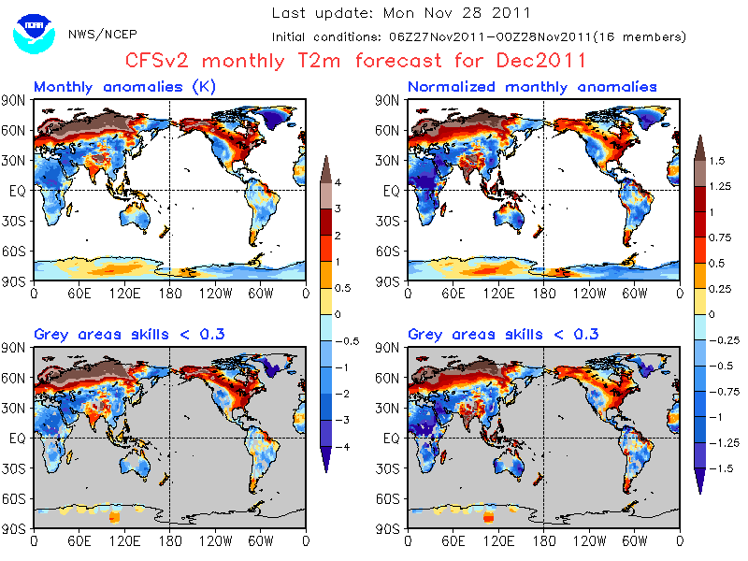
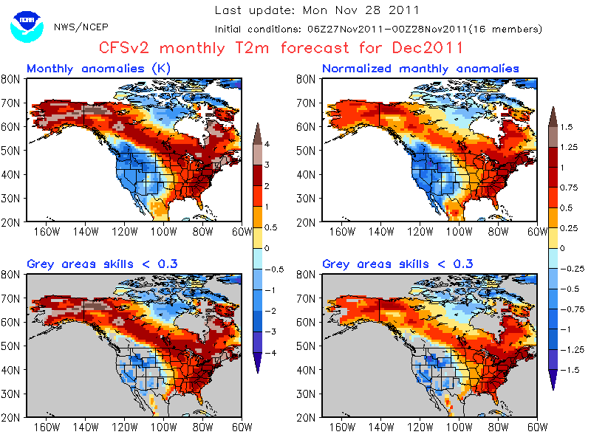
Monthly Forecasts

Slide 15
Forecast Display
CFS.v1
Seasonal: http://origin.cpc.ncep.noaa.gov/products/people/wwang/cfs_fcst/
Monthly: http://www.cpc.ncep.noaa.gov/products/people/mchen/cfsFcst/cfsMonPlot/monthPlot.html
CFS.v2
Seasonal: http://origin.cpc.ncep.noaa.gov/products/people/wwang/cfsv2fcst/
Monthly: http://origin.cpc.ncep.noaa.gov/products/people/mchen/CFSv2FCST/monthly/
Weekly: http://origin.cpc.ncep.noaa.gov/products/people/mchen/CFSv2HCST/metrics/

Slide 16
Hindcast Data
CFS.v1
http://www.cdacb.in/html/spim_data.aspx
CFS.v2
NCEP: http://cfs.ncep.noaa.gov/pub/raid0/cfsv2/reforecast.monthly
NCDC: http://nomads.ncdc.noaa.gov/data.php?name=access#cfs-refor
Forecast Data
CFS.v1
ftp://tgftp.nws.noaa.gov/SL.us008001/ST.opnl/MT.cfs_MR.fcst/
CFS.v2
http://nomads.ncep.noaa.gov/pub/data/nccf/com/cfs/prod/cfs

Slide 17
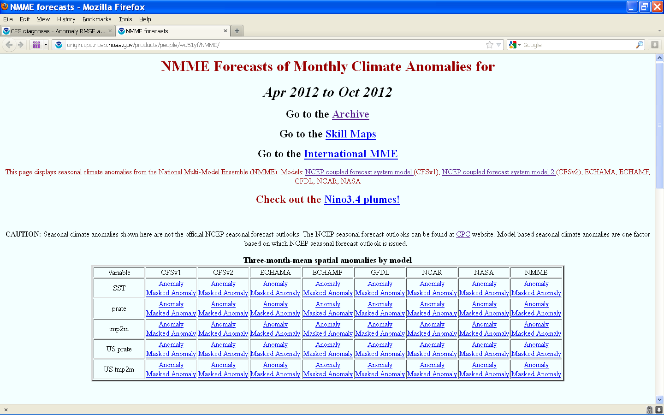
National MME (NMME)

Slide 18
National MME (NMME)
http://origin.cpc.ncep.noaa.gov/products/people/wd51yf/NMME/

Slide 19
Questions?

