Slide 1

Interpretation and Use of GPCs Products for RCOFs and African RCC demo phase at ACMAD
Andre KAMGA FOAMOUHOUE
ACMAD
Niamey-Niger
http://www.acmad.org/rcc/index.php

Slide 2
Outline
RCOFs products for West, Central and North Africa
Verification of RCOFs products
African RCC pilot demo LRF products
Interpretation of GPC inputs to RCC/RCOF
Additional needs
Key messages

Slide 3
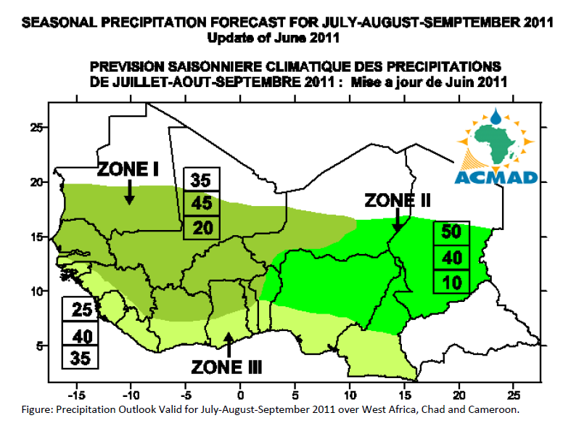
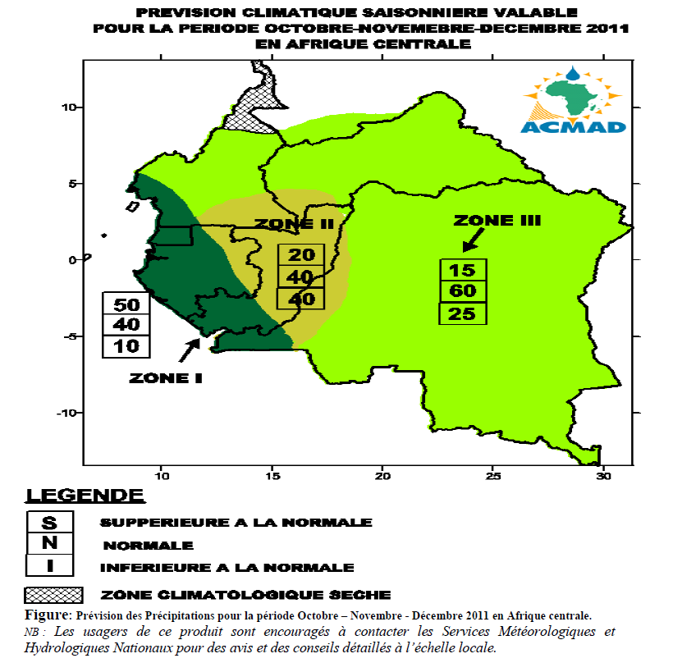
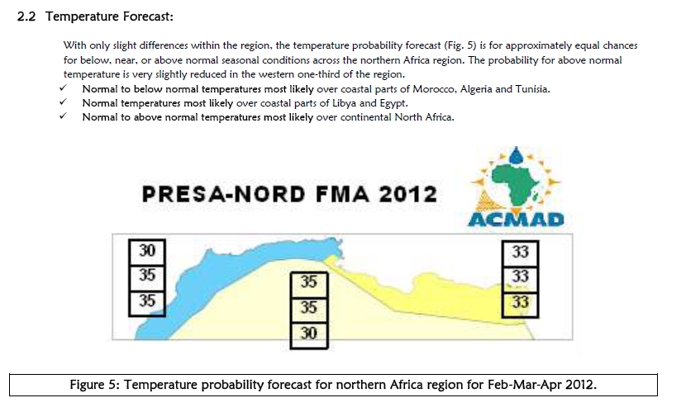
RCOFs products

Slide 4
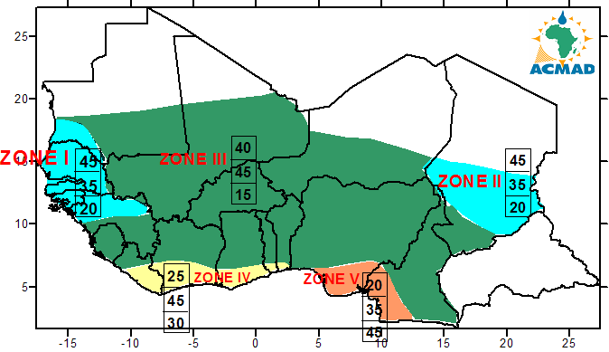
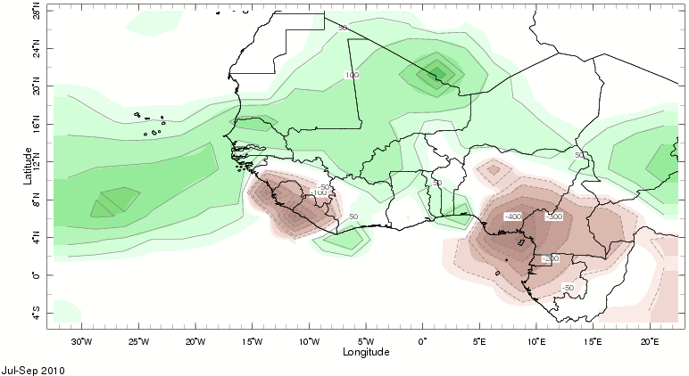
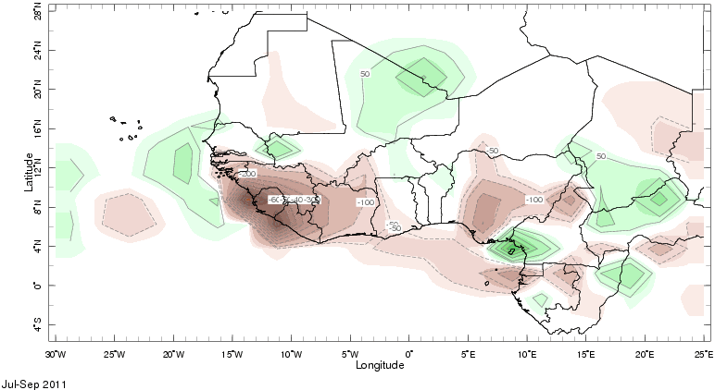
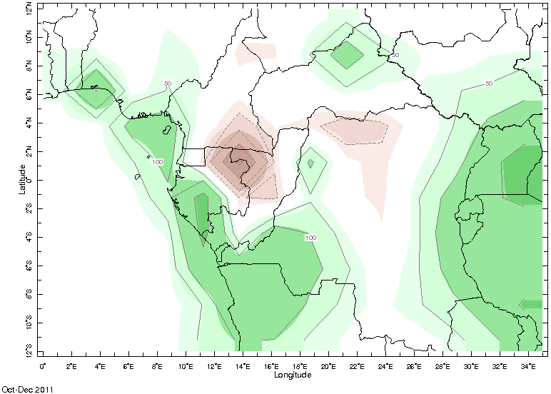
RCOFs products verification
Verification for sub-regional scale anomalies
Need latest 30, 90 days anomalies over stations
Impact of CPT on the forecasts for OND 2011
Need GPCs predictor fields on IRI data library for download in CPT format

Slide 5
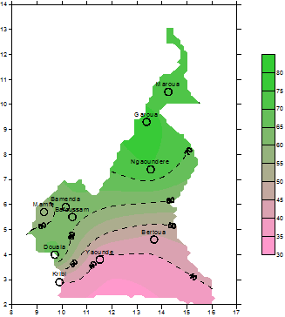
Forecast assessment in a country
RPSS and percent correct forecast scores
are applied in Africa to generate verification products at country level.
Need:
GPCs-RCCs-NMHSs agreement on common verification methods
STATIONS | Total | success | failure | % correct
Douala | 13 | 9 | 4 | 69
Garoua | 13 | 10 | 3 | 77
Maroua | 7 | 5 | 2 | 71
N'Gaoundéré | 12 | 9 | 3 | 75
Yaounde | 8 | 3 | 5 | 38
Kribi | 10 | 4 | 6 | 40
Mamfe | 9 | 5 | 4 | 56
Bafoussam | 13 | 8 | 5 | 62
Bamenda | 11 | 7 | 4 | 64
Bertoua | 7 | 3 | 4 | 43
Percent correct forecast score
1998-2010

Slide 6
Ivory coast for JAS 2011
Observed precipitation categories
In Ivory coast for JAS 2011
Need such maps for all Africa&globe
Work with GTS+internet to exchange more countries station precipitation data
RPSS for JAS 2012 in Ivory Coast
Need all Africa precipitation data to generate a regional RPSS maps

Slide 7
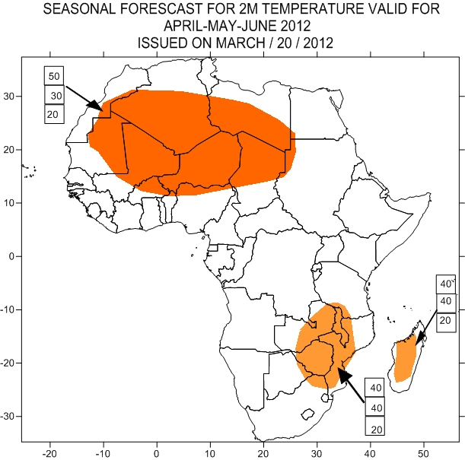
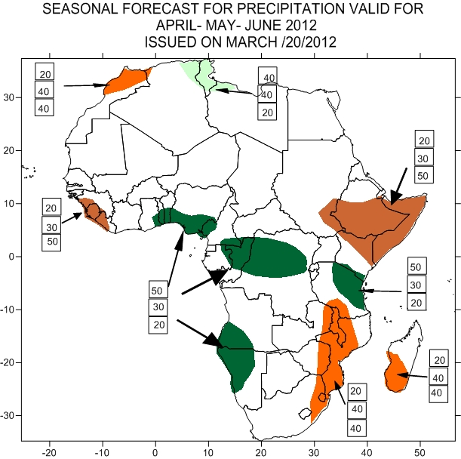
Products used
GPCs, Regional MME and LCs products
GPCs and LCs verification products
Observed historical climate products for the
most recent anomalies, trends and analogs.

Slide 8
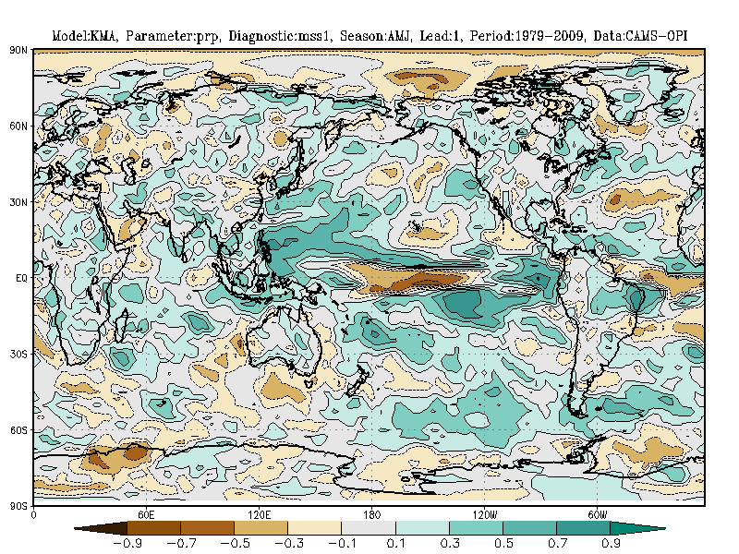
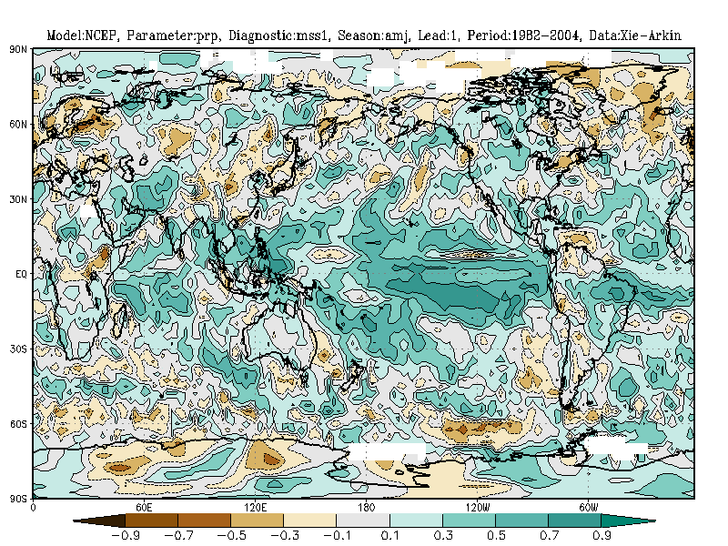
Need:
Common verification products for all GPCs and Regional MME and LC products ( SST, T2m, precipitation, atmospheric, oceanic and coupled patterns/phenomena) on the lead centre website

Slide 9
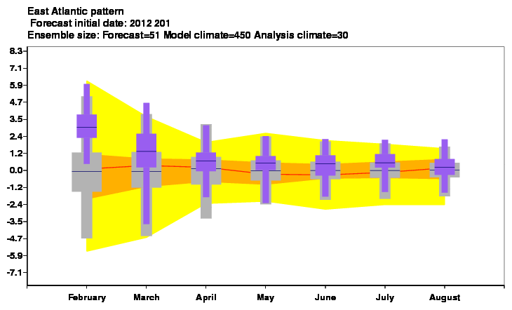
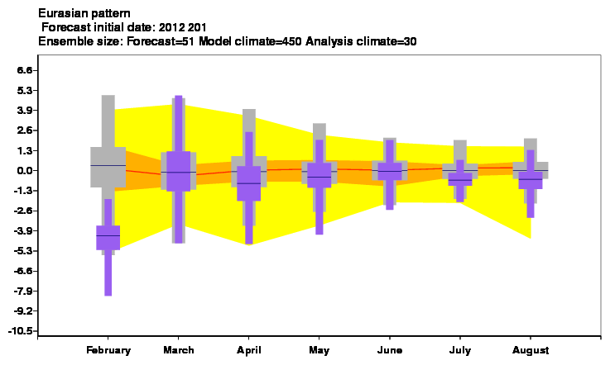
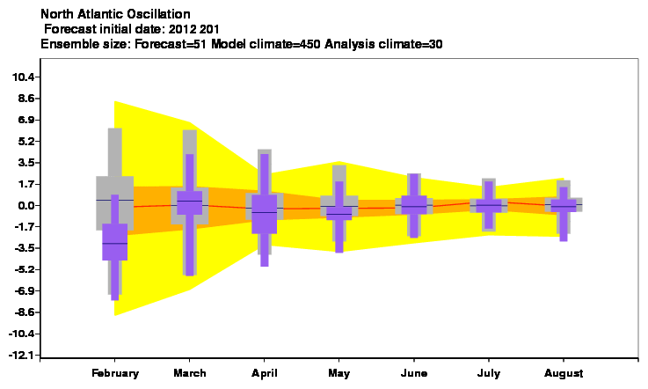
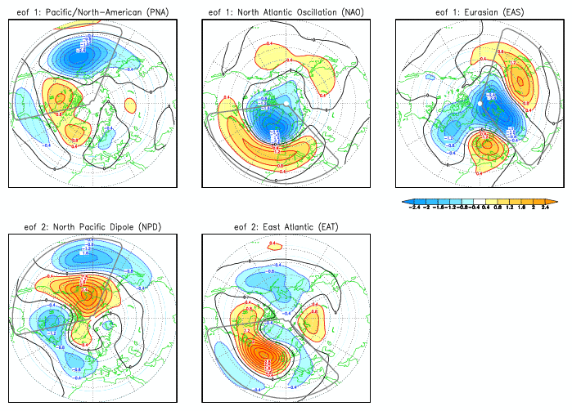
East Atlantic and Eurasian patterns from ECMWF
Products
Linkages with European cold wave in late January
Up to mid February 2012!!!
Need: GPCs, Regional MME and LC climagrams for these patterns and related verification products

Slide 10
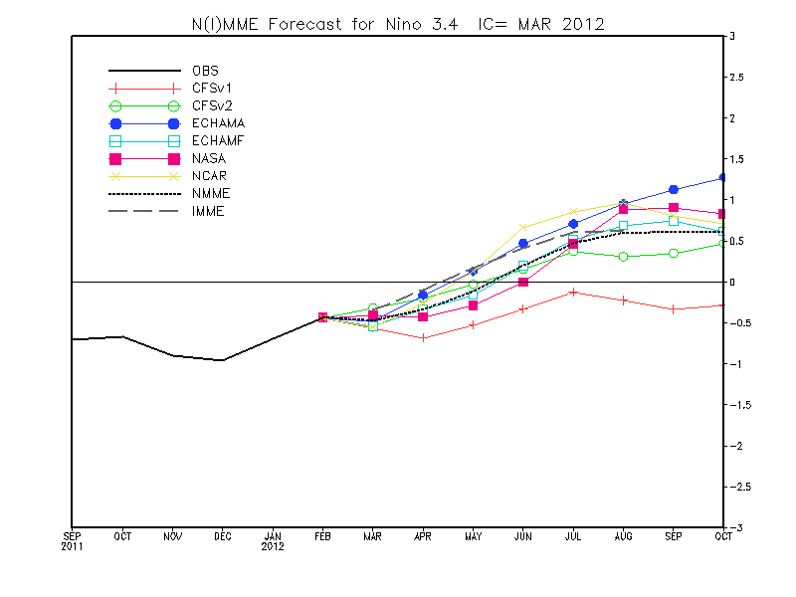
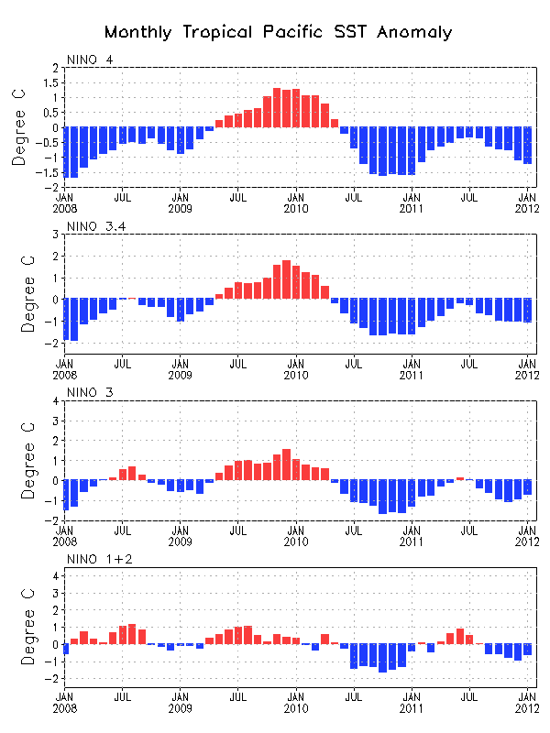
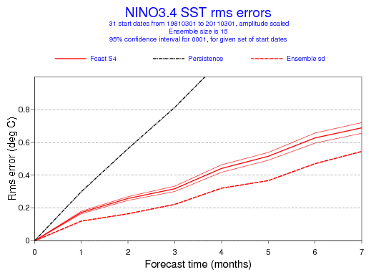
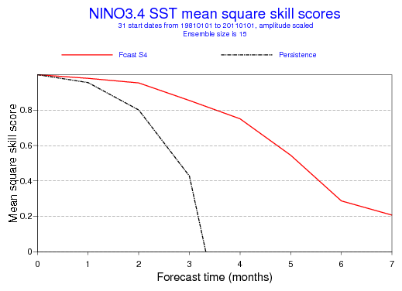
Need:
All GPCs provide SST indices for all relevant regions in the Atlantic, Indian Oceans and the Mediteranean In addition to the ENSO region (LC MME). Give opportunity to RCCs to choose SST regions for indices computation based on GPCs analyses and forecasts
-RMS errors and MSSS from all GPCs and all SST regions ( LC for verification)

Slide 11
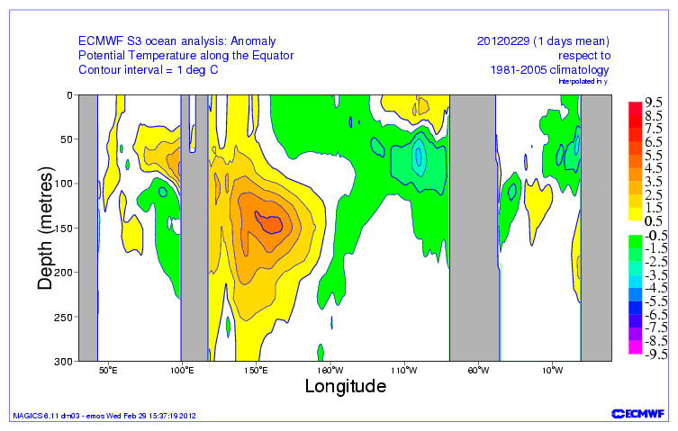
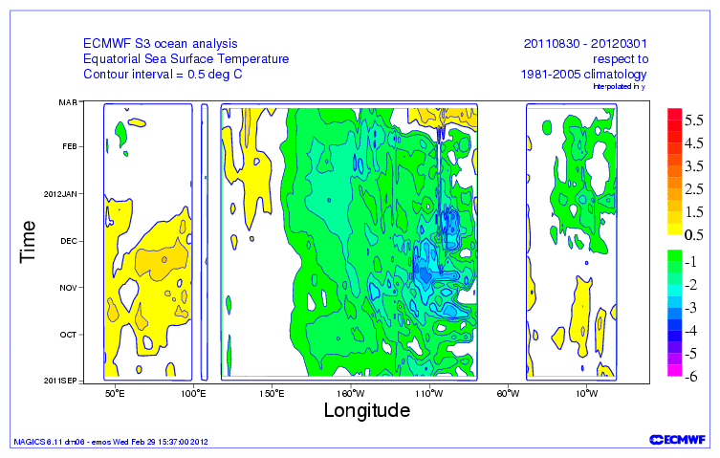
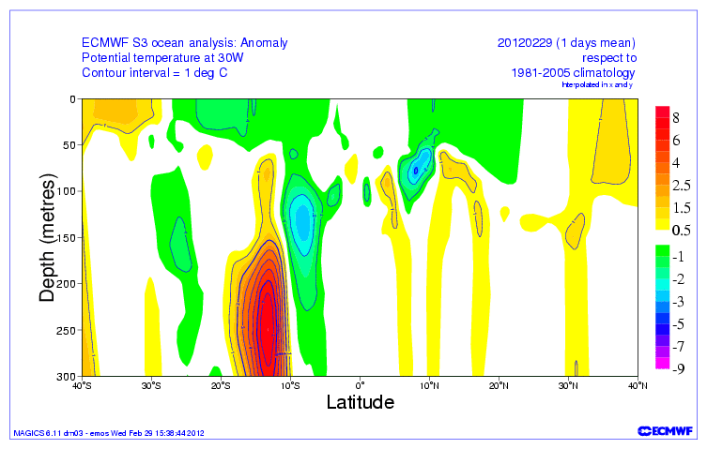
Sub-surface SST structure
Need:
Increase the number of Longitude/Latitude bands on which these diagrams are plotted using available analyzes and reanalyzes from all GPCs

Slide 12
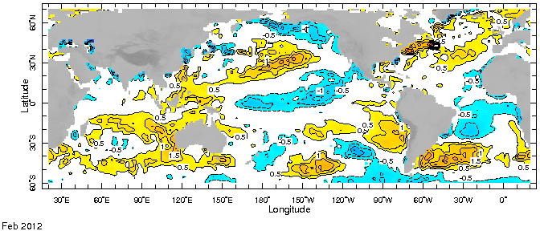
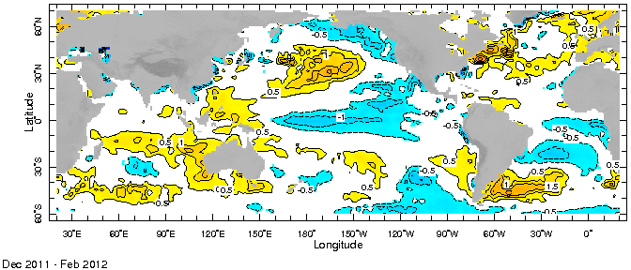
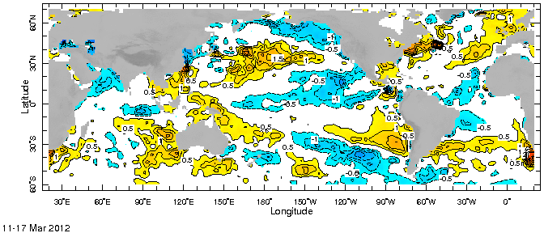
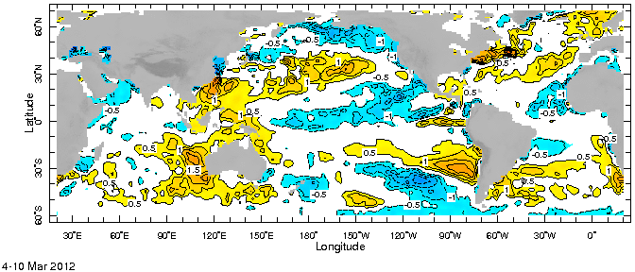
Most recent SST observations
Cold tropical south Atlantic, near normal to cold over tropical north Atlantic off the coast of Africa
Many GPCs run of March predict a persistence of cold anomalies in the tropical south Atlantic
Recent Observations provide some evidence of a transition to near normal and above normal.
Need the most recent SST analyzes, related trends and analog based on historical behavior

Slide 13
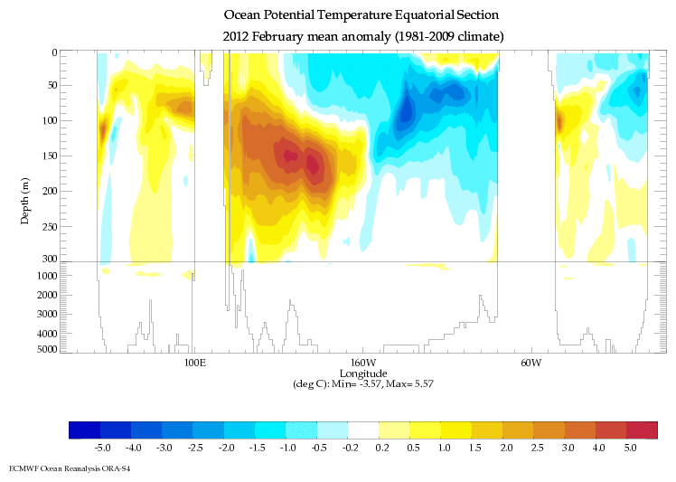
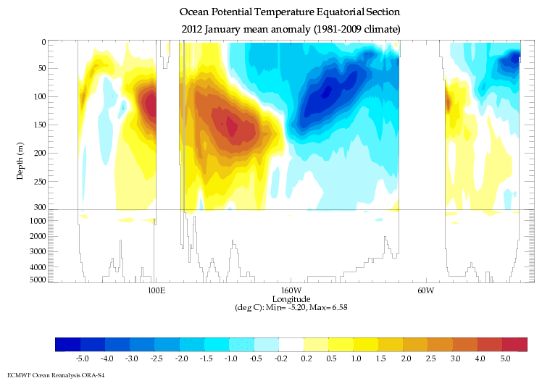
Sub-surface ocean temperature
From Jan to Feb 2012, the below normal conditions in the tropical south Atlantic is weakening
Need such maps and tendencies from more GPCs
analyses and forecasts over many latitude bands

Slide 14
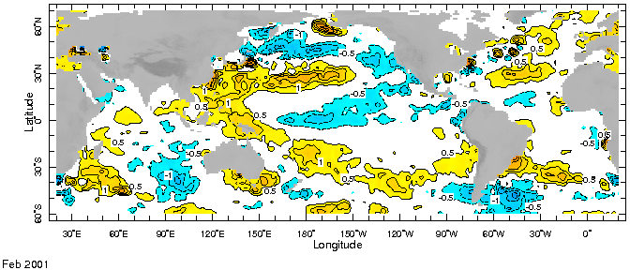
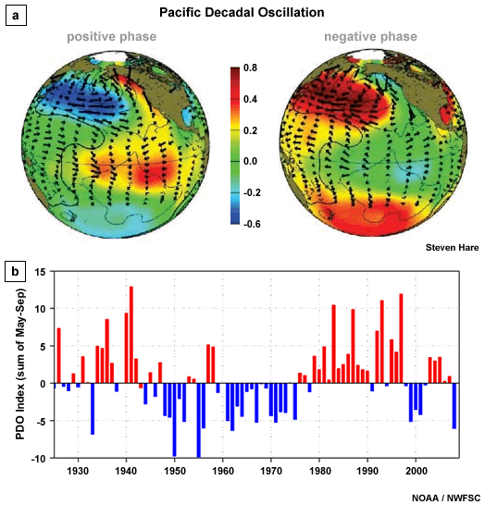
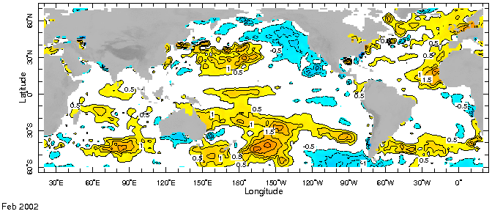
Detection of patterns and their analogs with historical data
February 2001 close to February 2012 over tropical Atlantic off the coast of Africa,
the Mediterranean sea and the pacific

Slide 15
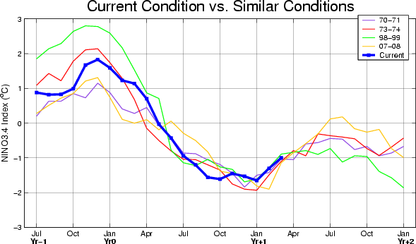
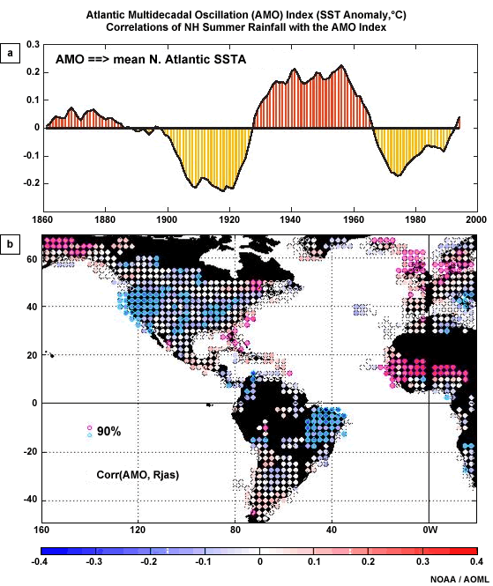
Need:
- Regularly updated historical SSTAs time series and similar conditions over the Atlantic and Indian oceans
- computer based identification of analog years with concepts and techniques of artificial intelligence and expert systems
“Quantification of experienced based expectations”
Use informal empirical rules could be quite important
The amount of empirical info is quite large. Even a team of scientists may not be able to keep track of it all.

Slide 16
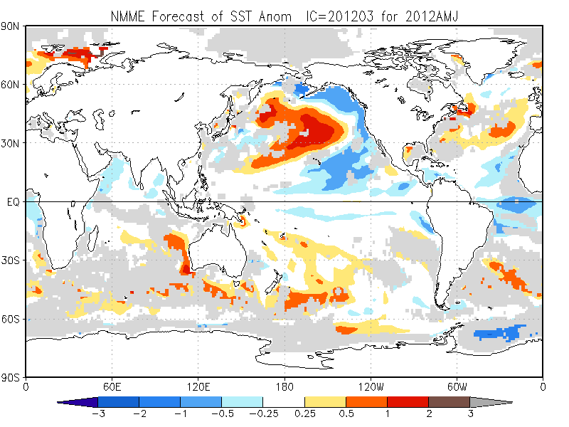
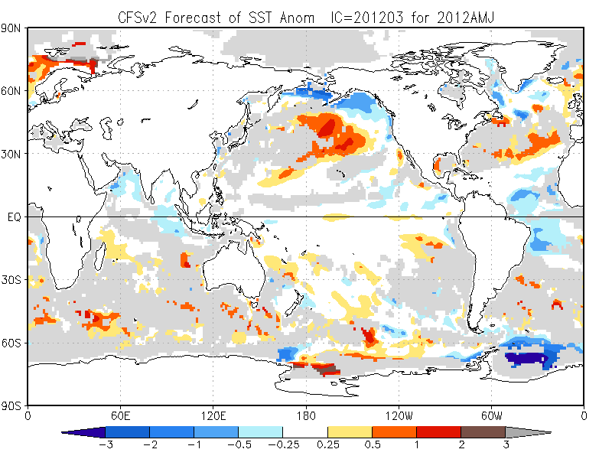
NMME favors ENSO neutral, conditions, near neutral tropical Indian ocean, mostly below normal tropical Atlantic off the coast of Africa. CFS2 indicates a quick transition to normal and positive SSTA in the ENSO region and off the African coast of tropical south Atlantic
Need products from National and Regional MME including verification

Slide 17
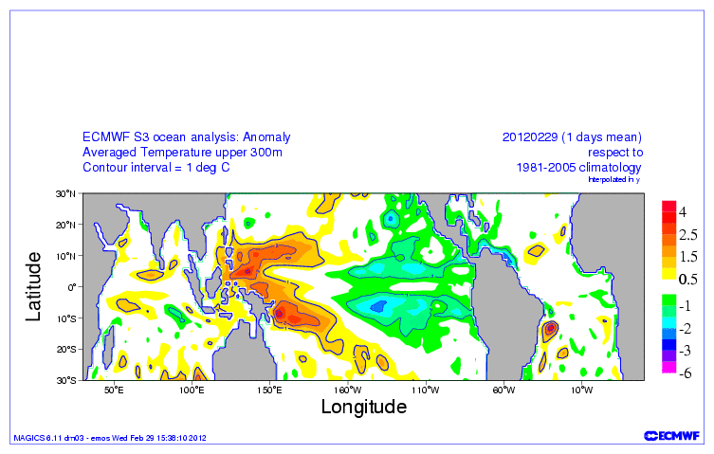
On March 20, 2012 the real time SST patterns of ECMWF analysis not updated
Product up to Feb 29, 2012 available.
The below normal SSTs in much of the tropical Atlantic persisted since December 2011. Very recent observations, recent CFS products and historical behavior are supporting a transition to near normal or above normal conditions in the tropical Atlantic oceanic regions influencing significantly African climate variability.
Need:
Regular update of SST analysis by GPCs

Slide 18
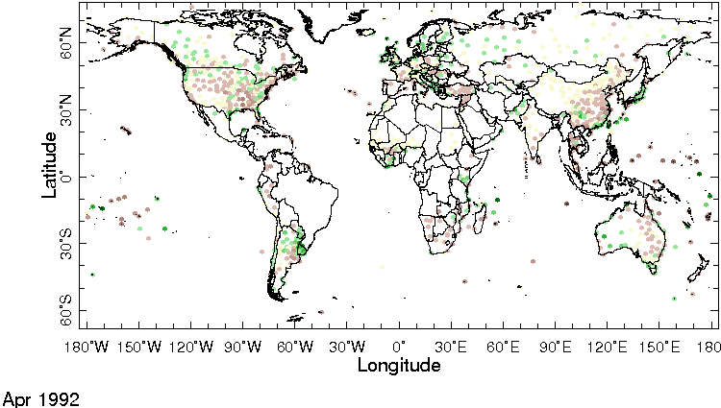
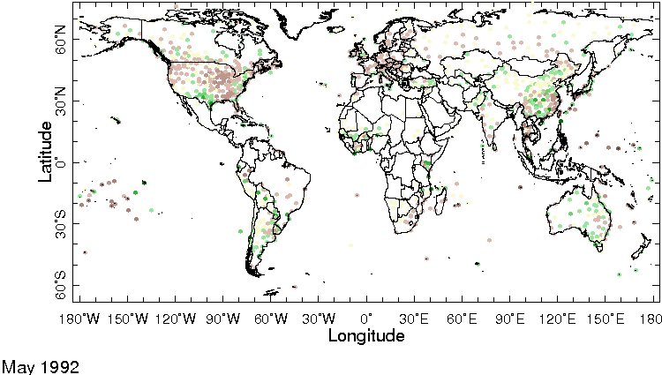
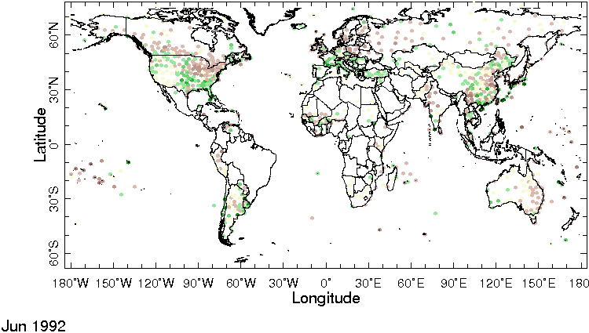
To facilitate precipitation and 2mTemp monitoring over stations GPCs may provide seasonal, the last 30 and 90 days rainfall anomalies and percentiles

Slide 19
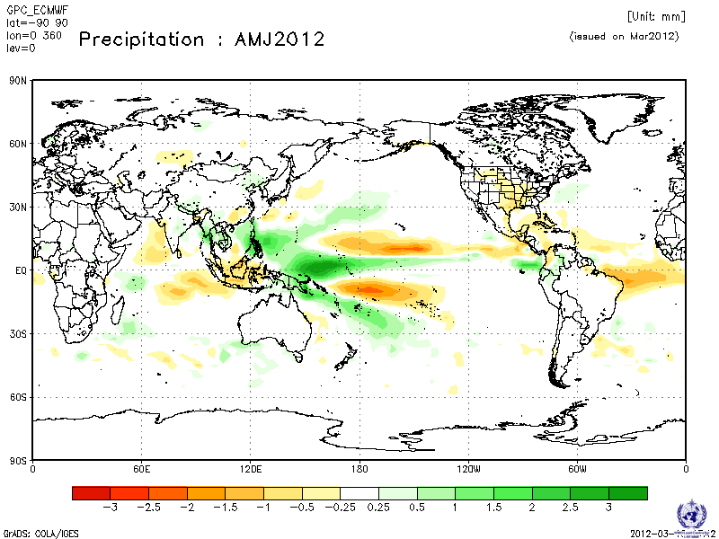
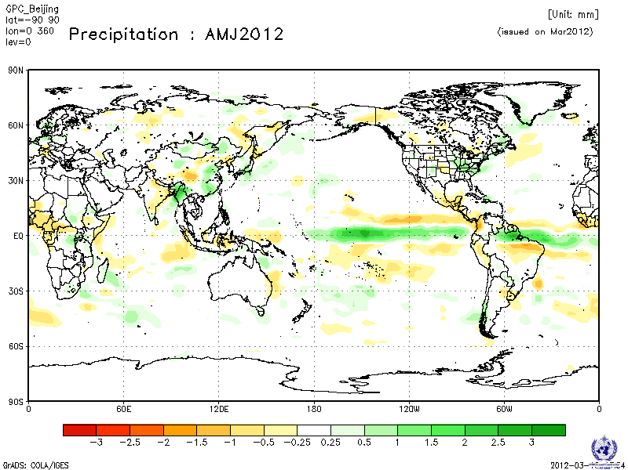
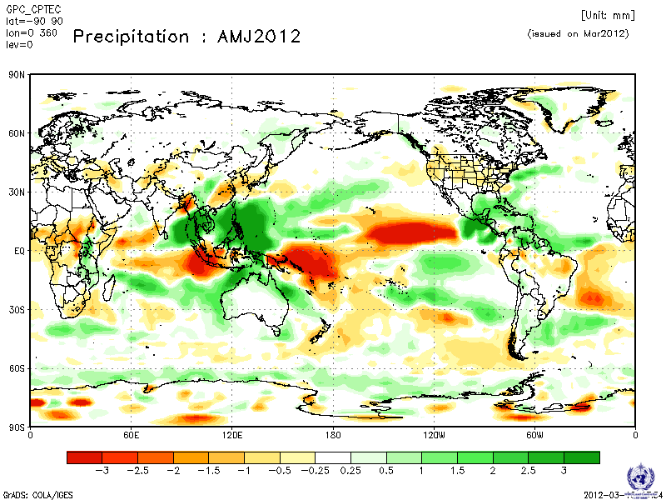
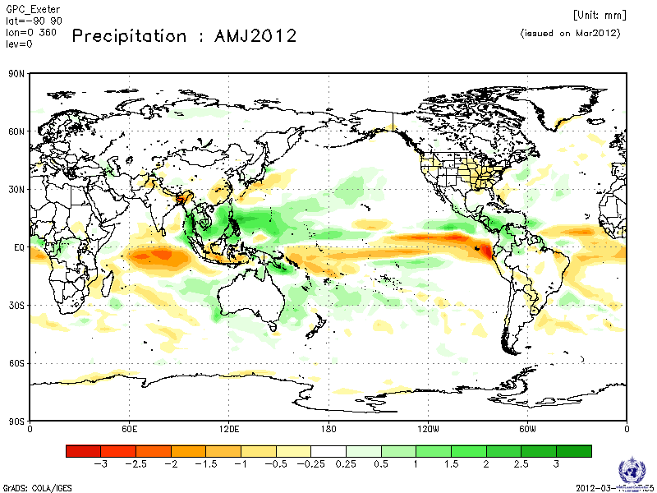
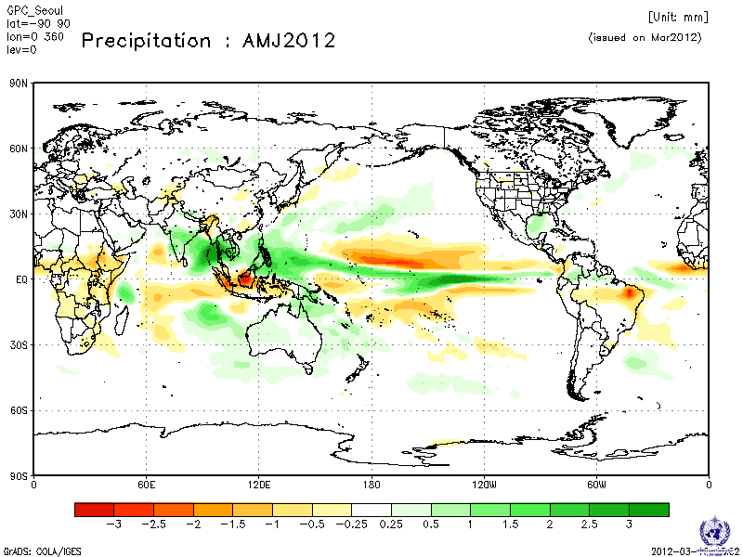
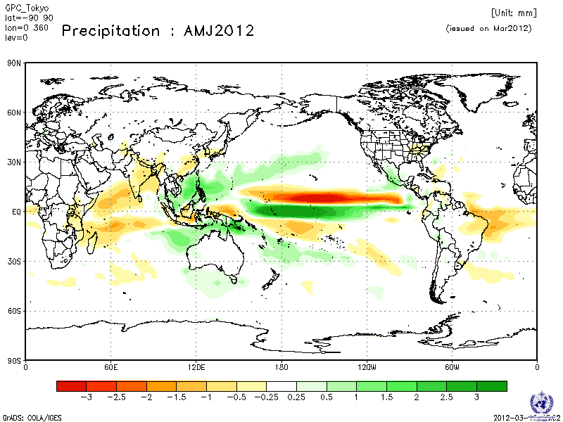
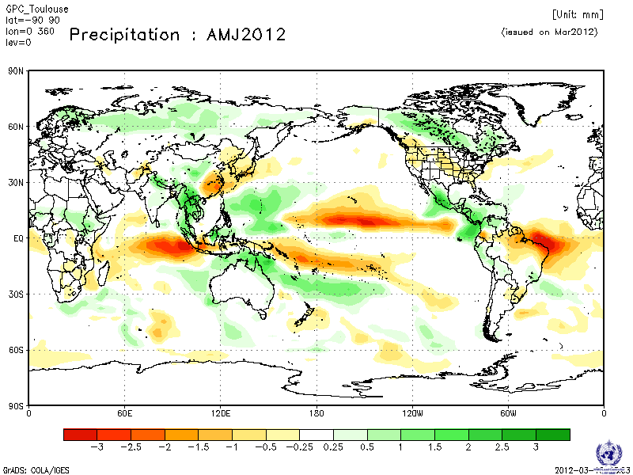
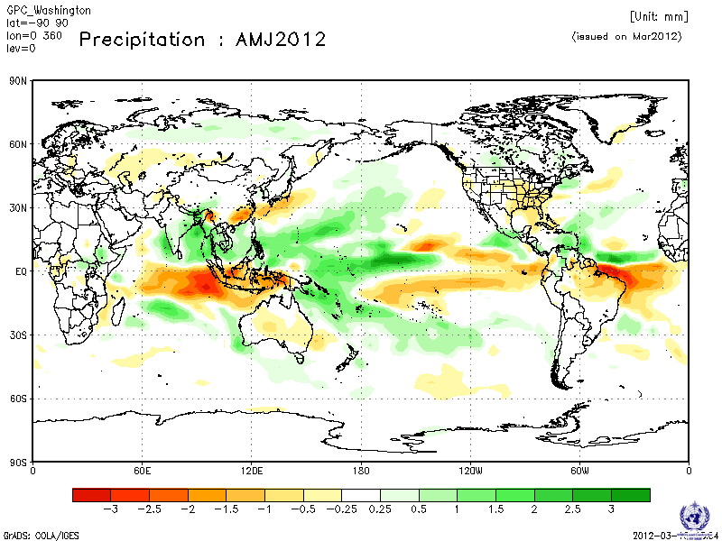
Need:
Verification information
for all single model and multimodel configurations

Slide 20
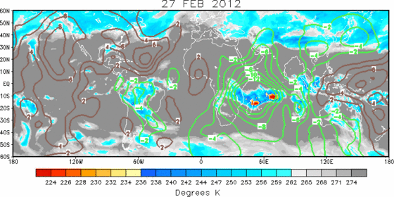
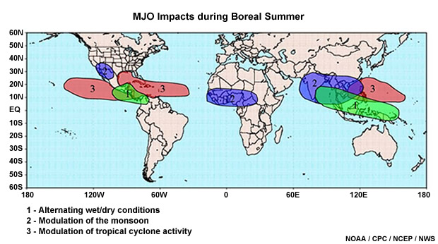
Requests have been made to include early/late onset/withdrawal and dry/wet spells information in RCOFs products.
These are elements of sub-seasonal variability often modulated by MJO and other intraseasonal oscillations.
Global Monthly forecasting systems are required.
Need:
GPCs with Monthly forecasting capabilities may agree to provide available sub-seasonal monitoring and forecasting products.
A Close collaboration with THORPEX/TIGGE may be relevant
Example of MJO associated with an active Cyclone period over southwest Indian ocean. Regular forecasts of MJO may provide advanced warning one to a few weeks ahead.

Slide 21


With computer based expert systems, how often has the predicted behavior of the MJO
been observed in the past ?
Is there some recently observed patterns that may be driving such an abrupt behavior?
Response to these questions are necessary to trust the forecasts and its implications
on regional weather.
Human and computer based expert systems built on historical climate could be used .

Slide 22
Key Messages on the GPCs Products
Encourage exchange of more station precip with WIS ( GTS + internet)
GPCs provide global maps of observed seasonal Precip and 2m Temp in terciles en quintiles
GPCs provide climagrams for patterns/phenomena like NAO, EAP, MJO,…
Each GPC provide SST indices (observed and predicted) for other relevant oceanic regions in the Atlantic, Indian and Pacific ( eg. Atlantic, Indian ocean dipole modes, AMO, PDO):, idem for atmospheric indices ( eg. QBO)
GPCs use Artificial Intelligence and expert system technique to facilitate identification of similar years from historical climate
additional and common GPC products to facilitate RCC services were proposed
GPCs and other centres with operational monthly forecasting capabilities agree to exchange products wit RCCs and NMHSs
Link RCOF/RCC , SWFDP, RSMC and WWRP/THORPEX Forecasts Demonstrations projects to prepare a generation of seamless climate service providers
GPCs provide predictors for downscaling in real time

Slide 23
Key messages on verification
Discuss adoption of RPSS and percent correct forecast as common verification methods for GPC/RCC/NMHS
All GPCs and MME products systematically provide agreed upon standard verification products
All GPCs provide verification products for patterns and phenomena like NAO, EA pattern
Each GPC provides RMS errors and MSSS for SST indices

Slide 24

Precip and 2mTemp Outlooks for AMJ 2012 for Africa

Slide 25
THANKS

