Slide 1
Linking the Severe Weather Forecasting Demonstration Project (SWFDP) with
Flash Flood Guidance System (FFGS)
WMO CLW/HWR

Slide 2
Overview of Presentation
The WMO Flood Forecasting Initiative (WMO FFI)
The WMO FFI – Advisory Group
The Flash Flood Guidance System (FFGS) with Global Coverage
FFGS Products
FFGS and SWFDP Project Coverages
Product Requirements
Southern Africa Region SWFDP and FFGS Integration Project
Linking Needs and Challenges

Slide 3
WMO Flood Forecasting Initiative (WMO FFI)
Res 21 (Cg-XV) – Strategy for the Enhancement of Cooperation between NMHSs for Improved Flood Forecasting
  Improved collaboration between meteorology and hydrology… to improve the capacity…required in flood forecasting and warnings…
  Relevant WMO Programmes… whose sphere of activities could have an influence on the improvement of flood forecasting practices…
  Support the implementation of demonstration projects such as the FFGS with global coverage

Slide 4
WMO FFI-AG
Res 15 (Cg-XVI) – Establishment of an Advisory Group for the WMO FFI (including Terms of Reference for the WMO FFI-AG)
  Includes representatives of WMO Technical Commissions…
WMO FFI-AG 2nd Meeting 1-3 Dec 2015
  Task 1: ensuring that all major demonstration projects and components, including but not limited to CIFDP, SWFDP, FFGS, include the requirements/best practices for effective and sustainable flood forecasting in their design and implementation
    Vice-Chair of CIFDP Steering Committee be from CHy – done Dec 2015
    Pres. CHy to coordinate with Pres. CBS on CHy Representation on SWFDP Steering Group - 2016

Slide 5
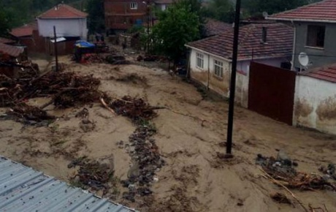
What is a Flash Flood?
The World Meteorological Organization (WMO) defines flash flood as “a flood of short duration with a relatively high peak discharge”.
Usually considered having less than a 6-hour lead time.
Flash floods causes annually an average of 5,000 deaths and inflict heavy economical losses worldwide, and losses are rising.
Lack of flash flood warning capabilities and capacities of NHMSs.
Lack of local expertise.
Need for donors and regional cooperation.
Ineffectiveness of riverine flood warning systems for flash floods.

Slide 6
FFGS Objective
The main objective of the Flash Flood Guidance System with global coverage is to:
Mitigate the adverse impacts of hydrometeorological hazards, by:
  Enhancing NMHSs capacity to issue flash flood warnings and alerts;
  Generating flash flood early warning products by using state-of-the-art hydrometerological forecasting models;
  Enhancing collaborations between NMHSs and Emergency Management Agencies;
  Providing extensive training including on-line training to the hydrometeorological forecasters; and
  Fostering regional developments and collaborations.

Slide 7
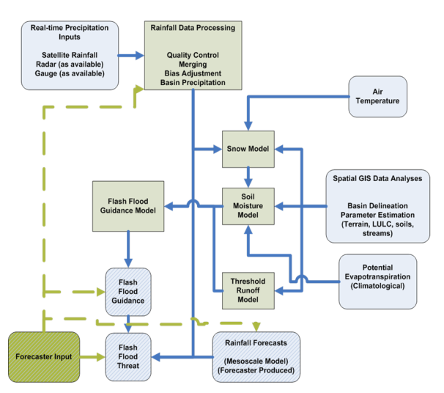
Flash Flood Guidance Model Concept

Slide 8
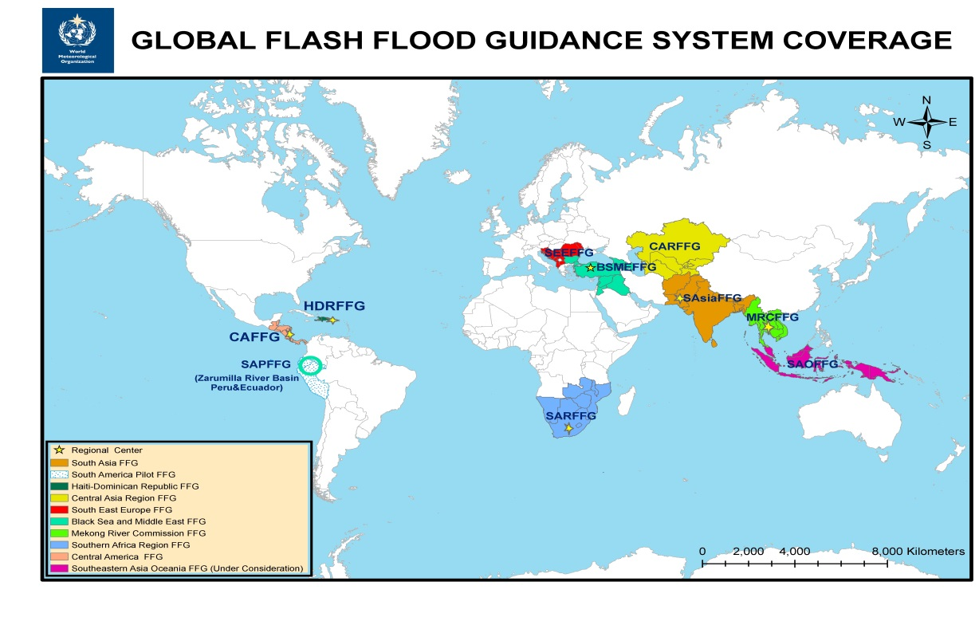
Flash Flood Guidance System (FFGS)
The WMO Commission for Hydrology (CHy) jointly with the WMO Commission for Basic Systems (CBS) and in collaboration with the US National Weather Service, Hydrologic Research Center (HRC), and USAID/OFDA have developed the concept of the Flash Flood Guidance System (FFGS) with global coverage. The concept has been endorsed by the Fifteenth WMO Congress and is being implemented through a series of regional projects with funding from USAID.
Flash Flood Guidance System with global coverage (Resolution 21, World Meteorological Congress-XV) enhances early warning capabilities of the NMHSs, currently covers fifty two (52) countries and more than two billion people around the world saving lives and decreasing economic losses.

Slide 9
FFGS Regional Projects
The following regional Flash Flood Guidance (FFGS) projects are implemented or under implementation or under consideration:
Central America FFG (CAFFG) (Operacional): Costa Rica (Regional Centre (RC)), Belize, Guatemala, Honduras, El Salvador, Nicaragua and Panama;
Southern Africa Region FFG (SARFFG): (Operational) South Africa (RC), Botswana, Lesotho, Malawi , Mozambique, Namibia, Swaziland, Zambia and Zimbabwe;
Mekong River Commission FFG (MRCFFG) (Operational): Cambodia (RC), Laos, Thailand, Vietnam and (possibly) Myanmar;
Black Sea and Middle East FFG (BSMEFFG) (Operational): Armenia, Azerbaijan), Bulgaria, Georgia, Iraq, Jordan, Lebanon, Syria, Turkey (RC);
South East Europe FFG (SEEFFG) (under implementation): Albania, Bosnia-Herzegovina, Croatia, Kosovo, Macedonia, Moldova, Montenegro, Romania, Serbia, Slovenia, and Turkey (RC);

Slide 10
GFFGS Regional Projects (cont.)
South Asia FFG (SAsiaFFG) (under implementation): Afghanistan, Bangladesh, Bhutan, Nepal, Pakistan, Sri Lanka and India;
Central Asia Region FFG (CARFFG) (under implementation): Kazakhstan, Kyrgyzstan, Tajikistan, Turkmenistan and Uzbekistan;
South America Pilot FFG (under implementation): Zarumilla River Basin (Peru and Ecuador);
Haiti-Dominican Republic FFG (HDRFFG) (being developed): Dominican Republic and Haiti;
Southeastern Asia - Oceania FFG (SAOFFG) (under consideration): Brunei, Indonesia, Malaysia, Papua New Guinea, Philippines, Singapore and Timor Lester.

Slide 11
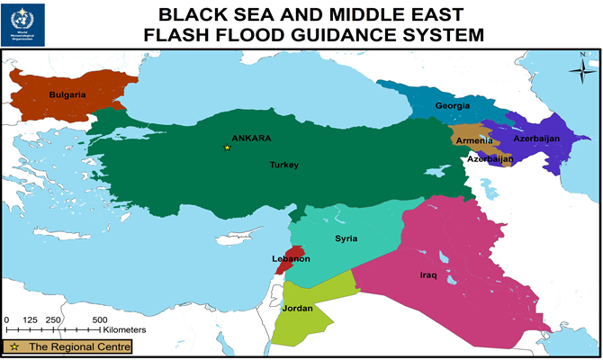
Regional Implementation
Regional Centre
Provide products and data to the participating countries.
Collaborate with WMO to implement flash flood hydromet training.
Evaluate FFG products from the regional perspective and conduct verification studies in collaboration with participating countries.
Have a good internet connection to download and exchange data.
Maintain servers.
National Centres
Prepare and issue flash flood warnings and alerts
to the public and national agencies including Emergency
Management Authorities.
Have good cooperation, collaboration, and communication
with the Regional Centre for the implementation of the
project.
Provide historical and in-situ local data to the FFG
system developer through the RC.
Participate in the Flash Flood Hydrometeorologist
Training Programme (Steps 1-5).
Conduct verification studies.

Slide 12
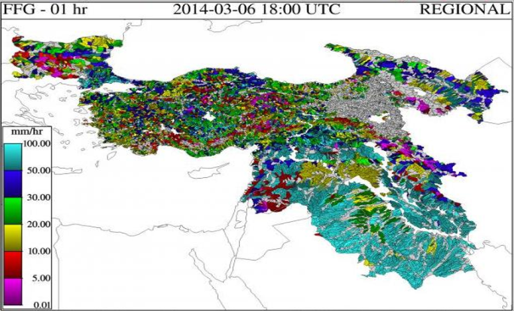
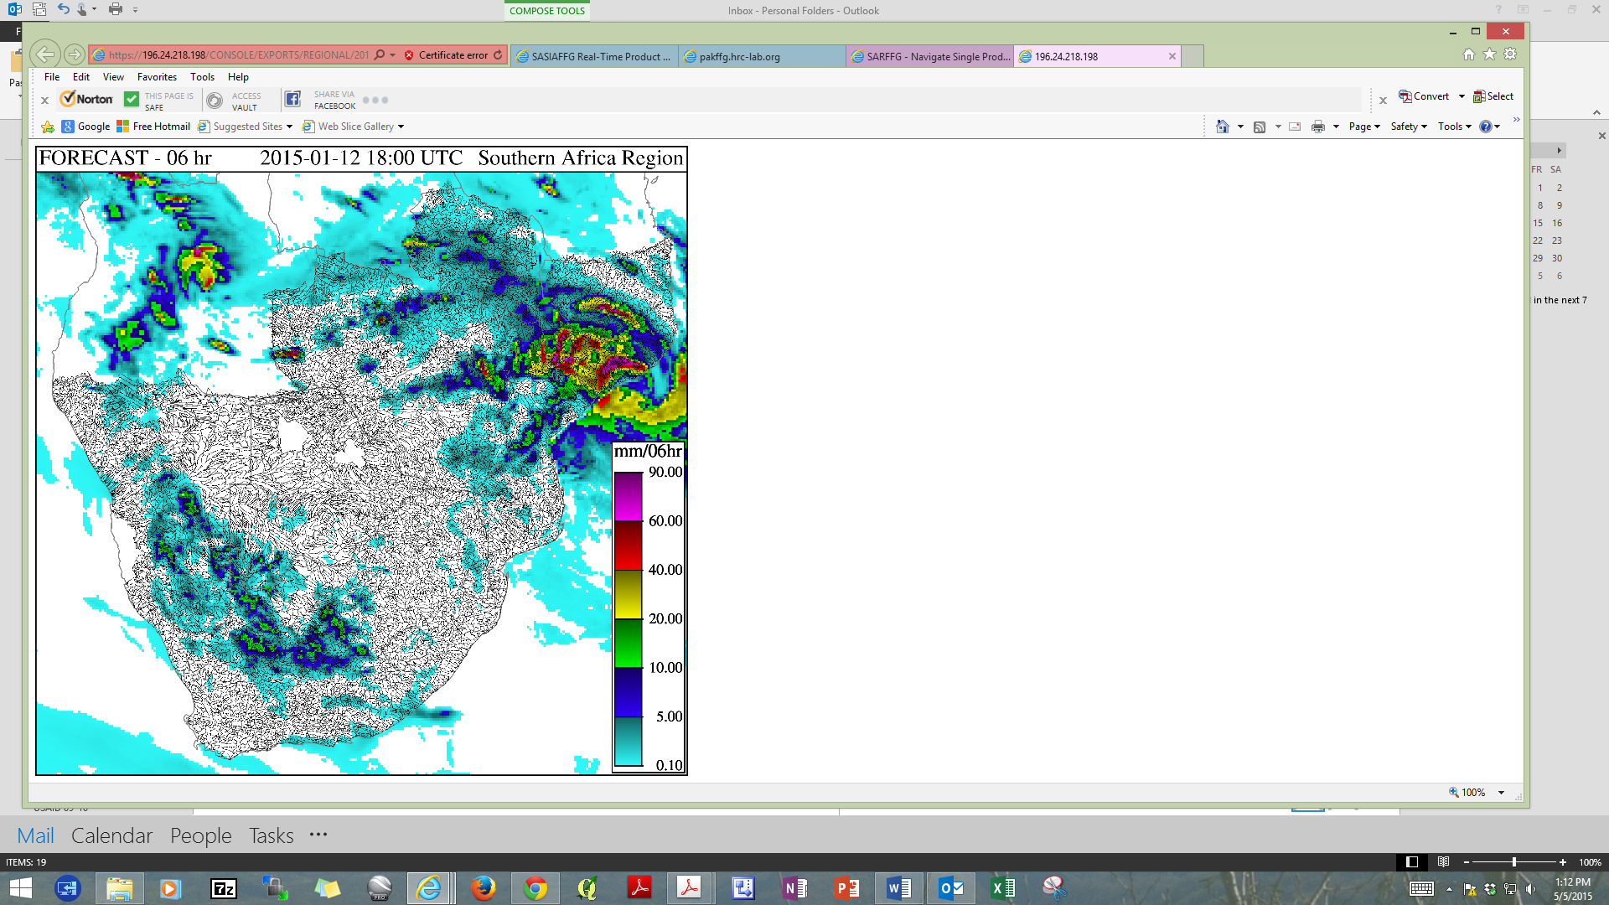
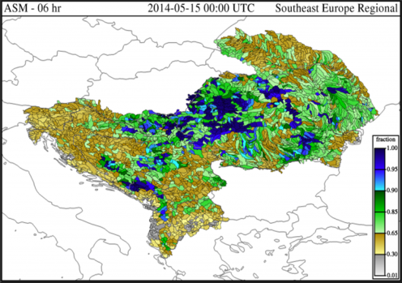
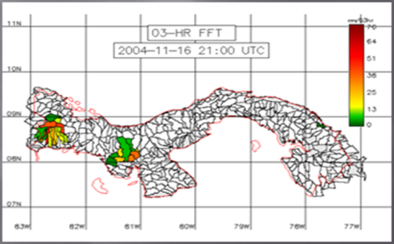
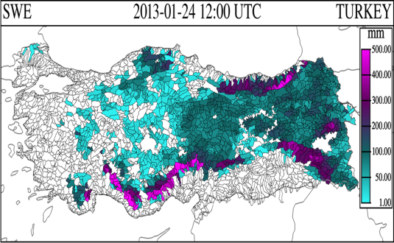
Flash Flood Guidance System (FFGS) Products
Flash Flood Guidance for Black Sea and Middle East FFGS.
GHE Satellite precipitation for Southern Africa Region FFGS.
Average Soil Moisture for South East Europe FFGS.
Flash Flood Threat for Central America FFGS
Snow Water Equivalent (SWE) for Turkey.
Forecast Mean Aereal Precipitation for Black Sea and Middle East FFGS.
Notes:
Global Hydro-Estimator (GHE)

Slide 13
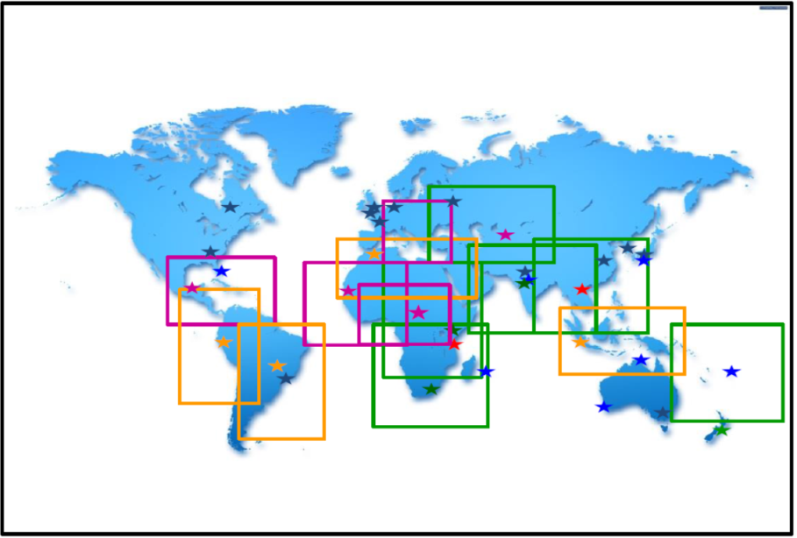
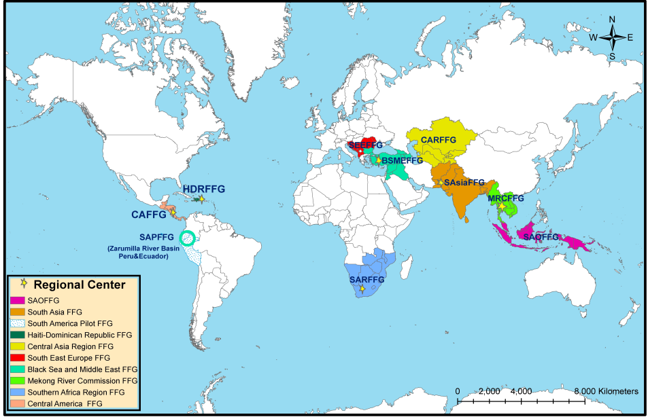
Regional Coverage
SWFDP
FFGS
SAOFFGS-SWFDP-SAO
MRFFGS-SWFDP-SEA
SAsaiFFGS-SWFDP-BoB
CARFFGS-SWFDP-CA
BSMEFFGS-SWFDP-SEE
SARFFGS-SWFDP-SA
CAFFGS-SWFDP-Caribbean

Slide 14
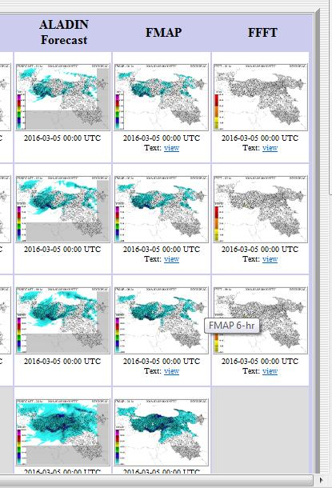
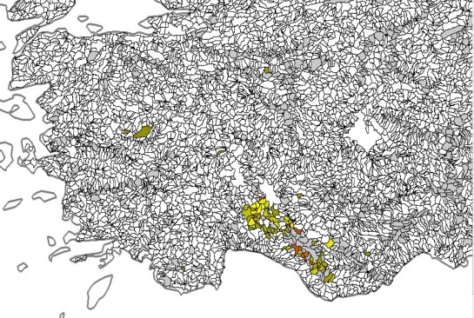
QPF Requirements for FFGS: High Resolution NWP QPF
High Resolution QPF
FFFT¹=FMAP-FFG
¹FMAP: Forecast Mean Areal Precipitation
FFG: Flash Flood Guidance
FFFT: Forecast Flash Flood Threat

Slide 15
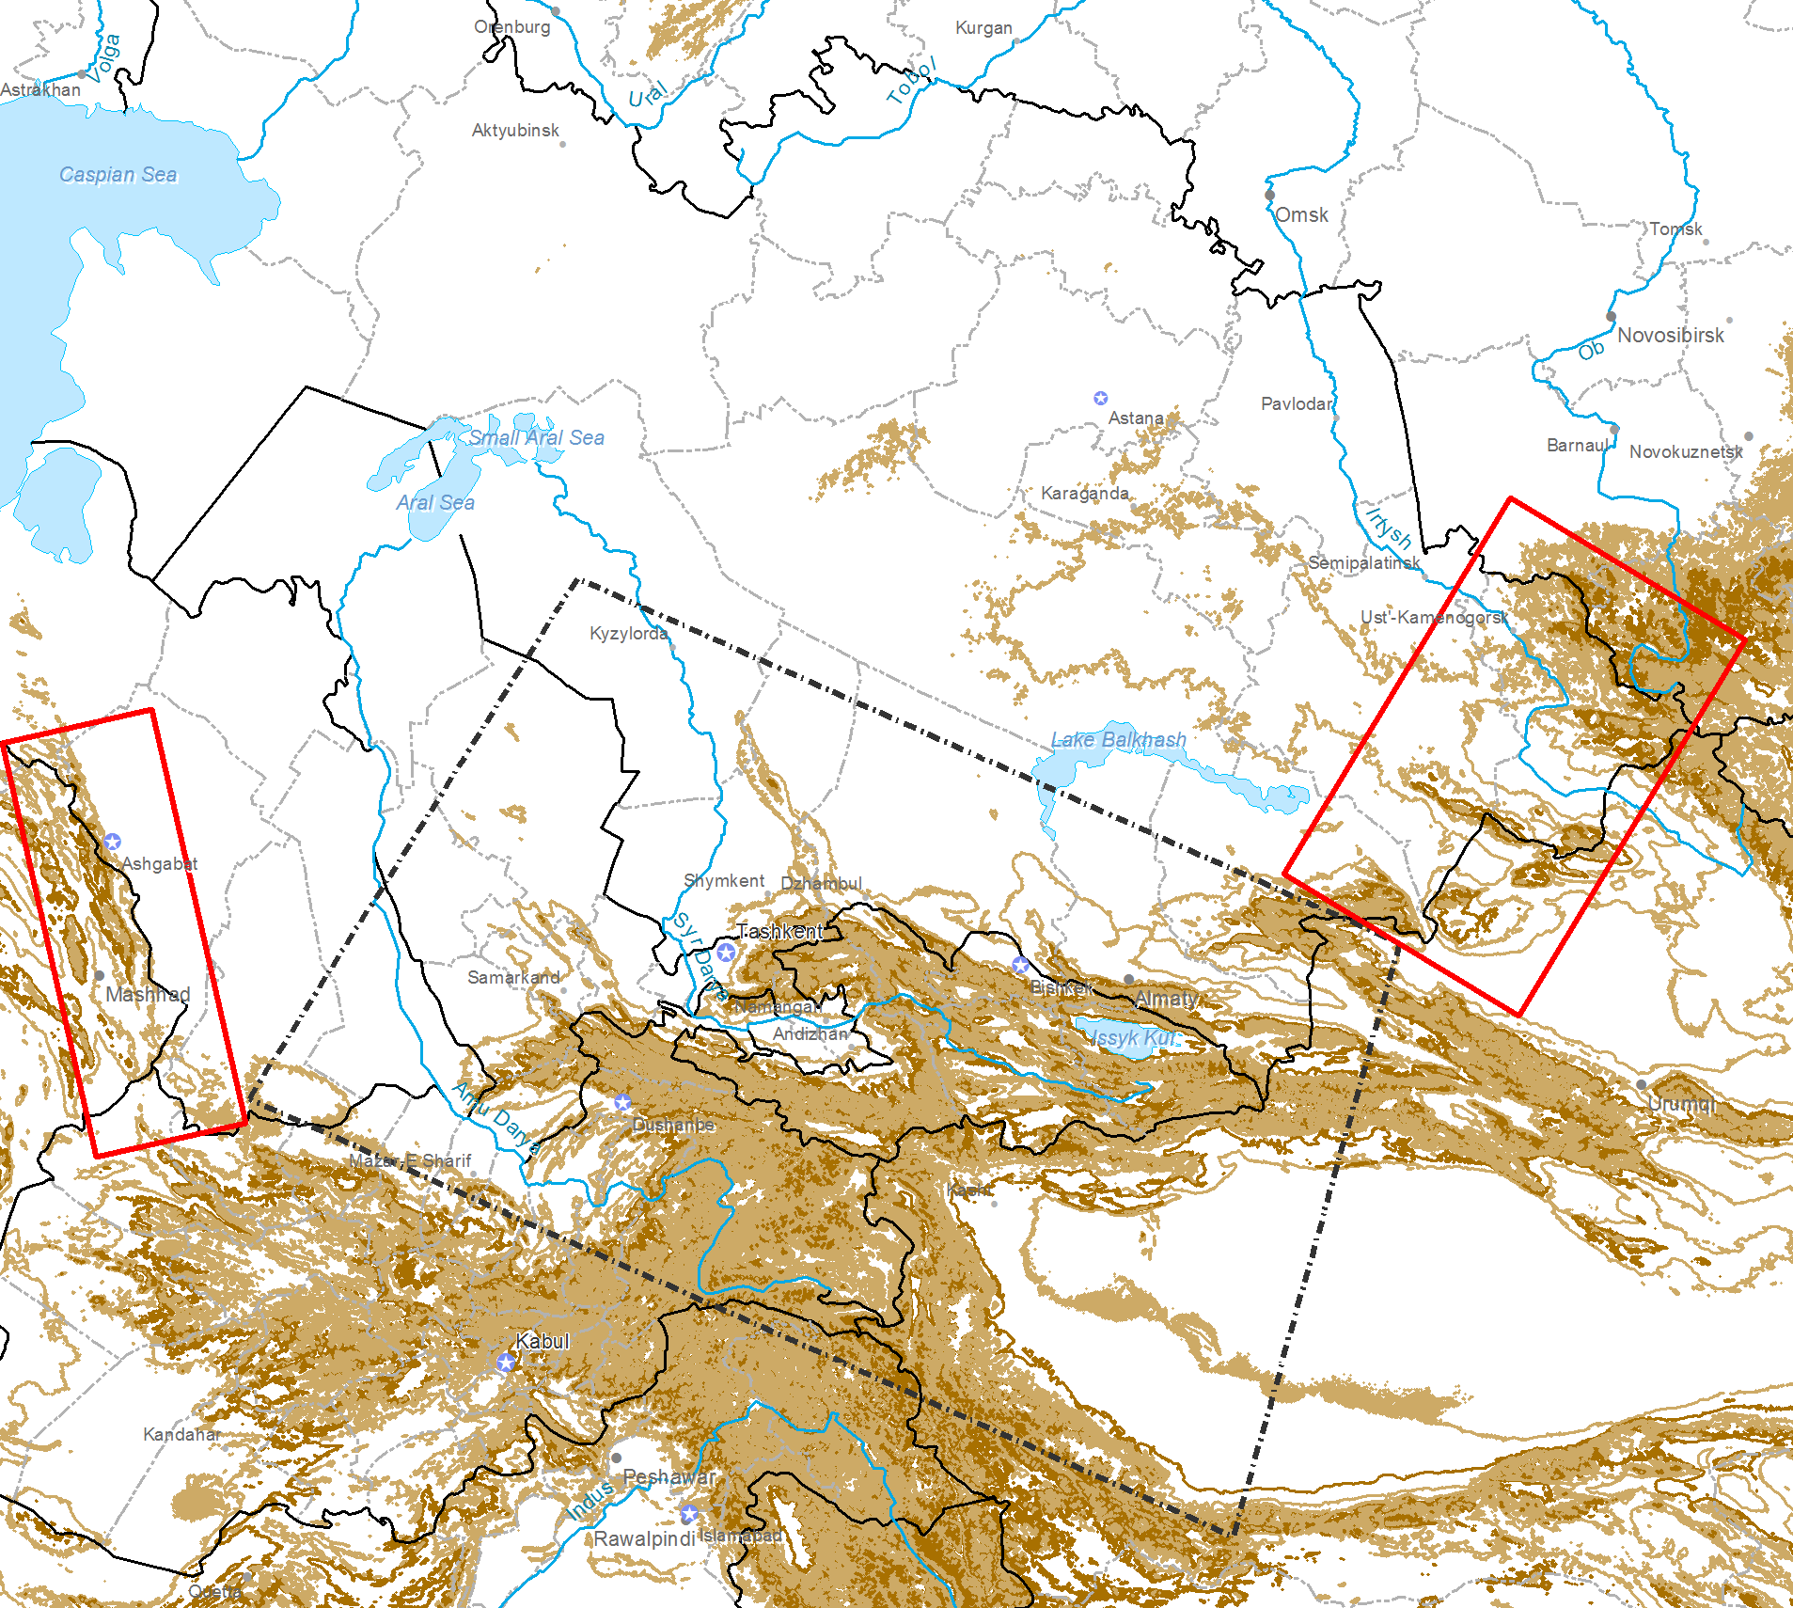
High Resolution NWP Requirement: CARFFG
High Resolution QPF is required for the mountainous regions
CARFFGS: Central Asia Region Flash Flood Guidance System

Slide 16
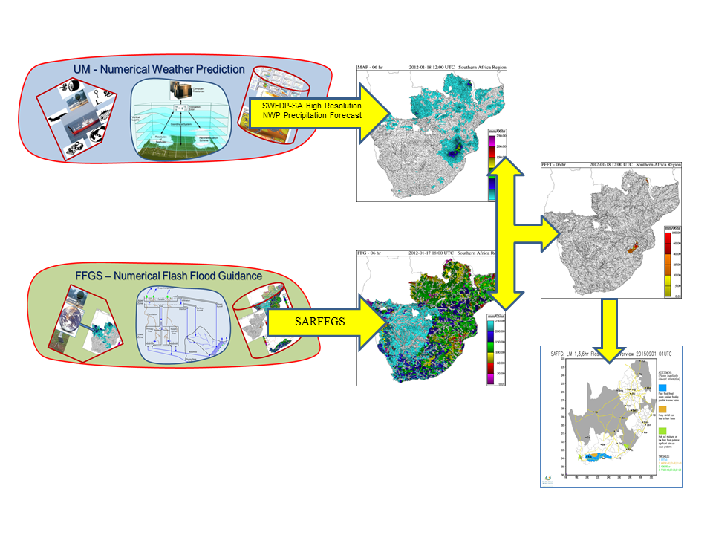
Integration of SWFWP-SA and SARFFGS
This slide is adopted from Eugene Poolman of the SAWS

Slide 17
Linking Needs and Challenges
Implementation process of the SWFDP project ∼ 4 or 5 years.
Implementation of FFGS ∼ 18 months.
Integration of SWFDP and FFGS:
  Closer cooperation between SWFDP and FFGS project teams and their partners.
  Need to align SWFDP window-on-weather to mesh with FFGS area coverage
  Need for higher-resolution mesoscale NWP → QPF and Nowcasting data and products, commensurate with factors causing flash flooding (topography - mountainous basins) and damage centres
  Need for infrastructure enhancement to allow product flow from SWFDP RC to FFGS RC
  Need of the participating National Centres to access the data and products such as internet speed,
  Need for WEB portal for disseminating forecasts and warning products for the Emergency Management Agencies.
This slide is adopted from Eugene Poolman of the SAWS

Slide 18
Thank you for your attention
Paul Pilon
ppilon@wmo.int
Ayhan Sayin
asayin@wmo.int

Slide 19
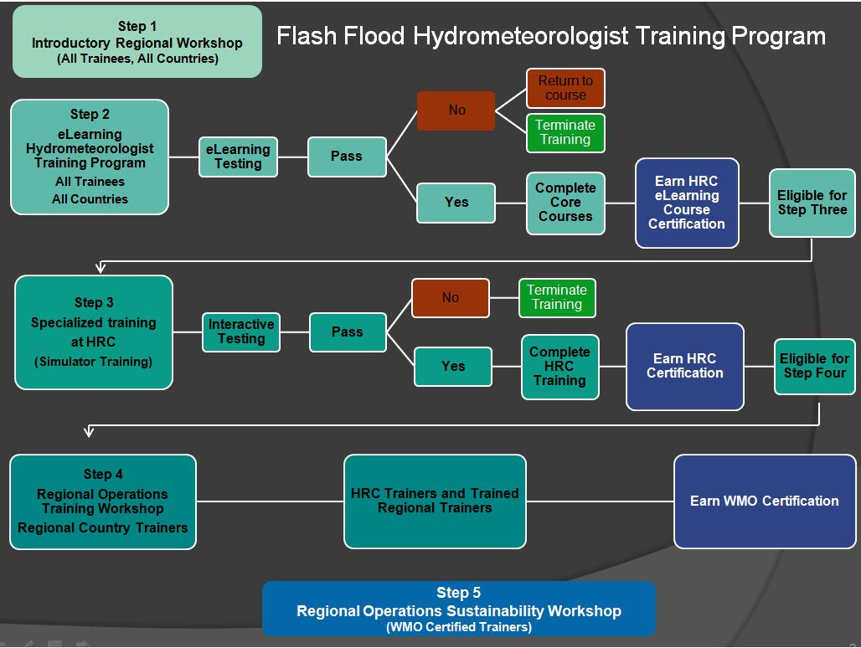
Flash Flood Hydrometeorologist Training Programme
Step-1: Introductory in-country workshops and meetings,
Step-2: On line eLearning,
Step-3: Advanced Operations and Interactive Simulator Training at the Hydrologic Research Center,
Step-4: Regional Operations Training Workshop,
Step-5: Regional Operation Sustainability (Refresher) Workshop.

Slide 20
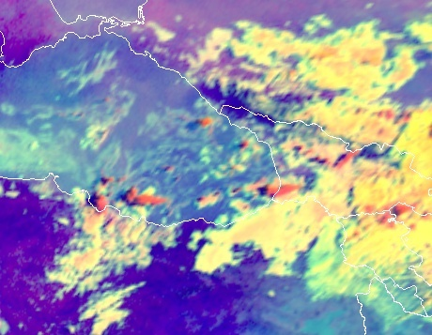
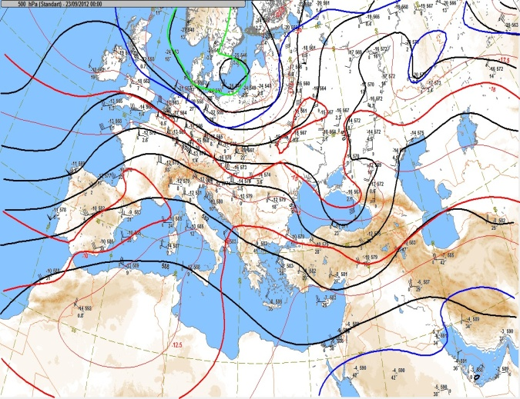
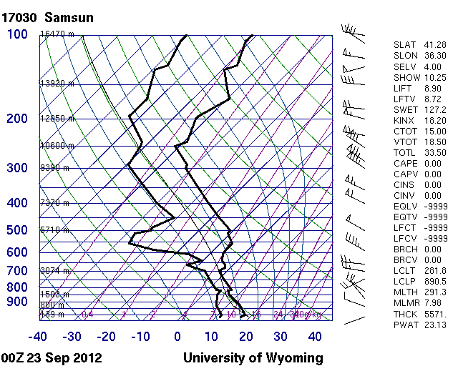
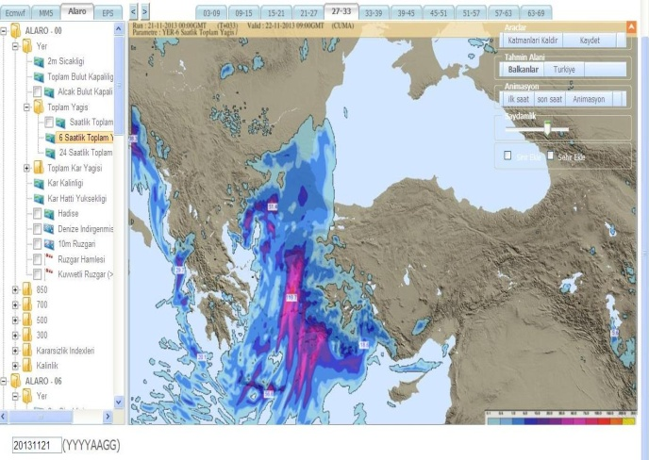
Nowcasting Product Needs
Satellite Images
Meteorological Charts (surface, 850 hPa, 700 hPa, 500 hPa, 850 hPa )
Heavy Precipitation
Atmospheric Soundings

Slide 21
Integration of SWFWP-SA and SARFFGS
Brings together the SWFDP and SARFFG systems;
Provides improved service delivery of forecasts, warnings and information to Disaster Risk Reduction (DRR) agencies;
Supports capacity-building of the hydrological and meteorological operations of each National Centre and the Regional Specialized Meteorological Centre (RSMC) in Pretoria.
Objective:
Mitigate the adverse impacts of hydrometeorological hazards, by:
  Improving forecasting of severe hydrometeorological events by National Meteorological and Hydrological Services (NMHSs);
  Enhancing user interfaces and expand the suite of products available to forecasters;
  Strengthening the capacity of NMHSs to provide timely and effective early warnings of extreme hydrometeorological events;
  Developing products and information that addresses needs of users to reduce loss of lives and livelihoods due to extreme hydrometeorological events.

