Slide 1
PREPARATION OF DOCUMENTATION FOR CONSTITUENT BODIES MEETINGS
● Document types
● Document flow
● References
● Meeting website
● WMO Tools ribbon
● Steps to produce documents
● Jobsys
December 2017

Slide 2
Description
INF | Additional information to a Doc. It has to have the same agenda item number as the related Doc. Not for discussion => No Status Posted in “Information Documents” tab
Doc. Status: Draft 1 or 2 | PRE-SESSION DOCUMENT DRAFT 1 => clean DRAFT 2 => track changes shown from previous version if corrections/suggestions from [Secretariat] and/or [EC members] are made before the beginning of session Posted in the folder “1. DRAFTS FOR DISCUSSION”
Doc. Status: Draft 2 or 3 | IN-SESSION DOCUMENT Track changes from previous version are accepted. New changes appear in track changes. Can be approved if acceptable or converted into a subsequent version if considerable changes are still required. Background information is deleted Posted in the folder “1. DRAFTS FOR DISCUSSION”
Doc. Status: Approved | DOCUMENT APPROVED DURING SESSION Track changes from previous version are accepted. New changes appear in track changes. Posted in the folder “2. PROVISIONAL REPORT (Approved documents)” Previous versions will be removed from “1. DRAFTS FOR DISCUSSION” and will be posted in folder “3. SESSION ARCHIVE”
DOCUMENT DEFINITIONS

Slide 3
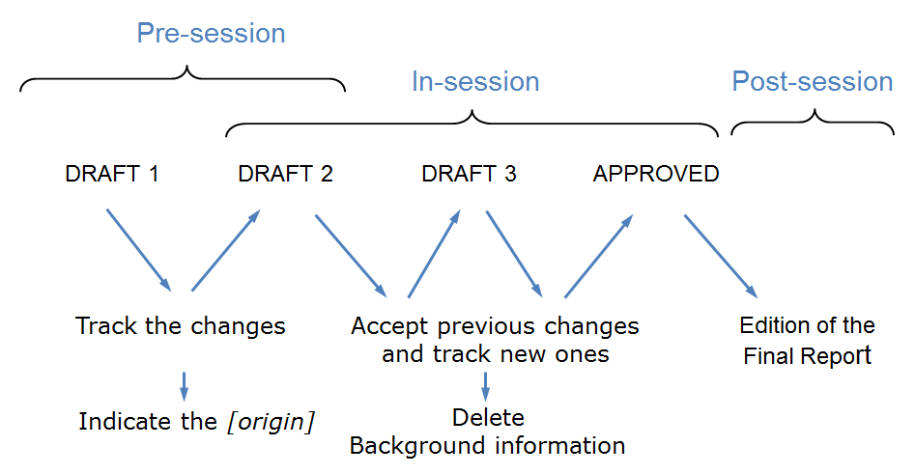
DOCUMENT FLOW

Slide 4
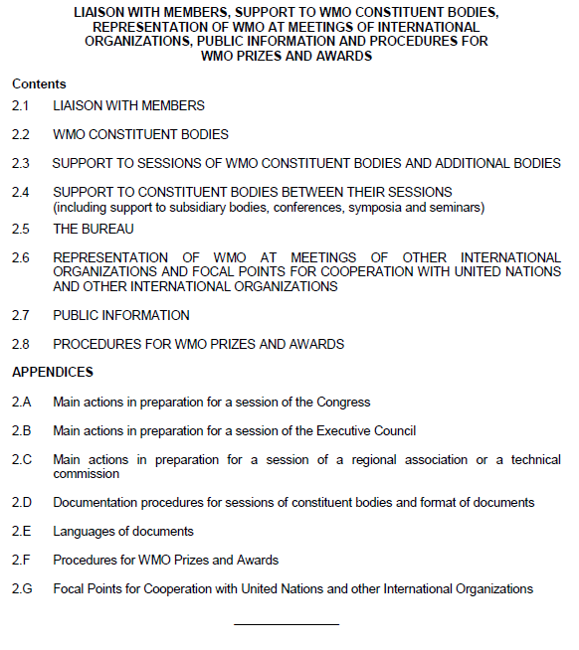
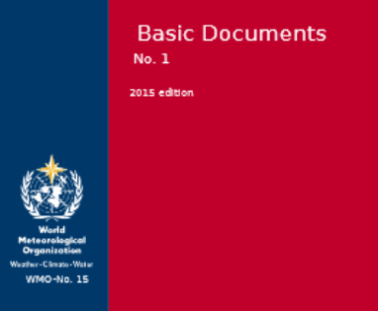
REFERENCES
Basic Documents WMO-N° 15
WMO Standing Instructions - Chapter 2
!
!
Composition of WMO (WMO-N° 5)

Slide 5
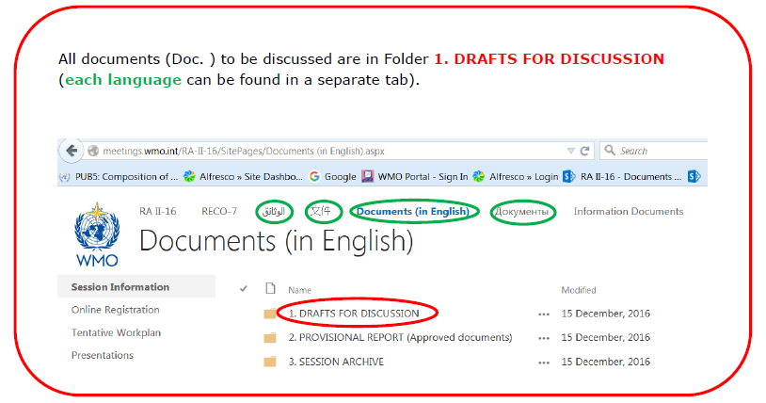
MEETING WEBSITE

Slide 6
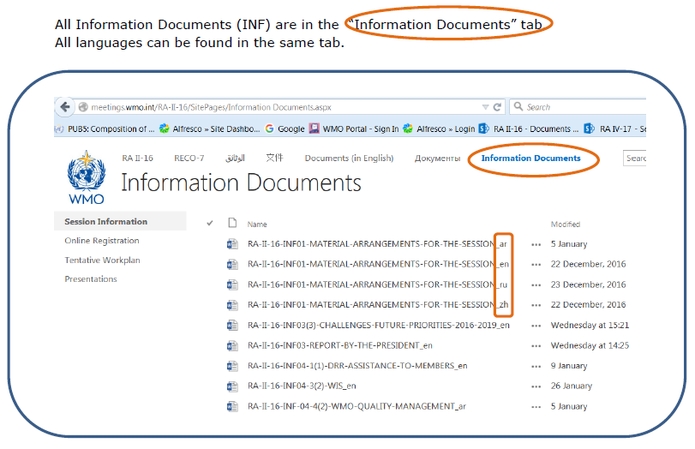
MEETING WEBSITE

Slide 7
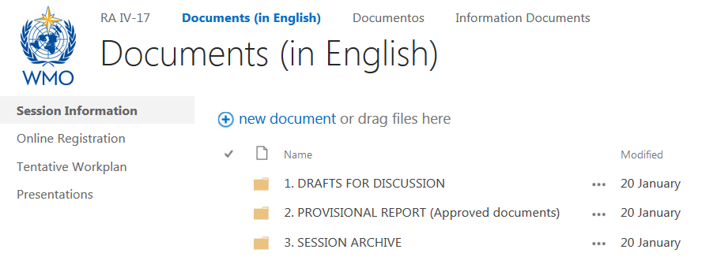
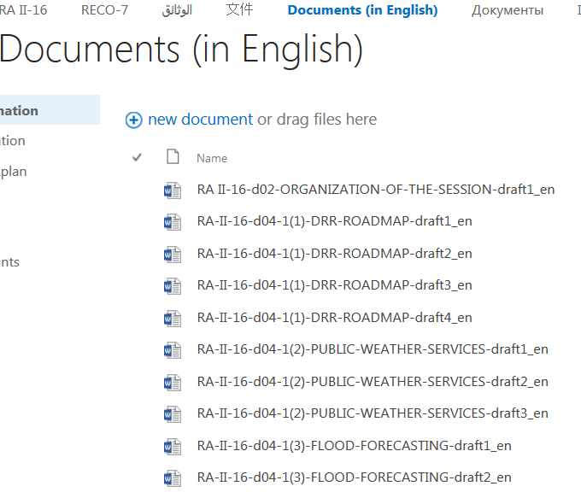
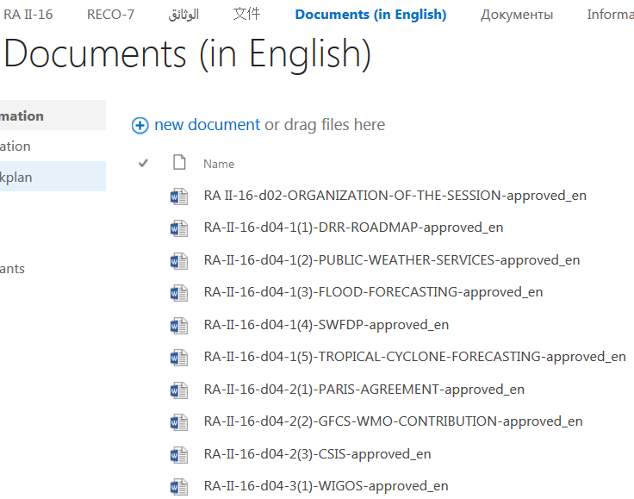
MEETING WEBSITE

Slide 8
WMO Tools ribbon
?
!
No Contact ITCSD Service Desk
Is the ribbon available ?
Yes Tutorial button
gives all the details

Slide 9
Buttons in WMO Tools automatically
produce INF, DRAFT 1, 2, 3 or APPROVED
Starting from DRAFT 2, in 1 click:
Saves the next version in the same folder (where the previous version was saved by the user)
Updates the file name
Accepts track changes (if any) from previous version
Keeps the manual track changes if any
Sets up the track changes mode
Generates the corresponding new headers

Slide 10
STEPS TO PRODUCE DOCUMENTS pre-session
“The documents shall be distributed as soon as possible, and preferably not later than 45 days before the opening of the session.” (Regulation 152 (b) – Basic documents, WMO-N°15)
Use the WMO Tools ribbon to produce a DRAFT 1 or an INF.
Use the document numbering according to the Provisional (Annotated) Agenda approved by the Executive Management.
By default, the Template proposes all the possibilities (Resolution, Decision and Recommendation). Delete the parts you don’t need. Respect the order given.
Circulate the document via a workflow for review by all concerned and consolidation before approval by the relevant Executive Management Office.
Send to DPMU the approved version for translation via a Jobsys request (in the “Contact” field, select the person to be contacted by the translators in case they have questions). Attach to Jobsys the version approved by EM – No Elios link is needed.
INFs are translated if resources/time permit.
From this stage onwards, you must use the version from the meeting website only. If the document is not yet on the website, contact DPMU to get the latest version.

Slide 11
STEPS TO PRODUCE DOCUMENTS in-session
All in-session documents are to be produced
immediately after discussions have been completed.
Download the document from the meeting website folder “DRAFTS FOR DISCUSSION” and save it without changing anything.
Use the WMO Tools ribbon to produce the next version (DRAFT 2, 3 or APPROVED).
Amend the document and save the changes.
Circulate the paper copy of the document using the History Sheet (automatically generated by the WMO Tools ribbon) for approval by the Executive Management Office.
After approval, insert new changes if any; and
Send to DPMU the consolidated approved version for translation via a Jobsys request (in the “Contact” field, select the person to be contacted by the translators in case they have questions), together with a scan of the History sheet signed by all concerned.

Slide 12
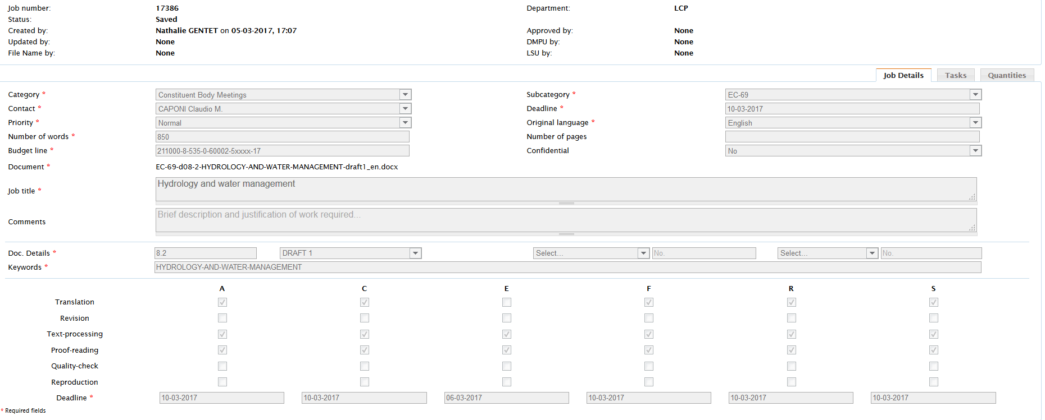
JOBSYS REQUEST
Name of the person who can reply to translators’ queries
Attach the consolidated file approved by the EM
Status of the document

Slide 13
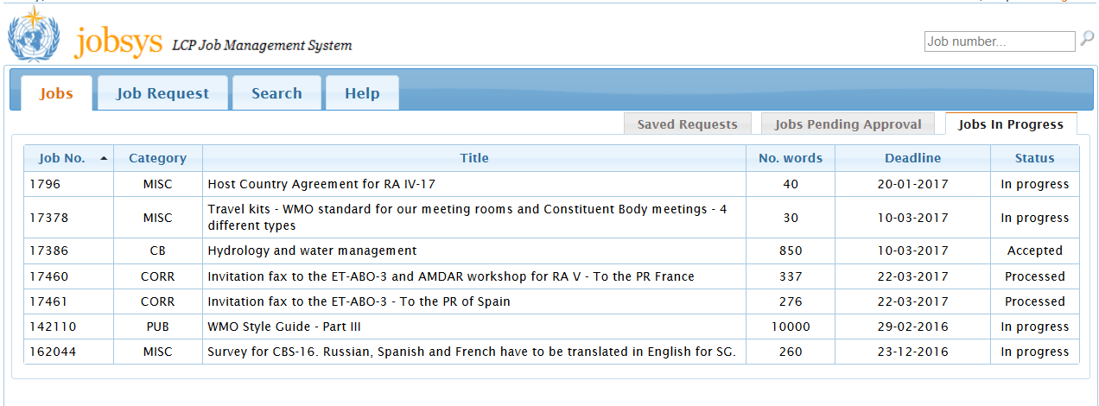
STATUS OF A JOBSYS REQUEST
Jobsys accepted by DPMU

Slide 14
TO SAVE TIME
- Write to DPMU mailbox only dpmu@wmo.int
Submit only documents that have been approved by the Executive Management
Indicate the origin of the changes in DRAFT 2/3 (pre-session only)
(e.g. [Secretariat] or [Name, Country] next to each change OR [All amendments in the document have been made by ………..] on top of first page)
When the Final Report of a CB session is completed, the numbering of Resolution/Decision/Recommendation will have changed during the editing from the in-session document (e.g. Decision 12(4)/1 (EC-68) became Decision 73 (EC-68). Therefore, check your references against the Final Report published on the WMO website.
Check the links
Attach the editable version of figures or Excel files for specific tables
Use “permanent” track changes for portions of text related to Publications
Update all the fields when you duplicate a Jobsys request
The documents need to be posted early to allow enough time for delegates to go through them

Slide 15
GET READY!
DO A DRY RUN before the session
CHECK THAT ALL YOU NEED TO PRODUCE YOUR DOCUMENTS IS AVAILABLE on YOUR WORK STATION
PLAY WITH THE WMO TOOLS RIBBON
TAKE TIME TO READ THE INSTRUCTIONS

Slide 16
Any question ? Any doubt?
Call DPMU:
Nathalie GENTET (4 L 41 – Ext. 8084)
Sasha KORETSKI (4 L 04 – Ext. 8282)
dpmu@wmo.int

Slide 17
Thank you
Merci

