Slide 1
Overview
GLOBAL FLASH FLOOD GUIDANCE PROGRAM
HYDROLOGIC RESEARCH CENTER
1 December 2015

Slide 2
Distinguishing Characteristics of Flash Floods
Short flood duration
Small area affected
Very high mortality rates
A local hydrometeorological phenomenon that requires:
BOTH Hydrological and Meteorological expertise for real-time forecasting/warning
Knowledge of local up-to-the-hour information for effective warning
Prior coordination of warning and disaster-management agencies for effective response
WMO (2008) country-level survey: Among 139 countries, 105 indicated that flash floods were
among the top two most important hazards and require special attention

Slide 3
The Need
Flash Floods are very significant disasters globally …
Highest number of deaths per people affected (mortality rate)
… BUT there are no discernible trends for loss reduction
No flash flood warnings for vast populated areas of the world
Lack of local expertise and of regional cooperation
Little in situ data in small regions
Large-river flood-warning strategies ineffective for flash floods

Slide 4
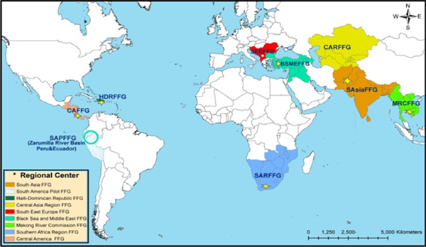
The Response: The Global Initiative for Flash Floods (2008 – Present)
http://www.wmo.int/pages/prog/hwrp/flood/ffgs/index_en.php
The Hydrologic Research Center (HRC) has signed a joint Memorandum of Understanding to implement regional flash flood guidance systems worldwide with:
the United Nations – World Meteorological Organization (WMO)
the U.S. Agency for International Development/Office of U.S.
Foreign Disaster Assistance (USAID/OFDA)
and the U.S. National Oceanic and Atmospheric Administration
(NOAA).
As of 2015, more than 2.5 billion people are served by these systems

Slide 5
Flash Flood Guidance Concept
FFG
Rainfall threshold (familiar concept )
Meteorology and hydrology decoupled
to facilitate adjustments
Concerned only with bankfull flow or equivalent return period flow (early warning)
Bankfull Flow
FFG: Amount of rainfall of a given
duration and over a given catchment that
is just enough to cause minor flooding conditions
at the outlet of the draining stream
Threshold exceedance concept to estimate occurrence only!

Slide 6
Research and Development History
1970-1988: US NWS Produces FFG statistically for each River Forecast Center. Also, research in adaptive site specific FF prediction systems.
1988-1993: IIHR/HRC develop physically consistent FFG formulations based on GIS and create the first operational codes for US NWS
1993-2005: HRC continues research in various aspects of the FFG process and system (sparsely gauged basins and uncertainty issues, forcing and models). The development of prototype regional systems using FFG is proposed and accepted in work plan of WMO CHy Working Group on Applications (2002-2003)
2004: The Central America Flash Flood Guidance System becomes operational (serves 7 countries in CA)
2008: WMO, USAID, NOAA, HRC sign a quad-part Memorandum of Understanding to collaborate in the development of a global flash flood guidance system (currently in second 5-year phase)

Slide 7
System for Flash Flood Guidance
(Global-to-Regional-to-Local Components)

Slide 8
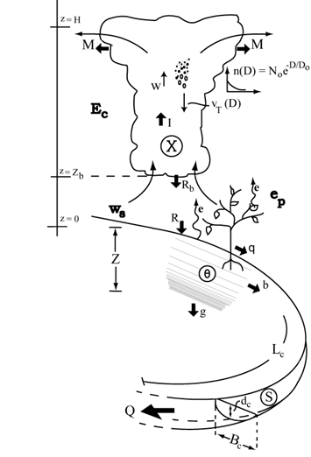
Integrated Systems for Real-Time Warning
Observations
or Forecaster
Experience
Last-Minute
Information
Decision to issue warning
Response
Forecast
ε
Predictions
Warning
Message
Adjustments
Decision Maker
Guidelines and
Preferences
Agency-
Coordination
Education Programs
Modeling Systems
Training and Local Experience

Slide 9
FLASH FLOOD GUIDANCE SYSTEM
From Global Data and Regional Hydrometeorology to Country Data and Warnings
Regional Center: Computational Core
Global/Regional Observations
& ATM Model Forecasts
Computational
Component
Local Products
& Uncertainty
Country NMHS: Adjustments and Warning
Core
Country Data
Country
Warning Generation System
Country
Warning Dissemination System
Decisions are made with multiple datasets and under uncertainty
There is a need to modify the products of the regional system by country forecasters and have capability for estimating consequences to local flash flood potential
Response Agencies

Slide 10
Local System for Warnings
Regional Dissemination
System
Regional Networks
Country Networks
Country
Data
Database
GIS Analysis Tools
Forecaster
Country
Warning Dissemination
System

Slide 11
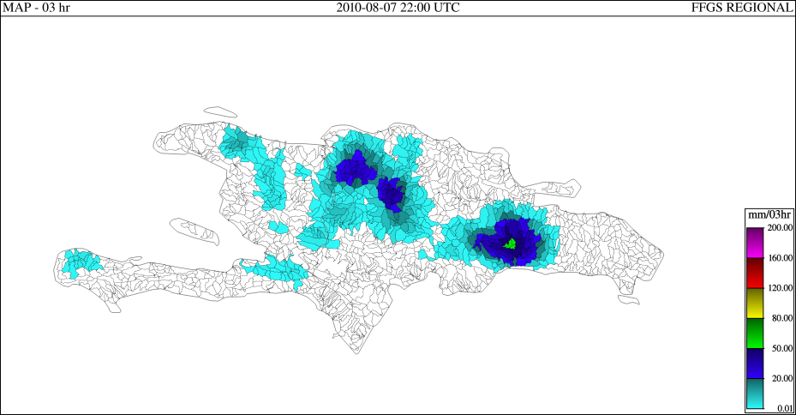
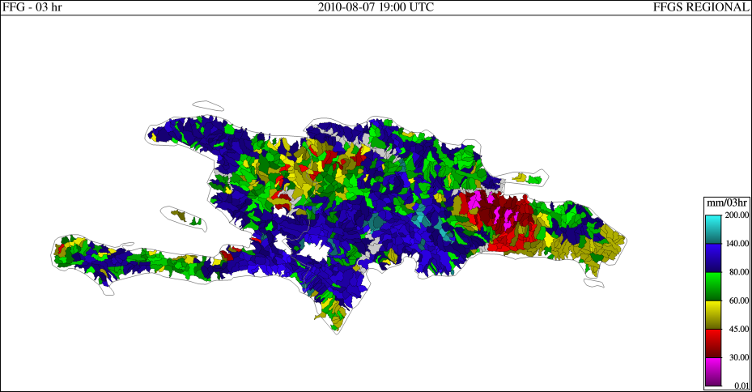
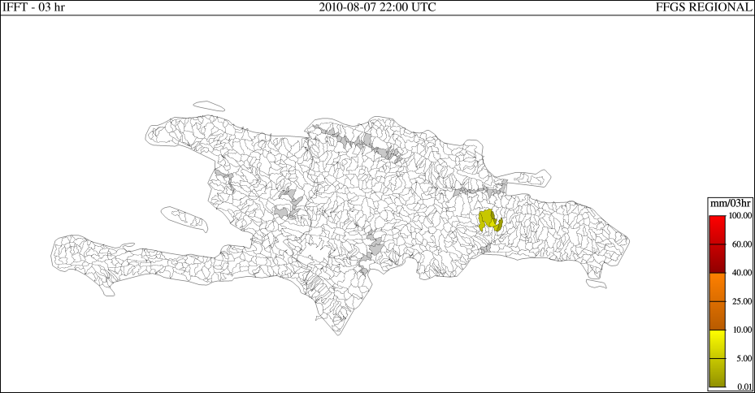
Application of Flash Flood Guidance
PREC 03hrs 2010-08-07 2200Z
FFG 03hrs 2010-08-07 1900Z
FFT 03hrs 2010-08-07 2200Z
Flash Flood Guidance (FFG): The amount of actual rainfall of a given duration over a small basin required to generate flooding flows at the outlet of the basin.

Slide 12
Snow Cover
Key Technical Components for the FFG System

Slide 13
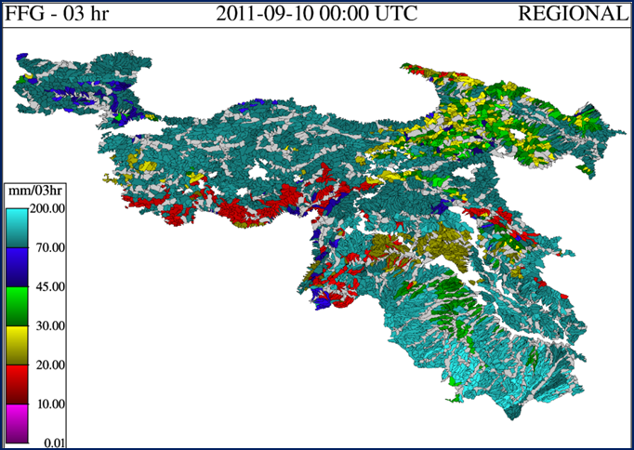
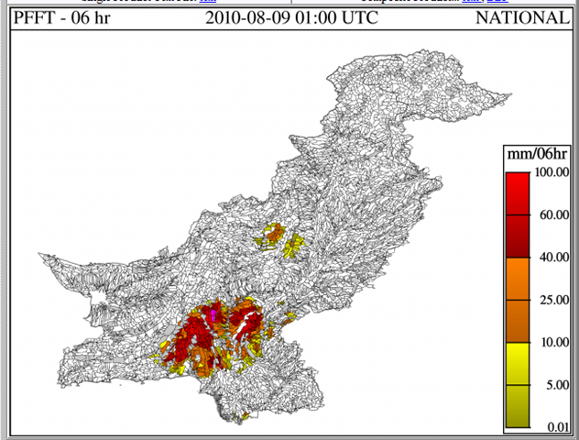
Global Flash Flood Guidance Products
DIAGNOSTIC
Flash Flood Guidance – volume of rainfall of a given duration (1-6 hours) over a given small catchment that is just enough to cause bankfull flow at the outlet
PROGNOSTIC
Flash Flood Threat – rainfall of a given duration in excess of the corresponding Flash Flood Guidance value (existing/past or “forecast” rainfall)

Slide 14
Real-Time Data Forcing Quality Controlled Multi-Spectral Satellite Rainfall
HE
CMORPH
IR – Based
30-min latency in operations
Based on measurements of top
cloud brightness temperature
MW – Based
18-26 hour latency in operations
Based on measurements of
microwave scattering from raindrops
Global FFGS product combines IR-based HE rainfall with MW-based CMORPH rainfall and with real-time raingauge reports (adaptive Kalman Filtering)

Slide 15
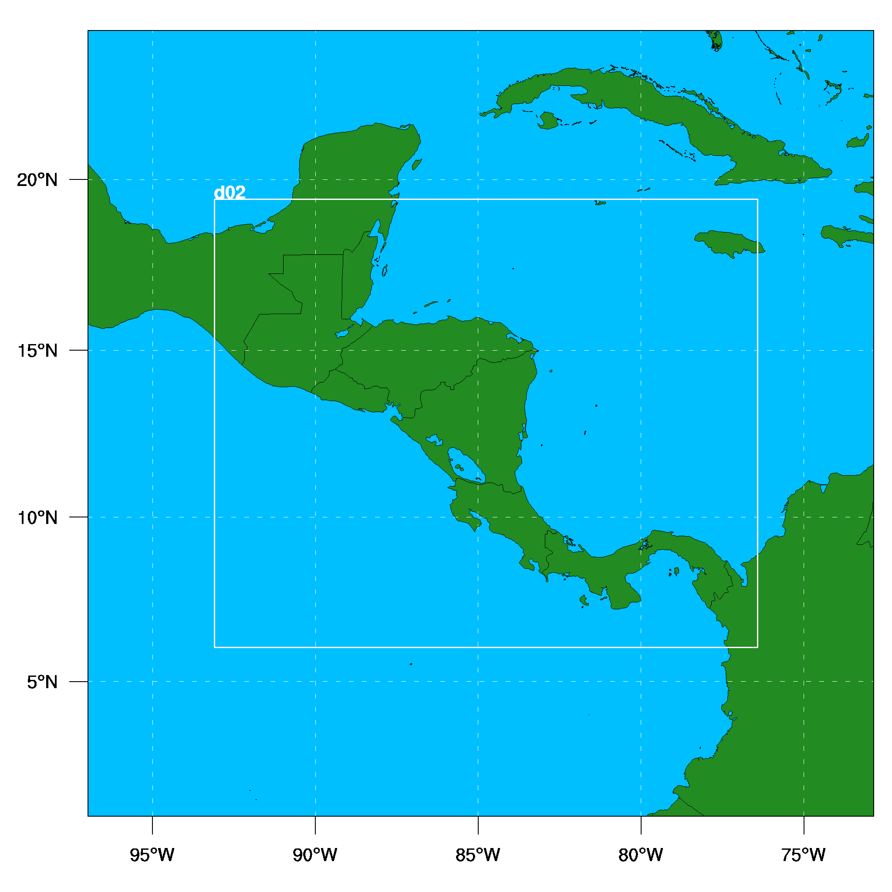
Real-Time Forecasts/Nowcasts Forcing Mesoscale Numerical Weather Prediction Modeling
CAFFG (Two Nested Grids)
  Two way communication
  Spatial Resolution
    18 & 6 km in horizontal
    30 layers in the vertical
    Mesh sizes of 150 x 130 and 256 x 310
  Temporal Resolution
    Model time steps of 60 & 20 seconds

Slide 16
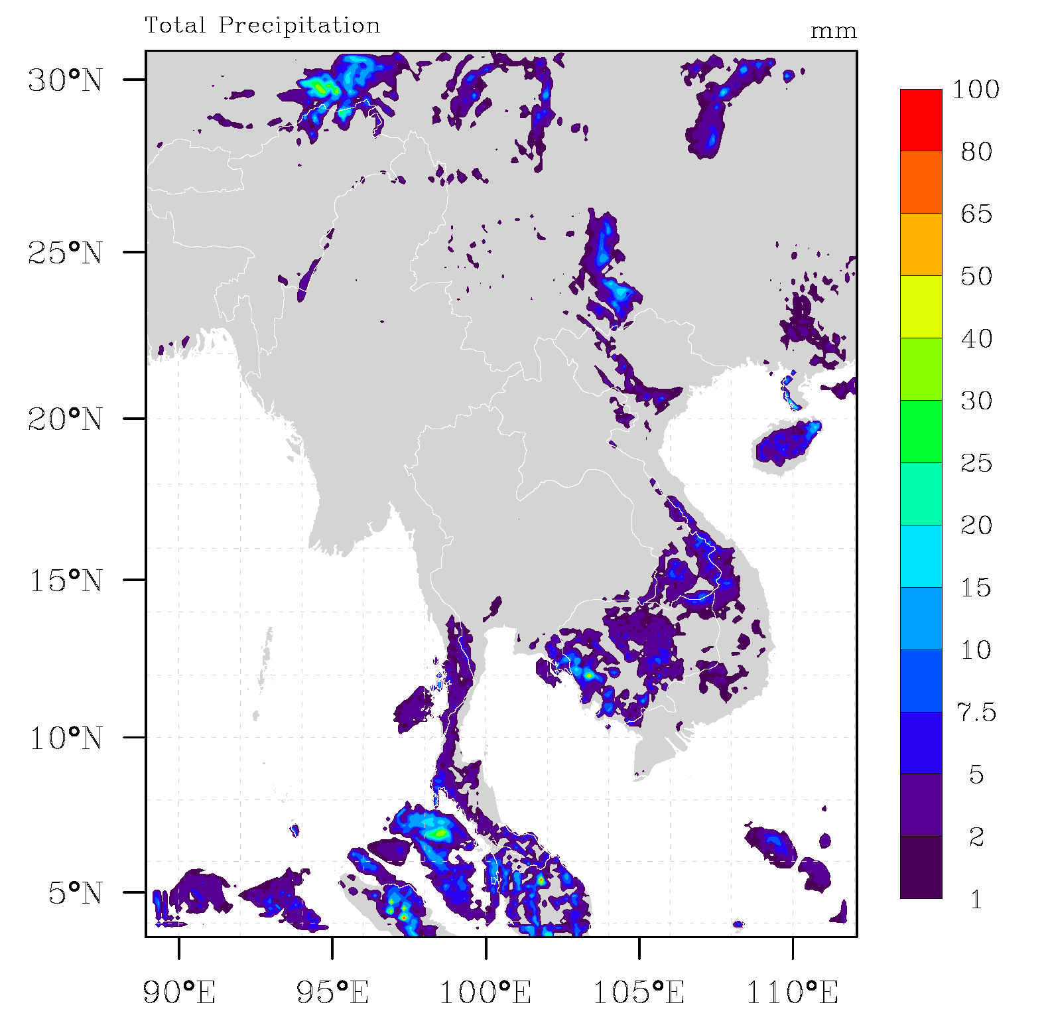
Real-Time Forecasts/Nowcasts Forcing Mesoscale Numerical Weather Prediction Modeling
MRCFFG
NCAR ARW v.3.2 Core
Initial Conditions: NCEP GFS (0.5⁰)
Final Resolution: 11 km
Forecasts at: 00Z and 12Z
Max Lead Time: 48 hours
Temporal Resolution: 1 hour

Slide 17
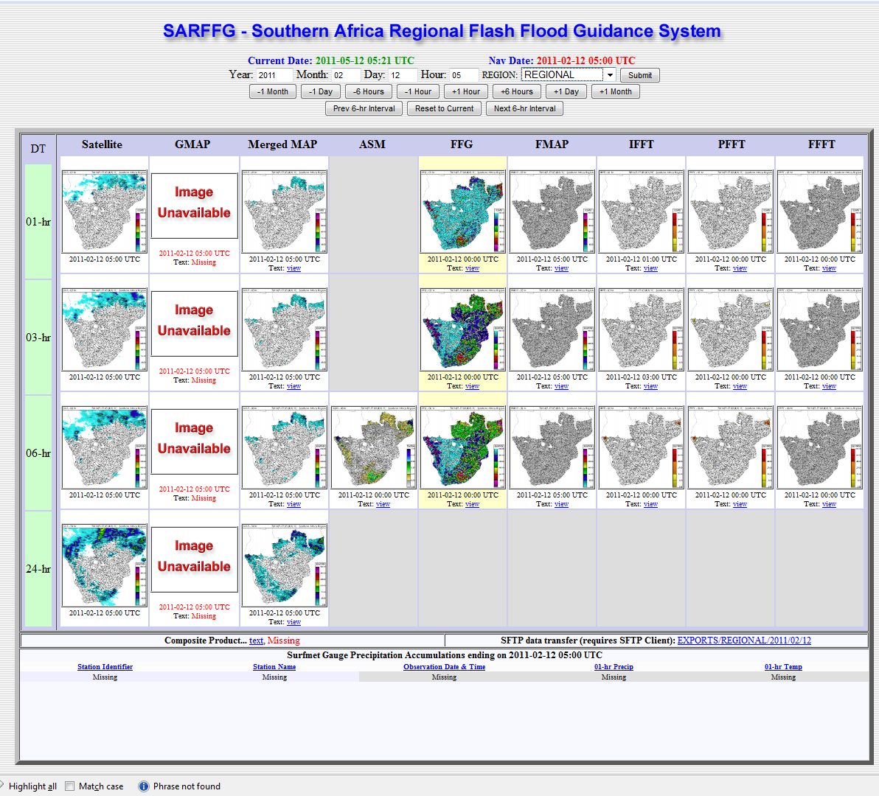
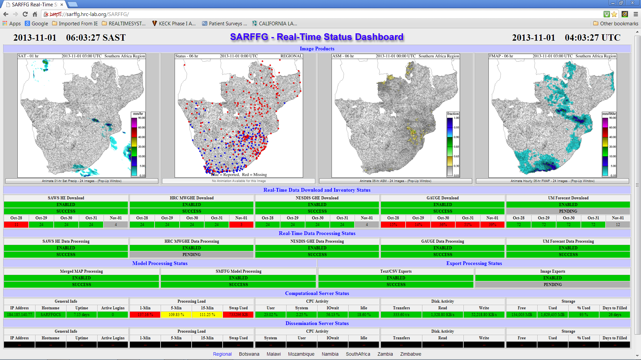

Slide 18
Education and Training Activities
Step 1
Introductory Regional Workshop
All Trainees
All Countries
HRC Trainers: Introduction to FFGS
Step 2
eLearning Hydrometeorologist Training Program
All Trainees
All Countries
No – Either Return to Course or Terminate Training
Pass
Yes
eLearning Testing
Course Certificates
Step 3
Specialized training
at HRC
(Simulator Training)
No – Either Return to Course or Terminate Training
Pass
Yes
Interactive
Testing
HRC Certificate
Step 4
Regional Operations Training Workshop
Nominated Trainees
All Countries
HRC Trainers and Trained Regional Trainers Regional Workshop
WMO Certificate to Regional Trainers
Step 5
Final Regional Operations Training Workshop
(One Year Later)
Trained Regional Trainers Regional Workshop w/HRC Observers

Slide 19




Flash Flood Hydrometeorologist Training (FFHT) Program
Five courses
Elements of Meteorology,
Elements of Hydrology,
GIS basics,
Flash Flood Guidance Model Products,
Remote sensing

Slide 20

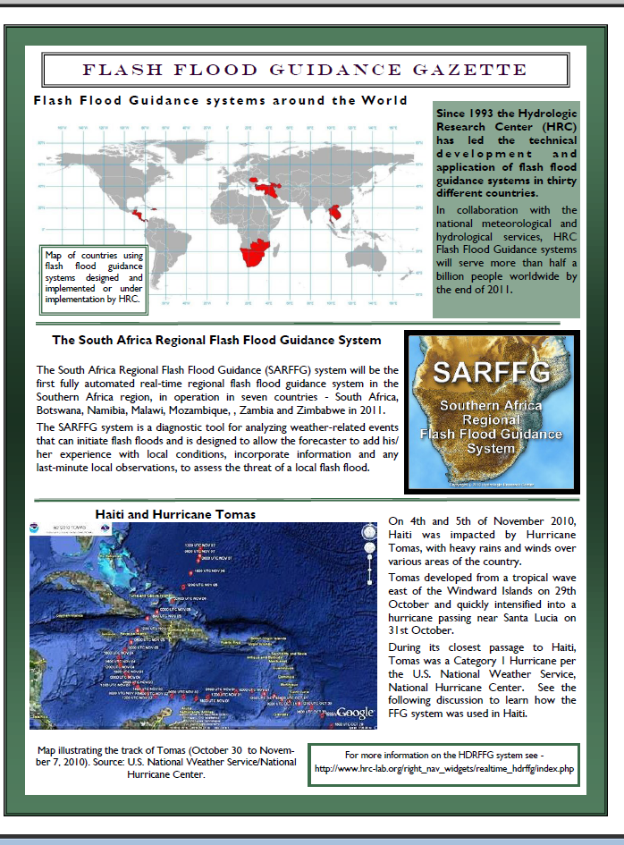
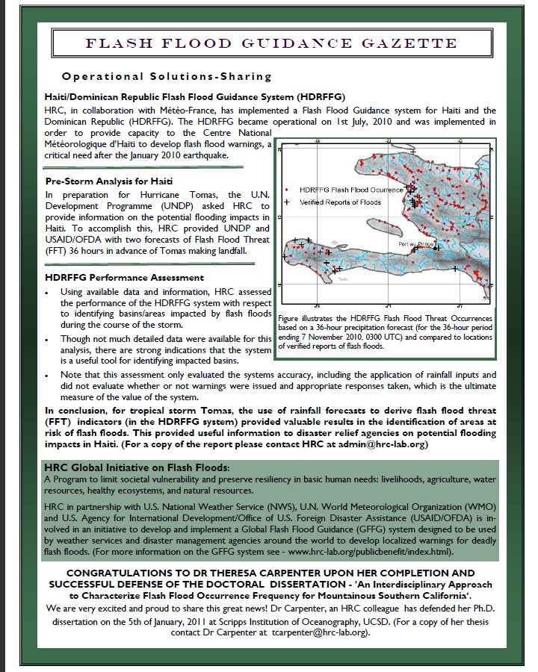
Forecaster Aid:
Gazette for Forecaster Contributions and Information
Exchange Worldwide

Slide 21
Operational Utility of Systems with Forecaster Adjustments
Trained forecaster adjustments have a beneficial effect on warning reliability especially for local bias situations
(Use of up to the minute information from the field very useful; Real-time cooperation of meteorologists
and hydrologists very useful for effective adjustments)
In-depth training of forecasters in system model behavior is required for sustainability
(In most cases several-month efforts are required)
A priori and real-time coordination of forecasters with response agencies necessary for high utility
Local experience of forecasters invaluable for warnings against short-fuse hydrometeorological phenomena – Validation/Databases
(Mesoscale model biases; hydrologic model biases; local soil behavior and flooding conditions)

Slide 22
Important Needs
Country data support (e.g., spatial data for soil type and texture, basin delineation
verification, historical hydrometeorological data for bias adjustment and snow/soil water
model calibration, etc.)
Links of regional center to national real time databases for reduction of uncertainty in
precipitation input and increase of reliability
Development of databases of observed flash flood occurrence for validation
Reciprocal training of forecasters and disaster managers and development
of well defined a priori plans for response
Enhance public information on flash floods, their perils and the needed
response measures

Slide 23
Enhancements for FFGS improved operations
Hydrologic Research Center
21 July 2015

Slide 24
Advances to be discussed
A. Multiple Mesoscale Model Input
B. Urban Flash Flood Warning
C. Use of satellite inundation mapping and surface soil moisture observations to correct FFGS soil water
D. Landslide occurrence prediction
E. Riverine discharge ensemble prediction

Slide 25
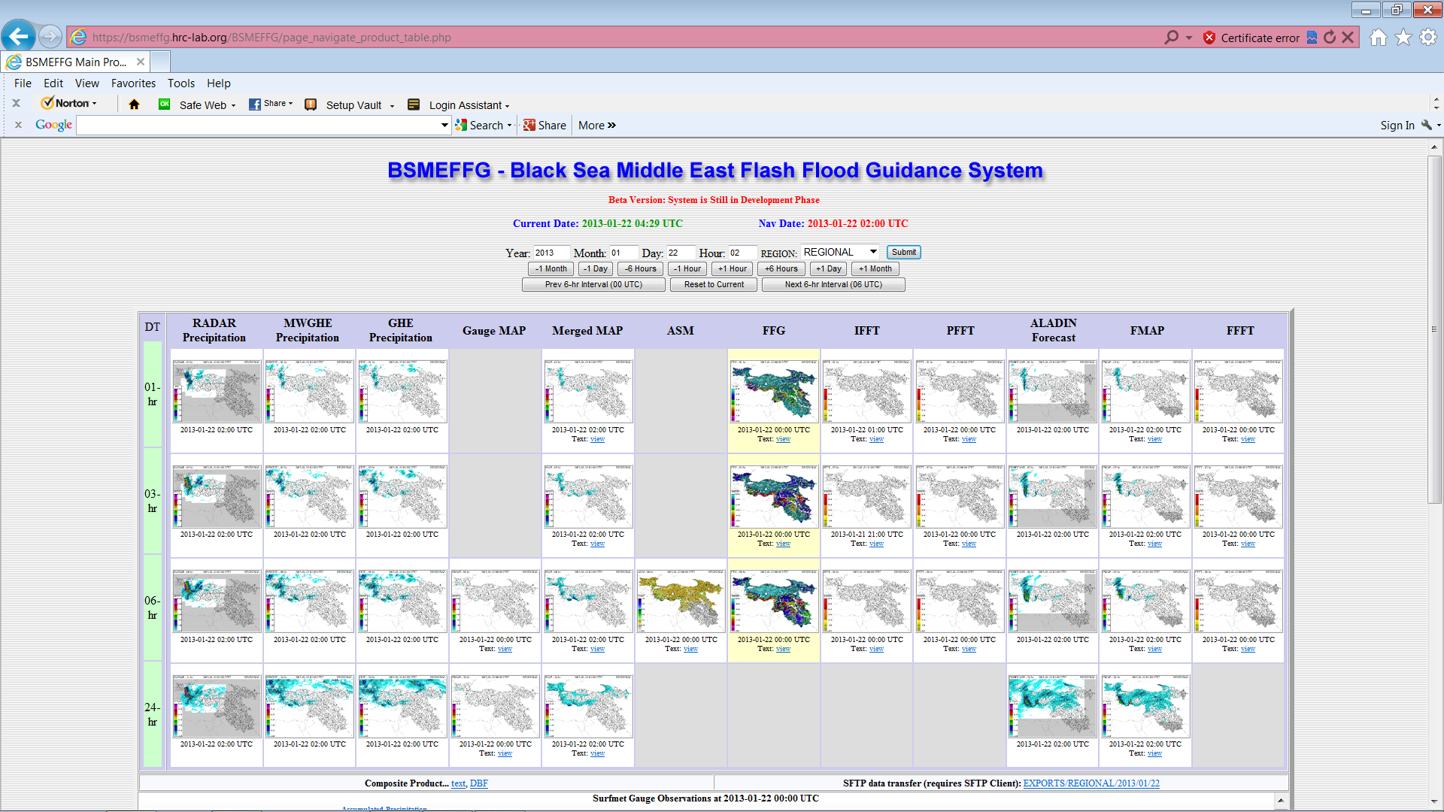
A. Multiple Mesoscale Mode Input

Slide 26
B. Urban Flash Flood Warning
Gridded Precipitation Input (observations and forecasts) from FFGS
Gridded Adjusted Radar Input and other local rainfall input
Q/C
High Resolution Soil Water Model
Initial States from FFGS
High res DEM and spatially-distributed data
Urban Routing Model
(surface and subsurface)
Urban infrastructure and control data
: UFFWS
: FFGS
Displays

Slide 27
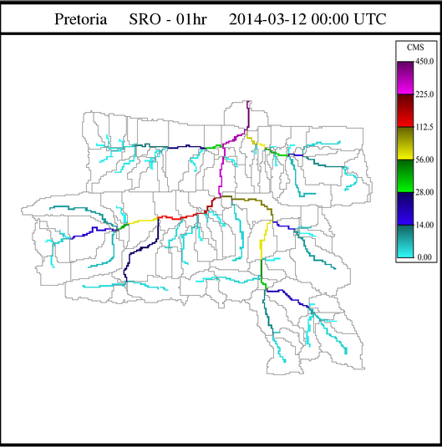
Surface Drainage Flow City of Pretoria Example

Slide 28
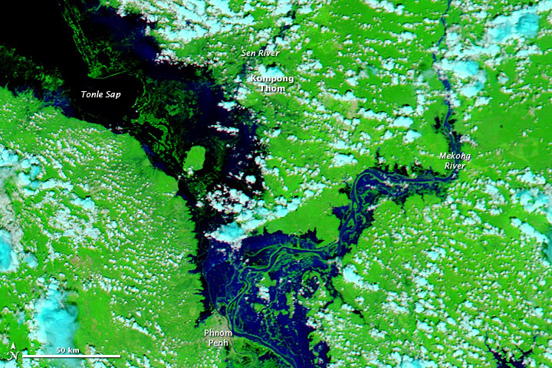
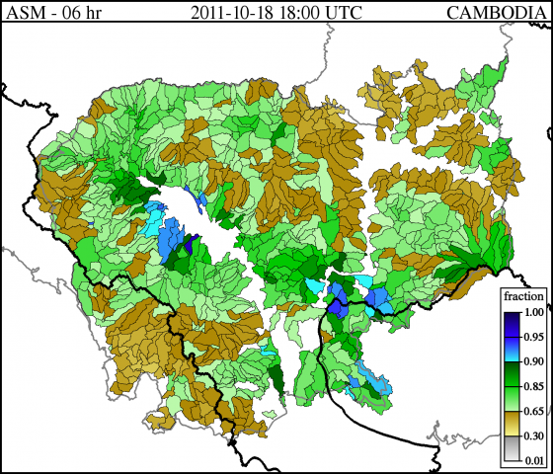
C1. Inundation Mapping for Soil Water Estimation
STANDING WATER CORRECTIONS TO MODEL SOIL WATER
FROM NASA PRODUCTS
MODIS-Based
Observed Inundation Area in Cambodia
MRCFFG Modeled
Drying Surface Soil Water in Cambodia
HRC Current Work: Feasibility and Effectiveness of Correcting Operational Model Soil Water
with MODIS Inundation Information in Real Time for Nonlocal Precipitation
forcing

Slide 29
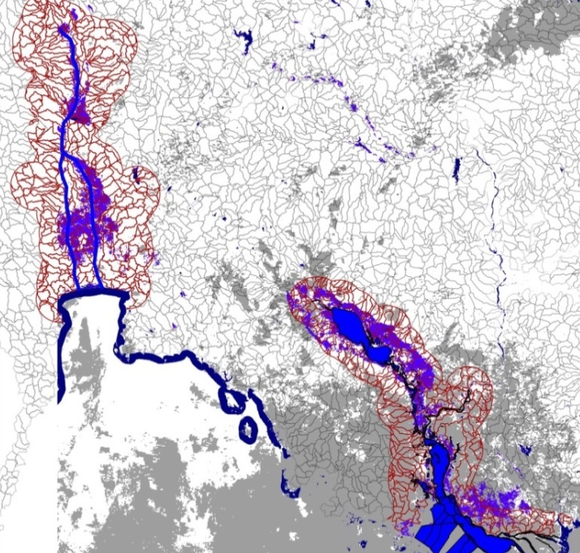
C1. Inundation Mapping for Soil Water Estimation
Posner et al. Remote Sens. 2014, 6, 10835-10859 – Open Access
Bangkok
Tonle Sap
Mekong River
Method: Assimilation of saturation of upper soil in catchments with
inundation greater than 85% and use of soil model to adjust
lower soil water.

Slide 30
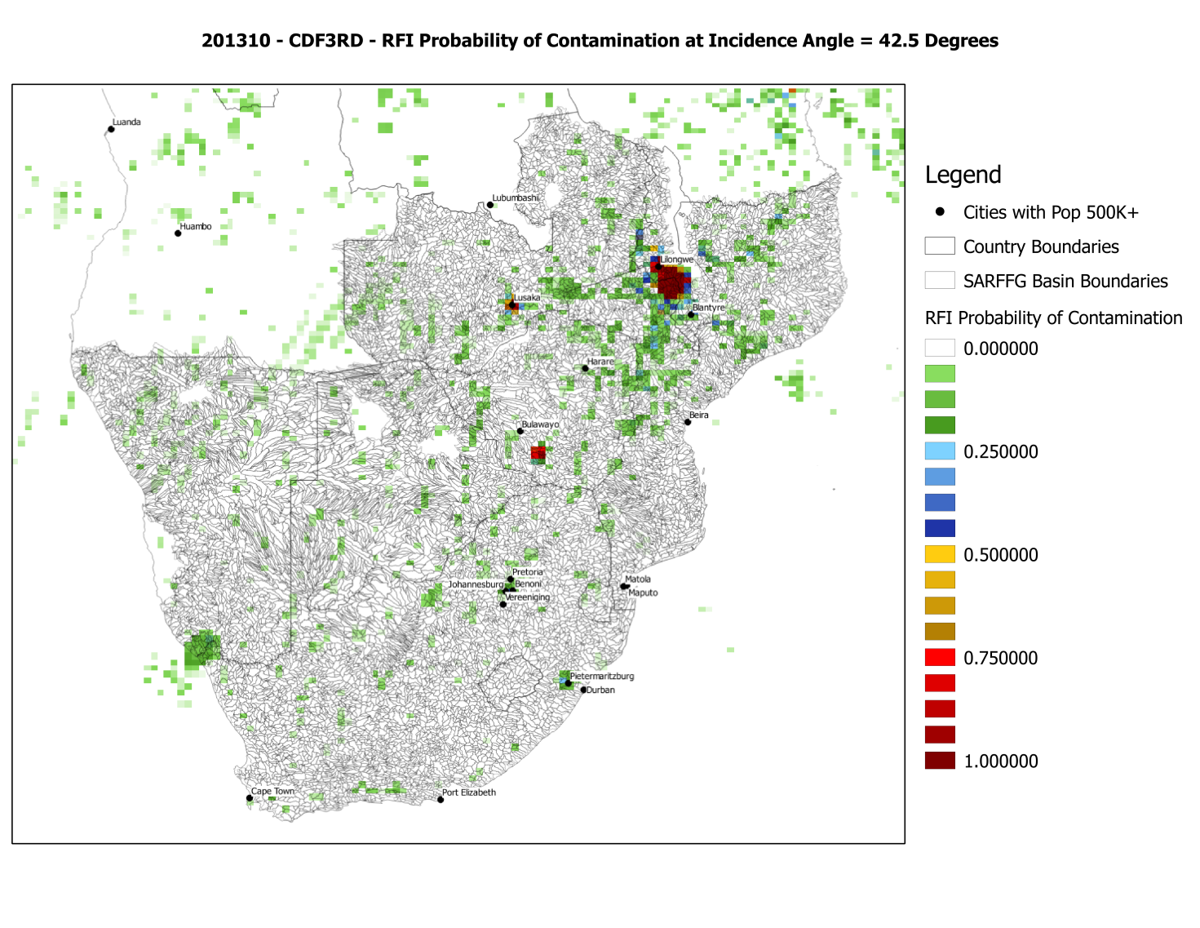
C2. Feasibility of using SMOS Data
Working with WMO(Bijinski), ESA(Drusch), CESBIO(Kerr) and UGent(Verhoest) to develop
a project for HRC to examine the utility of incorporating SMOS in FFG systems
Radio Frequency
Interference -RFI

Slide 31
D. Landslide prediction using FFGS output
D.1 Susceptibility map development in a region with an adequate database (El Salvador, Central America) (completed)
D.2 Real Time landslide prediction using FFGS rainfall and soil water thresholds in El Salvador (completed)
D.3 Generalization for Central America and implementation in CAFFG (on going)

Slide 32
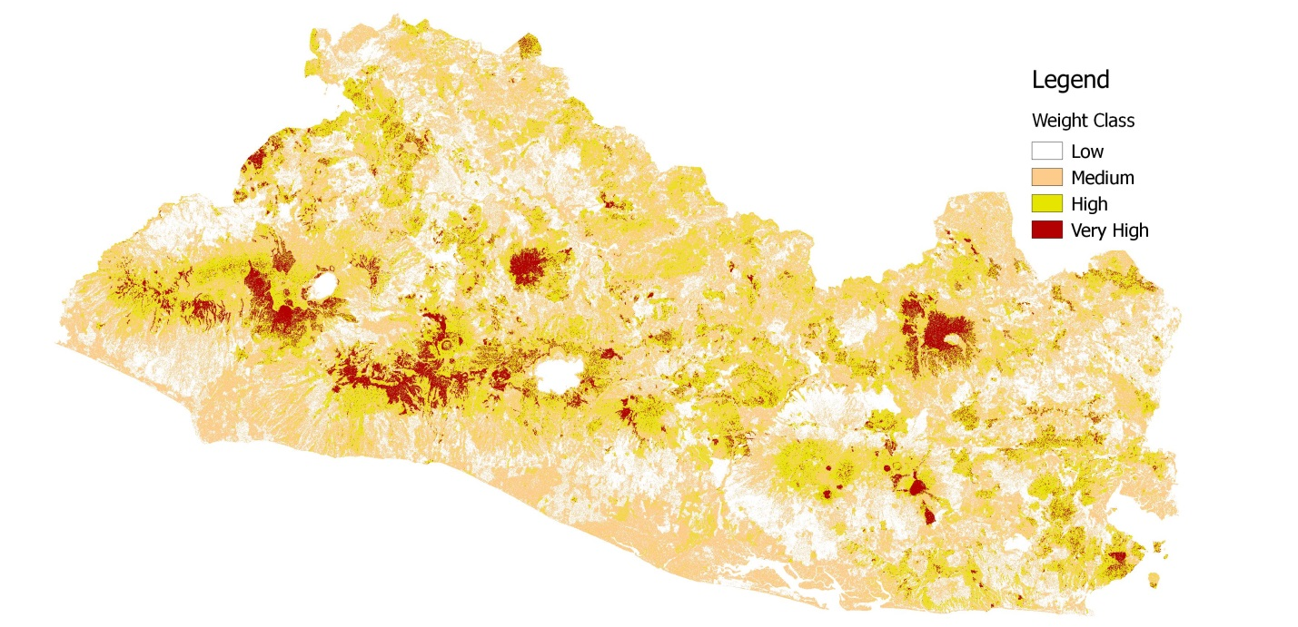



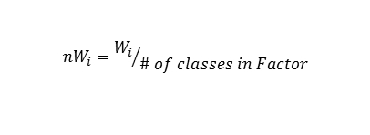

D.1 Susceptibility Mapping (hillslope scale)
Landslide Class Density
Landslide Map Density
Parameter
Classes
(e.g. Slope)
Low
$$\frac{N_{pixels}(with Landslides in Parameter Class)}{N_{pixels}(in Parameter Class)}$$
$$\frac{{Total N}_{pixels}(with Landslide)}{{Total N}_{pixels}(in region)}$$
Medium
High
Landslide Inventory Map
Normalized Factor Weight for each Class (i)
Continuous Susceptibility Weight Values to Discrete Classes
Factor Weight for each Class (i)
Total Susceptibility
$$\sum{{nW}_{i}}$$
$$W_{i}=\ln\left(\frac{Landslide Class Density}{Landslide Map Density}\right)$$
$${nW}_{i}={W_{i}}/{\# of classes in Factor}$$

Slide 33
D.2 Real-time Occurrence Prediction based on FFGS Rainfall and Soil Water
Landslides Occurred

Slide 34
E. Operational Riverine Routing
Real-Time Prototype implemented in Panama (CAFFG)
- Ensemble Prediction
- Lake operations included
- Interface operational supporting forecasters

Slide 35
Project Accomplishments
Demonstrated the feasibility for an operational distributed modeling application for the Rio Chagres.
Generate table of ensemble forecasts for the Chagres River Inflow to Madden Lake and specified upstream flow points
Also, generated initial graphical interface for user review of ensemble forecasts and simulations
Included Madden Lake operations and estimates and forecasts Madden Lake levels
Target lead times for ensemble prediction will be 36 hours with hourly resolution and 20 ensemble members (as available)
Twice daily starts with average spatial resolution of 2 km² for sub-basins.
Estimate model parameters from existing operational model parameters with historical data for initial adjustments

Slide 36
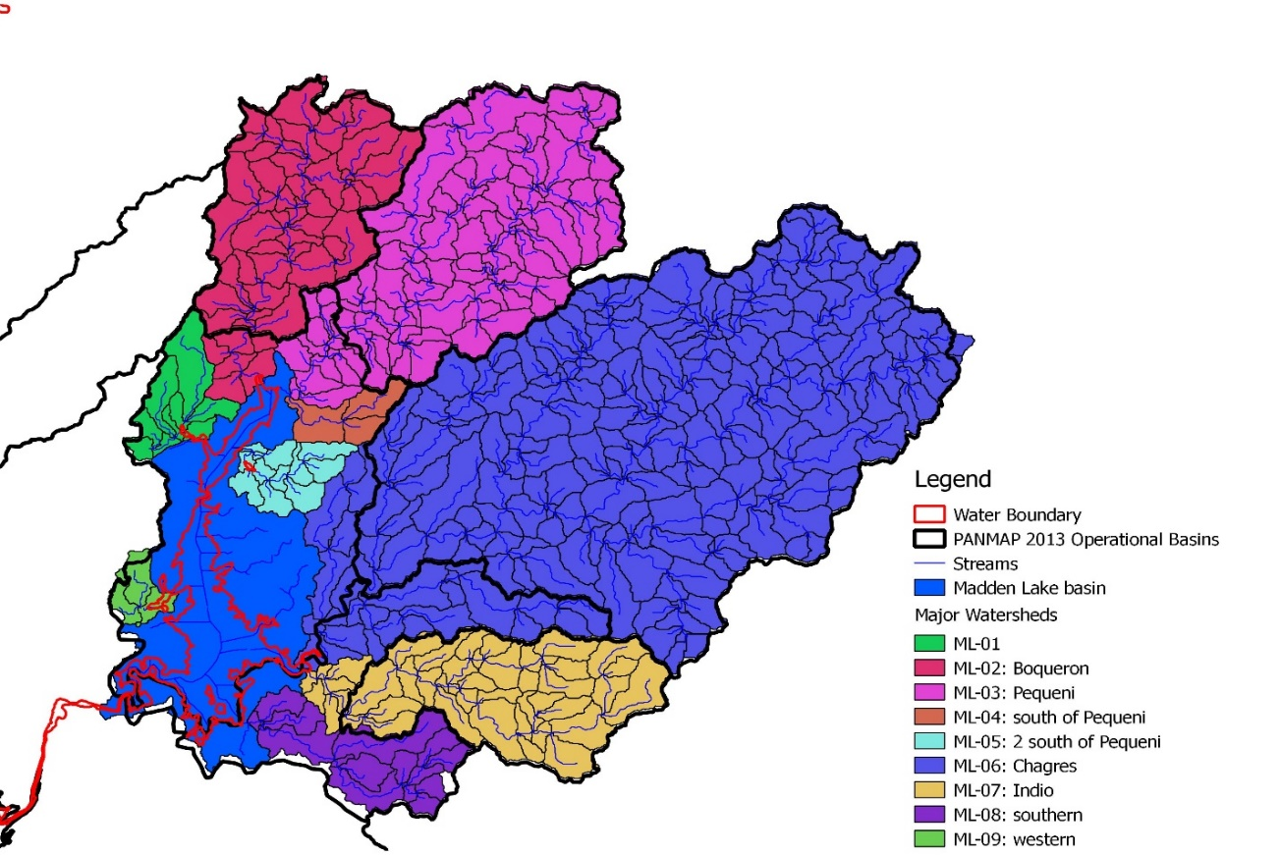
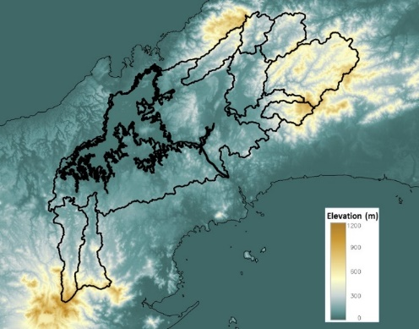
Geospatial Analysis
Subbasin Av. Resolution: 2 km²
SRTM 30m
Madden Lake boundary
(SRTM water boundary &
Google Earth Adjustments)

Slide 37
Distributed Model Diagram – PANDHM V.2015

Slide 38
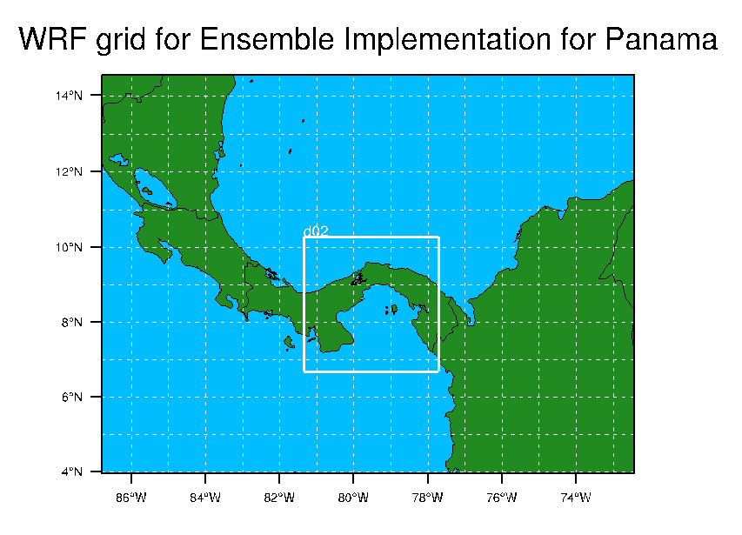
PANWRF Ensemble Run Configuration
20-Member Ensembles
4-km resolution
00 UTC and 12 UTC starts
NCEP GEFS forcing

Slide 39
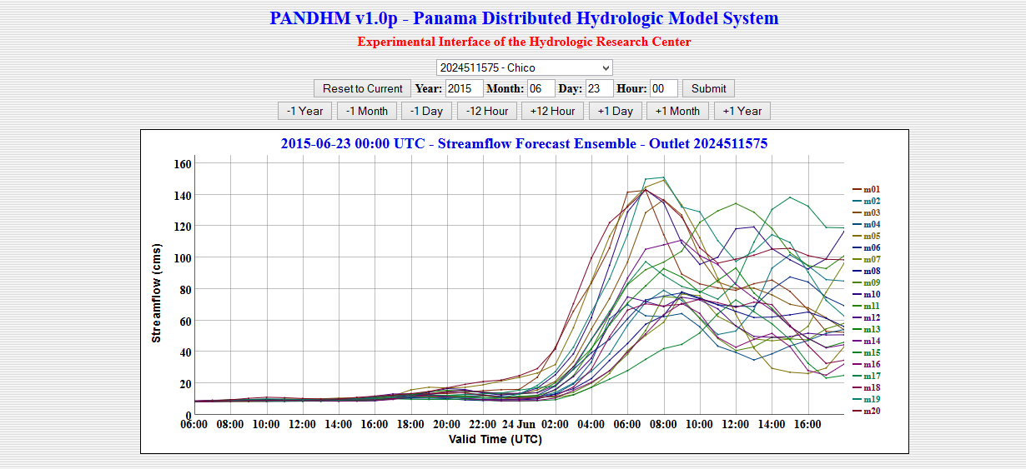
Example Forecast Products

Slide 40

FFG Development Team at HRC
Kosta Georgakakos – Technical Director/Hydrometeorology
Robert Jubach - Progr. Management/Disaster Risk Reduction
Jason Sperfslage - IT Systems Engineering
Theresa Carpenter - Mesoscale Modeling and Routing Models
Eylon Shamir – Soil Water and Snow Models
Cris Spencer – IT Engineering/Programming
Aris Posner – Land Slides/EOS Data Evaluation
Rochelle Graham – Education and Training

