Slide 1
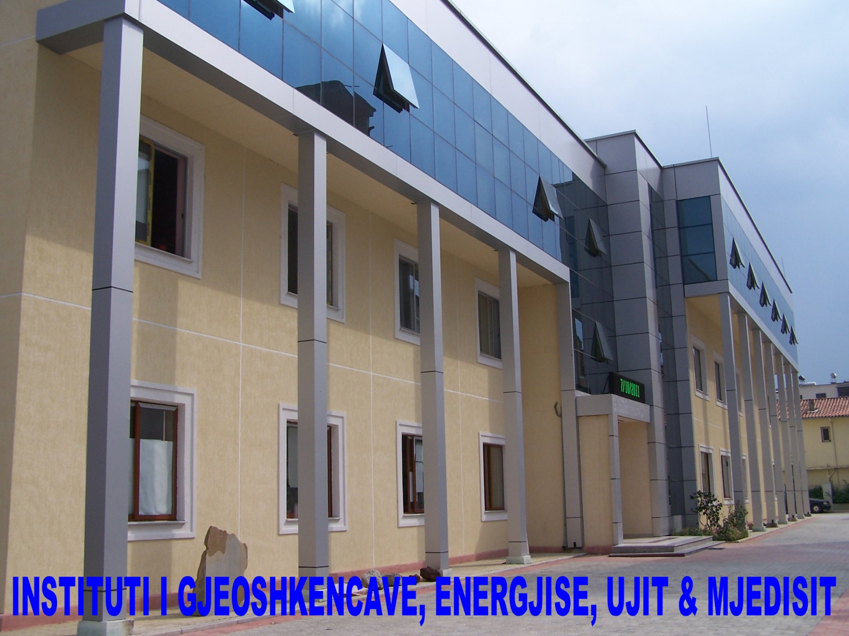
“ESTABLISHMENT OF THE DESIGN TEAM ON THE DESIGN OF REGIONAL MULTIHAZARD EARLY WARNING SYSTEM”
“Some considerations about the actual progress related to the hydro & meteorological monitoring networks in Albania”
Prof. Petrit ZORBA
Head of the Department of Climate and Environment
I GJ E U M
Skopje
May 29-30, 2013

Slide 2
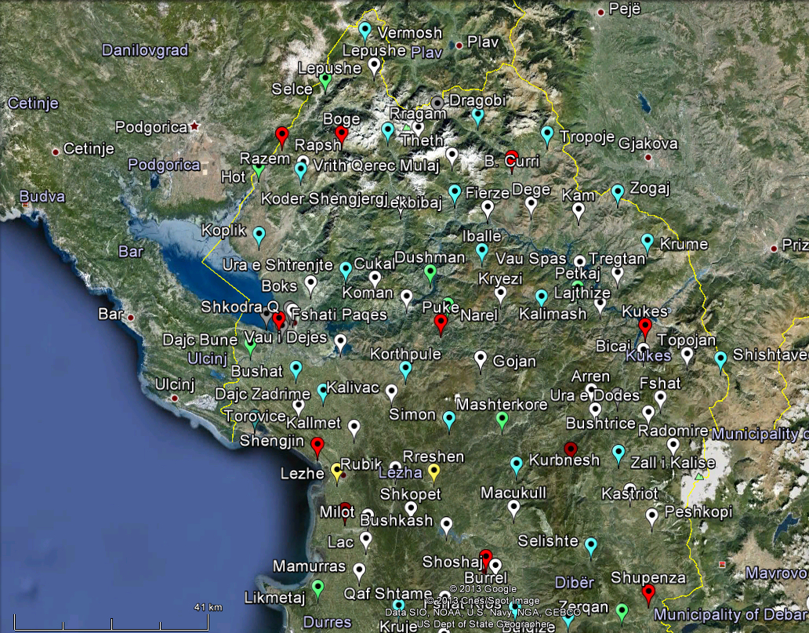
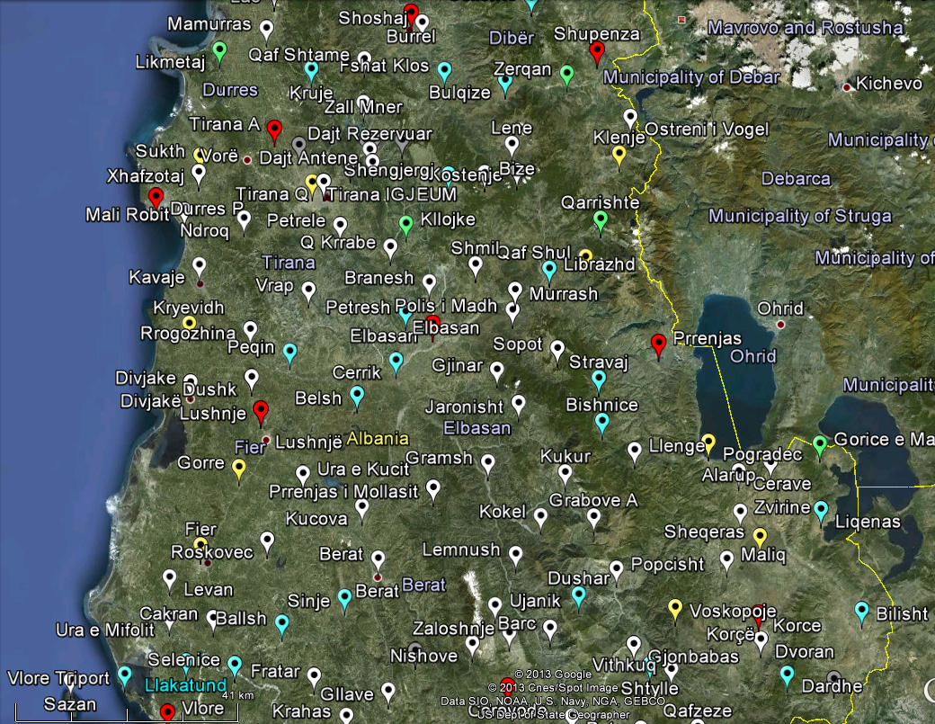
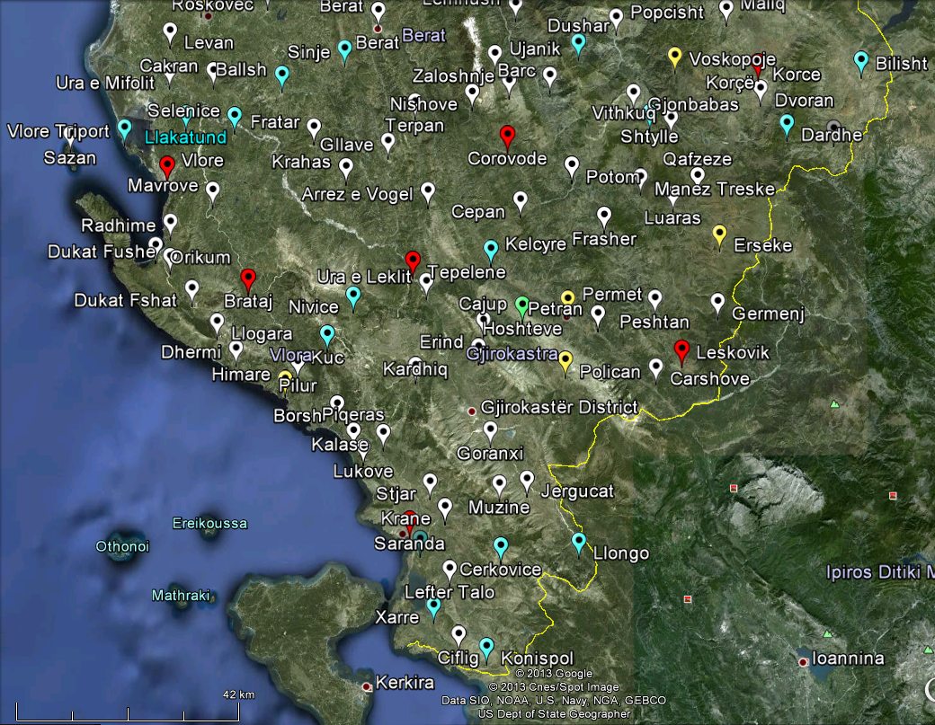
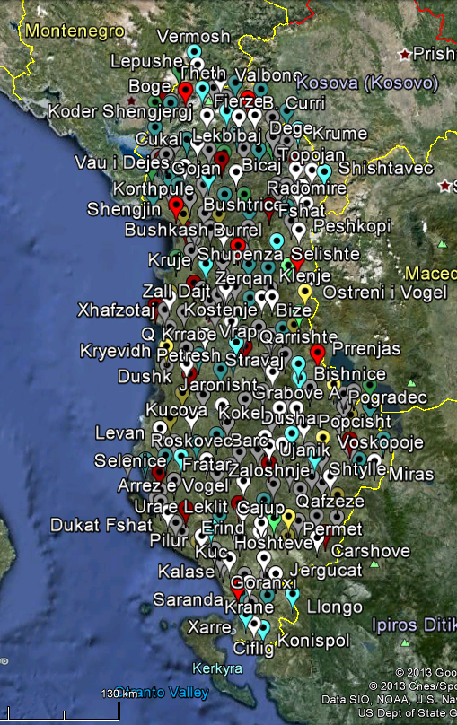
235
Meteorological
Stations
DATA
Archive
WB Project

Slide 3
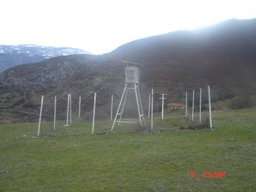
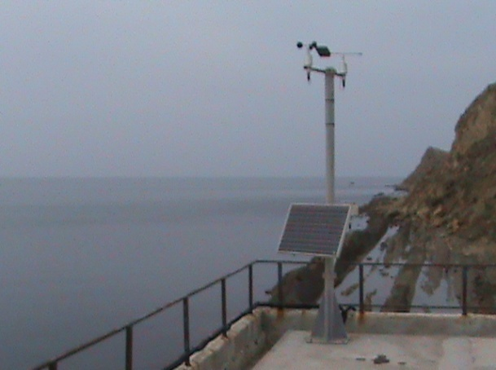
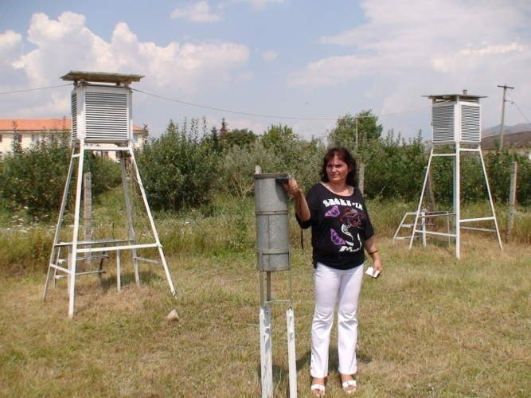
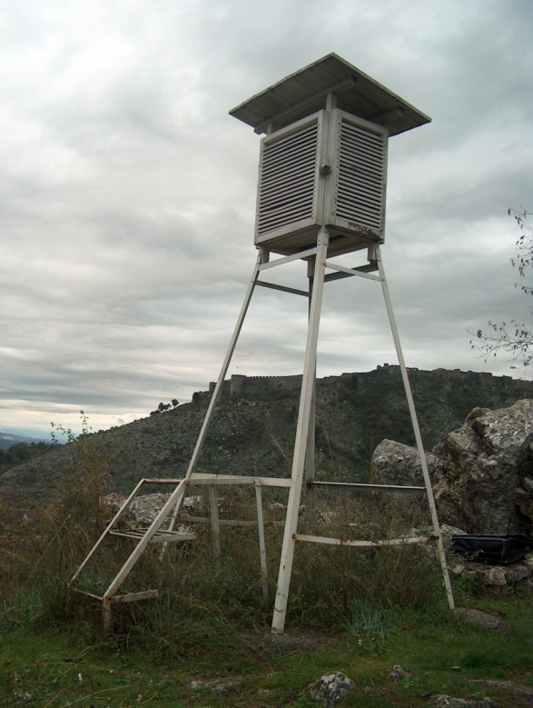
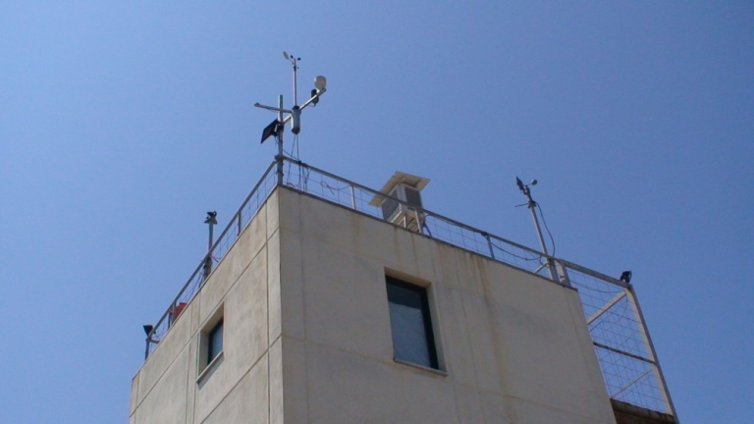
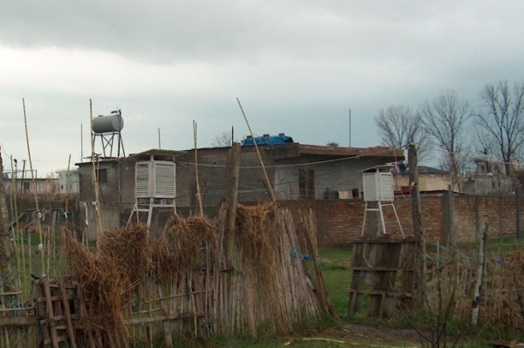
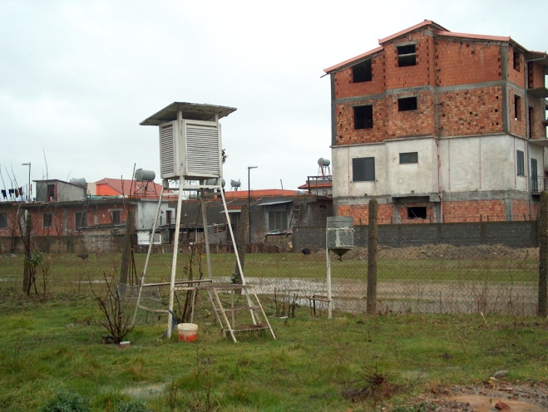
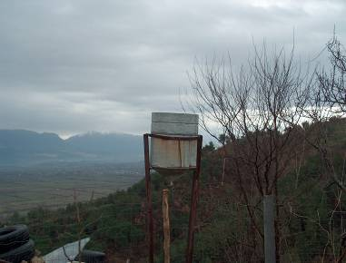
An overview thorough some photos of the meteorological network
Vlorë
Durrës
Korçë
Skavicë
Shkodër
Kavajë
Sukth
Burrel
Likmetaj
Peshkopi

Slide 4
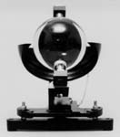
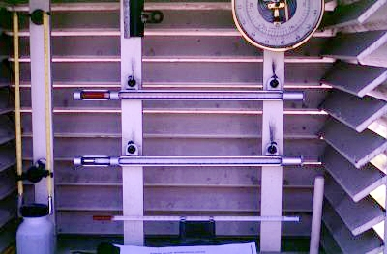
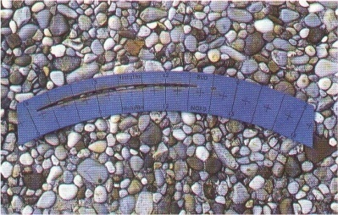
Different meteorological
instruments

Slide 5
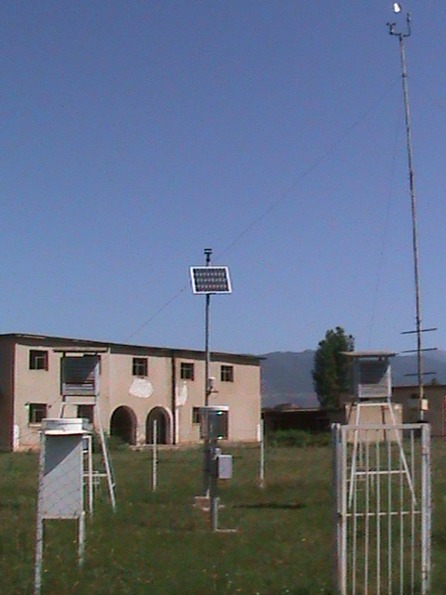
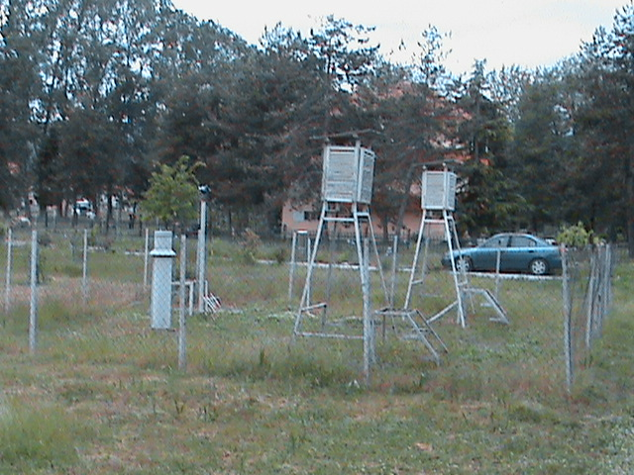
New one added recently
Kukës
Pogradec

Slide 6
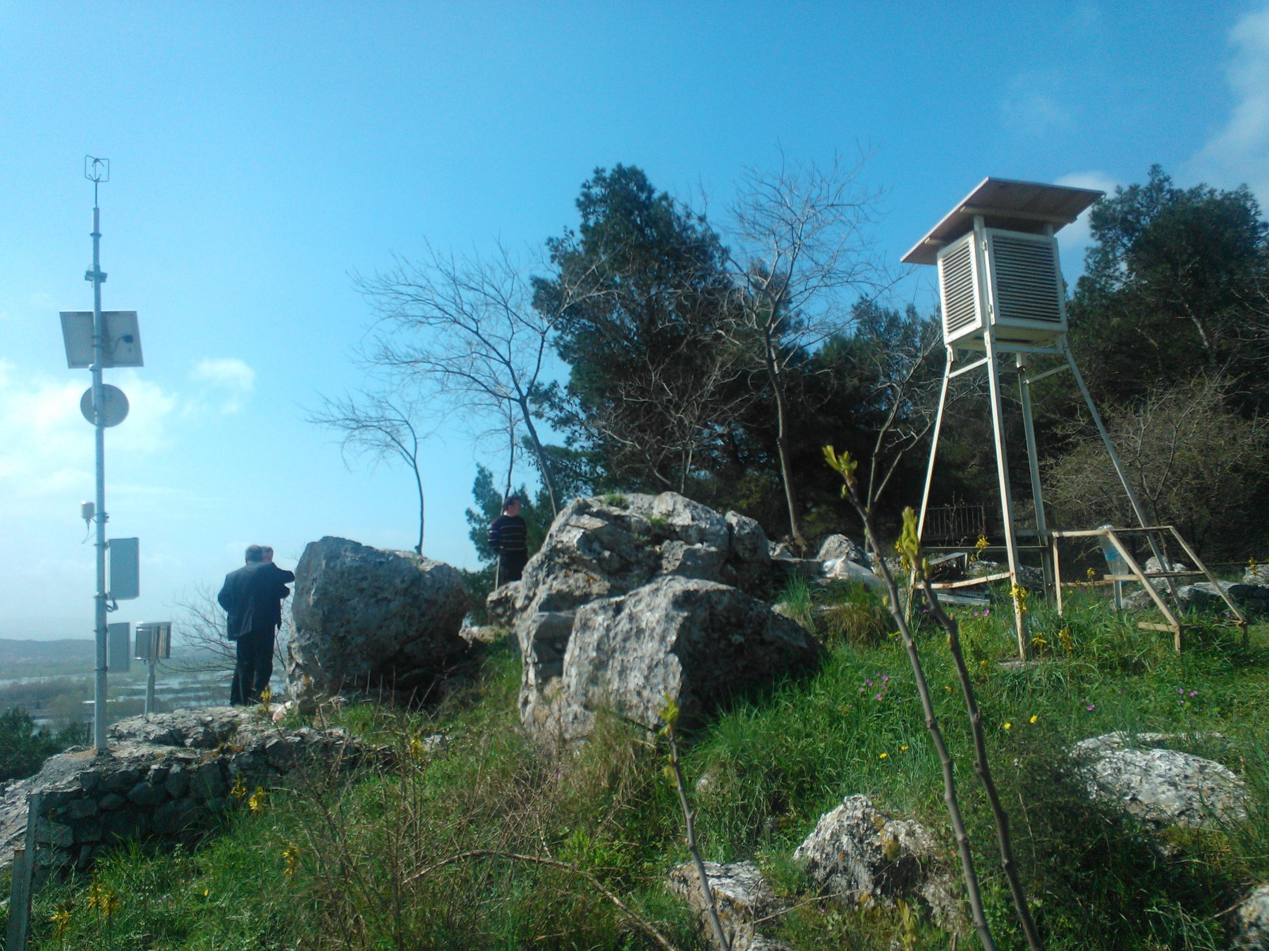
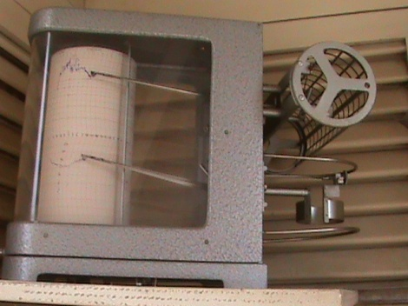
Shkodër
Fshati i Paqes

Slide 7
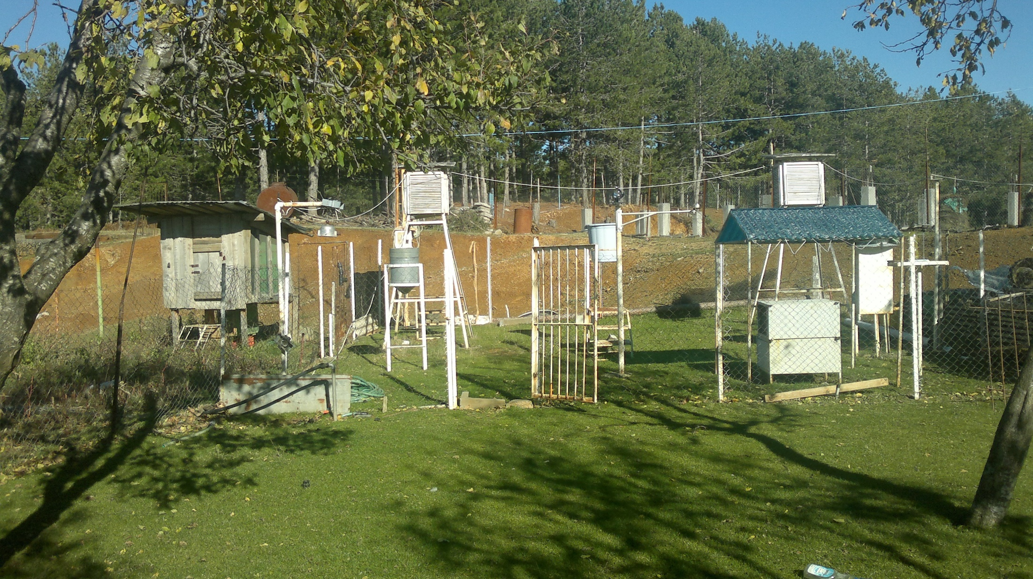
Puka

Slide 8
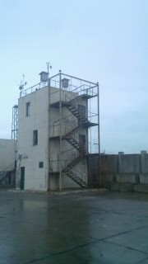
Durrës
Reconstruction
needed immediately !

Slide 9
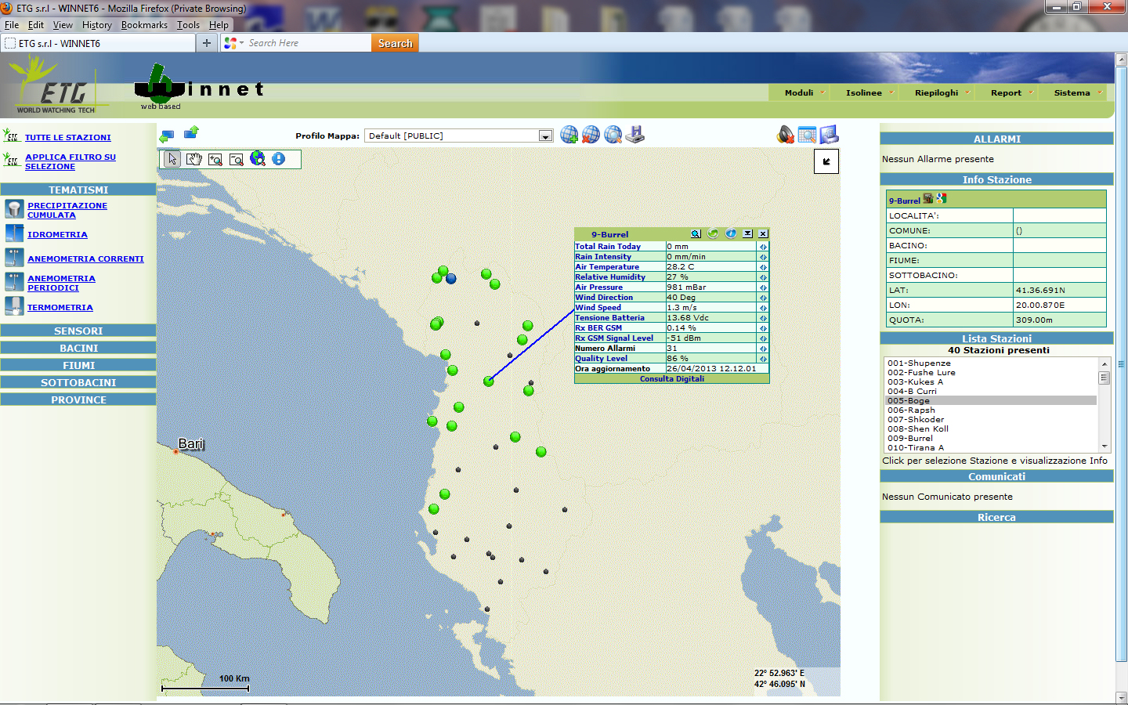
WB Project
40 hydro & meteo stations on line

Slide 10
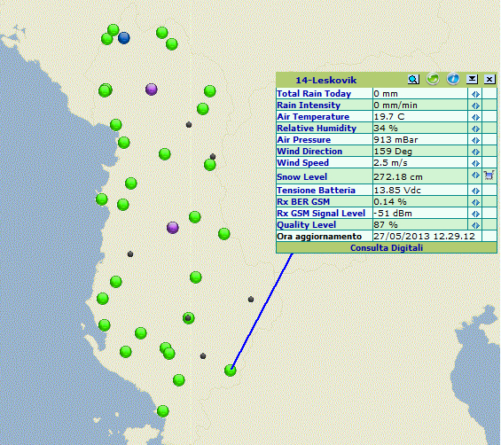
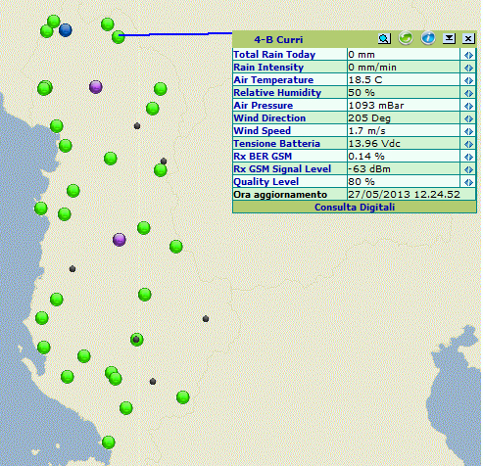
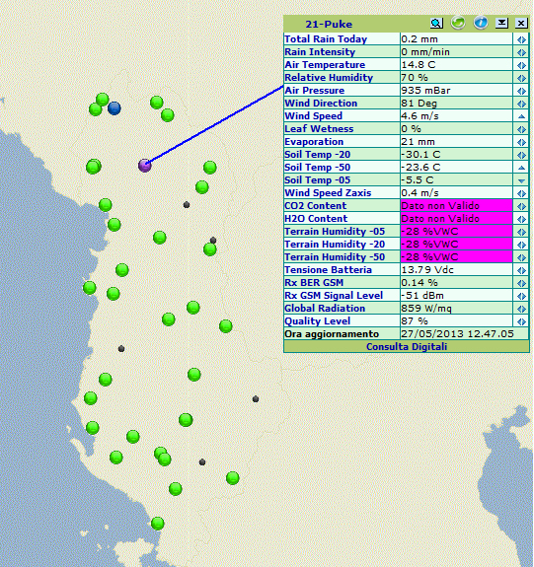
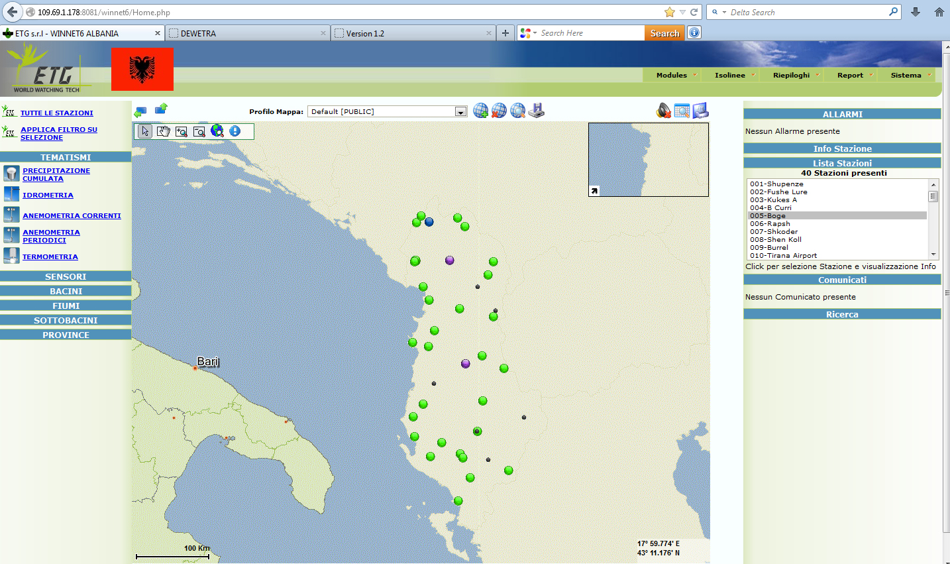

Slide 11
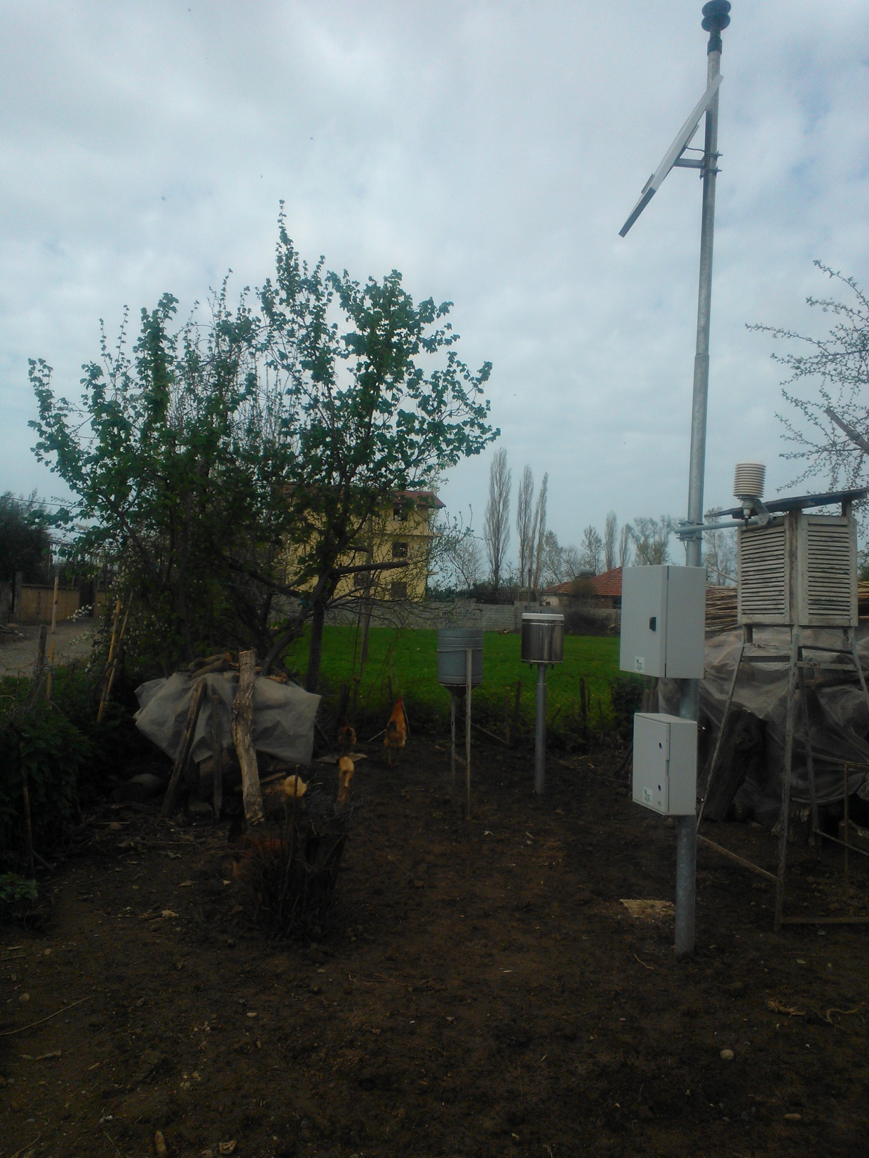
Wind measurements
needed at 10m!
Shën Koll

Slide 12
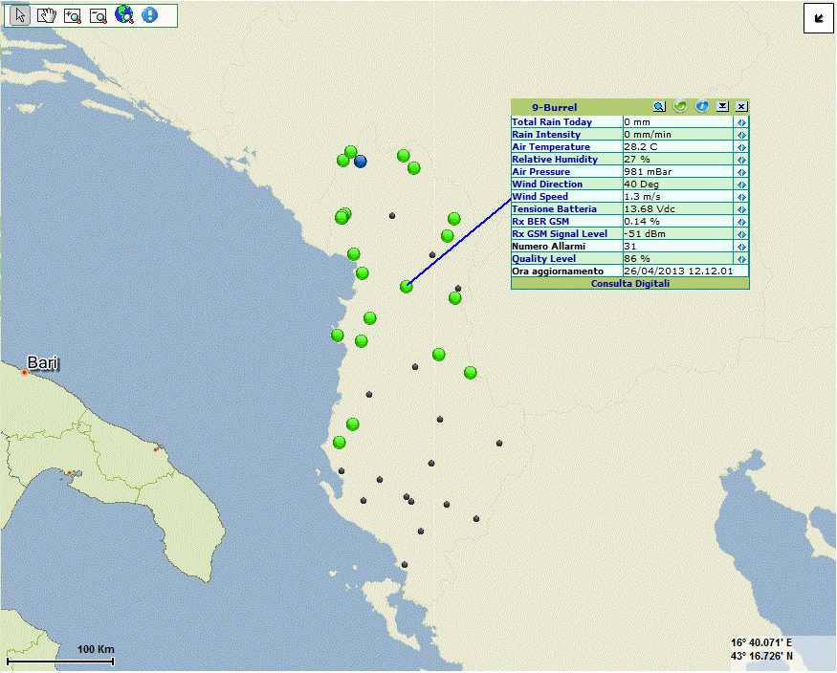
40

Slide 13
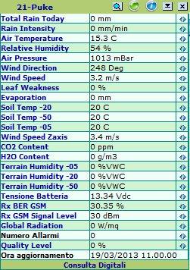
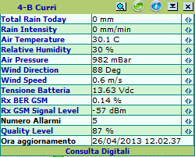
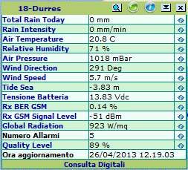
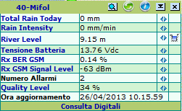
4
16
Agrometeorological
stations
Meteorological
stations
Marine
stations
Hydrological
stations
16
4

Slide 14
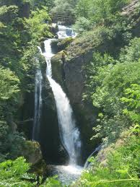
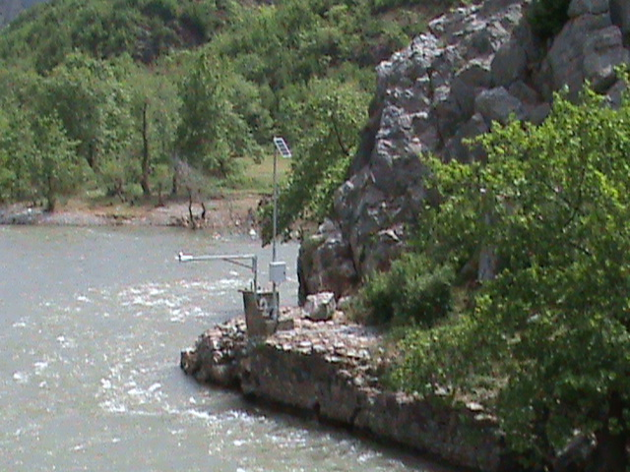
16
Hydrological
stations

Slide 15
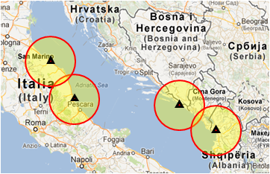
ADRIARadNet and Miniradar
ADRIARadNet project foreseen the installation and testing (through a measurement campaign) of 4 X-band miniradar sytems. Two of them in Italy (Marche and Abruzzo Region), one in Croatia and one Albania

Slide 16
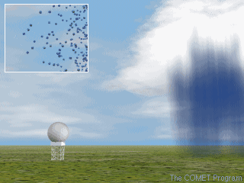
Principle of Operation
Radar system transmit and receive an electromagnetic signals at S, C or X band scanning a large portion of the atmosphere using different elevation antenna angle.
Based on received power (also called reflectivity Z) we can estimate the rain rate R (mm/h).
TX
mixer
antenna
RX
Display

Slide 17
Project proposal
for a Mini Radars network in Albania and around areas
Regards the Albania the coastal area of the central part (near Durres) seems to be one of the best area where installing a miniradar being far from the high mountains present in the inland territory as a first step.
An alternative might be to install the radar in internal area on top of a mountain but be aware at the logistic constraints and covering all the country

Slide 18
Main issues to improve the situations
To increases the automatic number of Hydro and Meteorological stations
To cover by a mini radar network all the rivers catchment areas
To maintain the old one network for a period of 3 years after the
installation of the new electronic stations.
To establish a new one system of info receiving from all the meteo
and hydro stations.
Calibration equipments are urgently needed.

Slide 19
INSTITUTE OF GEOSCIENCES, ENERGY, WATER AND ENVIRONMENT
(IGEWE) – TIRANA, ALBANIA
THANK YOU
INSTITUTI I GJEOSHKENCAVE, ENERGJISE, UJIT & MJEDISIT
You are welcome at our institute
UT – IGJEUM Tirana ALBANIA – Head of the Dep. of Climate and Environment © Prof. P. ZORBA 2013

