Slide 1


Example of
Early Warning System
in South East Europe: Croatia
M.Sc. Robert Mikac
National Protection and Rescue Directorate
Dr sc Vlasta Tutiš
Meteorological and Hydrological Service

Slide 2
Contents:
Legal framework of EWS in Croatia
2. DHMZ (Mission, Organizational Structure, Strategic Partners,
International Collaboration, Goals)
3. DUZS (Mission, Organizational Structure, Strategic Partners,
International Collaboration, Goals)
4. DHMZ and DUZS - Common Achievements and Activities
5 Conclusion
DUZS= National Protection and Rescue Directorate
DHMZ = Meteorological and Hydrological Service

Slide 3
Legal framework of EWS in Croatia
Meteorological and Hydrological Service
is a national centre of exellence based on high standards of
scientific, professional and technical resources for the production, collection and dissemination of high-quality meteorological and hydrological information
the basic tasks are stipulated by the Law on meteorological and hydrological activities in Croatia (to provide support to economic development, environment protection, to act towards the preservation of life and material goods from natural hazards and disasters and to mitigate their consequences)

Slide 4
Legal framework of EWS in Croatia
National Protection and Rescue Directorate
is an independent, professional and administrative organisation, tasked with preparing plans and managing operational forces as well as co-ordinating the activities of all participants in the protection and rescue system
the basic tasks are stipulated by the Law on protection and rescue came into force on December 18, 2004 (the most important tasks are risk and vulnerability assessment, drafting measures aimed at preventing crises and accidents, ensuring that these measures are implemented, and effective emergency management in case of major disasters)

Slide 5

Meteorological and Hydrological Service
Mission
Organizational Structure
Strategic Partners
International Collaboration
Goals

Slide 6
Mission of Meteorological and Hydrological Service
to provide support to economic development, environment protection and quality of life
to act towards the preservation of life and material goods from natural and social hazards and disasters and to mitigate their consequences
to maintain and develop the national meteorological and hydrological observation system

Slide 7
Structure of Meteorological and Hydrological Service:
Weather Analysis and Forecast Division
Weather and Climate Observation Division
Research and Development Division
Air Quality Division
Remote Sensing Division
Hydrology Division
IT Division
International and Customers Relation Division
Personnel, Legal and Finance Division
Independent Departement for Measurements Calibration

Slide 8
Strategic Partners:
1. State Administrative Organizations:
  National Protection and Rescue Directorate
  Croatian Waters
  State Office of Nuclear Safety
  State Institute of Radiation Protection
2. Universities and Scientific Institutes
3. Ministries:
  Ministry of Science
  Ministry of Sea, Transport and Infrastructure
  Ministry of Environmental Protection...
  Ministry of Forestry and Water Management
  Ministry of Health and Social Welfare

Slide 9
International colaboration
Meteorological and Hydrological Service
Membership in International Organisations:
WMO
ECMWF
EUMETNET
EUMETSAT
ALADIN/RC LACE
GEO
ECOMET
International Projects:
MAP – D PHASE
EMEP
EU FP 6/7, COST
MEDEX
EUMETSAT/CEI projects (SATREP, EUMeTrain, Nowcasting....)
WB/ISDR/WMO Sava project

Slide 10
Goals of Meteorological and Hydrological Service:
Improvement of our infrastructure:
Radar network - 3 new radars at the Adriatic sea and modernization of the old radars – national radar composite as input for regional radar network (EUMETNET project OPERA)
Lightning detection system integrated with neighbouring countries
Air quality monitoring
New premises in Zagreb
Capacity building
Strenghtening the units responsible
for warnings
River & Flash flood forecast

Slide 11
National Protection and Rescue Directorate
Mission
Organizational Structure
Strategic Partners
International Collaboration
Goals

Slide 12
Mission of National Protection and Rescue Directorate:
risk and vulnerability assessment, drafting measures aimed at preventing crises and accidents, ensuring that these measures are implemented
effective emergency management in case of major disasters.

Slide 13
Structure of National Protection and Rescue Directorate
- National level
  Sector for 112 System
  Civil Protection Sector
  Firefighting Sector
  Firefighting, Protection and Rescue School
  Personnel, Legal and Finance Sector

Slide 14
Structure of National Protection and Rescue Directorate
- County level
20 County Offices in the whole territory of the Republic of Croatia
Established at County Offices:
  Protection and Rescue Department
  County 112 centre
  At 4 County Offices, established national intervention units (Split, Zadar, Šibenik and Dubrovnik)

Slide 15
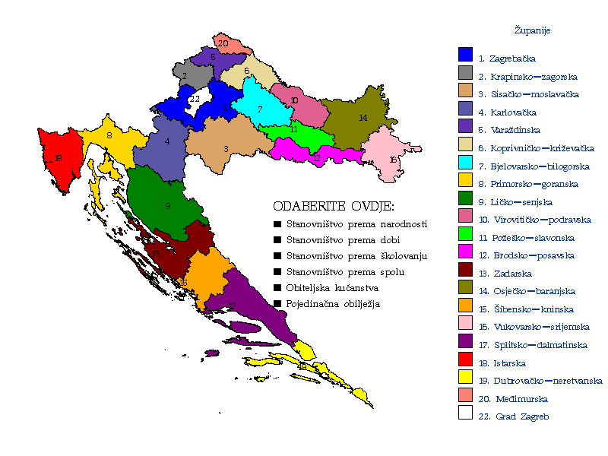
Structure of National Protection and Rescue Directorate:
20 COUNTY OFFICES
Protection & Rescue Department
County 112 Centre
NATIONAL INTERVENTION UNIT

Slide 16
Strategic Partners:
1. State Administrative Organizations:
  Meteorological and Hydrological Service
  State Office of Nuclear Safety
  State Institute of Radiation Protection
  Croatian Waters
  National Red Cross Society
  Mountain Rescue Service
Ministries:
  Ministry of Defense
  Ministry of Interior
  Ministry of the Sea, Transport and Infrastructure
  Ministry of Environmental Protection, Physical Planning and Construction
  Ministry of Forestry and Water Management
  Ministry of Health and Social Care

Slide 17
INTERNATIONAL COOPERATION
BILATERAL
REGIONAL
INTERNATIONAL ORGANIZATIONS
Hungary, Slovenia, B&H, Austria, Slovakia, Poland, France, Montenegro
MoU (Germany, Holland)
CMEP SEE Council
DPPI (DUZS as Chair-in-Office in 2008)
SEDM – SEESIM
Adriatic – Ionic Initiative
NATO CEP
UN (ISDR, OCHA, CADRI)
EU
Council of Europe
In progress:
FYR Macedonia, Russia, Serbia, Albania

Slide 18
Goals of the National Protection and Rescue Directorate:
Establishment of coordinated system of participants in protection and rescue
Establishment of single national disaster response system
Cost-effective disaster response system
Compatibility of equipment and procedures with those of EU and NATO

Slide 19
DHMZ and DUZS
Common Goals, Achievements
and Activities

Slide 20
National Protection and Rescue Directorate & Meteorological and Hydrological Service
Common goals and mutual interest:
improving natural disaster prevention, prediction, early warning, response and recovery
risk assessment, as outcome of the interaction between a hazard phenomena and vulnerability
Common achievements:
June 23th, 2006 come into force “Standard Operations Procedure on weather forecast information” - document deals with mutual rights and obligations in weather forecast information – dissemination for the purpose of prevention
Local hosts of joint workshops in Pula

Slide 21
Ac
COMMON ACTIVITIES
Early warning system

Slide 22
Role of DHMZ in the EWS
Strengthening the capacity to deliver severe weather forecast (observational network, forecasting tools,....)
Delivery of timely and understandable warnings and specialized forecasts
Integration of DHMZ data, products and services in disaster risk reduction management
Analyzing and providing hazard information for risk assessment
Public outreach campaigns
Strengthening cooperation and partnerships at national to international level with disaster risk reduction organizations

Slide 23
Role of DUZS in the EWS
Establishing legal framework (Regulation of the unique characters of alerting, Rules of Procedure of the population warning)
Strengthening cooperation and partnerships at national to international level with disaster risk reduction organizations
Organizing, building and maintenance of EWS infrastruture
Collecting, analyzing and delivering of warnings on all levels
Public information

Slide 24
All operative
activities are
governed by
SOP

Slide 25
And when there is expected exceptionally severe hazard weather or technological event with possible high impact, higher level personal contacts are recommended.
Phone links DHMZ – DUZS related to the severity of expected/possible events:
Chief of Weather forecast office – Shift leader of National 112 center
Head of Weather forecast analysis and forecast department – Head of National 112 center
Assistant Director of Weather forecast analysis and forecast division – Assistant Director of 112 Sector

Slide 26
DHMZ ACTIVITIES
Early warning system

Slide 27
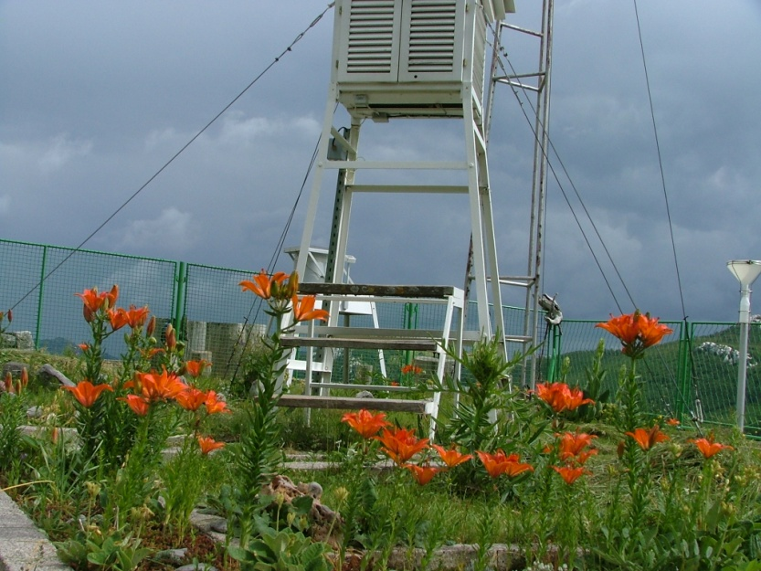
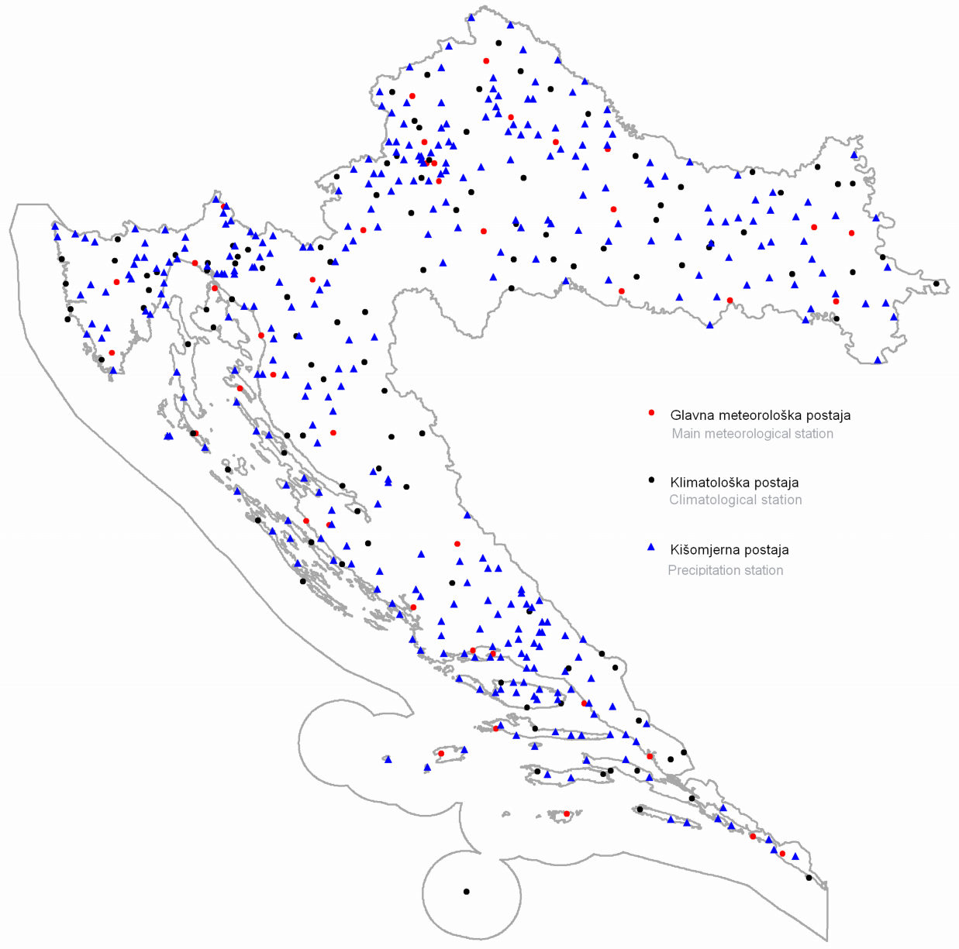
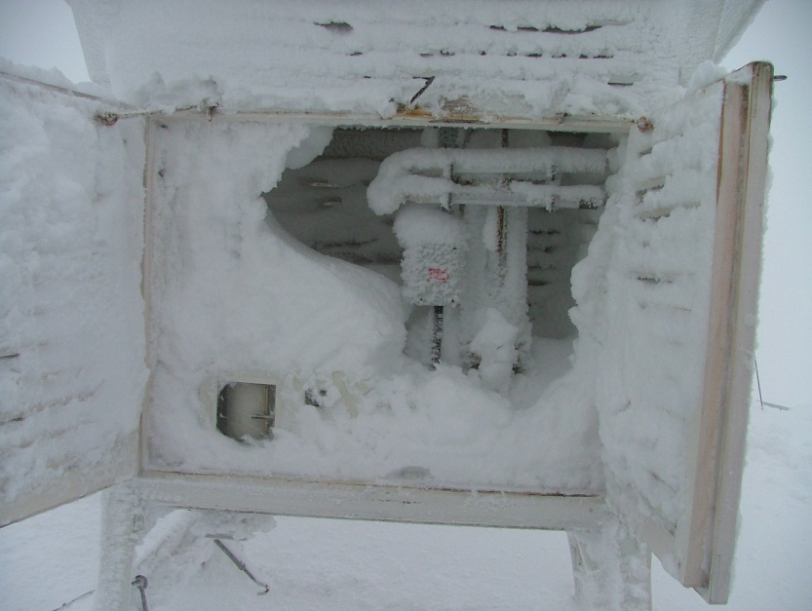
Observational classical meteorological network
Summer at Zavizan
41
117
336
Winter at Zavizan

Slide 28
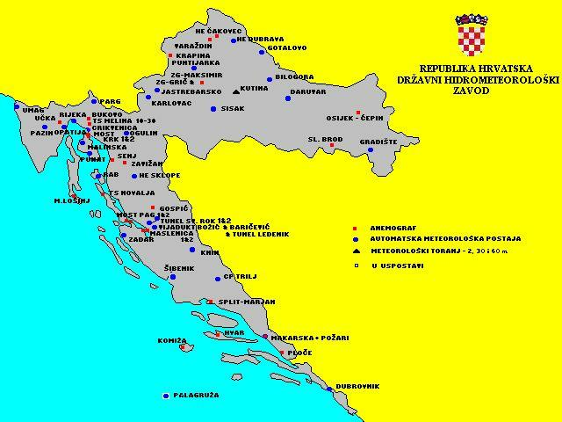
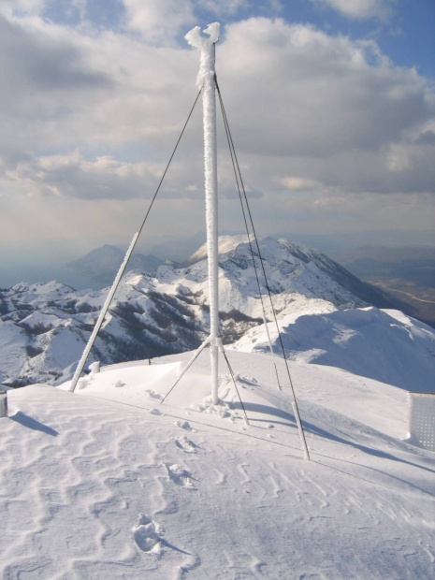
Automatic meteorological network
67 Automatic Weather Stations
1979 – the first automatic meteorological station at Vir island in central Adriatic
Biokovo

Slide 29
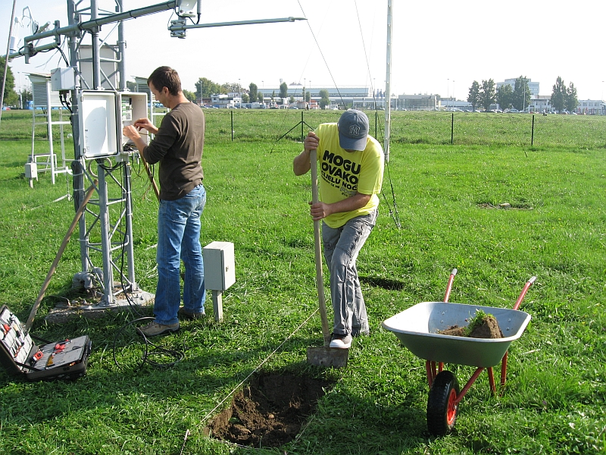
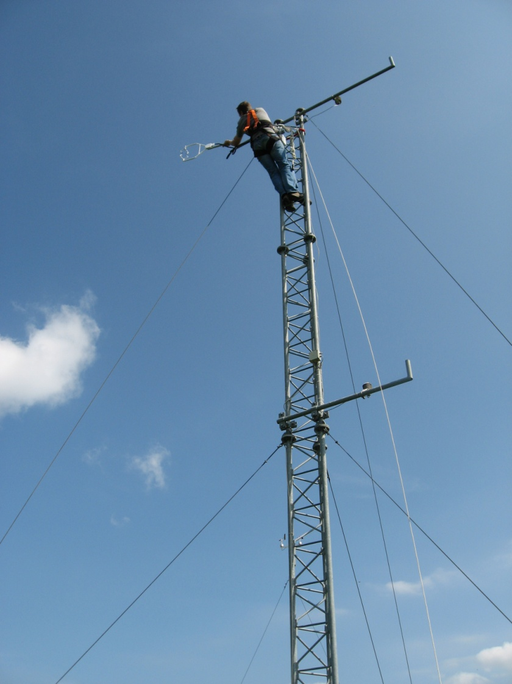
Automatic meteorological network
installation of AWS
maintenance of AWS

Slide 30
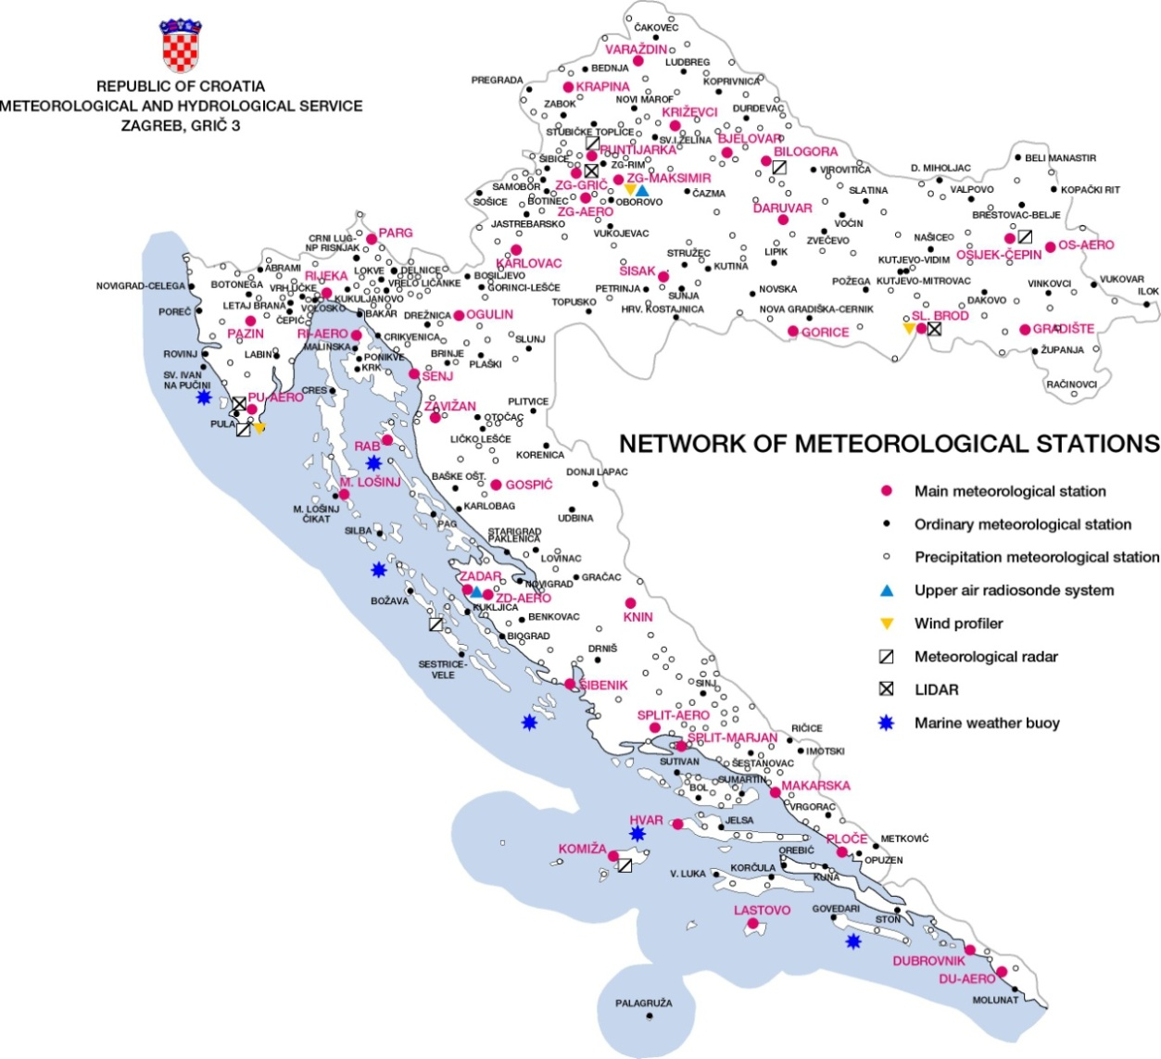
Automatic meteorological network
Modernization of meteorological network: EU Project of 30 M€ for the period 2014-2020
472 AWS
6 boys
2 radiosonding stations
3 wind – profilers
3 lidars
6 weather radars

Slide 31
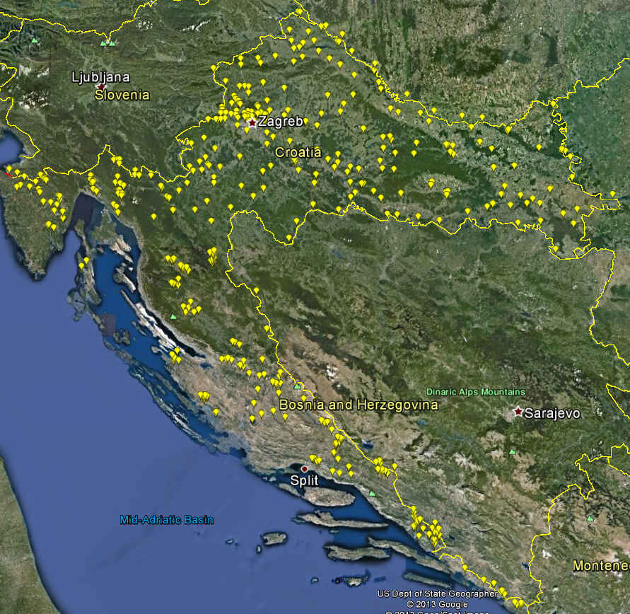
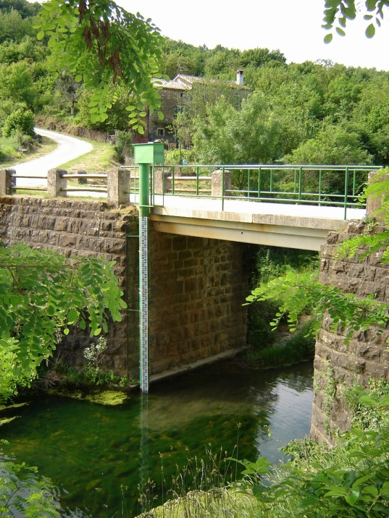
HYDROLOGICAL NETWORK
510 Water Gauge Hydrological Stations

Slide 32
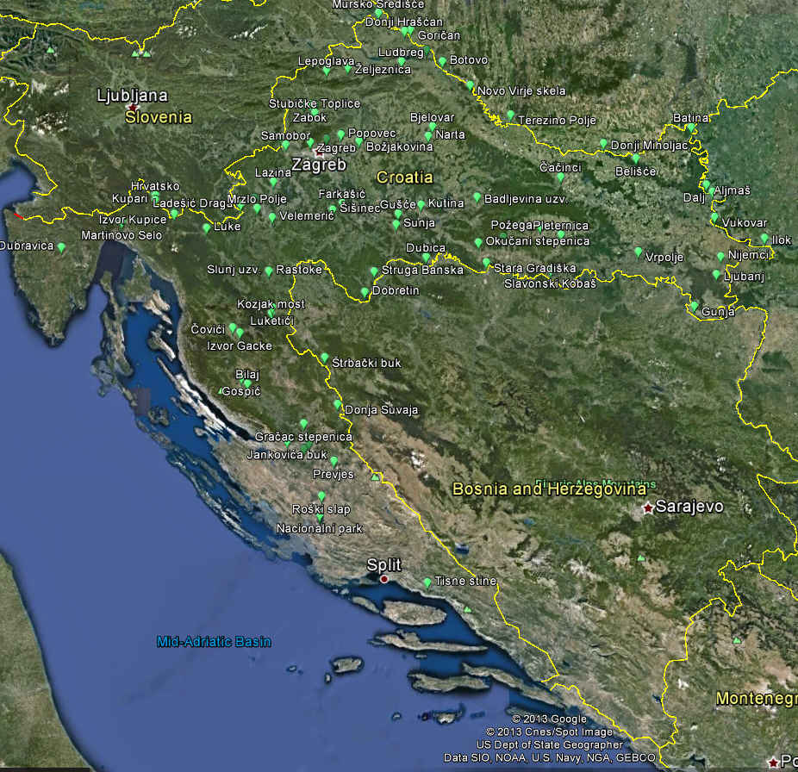
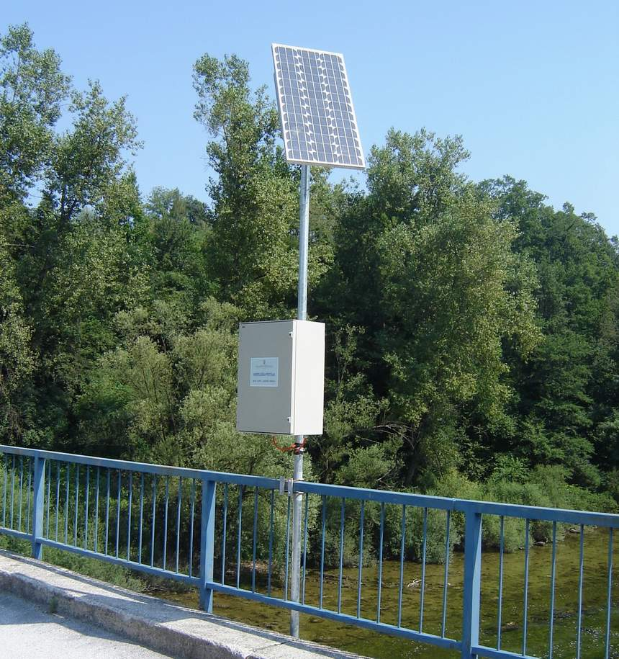
AUTOMATIC HYDROLOGICAL NETWORK
85 Automatic Water Gauge Hydrological Stations

Slide 33
NRT WATER LEVEL EXCHANGE
DHMZ NETWORK:
86 stations
GSM
SW: Hydras 3
CROATIAN WATERS NETWORK:
130 stations
CW NETWORK
SW: AVS
83 STATIONS
64 STATIONS
EFAS
ISRBC
HEP NETWORK:
15 stations
GPRS
SW: ADOS

Slide 34
WEATHER FORECAST
Nowcasting - (0 – 3 hours)
short range forecast –(up to 72 hours)
Medium range forecasts – (up to 10 days)
Long-range seasonal forecast– (up to 6 months)
CLIMATE FORECAST
Regional climate modeling – (up to 100 years)

Slide 35
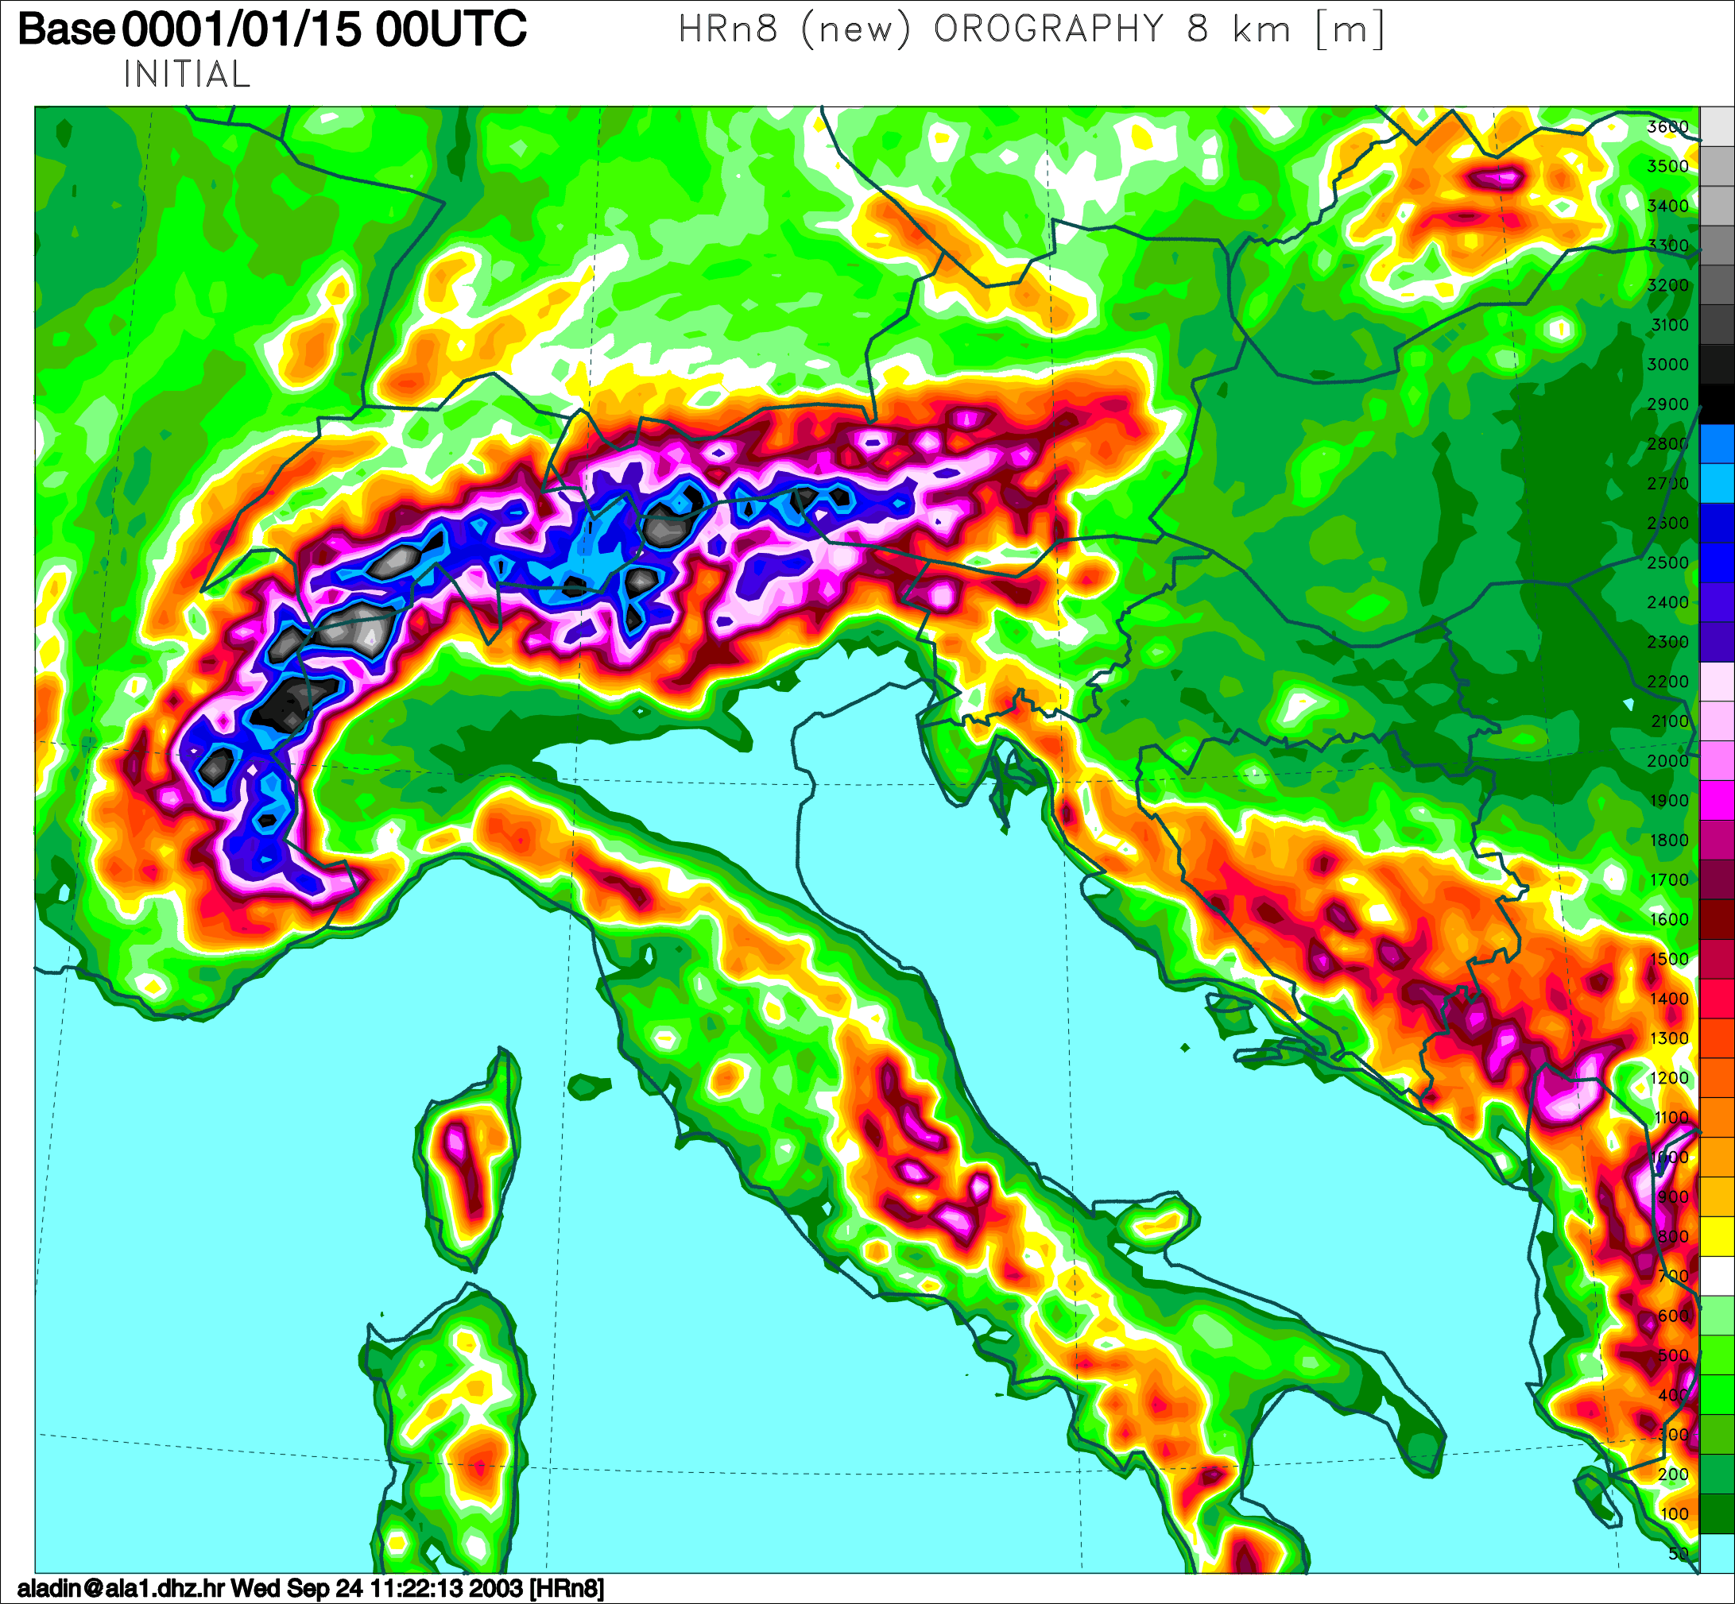
ALADIN/HR mesoscale numerical model
Horizontal resolution: 8 km
Coupling model: ARPEGE
Coupling frequency: 3 hours
Forecast range: 72 hours
Output every: 1 hour
Run: 00 and 12 UTC

Slide 36
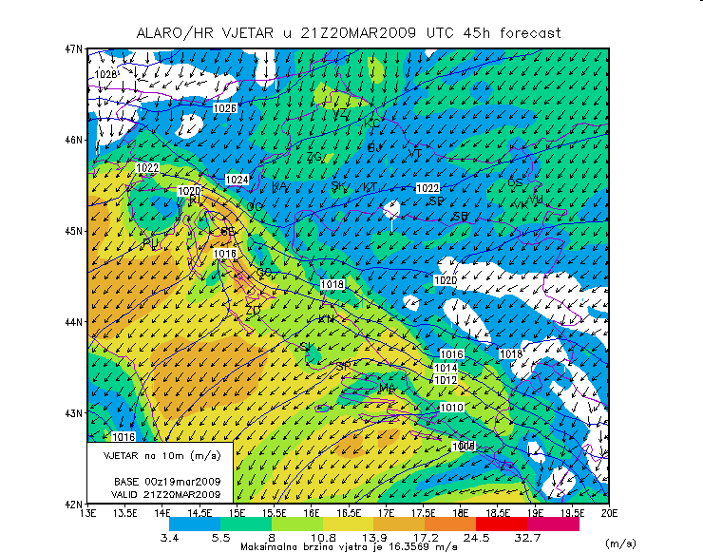
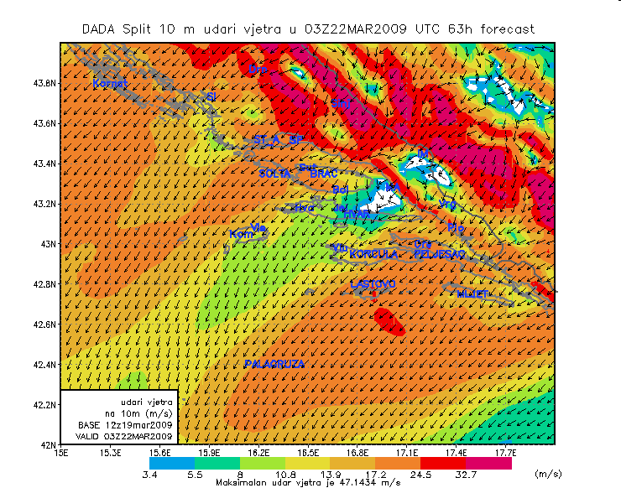
ALADIN/HR
www.meteo.hr
Dynamical adaptation
Resolution 2 x 2 km

Slide 37
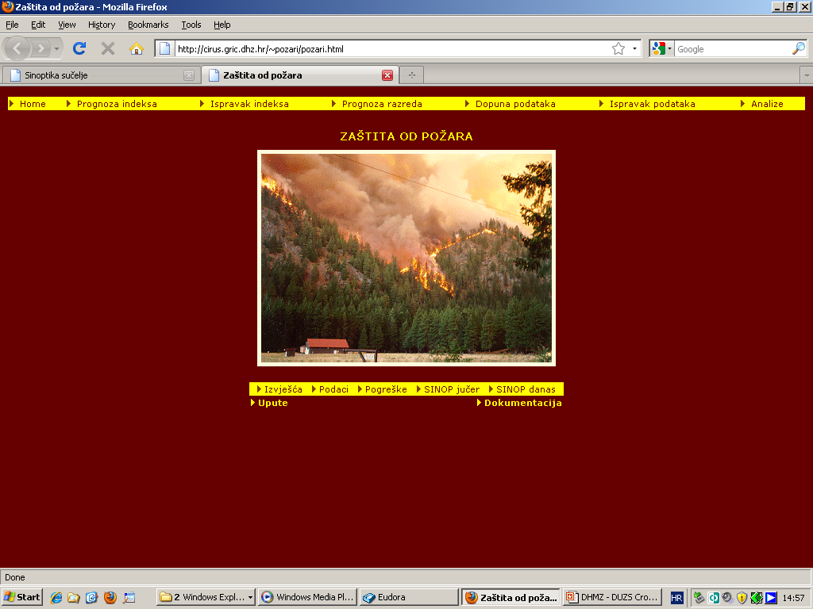
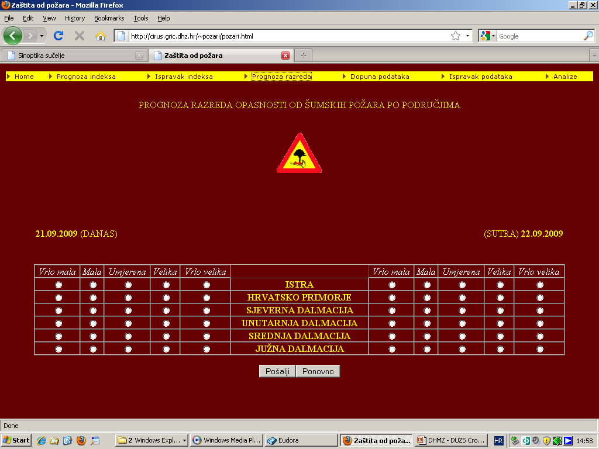
Weather forecast for Fire Fighting Sector

Slide 38
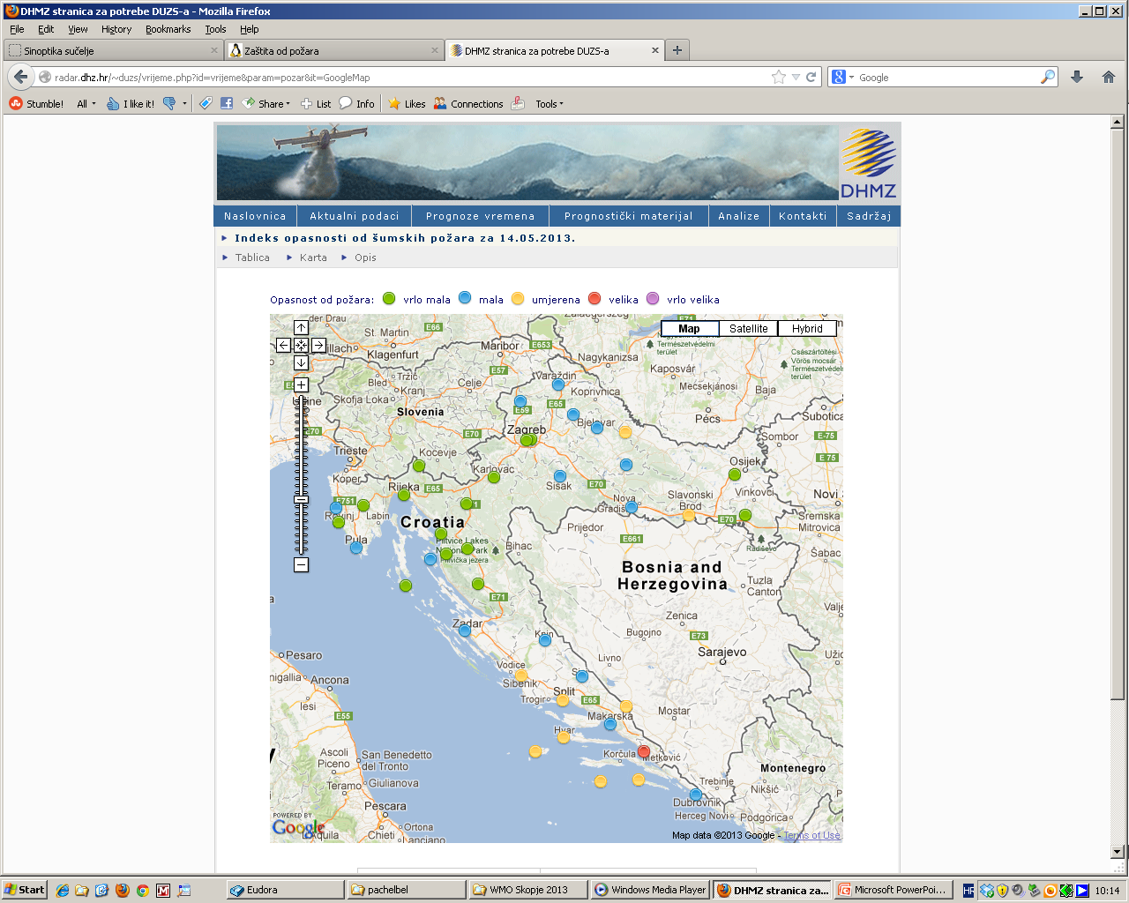
Weather forecast for Fire Fighting Sector

Slide 39
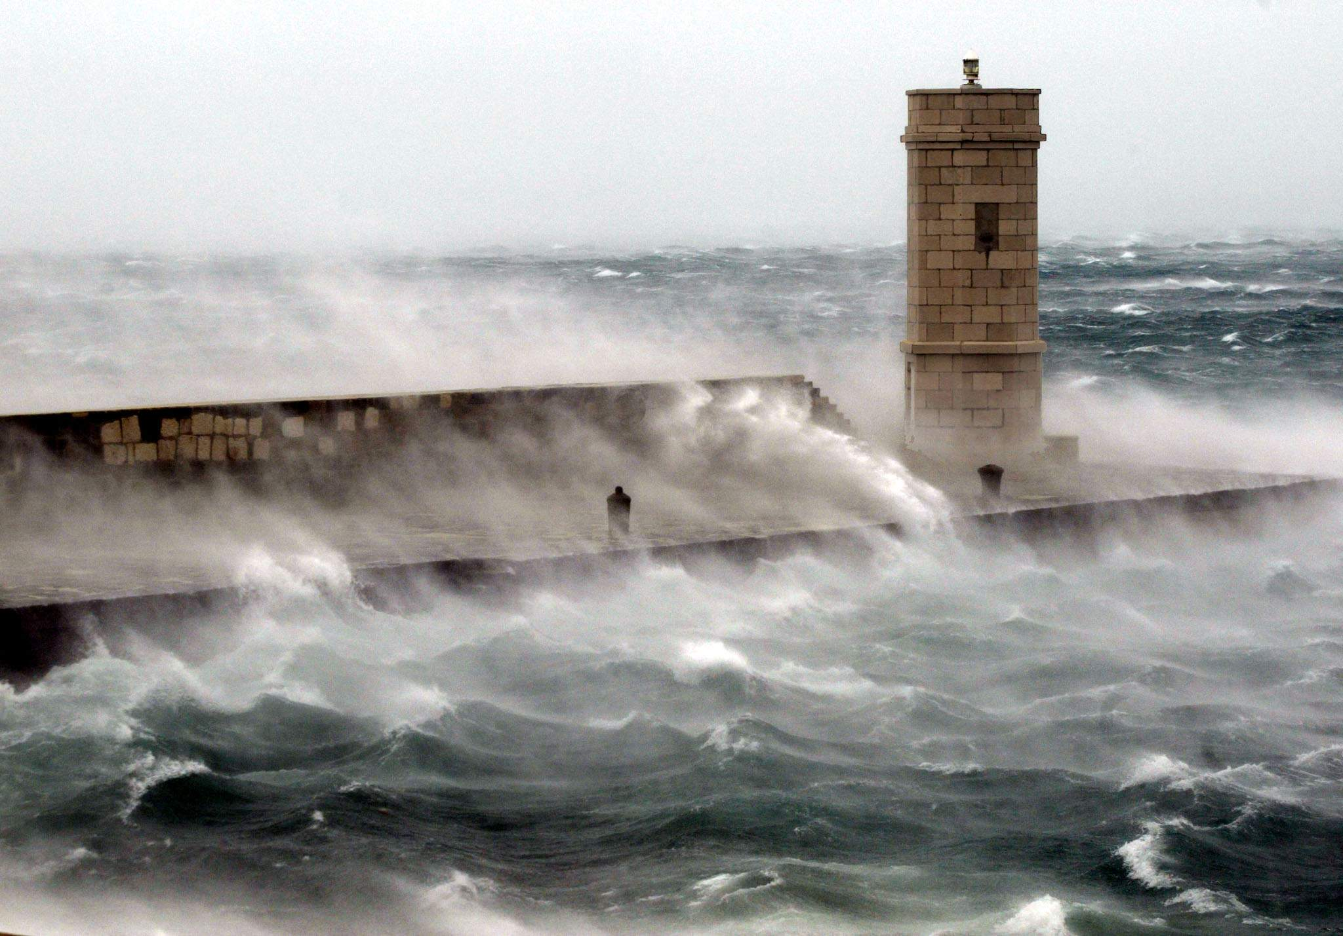

PUBLIC WARNINGS
TV, radio, web,...

Slide 40
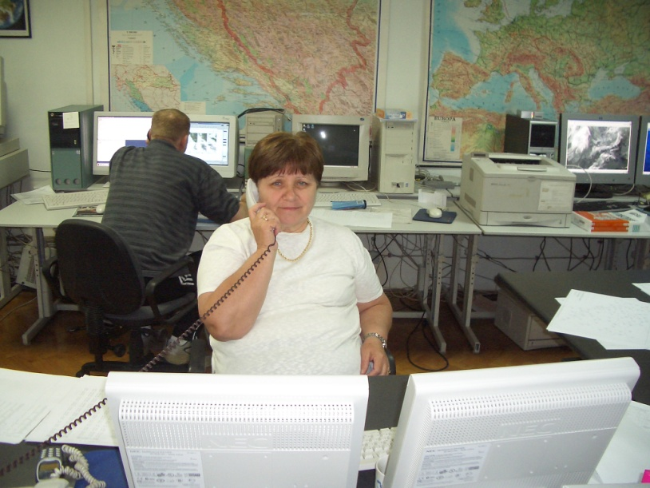
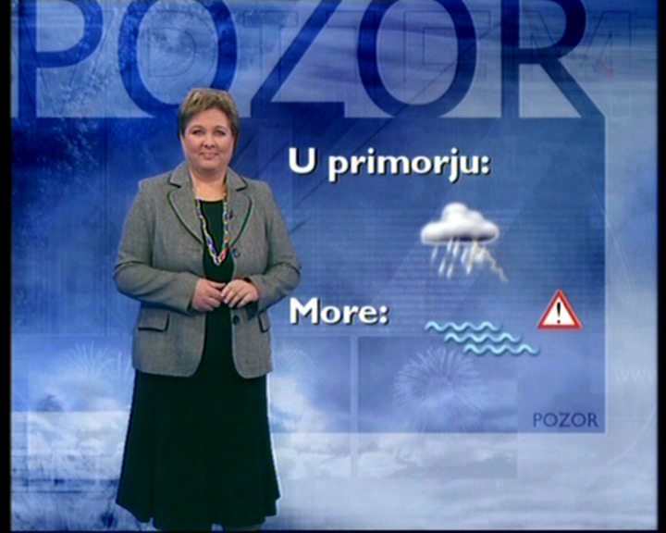
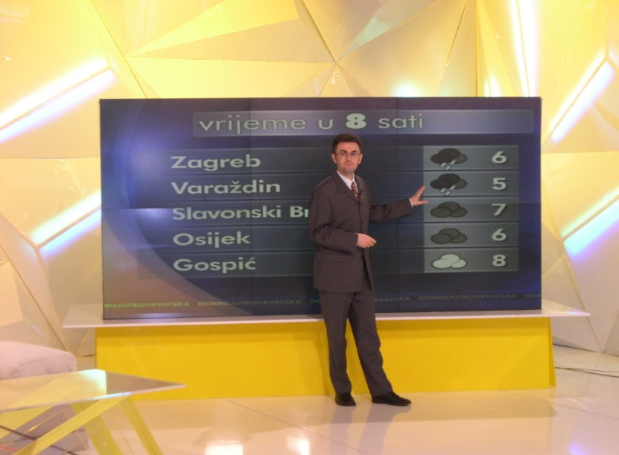
DHMZ = single official voice for weather warnings

Slide 41
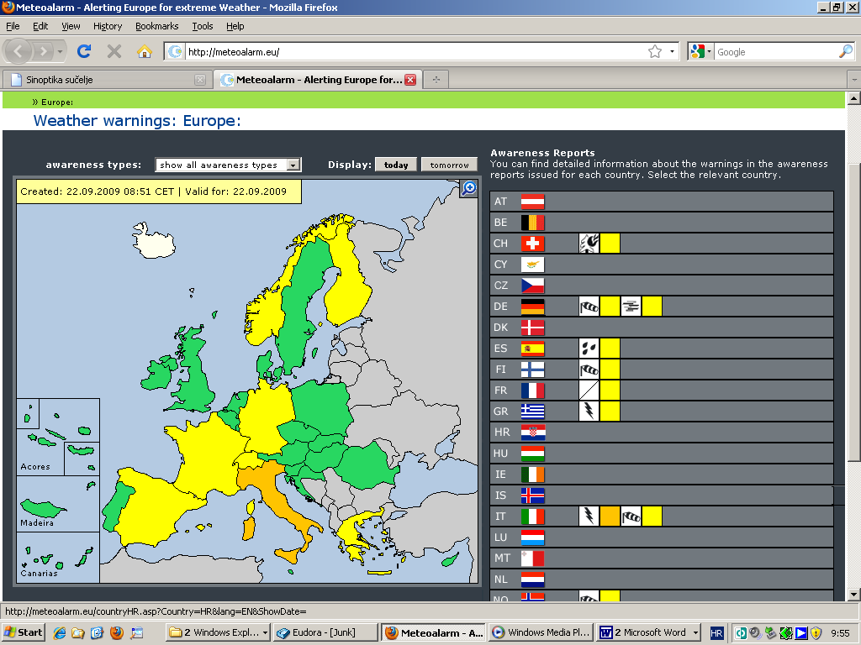
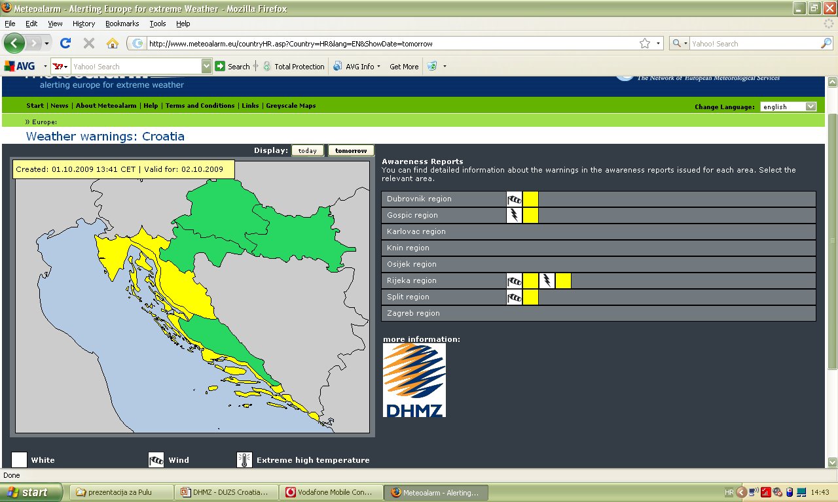
www.meteoalarm.eu
since 17 July 2009
climatological areas!

Slide 42
White:
Missing, insufficient, outdated or suspicious data.
Green:
No particular awareness of the weather is required.
Yellow:
The weather is potentially dangerous. The weather phenomena that have been forecast are not unusual, but be attentive if you intend to practice activities exposed to meteorological risks. Keep informed about the expected meteorological conditions and do not take any avoidable risk.
Orange:
The weather is dangerous. Unusual meteorological phenomena have been forecast. Damage and casualties are likely to happen. Be very vigilant and keep regularly informed about the detailed expected meteorological conditions. Be aware of the risks that might be unavoidable. Follow any advice given by your authorities.
Red:
The weather is very dangerous. Exceptionally intense meteorological phenomena have been forecast. Major damage and accidents are likely, in many cases with threat to life and limb, over a wide area. Keep frequently informed about detailed expected meteorological conditions and risks. Follow orders and any advice given by your authorities under all circumstances, be prepared for extraordinary measures.

Slide 43
CONCLUSIONS
Benefits of DHMZ – DUZS collaboration and cooperation:
Improved coordination during all phases of disaster management
Greater sustainability
Improved efficiency
Sharing the best practice
Capacity buliding
To be an essential partner whenever needed
Enhanced collective capability
of dealing with potential hazards
and disaster management

Slide 44

THANK YOU!

