Slide 1
MANDATE AND ACTIVITIES OF RHMS RS in providing information in hazardous situation Republic Hydro-Meteorological Service of Republika Srpska (one of two entity hidrometeorological services in Bosnia and Herzegovina)
Building Resilience to Disasters in Western Balkans and Turkey
KICK-OFF
MEETING-TASK 6
Design a
Regional Multy - Hazard
Early warning System
rhmz@teol.net Republic Hydro-Meteorological Service of Republika Srpska, B&H www.rhmzrs.com

Slide 2
Building Resilience to Disasters in Western Balkans and Turkey-kick off meeting task 6
MANDATE OF RHMZ RS
FOCUS ON LEGISLATION
LEGAL FRAMEWORK:
Law of hydrological and meteorological services, Official Gazette of the Republic of SRPSKA, no. 20/2000.
Law on seizmological activities, Official Gazette of the Republic of SRPSKA, no. 20/1997.
Law on Air Protection, Official Gazette of the Republic of SRPSKA, no. 28/2007
The Law on Environmental Protection, Official Gazette of the Republic of SRPSKA, no. 28/2007.
Water Law, Official Gazette of the Republic of SRPSKA, no. 53/2006.
rhmz@teol.net Republic Hydro-Meteorological Service of Republika Srpska, B&H www.rhmzrs.com

Slide 3
Building Resilience to Disasters in Western Balkans and Turkey-kick off meeting task 6
MANDATE OF RHMZ RS
FOCUS ON LEGISLATION
LEGAL FRAMEWORK:
Regulations on air quality, Official Gazette of the Republic of SRPSKA, no. 39/2005
Law regulation is in process of harmonization with
EU legislation: (According to Law on Air Protection (Official Gazzete 124/11)
ACTION:
Projects (INC and SNC): Initional and Second National Communication (UNFCCC)
rhmz@teol.net Republic Hydro-Meteorological Service of Republika Srpska, B&H www.rhmzrs.com

Slide 4
Building Resilience to Disasters in Western Balkans and Turkey-kick off meeting task 6
MANDATE OF RHMZ RS
FOCUS ON DRR ACTIVITIES
DOCUMENTS:
Preparation Republika Srpska Strategy (platform) for natural disaster reduction
Risk assessment of natural disasters in Republika Srpska
New and additional legislative acts
rhmz@teol.net Republic Hydro-Meteorological Service of Republika Srpska, B&H www.rhmzrs.com

Slide 5
Building Resilience to Disasters in Western Balkans and Turkey-kick off meeting task 6
MANDATE OF RHMZ RS
FOCUS ON RISK ASSESSMENT
RISK ASSESSMENT OF NATURAL DISASTERS IN REPUBLIC OF SRPSKA:
document prepared by order of the government
implemented through the Ministry of Internal Affairs Civil Protection as part of Ministry is leader, coordinator and responsible institutions for finalization of document
document is being finalized:
PHASE 1:
Legal framework, mandat , responsibility
PHASE 2:
Identification of the elements of vurnerability of water and meteorological hazard, based on analysis of influence to the social community
rhmz@teol.net Republic Hydro-Meteorological Service of Republika Srpska, B&H www.rhmzrs.com

Slide 6
Building Resilience to Disasters in Western Balkans and Turkey-kick off meeting task 6
MANDATE OF RHMZ RS
FOCUS ON RISK ASSESSMENT
PHASE 2:
provision of data, information, documents and analyzes related to the identified and most important (destructiv) meteorological and hydrological hazards
hazard analysis
influence of hydro-meteorological hazards to the -people -property -environment -infrastructure
risk matrix with estimate probability of events and the damage they can cause
rhmz@teol.net Republic Hydro-Meteorological Service of Republika Srpska, B&H www.rhmzrs.com

Slide 7
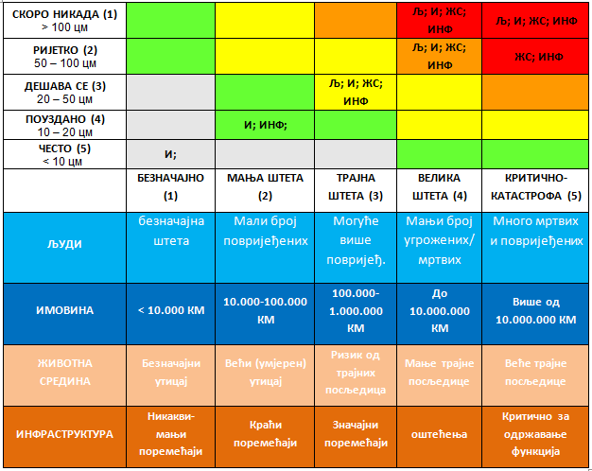
Building Resilience to Disasters in Western Balkans and Turkey-kick off meeting task 6
MANDATE OF RHMZ RS
FOCUS ON RISK ASSESSMENT
PHASE 2:
-example snow
rhmz@teol.net Republic Hydro-Meteorological Service of Republika Srpska, B&H www.rhmzrs.com

Slide 8
Building Resilience to Disasters in Western Balkans and Turkey-kick off meeting task 6
MANDATE OF RHMZ RS
FOCUS ON RISK ASSESSMENT
PHASE 3:
The main results of the risk analysis
The proposal for the type and level of the activities (ACTIONS) to improve the protection and rescue cosed by meteorological disasters
Necessary actions and tasks in terms of prevention and intervention
projection of the financial resources necessary to bring the system into operation function
recommendations
rhmz@teol.net Republic Hydro-Meteorological Service of Republika Srpska, B&H www.rhmzrs.com

Slide 9
Building Resilience to Disasters in Western Balkans and Turkey-kick off meeting task 6
29 – 30 May 2013_Skopje, The Former Yugoslav Republic of Macedonia
RHMS,RS hydrological department-monitoring results:
Special bulletins with announcement and warning are distribute to
Ministry of Internal Affairs
-
Goverment
Republic administration for Civil Protection –
Municipal Civil Protection Headquarters
Operating center 112
rhmz@teol.net Republic Hydro-Meteorological Service of Republika Srpska, B&H www.rhmzrs.com

Slide 10
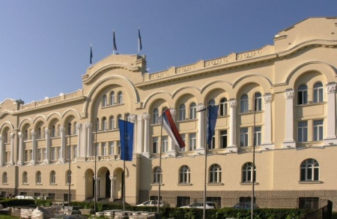
CIVIL PROTECTION SYSTEM is an institution
Mayor: Director of Republic
administration for Civil Protection
123
Member: The Director of Police
Deputy: Minister of Internal Affairs
Republic Civil
Protection Headquarters
Commander: Prime Minister
Service of CP
Goverment
122
121
Donors
Mayor
124
Media
Red cros and non governmental organizations
Citizens
Companies

Slide 11
Leadership and coordination in responding to disaster
Republic Civil Protection Headquarters
Republic institutions and services
Republic Administration for Civil Protection
Federation B&H
Ministry of internal
affairs
Tel.of CP - 121
Media
neighboring
countries
Civil Protection Headquarters
international
assistance
RESPONSEs
Services of Civil Protection
Emergency Services
Fire Brigade -First medical aid -Police
Entitets RS and FBandH
Management Company
Contracts
Mayor
Chief
Civil Protection Units
According to the
plans - Help of others
S O S
Citizens, Special services (NHMS)
- PERSONAL AND MUTUAL - DUE FROM SCHEDULE

Slide 12
range of hazards
Natural Cause of human factor
Unintentional Intense
Earthquakes
Floods
Storm,
Landslides
Avalanche
Drought
Hail
Blizzard
FIRES
Traffic Accidents
Industrial explosion
Water pollution
Radioactiv fallout
Food contamination
Incorrect medication

Slide 13
Building Resilience to Disasters in Western Balkans and Turkey-kick off meeting task 6
29 – 30 May 2013_Skopje, The Former Yugoslav Republic of Macedonia
ability to respond
recovery
response
disaster
vulnerability
preventive
PROTECTION AND RESCUE People and material goods

Slide 14
Building Resilience to Disasters in Western Balkans and Turkey-kick off meeting task 6
29 – 30 May 2013_Skopje, The Former Yugoslav Republic of Macedonia
Risk Assessment of natural and other disasters in Bosnia and Herzegovina
It is in working proces under the guidance of the Ministry of Security
steps in work
Identification of elements of the vulnerability of hazard based on the previous
analysis;
Determining the existing relevant laws and other documents regarding preventive
and operational plans for protection and rescue;
rhmz@teol.net Republic Hydro-Meteorological Service of Republika Srpska, B&H www.rhmzrs.com

Slide 15
Building Resilience to Disasters in Western Balkans and Turkey-kick off meeting task 6
29 – 30 May 2013_Skopje, The Former Yugoslav Republic of Macedonia
Temperature, Precipitation, wind, meteorological phenomena (hail;snow, ice)
Precipitation regime (annual mean monthly values, daily maxima)
Rainfall intensity and return periods
Drought and drought periods (Number of days without precipitation (<0.1 mm)
Number of days with snow, the maximum height of snow cover
Number of days with the hail
Number of days with frost
Temperature at 5 cm < 0°C
Temperature at 2m <3°C
Storms; annual and seasonal wind roses
rhmz@teol.net Republic Hydro-Meteorological Service of Republika Srpska, B&H www.rhmzrs.com

Slide 16
Building Resilience to Disasters in Western Balkans and Turkey-kick off meeting task 6
29 – 30 May 2013_Skopje, The Former Yugoslav Republic of Macedonia
Legislation: Federation - Law on hydrometeorological issues of interest for the Republic (Official Gazette
SR BiH no. 10/76) - Law on protection and rescue of people and property from natural and other
disasters (FBiH Official Gazette 39/03 and 22/06) - Regulation of the plans of flood control (FBiH Official Gazette 13/02) - Framework law on protection and rescue of people and property from natural or
other disasters in Bosnia and Herzegovina, 2008 - Environmental protection and recovery from natural and other disasters, the
Federation of BiH, 2008
rhmz@teol.net Republic Hydro-Meteorological Service of Republika Srpska, B&H www.rhmzrs.com

Slide 17
Building Resilience to Disasters in Western Balkans and Turkey-kick off meeting task 6
29 – 30 May 2013_Skopje, The Former Yugoslav Republic of Macedonia
DOCUMENTS:
The first national report of Bosnia and Herzegovina in accordance with the
framework UN Convention on Climate Change (UNFCCC), October 2009;
Risk Assessment of the Federation of Bosnia and Herzegovina from natural
and other accident, June 2005;
Methodology for vulnerability assessment of Bosnia and Herzegovina
natural and other accident, April 2010;
Risk Assessment Municipality Sarajevo, Center, of extreme meteorological
conditions, February 2004;
Climatological studies of hydrological and seismological characteristics Una Sana canton, September 2004;
Climatological studies of hydrological and seismological characteristics of
Tuzla Canton, October 2004;
Climatological analysis and background from the archives of climate divisions
of the RHMS and FHMS
rhmz@teol.net Republic Hydro-Meteorological Service of Republika Srpska, B&H www.rhmzrs.com

Slide 18
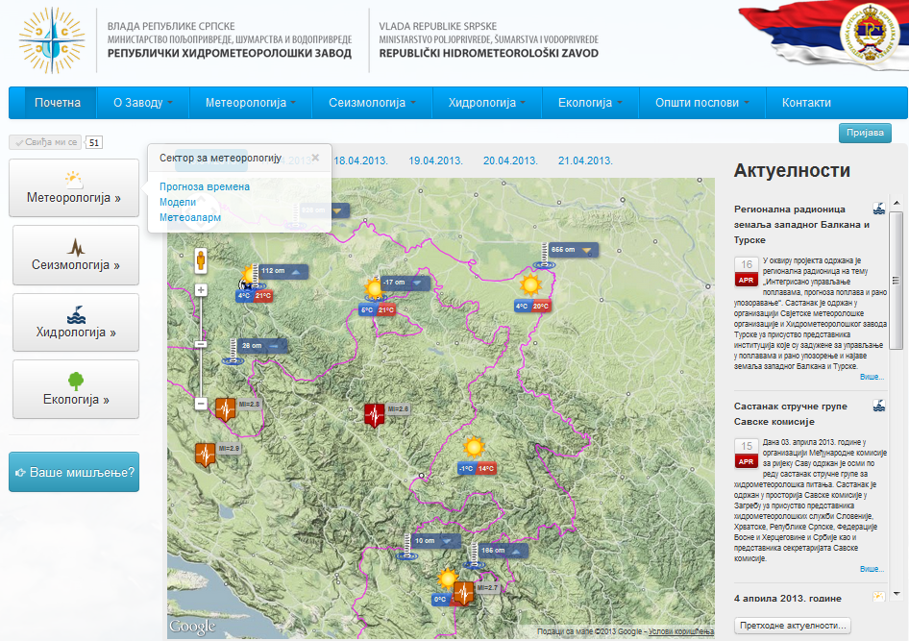
THANK YOU FOR YOUR ATTENTION Republic Hydro-Meteorological Service of Republika Srpska
Building Resilience to Disasters in Western Balkans and Turkey
KICK-OFF
MEETING-TASK 6
Design a
Regional Multy - Hazard
Early warning System
rhmz@teol.net Republic Hydro-Meteorological Service of Republika Srpska, B&H www.rhmzrs.com

