Slide 1
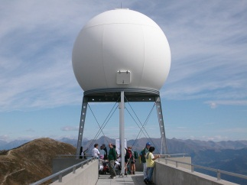
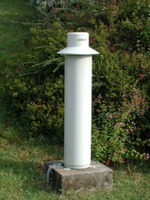
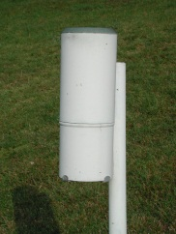
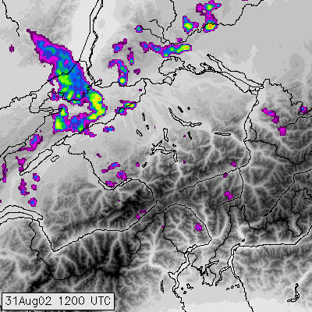
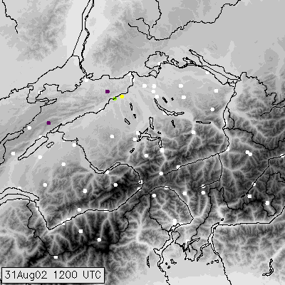
.. instead of two distinct observation systems

Slide 2
Conclusions /1
The Implementation of a central, integrated data platform for the collection, storage and processing of meteorological data and its metadata as well as the storage of metadata in one central metadata repository created an optimal basis for the integration of different observation systems as well as 3rd partner networks.
In Switzerland a lot of data is gathered by different authorities, institutions as well as private companies →big potential in the integration of data from internal as well as external partners in a composite to increase temporal and spatial resolution in a cost-effective way.

Slide 3
Conclusions /2
In a time with increasing requirements and decreasing resources it becomes of crucial importance to invest the available money where it creates most benefit → RRR helps to evaluate where this is the case → important basis for decision makers
As well shown in the example “CombiPrecip” there’s a big potential to trespass each observation systems specific limitation by combining them → this requires open minds by all system experts to find together new solutions.
⇨ All this is important to improve the data basis for early warning systems

