Slide 1
Measurements at MeteoSwiss and its application for natural hazards
The composition of the MeteoSwiss network, its Data Management and the integration of 3rd partner networks
Estelle Grueter
SE European Early Warning System WS, Skopje
May 29-30th, 2013

Slide 2
Outline of presentation
Introduction
Overview of MeteoSwiss’ automatic observation systems and their availability
Standardization, system interoperability & data compatibility
Integration of 3rd partner networks incl. quality assurance
Design, planning and optimized evolution
RRR at MeteoSwiss
Example of a composite of observation systems
Conclusions

Slide 3
Introduction
During the last decade MeteoSwiss has set main priorities on the integration of observation systems in different aspects :
Data governance and management
Implementation of a central, integrated data platform for the collection, storage and processing of meteorological data and its metadata ( → MeteoSwiss Data Warehouse)
Coordination of WMO observing systems with those of partner organizations
Systematic integration of internal and 3rd party networks & certification procedure
Evolving observing requirements of members
Implementation of RRR process at MeteoSwiss (in process)
Integration and optimized evolution of WMO observing systems
Development of products integrating data of different observation systems (e.g. rain gauges and radar) or the combination of observation systems with forecast models

Slide 4
Overview of MeteoSwiss’ automatic observation systems and their availability
Component | Number | Frequency | Availability after meas.
AWS (fully equipped) | > 130 | 10 Min. | > 98 % max 10 Min.
Autom. precip. Station network | 91 precip. 28 fully equipped | 10 Min. | 10 – 30 Min.
Radars | 3 + 2 (work in progr.) | Every 2.5 Min. | 2.5 min
Radiosounding | 1 | 2x /day | constantly while measuring
Windprofilers | 3 | 10 Min. | 10 Min.
Radiometers | 3 | 10 Min. | 10 Min.
Lidar | 1 | 15 – 60 Min.
AND integration of 3rd partner stations data to get a better spatial coverage for warning

Slide 5
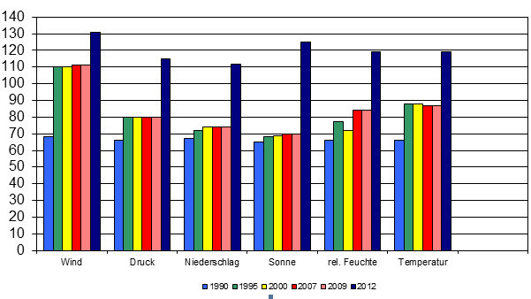
Availability of the main parameters
Number of automatic MeteoSwiss measure sites with a 10 min meas. frequency ⇨ available in realtime
Wind
Pressure
Precipitation
Sunshine
Rel. humidity
Temperature

Slide 6
Standardization, system interoperability & data compatibility → Integration of data sources
2000
Start of the MeteoSwiss Data Warehouse Project
2001
2002
Surface data (rain gauge measurements, AWS data, observations)
2003
Phenology & Pollen
2004
Aviation messages
2005
Lightning data
2006
Metadata
International surface data (SYNOP)
2007
National sounding measurements
2008
Homogenized Data
2009
National & International Upper Air Data
2010
Gridded Datasets
2011
Model Data

Slide 7
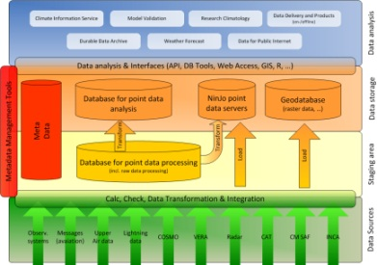
Standardization, system interoperability & data compatibility → MeteoSwiss Data Warehouse
The “MeteoSwiss Data Warehouse”
measurement data
metadata
control data
quality tests
specified in a uniform way, centrally administrated and configurable
Nat. & internat. Surface Data
AWS data for Switzerland (MCH & partners)
Observations
Rain gauge measurements
Pollen /Phenology
Data from GTS (SYNOP, ..)
..
DWH System
Nat. & international Upper Air Data
Soundings
Profiles (wind profiler, radiometers, etc.)
AMDAR
Lightning data
…
Aviation messages
- National & international aviation products
Gridded data
Climat. Analysis
Radar products
VERA
Spatial data
…
NWP Data

Slide 8
The MeteoSwiss Data Warehouse
Quasi realtime – available within minutes
Alarms

Slide 9
Standardization, system interoperability & data compatibility → Benefits
Benefits of this integrated, standardized data platform:
→ Allows an efficient and economic maintenance
independent from technical realisation
Central meta data repository for all data types
AND
company-wide data integration platform for the long term also used for the integration of 3rd party stations.

Slide 10
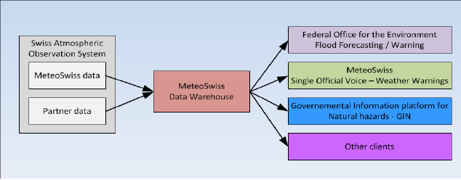
Integration of 3rd partner networks /1
In order to contribute to the amelioration of the hydrological forecasts the frequency had to be increased and (spatial) gaps had to be filled → generation of significant measurements in all warning regions
Automatization of precipitation stations
Construction of new precipitation and fully equipped stations
Integration of reliable partner stations

Slide 11
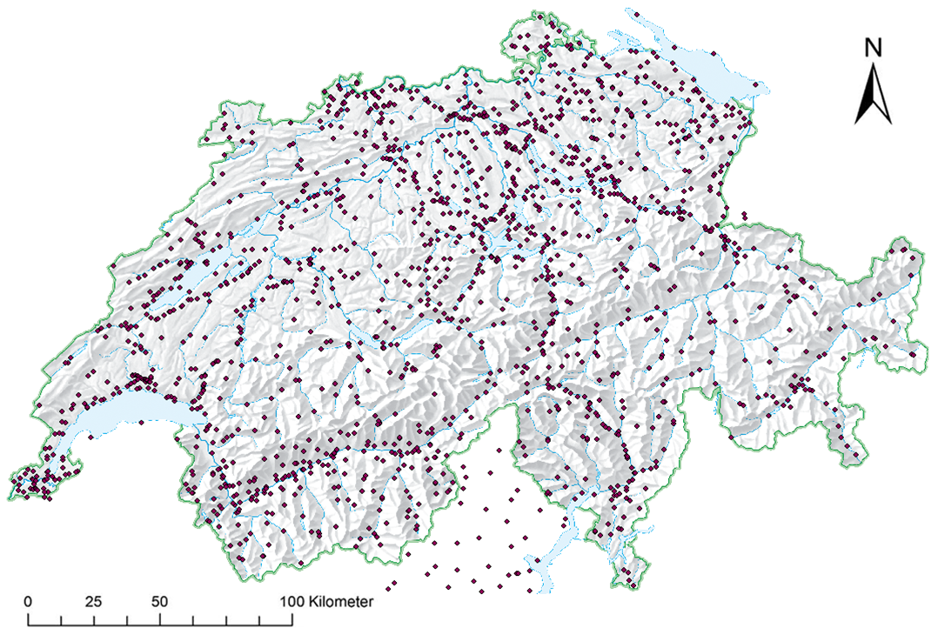
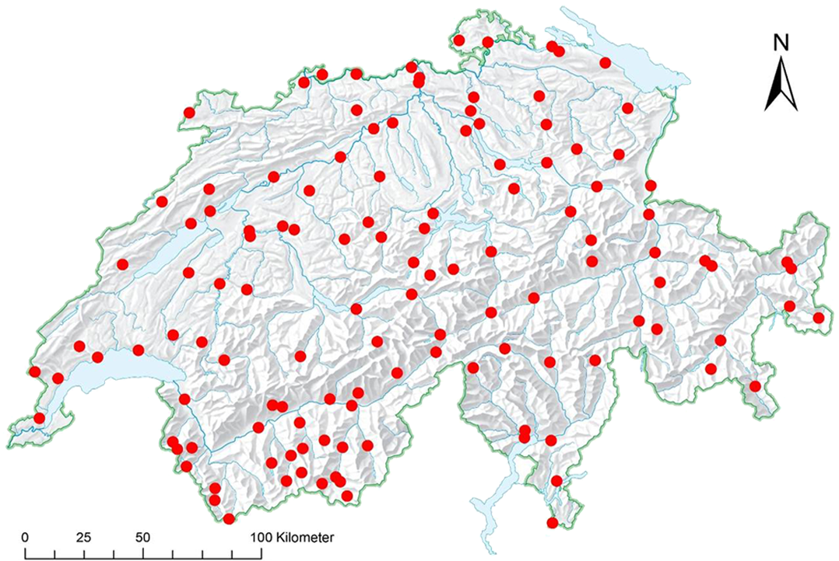
Integration of 3rd partner networks /2
In 2005 → Integration of 3rd Partner stations into MeteoSwiss Data Warehouse starts → since 2012 in a systematic approach
Includes stations from other federal (research) institutes, cantons, private partners as well as from other countries
Goals: - Increase of density in a cost-effective manner - Get representative measurements in all warning regions ( → gap filling) → important for
only MeteoSwiss stations
+ 3rd partner stations

Slide 12
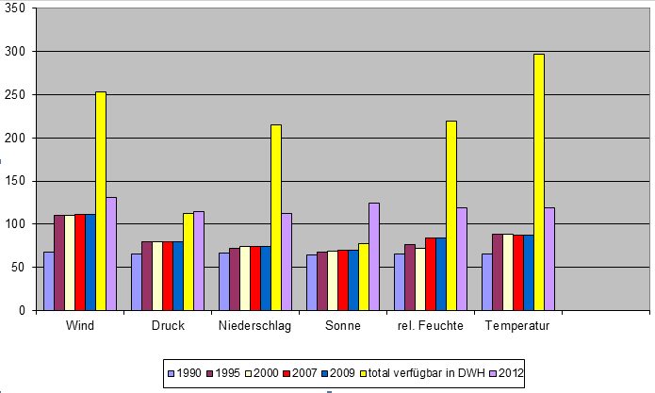
Integration of 3rd partner networks /3
Number of automatic MeteoSwiss & Partners measure sites with a 10 min meas. frequency ⇨ available in realtime
Wind
Pressure
Precipitation
Sunshine
Rel. humidity
Temperature

Slide 13
Integration of 3rd partner networks and quality assurance
Risk while integrating data from partner stations → unknown data quality
To make sure that observing system owners are operating and maintaining their systems in complying to regulations of WMO → elaboration of a certification procedure
Analysis
- Do we need the station?
- Basic requirements fulfilled?
Station visit
- Installed Sensors?
- Installation? Mainte- nance?
- Site evaluation
Data analysis
- Transmission?
- Availability?
- Failures?

Slide 14
Quality assurance
Procedure shall be applied to all stations in the network of MeteoSwiss
Requirement correspond to those defined in WMO CIMO Guide
Adaptations to Swiss peculiarities (stations in the Alps, historical aspects)
Limited to meteorological and climatological measurements (no road weather, agrometeorology)
Objectivity of criteria
Neutrality: evaluation is performed by third party (METAS)
Procedure is repeated (every 5 years)

Slide 15
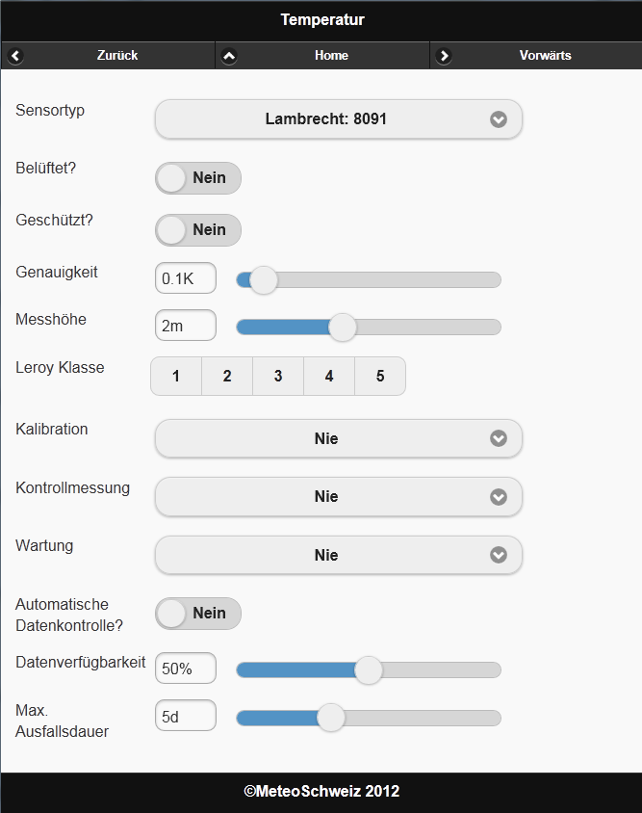
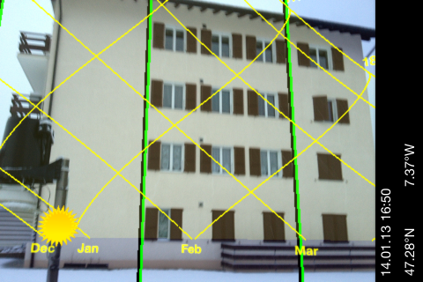
Form for certification and impres-sions of station visits
Evaluation of sites are carried out by Swiss Institute of Metrology ( → external partner)

Slide 16
Integration of 3rd partner networks → Forms of partenariats
Forms of partenariats:
MeteoSwiss as partner station provider and maintainer: Construction, management and maintenance of partner stations → the partner only wants the data but no responsibility for maintaining the network
Sites are chosen and realized following WMO Guidelines and manuals
quality control mechanisms are based on WMO guidelines
MeteoSwiss as data host Integration and hosting of partner data inclusive QC
quality control mechanisms based on WMO guidelines and regulations.
MeteoSwiss as data deliverer and data user Integration for delivery to the Swiss common platform for natural hazards and/or to ameliorate our products.
Only data integration => Problem → unknown data quality!

Slide 17
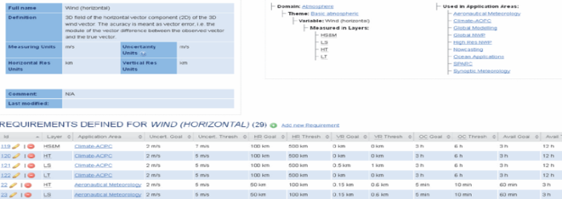
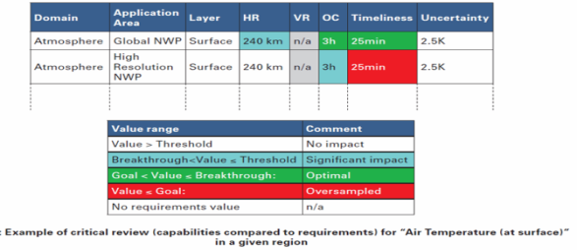
Design, planning and optimized evolution → RRR at MeteoSwiss
In order to govern the evolution of observing systems and to contribute to assess regional data requirements MeteoSwiss is on its way to implement the Rolling Review of Requirement process of WMO.
The components of this strategic approach and its appertaining processes and workflows are currently implemented within a project in the application area of aeronautical meteorology.
Based on OSCAR
RRR
GAP
Total cost of ownership

Slide 18
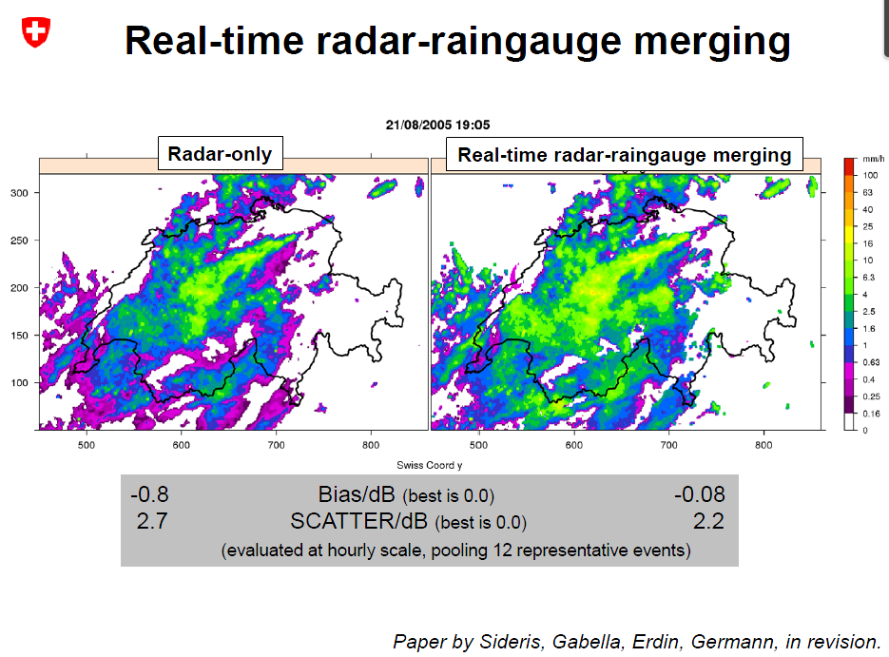
Example for composite systems to better fulfil requirements :

