Slide 1
WMO BRIEFING ON ORGANIZATION OF THE ECMA-15 CONFERENCE
Conference on the future of meteorological service provision to civil aviation in Europe
ORGANIZING COMMITTEE ECMA-15
(ISTANBUL, TURKEY, 9-10 APRIL 2015)
WMO Secretariat

Slide 2
CONTENTS
Report Regional Association VI (Europe) Sixteenth session, Helsinki, Finland, 11–17 September 2013
Structure of Regional Association VI
RA VI 2013 Survey
ECMA-15 OC meeting
Dates for the Conference?
Summary: ECMA-15 roadmap and further actions

Slide 3
Report Regional Association VI (Europe)
Regional Association VI (Europe)
Sixteenth session
Helsinki, Finland, 11–17 September 2013
Abridged final report with
resolutions and recommendations
WMO-No. 1125
https://2a9e94bc607930c3d739becc3293b562f744406b.googledrive.com/host/0BwdvoC9AeWjUazhkNTdXRXUzOEU/wmo_1125_en.pdf
Capacity Development for PWS

Slide 4
Report Regional Association VI (Europe)
Capacity Development for PWS
The Association recalled that aeronautical meteorology was one of the five WMO strategic priorities for the sixteenth financial period.
Even though there are different organizational modalities concerning the roles of meteorological authority and meteorological service provider, for a large part of the Region, the cost recovery from aviation continued to constitute a significant portion of the overall funding of the meteorological services.

Slide 5
Report Regional Association VI (Europe)
The Association noted the overall good progress in the Region in addressing the challenges for NMHSs in providing services to aviation (in accordance with the Commission for Aeronautical Meteorology (CAeM) five top level priorities:
(a) Implementing and sustaining of QMS for the provision of service to international air navigation, as required by ICAO Annex 3;
(b) Undertaking assessment and documentation of the competence of Aeronautical Meteorological Personnel (AMP), noting the implementation deadline of 1 December 2013;
(c) Improving the efficiency and effectiveness of SIGMET issuance through improved coordination;
(d) Further developing services to aviation, in particular for air traffic management in high-density airspace;
(e) Improving Members’ ability to respond to volcanic ash and other large-scale, high impact events, e.g. space weather, chemical and nuclear incidents.
Capacity Development for PWS

Slide 6
Report Regional Association VI (Europe)
The Association considered the vigorous developments towards a more efficient organization of the air traffic in the Region as formulated in the European Air Traffic Management (ATM) Master Plan endorsed by the European Council as a key element of the European Single European Sky (SES). The Association noted that the SES regulations, and their extension SES 2+, would have a major impact on the provision of meteorological services as part of the air navigation services by most RA VI Members (both EU and non-EU Members).
Capacity Development for PWS

Slide 7
Report Regional Association VI (Europe)
The Association recognized with concern the possible significant implications on future aviation MET service provision, of the numerous and complex ATM developments currently being planned at the global and regional level. The Association agreed on the need to gain a greater understanding of these issues to better inform future discussions and requested the WMO Secretariat to organize a regional conference that would also build on the outcomes of the Conjoint MET Divisional Meeting in July 2014. The conference would be organized with ICAO, and other relevant stakeholder groups to raise awareness among RA VI Members and promote the development of a coordinated approach among the RA VI Members in addressing the numerous organizational, regulatory and operational issues related to the meteorological service provision in the new European ATM environment. The Association adopted Resolution 2 (RA VI-16) – Conference on the future of meteorological service provision to civil aviation in Europe.
Capacity Development for PWS

Slide 8
Report Regional Association VI (Europe)
Capacity Development for PWS

Slide 9
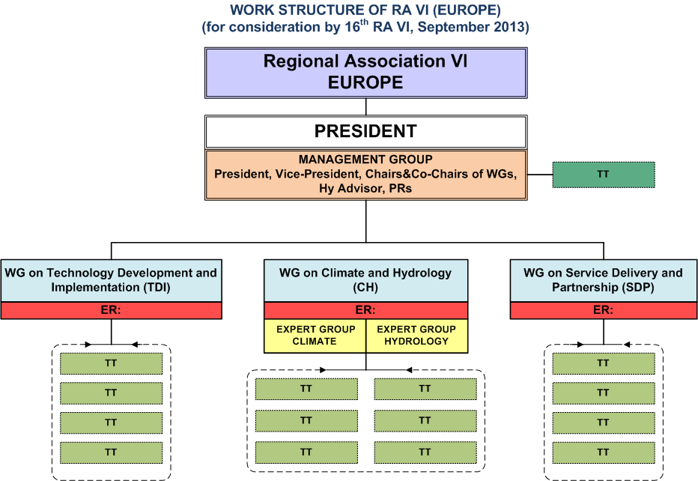
Structure of Regional Association VI
  Regional Association VI Working Group on Service Delivery and Partnership
  Rapporteur on Aviation matters Mr. José Fernandez
  [WG-SDP Meeting 10-11 December 2014, Offenbach – discussed options for timing of the ACME-15]
  WORK STRUCTURE OF RA VI (EUROPE)
Capacity Development for PWS

Slide 10
RA VI 2013 Survey
Capacity Development for PWS
Results of the RA VI Survey - http://www.wmo.int/pages/prog/dra/eur/RA6_survey_2013.php
Summary of the Survey - ftp://ftp.wmo.int/Documents/PublicWeb/dra/eur/surveys/RA6_Survey_2013/RA%20VI%20SURVEY_final_en.pdf

Slide 11
Organizing Committee OC - first meeting
11/21
ZAMG, Viennna, 23 March 2015 - Participants:
Bart Nikolai (Chair of EUMETNET AVIMET, Belgocontrol),
Ian Cameron (Vice-Chair of AVIMET, UK Met Office),
Nino Gelovani (Chair of ICAO Project Team for Eastern Europe PT-EAST, Georgian CAA),
Jose Fernandez (AEMET, RA VI TT Leader),
Dennis Hart (Eurocontrool),
Michael Ableidinger (Austrocontrol, ICAO METG),
Herbert Puempel (Austrocontrol, CAeM ET-ASC, EUMETNET),
Michael Staudinger (ZAMG),
Milan Dacic (WMO, ROE),
Dimitar Ivanov (WMO, AEM).
Notes:
JEWISH HOLIDAYS:
In 2015 these dates are:
13-15 September (New Year),
22-23 September,
27-28 September, and
4-5 October.

Slide 12
WG-SDP Chair proposal for OC
12/21
Expected outcome of the OC meeting
• Conference goal - Based the concept note, OC should agree on the expected outcome of the conference as well as the proper format needed to achieve the expected goals.
• Decide on the scope – Aeronautical meteorology and related services are complex issues. OC should therefore decide whether ECMA will present the broad picture (which means that we may have only one lecture/presentation per item) or if we aim to concentrate on two or three most important topics.
Agenda – the agenda of the OC meeting should follow some kind of “top-down” approach. OC should start to discuss the “big picture” and then go down stepwise. It is suggested to stay away from discussing the details too early. It is therefore proposed that the OC meeting agenda lines up with the following steps:
Discuss and agree on the expected outcome and scope of the conference.
Decide on the right format
Following the agreed format we can decide on a conference structure and the order of the sessions
To identify speakers and session chairs would be the final step (could be postponed as needed)
OC should propose tentative dates (2 options) to MG for approval
OC should agree on responsibilities for the organizational and programmatic issues
Notes:
JEWISH HOLIDAYS:
In 2015 these dates are:
13-15 September (New Year),
22-23 September,
27-28 September, and
4-5 October.

Slide 13
Format and Programme
13/21
The OC had an in-depth discussion on the scope and objective of the conference. This included the role and responsibility of the WMO as an aviation stakeholder, the role of the NMHSs at State level and the specific “European landscape” in the aviation MET field. It was agreed that the scope and objective of ECMA should be built on the understanding of four core roles and functions of WMO as follows:
WMO is the ultimate contain of MET expertise
WMO sets regulations - standards and procedures for the aviation MET (this is together with ICAO, but WMO has the specific role in the pure MET domain (e.g., methods and practices for observations and forecasts)
WMO through its Members is the main “owner” and caretaker of the basic meteorological network that is essential for any meteorological service to industry
WMO through its Members’ NMHSs provides services to a variety of users including aviation.
The meeting further agreed that in the above four domains, WMO has its core role and definite leadership in the first three.
Notes:
JEWISH HOLIDAYS:
In 2015 these dates are:
13-15 September (New Year),
22-23 September,
27-28 September, and
4-5 October.

Slide 14
Target Audience – Expected Participation
14/21
  Permanent Representatives with the WMO
  Directors of the NMHSs
  Senior management of NMHSs
  MET stakeholders
  International organizations
Notes:
JEWISH HOLIDAYS:
In 2015 these dates are:
13-15 September (New Year),
22-23 September,
27-28 September, and
4-5 October.

Slide 15
Dates and venue for the Conference?
15/21
Dates
ECMA/OC proposal is for a 2-day event, starting in the morning of day 1 and continuing until mid-afternoon on day 2. The proposed dates are:
Option 1 (preferred option): 13-14 October 2015 (arrival date should be 12 October (Monday) in order to start the meeting at 9 or 9.30 on the 13th);
Option 2: 17-18 November with arrival date of 16 November (Monday).
Venue
The hosts from ZAMG and Austro control proposed two options:
Option 1: a relatively remote venue about 30 min from Vienna centre (name of the place) in a historical site that would offer a good and friendly environment, including for the free time of the participants. It is expected that the conference cost for this venue will be very reasonable.
Note: later information received that the hotel that is collocated with this venue can offer only 45 rooms, which most probably will be insufficient.
Option 2: A hotel in the centre of Vienna (e.g., Hilton). Organizer will check the possibility and the conference cost for such a venue. WMO secretariat need to be advised whether the conference cost could be covered by the host organizations or assistance from WMO would be expected.

Slide 16
Summary: ECMA-15 roadmap and actions by OC members
16/21
Report to RA VI Management Group
- urgent Decision on dates required
Report to CAeM President
Define the Agenda/Programme (in detail)
Communication
- launch first announcement (a.s.a.p.)
- Cg-17 information event(?)
Invitation letters, etc.
WMO will support the countries with lower GDP to participate at the Conference
Support by host country (?)
Possibility for support from stakeholders (?)

Slide 17


