Slide 1
Cg-17/Doc. 2.4 (Geneva, Switzerland, 25 May – 12 June 2015) Report of the President of RA VI (Europe)
Ivan Čačić

Slide 2
CONTENTS
RA VI Operational Plan
New – Old RA VI Structure
RA VI Activities and Acievements
RA VI challenges
Agreed set of RA VI priorities

Slide 3
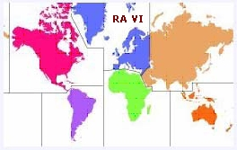
RA VI Operational Plan
Performance of the RA VI is based on the RA VI Operating Plan (2012–2015) and successfully executed by RA VI / WMO subsidiary bodies and WMO Secretariat, in particular Office for Europe
Follow up activities are arranged by the Draft RA VI Operating plan 2016 – 2019 what is
consolidated with the Draft WMO Strategic Plan 2016 – 2019 and is holding the two consecutive periods: (2016 – 2017) and (2018 – 2019) in order to facilitate proper performance of the existing RA VI subsidiary bodies
tuned on regional specifics, requirements and priorities with defined Key Outcomes and Key Performance Indicators

Slide 4
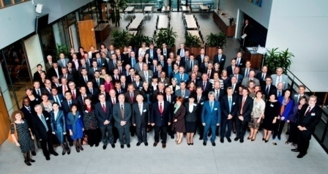
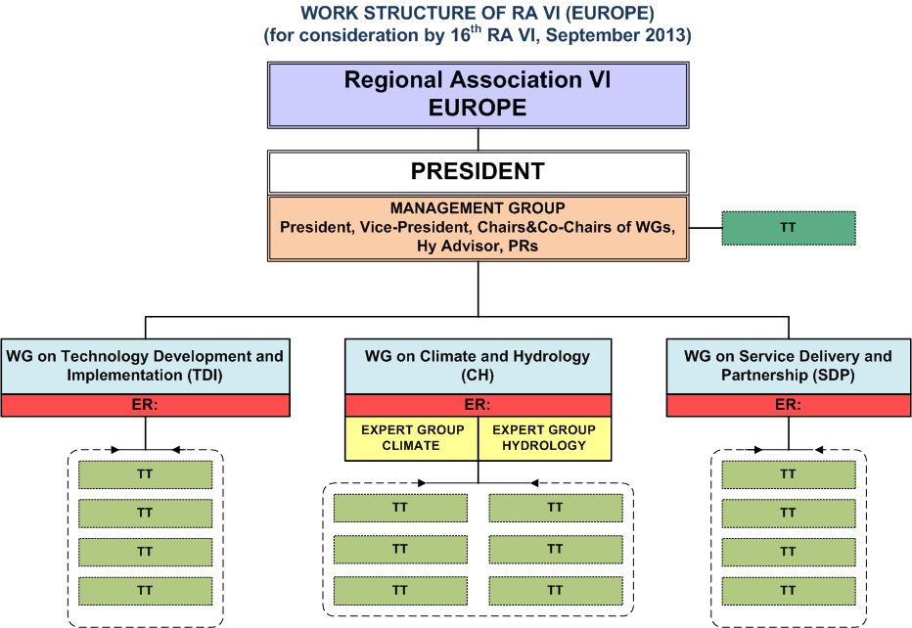
New – Old Work Structure
As approved by the 16th Session RA VI, Helsinki, September 2013
Slightly enlarged of MG for a better geographical balance
Continuation of the same basic structure of WGs and flexible use of TTs
Notes:
4

Slide 5
RA VI Activities and Achivements
Successful completion and designation of the RA VI RCC-Network
Implementation of pilot activities in introducing of Climate Watch Services
Further expansion of the RA VI RCOFs by the establishment
Mediterranean COF - MEDCOF with the bridging collaboration with SEECOF - interregional pertnership RA VI and RA I
North-Eurasia COF - NEACOF - interregional pertnership RA VI and RA II
Setting up of the 1st Regional Specialized Meteorological Centre (RSMC) on Atmospheric Sand and Dust Forecast for Northern Africa, Middle East and Europe (WMO/AEMET/BSC) - interregional collaboration (RA I, II, VI)
Establishment of the RA VI Hydrology Forum as a platform for hydrologists within the Region to discuss matters of common concern

Slide 6
RA VI Activities and Achivements
Effective mechanism for monitoring the WIS implementation through a regional focal point
Putting into operation four GISCs (Offenbach, Bracknell, Touluse, Moskva)
Designation of the WIS National Centers (NCs) and WIS focal points
Steady progress with the migration to the table-driven code forms (TDCF) by the majority of the RA VI Members
Progres in preparation of the RA VI WIGOS Implementation Plan for regional and national WIGOS-related activities what was facilitated by the Regional WIGOS Conference
Progress in developing methodologies, sharing experience and engaging Members in conducting analysis of the socio-economic benefits (SEB), what was facilitated by the Regional SEB Conference

Slide 7
RA VI Activities and Achivements
Continuous DRR capacity development activities though:
completion of the two phases EU project for Western Balkans and Turkey (WMO/UNDP/UNISDR)
the two Flash Flood Guidance Systems projects for the South Eastern Europe, Black Sea and Middle East
the project in the Middle East (Jordan and Lebanon) for provision of services in support of water management
Active involvement of the Association in the teamwork and partnership with the WMO constituent and subsidiary bodies along with the close collaboration with the WMO Secretariat, in particular Office for Europe
Several initiatives for the improvement of the effective and efficient performance of the WMO (e.g. role and responsibilities of RAs)
Initiative for securing climate data homogeneity in the transition process from conventional to automatic meteorological station performance

Slide 8
RA VI Chalenges
Lack of financial resources
continuous budget and staff cuts by governments
insufficient qualified personnel
difficulties to maintain and sustain basic functions
Harmonization with the capacity development segments of the Copernicus Programme (including harmonization of vocabularies and metadata)
Fussy status of the aeronautical meteorological services
Increasing role of the private sector in service delivery and requirements for compliance with data policies
Technological and institutional gaps between the developed and developing NMHSs

Slide 9
Agreed sets of RA VI Priorities
16th Session RA VI
Helsinki , 2013
Many of the key priorities for 2016 – 2019 are continuing from the previous period and are based on the regional consensus, output of the 16th RA VI Session
Coping with issues related to the economic conditions affecting the NMHSs
Demonstration and communication of the value of the NMHSs to decision makers / Government . High importance in the current economic conditions
Implementation of WIGOS and WIS - paricularly focusing on the
maintenance and improvement of the observing systems
quality of observations
Enhancement of Climate Services - implementation of GFCS at regional and national level
Securing climate data homogeneity in the transition process from conventional to automatic meteorological station performance

Slide 10
Agreed sets of RA VI Priorities
16th Session RA VI
Helsinki , 2013
Enhancement of Services: PWS, DRR / EWS, aviation and related services
Building common regional position and activities on data policy, commercialization and public / private sector relationships
Enhancement of regional cooperation and partnership with
EMI entities (EUMETSAT, EUMETNET, ECMWF, ECOMET) and European Commission, in particular related to the
INSPIRE and PSI Directive
Copernicus
Horizon 2020
EUROCONTROL
ICH/CIS on the harmonisation with EMI entities (MI of RA VI)
Enhancement of interregional cooperation and partnership, in particular with RA I and RA II

Slide 11
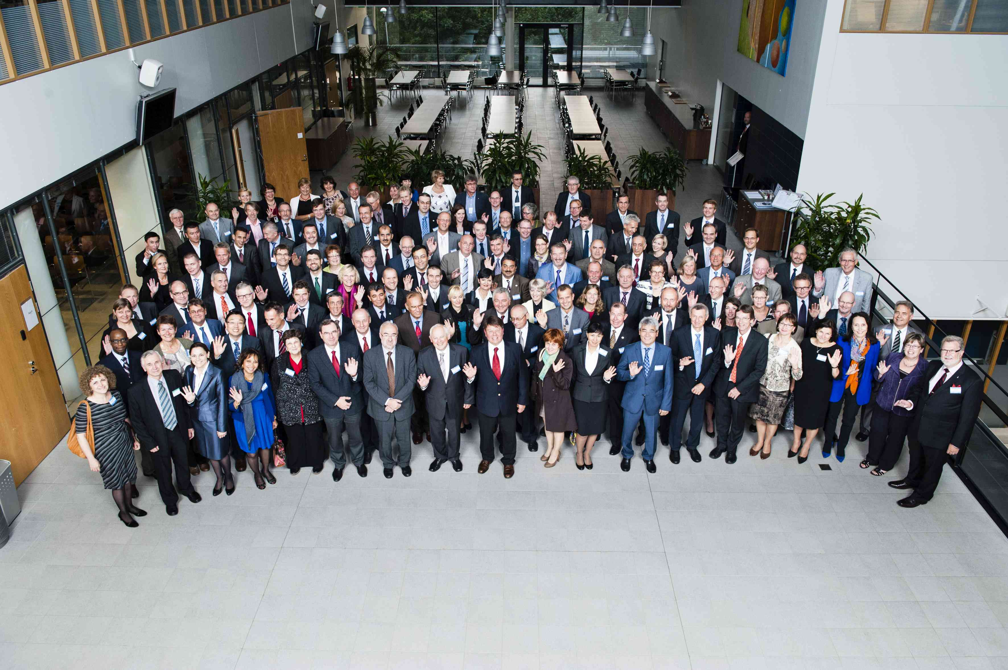
Thank you

