Slide 1
RA VI MG-5
(Vilnius, Lithuania, 26 – 27 April 2017)
MULTI-HAZARD EARLY WARNING ADVISORY SYSTEM IN SOUTH EAST EUROPE
Sub-regional / Regional /Global
Cooperational Mechanism
Milan Dacić
WMO Representative for Europe
Ivan Čačić
President RA VI (Europe)
Michael Staudinger
PR of Austria with WMO

Slide 2
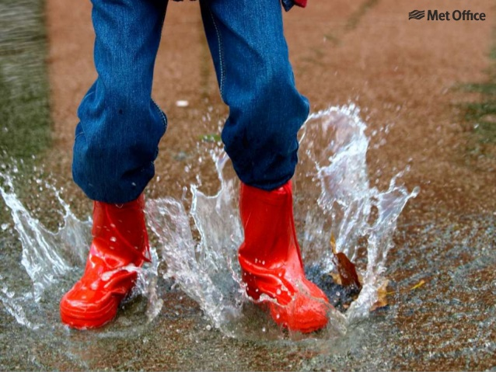
The need for a sub-regional MHEWS-A
Need to achieve common technical and communication platform for warnings and alerts on subregional level what is in line with Sendai Framework for DRR
impact based forecasting new role of forecasters as intermediators between
multi-model outputs and Civil Protection
exchange of best practise between countries different structures of warnings, relationship with Civil Protection
Information for „moving users“ and media NGO´s in emergency situations, tourists,
foreign investors and workers etc.
Technical standardisation CAP 2.0 could profit from experience of applications like Meteoalarm
5th RA VI MG, Vilnius, Lithuania, 26 – 27 April 2017

Slide 3
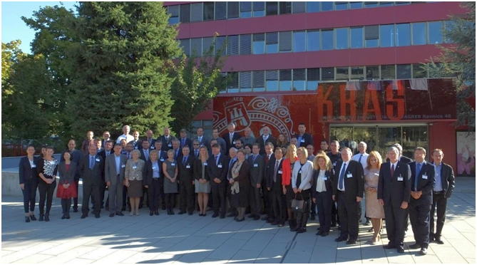
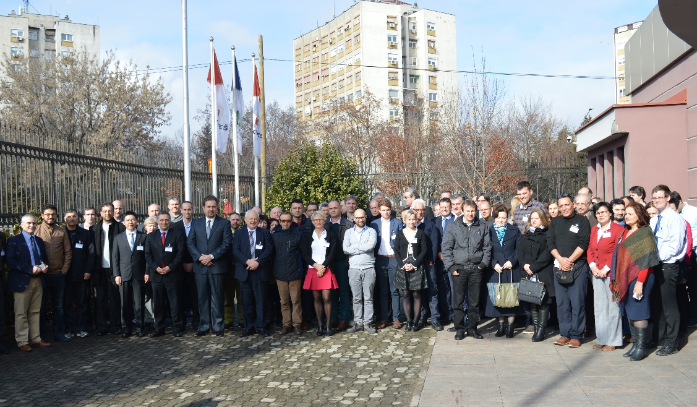
Establishment of the SEE MHEWS-A Project
WMO in cooperation with and financial support of the U.S. Agency for
International Development - USAID initiated SEE-MHEWS-A project which aims
to strengthen the existing early warning capacity in the region
October 2016 - Regional Conference on SEE MHEWS marked the commencement
of the SEE-MHEWS-A project and comprised of
Project kick-off meeting
Workshop on CAP
2016 ICSEED
SEE-MHEWS-A Forecasters Workshop, 7-9 February 2017
Harmonized meteorological, hydrological and marine forecasters
requirements - 1st building block of the Implementation Plan
Observational datasets
Modelling
common to all
specific hydrological and marine requirements
5th RA VI MG, Vilnius, Lithuania, 26 – 27 April 2017

Slide 4
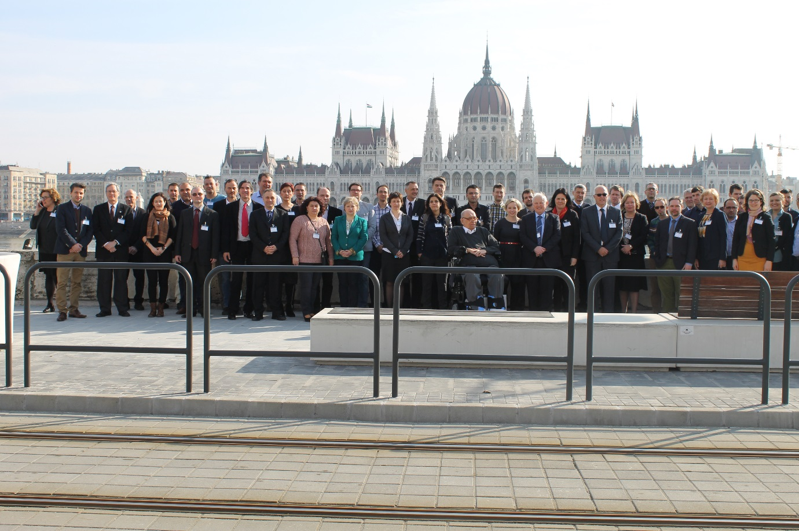
Establishment of the SEE MHEWS-A Project
SEE-MHEWS-A Numerical Modelling Workshop, Budapest, 8-9 March 2017
Operational numerical weather prediction
Operational hydrological modelling
Forecasters Requirements
Required capabilities / functions and design of SEE-MHEWS-A
Centralized Observational Data Base
The suite of coupled met/hydro/marine models
Common Information and Communication Platform
Access to SEE-MHEWS-A data and products by project participants
5th RA VI MG, Vilnius, Lithuania, 26 – 27 April 2017

Slide 5
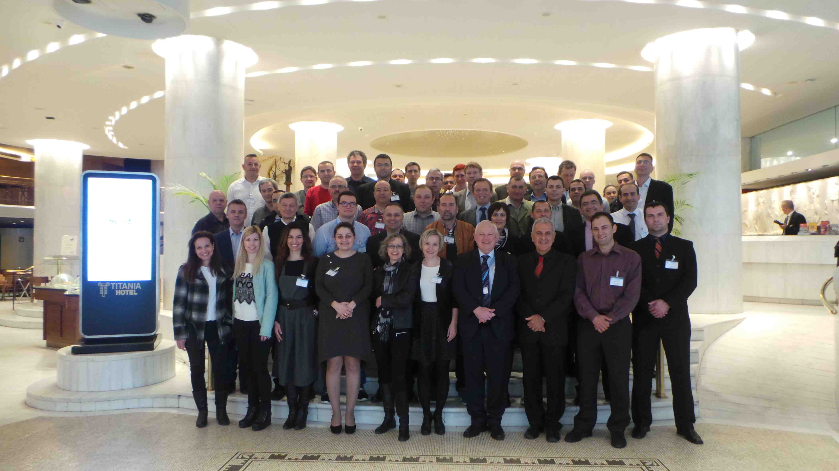
Establishment of the SEE MHEWS-A Project
SEE-MHEWS-A ICT and OBS Workshop, Athens, 4 - 6 April 2017
The purpose to propose ICT solutions / scenarios for the operations of the
SEE-MHEWS-A. This includes:
○ Operation of the suite of the
coupled Met/Hydro/Marine models
○ Operation of Centralized DB of
observations (CDBO)
○ Operation of Common Information
Platform (CIP)
○ Provision of observational data
by the project participants into CDBO
○ Access to information available at CIP by all beneficiaries,
○ Identification of ICT gaps on national levels and respective capacity
development activities
5th RA VI MG, Vilnius, Lithuania, 26 – 27 April 2017

Slide 6
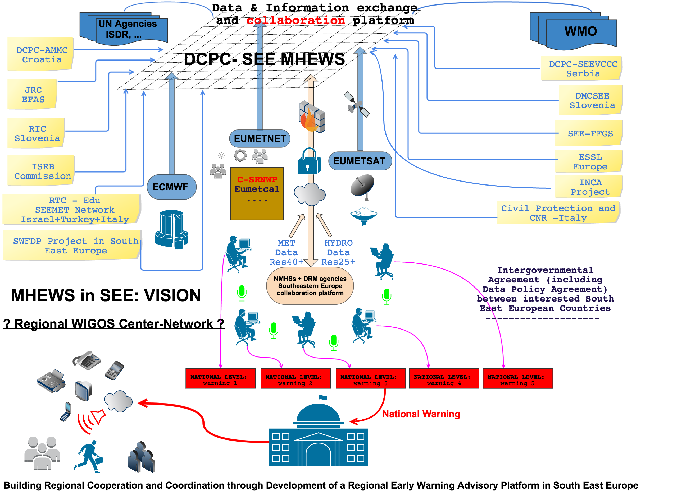
Technical Platform SWFDP - Part of MHEWS Distributed Network in SEE

Slide 7
Cloud provider
Global Models
Regional Hydrological Models
Centralized Observational Database (CODB)
Nested A (HR model)
Nested B (HR model)
Nested C (HR model)
Regional Marine Models
OB S
Da t a
SEE-MHEWS-A Common Information Platform (CIP)
MET (Products)
HYDRO (Products)
NOWCASTING
VERIFICATION
WEB SERVICES (Dissemination/FTP, Visualization , Interactive tools, Catalogues, API)
MARINE (Products)
Data & Products Handling
WARNINGS
COMMS (among forecasters)
Project participants (NMHSs, NMSs, NHSs, Water Authorities)
Products, Data & Comms
Contributing stakeholders
NWP Consortia
WMO Regional Centers & Programmes
NMHSs
ECMWF
EUMETNET
EUMETSAT
EU / COPERNICUS
Users
Research Institutes
Intl. River Commissions
…

Slide 8
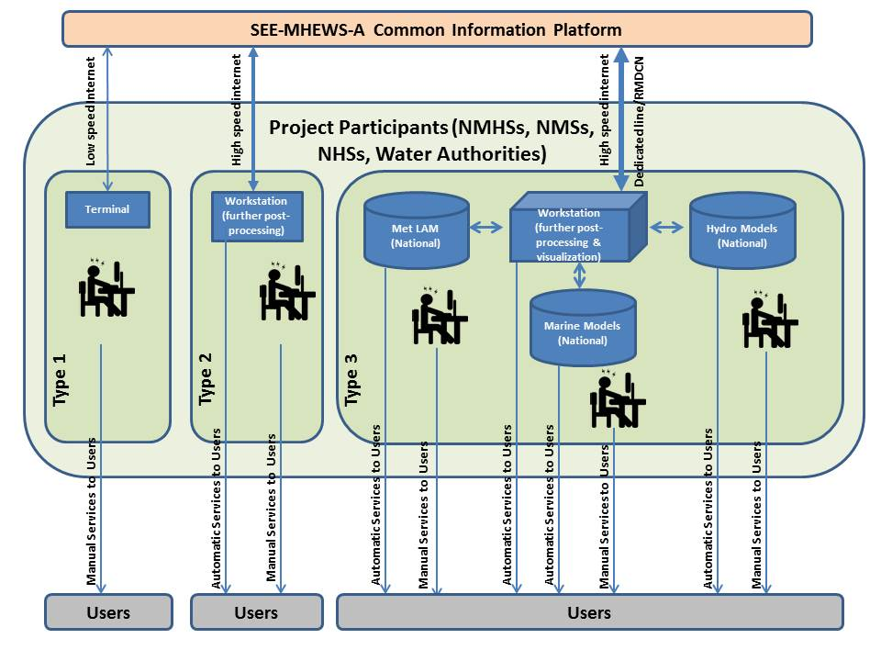
5th RA VI MG, Vilnius, Lithuania, 26 – 27 April 2017
Notes:
Depiction of three different types of participating entities depending on their information and communication technologies. Note: Through the capacity development all entities will eventually transit to type 3.

Slide 9
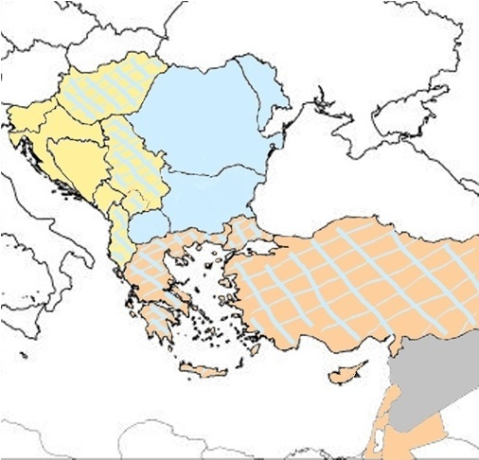
Organizational Platform
MHEWS-A Consortium of Operations / SEE
3 Clusters of Operations
oriented from NW towards SE
Sava River
Panonian Valley
Adriatic Sea
C2
C1
Danube River
Black Sea
Ionean Sea
C3
Meadle East
East Mediteranean
Slovenia
Hungary ---- C12
Croatia
Bosnia and
Herzegovina
Serbia ---- C12
Kosovo (UNSCR 1244)
---- C12
Montenegro
Albania ---- C12
Ukraine
Hungary ---- C12
Serbia ---- C12
Kosovo (UNSCR 1244)
---- C12
Bulgaria
Romania
Moldova
The former Yugoslav Republic of Macedonia
Albania ---- C12
Greece ---- C23
Turkey ---- C23
Greece ---- C23
Turkey ---- C23
Cyprus
Israel
Lebanon
Jordan
Distributed MHEWS

Slide 10
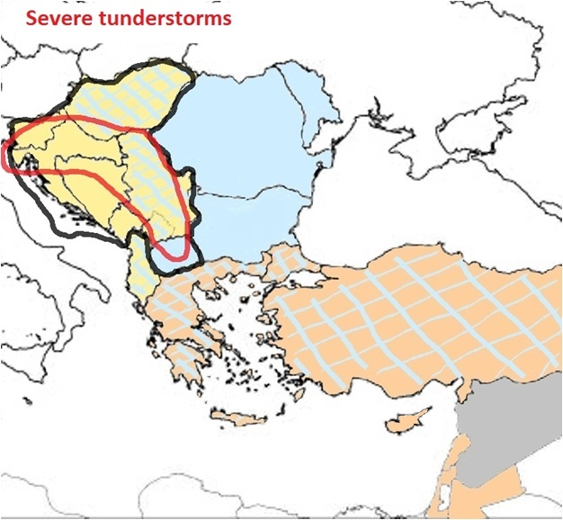
Organizational Platform
MHEWS-A Consortium of Operations / SEE
3 Clusters of Operations
oriented from NW towards SE
Fixed Clusters
Swich to
AD-Hoc Clusters of Operations
Dynamic Clusters
Dynamic Clusters
Flash Flood Risk
C1
Sava River
Panonian Valley
Adriatic Sea
Cross-boarder SOP
Cross-boarder SOP
Slovenia → Croatia
Croatia → Bosnia and Herzegovina → Serbia
Serbia → Kosovo (UNSCR 1244) →
The former Yugoslav Republic of Macedonia
C2
Danube River
Black Sea
Ionean Sea
5th RA VI MG, Vilnius, Lithuania, 26 – 27 April 2017

Slide 11
Meteoalarm – Communication Tool
Closed system – for forecasters only
Structured communication
Vital also for cross-border communication
5th RA VI MG, Vilnius, Lithuania, 26 – 27 April 2017

Slide 12
Meteoalarm– as a Communication Tool
Closed system – for forecasters only
More detailed communication
Great tool for cross-border communication
Communication is only on forecasters level
between neighbouring NMHSs
Strong potential to tune forecasters perspective
Hyperlinks, e.g. radar data

Slide 13
Meteoalarm – Public Awareness Tool
Open system for public
5th RA VI MG, Vilnius, Lithuania, 26 – 27 April 2017

Slide 14
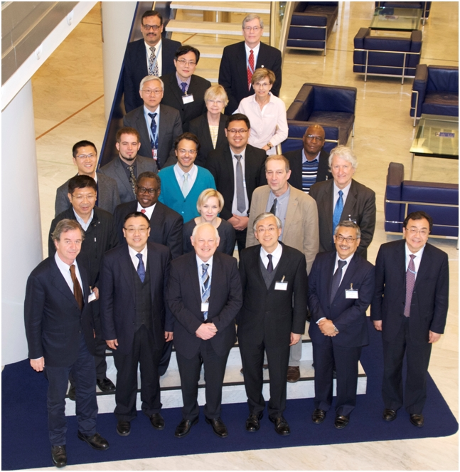
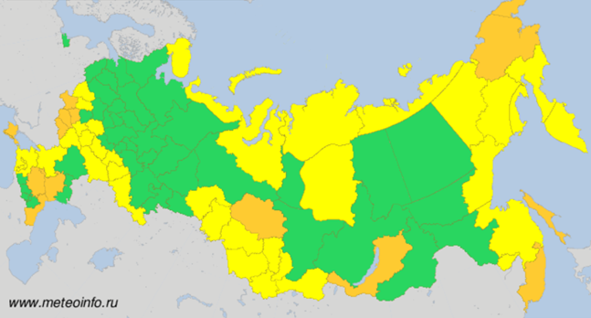
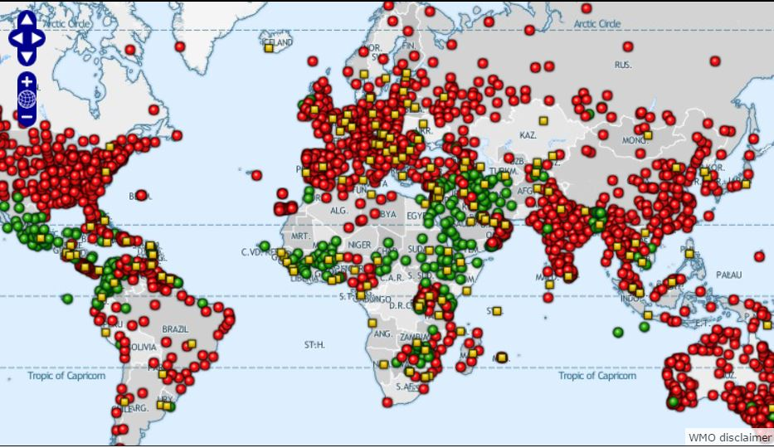
SEE MHEWS-A Project as a Template for Other Regions
First Meeting of the Advisory Group and Technical Team on WMO Global Meteo Alarm System (GMAS), Geneva, March 13-15 2017
recognized SEE-MHEWS-A as an important
supporter of the GMAS
Geneva, 13-15 March 2017
WMO Global Meteo Alarm
WWIS/SWIC
5th RA VI MG, Vilnius, Lithuania, 26 – 27 April 2017

Slide 15
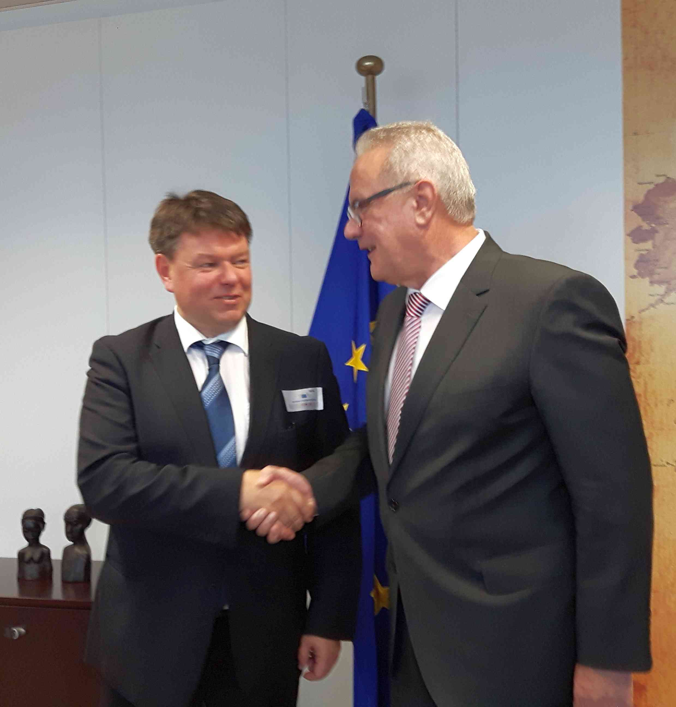
SEE MHEWS-A Project as a Template for Other Regions
Following the 2016 EC WG DRR recommendation SEE MHEWS-A project was
successfully presented at the
28th Session of Interstate Council on Hydrometeorology of the
Commonwealth of Independent States, Dushanbe, Tajikistan
President RA I supported an initiative of RA VI on regional collaboration
between RA I, RA II and RA VI on MHEWS, particularly linking the North
African region that has Mediterranean climate with Europe and Middle East
PRA I expressed his willingnes to participate at the extraordinary ICSEED in June in Ljubljana
The two meetings of the WMO SG, Mr. Petteri Taalas with Mr. Neven Mimica
European Commissioner for
International Cooperation and Development
opened possibility to expand the EWS implementation
initiated by SEE MHEWS-A into Central Asia or Africa
under the EC DG DEVCO support
5th RA VI MG, Vilnius, Lithuania, 26 – 27 April 2017

Slide 16
Thank you

