Slide 1
WG – TDI Status of Work
5. Meeting of the RA VI Management Group
Vilnius, Lithuania, 26 – 28 April 2017
Dr. Dieter Schröder - Chair WG TDI in RA VI
Deutscher Wetterdienst

Slide 2
1. WG-TDI at a Glance
Basic Composition
Chair: Dieter Schröder, DWD Germany
Co-Chair: Ercan Büyükbas, TSMS Turkey.
4 Task Teams, 4 Rapporteurs
Tasks in the Workplan are derived from
ToRs from the predecessor teams
Deliverables and Key Activity Areas from the RA VI Operation Plan.
Results from the 16th Session of RA VI in Helsinki
Accepted at the meeting of MG 2014 in Tallinn
Meetings of WG TDI
1st meeting: November 2014 at DWD Germany
2nd meeting: September 2015 at TSMS Turkey
3rd meeting: June 2016 at National Weather Service Serbia

Slide 3
1. WG-TDI at a Glance (II)
TT/WIGOS-I
Chair: Ercan Büyükbas, TSMS Turkey
ToR: changed, approved☺ List of Members: ☺
TT/RIC
Chair: Drago Groselj, EAS-MO Slovenia
ToR: ☺ List of Members: ☺
TT/MTDCF
Chair: Alexander Kats, Roshydromet Rusia
ToR: ☺ List of Members: ☹ ☹ !!
TT/RMDCN
Chair: Ilona Glaser, DWD Germany
ToR: ☺ List of Members: ☹ ☹ !!

Slide 4
1. WG-TDI at a Glance (III)
Rapporteur on WIS
Antonio Vocino, COMET, Italy ToR: ☺
Rapporteur on ISS
East: Leonid Bezruk, Roshydromet, Russia ToR: ☺
West: Hermann Asensio, DWD Germany ToR: ☺
Rapporteur on DPFS
Laurent Perron, Météo France ToR: ☺

Slide 5
1. WG-TDI at a Glance (IV)

Slide 6
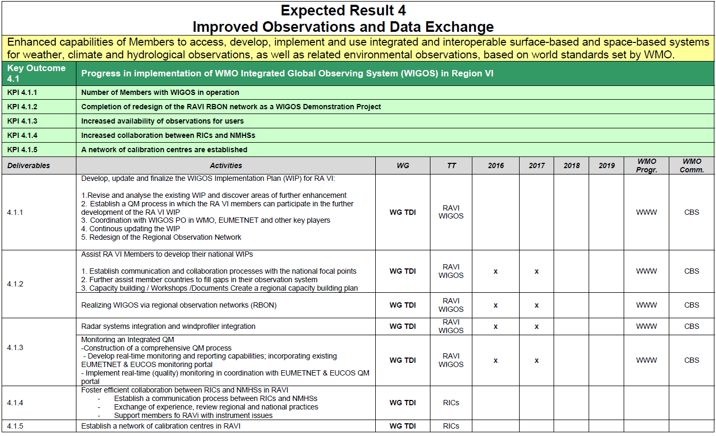

Slide 7
?
?
ISS
ISS
DPFS
DPFS
RMDCN
RMDCN
?
?

Slide 8
2. TT WIGOS Implementation: Key Activity Areas
Regional WIGOS Implementation Plan → 4.1.1 Recommendations for National WIGOS-I → 4.1.2
Proposal / Concept for RWCs in RA VI Pilot Installation “RWC in a Nutshell”
Towards an Entire Radar Network in RA VI → 4.1.3
Analysing Possibilities for RBON in RA VI → 4.1.1

Slide 9
2. TT WIGOS : R-WIP / National WIGOS Implementation
Generic R-WIP for RA VI is already adopted in 2014 and updated in 2017
N-WIP for TSMS has been developed which can be used as a template for other member states
Generic implementation plans are often not helpful enough to solve practical problem of WIGOS Implementation in the member states
Decision of TT WIGOS-I: - Enhance R-WIP / N-WIP with best practice recommendations - Derived from NCs which already implemented WIGOS

Slide 10
2. TT WIGOS : R-WIP / National WIGOS Implementation
Examples:
Integration of synoptical and climatological stations into one national WIGOS network
Recommendations how to integrate radiosoundings, remote sensing data, military stations, partner networks, (…) into the national WIGOS network.
Recommendations how standardisation of technology and stations could be achieved

Slide 11
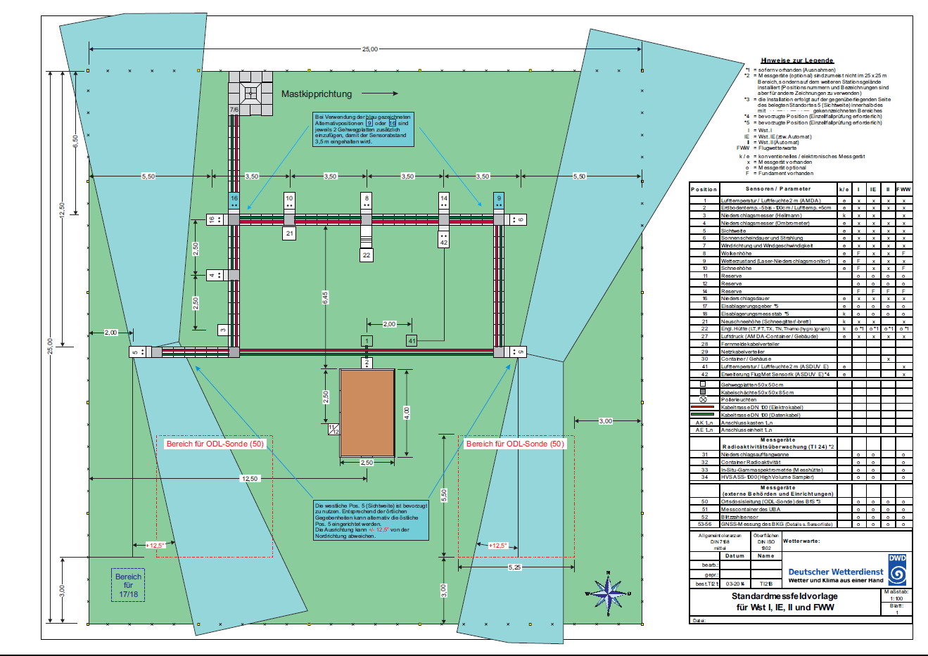
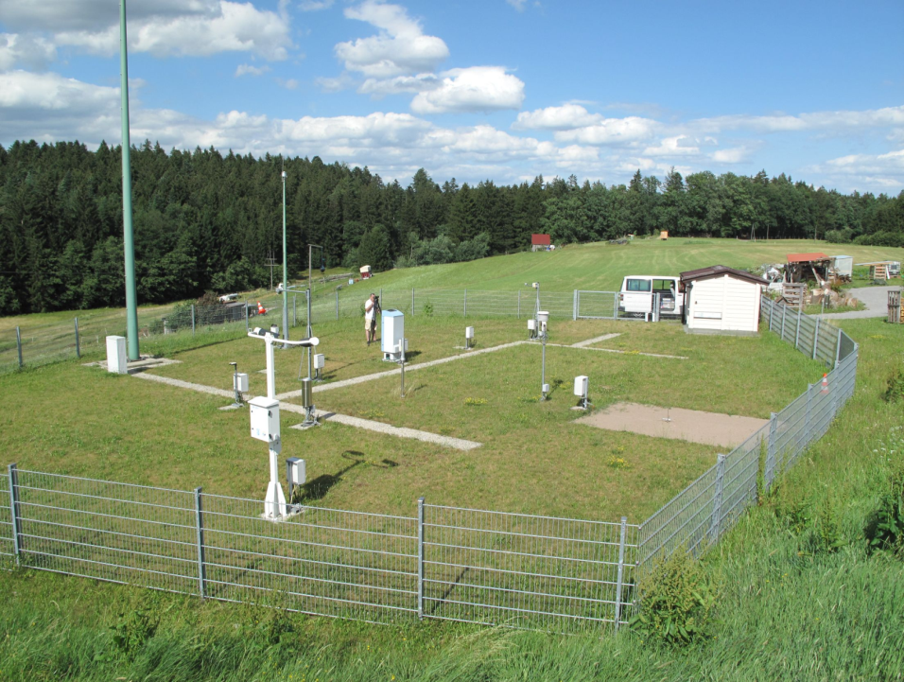
2. TT WIGOS : R-WIP / National WIGOS Implementation
Template for a standard automatic obs station / measure field

Slide 12
2. TT WIGOS : R-WIP / National WIGOS Implementation
Suggestion for interaction of national and private partner networks
Precipitation Network
rain (1min; 10 min)
rain (1h; 6h; 24h)
snow
water equivalent of snow (man. 24h; auto. 10min)
Agricultural Network
air temperature in 2m
soil temperature in 5 cm
soil temperature in 20 cm
soil temperature in 50 cm
relative humidity in 2m in %
wind-speed in 2.5m
global radiation
rain
gust
Road Network
air temperature in 4m
dew point
road-surface temperature
soil temperature
wind-speed in 4m
gust
rain
road-condition
Atmospheric Network
air temperature
humidity
atmospheric pressure
wind-speed + -direction
Wind Network
wind-speed + -direction in several levels
These networks differ a lot in parameters, sensors, frequency, quality and transfer

Slide 13
2. TT WIGOS-I: Regional WIGOS Centers (RWC)
Why?
Many WMO Members requesting support from Secretariat for national implementation efforts
This can be addressed more efficiently and effectively at regional level
What?
Initial role of RWC will be to support national WIGOS Implementation efforts, in particular as concerns
OSCAR/Surface; ensuring metadata input and QC
WDQMS; especially fault management component
How will this be implemented?
To be decided by individual WMO Regions
Initial prototype implementation in RA-VI based on activities of the members in TT WIGOS (WG-TDI)

Slide 14
2. TT WIGOS-I: Regional WIGOS Centers (RWC)
Unique characteristic of Region VI: EUMETNET, which encompasses more than half the WMO RA-VI Members, is already actively pursuing several elements of WIGOS implementation
A strawman concept for a Regional WIGOS Centre for Region VI entered around existing EUMETNET activities currently hosted by DWD has been developed through a series of consultations:
RA-VI Workshop on WIGOS (Belgrade, Nov 2015)
WMO-DWD meeting (Offenbach, Jan 2016)
ICG-WIGOS-5 (Geneva, Jan 2016)
EUMETNET STAC/PFAC (Bratislava, March 2016)
RA-VI MG (Lisbon, May 2016)
EUMETNET Assembly (Prague, May 2016)
RA-VI Task Team on WIGOS (Belgrade, June 2016)

Slide 15
2. TT WIGOS-I: Regional WIGOS Centers (RWC)
Difficult for most NMHSs to identify new resources for such entities
However, it is felt that it would be attractive for many Members to take on responsibility for one or more functionalities
Networking between these active members will motivate and strengthen the cooperation
→Virtual RWC concept in RA VI

Slide 16
2. TT WIGOS-I: Regional WIGOS Centers (RWC)
In RA-VI …
RWCs could be implemented as virtual centers, where a group of NMHSs would share the relevant tasks between them under the overall coordination of one of them (illustrated in the next slide)
RWCs need not cover the Region as a whole; tasks could be shared between Regional WIGOS Centers covering subregions, with areas of responsibilty aligned with existing geographic or linguistic boundaries within the Region
In RA-VI, the existing EUMETNET activities could be strengthened and broadened to encompass several intended RWC functionalities at the WMO level

Slide 17
Proposed functionalities of RWC
Coordination (if implemented as Virtual Center involving more than one NMHSs)
Overarching coordination and communication with all RWCs in the Region, WMO Regional Office, relevant RA Working Groups and Task Teams RA, WMO Secretariat
Communication … and more (Problem Management).
Act as Regional information resource for Members concerning various aspects of WIGOS implementation
Collect and document regional experience with WIGOS implementation and its benefits
Support for education & training in WIGOS implementation, especially concerning
Establishment of partnerships
WIGOS metadata management (OSCAR/Surface)

Slide 18
Proposed functionalities of RWC
(continued)
Technical Support
Regional network management (network design and coordination)
Regional data monitoring & data quality management (WDQMS)
Regional metadata management (OSCAR/Surface)
(Support concerning national data management)*
Linking WIGOS to external entities/ establishing partnerships
Establishing and maintaining links with Regional Oceanographic Groups
Establishing and maintaining links with Regional Climate Centres
Establishing and maintaining links with Regional Instrument Centres
Establishing and maintaining links with Regional Hydrological Groups
Establishing and maintaining links with Regional Training Centres

Slide 19
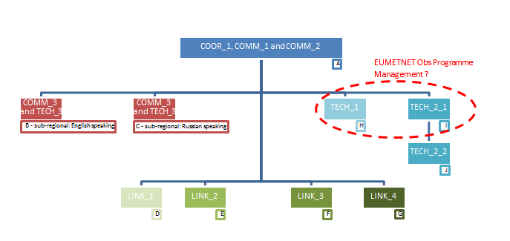
Structure of (virtual) RWC in RA VI
WMO
→confirmed

Slide 20
RA VI RWC “in a nutshell” – preliminary operation til summer 2017
The roles of the RWC are assign to voluntary TT members. This group forms a “RWC in a nutshell”
Currently involved: TSMS, EUMETNET, DWD, UKMO, Bosnia-Herzegovina, Serbia, Lebanon
“RWC in a nutshell” operate and “experiment” like a real RWC would do it.
Foreseen operational and “experimental” tasks:
Filling “OSCAR/Surface” (data base) with metadata of RA VI (task 6.3.3 from RA VI WIP)
WIGOS Quality monitoring
Extent the AMDAR Program to aircrafts of Turkish Airlines (task 1.2.4 from RA VI-WIP)

Slide 21
Nutshell Task 1: Filling OSCAR surface data base
Improvement of OSCAR/Surface stations in WMO RA VI
Continuous import and comparision with local DWD database (locating significant differences in name/lat/lon/elevation)
Detecting stations which are not listed in OSCAR but report via GTS (up to 100 at present)
Using WMO forum to communicate results and offer assistance Volunteers: Bosnia and Herzegovina, Turkey and Lebanon
Informing local NFP in case of differences

Slide 22
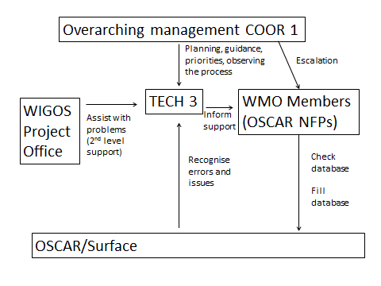
Nutshell Task 1: Filling OSCAR surface data base (Process diagram)
TSMS/chair WG TDI
DWD
UK
Lebanon
Bosnia-Hz
Turkey

Slide 23
Nutshell Task 2: WIGOS Data Quality Monitoring
Improvement of WIGOS Data Quality
EUMETNET Obs Programme runs operationally the RA VI QM portal, displaying information on SYNOP and radiosonde data
EUMETNET Obs Programme Management Team provided training to staff member (Kemal S.) of Federal Hydrometeorological Institute of Bosnia and Herzegovina in December 2016
FHI BH staff member carried out the monitoring tasks
- Countries monitored: Bulgaria, Bosnia and Herzegovina, Serbia, Turkey
- Focus on availability (‘silent stations’), timeliness and SYNOP stations with permanently high sea level pressure RMS errors

Slide 24
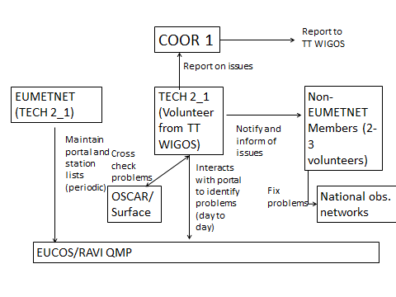
Nutshell Task 2 : WIGOS Data Quality Monitoring System (Process diagram)
TSMS/chair WG TDI
Bosnia-Herzegovina.
EUMETNET

Slide 25
Nutshell Task 2: WIGOS Data Quality Monitoring
Lessons Learnt
Most prominent issues with observing stations: there’s a number of stations with non precise position meta data having adverse effect on observation accuracy -> clear need to properly maintain OSCAR
Communication with people in charge of obs networks was difficult (e.g. little time for real conversation on issues)
Resolving of reported issues was hardly observed
Display of information in Monitoring Portal could be further improved
- Wish for one comprehensive monitoring tool which e.g. immediately displays a geographical map with ‘reported’ station position when clicking on station ID… - Shortlists of stations where errors exceed certain thresholds
In-depth analysis of apparent issues was often much more time consuming than originally expected -> if RWC on QM should be operationalised this requires sufficient staff resources

Slide 26
WIGOS Partnership: Expand AMDAR coverage with Turkish Airlines
Negotiations TSMS – Turkish Airlines still in progress
→ Task will delay

Slide 27
Next steps foreseen …are too ambitious !!
“RWC in a nutshell” will operate until next RA VI plenary
The nutshell experiment will finish before next RA VI plenary
Progress report at the next RA VI management group meeting
Presentation of the results at the next RA VI plenary
Decision for the RA VI plenary will be prepared
Depending on the decision a RWC designation process for RWC in RA VI could be established

Slide 28
2. TT WIGOS : Proposal for RBON Concept
Combined network of RBSN and RBCN
Institutional meteorological network in RA VI
- Homogeneous distribution of the observation stations in a country - Standardized measurement technique - If possible RBON-stations with CIMO classification number 1 till 3 - Transmission of high frequency observation data - Future: 10 minutes transmission in BUFR
Sensible proposal for deconcentration of observation stations in south-east Europe

Slide 29
2. TT WIGOS : Proposal for RBON Concept
RBSN-stations are plotted
Sensible Deconcentration (needs „political support“)

Slide 30
2. TT WIGOS : Towards an Entire Radar Network in RA VI
Existing Radar Networks in RA VI
OPERA (31 members, 216 radars)
BALDRAD (10 members
NORDRAD ( 5 members, 32 radars)
82 Radars in RA VI are not organized in sub-regional Networks
Proposal of TT-WIGOS: Establish 2 additional sub-regional Radar Networks
BLACKRAD (11 members round the Black See)
SEERAD (South East European Radar Network: 29 members)
note: former proposed BALKANRAD Network is now included in SEERAD

Slide 31
2. TT WIGOS Implementation: Conclusion
KPI 4.1.1 (Number of WIGOS compliant NMHSs) → Red - Amber
KPI 4.1.2 (RBON as a demo project) → Red - Amber
KPI 4.1.3 (Entire radar coverage) → Green – Amber
Suggestions for the next intersession period:
Strengthen TT with subordinate bodies
Foci: National Support, RBON, RWC Concept, RWC Designation Process

Slide 32
3. TT RIC: Key Activity Areas
Collaboration / Communication RICs – NMHSs → 4.1.4
RA VI Network of Calibration Centres → 4.1.5 Pilot Installation “RWC in a Nutshell”

Slide 33
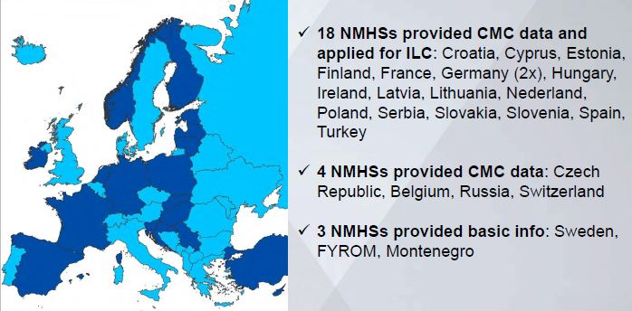
3. TT RIC: Collaboration & Support for NMHSs
Inter-laborotory comparison & capability survey Including basic parameters (temperature, pressure, humidity)
Survey finished: Dez 2016
Report finished: Jun 2017
Capability data base
CMC data published on WMO web site

Slide 34
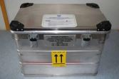
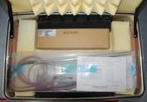
3. TT RIC: Future Support for NMHSs
Support to improve data quality of NMHSs – RICs provide transferable call. kits
Capacity building for NMHSs - RICs provide calibration reference standards in order to establish traceability functions in data dissemination - RIC prepare “hands-on” training on the job (limited resources)

Slide 35
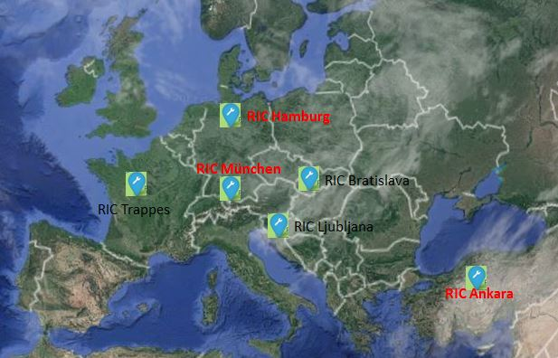
3. TT RIC: Enhancing the RA VI – RIC – Network
3 new RICs in designation process Ankara, Hamburg, München
Accredited labs according to ISO 17025
Parameters: Wind, pressure, temperature, humidity, precipitation

Slide 36
3. TT RIC: Conclusion
KPI 4.1.4 (Collaboration RIC – NMHSs) → Green
KPI 4.1.5 (RIC-Network) → Green
Suggestions for the next intersession period:
Keep TT-RIC in current configuration
Foci: Fullfill the ongoing tasks

Slide 37
4. TT MTDCF: Key Activity Areas
Coordination & Supervision of the Migration to TDCF in RA VI → 4.2.2
Support to RA VI Members → 4.2.2

Slide 38
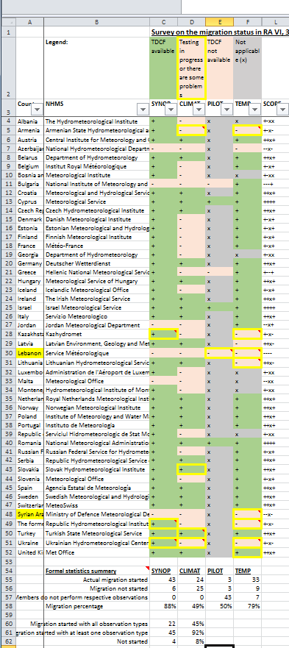
4. TT MTDCF: Coordination & Supervision of the Migration
Small TT: A. Kats (Russ Fed.), S. Krebber (Ger)
Both highly regarded & networked in community
Both members of IPED-DRMM
Provide survey / report regularly
BUFR diss. Is reality since Nov. 2014
Diss, of TAC is diminishing
Migration fullfiled in RA VI: Synop: 80 %; Temp: 79 % Pilot: 50 %; Climat: 49 %
RAVI is leading WMO region

Slide 39
4. TT MTDCF: Support to RA VI Members
Due to the small team …
Support is given in form of personal advice to the focal points
Training events organized by the TT are not possible - TT required from WIS-centres to organize training events in their areas of responsibility - MTDCF, however, is not a task of a GISC or DCPC

Slide 40
4. TT MTDCF: Conclusion
KPI 4.2.2 (Number of TDCF compliant NMHSs) → Amber - Green
Problems: - A few member states are in danger to be left behind - Establishing a TT which is strong enough to fulfil all the tasks - GRIB migration, training events, analysis of discrepancy to WMO monitoring
Suggestions for the next intersession period:
Supervision of MTDCF is still necessary during the next period
If a strong TT could not be established in the next period Downgrade to a Rapporteur of MTDCF

Slide 41
5. TT RMDCN: Key Activity Areas / Problems
Monitor status of RMTN → Rapporteur ISS (4.2.2) Support members to be connected to RMDCN → TT-RMDCN (4.2.2) → CBS-TT, Interroute Support implementation of OPAC-ISS recomm. → CBS-TT
Migration to RMDCN-NG → CBS-TT, Interroute
Problems:
Conflict with CBS-TT RMDCN
RA VI TT-RMDCN could never be established

Slide 42
5. TT RMDCN: Support with the Connection to RMDCN-NG
Some “Independent States” and Arabic States are still not connected to RMDCN-NG
Interroute offers two low budget service levels “IRON A” & “IRON B”
Even these low budget connections seem not to be attractive to these countries
RTH/GISC Washington stepped back from RMDCN connection and established a pure internet connection
RMDCN will be facing severe problems in the future
RA VI should leave the solution of these issues to CBS (and eventually to Interroute)

Slide 43
5. TT RMDCN: Conclusion
KPI 4.2.2 (Number of NMHSs connected to RMDCN-NG) → Amber – Red
Suggestions for the next intersession period:
Dismiss RA VI TT-RMDCN and wait for next concept from CBS
Monitoring task (RMDCN-connections) is excellently fulfilled by Rapporteur ISS

Slide 44
6. Rapporteur WIS: Key Activity Areas
Status on Implementation of WIS requirements → 4.2.1
Assessment of WIS operation in RA VI → 4.2.1
Evolution of WIS requirements in RA VI → 4.2.1

Slide 45
6. Rapporteur WIS: WIS assessment (Implementation & Operation)
Updated list of WIS focal points – regular contacts - 3 national focal points not yet nominated (Albania, Lebanon, Syria) - Follow up: WMO ROE to urge PRs
Survey of WIS within RA VI - Assessment of the achieved, ongoing and planned activities regarding WIS implementation by NMHSs (see next slide). - Follow-up: WMO ROE to host next surveys on its website

Slide 46
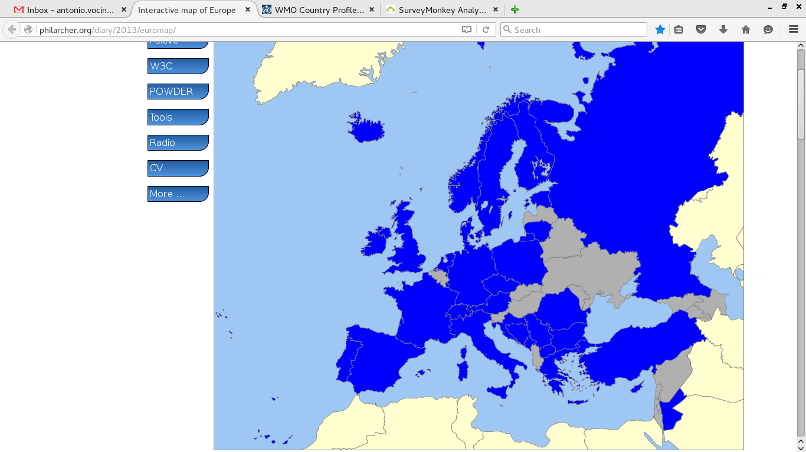
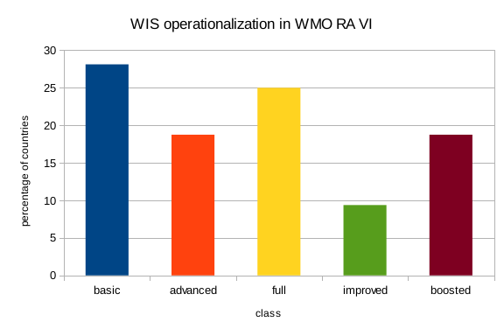
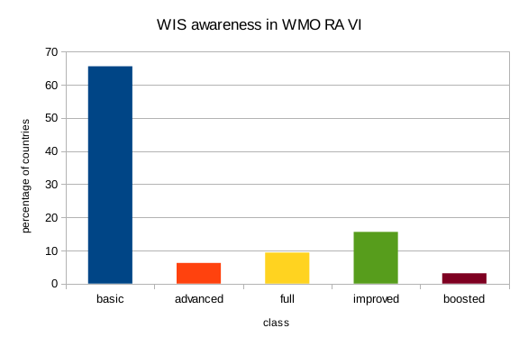
6. Rapporteur WIS: WIS assessment (Implementation & Operation)
Based on direct feedback from WIS National Focal Points, indicators about:
WIS operationalization in RA VI, with respect to the Regional WIS Implementation Plan
WIS awareness of members, in particular on improvements of Data Management processes
have been assessed by the rapporteur.
The results are in line with the outcome of “Questionnaire on Impacts of Achieved Results on Members” (WMO 2015).

Slide 47
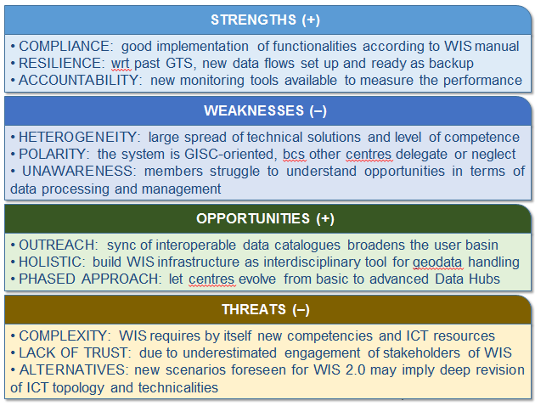
6. Rapporteur WIS: Towards RA VI Requirements on evolution of WIS
SWOT Analysis of WIS operation in WMO RA VI

Slide 48
6. Rapporteur WIS: Towards RA VI Requirements on evolution of WIS
As key objective of the Regional Operating Plan, the WIS played a primary role within WG-TDI. WMO Secretariat and ROE continuously supported the work of the Rapporteur, with the added value of the WG Chair vision and guidance.
Given the importance and the implications of the current and future WIS requirements on NHMSs activities, keeping a special focus on it is recommended for the next phase.
The working mechanism, based on a single focal point/rapporteur, should be complemented by a closer cooperation with CBS ETs (OPAG-ISS) to ensure better communication from/to the member states.
The evolution of the WIS should take into account the weaknesses demonstrated so far. A more balanced trade-off between WIS concept (the vision) and WIS capacity (the real world) is necessary to drive the system from a niche expertise to a shared knowledge.
Finally, efforts should facilitate the implementation and the development of the WIS across the Programs and the works of Technical Commissions of WMO (including JCOMM), avoiding duplicated and independent similar initiatives. WIS should be perceived as a real common infrastructure.

Slide 49
6. Rapporteur WIS: Conclusion
KPI 4.2.1 (WIS implementation 6 operation in RA VI) → Green
In conclusion: - Strength of WIS: Data discovery / Metadata - Weakness of WIS: Real time data exchange / 24 h cache concept → Development of WIS 2.0 (data cache in the cloud)
Suggestions for the next intersession period:
CBS will develop WIS 2.0 with cloud technologies
Rapporteur WIS has to observe activities (WG TDI-chair is member of TT eWIS)
Keep Rapporteur WIS for the next intersession period
When WIS 2.0 has to be implemented → Upgrade to RA VI TT WIS necessary

Slide 50
7. Rapporteur DPFS: Key Activity Areas
Deliverables: → 3.1.2, 4.2.1

Slide 51
7. Rapporteur DPFS: Conclusion
KPI 3.1.2 (Awareness of improvements of NWP) → Green
KPI 4.2.1 (Development NWP severe weather) → Green
Suggestions for the next intersession period:
Keep Rapporteur DPFS with his ongoing observation & reporting tasks
Nominate RA VI representative for “EC Steering Group on Future Seamless GDPFS” (already in process)

Slide 52
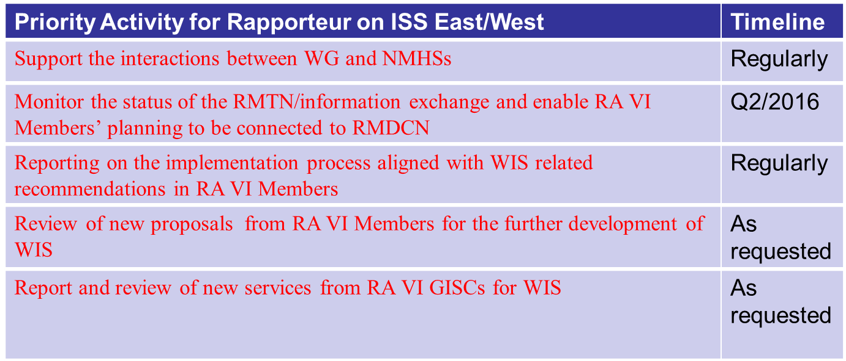
8. Rapporteur ISS: Key Activity Areas
→ 4.2.1
Rapporteur ISS West focusses on AvXML and IWXXM!

Slide 53
8. Rapporteur ISS: Support interactions WG - NMHSs
The interactions between Rapporteur on ISS and NMHSs were carried out in the direction of:
- changing RMTN circuit technical features;
- searching data and changing data reception routes;
- real-time and non-real-time monitoring of primary data type collection (SYNOP, Upper-Air, CLIMAT), analysis of collection deficiencies and their correction.
Outcome: SYNOP data collection in Eastern Europe was above 98 per cent as a result of deficiency correction in message formatting and bringing the meteorological bulletin catalogue (Volume C1) to conformity with current observations.
Upper-Air data collection in Eastern Europe increased insignificantly owing to the lack of observations.

Slide 54
8. Rapporteur ISS: Support interactions WG - NMHSs
Comments
Real-time monitoring of SYNOP data collection has revealed major deficiencies in data collection of Italy, Croatia and Norway. Some stations of those countries do not transmit data at all or do not transmit data at regular intervals. Careful analysis of data arrival from Italy as compared with the data scheduled in Volume C1, Volume A, RBSN, OSCAR has discovered discrepancies between the documents listed and deficiencies in formatting the bulletins in Volume C1. So, for example, in Volume A, Stations 16033, 16138, 16470, 16539 are envisaged to be transmitted at all the hours except for 00 and 03 UTC6; they are present in RBSN. In Volume С1, they are foreseen to be transmitted at all the hours and in OSCAR, transmission hours are not provided. Therefore in the results of the last AGM that was conducted according to the list of OSCAR stations, the data arrival from those stations has been estimated as 75 percent. The same is true for the additional list of stations: 16040, 16045, 16261, 16337, 16434, 16453. Station 16072 is present in Volume С1, absent in Volume А and not transmitted.

Slide 55
8. Rapporteur ISS: Support interactions WG - NMHSs
Conclusions and suggestions
Conclusions: Part of RА VI Members does not monitor the content of Volume С1, Volume А, RBSN, RBCN, OSCAR and their compatibility. A number of RA VI Members does not analyse the results of real-time/non-real-time monitoring (AGM, IWM). As a consequence, the deficiencies in observation data transmission occur over and over again.
Suggestions:
1. Attract attention of Members to the necessity of regular maintenance of Volume C1, Volume A, RBSN, RBCN, OSCAR and their compatibility.
2. Suggest that Members analyse the monitoring results and remove the deficiencies discovered.
3. Assign a regional expert (experts) regarding the maintenance of a regional part of Volume С1, Volume А, RBSN, RBCN, OSCAR, charging him/her or them with the analysis of the quantative monitoring results and support of Members in deficiency correction.

Slide 56
8. Rapporteur ISS: Carry out RMTN – RMDCN – WIS Monitoring
- A number of RMTN circuits more than doubled, in general, due to AMDCN arrangement and GISC backup;
- Annually the RMTN scheme (including RMDCN) was updated, taking into account comments and suggestions responsible for RTH. Now it is available updated (See on the following slide)

Slide 57
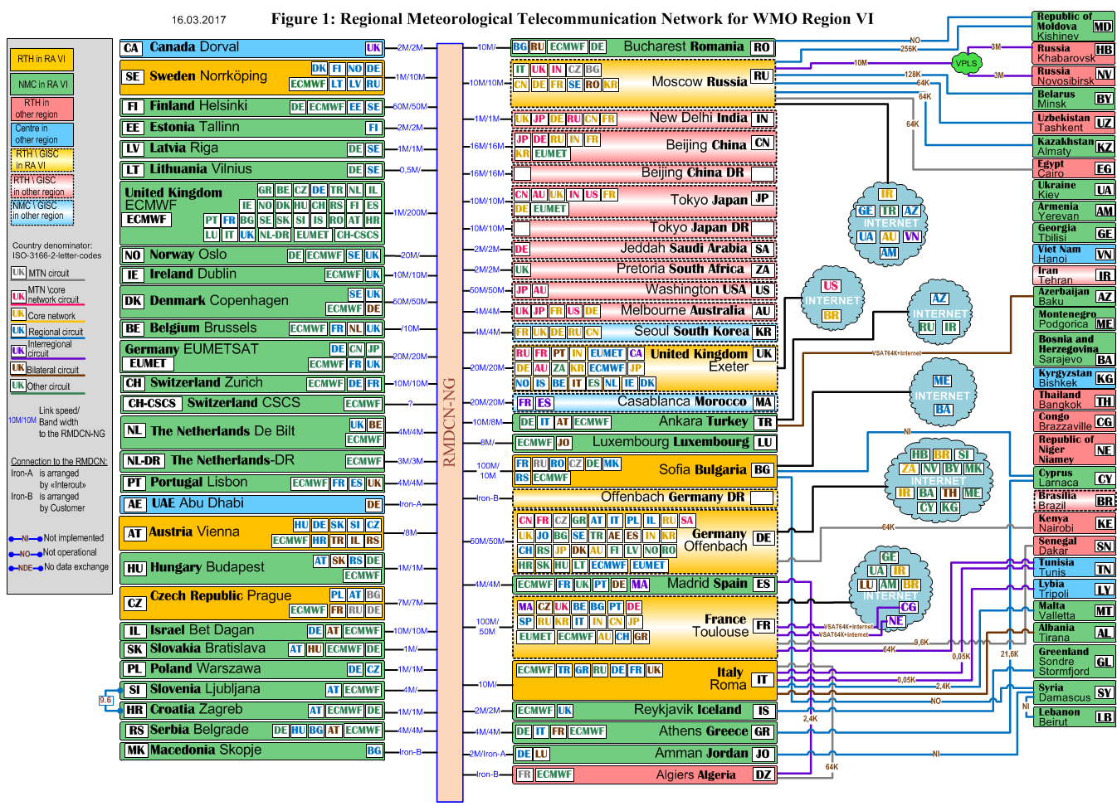
8. Rapporteur ISS: Carry out RMTN – RMDCN – WIS Monitoring

Slide 58
8. Rapporteur ISS: Carry out RMTN – RMDCN – WIS Monitoring
Comments and suggestions
Circuit naming in the RMTN/RMDCN scheme corresponds to the names accepted in Manual on GTS and Manual on WIS, except for the circuits named as «Other circuit», which are arranged within the framework of AMDCN creation and GISC backup setting.
Suggested:
1. The circuits arranged within the framework of AMDCN creation and GISC backup setting be named thereafter as «Other WIS circuits».
2. Changes in the RMTN/RMDCN scheme occur quite often, therefore in order that it be actual, it should be updated at least once a year and located at the WMO site.

Slide 59
8. Rapporteur ISS: Carry out RMTN – RMDCN – WIS Monitoring
3. Support Members which should be connected to RMDCN in RA VI
- A document with explenatory notes on the types of connection to RMDCN, including Internet (Iron-A and Iron-B) and the cost of connection/operation in RMDCN was prepared and circulated to 13 RA VI NMHSs;
Additional clarification was provided by phone or e-mail
Outcome: The majority of NMHSs cannot be connected to RMDCN due to the lack of funding required. Some NMHSs will try to ask for funding for the further fiscal period to be connected to RMDCN.

Slide 60
8. Rapporteur ISS: Carry out RMTN – RMDCN – WIS Monitoring
Comments and suggestions
Connections to RMDCN of RA-VI NMHSs needing support are still possible.
Suggested that an expert be assigned within the framework of WG-TDI who would follow the changes in the RMTN/RMDCN scheme and support the NMHSs wishing to be connected to RMDCN. The expert should be a member of ROC. It is obviously possible to combine this activity with the activity of the expert on the issues of support of a regional part of Volume C1, Volume A, RBSN, RBCN, OSCAR and the analysis of the quantative monitoring results and support of Members in deficiency correction.

Slide 61
Thank you for your kind attention

Slide 62
