Slide 1
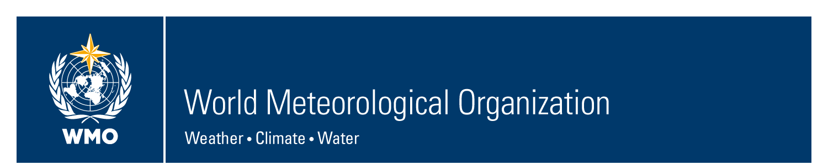
WMO, 5th Meeting of the RA VI Management Group, 26-28 April 2017, Vilnius, Lithuania
Working Group Climate and Hydrology
Cristina Alionte Eklund and Ernesto Rodriguez Camino

Slide 2
Vision of the WG Climate and Hydrology
Contribution to WMO activities
Special focus on GFCS
Climate and Hydrological services
Support of NMHSs enhance capacities

Slide 3
Work plan, overview
Regional Climate Centers and Regional Climate Outlook Forum (climate)
Climate Watch System (climate)
Agricultural Meteorology (joint)
Water Scarcity and Drought (joint)
Hydrological modeling, forecasting and warning (Hydro)
Data operations & Management (joint)

Slide 4
Development of activities
Joint activities Climate and Hydrology are well established, but improvement still needed
Probably too optimistic with the operational plan
Problems with recruitment process of task team members. Lack of engagement by experts/institutions.
Gender and regional balance an issue
4 teleconferences and one face-to-face meeting coinciding with Hydrology Forum (Oslo, Sept. 2016).

Slide 5
TT RCCs and RCOF: Leader J.-P. Ceron (France)
TOR (excerpt):
Provide overall guidance, assistance and support for the implementation of the GFCS in Region VI
Cooperation with relevant regional bodies and organizations on issues related to implementing climate and hydrology services
Foster & promote best practices in establishing and implementing national GFCS
Promote enhanced utilization and broadening of WMO RCC Network products and services, based on user requirements and effectiveness
Improve link between the RCCs and RCOFs and assist RCOF mechanism in RA VI and the inter-regional COFs
Develop methods and mechanisms to analyze requirements and feedback on effectiveness, gaps and improvement of RCOF and RCC services
Include downscaled LRF products in RCOFs practice and provide training on downscaling technologies to NMHSs
Provide assistance in strengthening RCOF mechanisms in RA VI including hydrological and agrometeorological information and implementation of Climate Outlook Forums, under the technical guidance of WMO RCCs

Slide 6
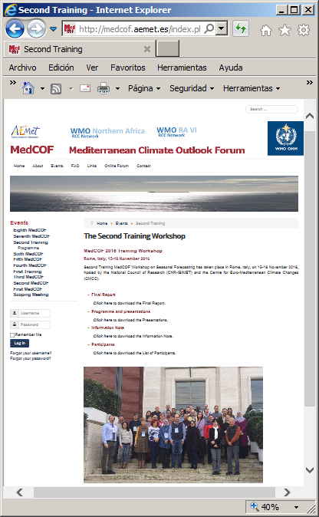
Targeted training for RCOFs
!st MedCOF Training Workshop (Madrid, Oct 2015)
2nd MedCOF Training Workshop (Rome, Nov 2016)
Planned 3rd MedCOF Training Workshop (Zagreb, Nov 2017)

Slide 7
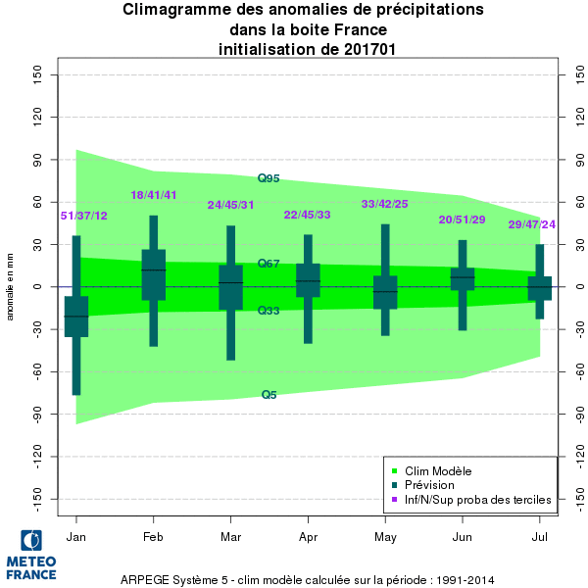
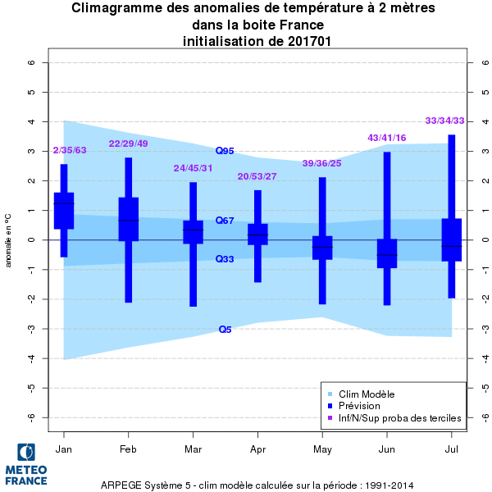
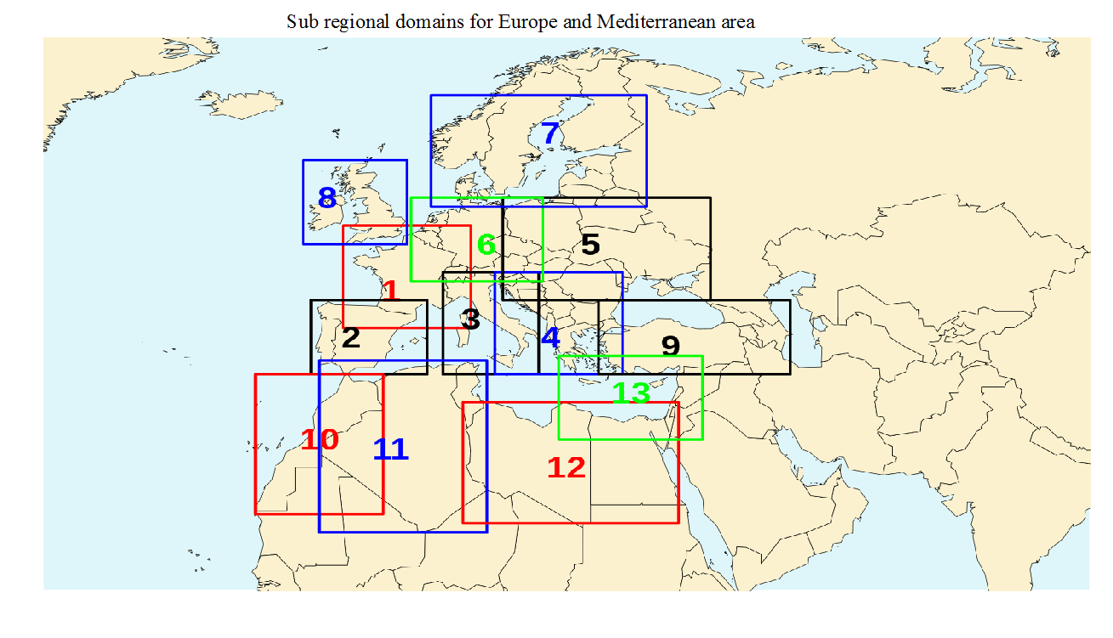
Work in progress to improve LRF verification, monitoring, etc. (including C3S, RCCs, RCOFs)
Coordination between regions to produce agreed products.
Fluent link between the RCCs and RCOFs through RCOFs MG

Slide 8
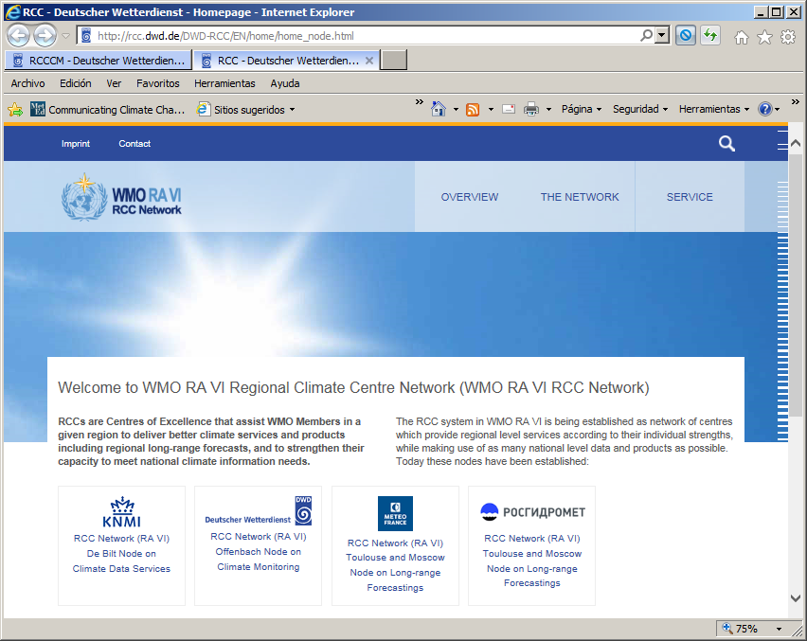
Review of RAVI RCC Network
RAVI RCC Network has already a few years history.
Time to review implementation → RCC workshop and 3rd coord. meeting of RA VI RCC Network (Nov 2016, Belgrade, Serbia.)
First milestones towards a new RCC Operation Plan were defined. Further aspects were taken into consideration, such as outreach and website, the CWS, the role of the RCC Network in RCOFs, training functions, the future Arctic Polar RCC, and funding options.

Slide 9
TT RCCs and RCOFs:
Achievements May 2015 – April 2016
MedCOF 7 meeting in parallel with SEECOF/PRESANORD in November 2016.
Targeted training for RCOFs (Rome, Nov 2016)
RCC workshop (Belgrade, Nov 2016)
Fluent link between the RCCs and RCOFs through RCOFs MG
Work in progress to improve LRF verification, monitoring, etc. (including C3S, RCCs, RCOFs)
Expansion of RAVI RCC network to the North → Polar RCC

Slide 10
TT Climate Watch System, Leader: Hermann Mächel (Germany)
TOR (excerpt):
Develop guidance for Climate Watch implementation at regional, sub-regional and national level, considering inclusion of hydrological and agrometeorological aspects,
Develop methods and mechanisms to analyze requirements and feedback on effectiveness, gaps and improvement of Climate Watch implementation at regional, sub-regional and national level based on the pilot projects developed in the previous period,
Promote enhanced utilization and broadening of WMO RCC Network products and services, ensuring a good coordination with RCCs and RCOFs in the region

Slide 11
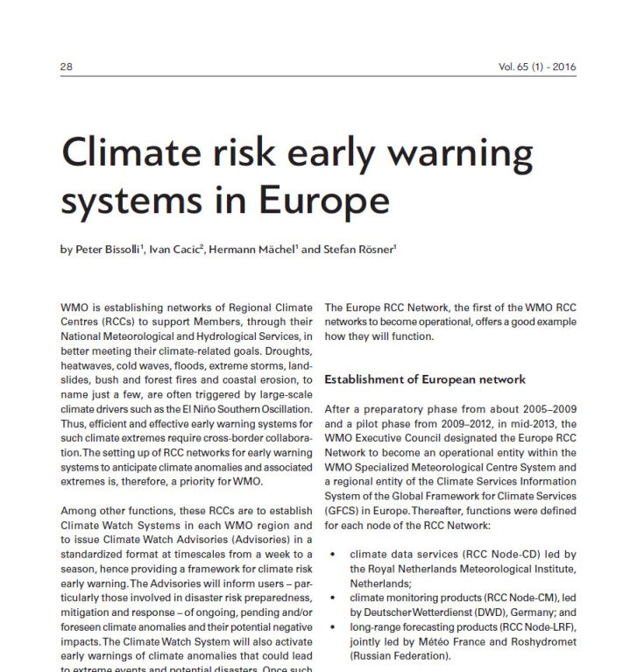

Increasing the awareness of Climate Watch System (CWS) by publishing an article in the WMO Bulletin

Slide 12
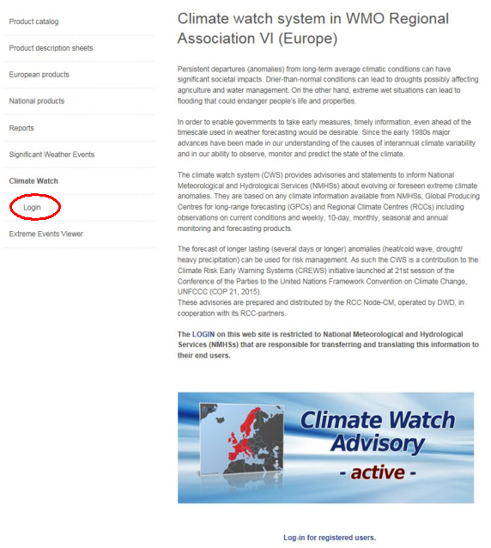
Climate Watch Advisory - Website
New established website with restricted access, but
free for all NMHSs of the WMO - RA VI
Special reports on selected climate events. See:
www.dwd.de/rcc-cm

Slide 13
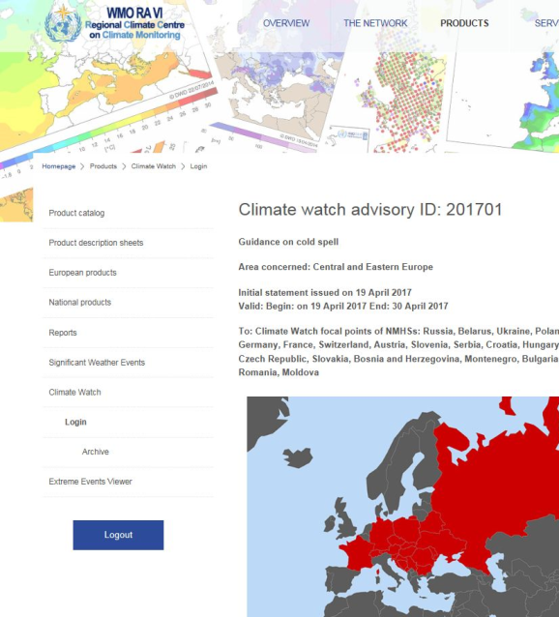
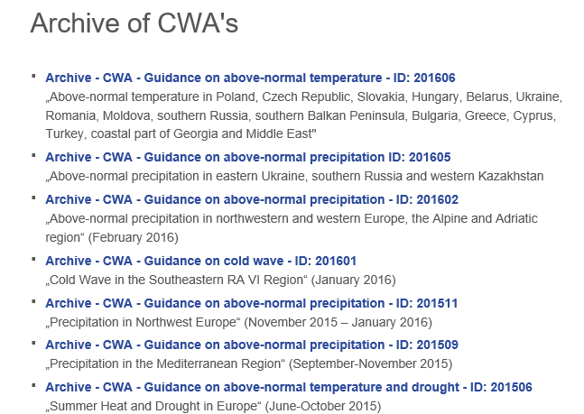
Climate Watch Advisory - Website
Current advisory issued on 19th April 2017 for Central and Eastern Europe that was send to the focal points of the affected countries
via e-mail.

Slide 14
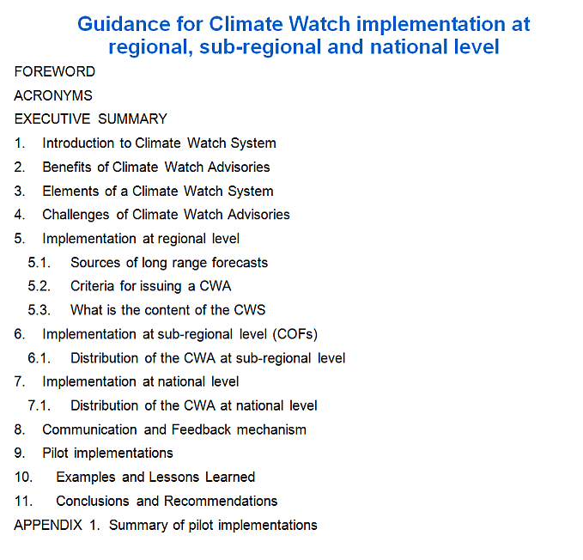
Guidance for Climate Watch Implementation
The proposed structure of the guidelines document.
The finalization of the document will need several additional iterations.
Problematic to recruit active Task Team members.

Slide 15
TT Climate Watch System:
Achievements May 2016 – April 2017
CWS Website accessible on the RCC web page
Promote enhanced utilization and broadening of WMO RCC Network products
Not enough feedback from users of climate watch advisories.
Guidance for Climate Watch implementation based on the pilot’s experiences→ behind schedule (only ready the structure of the document)

Slide 16
TT Agricultural Meteorology, Leader: Josef Eitzinger (Austria)
TOR (excerpt):
Identify methods and results of economic studies of agrometeorological products/services and develop recommendations,
Tailor the agrometeorological services and products at local level, taking into account climate change impacts on the whole agricultural production chain, including related training and education,
Evaluate hydrological data bases, products and services and explore the opportunities of synergies with the hydrological activities of relevance for agricultural meteorology.

Slide 17
The economic impacts of agrometeorological information in Europe
  Subtasks:
  ● Literature survey on up to date methods (9.1)
  ● List of existing research activities in the field of economic assessments of adaptation options (i.e. cooperation with MACSUR project) (9.1)
  ● Collection of new case studies, incl. estimation of potentials of agrometeorological information (reality vs. optimum) (9.2) (completed in 2016)
  ● Recommendations (9.3) (completed in 2016)

Slide 18
Tailoring agrometeorological services and products at local level, taking into account climate change impacts/adaptation on the whole agricultural production chain
  Subtasks:
  ● Literature review/update on operational methods, services and products (10.1)
  ● Case studies of related activities of services out of NMHs i.e. agricultural insurances and service cooperations with NMHs (good practices) (10.2) (completed in 2016)
  ● Specific evaluation of operational products/services related to extreme meteorological events (i.e. Meteo-Alarm) (10.3) (completed in 2016)
  ● Evaluation on available data bases/gaps/technologies (10.4) (addressed only partly and is a suggested focus for the next intersessional period)
  ● Develop recommendations (10.5) (completed in 2016)

Slide 19
Evaluation of hydrological data bases, products and services for agrometeorological issues (in coop. with hydro-meteorological task teams)
  ● Review and assess potential of cross cutting issues for related agrometeorological problems (i.e. irrigation water management, soil erosion, flooding and soil wetness); reporting based on available case studies (11.1) (completed in 2016)
  ● Recommendations (11.1)
  -how synergies could be better used (of data, services)
  -improving related products and services

Slide 20
TT Agricultural Meteorology:
Achievements May 2016 – April 2017
Numerous contribution from experts (including outside the nominated ones) (*)
Detailed intermediate and final report of the TT available.
Clear reporting schedule for activities/deliverables with responsible persons assigned to each of them.
(*) With contributions from the actual expert team members:
J. Eitzinger¹, A. Susnik², B. Lalic³, L. Dekic¹⁰, D.P. Anastasiou⁴, P. Struzik⁵, M. Kepinska-Kasprzak⁵, E. Mateescu⁶, F. Rossi⁷, L. Mariani⁸, S. Parisi⁸, L. Saylan⁹, V. Vucetic¹¹, P. Svilicic¹¹, M. Trnka¹², H.H. Schmitt¹³, J. Kozyra¹⁴

Slide 21
TT Water Scarcity and Drought, TT: Silvano Pecora (Italy) & Sandor Szalai (Hungary)
TOR (excerpt):
Review and strengthen drought monitoring systems, especially development and implementation on methodologies as well as application of related information by users, in RA VI countries, considering existing mechanisms as well as deficits in drought information services
Identify the scope for, and implementation of, Integrated drought management w.r.t. water resources and agriculture
Provide annual progress reports in due time before the end of the year and a final report as soon as the tasks are implemented, but preferably not later than 6 months before the next session.

Slide 22
TT Water Scarcity and Drought:
Achievements May 2016 – April 2017
Periodic Telecons and Annual Reports
International conferences participation
  ECCA, EWAS2, WMO (RA VI, CHy-15, UNCCD)
Data and analysis
  CarpatClim, EDO, data brokering and standardization (WMO services): data homogeneisation, publications
Monitoring
  Hydrological monitoring; soil moisture (Remote sensing, in situ,model harmonisation)
Adaptation
  Mountain regions; Enhance FP7 Project; Center for Water Sustainable Development and Adaptation to Climate Change (WSDAC,Serbia)
Capacity building and networking
  DMCSSE (WMO and UNCCD); EDO, EDC
  IDMP (project and follow up); GWP/GWP CEE
European project (FP7, H2020, INTERREG)/International projects
  Climate KIC-FWOO; Copernicus C3S; Central Europe Proline-CE; ENHANCE; UNCCD

Slide 23
TT Hydrological Modeling, Forecasting and Warning,
Leader: Eric Sprokkereef (Netherlands), since Sept 2016
TOR (excerpt)
Follow up, coordination and support EFAS, FFGS and other WMO-CHY and EC activities.
Organize RA VI Workshop-training on hydro modeling, forecasting and warning services.
Identify and follow up relevant activities in RA VI (focus on transboundary hydro modelling) and disseminate outcomes to the RA VI Members.
Follow up development of WMO FFI proposal for a Framework for the assessment of service Delivery capabilities of hydrological services.

Slide 24
TT Hydrological Modeling, Forecasting and Warning
Achievements May 2015 – April 2016 (1)
Follow up and coordination with COPERNICUS/EFAS, METEOALARM and WMO-FFGS SE Europe:
  Most of the WMO RAVI members are part of the EFAS Network;
  WMO was invited to the EFAS Annual meeting 2016; presented Flash Flood Guidance System (FFGS);
  WMO-FFGS/South East Europe Flash Flood Guidance System; presented at the Hydrology Forum, Sept 2016; common view on better understanding and coordination with regard to use of flash floods products produced by EFAS and FFGS SE Europe;
  METEOALARM invited at the Hydrology Forum/Workshop in Sept 2016;
  EFAS Annual meeting 2017- back-to back with METEOALARM meeting;

Slide 25
TT Hydrological Modeling, Forecasting and Warning
Achievements May 2015 – April 2016 (2)
RAVI Workshop on hydro modeling, forecasting and warning services
  20 Sept 2016, back-to-back with the Hydrology Forum;
  Session1: "Hydrological forecasting, warning and communication with end-users”
  Session 2: "Remote Sensing and Hydrological Modelling, Forecasting and Warning”
  Session 3: “Flash Floods and Urban Floods”

Slide 26
TT Hydrological Modeling, Forecasting and Warning
Achievements May 2015 – April 2016 (3)
Identify and follow up relevant activities in RA VI (focus on transboundary hydro modelling) and disseminate outcomes to the RA VI Members
  Short review on relevant projects and activities in RAVI focused on transboundary hydrological modelling;
    Compiled by Mr. Dejan Komatina (Sava River Commission) with input from the other River Commissions in the region
  Best practices on Probabilistic Forecasting, draft proposal prepared by RWS/Deltares (the Netherlands)
Follow up development of WMO FFI proposal for a Framework for the assessment of service Delivery capabilities of hydrological services.
  the issue seems to be restarted during the next intersessional period of CHy;

Slide 27
TT Data operations & Management: Jose Antonio Guijarro (Spain) & Harry Dixon (UK)
TOR (excerpt):
Maintain and improve existing Website on Data Rescue, including information on available digitized data, data rescue projects, homogeneity methods;
Support the design and optimization of monitoring;
Provide support to standards development,
Maintain support for monitoring systems,
Encourage harmonization of methodologies for quality control and access to data,
Promote data exchange and sharing.

Slide 28
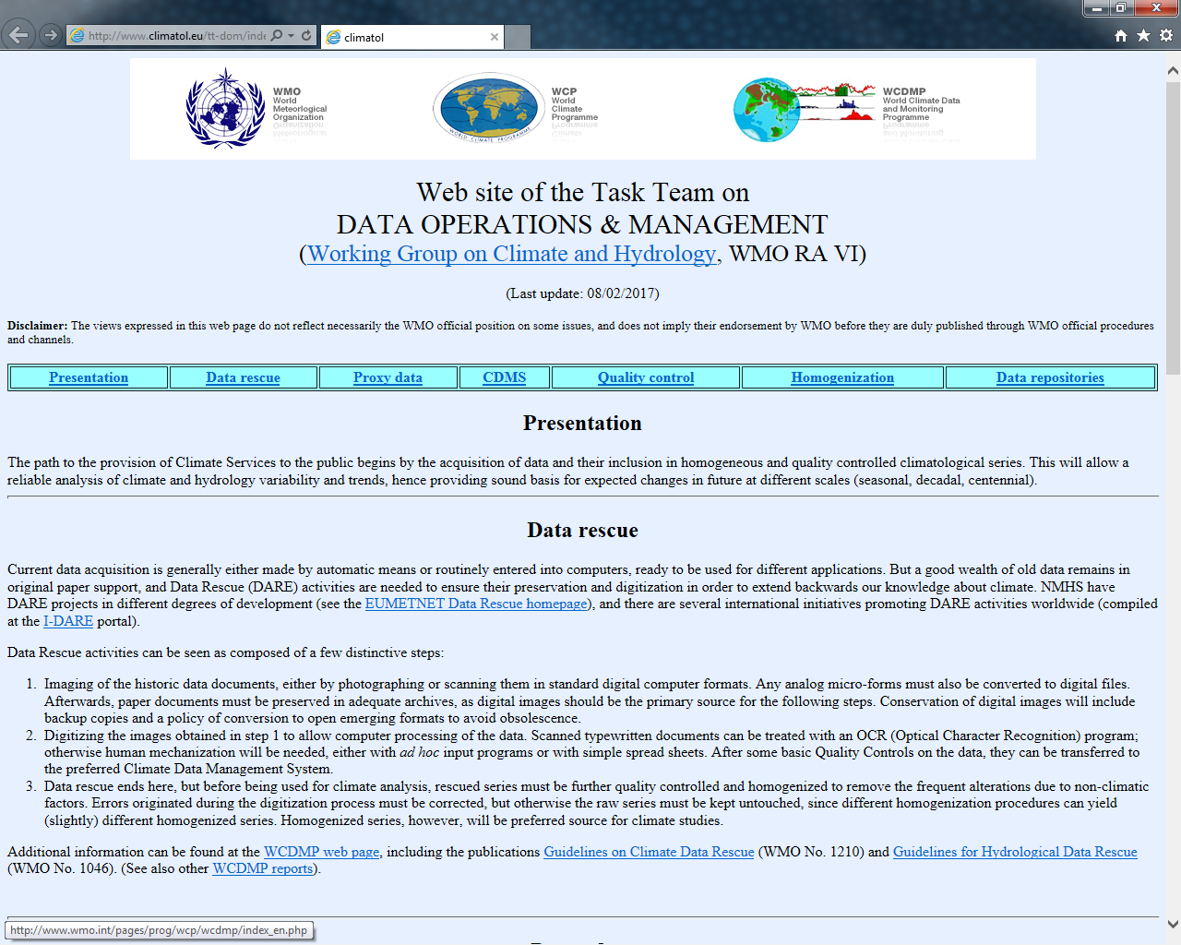
RA VI /CCl Website on Data Rescue
Website from last intersessional period maintained and developed.
http://www.climatol.eu/tt-dom/index.html
Section added on proxy data in hydrology
Other sections have incorporated new information and links to relevant resources.

Slide 29

Promotion of Data Exchange and Sharing
Case Study Article published in MeteoWorld on Free data access – the experience of the Israel Meteorological Service
Links maintained with Global Runoff Data Centre and CHy WMO Hydrological Observing System

Slide 30


Support for Standards Development
TT Members contributing to:
  OGC-WMO Hydrology Domain Working Group which is developing data standards (e.g. WATERML2.0)
  CEN TC318 (Hydrometry) Working Group developing a European standard on hydrometric data management

Slide 31
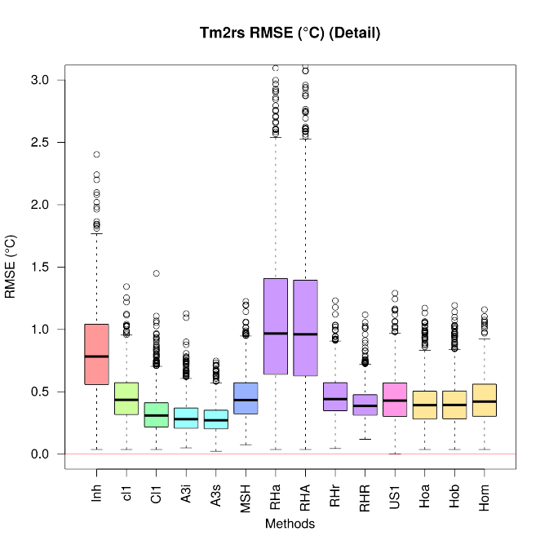
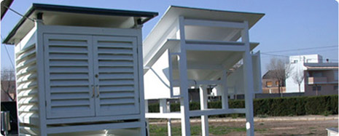
Engagement on homogenization tasks
TT Members contributing to:
  TT on Homogenization (WMO Commission for Climatology)
  MULTITEST Spanish project on inter-comparison of homogenization software packages
  IMPACTRON network to study the impact of transitions from manual to automatic observations, cities to airports, and different types of thermometric shelters

Slide 32
TT on Data operations & Management: Achievements May 2015 – April 2016
Regular teleconferences
Very good data sharing experience of Israel Met Service, wish to publish on the WMO Bulletin
Webpage (shared with CCl) with material on data rescue, network design and optimization ready, yet still work on progress

Slide 33
Consultation process with the Hydrological Advisers of RAVI,
January-February 2017 (1)
Background
During January and February 2017 a consultation process was conducted with the Hydrological Advisers of RAVI. The consultation process was a response to some issues that were raised by Hydrological Advisers during the 3-rd Hydrology Forum in Oslo, in September 2016 and, through informal meetings, during the CHy-15 in Rome, in December 2016.
A set of questions was defined and sent by e-mail to the Hydrological Advisers. The consultation process started on 12 January and ended on 17 February.
A number of 38 countries with nominated Hydrological Advisers were on the PUB-
e-mailing list.
21 Hydrological Adviser, out of 38, answered the questions; 12 didn’t answer at all and 5 had e-mails that bumped back.

Slide 34
Consultation process with the Hydrological Advisers of RAVI,
January-February 2017 (2)
Following questions were addressed:
Q1: Should the work structure for hydrology at the regional level reflect the structure of the CHy?
Q2: Is better coordination between RAVI Working Groups activities desirable/required? , i.e. between activities of RAVI WG on Climate and Hydrology, WG on Service Delivery and Partnership and WG on Technology Development and Implementation;
Q3: What is, in your opinion, the most suitable way to make the work of WG CH more effective and visible? Kindly indicate your option(s) and comment on it!
Bring in more innovative and flexible ways of working:
e.g.: task teams/activities adapted to the priorities that the Region identifies at each session; a common, flexible “pool of experts” that can serve for different task teams/activities according to the current regional priorities, etc;
Find a suitable mechanism for better coordination of possible common activities that implies both a climate and a hydrological component;
Any other option/options that might apply; if any, please comment on your proposed option.

Slide 35
Consultation process with the Hydrological Advisers of RAVI,
January-February 2017 (3)
The priorities highlighted by the respondents were:
Improve connectivity and coordination with EU activities e.g. those related with WFD/Flood Directive implementation and Copernicus services;
Maintain a regional WMO structure to serve as a platform for continuous communication for the hydrological community, in support of the regular meeting of the Hydrology Forum; better coordination between the Hydrology Forum activities and the activities of WG (C)H is needed;
Stimulate the participation of HAs at RA session, especially by giving more visibility to water related issues in the agenda (also to make administratively easier to justify the attendance with supervising authorities)

Slide 36
Consultation process with the Hydrological Advisers of RAVI,
January-February 2017 (4)
Concerning the activities of the Working Group, it was stressed and/or underlined (1):
The need for better focused activities and measurable deliverables; promote small, time-limited teams for specific tasks (project based-approach);
In the definition of the work plan, the difference between climatological and hydrological activities (time and space scales, and methods) should be recognized, as well as the regional priorities expressed by the Hydrology Forum. There should also be better information and coordination with the activity of other regional WGs which is presently very scarce.
Mechanism to ensure following:
  Feed in priorities of WG H into the CHy-AWG
  Reflection of RAVI activities in the work programme of CHy

Slide 37
Consultation process with the Hydrological Advisers of RAVI,
January-February 2017 (5)
Concerning the activities of the Working Group, it was stressed and/or underlined (2):
The need to speed up the nomination process of WG and TT members (involvement of HAs)
The Terms of Reference of the Group should also be shorter and focus on a limited number of clearly identifiable and measureable deliverables (the climatological activities suffer from the same problems)
The use of communication/coordination tools for favouring a more frequent interaction between HAs and with other WGs should be enhanced e.g. the e-forum and WMO enterprise content management (Elios and Google drive).

Slide 38
RA VI HYDROLOGY FORUM
3-rd meeting , Oslo, Norway, 21-23September 2016 (1)
Following critical areas and related themes were identified:
Adapting to new hydrometric technologies and improving field hydrology
  Improving the data chain
  Sharing best practices in forecasting
  Developing better services and products
  Support hydrological education
  Modalities of work
    keeping the expert level topical meetings (Hydrological Forum); need for a platform for meeting of hydrological advisors/managers of NHSs across the region (former WG on Hydrology)

Slide 39
RA VI HYDROLOGY FORUM
3-rd meeting , Oslo, Norway, 21-23 September 2016 (2)
Priorities:
Hydrological data
  Network design and optimization, including the organization of a thematic workshop in connection with the next meeting of the forum
Flood forecasting
  Further develop relation with METEOALARM, EFAS, EUMETNET and CAP; especially potential synergies between EFAS and FFGS concerning flash flood awareness products;
  Share experiences (data and techniques requirements, communication with end users) and mapping the present situation in Europe and assess the need for impact based warnings;
  Collect material and best practices on validation of forecasts, including ensemble forecasts;
  Develop guidance on the communication of uncertainty in coordination with Euporias project, http://www.euporias.eu/);
Supporting hydrological education
  Improve exchanges between NHSs and universities
  Map the skills required at institutional level to deliver best services

Slide 40
Main achievements of WG CH since MG IV Apr 2016 (1)
3-rd Hydrology Forum and Workshop on Hydrological Modelling, forecasting and warnings (Oslo, Sept. 2016)
Started dialogue on collaboration with COPERNICUS/EFAS and METEOALARM
Participation in WMO RA VI RCC Workshop and 3rd Coordination meeting of the RA VI RCC Network (Belgrade, Nov. 2016)

Slide 41
Main achievements of WG CH since MG IV Apr 2016 (2)
RCCs/RCOFs network well established and expanding (RCC-Polar, Review of RCC implementation, Coordination with COPERNICUS)
Bases for climate watch information system
Webpage for data rescue established and expanding
Started coordination with CCl and CHy, but closer collaboration needed

Slide 42
Some issues (1)
Some tasks are delayed and objectives not achieved due to lack of engagement of members/institutions. Need to review the experts recruiting process and their commitment to the TTs.
ToR for Task Teams are generally not realistic given the level of resources available. They should be more targeted and concrete.
While there are overlaps and synergies between the climate and hydrology communities, there are many areas where the need and activities differ → Discussion about the convenience of keeping Climate & Hydrology activities together or not.

Slide 43
Some issues (2)
Need to improve the links and joint activities with Technical Commissions.
Participation from some subregions of RAVI is largely missing.
Some TTs are coping with a mosaic of applications; there is need for a better structured information flow;
Need of operationalization of research products/services. Sharing operational experiences.

Slide 44
Conclusions
Joint-venture Climate-Hydrology yet to be improved
Contributions (experts) to be reinforced, commitment required
COPERNICUS, ERA4CS (and other EU initiatives), GFCS deployment, etc need to the globally addressed

